Slide 1
Sexually Transmitted Infections
Surveillance 2024 (Provisional)
Notes:
Sexually Transmitted Infections Surveillance 2024 (Provisional) provides the latest, national data on trends for three nationally notifiable sexually transmitted infections (STIs): chlamydia, gonorrhea, and syphilis, including congenital syphilis. Nationally Notifiable Diseases Surveillance System (NNDSS) STI case notification data presented in this slide deck, and the accompanying data files, are provisional as of August 14, 2025; therefore, case counts and rates may change when 2024 data are finalized.
See the final slide of this slide deck for more information about the 2024 provisional data displayed in this report. Please see the Technical Notes from the 2023 STI Surveillance Report (https://www.cdc.gov/sti-statistics/media/pdfs/2025/09/2023_STI_Surveillance_Report_FINAL_508.pdf) for additional information on STI case reporting formats and practices.
All data points for figures presented in these slides are available at https://www.cdc.gov/sti-statistics/media/files/2025/09/STI-Surveillance-Report-2024-Provisional_data-files.zip.
NOTE: This slide set is in the public domain. You may reproduce these slides without permission; however, citation as to source is appreciated.
Centers for Disease Control and Prevention. Sexually Transmitted Infections Surveillance 2024 (Provisional). Atlanta: U.S. Department of Health and Human Services; 2025.
You are also free to adapt and revise these slides; however, you must remove the CDC name and logo if changes are made.

Slide 2
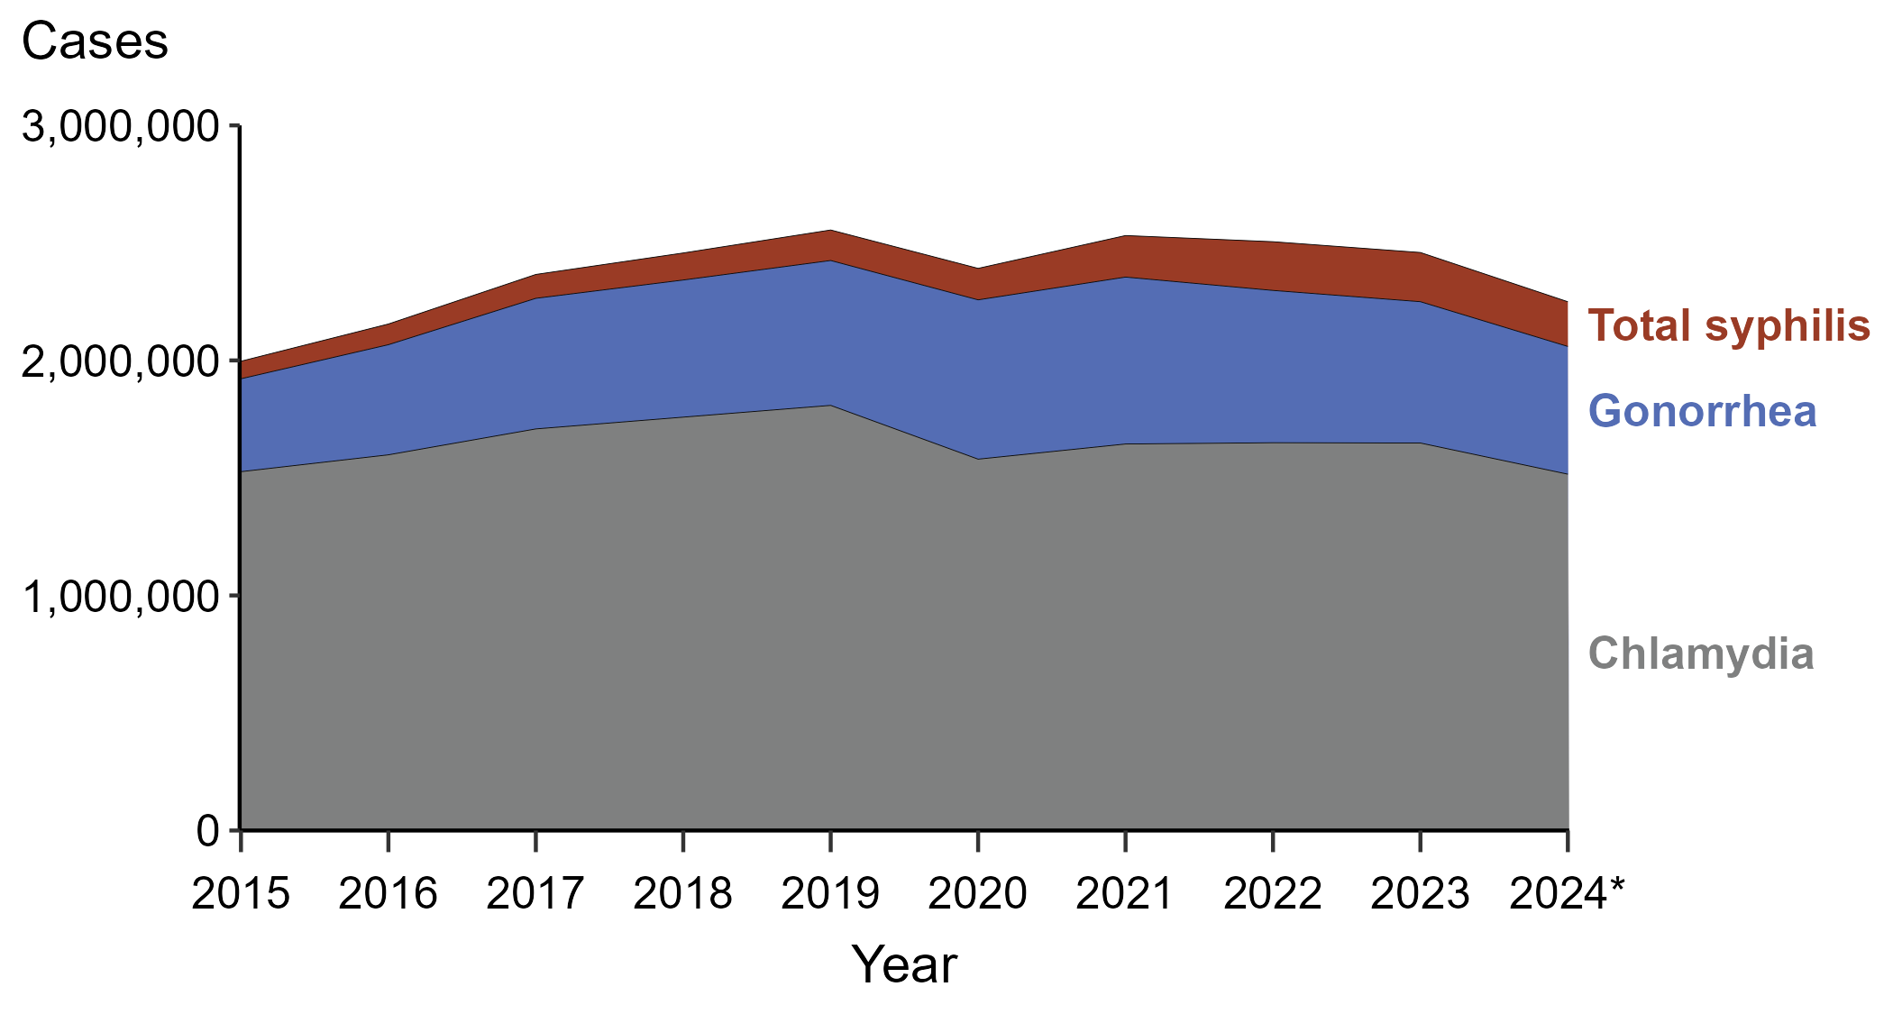
Sexually Transmitted Infections (STIs) — Reported Cases by STI and Year, United States, 2015–2024
* 2024 data are provisional as of August 14, 2025.
NOTE: “Total syphilis” includes all stages of syphilis and congenital syphilis.
Notes:
In 2024, 2,249,636 cases of total syphilis, gonorrhea, and chlamydia were reported in the United States.
This represents an:
8.5% decrease from 2023
5.9% decrease from 2020
12.7% increase from 2015
This report includes data from years that coincide with the COVID-19 pandemic, which introduced uncertainty and difficulty in interpreting STI surveillance data. See Impact of COVID-19 on STIs (https://www.cdc.gov/sti-statistics/about/impact-of-covid-19.html) for more information.
See the final slide of this slide deck for more information about the 2024 provisional data displayed in this report. Please see the Technical Notes from the 2023 STI Surveillance Report (https://www.cdc.gov/sti-statistics/media/pdfs/2025/09/2023_STI_Surveillance_Report_FINAL_508.pdf) for additional information on STI case reporting formats and practices.
Data for all figures are available at https://www.cdc.gov/sti-statistics/media/files/2025/09/STI-Surveillance-Report-2024-Provisional_data-files.zip. The file “STI - Cases by Year (US 2015-2024).xlsx” contains the data for the figure presented on this slide.

Slide 3
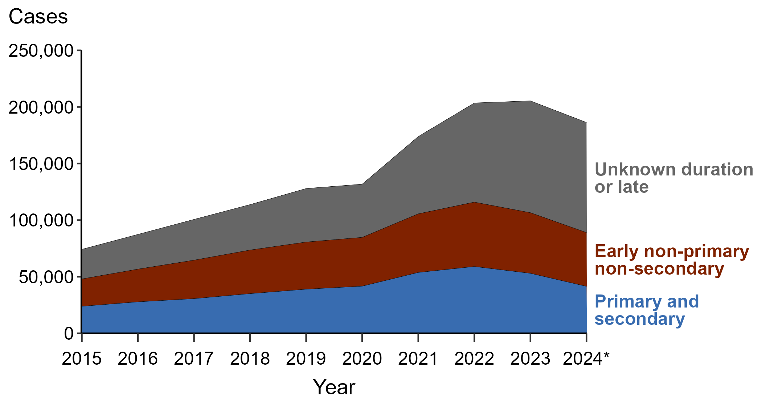
Syphilis — Reported Cases by Stage and Year, United States, 2015–2024
* 2024 data are provisional as of August 14, 2025.
Notes:
In 2024, 186,301 cases of syphilis (all stages) were reported in the United States.
Percentage of 2024 syphilis cases by stage:
52.2% - Unknown duration or late
25.5% - Early non-primary non-secondary (ENPNS)
22.3% - Primary and secondary (P&S)
Comparing 2023 to 2024 syphilis cases by stage:
Unknown duration or late syphilis decreased 1.5% (98,791 to 97,266)
ENPNS syphilis decreased 11.3% (53,573 to 47,539)
P&S syphilis decreased 21.7% (53,007 to 41,496)
Syphilis (all stages) decreased 9.3% (205,371 to 186,301)
Syphilis (all stages) excludes cases of congenital syphilis. Case definitions are periodically revised using the Council of State and Territorial Epidemiologist’s (CSTE’s) Position Statements and provide uniform criteria of nationally notifiable conditions for reporting purposes. Prior to 2018, syphilis cases identified as “early non-primary non-secondary syphilis” were classified as “early latent syphilis.” Prior to 2018, cases in the “unknown duration or late syphilis” category included cases classified as “late latent syphilis,” “latent syphilis of unknown duration,” “late syphilis with clinical manifestations,” and “neurosyphilis.” Please see the National Notifiable Diseases Surveillance System (NNDSS) website (https://ndc.services.cdc.gov/) for historical and current case definitions.
This report includes data from years that coincide with the COVID-19 pandemic, which introduced uncertainty and difficulty in interpreting STI surveillance data. See Impact of COVID-19 on STIs (https://www.cdc.gov/sti-statistics/about/impact-of-covid-19.html) for more information.
See the final slide of this slide deck for more information about the 2024 provisional data displayed in this report. Please see the Technical Notes from the 2023 STI Surveillance Report (https://www.cdc.gov/sti-statistics/media/pdfs/2025/09/2023_STI_Surveillance_Report_FINAL_508.pdf) for additional information on STI case reporting formats and practices.
Data for all figures are available at https://www.cdc.gov/sti-statistics/media/files/2025/09/STI-Surveillance-Report-2024-Provisional_data-files.zip. The file “Syphilis — Cases by Stage and Year (US 2015-2024).xlsx” contains the data for the figure presented on this slide.

Slide 4
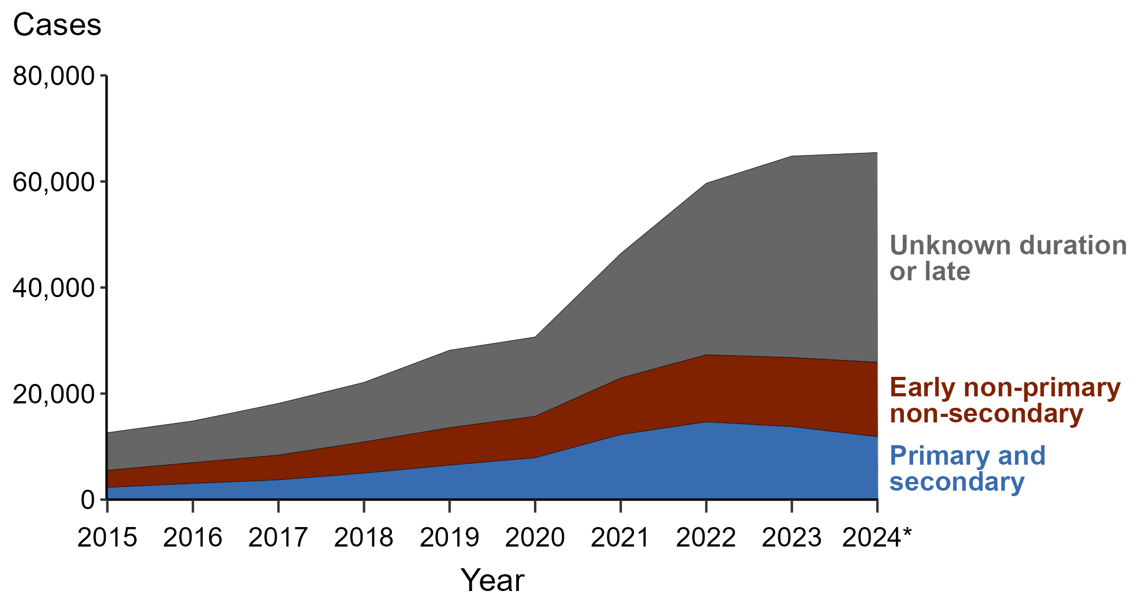
Syphilis — Reported Cases Among Women by Stage and Year, United States, 2015–2024
* 2024 data are provisional as of August 14, 2025.
Notes:
In 2024, 65,460 cases of syphilis (all stages) among women were reported in the United States.
Percentage of 2024 syphilis cases by stage among women:
60.4% - Unknown duration or late
21.5% - Early non-primary non-secondary (ENPNS)
18.1% - Primary and secondary (P&S)
Comparing 2023 to 2024 syphilis cases by stage among women:
Unknown duration or late syphilis increased 4.1% (37,996 to 39,540)
ENPNS syphilis increased 7.9% (13,036 to 14,061)
P&S syphilis decreased 13.8% (13,763 to 11,859)
Syphilis (all stages) increased 1.0% (64,795 to 65,460)
Syphilis (all stages) excludes cases of congenital syphilis. Case definitions are periodically revised using the Council of State and Territorial Epidemiologist’s (CSTE’s) Position Statements and provide uniform criteria of nationally notifiable conditions for reporting purposes. Prior to 2018, syphilis cases identified as “early non-primary non-secondary syphilis” were classified as “early latent syphilis.” Prior to 2018, cases in the “unknown duration or late syphilis” category included cases classified as “late latent syphilis,” “latent syphilis of unknown duration,” “late syphilis with clinical manifestations,” and “neurosyphilis.” Please see the National Notifiable Diseases Surveillance System (NNDSS) website (https://ndc.services.cdc.gov/) for historical and current case definitions.
This report includes data from years that coincide with the COVID-19 pandemic, which introduced uncertainty and difficulty in interpreting STI surveillance data. See Impact of COVID-19 on STIs (https://www.cdc.gov/sti-statistics/about/impact-of-covid-19.html) for more information.
See the final slide of this slide deck for more information about the 2024 provisional data displayed in this report. Please see the Technical Notes from the 2023 STI Surveillance Report (https://www.cdc.gov/sti-statistics/media/pdfs/2025/09/2023_STI_Surveillance_Report_FINAL_508.pdf) for additional information on STI case reporting formats and practices.
Data for all figures are available at https://www.cdc.gov/sti-statistics/media/files/2025/09/STI-Surveillance-Report-2024-Provisional_data-files.zip. The file “Syphilis — Cases Women by Stage and Year (US 2015-2024).xlsx” contains the data for the figure presented on this slide.

Slide 5
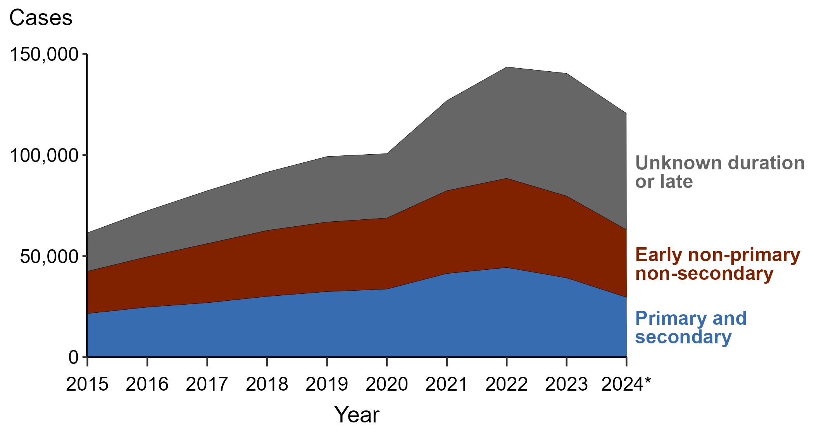
Syphilis — Reported Cases Among Men by Stage and Year, United States, 2015–2024
* 2024 data are provisional as of August 14, 2025.
Notes:
In 2024, 120,567 cases of syphilis (all stages) among men were reported in the United States.
Percentage of 2024 syphilis cases by stage among men:
47.8% - Unknown duration or late
27.7% - Early non-primary non-secondary (ENPNS)
24.5% - Primary and secondary (P&S)
Comparing 2023 to 2024 syphilis cases by stage among men:
Unknown duration or late syphilis decreased 5.2% (60,718 to 57,591)
ENPNS syphilis decreased 17.5% (40,486 to 33,401)
P&S syphilis decreased 24.5% (39,188 to 29,575)
Syphilis (all stages) decreased 14.1% (140,392 to 120,567)
Syphilis (all stages) excludes cases of congenital syphilis. Case definitions are periodically revised using the Council of State and Territorial Epidemiologist’s (CSTE’s) Position Statements and provide uniform criteria of nationally notifiable conditions for reporting purposes. Prior to 2018, syphilis cases identified as “early non-primary non-secondary syphilis” were classified as “early latent syphilis.” Prior to 2018, cases in the “unknown duration or late syphilis” category included cases classified as “late latent syphilis,” “latent syphilis of unknown duration,” “late syphilis with clinical manifestations,” and “neurosyphilis.” Please see the National Notifiable Diseases Surveillance System (NNDSS) website (https://ndc.services.cdc.gov/) for historical and current case definitions.
This report includes data from years that coincide with the COVID-19 pandemic, which introduced uncertainty and difficulty in interpreting STI surveillance data. See Impact of COVID-19 on STIs (https://www.cdc.gov/sti-statistics/about/impact-of-covid-19.html) for more information.
See the final slide of this slide deck for more information about the 2024 provisional data displayed in this report. Please see the Technical Notes from the 2023 STI Surveillance Report (https://www.cdc.gov/sti-statistics/media/pdfs/2025/09/2023_STI_Surveillance_Report_FINAL_508.pdf) for additional information on STI case reporting formats and practices.
Data for all figures are available at https://www.cdc.gov/sti-statistics/media/files/2025/09/STI-Surveillance-Report-2024-Provisional_data-files.zip. The file “Syphilis — Cases Men by Stage and Year (US 2015-2024).xlsx” contains the data for the figure presented on this slide.

Slide 6
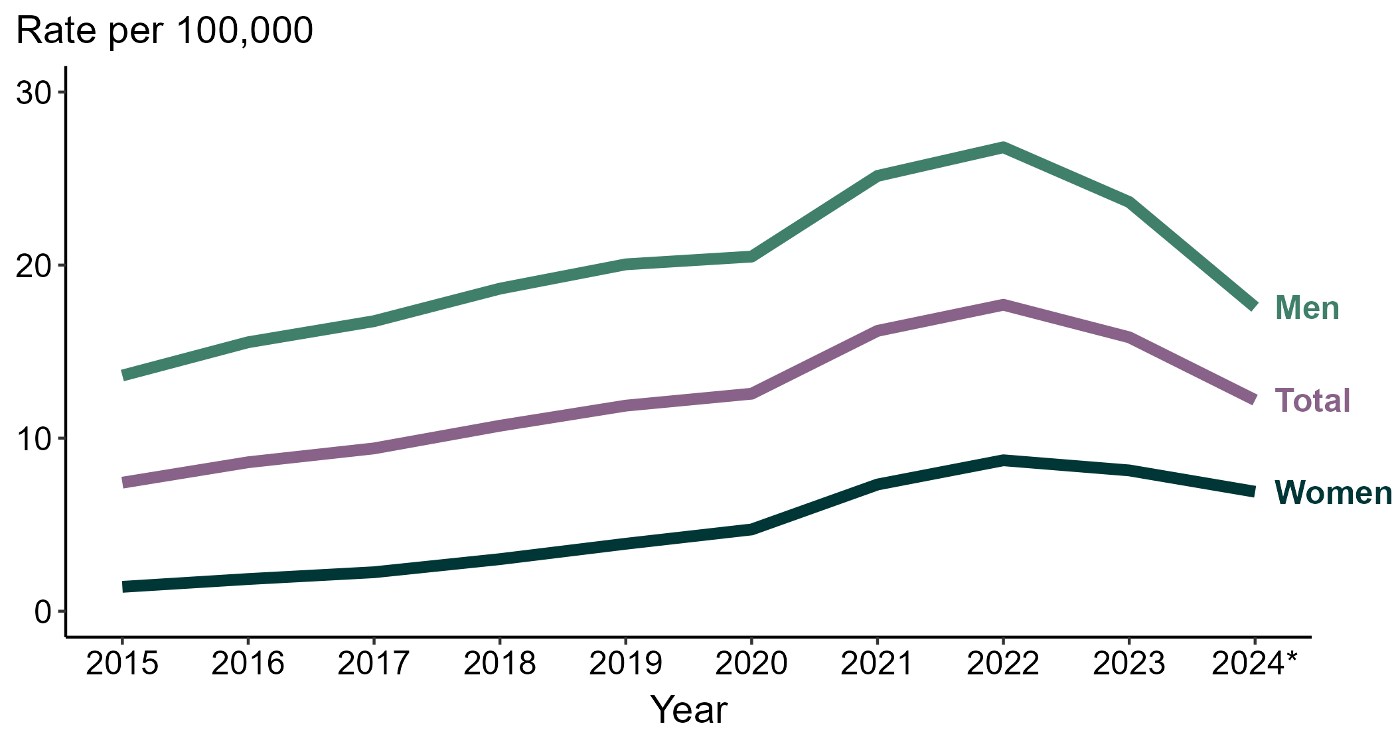
Primary and Secondary Syphilis — Rates of Reported Cases by Sex and Year, United States, 2015–2024
* 2024 data are provisional as of August 14, 2025.
Notes:
In 2024, the total rate of reported primary and secondary (P&S) syphilis in the United States was 12.2 per 100,000 population.
Comparing rates of P&S syphilis:
1 year (2023 to 2024):
Men: 25.4% decrease (23.6 to 17.6 per 100,000)
Total: 22.8% decrease (15.8 to 12.2 per 100,000)
Women: 14.8% decrease (8.1 to 6.9 per 100,000)
5 years (2020 to 2024):
Men: 14.1% decrease (20.5 to 17.6 per 100,000)
Total: 3.2% decrease (12.6 to 12.2 per 100,000)
Women: 46.8% increase (4.7 to 6.9 per 100,000)
10 years (2015 to 2024):
Men: 29.4% increase (13.6 to 17.6 per 100,000)
Total: 64.9% increase (7.4 to 12.2 100,000)
Women: 392.9% increase (1.4 to 6.9 per 100,000)
This report includes data from years that coincide with the COVID-19 pandemic, which introduced uncertainty and difficulty in interpreting STI surveillance data. See Impact of COVID-19 on STIs (https://www.cdc.gov/sti-statistics/about/impact-of-covid-19.html) for more information.
See the final slide of this slide deck for more information about the 2024 provisional data displayed in this report. Please see the Technical Notes from the 2023 STI Surveillance Report (https://www.cdc.gov/sti-statistics/media/pdfs/2025/09/2023_STI_Surveillance_Report_FINAL_508.pdf) for additional information on STI case reporting formats and practices.
Data for all figures are available at https://www.cdc.gov/sti-statistics/media/files/2025/09/STI-Surveillance-Report-2024-Provisional_data-files.zip. The file “PS Syphilis - Rates by Sex (US 2015-2024).xlsx” contains the data for the figure presented on this slide.

Slide 7
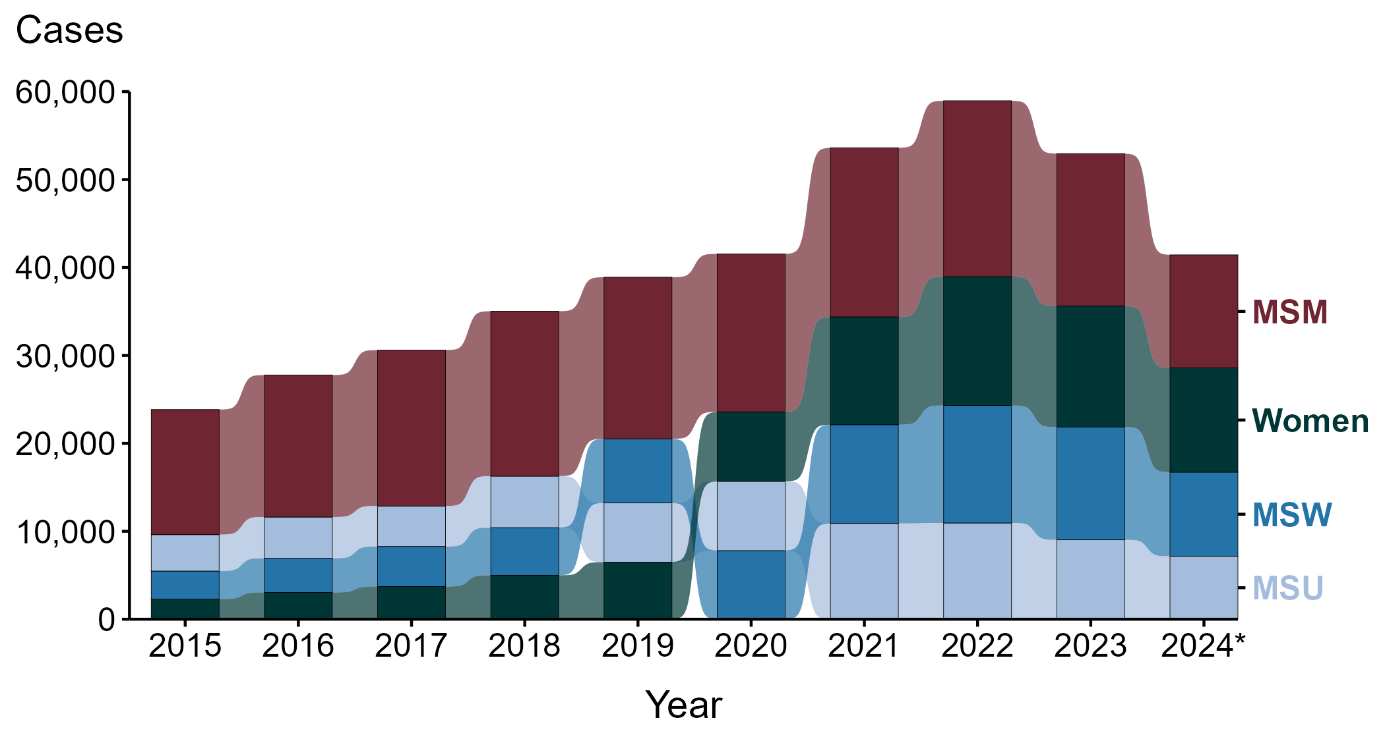
Primary and Secondary Syphilis — Reported Cases by Sex and Sex of Sex Partners and Year, United States, 2015–2024
* 2024 data are provisional as of August 14, 2025.
ACRONYMS: MSM = Men who have sex with men; MSU = Men with unknown sex of sex partners; MSW = Men who have sex with women only
Notes:
Of the 41,496 cases of primary and secondary (P&S) syphilis reported in the United States in 2024, 41,434 (99.9%) had a reported sex.
Comparing P&S syphilis case counts:
2023 to 2024 21.8% decrease (52,951 to 41,434)
Percentage of 2024 P&S syphilis by sex and sex of sex partners:
31.0% - Men who have sex with men (MSM)
28.6% - Women (all partners)
23.1% - Men who have sex with women only (MSW)
17.3% - Men with unknown sex of sex partners (MSU)
Comparing P&S syphilis case counts:
1 year (2023 to 2024):
MSM: 25.8% decrease (17,331 to 12,855)
Women: 13.8% decrease (13,763 to 11,859)
MSW: 25.5% decrease (12,829 to 9,559)
MSU: 20.7% decrease (9,028 to 7,161)
5 years (2020 to 2024):
MSM: 28.5% decrease (17,968 to 12,855)
Women: 50.1% increase (7,901 to 11,859)
MSW: 22.5% increase (7,801 to 9,559)
MSU: 9.1% decrease (7,877 to 7,161)
10 years (2015 to 2024):
MSM: 9.7% decrease (14,229 to 12,855)
Women: 416.1% increase (2,298 to 11,859)
MSW: 200.8% increase (3,178 to 9,559)
MSU: 73.0% increase (4,140 to 7,161)
This report includes data from years that coincide with the COVID-19 pandemic, which introduced uncertainty and difficulty in interpreting STI surveillance data. See Impact of COVID-19 on STIs (https://www.cdc.gov/sti-statistics/about/impact-of-covid-19.html) for more information.
See the final slide of this slide deck for more information about the 2024 provisional data displayed in this report. Please see the Technical Notes from the 2023 STI Surveillance Report (https://www.cdc.gov/sti-statistics/media/pdfs/2025/09/2023_STI_Surveillance_Report_FINAL_508.pdf) for additional information on STI case reporting formats and practices.
Data for all figures are available at https://www.cdc.gov/sti-statistics/media/files/2025/09/STI-Surveillance-Report-2024-Provisional_data-files.zip. The file “PS Syphilis - Cases by Sex and Sex of Sex Partners (US 2015-2024).xlsx” contains the data for the figure presented on this slide.

Slide 8
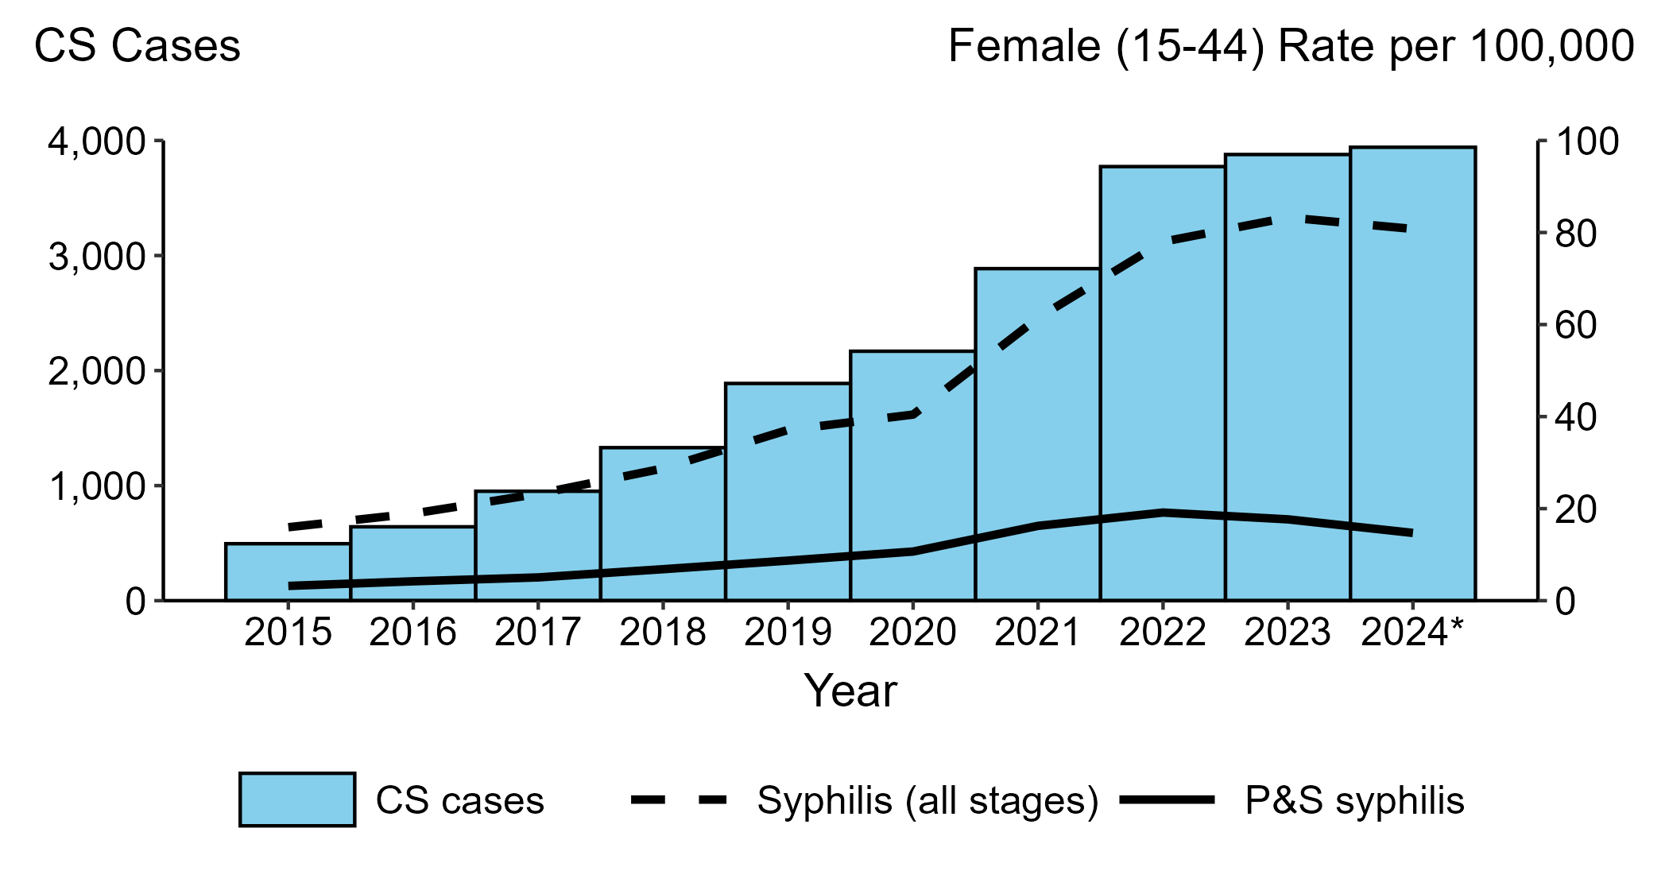
Congenital Syphilis — Reported Cases by Year of Birth and Rates of Reported Cases of Primary and Secondary Syphilis and Syphilis (All Stages) Among Women Aged 15–44 Years, United States, 2015–2024
* 2024 data are provisional as of August 14, 2025.
ACRONYMS: CS = Congenital syphilis; P&S Syphilis = Primary and secondary syphilis
Notes:
Congenital syphilis (CS)
In 2024, 3,941 cases of congenital syphilis (CS) were reported in the United States (rate of 109.6 cases per 100,000 live births).
Comparing CS case counts:
1 year (2023 to 2024) - CS cases increased 1.6% (3,878 to 3,941)
5 years (2020 to 2024) - CS cases increased 81.8% (2,168 to 3,941)
10 years (2015 to 2024) - CS cases increased 696.2% (495 to 3,941)
Among women aged 15 to 44 years:
In 2024, 54,447 cases of syphilis (all stages) (rate of 80.8 per 100,000)
In 2024, 9,921 cases of primary and secondary (P&S) syphilis (rate of 14.7 per 100,000)
Comparing rates of syphilis (all stages):
1 year (2023 to 2024) - rates decreased 3.0% (83.3 to 80.8 per 100,000)
5 years (2020 to 2024) - rates increased 100.0% (40.4 to 80.8 per 100,000)
10 years (2015 to 2024) - rates increased 405.0% (16.0 to 80.8 per 100,000)
Comparing rates of P&S syphilis:
1 year (2023 to 2024) - rates decreased 16.9% (17.7 to 14.7 per 100,000)
5 years (2020 to 2024) - rates increased 37.4% (10.7 to 14.7 per 100,000)
10 years (2015 to 2024) - rates increased 359.4% (3.2 to 14.7 per 100,000)
This report includes data from years that coincide with the COVID-19 pandemic, which introduced uncertainty and difficulty in interpreting STI surveillance data. See Impact of COVID-19 on STIs (https://www.cdc.gov/sti-statistics/about/impact-of-covid-19.html) for more information.
See the final slide of this slide deck for more information about the 2024 provisional data displayed in this report. Please see the Technical Notes from the 2023 STI Surveillance Report (https://www.cdc.gov/sti-statistics/media/pdfs/2025/09/2023_STI_Surveillance_Report_FINAL_508.pdf) for additional information on STI case reporting formats and practices.
Data for all figures are available at https://www.cdc.gov/sti-statistics/media/files/2025/09/STI-Surveillance-Report-2024-Provisional_data-files.zip. The file “CS - Cases by Year of Birth and Syphilis Rates Women 15-44 (US 2015-2024).xlsx” contains the data for the figure presented on this slide.

Slide 9
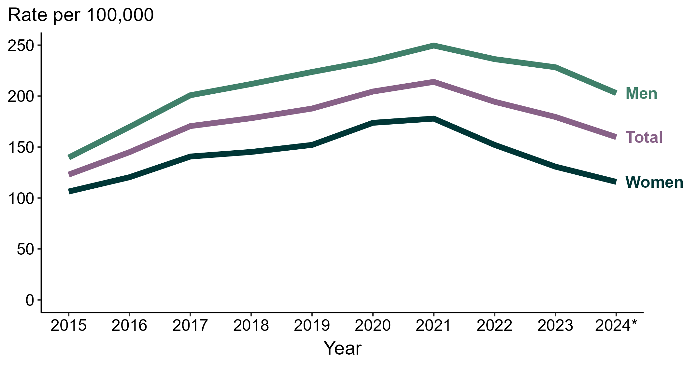
Gonorrhea — Rates of Reported Cases by Sex and Year, United States, 2015–2024
* 2024 data are provisional as of August 14, 2025.
Notes:
In 2024, the total rate of reported gonorrhea in the United States was 159.8 per 100,000 population.
Comparing rates of gonorrhea:
1 year (2023 to 2024):
Men: 11.1% decrease (228.3 to 203.0 per 100,000)
Total: 11.0% decrease (179.5 to 159.8 per 100,000)
Women: 11.4% decrease (130.7 to 115.8 per 100,000)
5 years (2020 to 2024):
Men: 13.5% decrease (234.8 to 203.0 per 100,000)
Total: 21.9% decrease (204.5 to 159.8 per 100,000)
Women: 33.4% decrease (173.8 to 115.8 per 100,000)
10 years (2015 to 2024):
Men: 45.3% increase (139.7 to 203.0 per 100,000)
Total: 29.9% increase (123.0 to 159.8 100,000)
Women: 8.9% increase (106.3 to 115.8 per 100,000)
This report includes data from years that coincide with the COVID-19 pandemic, which introduced uncertainty and difficulty in interpreting STI surveillance data. See Impact of COVID-19 on STIs (https://www.cdc.gov/sti-statistics/about/impact-of-covid-19.html) for more information.
See the final slide of this slide deck for more information about the 2024 provisional data displayed in this report. Please see the Technical Notes from the 2023 STI Surveillance Report (https://www.cdc.gov/sti-statistics/media/pdfs/2025/09/2023_STI_Surveillance_Report_FINAL_508.pdf) for additional information on STI case reporting formats and practices.
Data for all figures are available at https://www.cdc.gov/sti-statistics/media/files/2025/09/STI-Surveillance-Report-2024-Provisional_data-files.zip. The file “GC - Rates by Sex (US 2015-2024).xlsx” contains the data for the figure presented on this slide.

Slide 10
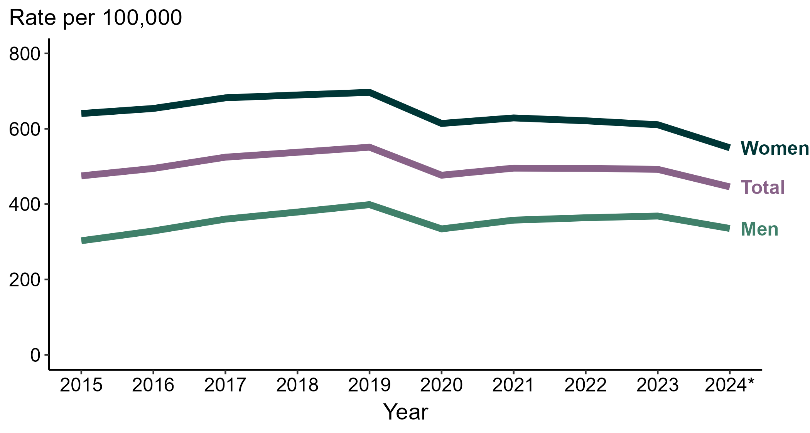
Chlamydia — Rates of Reported Cases by Sex and Year, United States, 2015–2024
* 2024 data are provisional as of August 14, 2025.
Notes:
In 2024, the total rate of reported chlamydia in the United States was 445.7 per 100,000 population.
Comparing rates of chlamydia:
1 year (2023 to 2024):
Women: 10.0% decrease (610.7 to 549.5 per 100,000)
Total: 9.4% decrease (492.2 to 445.7 per 100,000)
Men: 9.0% decrease (368.3 to 335.3 per 100,000)
5 years (2020 to 2024):
Women: 10.5% decrease (614.1 to 549.5 per 100,000)
Total: 6.5% decrease (476.7 to 445.7 per 100,000)
Men: <1.0% change (334.2 to 335.3 per 100,000)
10 years (2015 to 2024):
Women: 14.2% decrease (640.4 to 549.5 per 100,000)
Total: 6.2% decrease (475.0 to 445.7 100,000)
Men: 10.8% increase (302.7 to 335.3 per 100,000)
This report includes data from years that coincide with the COVID-19 pandemic, which introduced uncertainty and difficulty in interpreting STI surveillance data. See Impact of COVID-19 on STIs (https://www.cdc.gov/sti-statistics/about/impact-of-covid-19.html) for more information.
See the final slide of this slide deck for more information about the 2024 provisional data displayed in this report. Please see the Technical Notes from the 2023 STI Surveillance Report (https://www.cdc.gov/sti-statistics/media/pdfs/2025/09/2023_STI_Surveillance_Report_FINAL_508.pdf) for additional information on STI case reporting formats and practices.
Data for all figures are available at https://www.cdc.gov/sti-statistics/media/files/2025/09/STI-Surveillance-Report-2024-Provisional_data-files.zip. The file “CT - Rates by Sex (US 2015-2024).xlsx” contains the data for the figure presented on this slide.

Slide 11
Sexually Transmitted Infections Surveillance, 2024 (Provisional) Technical Notes
Sexually Transmitted Infections Surveillance, 2024 (Provisional) provides the latest, national data on trends for three nationally notifiable sexually transmitted infections (STIs): chlamydia, gonorrhea, and syphilis, including congenital syphilis.
Nationally Notifiable Diseases Surveillance System (NNDSS) STI case notification data presented in this slide deck, and the accompanying data files, are provisional as of August 14, 2025; therefore, case counts and rates may change when 2024 data are finalized.
Because 2024 data are provisional, only national level trends are presented.
National trends include cases reported among non-U.S. residents and exclude U.S. territories.
As congenital syphilis cases may be diagnosed and reported years after birth, 2024 case counts will likely increase prior to data finalization.
Provisional congenital syphilis case rates presented in this report were calculated using the most recent data available for live birth denominators (2023); all other provisional case rates were calculated using 2024 population denominators.
For additional data visualizations using the most current finalized data, please see
2023 STI Surveillance Report, available at: https://www.cdc.gov/sti-statistics/media/pdfs/2025/09/2023_STI_Surveillance_Report_FINAL_508.pdf
NCHHSTP AtlasPlus, available at https://www.cdc.gov/nchhstp/about/atlasplus.html
For more information on the source and technical details of the data presented in this report, including interpretation of trends, please see:
Technical Notes from the 2023 STI Surveillance Report, available at: https://www.cdc.gov/sti-statistics/media/pdfs/2025/09/2023_STI_Surveillance_Report_FINAL_508.pdf
Impact of COVID-19 on STIs, available at: https://www.cdc.gov/sti-statistics/about/impact-of-covid-19.html

