Slide 1
Topic 9:
Hand Hygiene
Notes:
Facilitator Notes
Participants log in and get settled.

Slide 2
Agenda
Introduction
Hand Hygiene
Reflection & Next Steps
Notes:
Facilitator Notes
Welcome
Housekeeping, either orally or via chat
If needed, additional notes specific to the platform you’re using (e.g., how to “raise your hand,” how to post questions)
Overview of agenda
If this session is part of an ongoing series, you may choose to say “welcome back,” “thank you for joining us again,” etc.
Sample Script
“Welcome to Project Firstline. Over the next 10 minutes, we’ll focus on the importance of hand hygiene in healthcare. Please keep your videos on, to the extent possible, and keep your microphone muted when you are not contributing to the discussion. It’s great to see you all here today!
“Today we’ll discuss the importance of having clean hands in healthcare, review how and why germs can be spread by hands, and practice supporting good hand hygiene practices at work..”

Slide 3
Learning Objectives
Describe two (2) reasons why having clean hands is especially important in healthcare.
Discuss two (2) reasons why hands are a main way that germs can spread in the environment.
Notes:
Facilitator Notes
Provide an overview of the session’s learning objectives.
Sample Script
“Here is what we expect we will learn today. By the end of today’s training, you will be able to describe why it’s so important for those of us in healthcare to have clean hands. You’ll also be able to describe why hands are a main way that germs can spread in the environment.”

Slide 4
Definitions
Hand Hygiene | Hand hygiene means cleaning your hands by using either handwashing (washing hands with soap and water), antiseptic hand wash, antiseptic hand rub (i.e., alcohol-based hand sanitizer including foam or gel), or surgical hand antisepsis.
Notes:
Facilitator Notes
Either allow time for participants to read the definition themselves or read it aloud.
“Hand Hygiene means cleaning your hands by using either handwashing (washing hands with soap and water), antiseptic hand wash, antiseptic hand rub (i.e., alcohol-based hand sanitizer including foam or gel), or surgical hand antisepsis.”
CDC source for the definition: https://www.cdc.gov/handhygiene/providers/index.html
Establish that hand hygiene, or cleaning your hands, includes both washing hands with soap and water and using alcohol-based hand sanitizer.
You may choose to ask participants to share their reactions orally, via chat, or both.
Sample Script
“Before we get started, let’s review a definition of hand hygiene. Go ahead and read the definition to yourself.”
(Pause as participants read.)
“We talk about hand hygiene – the simpler way to say it is just ‘cleaning your hands!’ – and not ‘washing your hands.’ Does anyone have an idea why?”
(Pause for responses.)
“Right. It’s because hand hygiene includes washing your hands with soap and water and using alcohol-based hand sanitizer.”

Slide 5
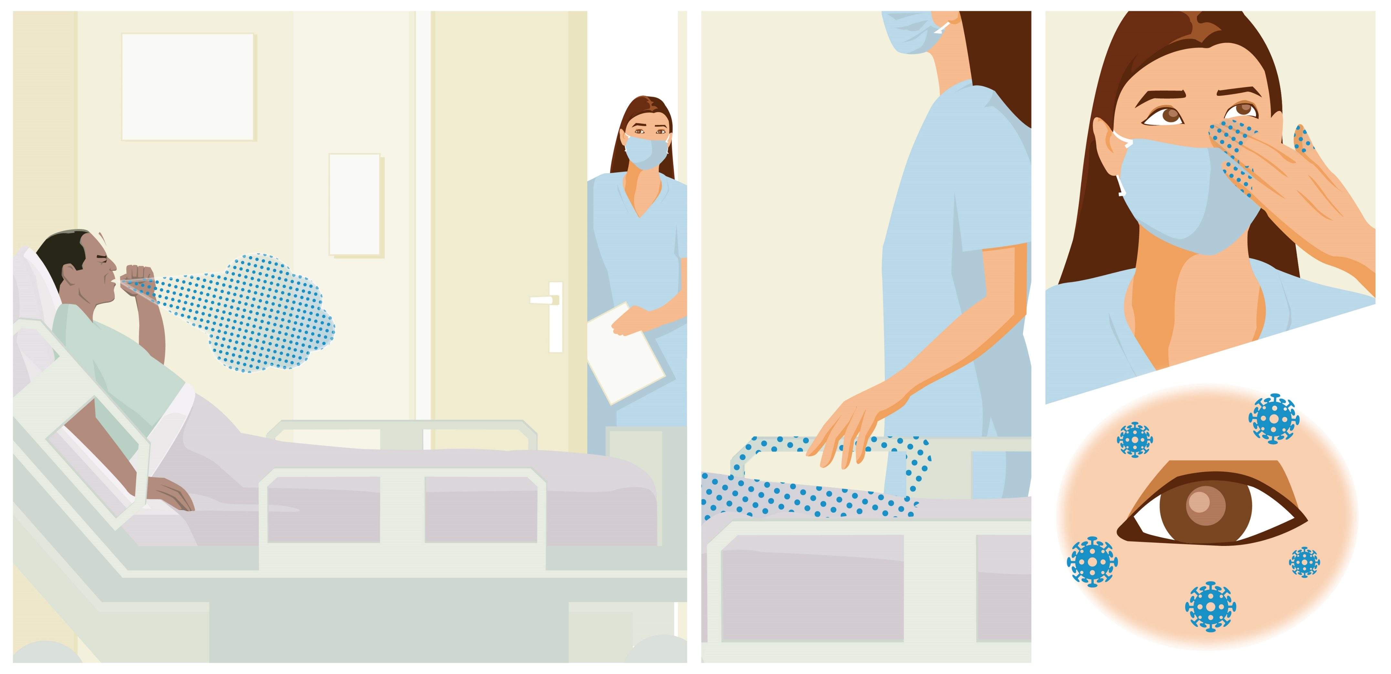
GERMS Can SPREAD From Surfaces
Notes:
Facilitator Notes
While this graphic provides an overview of how viruses can spread from surfaces to people, for more information, you can also share Episode 6 of Inside Infection Control: How Do Viruses Spread from Surfaces to People?: bit.ly/SurfaceToPeopleSpread
The Content Outline for this video episode is provided at the end of this document for your reference.
CDC sources for statistics about healthcare provider hand hygiene compliance: Hand Hygiene in Healthcare Settings | CDC (https://www.cdc.gov/handhygiene/index.html) and Show Me the Science | Hand Hygiene | CDC (https://www.cdc.gov/handhygiene/science/index.html).
You may choose to research specific rates for your audience.
Sample Script
“Germs are everywhere, and we can spread them, without knowing it, to other surfaces, things, and people. In healthcare, you are likely to come into contact with things that carry germs, like respiratory droplets, saliva, blood, and waste, and you’re more likely to touch patients at risk for bad infections.
“In this graphic, we see a patient who is ill and coughing, with respiratory droplets traveling into the air and landing on surfaces, where the healthcare worker picks them up with her hands and, unfortunately, carries the germs to her eyes. The healthcare worker could also easily carry the germs to her nose or mouth while or after removing her mask.
“As a quick reminder, if we touch something that has germs on it with our hands and then touch our eyes, mouth, or nose, without cleaning our hands first, we could get sick. If we touch something with germs on it, and then touch something else without cleaning our hands first, we can spread germs that can be picked up by someone else. This is how a lot of germs spread in healthcare – not just viruses.
“That’s why cleaning our hands is such an important part of infection control.
“Let’s hear more about how hand hygiene can help from the CDC’s Dr. Carlson.”

Slide 6
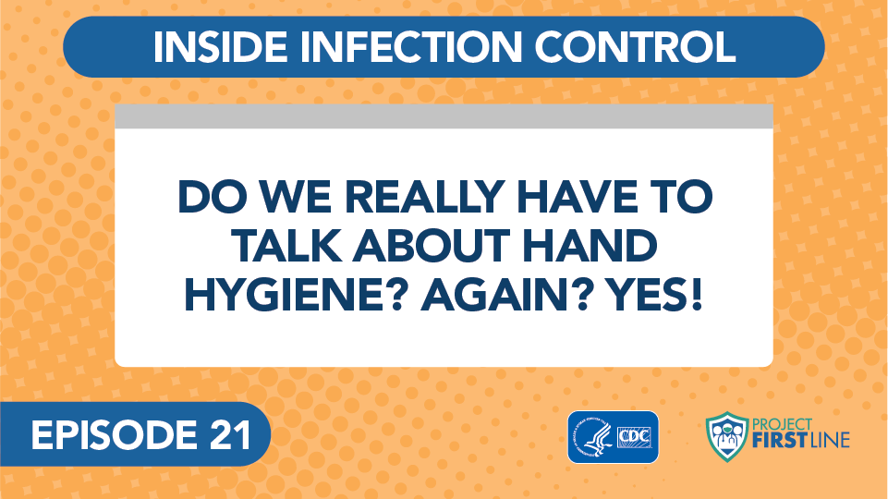
Inside infection control
Notes:
Facilitator Notes
Play Inside Infection Control Episode 21: Do We Really Have to Talk About Hand Hygiene? Again? Yes!: bit.ly/HandHygieneAgain

Slide 7
Key Takeaways
Healthcare workers touch a lot of items during their workday, so being diligent about hand hygiene matters.
Some parts of the hands make it easier for germs to grow, like between fingers, under the fingernails, and in breaks in the skin. That’s why we need to clean our hands very well.
Notes:
Facilitator Notes
Summarize key takeaways from the video.
You may wish to refer to the Content Outline for this episode for additional key points.
Sample Script
“To sum up, healthcare workers touch a lot of things during their workday, so being diligent about hand hygiene is really important. For example, nursing staff touch up to 15 different surfaces during a single patient interaction – adding up to over 900 surfaces in the average 12-hour shift. Every one of those surfaces has germs on it, so it makes sense that cleaning your hands and using gloves correctly is so important. But even though we all know how important it is to clean our hands to keep germs from spreading, especially to our patients who may be at risk for infection, studies show that on average, healthcare providers clean their hands less than half of the times they should.
“The other key takeaway is that some parts of the hand make it easier for germs to grow, like between fingers, under the fingernails, and in breaks in the skin, such as a rash or cut. Viruses, bacteria, and fungi can all stick to your hands and be carried around the environment and spread to surfaces, devices, and people. So, we need to be very careful to clean our hands – and those parts in particular – very well.”

Slide 8
Reflection
Notes:
Facilitator Notes
Encourage participants to reflect on the content of the session, and how they will put their knowledge into practice.
Sample Script
“Let’s use our last few minutes together to reflect on what we’ve learned and think about how we can put what we’ve learned into practice.”

Slide 9
Resources and Future Training sessions
Project Firstline Resources
Project Firstline on CDC:
https://www.cdc.gov/infection control/projectfirstline/index.html
CDC’s Project Firstline on Facebook:
https://www.facebook.com/CDCProjectFirstline
CDC’s Project Firstline on Twitter:
https://twitter.com/CDC_Firstline
Project Firstline Inside Infection Control on YouTube:
https://www.youtube.com/playlist?list=PLvrp9iOILTQZQGtDnSDGViKDdRtIc13VX
To sign up for Project Firstline e-mails, click here: https://tools.cdc.gov/campaignproxyservice/subscriptions.aspx?topic_id=USCDC_2104
CDC Hand Hygiene Resources
CDC’s Hand Hygiene in Healthcare Settings: https://www.cdc.gov/handhygiene/index.html
Clean Hands Count for Healthcare Providers: https://www.cdc.gov/handhygiene/providers/index.html
Clean Hands Count for Patients: https://www.cdc.gov/handhygiene/patients/index.html
Clean Hands Save Lives: https://www.cdc.gov/handwashing/index.html (Community-Focused resource)
Notes:
Facilitator Notes
Share additional resources from Project Firstline and CDC.
Explain how participants can reach you, by the means of your choosing, and how they can reach Project Firstline.
If this session is part of a series, you may choose to describe the themes of upcoming sessions.
Sample Script
“We covered a lot today, and there is still more to learn. You can keep exploring these topics on your own using the resources on this slide. The CDC also has a lot of resources about hand hygiene. They have materials for healthcare providers and healthcare settings, as well as materials for the community that may help you. You can also follow us on social media. I will stay on the line for a few minutes after our session ends and will be happy to discuss any other questions!”
(If this session is part of a series) “Next time, we will cover [insert next training topic].”

Slide 10
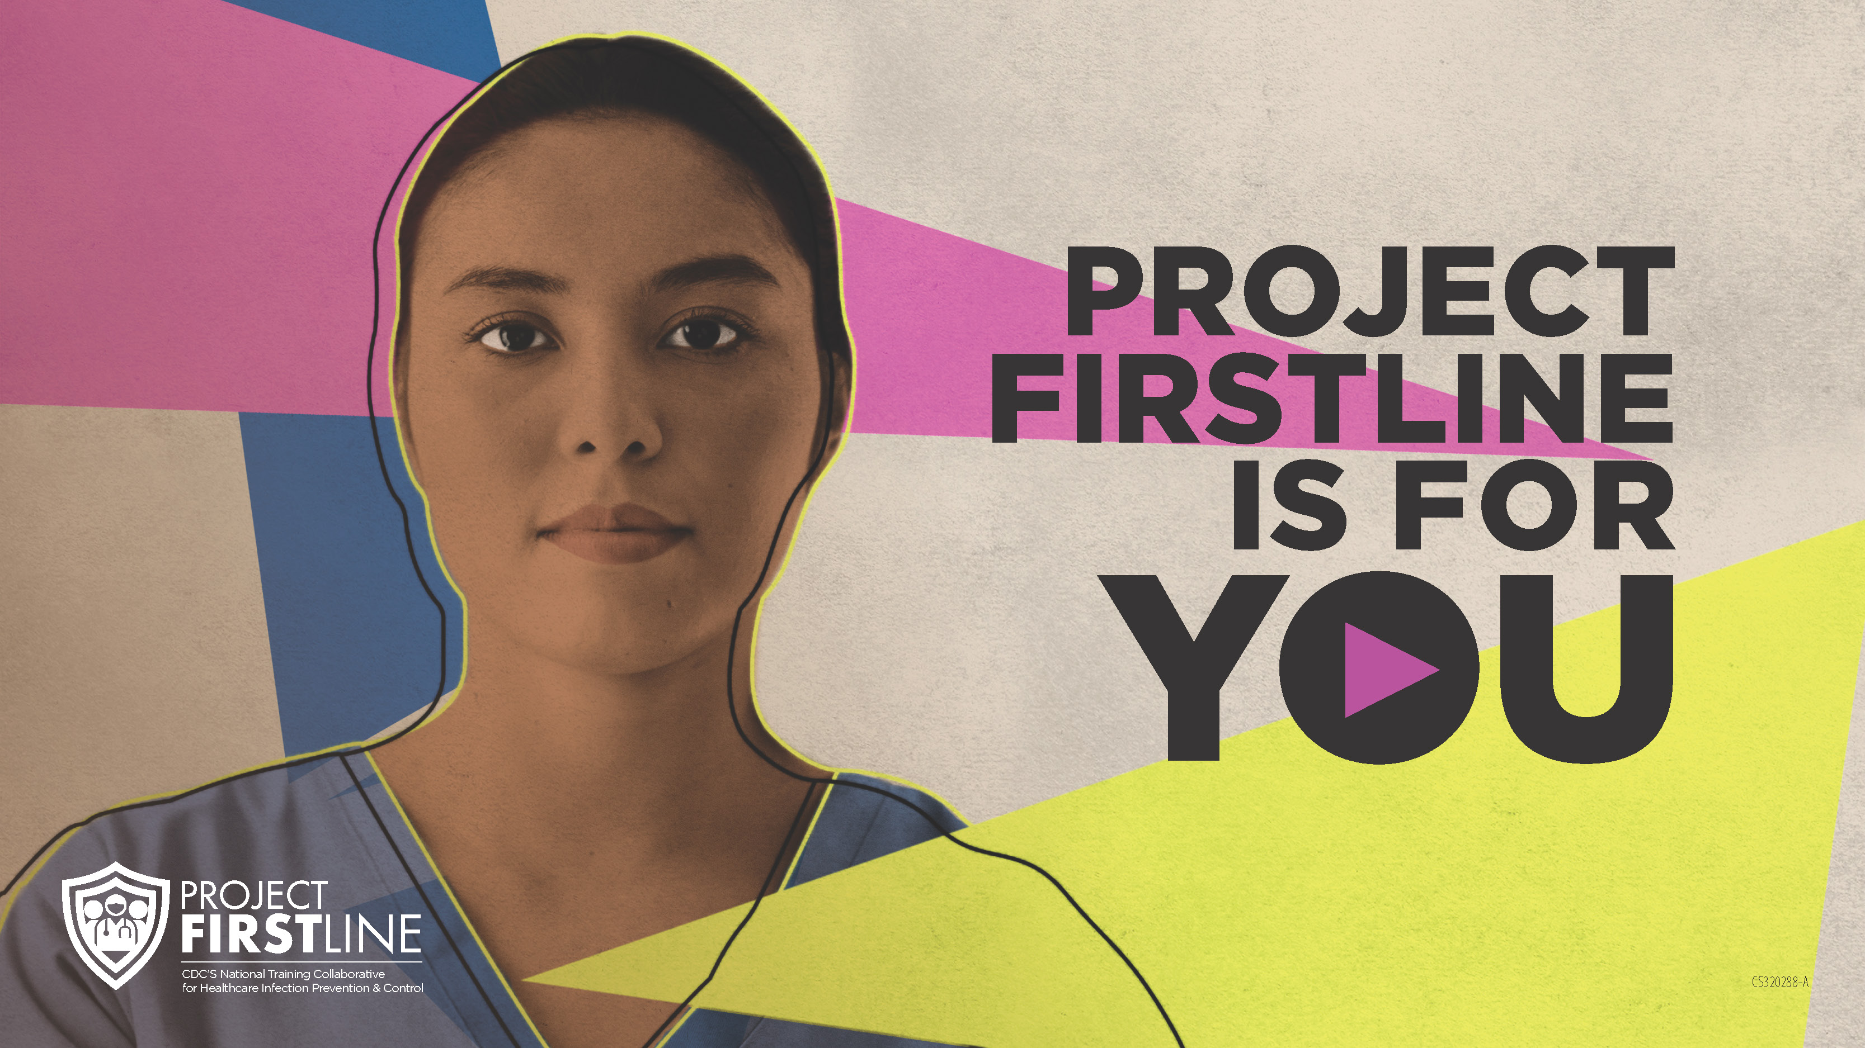
Feedback Form
Notes:
Facilitator Notes
Explain how to access the Feedback Form.
Sample Script
“And, finally, please let us know how you enjoyed today’s session by completing the feedback form. Thanks again for joining us today.”
After the Session
Send list of participant questions compiled during this session to ProjectFirstline@cdc.gov.

