Slide 1

Topic 7:
Ppe part 1 –
Eye protection
[Date of Training]
Notes:
Participants log in and get settled.

Slide 2
Agenda
Introductions
Videos and Discussion
  PPE Overview
  Eye Protection
Next Steps
Notes:
Facilitator Notes
Welcome the group and add a greeting to the chat box.
You may adapt the introduction time as needed: spend time on introductions if there are new faces or if group members still do not know each other.
If this session is part of an ongoing series, you may choose to say “welcome back,” “thank you for joining us again,” etc.
Depending on the structure of your series, you may choose to indicate that future sessions will focus on other pieces of personal protective equipment (PPE).
Housekeeping, either orally or via chat.
If needed, additional notes specific to the platform you’re using (e.g., how to “raise your hand,” how to post questions).
Give an overview of the agenda.
Sample Script
“Welcome to Project Firstline. Thank you for joining us! Before we begin, a few housekeeping notes. We’ll meet today for one hour. Please keep your videos on, to the extent possible, and keep your microphone muted when you are not contributing to the discussion. It’s great to see you all here today!
“Today we’ll talk about PPE – personal protective equipment. We’ll talk about what PPE is and how it works for infection control, and then we’ll focus on one piece of PPE: eye protection. In future sessions, we’ll dive deeper into other pieces of PPE.”

Slide 3
Learning objectives
Define PPE and describe two (2) functions of PPE in healthcare.
Discuss one (1) reason that eye protection is recommended for COVID-19.
Notes:
Facilitator Notes
Provide an overview of the session’s learning objectives.
Sample Script
“Here is what we expect we will learn today. By the end of today’s training, you will be able to describe PPE and how it works for infection control in healthcare. You’ll also be able to discuss why eye protection is part of the recommended PPE for COVID-19.”

Slide 4
Introductions
Please introduce yourself with:
Your name
Your role (e.g., organization, unit)
One example of a type of PPE that you regularly use in your work duties
Notes:
Facilitator Notes
These questions will give you a better understanding of your participants’ backgrounds, experience, and level of knowledge.
Tailor your slide delivery for the virtual format and platform, and your participants:
You may wish to add role- or facility-specific questions to the introductions.
If you have a large group, you may decide to skip oral introductions and use the chat.
If your group meets regularly, you may wish to skip or shorten the introductions, or use a different “icebreaker” approach.
Be sure to introduce yourself and anyone who is assisting you.
Sample Script
“Let’s take a minute to get to know each other. Please share in 30 seconds or less your name and your role and name a type of PPE that you use regularly at work.”

Slide 5
How would you define PPE?
How would you define PPE?
Notes:
Facilitator Notes
Invite participants to define PPE, and describe in their own words what it does:
PPE stands for “personal protective equipment.”
When used correctly, PPE can help stop germs from spreading between you and other people in your facility, including patients, visitors, and co-workers.
You may choose for them to respond orally or via chat.
You may consider capturing their responses, either on a new slide or in the chat.
Sample Script
“I said it a moment ago – but would anyone volunteer to share what PPE stands for?”
(Pause for responses.)
“Great, thank you for that response. As you mentioned, PPE is the abbreviation for ‘personal protective equipment.’ Now, would anyone like to share, in your own words, what PPE is for? What does it do?”
(Pause for responses.)
“PPE is a familiar concept to many of us, especially now. But we may not always think about its specific definition, its role in healthcare, or what it can and can’t do.”

Slide 6
What is PPE?
While watching the video:
Think about your workday.
Jot down reasons why we use PPE in healthcare.
Notes:
Facilitator Notes
Encourage participants to make note of the functions of PPE in healthcare described in the video.
Sample Script
“Let’s check in with the CDC’s Dr. Abby Carlson. She’ll define PPE, like we just did, but she’ll also talk about its role in healthcare. As you watch, see if you can identify at least two functions of PPE in healthcare, and jot down your thoughts in your Participant Booklet.”

Slide 7
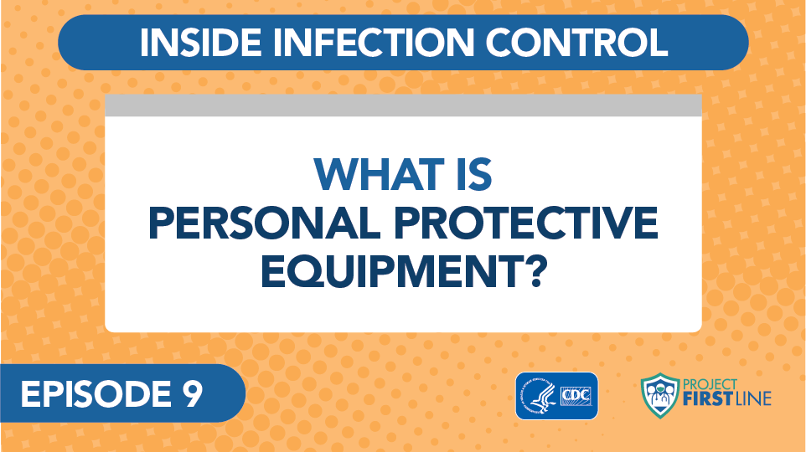
What is Personal Protective Equipment?
Notes:
Facilitator’s Notes
Access the video here:
CDC Website: https://www.cdc.gov/infectioncontrol/projectfirstline/videos/EP9-PPE-LowRes-New.mp4
OR
Project Firstline YouTube Playlist:
https://www.youtube.com/watch?v=e-t2yZsEo70&lis t=PLvrp9iOILTQZQGtDnSDGViKDdRtIc13VX&index=10

Slide 8
What are the two functions of PPE in healthcare settings?
What are the
two functions of PPE in healthcare settings?
Notes:
Facilitator Notes
Invite participants to return to the thoughts they wrote down during the video and share, either orally or in the chat, their ideas regarding the functions of PPE in healthcare.
In healthcare, PPE is used to:
Protect the wearer from dirty surfaces or equipment and prevent exposure to germs from patients that could make you sick.
Keep the wearer from spreading germs to others, like patients and co-workers.
Sample Script
“Can anyone name the two functions of PPE in healthcare?”
(Pause for responses.)
“Thanks for your responses. That’s right: PPE protects you, and PPE protects others.”

Slide 9
How does ppe work?
1. PPE protects YOU from things in the environment.
2. PPE protects OTHERS from germs you might be carrying.
For PPE to work, it must be worn correctly every time.
Notes:
Facilitator Notes
Invite participants to share examples of how PPE is an important part of infection control in healthcare:
A mask protects your nose and mouth so you aren’t splashed by or inhaling something that could make you sick, and it keeps a lot of germs that you are exhaling from reaching other people or the environment.
When you use a gown and gloves, you’re keeping germs off your hands and clothes. You’re also keeping any germs that have gotten on your clothes or hands from spreading around, either to the environment or to other people, by taking off gowns and gloves when you’re supposed to.
Emphasize the messages that:
PPE is important, but it is just one part of infection control.
PPE must be worn correctly and at the right time, every time, in order to protect yourself and others.
Other ways to reduce the risk of infection to yourself and others include:
Working in ways to avoid exposure entirely, like phone triage and tele-medicine.
Ensuring that your workspace is set up in the safest way possible, like making sure the air handling system is working correctly.
Make sure that you’re following all IPC practices, including correct screening, triage and patient placement; safe management of patient care equipment and environmental surfaces (including cleaning and disinfection); staying home when you’re sick; and keeping up with recommended vaccinations.
Sample Script
“Can anyone share examples of a piece of PPE, and how it protects both you and others?”
(Pause for responses.)
“That’s right. And of course, another important point to remember from the video is that while PPE is important, it’s just one part of infection control. Other ways to reduce the risk of infection to yourself and others include things like safe management of patient care equipment and environmental surfaces (including cleaning and disinfection) and ensuring correct screening, triage, and patient placement. Also, don’t forget that PPE has to be used correctly, every time, to protect you and others.”

Slide 10
PPE role play
How would you explain PPE to a patient or a patient’s family?
Notes:
Facilitator Notes
Lead participants in a role-playing exercise in which they are explaining to others what PPE is, and why it is important.
Ask a volunteer to come off mute to role play with you, in which the volunteer is explaining PPE to you.
Ask the volunteer to “set the scene” and explain your role (e.g., co-worker, patient).
Encourage a focus on why PPE is important, and emphasize that it needs to be worn correctly, every time, to be protective.
Time permitting, invite additional volunteers to role-play different situations. You may wish to suggest different roles to consider.
Sample Script
“Now that we’ve defined PPE, let’s spend a few minutes thinking about how we explain and describe PPE to others. Everyone might not understand why PPE is important, especially when it can be a hassle to use it.
“How can we explain PPE’s important role when we’re on the job? And who might we need to explain it to? Spend a few moments thinking to yourself about possible situations, and what you might do in them.”
(Pause to allow participants to reflect.)
“Is someone willing to volunteer to come off mute and role play with me?” (After volunteer identifies.) “Hi, thank you! Okay, who am I in this scene?”
(Role play with volunteer.)
“That was great, thank you! Let’s have another volunteer see if they can explain PPE to me. Does anyone have a different situation that we could explore?”
(Repeat with another volunteer as time allows.)

Slide 11
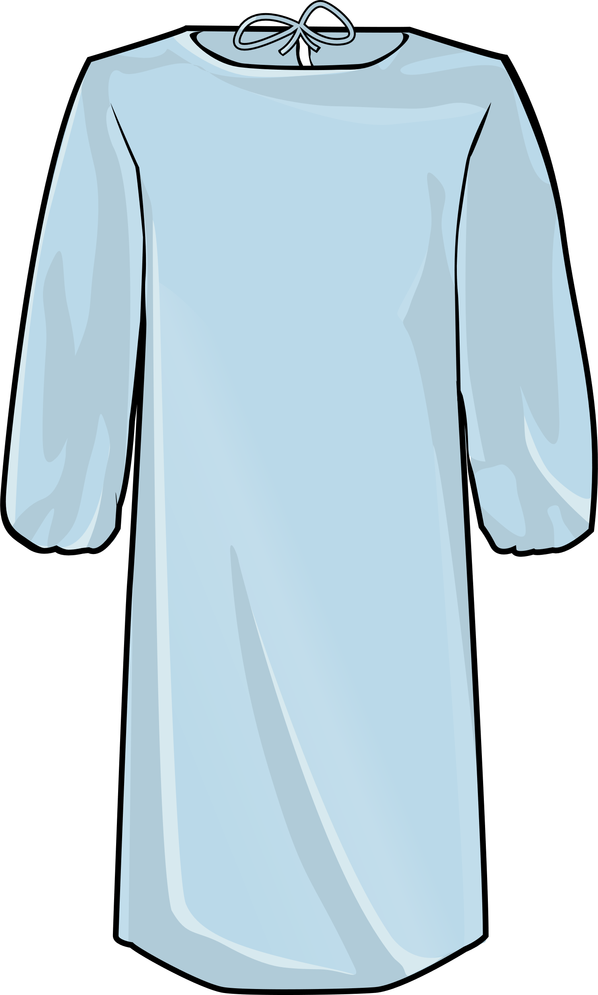
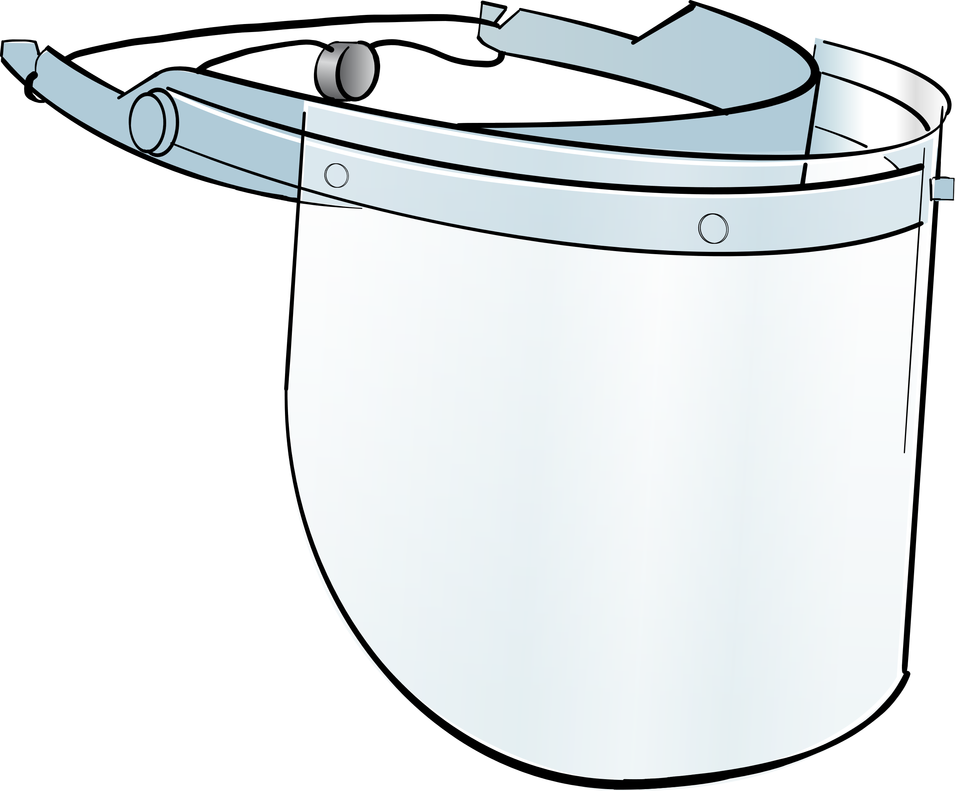

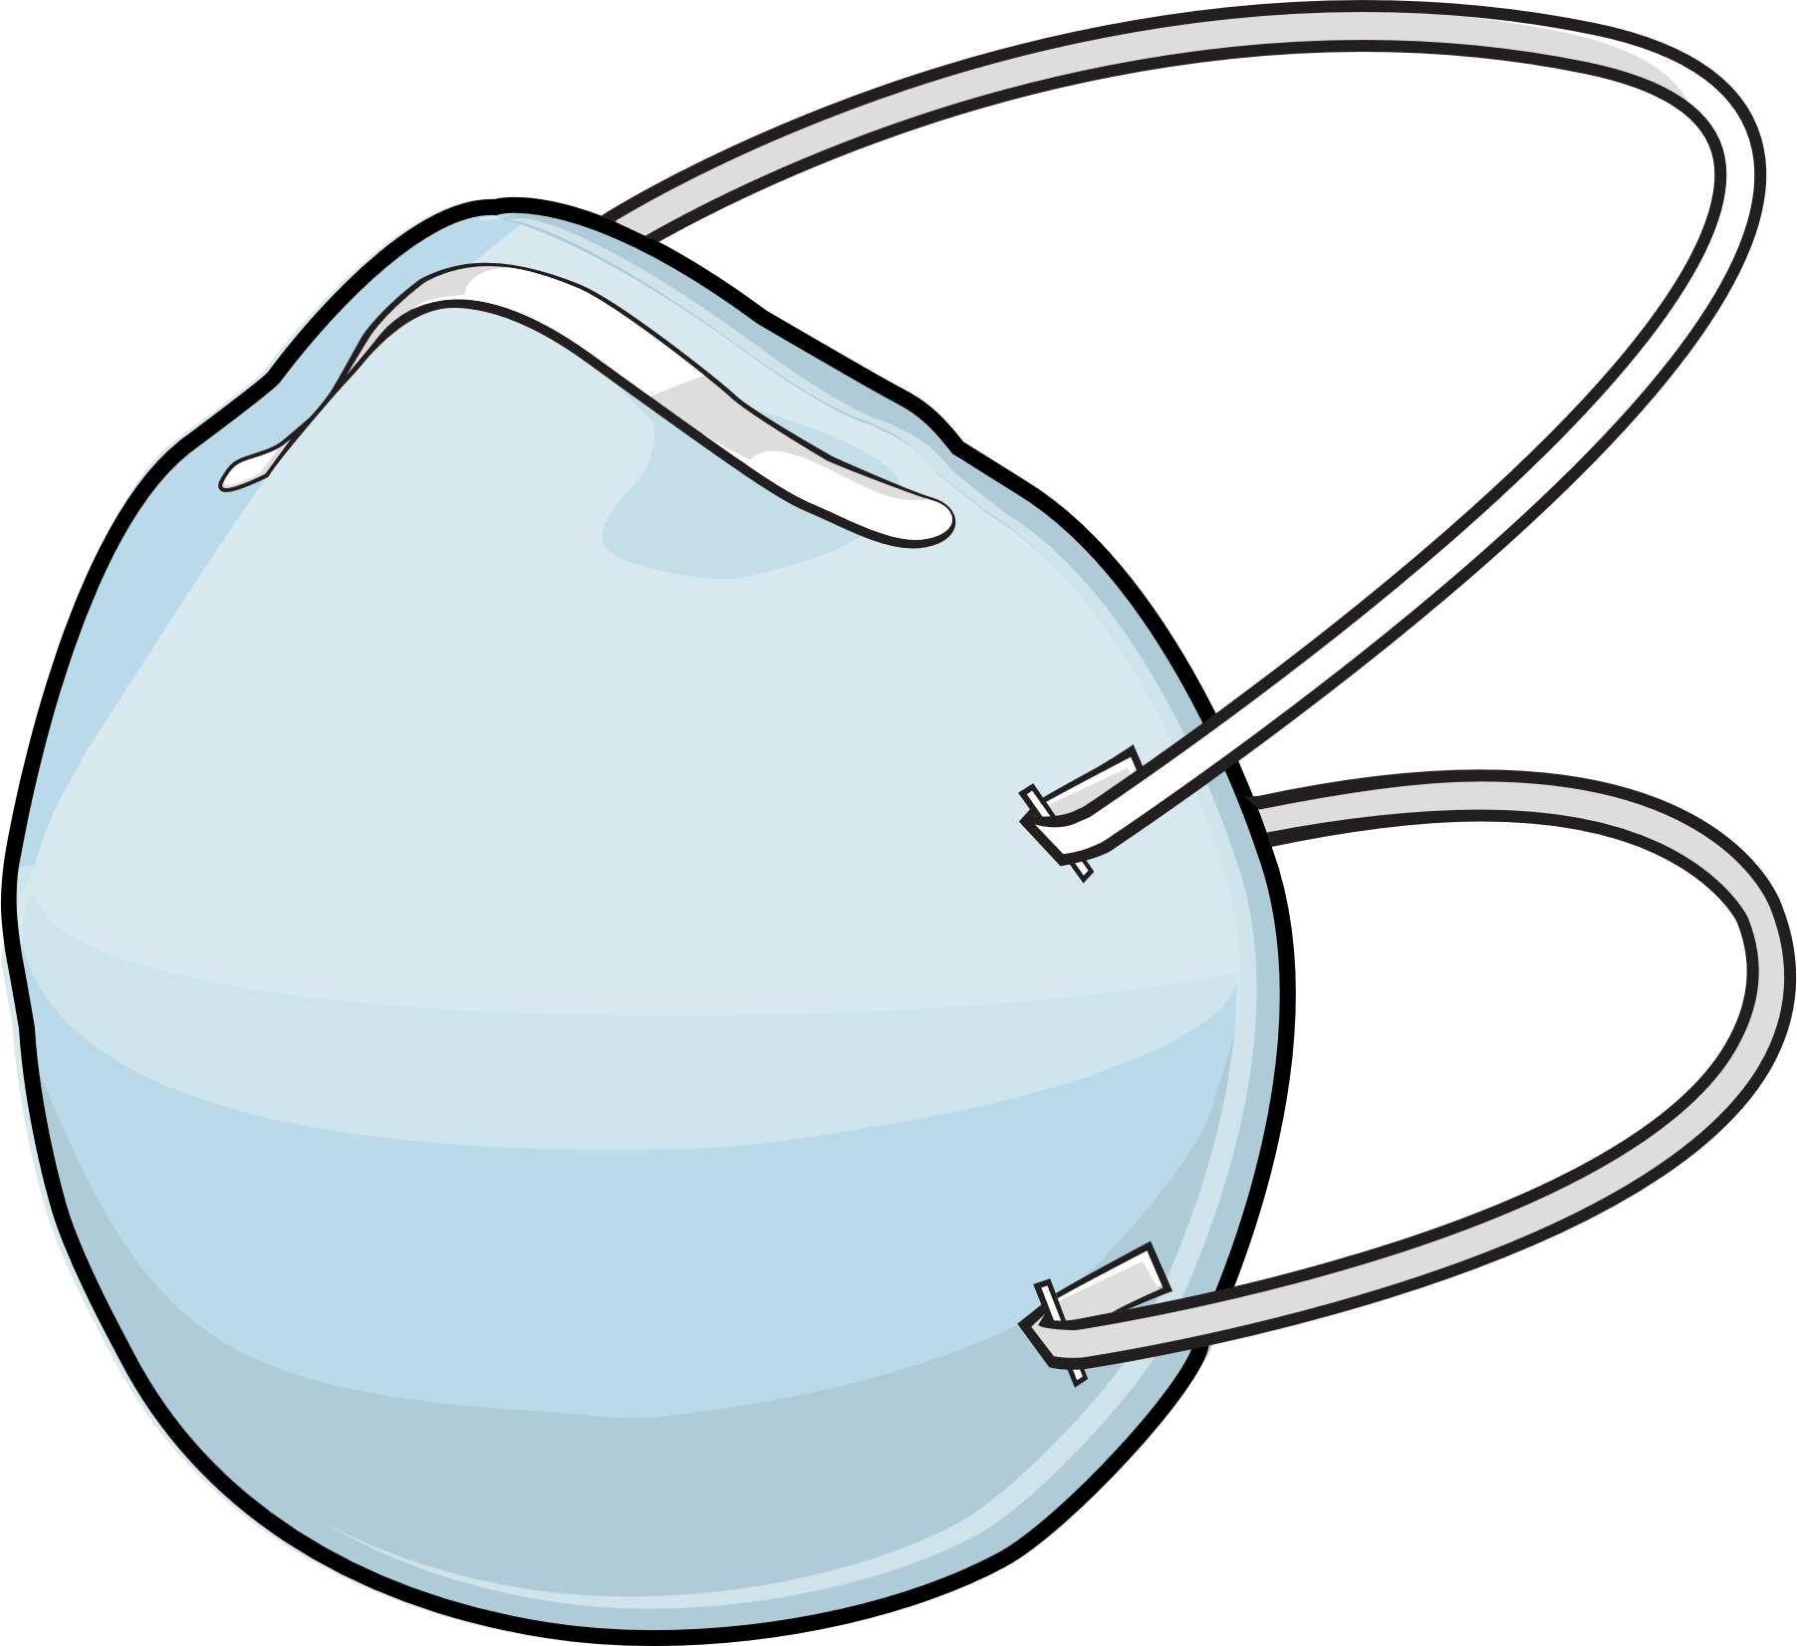

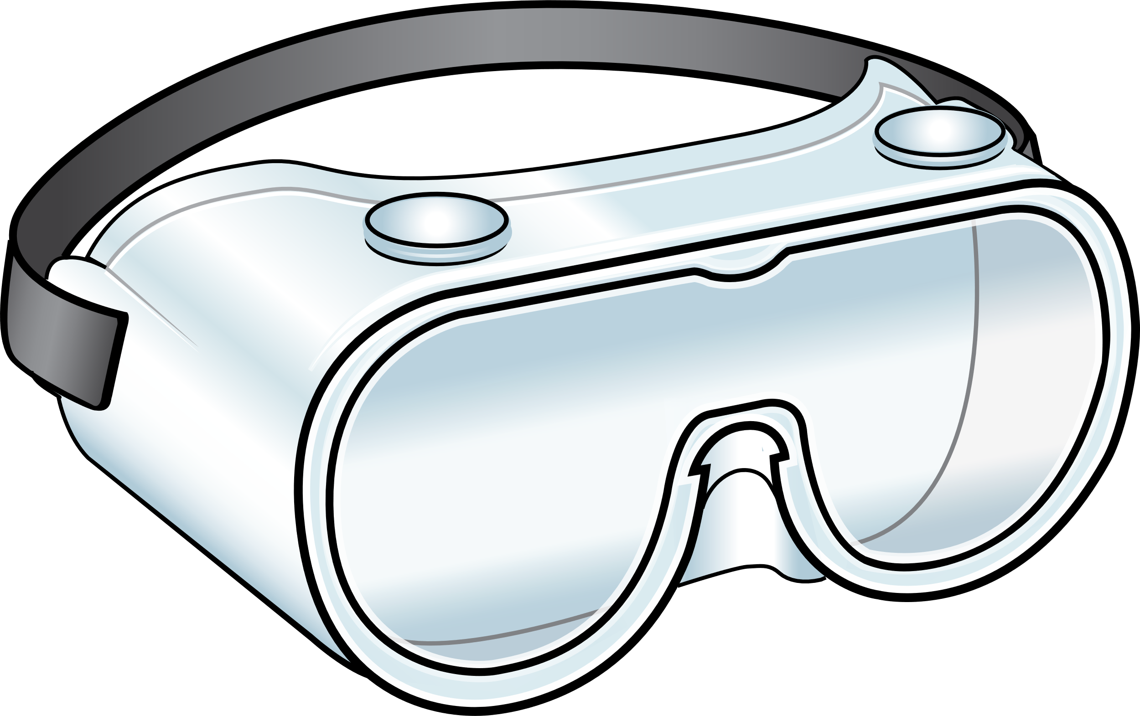
Recommended PPE for COVID-19
Eye Protection
Gloves & Gown
Respirator
Notes:
Facilitator Notes
Transition to discussion of PPE recommended for COVID-19.
If this session is part of a series, you may choose to indicate that future sessions will focus on other pieces of PPE.
Sample Script
“Now let’s think about the specific PPE recommended for COVID-19. Today, we’ll focus on eye protection. In future sessions, we’ll examine other types of PPE.”

Slide 12
Eye protection for COVID-19: What are some examples?
Eye Protection for COVID-19: What are some examples?
Notes:
Facilitator Notes
Ask the participants to indicate whether they have experience working with COVID-19 patients.
Depending on your virtual platform, you might ask them to “raise their hand,” type in the chat, or use the poll feature.
React to the answers and link to the next question.
Recall the examples of PPE that participants listed at the beginning of the session, and ask them to provide, either orally or in the chat, examples of eye protection used for PPE.
You may expect to hear goggles and face shields.
It may be necessary to clarify that regular eyeglasses and some protective eyewear (e.g., safety glasses, trauma glasses) with gaps between the glasses and the face are not considered eye protection for COVID-19, because they do not protect eyes from all splashes and sprays. Additional information is here: Infection Control: Severe acute respiratory syndrome coronavirus 2 (SARS-CoV-2) | CDC (https://www.cdc.gov/coronavirus/2019-ncov/hcp/infection-control-recommendations.html).
Sample Script
“First, I’ll ask you all – who has had experience working with COVID-19 patients?”
(Pause to allow responses.)
“All right, it looks like most of you have. Now I’ll ask you to think about the PPE that you wear, that we talked about at the beginning of the session. Can anyone share examples of the eye protection that you wear for PPE in healthcare?”
(Pause to allow responses. Respond as appropriate.)

Slide 13
Why do you think eye protection is important?
Why do you think eye protection is important?
Notes:
Facilitator Notes
Thank participants for their responses.
Ask the participants to explain why eye protection is recommended for COVID-19 and make a note of their answer in their Participant Booklet.
Introduce video episode of Inside Infection Control.
Sample Script
“Thank you for sharing your thoughts! Now, does anyone know why eye protection is recommended for COVID-19? What do the eyes have to do with COVID-19 infection? If you have an answer, jot it down in your Participant Booklet. We’ll watch a video from Dr. Carlson and then discuss it together. Feel free to add to or change your answer as we watch.”

Slide 14
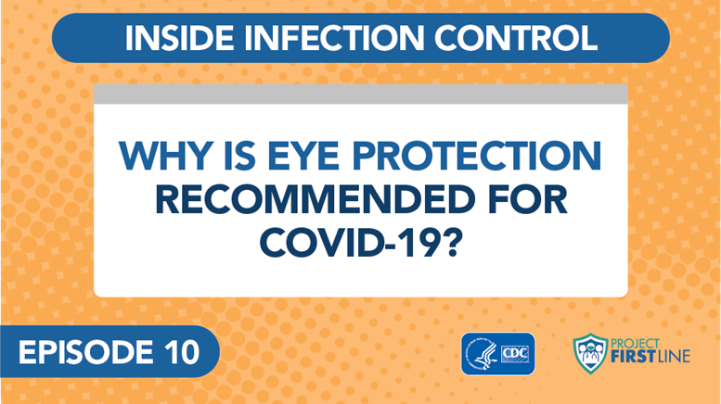
Why is eye protection recommended for covid-19?
Notes:
Facilitator Notes
Play Episode 10: Why is Eye Protection Recommended for COVID-19?
Access the video here:
CDC Website: https://www.cdc.gov/infectioncontrol/projectfirstline/videos/EP10-EYE-LowRes-New.mp4
OR
Project Firstline YouTube Playlist: https://www.youtube.com/ watch?v=kkruNHsMbMY

Slide 15
Discussion: What did we learn about eye protection?
Discussion: What did we learn about eye protection?
Notes:
Facilitator Notes
After the episode, ask the group to discuss: What did you learn from this video about why eye protection is recommended for COVID-19? Was anything in the video new to you?
You may choose to ask participants to share their reactions orally, via chat, or both.
As participants respond, you may choose to capture their answers, either on a new slide or in the chat.
Sample Script
“Based on what you heard in the video, what did you learn about why eye protection is recommended for COVID-19? Was any of the information in the video new to you?”
(Pause to allow for responses. Encourage additional discussion.)

Slide 16
Why is eye protection recommended for covid-19?
In addition to getting in the nose and mouth, or being inhaled, the virus can get into the nose and throat through the tear ducts and cause infection.
Respiratory droplets that can carry virus can land on your eyes and travel from your eyes to reach the “target zones” of the nose, mouth, back of the throat, and lungs.
Some viruses can also infect cells in the eye directly.
Whatever is used to protect the eyes should allow you to see clearly and do your work safely.
Notes:
Facilitator Notes
The bullet points on this slide summarize the messages from the video regarding why eye protection is recommended for COVID-19. If any of the points were not raised in discussion, note them now.
Eye protection – either goggles or a face shield – is part of the PPE recommended for COVID-19 because, in addition to getting in the nose and mouth, or being inhaled, the virus can get into the nose and throat through the tear ducts and cause infection.
Respiratory droplets that can carry virus can land on your eyes and travel from your eyes to reach the “target zones” of the nose, mouth, back of the throat, and lungs.
Some viruses can also infect cells in the eye directly.
Make sure that your eye protection doesn’t get in the way and that you can see what you’re doing. If your vision is blocked, you can be injured, and you might injure someone near you. Encourage additional discussion as appropriate.
Ask participants to summarize how virus can travel through the eye system and cause infection.
Germs that land in the eyes, including tiny respiratory droplets that can carry virus, can travel through the tear ducts to your nose and throat and infect you. The virus can also infect the eye directly, like we see with pink eye.
You may wish to refer to the Content Outline for Episode 10 of Inside Infection Control for additional discussion points.
Sample Script
“Thank you for your responses. You’ll see many of them reflected on this slide.”
(Review any points that were not mentioned by participants.)
“In the video, Dr. Carlson also explained how germs, including the virus that causes COVID-19, can enter the body through the eyes. Would anyone like to recap how that happens?”
(Pause for responses and add any clarifying points.)

Slide 17
Breakout Group
Using eye protection at your workplace
1. How is eye protection used at your workplace?
  What does your workplace do well?
2. What strategies could you use to suggest improvements?
Notes:
Facilitator Notes
Use breakout rooms appropriate to your virtual platform to divide participants into small breakout groups and task each with reflecting on the use of eye protection in their workplace: What is going well? What are some strategies to help make improvements?
If possible, groups should have approximately three members in each.
As needed, provide instructions related to the breakout room format, such as how to ask questions.
Inform the groups that they have 5 minutes to work together.
Ask each group to identify a volunteer who will be willing to report the group’s ideas when everyone reconvenes.
If applicable and possible, try to create groupings of participants who haven’t yet worked together in past small-group activities.
After the small groups have gathered, depending on your virtual platform, you may use the broadcast message feature or another means to send reminders of the discussion prompts, how much time is remaining, etc. You may also choose to “visit” each group to encourage conversation and to hear their thoughts.
Use your chime or timekeeper to warn participants when they have 1 minute remaining.
Sample Script
“Let’s spend a few moments thinking about how eye protection plays a role in your work life. On the slide are questions to help you reflect on eye protection at work. What is going well? Are there activities during your workday that put you at risk of exposure to respiratory droplets, splashes, or sprays from patients that could land in your eyes? What could you do to help make improvements, or how could things be done differently?
“We’re going to break into small groups to discuss your responses to the first question. Then we’ll come back together to brainstorm strategies for question 2. Please select a spokesperson to report out when we come back together in 5 minutes.”

Slide 18
Report out
How is eye protection used at your workplace?
Working Well | Improvement Strategies
Notes:
Facilitator Notes
After 10 minutes, reconvene the groups.
In turn, invite a spokesperson from each group to share their discussion regarding “what’s going well.”
Then, ask the full group to discuss strategies for how to make improvements or do things differently.
If possible within your virtual platform, capture the groups’ responses on a slide.
Write their responses to “what’s going well” in Column 1.
Next, as participants discuss strategies for making improvements, capture them in Column 2.
Encourage participants to think concretely and critically about how they could make improvements, especially if any examples given are of inappropriate PPE use.
Help participants make connections between the information in the two columns and their own work.
Sample Script
“Welcome back. I hope you had the chance to talk about how eye protection is used at work. I’d like for each spokesperson to report out on what’s going well. I’ll add them to the chart on this slide as you talk.”
(As groups report, capture or summarize their reports on the slide.)
“Great. Thanks for sharing. Now let’s think about how we can make improvements, or do things differently, about eye protection at work. Does anyone have any ideas? Who could you talk to if you have concerns?”
(Pause for responses, and capture or summarize ideas on the slide.)
“Thanks for the good ideas. Remember that you can speak with your supervisors and trusted mentors if you have any concerns about eye protection at work.”

Slide 19
Reflection
Notes:
Facilitator Notes
Transition to wrap-up of session.
Sample Script
“Let’s use our last few minutes together to reflect on what we’ve learned and think about how we can put what we’ve learned into practice.”

Slide 20
Reflection, continued
What is one thing that you have learned today about PPE or eye protection for COVID-19?
Notes:
Facilitator Notes
Encourage participants to reflect on what they learned today and how they will put what they learned into practice.
You may choose to ask participants to respond orally, in the chat, or both.
If most of the responses are about eye protection, remind the group of some of the key points covered regarding PPE, and vice versa.
Sample Script
“I hope you’ve learned a lot today. Before we go, I’d like for you to share with me one thing you learned either about PPE, or about eye protection for COVID-19, and how you’ll put that knowledge to use on the job.”
(Pause for responses. Acknowledge and respond as appropriate.)

Slide 21
What questions do you still have about eye protection?
What questions do you still have?
Notes:
Facilitator Notes
Invite additional, remaining questions.
You may choose to ask participants to respond orally, in the chat, or both.
If the answers are information that is already included in this session, please respond.
If the questions address content that is not covered in this session, please do not attempt to answer. Instead, take note of the questions and consult with CDC resources to follow up with answers after the session.
Sample Script
“Thank you all for your time! Please take a moment to reflect on today’s session and share any remaining questions you have. Does anyone have any questions still remaining?”
(Address questions as appropriate.)
“Thank you for sharing those questions. Project Firstline is actively collecting your questions to help inform more training resources as they’re developed. I’ve written them down, and I will get back to you with responses.”

Slide 22
Key Takeaways
PPE is used in healthcare both to protect YOU and to protect OTHERS.
Eye protection is recommended for COVID-19 because the virus can enter the body through the eyes.
Whatever is used to protect your eyes should allow you to see clearly and do your work safely.
Notes:
Facilitator Notes
Review key takeaways.
You may choose to revisit discussion points or questions that arose during the session.
Sample Script
“I hope this training gave you some good information about what PPE is, why it’s so important, and why eye protection is recommended for COVID-19. I’ve captured some key takeaways here, which you can review at your leisure after the session today.”

Slide 23
Resources and Future Training sessions
Project Firstline on CDC:
https://www.cdc.gov/infectioncontrol/projectfirstline/index.html
Project Firstline on Facebook:
https://www.facebook.com/CDCProjectFirstline/
Twitter:
https://twitter.com/CDC_Firstline
Youtube:
https://www.youtube.com/playlist?list=PLvrp9iOILTQZQGtDnSDGViKDdRtIc13VX
CDC’s One and Only Campaign:
https://www.cdc.gov/injectionsafety/one-and-only.html
Notes:
Facilitator Notes
Share additional resources from Project Firstline and CDC.
Explain how participants can reach you, by the means of your choosing, and how they can reach Project Firstline.
If this session is part of a series, you may choose to describe the themes of upcoming sessions.
Sample Script
“We covered a lot today, and there is still more to learn. You can keep exploring these topics on your own using the resources on this slide. You can also follow us on social media. I will stay on the line for a few minutes after our session ends and will be happy to discuss any other questions!”
(If this session is part of a series.) “Next time, we will cover [insert next training topic].”

Slide 24
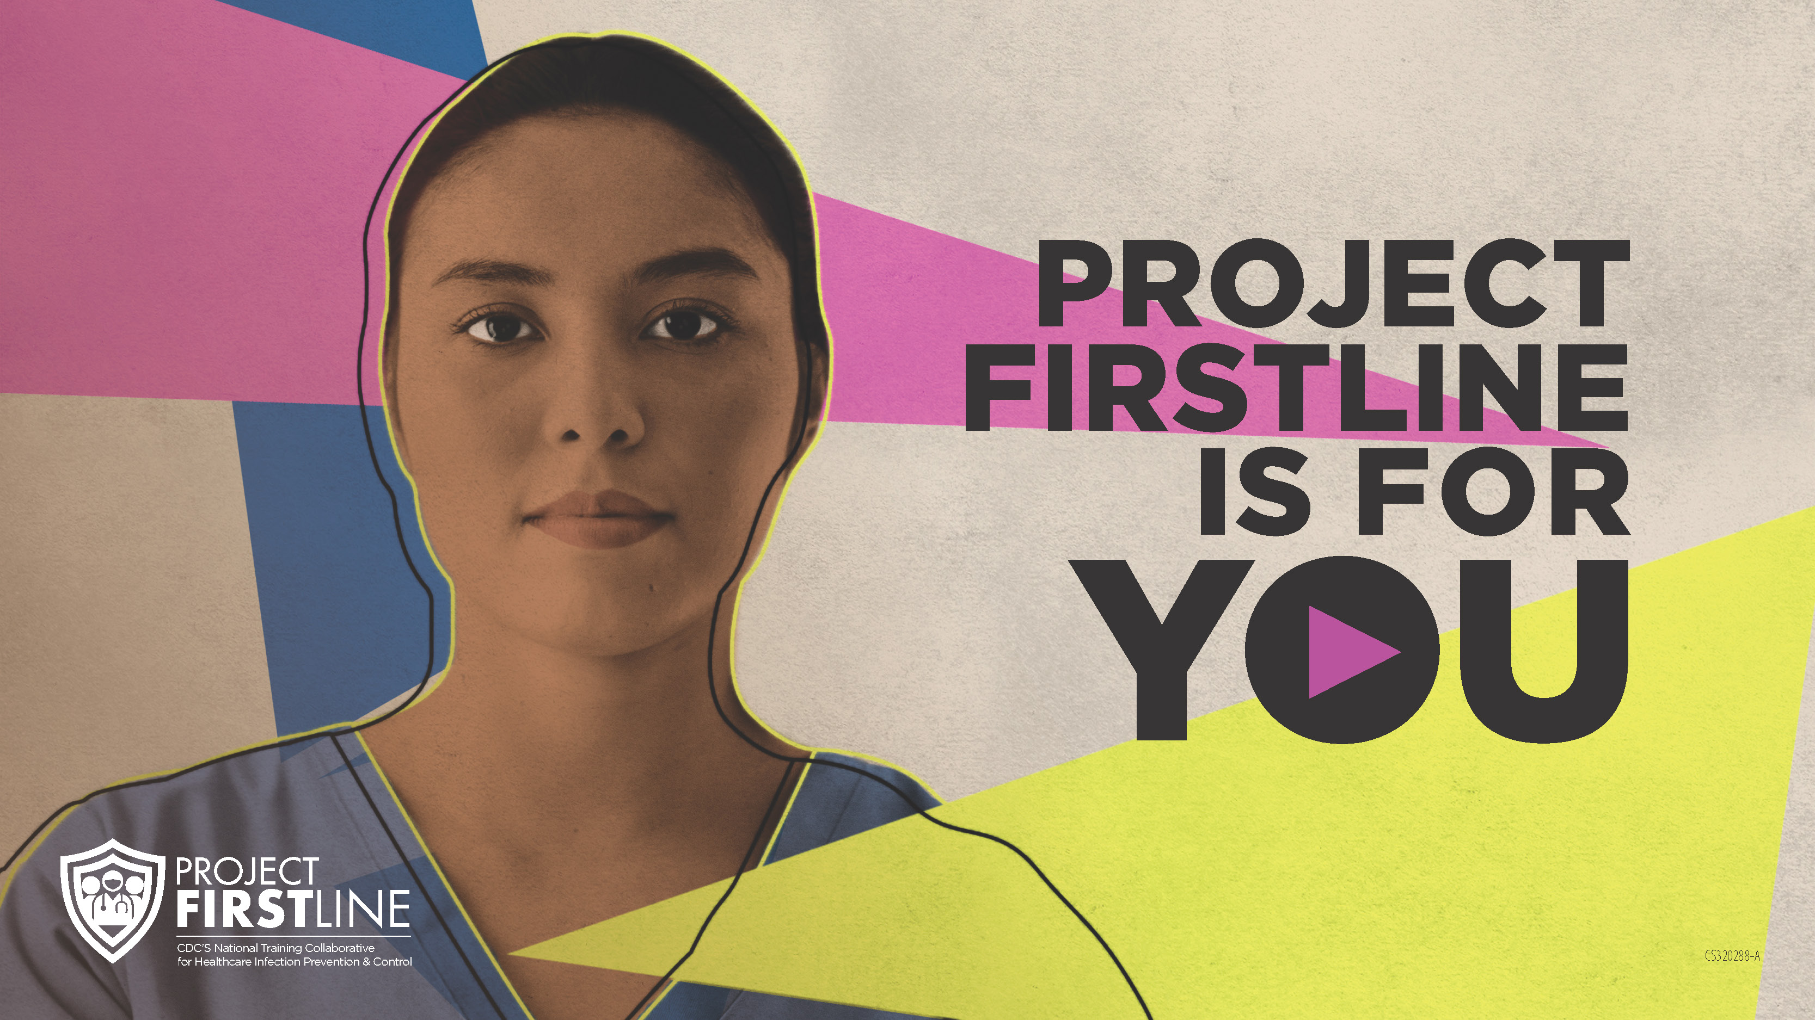
Feedback Form
Notes:
Facilitator Notes
Explain how to access the feedback form.
Sample Script
“And, finally, please let us know how you enjoyed today’s session by completing the following feedback form. Thanks again for joining us today.”
After the Session
Send list of participant questions compiled during this session to ProjectFirstline@cdc.gov.

