Slide 1
Topic 7: Ppe part 1 – Eye protection
[Date of Training]
Notes:
Participants log in and get settled.

Slide 2
Agenda
Introductions
Videos and Discussion
PPE Overview
Eye Protection
Next Steps
Notes:
Facilitator Notes
Welcome the group and add a greeting to the chat box.
You may adapt the introduction time as needed: spend time on introductions if there are new faces or if group members still do not know each other.
If this session is part of an ongoing series, you may choose to say “welcome back,” “thank you for joining us again,” etc.
Depending on the structure of your series, you may choose to indicate that future sessions will focus on other pieces of personal protective equipment (PPE).
Housekeeping, either orally or via chat.
If needed, additional notes specific to the platform you’re using (e.g., how to “raise your hand,” how to post questions).
Give an overview of the agenda.
Sample Script
“Welcome to Project Firstline. Thank you for joining us! Before we begin, a few housekeeping notes. We’ll meet today for 20 minutes. Please keep your videos on, to the extent possible, and keep your microphone muted when you are not contributing to the discussion. It’s great to see you all here today!
“Today we’ll talk about PPE – personal protective equipment. We’ll talk about what PPE is and how it works for infection control, and then we’ll focus on one piece of PPE: eye protection. In future sessions, we’ll dive deeper into other pieces of PPE.”

Slide 3
Learning objectives
Define PPE and describe two (2) functions of PPE in healthcare.
Discuss one (1) reason that eye protection is recommended for COVID-19.
Notes:
Facilitator Notes
Provide an overview of the session’s learning objectives.
Sample Script
“Here is what we expect we will learn today. By the end of today’s training, you will be able to describe PPE and how it works for infection control in healthcare. You’ll also be able to discuss why eye protection is part of the recommended PPE for COVID-19.”

Slide 4
Introductions
Please introduce yourself with:
Your name
Your role (e.g., organization, unit)
Notes:
Facilitator Notes
These questions will give you a better understanding of your participants’ backgrounds, experience, and level of knowledge.
Tailor your slide delivery for the virtual format and platform, and your participants:
You may wish to add role- or facility-specific questions to the introductions.
If you have a large group, you may decide to skip oral introductions and use the chat.
If your group meets regularly, you may wish to skip or shorten the introductions, or use a different “icebreaker” approach.
Be sure to introduce yourself and anyone who is assisting you.
Sample Script
“Let’s take a minute to get to know each other. Please share in 10 seconds or less your name and your role.”

Slide 5
How would you define PPE?
How would you define PPE?
Notes:
Facilitator Notes
Invite participants to define PPE, and describe in their own words what it does:
PPE stands for “personal protective equipment.”
When used correctly, PPE can help stop germs from spreading between you and other people in your facility, including patients, visitors, and co-workers.
You may choose for them to respond orally, or via chat.
You may consider capturing their responses, either on a new slide or in the chat.
Sample Script
“I said it a moment ago – but would anyone volunteer to share what PPE stands for?”
(Pause for responses.)
“Great, thank you for that response. As you mentioned, PPE is the abbreviation for ‘personal protective equipment.’ Now, would anyone like to share, in your own words, what PPE is for? What does it do?”
(Pause for responses.)
“PPE is a familiar concept to many of us, especially now. But we may not always think about its specific definition, its role in healthcare, or what it can and can’t do.”

Slide 6
How does ppe work?
1. PPE protects YOU from things in the environment.
2. PPE protects OTHERS from germs you might be carrying.
For PPE to work, it must be worn correctly every time.
Notes:
Facilitator Notes
Invite participants to share examples of how PPE is an important part of infection control in healthcare:
A mask protects your nose and mouth so you aren’t splashed by or inhaling something that could make you sick, and it keeps a lot of germs that you are exhaling from reaching other people or the environment.
When you use a gown and gloves, you’re keeping germs off your hands and clothes. You’re also keeping any germs that have gotten on your clothes or hands from spreading around, either to the environment or to other people, by taking off gowns and gloves when you’re supposed to.
Emphasize the messages that:
PPE is important, but it is just one part of infection control.
Other ways to reduce the risk of infection to yourself and others include:
Working in ways to avoid exposure entirely, like phone triage and tele-medicine.
Ensuring that your workspace is set up in the safest way possible, like making sure the air-handling system is working correctly.
Make sure that you’re following all IPC practices, including correct screening, triage, and patient placement; safe management of patient care equipment and environmental surfaces (including cleaning and disinfection); staying home when you’re sick; and keeping up with recommended vaccinations. PPE must be worn correctly and at the right time, every time, in order to protect yourself and others.
Sample Script
“Can anyone share examples of a piece of PPE, and how it protects both you and others?”
(Pause for responses.)
“That’s right. And of course, another important point to remember from the video is that, while PPE is important, it’s just one part of infection control. Other ways to reduce the risk of infection to yourself and others include things like safe management of patient care equipment and environmental surfaces (including cleaning and disinfection) and ensuring correct screening, triage, and patient placement. Also, don’t forget that PPE has to be used correctly, every time, to protect you and others.”

Slide 7
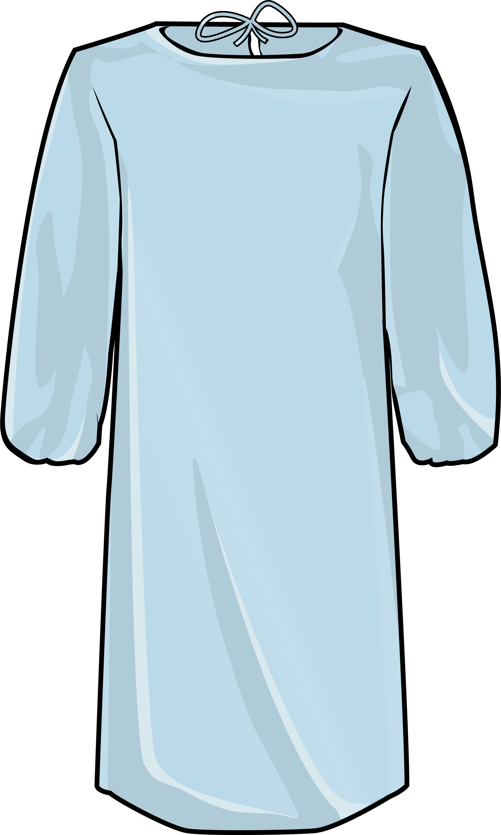
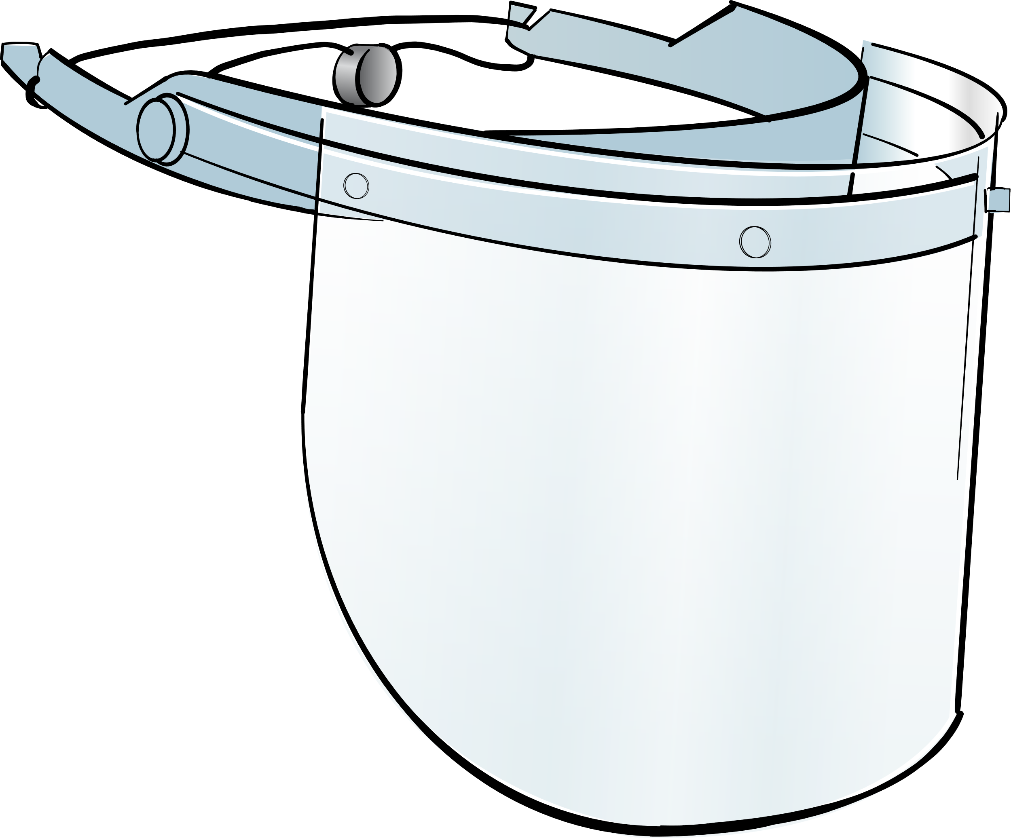
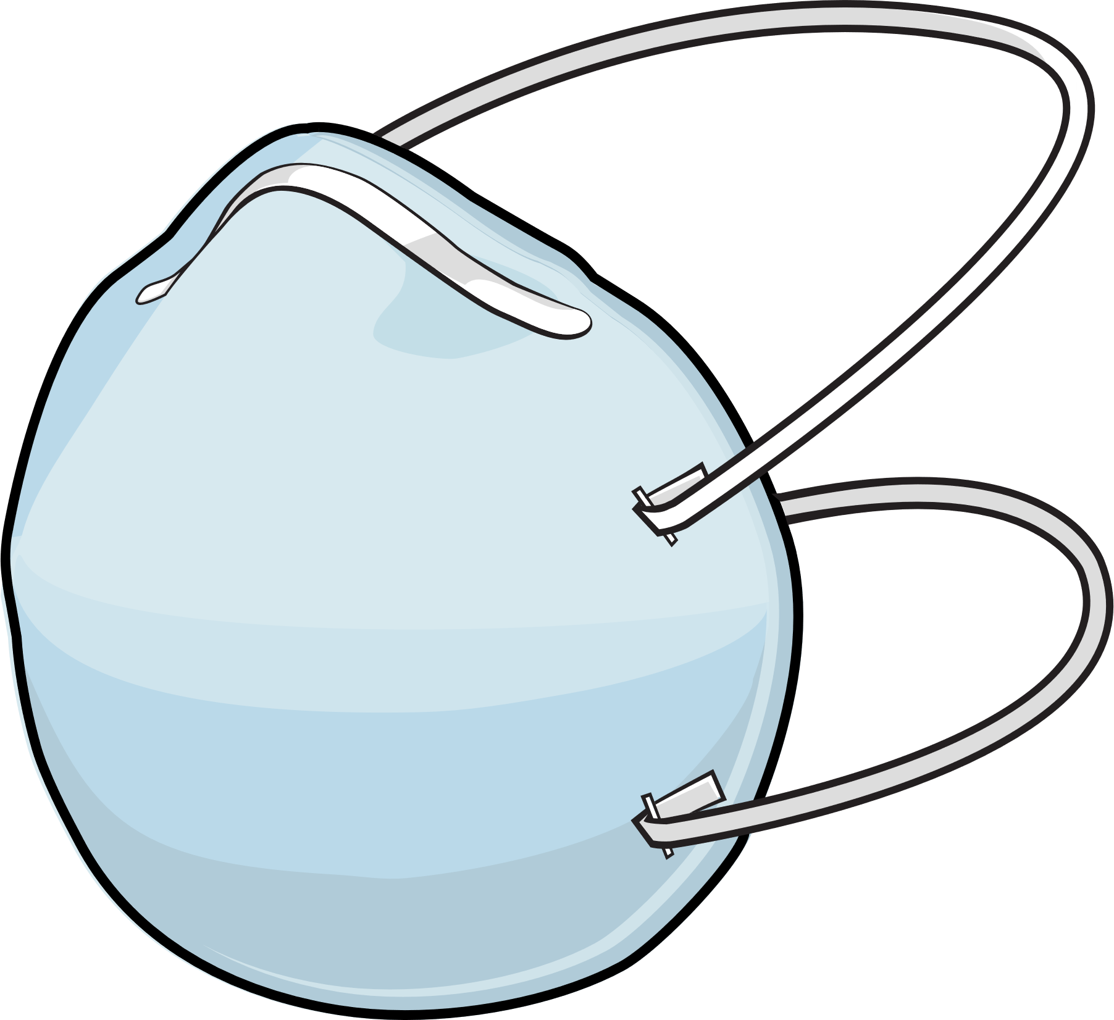
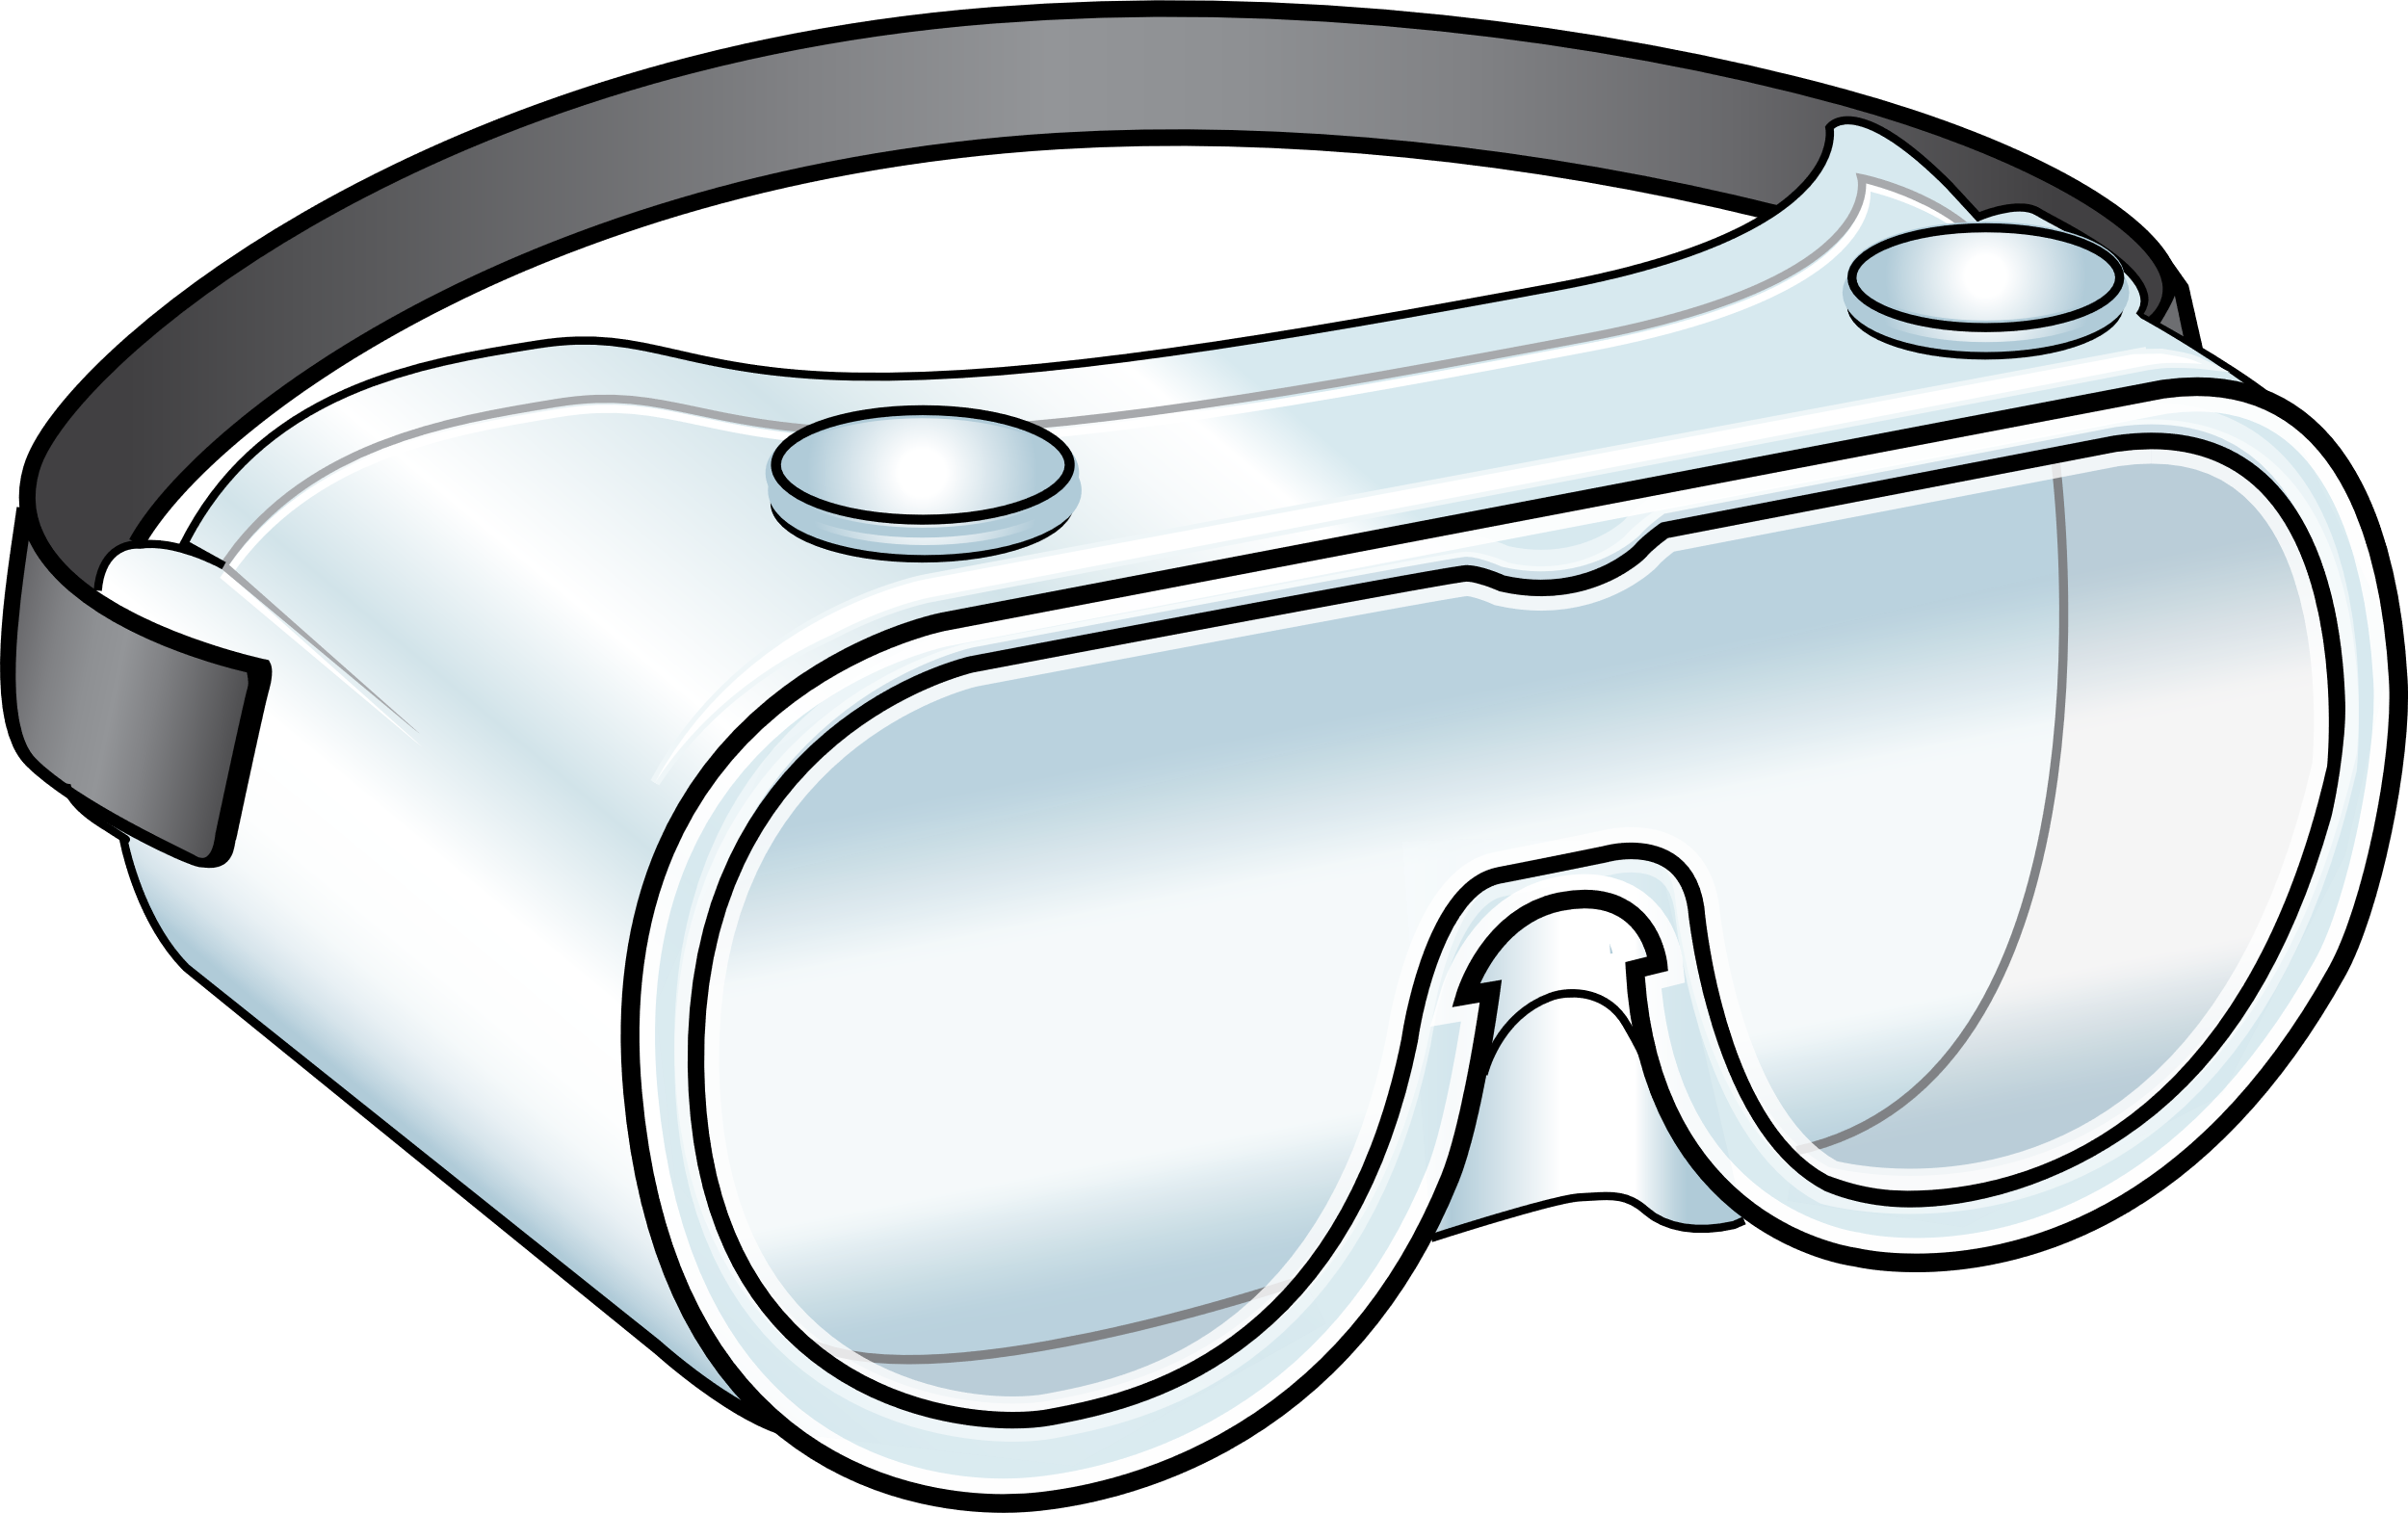
Recommended PPE for COVID-19
Eye Protection
Gloves & Gown
Respirator
Notes:
Facilitator Notes
Transition to discussion of PPE recommended for COVID-19.
If this session is part of a series, you may choose to indicate that future sessions will focus on other pieces of PPE.
Sample Script
“Now let’s think about the specific PPE recommended for COVID-19. Today, we’ll focus on eye protection. In future sessions, we’ll examine other types of PPE.”

Slide 8
Why do you think eye protection is important?
Why do you think eye protection is important?
Notes:
Facilitator Notes
Ask participants to explain why eye protection is recommended for COVID-19 and make a note of their answer in their Participant Booklet.
Introduce video episode of Inside Infection Control.
Sample Script
“Does anyone know why eye protection is recommended for COVID-19? What do the eyes have to do with COVID-19 infection? If you have an answer, jot it down in your Participant Booklet. We’ll watch a video from Dr. Carlson and then discuss it together. Feel free to add to or change your answer as we watch.”

Slide 9
Why is Eye Protection Recommended for COVID-19?
Notes:
Facilitator Notes
Play Episode 10: Why is Eye Protection Recommended for COVID-19?
Access the video here: CDC Website: https://www.cdc.gov/infectioncontrol/projectfirstline/videos/EP10-EYE-LowRes-New.mp4
OR Project Firstline YouTube Playlist: https://www.youtube.com/ watch?v=kkruNHsMbMY

Slide 10
Why is eye protection Recommended for covid-19?
In addition to getting in the nose and mouth, or being inhaled, the virus can get into the nose and throat through the tear ducts and cause infection.
Respiratory droplets that can carry virus can land on your eyes and travel from your eyes to reach the “target zones” of the nose, mouth, back of the throat, and lungs.
Some viruses can also infect cells in the eye directly.
Whatever is used to protect the eyes should allow you to see clearly and do your work safely.
Notes:
Facilitator Notes
The bullet points on this slide summarize the messages from the video regarding why eye protection is recommended for COVID-19. If any of the points were not raised in discussion, note them now.
Eye protection – either goggles or a face shield – is part of the PPE recommended for COVID-19 because, in addition to getting in the nose and mouth, or being inhaled, the virus can get into the nose and throat through the tear ducts and cause infection.
Respiratory droplets that can carry virus can land on your eyes and travel from your eyes to reach the “target zones” of the nose, mouth, back of the throat, and lungs.
Some viruses can also infect cells in the eye directly.
Make sure that your eye protection doesn’t get in the way and that you can see what you’re doing. If your vision is blocked, you can be injured, and you might injure someone near you. Encourage additional discussion as appropriate.
Ask participants to summarize how virus can travel through the eye system and cause infection.
Germs that land in the eyes, including tiny respiratory droplets that can carry virus, can travel through the tear ducts to your nose and throat and infect you. The virus can also infect the eye directly, like we see with pink eye.
You may wish to refer to the Content Outline for Episode 10 of Inside Infection Control for additional discussion points.
Sample Script
“Thank you for your responses. You’ll see many of them reflected on this slide.”
(Review any points that were not mentioned by participants.)
“In the video, Dr. Carlson also explained how germs, including the virus that causes COVID-19, can enter the body through the eyes. Would anyone like to recap how that happens?”
(Pause for responses and add any clarifying points.)

Slide 11
Discussion
Using eye protection at your workplace
1. How is eye protection used at your workplace?
What does your workplace do well?
2. What strategies could you use to suggest improvements?
Notes:
Facilitator Notes
Facilitate group discussion to reflect on the use of eye protection in participants’ workplaces: What is going well? What are some strategies to help make improvements? Who would you talk to if you have concerns?
You may choose to ask volunteers to respond orally or in the chat.
Sample Script
“Let’s spend a few moments thinking about how eye protection plays a role in your work life. On the slide are questions to help you reflect on eye protection at work. What is going well? Are there activities during your workday that put you at risk of exposure to respiratory droplets, splashes, or sprays from patients that could land in your eyes? What could you do to help make improvements, or how could things be done differently?
“Take a few minutes to think about your responses to these questions and to jot down any notes.”
(Pause to allow for reflection and responses.)
“Let’s discuss your responses to these questions. I would like for 2-3 volunteers to share examples of how eye protection is being used at your workplace.”
(Invite responses via chat and orally.)
“Great. Thanks for sharing. Now let’s think about how we can make improvements, or do things differently, about eye protection at work. Does anyone have any ideas? Who could you talk to if you have concerns?”
(Pause to invite participants to share by chat or orally.)
“Thanks for the good ideas. Remember that you can speak with your supervisors and trusted mentors if you have any concerns about eye protection at work.”

Slide 12
Reflection
What questions do you still have?
Notes:
Facilitator Notes
Encourage participants to reflect on what they learned today and how they will put what they learned into practice.
Invite additional, remaining questions.
You may choose to ask participants to respond orally, in the chat, or both.
If the answers are information that is already included in this session, please respond.
If the questions address content that is not covered in this session, please do not attempt to answer. Instead, take note of the questions and consult with CDC resources to follow up with answers after the session
Sample Script
“Thank you all for your time! Please take a moment to reflect on today’s session and how you’ll put that knowledge to use on the job. Does anyone have any questions still remaining?”
(Address questions as appropriate.)
“Thank you for sharing those questions. Project Firstline is actively collecting your questions to help inform more training resources as they’re developed. I’ve written them down, and I will get back to you with responses.”

Slide 13
Key Takeaways
PPE is used in healthcare both to protect YOU and to protect OTHERS.
Eye protection is recommended for COVID-19 because the virus can enter the body through the eyes.
Whatever is used to protect your eyes should allow you to see clearly and do your work safely.
Notes:
Facilitator Notes
Review key takeaways.
You may choose to revisit discussion points or questions that arose during the session.
Sample Script
“I hope this training gave you some good information about what PPE is, why it’s so important, and why eye protection is recommended for COVID-19. I’ve captured some key takeaways here, which you can review at your leisure after the session today.”

Slide 14
Resources and Future Training sessions
Project Firstline on CDC:
https://www.cdc.gov/infectioncontrol/projectfirstline/index.html
Project Firstline on Facebook:
https://www.facebook.com/CDCProjectFirstline/
Twitter:
https://twitter.com/CDC_Firstline
Youtube:
https://www.youtube.com/playlist?list=PLvrp9iOILTQZQGtDnSDGViKDdRtIc13VX
CDC’s One and Only Campaign: https://www.cdc.gov/injectionsafety/one-and-only.html
Notes:
Facilitator Notes
Share additional resources from Project Firstline and CDC.
Explain how participants can reach you, by the means of your choosing, and how they can reach Project Firstline.
If this session is part of a series, you may choose to describe the themes of upcoming sessions.
Sample Script
“We covered a lot today, and there is still more to learn. You can keep exploring these topics on your own using the resources on this slide. You can also follow us on social media. I will stay on the line for a few minutes after our session ends and will be happy to discuss any other questions!”
(If this session is part of a series) “Next time, we will cover [insert next training topic].”

Slide 15
Feedback Form
Notes:
Facilitator Notes
Explain how to access the feedback form.
Sample Script
“And, finally, please let us know how you enjoyed today’s session by completing the following feedback form. Thanks again for joining us today.”
After the Session
Send list of participant questions compiled during this session to ProjectFirstline@cdc.gov.

