Slide 1
Topic 6:
Multi-Dose Vials
[Date of Training]
Notes:
Participants log in and get settled.

Slide 2
Agenda
Introductions
Why Injection Safety Matters for Multi-Dose Vials
Infection Control Actions for Using Multi-Dose Vials
Reflection
Notes:
Facilitator Notes
Welcome
Housekeeping, either orally or via chat
If needed, additional notes specific to the platform you’re using (e.g., how to “raise your hand,” how to post questions)
Overview of agenda
If this session is part of an ongoing series, you may choose to say, “welcome back,” “thank you for joining us again,” etc.
Sample Script
“Welcome to Project Firstline. Thank you for joining us! Before we begin, a few housekeeping notes. We’ll meet today for one hour. Please keep your videos on, to the extent possible, and keep your microphone muted when you are not contributing to the discussion. It’s great to see you all here today!
“Today, we’re going to be talking about multi-dose vials. We’ll talk specifically about why injection safety is so important, and about the things you can do to make sure you’re using multi-dose vials safely.”

Slide 3
Learning OBJECTIVES
Discuss two (2) reasons why injection safety actions are important when using multi-dose vials.
Describe at least four (4) injection safety steps to take when using a multi-dose vial.
Notes:
Facilitator Notes
Provide an overview of the session’s learning objectives.
Sample Script
“After today, you’ll be able to recognize and describe the injection safety actions to take when you’re using a multi-dose vial, and you’ll understand why the actions are so important.”

Slide 4
Introductions
Please introduce yourself with:
Your name
Your role (e.g., organization, unit)
Your experience with multi-dose vials:
  I administer multi-dose vials as part of my job.
  I will administer multi-dose vials as part of my job.
  I support the administration of multi-dose vials.
Notes:
Facilitator Notes
These questions will give you a better understanding of your participants’ backgrounds, experience, and level of knowledge.
Tailor your slide delivery for the virtual format and platform, and the number of participants:
You may wish to add role- or facility-specific questions to the introductions.
If your virtual platform has poll functionality, you may use a poll for the third bullet on the slide, which asks about participants’ experience with multi-dose vials. This approach is advised if you have more than 15 participants.
If you have a large group, you may decide to skip introductions and use the chat or poll feature for introductions.
Be sure to introduce yourself, and anyone who is assisting you.
Sample Script
“Please share in 30 seconds or less your name, your role, and your experience with multi-dose vials.”

Slide 5
What do you know, right now, about multi-dose vials?
What do you know, right now, about multi-dose
vials?
Notes:
Facilitator Notes
As you invite participants to share their responses to this question, use a method for writing down their responses, such as typing responses in a new slide, or recording them in the chat.
Likely answers could include the following: the currently available SARS-CoV-2 vaccines come in multi-dose vials; you have to use a new needle and new syringe for every vaccine you draw; some vials have an extra dose of vaccine depending on how you draw them up; multi-dose vials can be more dangerous than single dose vials; if you don’t use all the vaccine in a multi-dose vial, you may end up wasting some because it can’t be stored once it’s prepared.
Sample Script
“Let’s first share what you already know about multi-dose vials.”
(Pause for participants to share their responses and to document them.)

Slide 6
What do you want to know about multi-dose vials?
What do you
want to know about multi-dose vials?
Notes:
Facilitator Notes
As you invite participants to share their responses to this question, use a method for writing down their responses, such as typing responses on a new slide or recording them in the chat.
Responses will likely be connected to participants’ work duties. This question is intended to help them connect and apply the training content to their real-life work.
Sample Script
“That was great. Now I’d love to learn more about what you want to know, or what you wonder, about multi-dose vials.”

Slide 7
Why injection safety matters for multi-dose vials
Why injection safety for multi-dose vials is so important.
Notes:
Facilitator Notes
Acknowledge responses to questions and link the responses to the next content: definitions and video.
Note that this session will answer many of their questions and consider explaining that any questions that aren’t answered will receive follow-up.
Sample Script
“Thank you so much for sharing this. We’ll be able to answer most, or all, of your questions by the end of this training. We’re going to begin by talking about why injection safety matters so much for multi-dose vials.”

Slide 8
Definitions
Multi-dose vials | A multi-dose vial is a vial of liquid medication intended for parenteral administration (injection or infusion) that contains more than one dose of medication. Multi-dose vials are labeled as such by the manufacturer.
Source: CDC Website. “Questions about multi-dose vials”. Retrieved from: https://www.cdc.gov/injectionsafety/providers/provider_faqs_multivials.html
Notes:
Facilitator Notes
Either allow time for participants to read the definitions themselves or read them aloud.
CDC sources for the definitions:
Multi-dose vials: https://www.cdc.gov/injectionsafety/providers/provider_faqs_multivials.html
Sample Script
“But first, let’s start with some vocabulary. Here are definitions from the CDC for multi-dose vials.”

Slide 9
Why is injection safety important for multi-dose vials?
Why is injection safety important for multi-dose vials?
Notes:
Facilitator Notes
Ask participants about their familiarity with the definitions.
Play episode 8, Part 1 of Inside Infection Control: How Do I Safely Use a Multi-Dose Vaccine Vial?
Sample Script
“Did you already know these definitions? Or was anything in the definitions new to you?”
(Acknowledge responses.)
“To begin, we’re going to watch a CDC Project Firstline video from Dr. Abby Carlson. She’s going to explain why injection safety is so important for multi-dose vials.”

Slide 10
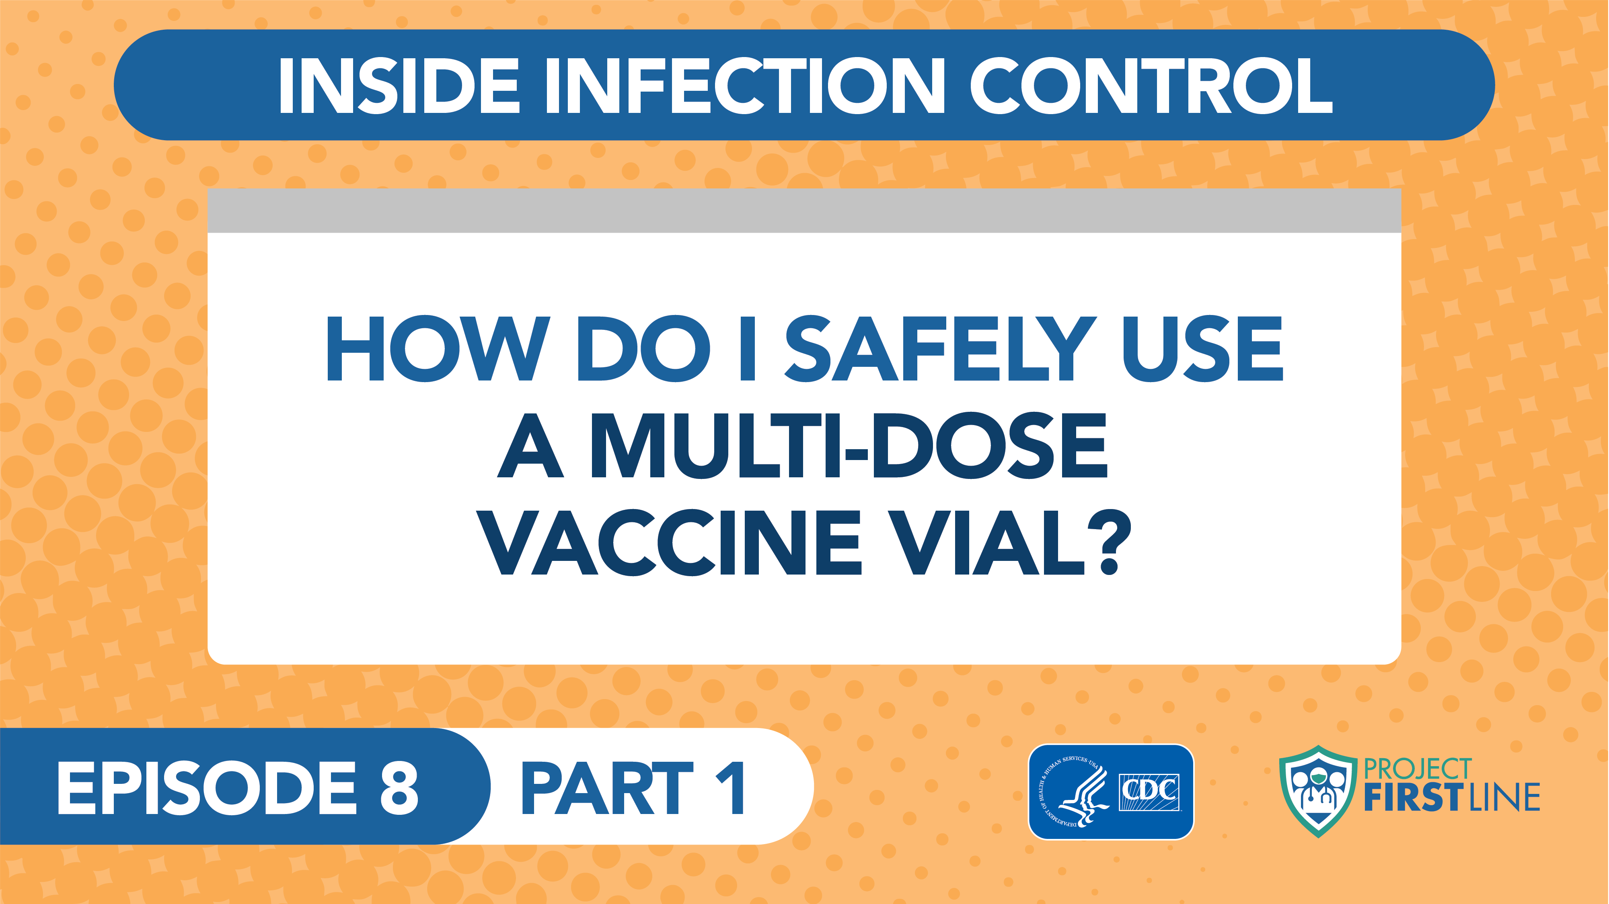
How Do I Safely Use a Multi-Dose Vaccine Vial? Episode 8, Part 1
Notes:
Facilitator Notes
Access the video here:
CDC Website: https://www.cdc.gov/infectioncontrol/projectfirstline/videos/EP8a-MDVP1-LowRes.mp4
OR
Project Firstline YouTube Playlist: bit.ly/MultiDoseVialPt1

Slide 11
Multi-Dose Vials are different
Multi-dose vials are different.
Multi-dose vials are different from single-dose vials in several ways and require important injection safety actions.
Why?
Multi-dose vaccine vials are accessed by a new needle and syringe more than once, to pull out individual doses for separate patients.
Accessing the vial more than once can be an infection control issue.
Notes:
Facilitator Notes
This slide has animations for the second column. When you advance to the slide, only the first column will appear.
After you introduce the message that multi-dose vials are different from single-dose vials, ask participants to share answers to the question, “Why?”
After they provide responses, use the animation to reveal the answers.
Sample Script
“Multi-dose vials are different from single-dose vials in several ways and require important injection safety actions. Can you share some of the reasons you heard?”
(Pause for responses, then advance to reveal second column.)
“Thank you. That’s right. Multi-dose vials are accessed by a new needle and syringe more than once to pull out individual doses for separate patients. Accessing the vial more than once can be an infection control issue. It is important to take injection safety actions to reduce the chance of contamination and protect patients.”

Slide 12
Contaminated vaccines cannot be used
Contaminated vaccines cannot be used.
If a needle or syringe gets dirty and goes into the vial, it will contaminate the rest of the doses of vaccine inside the vial.
If the vaccine is contaminated, it cannot be used anymore and must be thrown away.
Why?
If contaminated vaccine is used on a patient, the patient could get sick or die.
We don’t want to throw away vaccines that could be given to patients.
Notes:
Facilitator Notes
This slide has animations for the second column. When you advance to the slide, only the first column will appear.
After you introduce the Key Message, ask participants to share answers to the question, “Why?”
After they provide responses, use the animation to reveal the answers.
Sample Script
“One of the other key messages that we heard from Dr. Carlson is that contaminated vaccines cannot be used. If a needle or syringe is reused or dirty and goes into the vial, anything that’s on the needle or syringe will get into the vial and contaminate the rest of the vaccine inside. If the vaccine is contaminated, it can’t be used anymore, and it has to be thrown away. Why does this matter?”
(Pause for responses.)
“That’s right. If a multi-dose vial is contaminated by a used needle or syringe, every patient who gets an injection from that vial after the contamination occurs could get a disease like hepatitis or HIV. Some patients have even died from hepatitis after getting a contaminated injection. If a contaminated vial is used, public health authorities need to be notified right away. That’s because everyone who got a dose from that vial has to be contacted and followed so that they get the information about what happened and so they can be tested to find out whether they got infected. And finally, of course - we don’t want to throw away vaccine that could have been given to patients.”

Slide 13
Injection Safety actions are important for multi-dose vials
How to implement injection safety actions for multi-dose vials.
Notes:
Sample Script
“Now that we understand why injection safety actions for multi-dose vaccine vials are so important, let’s dive deeper into what those actions are. We’re going to hear again from Dr. Abby Carlson from the CDC for Part 2 of Inside Infection Control: How do I safely use a multi-dose vaccine vial?”

Slide 14
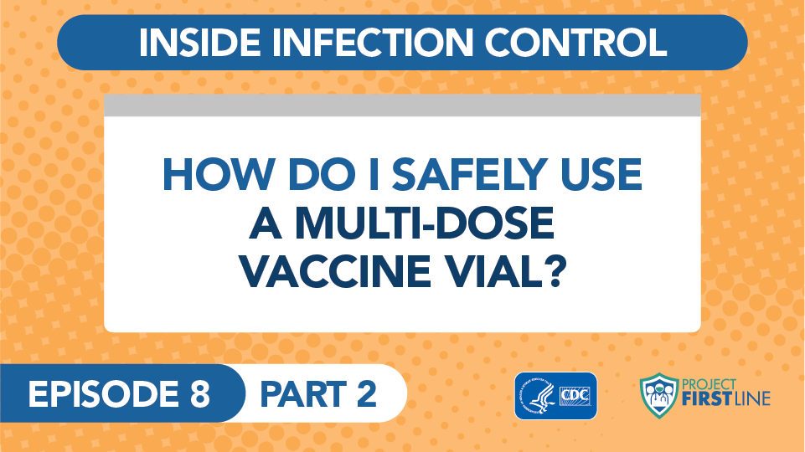
How do I safely Use a Multi-Dose Vaccine Vial? Episode 8 Part 2
Notes:
Facilitator Notes
Access the video here:
CDC Website: https://www.cdc.gov/infectioncontrol/projectfirstline/videos/EP8b-MDVP2-LowRes.mp4 OR
Project Firstline YouTube Playlist: bit.ly/MultiDoseVialPt2
If you would prefer to show a shorter (3.5 minute) video, you can show this animated video about using multi-dose vials safely:
CDC Website: https://www.cdc.gov/infectioncontrol/projectfirstline/videos/MultiDoseVial-LowRes.mp4 OR
Project Firstline YouTube Playlist: https://bit.ly/MDVSafetyTips

Slide 15
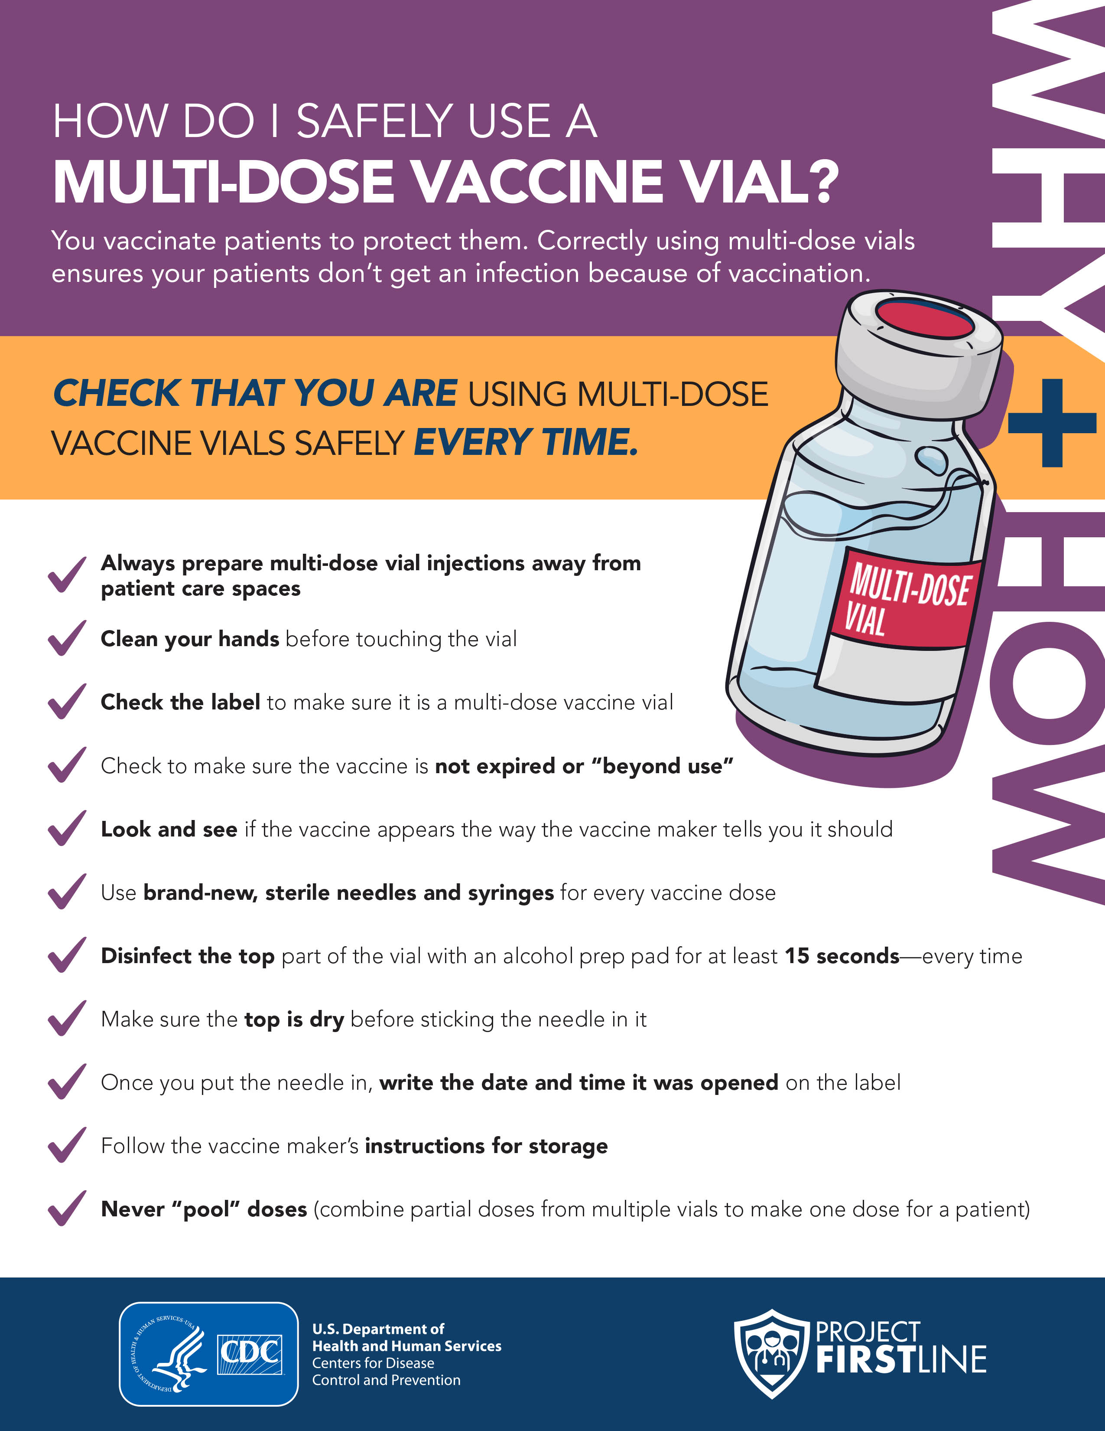
Injection safety
Injection safety actions are important for multi-dose vials.
Notes:
Sample Script
“As you heard from Dr. Carlson, there are a few things to remember for injection safety when you’re using multi-dose vials.”

Slide 16
prepare the vial
Injection safety actions are important.
Q: Where should multi-dose vials be prepared?
A: Prepare the vial in a quiet, private space. Never bring multi-dose vials into patient care spaces.
Notes:
Facilitator Notes
The next few slides are an opportunity to interact with your group, and to reinforce the reasons why the injection safety actions are important.
You may ask participants to come off “mute” to answer, or respond in the chat, or a combination of both.
If your group is large, consider asking participants to respond in the chat.
These slides use animations to allow the answer to appear after participants have had the chance to share their responses.
Sample Script
“Let’s review some of these actions. First, where should multi-dose vials be prepared?”
(Pause for responses. Trigger animation.)
“That’s right. Always prepare a multi-dose vial in a space that is clean and away from patients, where you can safely draw up the doses and prepare the vaccine. Never bring multi-dose vaccine vials into patient care spaces, like a vaccination station where the patient is getting the shot or into a patient room.
“Why is that?” (Pause for responses.) “Yes, because bringing a multi-dose vial into a patient care space increases the chances that someone might mistakenly put a used needle or syringe into the vial and contaminate the vial without realizing it.
“Remember that before you touch any vials, clean your hands with alcohol-based hand sanitizer or soap and water. This keeps the germs on your hands from getting into the vial, especially the top area where you’re going to stick the needle in.”

Slide 17
Check the vial
Injection safety actions are important.
Q: What do you want to check before using the vial?
A: Check the label to make sure it is a multi-dose vial, and it is not expired. Also check to make sure the vaccine looks the way it is supposed to.
Notes:
Sample Script
“What do you want to check before using the vial?”
(Pause for responses. Trigger animation.)
“That’s right. Check the label to make sure the vial is a multi-dose vial, and that it is not expired or beyond use. If it’s expired or beyond its use date, do not use it.
“It’s also important to look at the vaccine to make sure it looks right. If it doesn’t or you are not sure, do not use it. You can check the instructions from the vaccine maker to find out what the vaccine is supposed to look like. Any unusual color or cloudiness is concerning.“

Slide 18
Disinfect the Top of the Vial
Injection safety actions are important.
Q: Why should you disinfect the top of the vial before inserting the needle?
A: Disinfect the top of the vial with an alcohol prep pad to kill any germs on the top, so you don’t push germs into the vial when you insert the needle. Let the top dry before you insert the needle.
Notes:
Sample Script
“Why should you disinfect the top of the vial before inserting the needle?”
(Pause for responses. Trigger animation.)
“That’s right. Disinfect the top of the vial with an alcohol prep pad to kill any germs on the top, so you don’t push germs into the vial when you insert the needle. Let the top dry before you insert the needle.”

Slide 19
Access the vial
Injection safety actions are important.
Q: What do you need to do the first time you open a multi-dose vaccine vial?
A: How long you can use the vaccine after you first access the vial varies by product. Writing the date and time the vial was opened on the label helps prevent vaccine from being given to a patient beyond its use date.
Notes:
Sample Script
“What do you need to do the first time a vial is opened?”
(Pause for responses. Trigger animation.)
“Yes. Make sure you write the time and date in the appropriate space on the label. Follow the vaccine maker’s instructions for how long you can use the vaccine after you first access it, and when it should be thrown away.”

Slide 20
Vaccine in the vial
Injection safety actions are important.
Q: What do you do if there is a little bit of vaccine left in the vial, but it’s not enough for a full dose?
A: Throw the remaining vaccine away. Never combine doses from different vials or give someone less than a full dose.
Notes:
Sample Script
“What do you do if there is a little bit of vaccine left in a vial, but it’s not enough for a full dose?”
(Pause for responses. Trigger animation.)
“That’s right. You have to throw it away. We can never combine doses from different vials to make a full dose for someone or give someone less than a full dose.”

Slide 21
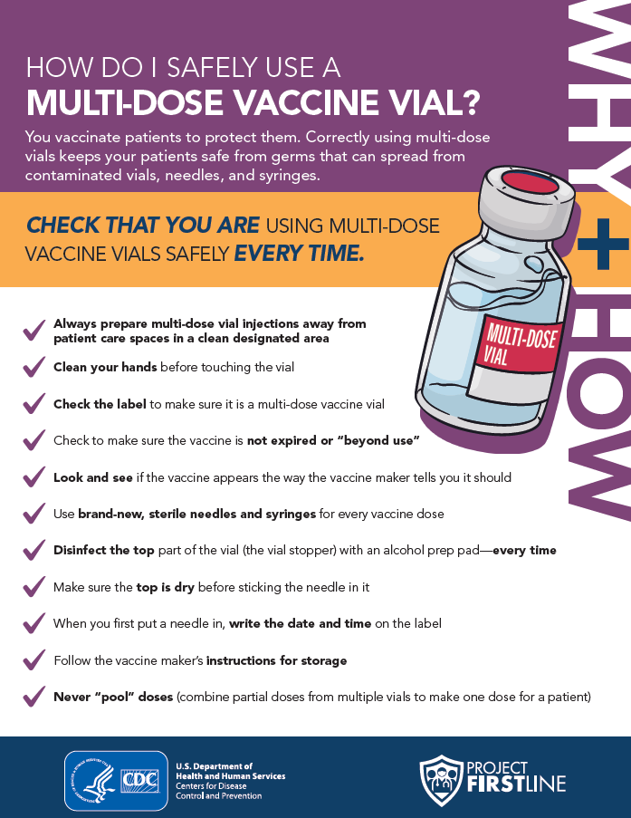
Handout: How Do I safely use a multi-Dose vial?
Multi-Dose Vial Infection Control Procedure
Use the checklist to familiarize yourself with the appropriate infection control procedures.
Notes:
Facilitator Notes
Depending on the delivery of this training, you may share the handout with participants in one of several ways: emailing PDF copies, providing a link to the PDF hosted on your organization’s website or Project Firstline’s website, or downloading the document through your webinar platform.
Sample Script
“This is for you to keep, use, and share!”
(Distribute the handout, How Do I Safely Use a Multi-Dose Vial. )
“Take another minute to make sure all of these steps make sense to you. Are there any questions about any of the steps?”
(Address any questions.)

Slide 22
Breakout Group: Using the Checklist
In a small group, review the checklist and write down the materials you would need to successfully follow the steps on this checklist.
Materials Needed:
Soap and water or alcohol-based hand sanitizer (to clean your hands before you touch the vial)
Alcohol prep pad (to disinfect the top of the vial before sticking the needle in)
Brand-new, sterile needle
Brand-new, sterile syringe
Pen (to write the date and time the vial was opened on the label)
Notes:
Facilitator Notes
Use breakout rooms appropriate to your virtual platform to divide participants into groups of approximately three.
As needed, provide instructions related to the breakout room format, such as how to ask questions.
Inform the groups that they have 5 minutes to make their lists.
Ask each group to identify a spokesperson who will be willing to share the items on the group’s list when everyone reconvenes.
The slide has animations. Before participants go into breakout groups, only show the first column.
After the small groups have gathered, depending on your virtual platform, you may use the broadcast message feature or another means to send reminders of the task, how much time is remaining, etc. You may also choose to “visit” each group to encourage conversation and to hear their thoughts.
Use your chime or timekeeper to warn participants when they have 1 minute remaining.
When you reconvene participants after the breakout, have each group share one item from their list until they have finished listing materials.
Then show the second column on the slide to confirm the materials they list.
The groups may list items and materials that are not on the slide, such as PPE that they might use, alcohol prep pads, a sharps disposal container, a pen, and gauze or an adhesive bandage.
Sample Script
“Great! Now let’s think a little bit more about what materials you will need to have, other than the multi-dose vial, of course, to do these injection safety actions. Let’s break up into small groups to review your handout and think about the materials that you will need to work safely. You will have 5 minutes, and I’ll give you a warning when you have 1 minute left.”
(Allow 5 minutes for the groups to make their lists, giving a warning when there is 1 minute left. Reconvene the groups from their breakout rooms.)
“All right, let’s see what we’ve got! Group One, can you please share one item on your list?”
(When groups have finished contributing, reveal the second column on the slide.)

Slide 23
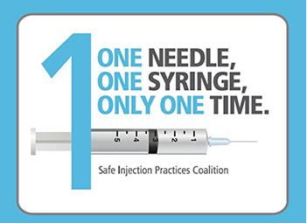
One Needle, One Syringe, Only One Time
The CDC has developed resources to support the understanding of the basics of injection safety.
Resources include:
  FAQs
  Checklists
  Patient handouts
  Videos on clinical practices
  Posters
https://www.cdc.gov/injectionsafety/one-and-only.html
Notes:
Facilitator Notes
Share additional CDC injection safety resources.
Sample Script
“That was great – you did a great job! If you would like more information or resources about the importance of using a brand-new, sterile needle and syringe, explore CDC’s resources about injection safety and their “One and Only” injection safety campaign. These include FAQs, checklists, patient handouts, posters, and videos about injection safety in clinical practice.”

Slide 24
Reflection
Notes:
Facilitator Notes
Encourage participants to reflect on the content of the session, and how they will put their knowledge into practice.
Sample Script
“Let’s use our last few minutes together to reflect on what we’ve learned and think about how we can put what we’ve learned into practice.”

Slide 25
Key Takeaways
Multi-dose vials require a specific set of safety procedures that are different from those for single-dose vials or multi-dose vials used with only one patient.
Contaminated vaccines cannot be used.
Injection safety actions are important.
Notes:
Facilitator Notes
Review key takeaways.
You may choose to revisit discussion points or questions that arose during the session.
Sample Script
“I hope you enjoyed today’s conversation. I’ve captured some key takeaways here, which you can review at your leisure after the session today.”

Slide 26
What did you learn today?
What did you learn today?
Notes:
Facilitator Notes
Invite participants to share what they learned during the session.
Invite additional, remaining questions.
If the answers are information that is already included in this session, please respond.
If the questions address content that is not covered in this session, please do not attempt to answer the question. Instead, take note of the questions and consult with CDC resources to follow up with answers after the session.
Sample Script
“I’d love to hear from you about what you learned today. Would anyone like to share?”
(Acknowledge and address responses.)
“Thank you for sharing! Does anyone have any questions still remaining?”
(Address questions as appropriate.)
“Thank you for sharing those questions. Project Firstline is actively collecting your questions to help inform more training resources as they’re developed. I’ve written them down, and I will get back to you with responses.”

Slide 27
Applying what you learned
Type into the chat one thing you’ll need to do, or continue to do, in your practice to make sure you’re using multi-dose vials safely.
Notes:
Facilitator Notes
Encourage participants to describe how they will use multi-dose vials safely. They may come off mute and speak, or type in the chat, or both.
As appropriate, make connections between participants’ responses and the material from the session, particularly the “why” behind the injection safety actions.
Sample Script
“As we just heard, you’ve learned a lot today. I’d like you to identify one thing you’ll need to do, or continue to do, in your practice to make sure you’re using multi-dose vials safely.”

Slide 28
Resources and Future Training sessions
Project Firstline on CDC:
https://www.cdc.gov/infection control/projectfirstline/index.html
Project Firstline on Facebook:
https://www.facebook.com/CDCProjectFirstline/
Twitter:
https://twitter.com/CDC_Firstline
Youtube:
https://www.youtube.com/playlist?list=PLvrp9iOILTQZQGtDnSDGViKDdRtIc13VX
CDC’s One and Only Campaign:
https://www.cdc.gov/injectionsafety/one-and-only.html
To sign up for Project Firstline e-mails, click here: https://tools.cdc.gov/campaignproxyservice/subscriptions.aspx?topic_id=USCDC_2104
Notes:
Facilitator Notes
Share additional resources from Project Firstline and CDC.
Explain how participants can reach you, by the means of your choosing, and how they can reach Project Firstline.
If this session is part of a series, you may choose to describe the themes of upcoming sessions.
Sample Script
“That’s great, thank you. We covered a lot today, and there is still more to learn. You can keep exploring these topics on your own using the resources on this slide. You can also follow us on social media.”
(If this session is part of a series) “Next time, we will cover [insert next training topic].”

Slide 29
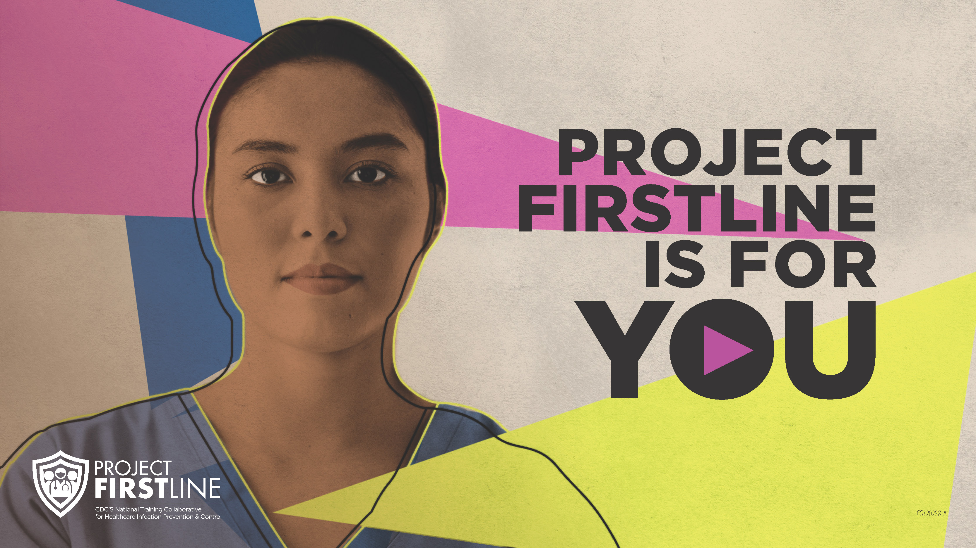
Feedback Form
Notes:
Facilitator Notes
Explain how to access the Feedback Form.
Sample Script
“And, finally, please let us know how you enjoyed today’s session by completing the following feedback form. Thanks again for joining us today.”
After the Session
Send list of participant questions compiled during this session to ProjectFirstline@cdc.gov.

