Slide 1
Topic 6:
Multi-Dose Vials
[Date of Training]
Notes:
Participants log in and get settled.

Slide 2
Agenda
Why Injection Safety Matters for Multi-Dose Vials
Infection Control Actions for Using Multi-Dose Vials
Notes:
Facilitator Notes
Welcome
Housekeeping, either orally or via chat
If needed, additional notes specific to the platform you’re using (e.g., how to “raise your hand,” how to post questions)
Overview of agenda
If this session is part of an ongoing series, you may choose to say, “welcome back,” “thank you for joining us again,” etc.
Sample Script
“Welcome to Project Firstline. Thank you for joining us! Before we begin, a few housekeeping notes. We’ll meet today for 10 minutes. Please keep your videos on, to the extent possible, and keep your microphone muted when you are not contributing to the discussion. It’s great to see you all here today!
“Today, we’re going to be talking about multi-dose vials. We’ll talk specifically about why injection safety is so important, and about the things you can do to make sure you’re using multi-dose vials safely.”

Slide 3
Learning OBJECTIVES
Discuss two (2) reasons why injection safety actions are important when using multi-dose vials.
Describe at least four (4) injection safety steps to take when using a multi-dose vial.
Notes:
Facilitator Notes
Provide an overview of the session’s learning objectives.
Sample Script
“After today, you’ll be able to recognize and describe the injection safety actions to take when you’re using a multi-dose vial, and you’ll understand why the actions are so important.”

Slide 4
Definitions
Multi-dose vaccine vials | A multi-dose vial is a vial of liquid medication intended for parenteral administration (injection or infusion) that contains more than one dose of medication. Multi-dose vials are labeled as such by the manufacturer.
Source: CDC Website. “Questions about multi-dose vials”. Retrieved from: https://www.cdc.gov/injectionsafety/providers/provider_faqs_multivials.html
Notes:
Facilitator Notes
Either allow time for participants to read the definitions themselves or read them aloud.
CDC source for the definitions:
Multi-dose vials: https://www.cdc.gov/injectionsafety/providers/provider_faqs_multivials.html
Sample Script
“Let’s start with some vocabulary. Here is the definition from the CDC for multi-dose vials.”

Slide 5
Multi-Dose Vials are different
Multi-dose vials are different from single-dose vials in several ways and require important injection safety actions.
Why?
Multi-dose vaccine vials are accessed by a new needle and syringe more than once, to pull out individual doses for separate patients.
Accessing the vial more than once can be an infection control issue.
Notes:
Facilitator Notes
This slide has animations for the second column. When you advance to the slide, only the first column will appear.
After you introduce the message that multi-dose vials are different from single-dose vials, ask participants to share answers to the question “Why?”
After they provide responses, use the animation to reveal the answers.
Sample Script
“Multi-dose vials are different from single-dose vials in several ways and require important injection safety actions. Does anyone know what those might be?”
(Pause for responses, then advance to reveal second column.)
“Thank you. That’s right. Multi-dose vials are accessed by a new needle and syringe more than once, to pull out individual doses for separate patients. Accessing the vial more than once can be an infection control issue. It is important to take injection safety actions to reduce the chance of contamination and protect patients.”

Slide 6
Contaminated Vaccines cannot be used
If a needle or syringe gets dirty and goes into the vial, it will contaminate the rest of the doses of vaccine inside the vial.
If the vaccine is contaminated, it cannot be used anymore and must be thrown away.
Why?
If contaminated vaccine is used on a patient, the patient could get sick or die.
We don’t want to throw away vaccines that could be given to patients.
Notes:
Facilitator Notes
This slide has animations for the second column. When you advance to the slide, only the first column will appear.
After you introduce the Key Message, ask participants to share answers to the question “Why?”
After they provide responses, use the animation to reveal the answers.
Sample Script
“Contaminated vaccines cannot be used. If a needle or syringe is reused or dirty and goes into the vial, anything that’s on the needle or syringe will get into the vial and contaminate the rest of the vaccine inside. If the vaccine is contaminated, it can’t be used anymore, and it has to be thrown away. Why does this matter? Any thoughts?”
(Pause for responses.)
“That’s right. If a multi-dose vial is contaminated by a used needle or syringe, every patient who gets an injection from that vial after the contamination occurs could get a disease like hepatitis or HIV. Some patients have even died from hepatitis after getting a contaminated injection. If a contaminated vial is used, public health authorities need to be notified right away. That’s because everyone who got a dose from that vial has to be contacted and followed so that they get the information about what happened and so they can be tested to find out whether they got infected. And finally, of course - we don’t want to throw away vaccine that could have been given to patients.
“Now that we understand why injection safety actions for multi-dose vials are so important, let’s dive deeper into what those actions are. We’re going to watch a short video: How do I safely use a multi-dose vial?”

Slide 7
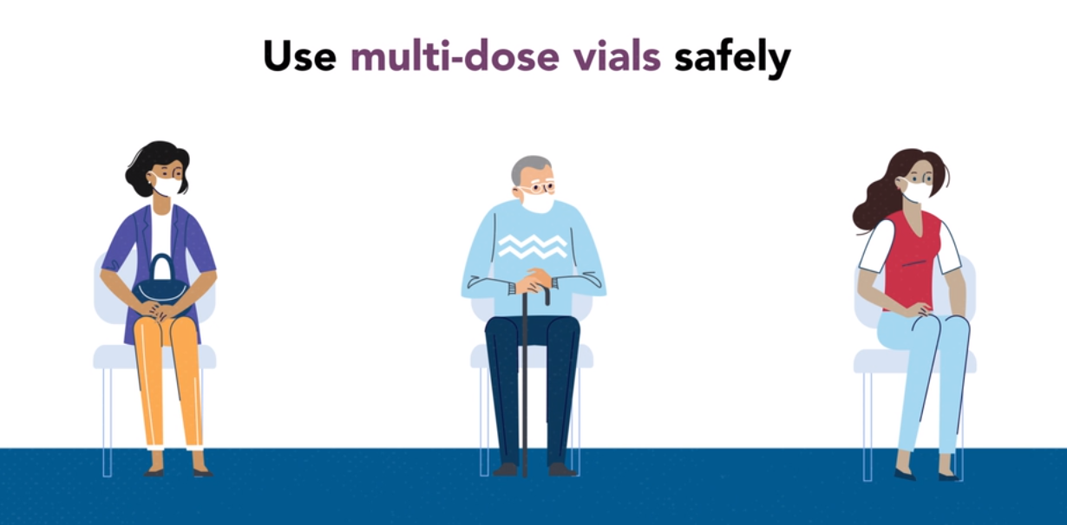
Video: Use Multi-Dose Vials Safely Video
Notes:
Facilitator Notes
Show this 3.5-minute video about how to use multi-dose vials safely at one of the following links:
CDC Website: https://www.cdc.gov/infectioncontrol/projectfirstline/videos/MultiDoseVial-LowRes.mp4 OR
Project Firstline YouTube Playlist: https://bit.ly/MDVSafetyTips
If you would prefer a longer video, you can access the Inside Infection Control video with Dr. Abby Carlson here:
CDC Website: https://www.cdc.gov/infectioncontrol/projectfirstline/videos/EP8b-MDVP2-LowRes.mp4 OR
Project Firstline YouTube Playlist: bit.ly/MultiDoseVialPt2
Sample Script
“Now that we understand why injection safety actions for multi-dose vials are so important, let’s dive deeper into what those actions are. We’re going to watch a short video: How do I safely use a multi-dose vial?”

Slide 8
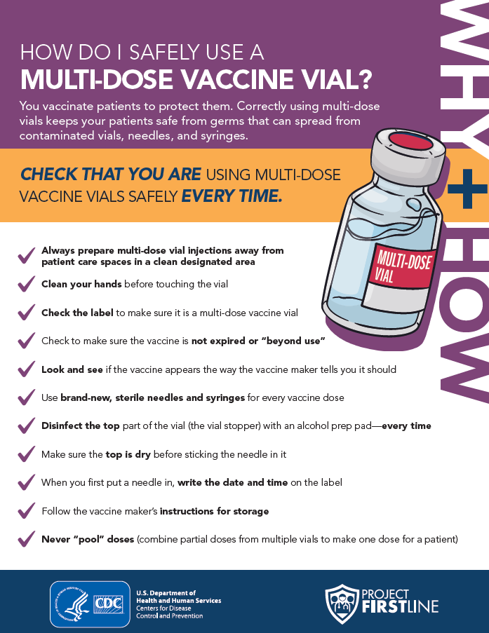
Handout: How Do I safely use a multi-Dose vial?
Multi-Dose Vial Infection Control Procedure
Use the checklist to familiarize yourself with the appropriate infection control procedures.
Notes:
Facilitator Notes
Depending on the delivery of this training, you may share the handout with participants in one of several ways: emailing PDF copies, providing a link to the PDF hosted on your organization’s website or Project Firstline’s website, or downloading the document through your webinar platform.
Invite participants to share what they learned during the session.
Invite additional, remaining questions.
If the answers are information that is already included in this session, please respond.
If the questions address content that is not covered in this session, please do not attempt to answer the question. Instead, take note of the questions and consult with CDC resources to follow up with answers after the session.
Sample Script
“This handout is for you to keep, use, and share!”
(Distribute the handout, How Do I Safely Use a Multi-Dose Vaccine Vial? )
“Take another minute to make sure all of these steps make sense to you. Are there any questions about any of the steps?”
(Address any questions.)

Slide 9
Key Takeaways
Multi-dose vials require a specific set of safety procedures that are different from those for single-dose vials or multi-dose vials used with only one patient.
Contaminated vaccines cannot be used.
Injection safety actions are important.
Notes:
Facilitator Notes
Review key takeaways.
You may choose to revisit discussion points or questions that arose during the session.
Sample Script
“I hope you enjoyed today’s conversation. I’ve captured some key takeaways here, which you can review at your leisure after the session today.”

Slide 10
Resources and Future Training sessions
Project Firstline on CDC:
https://www.cdc.gov/infection control/projectfirstline/index.html
Project Firstline on Facebook:
https://www.facebook.com/CDCProjectFirstline/
Twitter:
https://twitter.com/CDC_Firstline
Youtube:
https://www.youtube.com/playlist?list=PLvrp9iOILTQZQGtDnSDGViKDdRtIc13VX
CDC’s One and Only Campaign:
https://www.cdc.gov/injectionsafety/one-and-only.html
To sign up for Project Firstline e-mails, click here: https://tools.cdc.gov/campaignproxyservice/subscriptions.aspx?topic_id=USCDC_2104
Notes:
Facilitator Notes
Share additional resources from Project Firstline and CDC.
Explain how participants can reach you, by the means of your choosing, and how they can reach Project Firstline.
If this session is part of a series, you may choose to describe the themes of upcoming sessions.
Sample Script
“That’s great, thank you. We covered a lot today, and there is still more to learn. You can keep exploring these topics on your own using the resources on this slide. You can also follow us on social media.”
(If this session is part of a series) “Next time, we will cover [insert next training topic].”

Slide 11
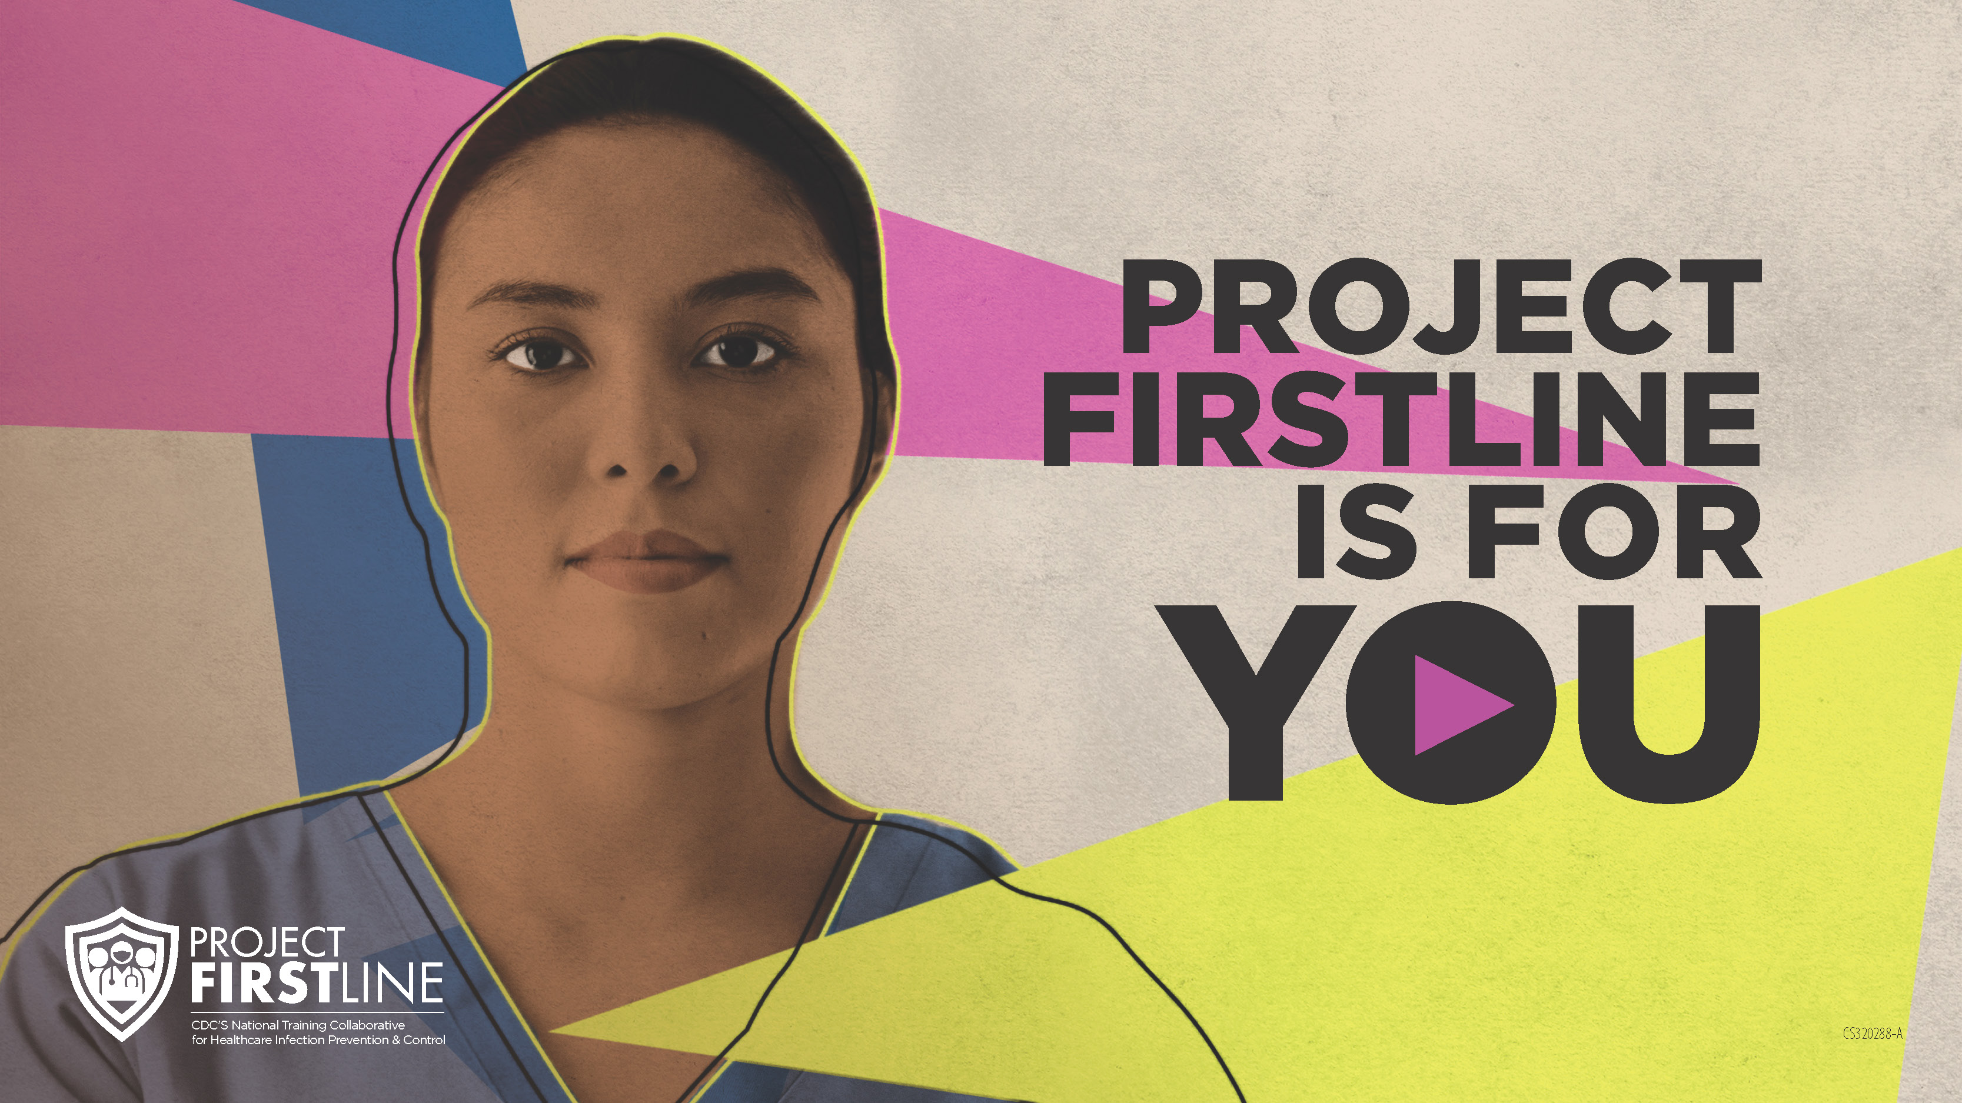
Feedback Form
Notes:
Facilitator Notes
Explain how to access the Feedback Form.
Sample Script
“And, finally, please let us know how you enjoyed today’s session by completing the following feedback form. Thanks again for joining us today.”
After the Session
Send list of participant questions compiled during this session to ProjectFirstline@cdc.gov.

