Slide 1

Topic 4: How Viruses Spread From Surfaces to People
[Date of training]
Notes:
Participants log in and get settled

Slide 2

Agenda
Introductions
How Viruses Spread From Surfaces to People
  Video
  Discussion and reflection
Session feedback form and next steps
Notes:
[Please note that the toolkit topics are presented in sequence, with the expectation that participants will progress through the series. You may, however, mix and match content to meet participant needs and you will need to adjust the sample script below.]
Sample Script
“Welcome back to Project Firstline. Last time, we focused on the important concept of respiratory droplets, and how they spread COVID-19. Today we will focus on another way that germs can spread: from surfaces to people.”

Slide 3
Learning Objectives
Describe two (2) ways viruses can spread from surfaces to people
Explain one (1) reason why good hand hygiene and environmental cleaning are important to keep germs from spreading in healthcare

Slide 4
Definitions
Fomite transmission:
  Infection spread through direct contact with an article or surface (e.g., from a stethoscope) that has become contaminated with infectious material.
    Fomite: nonliving object contaminated with microorganisms that can spread the microorganisms to other persons.
Contact transmission:
  Infection spread through direct contact with an infectious person (e.g., touching during a handshake or taking a pulse) or with an article or surface that has infectious material on it.
Notes:
Sample Script
“First let’s talk about vocabulary. What’s a fomite? Would anyone like to explain in your own words what ‘fomite transmission’ means? Or ‘contact transmission?’”

Slide 5
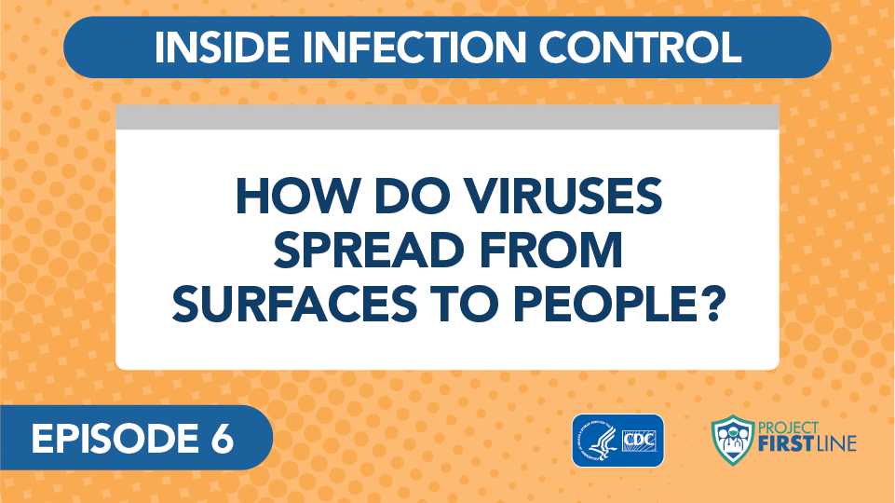

Video blog 6: How Do Viruses Spread from Surfaces to People? (link)
Notes:
Sample Script
“Although COVID-19 is mainly spread through respiratory droplets, it’s important to understand other ways that the disease can spread. Let’s check in with Dr. Carlson for more information.”
Access the video here:
CDC Website: https://www.cdc.gov/infectioncontrol/projectfirstline/videos/Ep6-Spread-LowRes-New.mp4OR
Project Firstline YouTube Playlist: https://www.youtube.com/watch?v=KmyxsnuREGs

Slide 6
Key Messages: How would you explain these concepts to others?
Although COVID-19 is mainly spread through respiratory droplets, another way you can get sick is if you touch something that has live virus on it and then touch your face without cleaning your hands first.
Virus can get on surfaces when respiratory droplets land on those surfaces.
Virus can also get on surfaces when body fluids from an infected person – like spit and snot – get onto things nearby.
Notes:
Sample Script
“In a few sentences, would anyone like to share some key messages from this video? Or to put it another way, how would you explain this concept to others?”

Slide 7
What is the hardest part about protecting ourselves from germs that can spread from surfaces?
Notes:
Sample Script
“So now let’s think about this further. We know that contact transmission and fomites can spread disease. What is the hardest part about protecting ourselves against this kind of disease spread?
[After answers]
“Thank you for your responses! There are a lot of factors at play, aren’t there?”

Slide 8
What are some possible strategies for protecting ourselves against germs that spread from surfaces?
What does your facility do?
What can you do?
Notes:
Sample Script
“Let’s think for a moment about our work environments. I’d like you to close your eyes and really imagine yourself there. Think about all the routines and environments in your daily work. Thinking about this, I’d like you to spend a moment thinking about strategies that are in place, or that could be in place, to help us all keep germs from spreading from surfaces. What are some possible strategies we could use to help us remember to protect ourselves against this kind of disease spread? Think about what your facility does, and what you can do.
[Pause to allow participants to reflect]
“Would anyone like to share a creative strategy that you identified? How can we support each other in keeping germs from spreading from surfaces?”

Slide 9
Key Messages
Although COVID-19 is mainly spread through respiratory droplets, another way you can get sick is if you touch something that has live virus on it and then touch your face without cleaning your hands first.
Virus can get on surfaces when respiratory droplets land on those surfaces.
Virus can also get on surfaces when body fluids from an infected person – like spit and snot – get onto things nearby.
Notes:
[Be ready to add to the list, as needed.]
Sample Script
“I hope you enjoyed today’s conversation. I’ve captured some key messages here, which you can review at your leisure after the session today.”

Slide 10
Resources and Future Training sessions
Project Firstline on CDC:
https://www.cdc.gov/infectioncontrol/projectfirstline/index.html
Project Firstline on Facebook:
https://www.facebook.com/CDCProjectFirstline/
Twitter:
https://twitter.com/CDC_Firstline
Youtube:
https://www.youtube.com/playlist?list=PLvrp9iOILTQZQGtDnSDGViKDdRtIc13VX
To sign up for Project Firstline e-mails, click here: https://tools.cdc.gov/campaignproxyservice/subscriptions.aspx?topic_id=USCDC_2104
Notes:
Sample Script
“Next time, we will cover a brief review of how COVID-19 spreads.
“In the meantime, you can keep exploring these topics on your own, using the resources on this slide. You can also follow us on social media.”

Slide 11
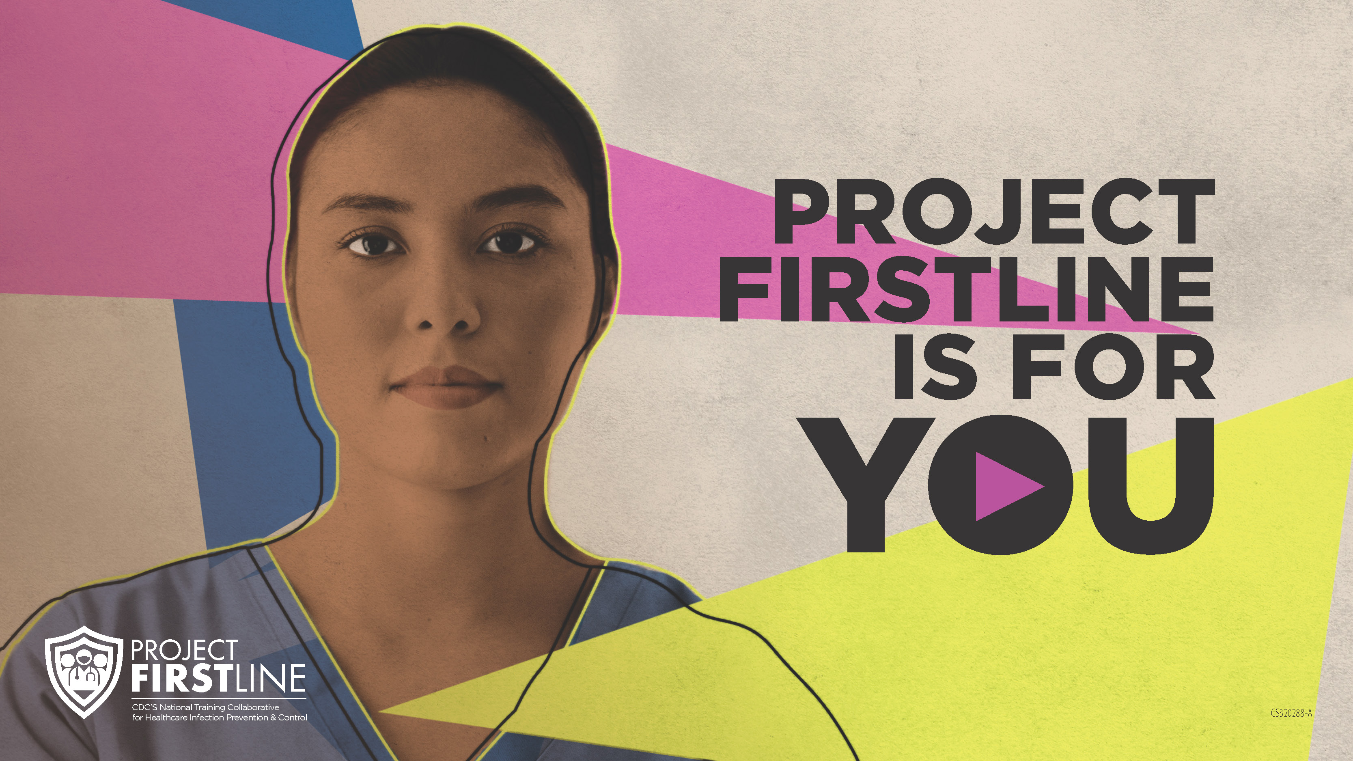
Feedback Form
Notes:
[Facilitator should add information about how to access form]
Sample Script
“And finally, please let us know how you enjoyed today’s session by completing the following feedback form. Thanks again for joining us today.”

