Slide 1

Topic 3: How Respiratory Droplets Spread COVID-19
[Date of Training]
Notes:
Participants log in and get settled.

Slide 2

Agenda
Introduction
How Respiratory Droplets Spread COVID-19
  Video
  Discussion and reflection
Session feedback form and next steps
Notes:
[Please note that the toolkit topics are presented in sequence, with the expectation that participants will progress through the series. You may, however, mix and match content to meet participant needs and you will need to adjust the sample script below.]
Sample Script
“Welcome! Today we'll be focusing on the important concept of respiratory droplets, and how they spread COVID-19.
“Today we're going to talk about something that has been a hot topic ever since COVID-19 first emerged: respiratory droplets. What are they? How do they spread COVID-19? We know how important these questions are, and sometimes it's hard to explain these ideas to others.””

Slide 3
Learning Objectives
Describe one characteristic (1) of respiratory droplets
Understand one (1) primary way that SARS-CoV-2 moves between people
Explain one (1) reason why infection control actions focus on keeping respiratory droplets out of the air and away from other people

Slide 4
Checking in
Hello! How are you feeling today?
Notes:
[Please note that the toolkit topics are presented in sequence, with the expectation that participants will progress through the series. You may, however, mix and match content to meet participant needs and you will need to adjust the sample script below.]
Sample Script
“Let’s remind ourselves who’s in the room. As many of us know each other already, we’re not going to do formal introductions today. How are you feeling today? Give us a shout in chat to let us know how you are.”

Slide 5
Thinking back to last session….
Did anyone find a way to use these analogies on the job?
Did anyone have other infection control conversations that they would like to report?
Would anyone like to share a key message from last time that stands out in your memory?
Notes:
Sample Script
“Last time, we talked about viruses and how to explain some of the concepts to others. Did anyone find a way to use these analogies on the job? Did anyone have other infection control conversations that they would like to report? Would anyone like to share a key message from last time that stands out in your memory?
[after participants answer]
“Today we're going to talk about something that has been a hot topic ever since COVID-19 first emerged: respiratory droplets. What are they? How do they spread COVID-19? We know how important these questions are, and sometimes it's hard to explain these ideas to others.”

Slide 6
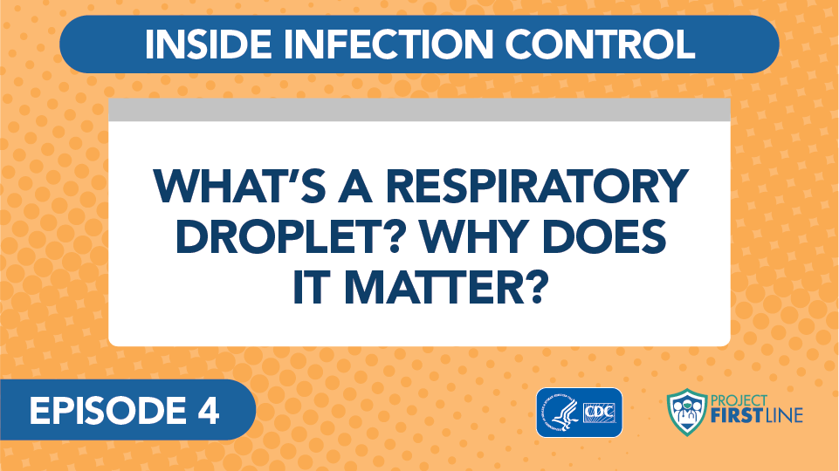
Video: What’s a Respiratory Droplet? Why Does it Matter?
Notes:
Access the video here:
CDC Website: https://www.cdc.gov/infectioncontrol/projectfirstline/videos/Ep4-Droplet-LowRes-New.mp4OR
Project Firstline YouTube Playlist: https://www.youtube.com/watch?v=eiuCeBt3itQ

Slide 7
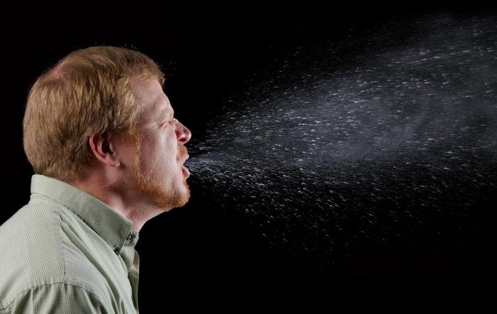
Picture of man sneezing
Notes:
Sample Script
“Before we discuss how respiratory droplets apply to your work life, how many of you have seen images such as this one? When we look at photos like this, it’s easy to understand why these little droplets matter and why we care about preventing people from breathing in each other’s respiratory droplets.”

Slide 8
What is your facility doing to keep people from breathing in each other's respiratory droplets?
Notes:
Sample Script
“So, what are some things that your facility is doing to protect people from breathing in each other’s respiratory droplets?”

Slide 9
Which of these strategies are easy to implement consistently, and which are hard to implement consistently? Why?
Notes:
[Facilitator can insert strategies from group on this slide]
Sample Script
“This next question is perhaps more challenging. When you think about being able to implement these strategies consistently, which are easy and which are hard? Let’s talk first about the easy ones—are there any easy ones?
[Pause so that participants can reflect.]
“Would anyone like to respond to this question? Are there any strategies that are easy to implement consistently?
[Wait for answers.]
“Now let’s talk about strategies that are challenging to implement consistently. Who would like to share a thought about this?
[Wait for answers.]
“Thank you, these are important thoughts. I’d like to spend some time identifying specific actions we can take that can address some of these challenges. How can we find solutions?”

Slide 10
Role-play!
Finding solutions to infection control challenges
Notes:
Sample Script
“We’re going to examine some specific scenarios in small groups. You will each be given a scenario showing a realistic healthcare challenge. In your group, I’d like you to strategize about how you would address this challenge if it happened in real life. Your aim should be to rectify the situation while ‘keeping the peace’ with all concerned. In groups, spend some time brainstorming and then I’d like you to develop a short skit illustrating your solutions in practice. Even though we’re online and can’t use props, plan out a short dialogue as if you were in a real-life role-play. You will have 10 minutes to work.”

Slide 11
Let’s Regroup
Notes:
Sample Script
“Let’s regroup. We have three separate scenarios and I’m eager to see your role-plays. Who would like to go first?
[reenactments]
“Thank you all for these great role-plays. As you think about all three scenarios, what are some strategies that you think might be relevant to your daily lives, to the real-life scenarios you find yourselves in?”

Slide 12
Reflection
How can you positively promote respiratory droplet protection at work?
Notes:
Sample Script
“We’re at the end our time today, and we covered a lot of ground. We have a lot to cover next time as well, when we begin discussing how viruses spread from surfaces to people. Before we close, I’d like to encourage each of you to reflect for a moment about your own job, and how you can positively promote respiratory droplet protection at work. I’m going to pause for 60 seconds and invite you to write down some action steps you could take, or that you already take and would like to affirm. Think about how these role-plays may apply to you and your everyday interactions with others.”
[Give participants one full minute to reflect.]
“We will continue to take this time at the end of each section, because it’s important to continue thinking about how we can each feel empowered to act for our own health and the health of others.”

Slide 13
Key Messages
Our breath contains a lot of water that you can’t usually see.
  When we see our breath in cold air or see our glasses fog up when we’re wearing a mask, what we’re seeing is all the water in our breath.
  Those are our respiratory droplets.
The main way that SARS-CoV-2, the virus that causes the disease COVID-19, travels between people is through respiratory droplets.
  When someone is infected with SARS-CoV-2, the droplets that they breathe out have virus particles in them.
  People who are close by can breathe the droplets in, or the droplets can land on their eyes, and they can get infected.
Notes:
Sample Script
“I hope you enjoyed today’s conversation. I’ve captured some take-home messages here, which you can review at your leisure after the session today.”

Slide 14
Resources and Future Training sessions
Project Firstline on CDC:
https://www.cdc.gov/infectioncontrol/projectfirstline/index.html
Project Firstline on Facebook:
https://www.facebook.com/CDCProjectFirstline/
Twitter:
https://twitter.com/CDC_Firstline
YouTube:
https://www.youtube.com/playlist?list=PLvrp9iOILTQZQGtDnSDGViKDdRtIc13VX
To sign up for Project Firstline emails, click here: https://tools.cdc.gov/campaignproxyservice/subscriptions.aspx?topic_id=USCDC_2104
Notes:
Sample Script
“Next time, we start talking about how viruses spread from surfaces to people.
“In the meantime, you can keep exploring these topics on your own, using the resources on this slide. You can also follow us on social media.”

Slide 15

Feedback Form
Notes:
[Facilitator should add information about how to access form]
Sample Script
“And finally, please let us know how you enjoyed today’s session by completing the following feedback form. Thanks again for joining us today.”

