Slide 1

Topic 2: The Basic Science of Viruses
[Date of training]
Notes:
Participants log in and get settled.

Slide 2

Agenda:
Introduction
The Basic Science of Viruses
  Video
  Discussion and reflection
Session feedback form and next steps
Notes:
[Please note that the toolkit topics are presented in sequence, with the expectation that participants will progress through the series. You may, however, mix and match content to meet participant needs and you will need to adjust the sample script below.]
Sample Script
“Welcome! Thank you for joining us. We’re so glad to have this time together to discuss infection control on the frontlines. Today we’ll focus on the basic science of viruses.
“Before we begin, I’d also to remind you of some housekeeping matters. We’ll meet today for one hour. We ask everyone to keep their videos on, to the extent possible. This helps us have a more authentic discussion. You may use your mute/unmute button at any time to contribute to the discussion, but when you’re not speaking, please keep your microphone muted.”

Slide 3
Learning Objectives:
Differentiate one (1) core difference between SARS-CoV-2 and COVID-19.
Identify, and explain to others, the three (3) main parts of a virus.
Describe three (3) steps showing how viruses use of the cells of living things to make more copies of themselves.
Explain one (1) reason why infection control actions focus on keeping respiratory droplets out of the air and away from other people.

Slide 4
Introductions
Please be prepared to introduce yourself, answering the questions below:
  Name and professional role
  How long you’ve been working in healthcare
Notes:
[Please note that the toolkit topics are presented in sequence, with the expectation that participants will progress through the series. You may, however, mix and match content to meet participant needs and you will need to adjust the sample script below.]
Sample Script
“We got to meet each other in the last session, but let’s go briefly around the virtual room to give us all a chance to introduce ourselves. Please share your name and professional role, and how many years you’ve been working in healthcare.
“On the slide, you’ll find a brief prompt. When I call on you, please answer as much of this as you feel comfortable sharing.”
[After introductions]
“Thank you. Now you may remember, in the last session, I asked each of you to share topics of special interest to you. Today, our session will include a discussion of the following topics from that list:”
[Insert based on Session 1 list]

Slide 5
What stands out most in your memory from the last session?
Were you able to successfully implement the personal action you identified at the end of the session?
Notes:
[Please note that the toolkit topics are presented in sequence, with the expectation that participants will progress through the series. You may, however, mix and match content to meet participant needs and you will need to adjust the sample script below.]
Sample Script
“Last session, we focused on introducing the goals of infection control. What stands out most in your memory from this discussion? Were you able to successfully implement the personal action you identified at the end of the session? If you wish, please unmute and share your thoughts to one or both of these questions.
[After participants answer]
“So, if the ultimate goal of infection control is to prevent people from getting sick, the first thing we need to understand is how sickness happens. How do people get sick with COVID-19?
“In order to answer that question, we have to talk about the germ that causes COVID-19: the virus SARS-CoV-2”

Slide 6
As you watch, consider the following questions:
Did you learn something new from this video, or were you reminded of something important that especially resonates with you? Can you think of someone you know who would benefit from these concepts?
Have you ever received questions from patients or coworkers on these topics? Does this video give you any ideas of how you could explain these concepts to others?
Notes:
Sample Script
“Let’s check in with Dr. Carlson to see what she has to say on this topic. Before playing the video, here are some questions to consider as you watch.
“Now let’s watch the video.”

Slide 7
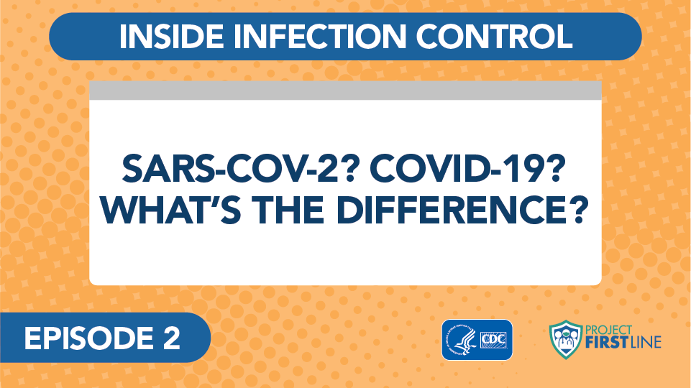
Video: SARS-COV-2? COVID-19? What’s the Difference?
Notes:
Access the video here:
CDC Website: https://www.cdc.gov/infectioncontrol/projectfirstline/videos/Ep2-Difference-LowRes-New.mp4
OR
Project Firstline YouTube Playlist:
https://www.youtube.com/watch?v=s2k1IPSdLgk

Slide 8
Let’s Discuss
Did you learn something new from this video, or were you reminded of something important that especially resonates with you? Can you think of someone you know who would benefit from these concepts?
Have you ever received questions from patients or coworkers on these topics? Does this video give you any ideas of how you could explain these concepts to others?
Notes:
Sample Script
“Let’s discuss these questions together. I’m interested in your reactions to this episode. In any order, with any of the questions that appeal to you, please share your thoughts with the group.
[After discussion]
“Thank you, everyone. Let’s watch two more short segments together from Dr. Carlson, and then we’ll discuss together how we can use this information in our daily lives.”

Slide 9
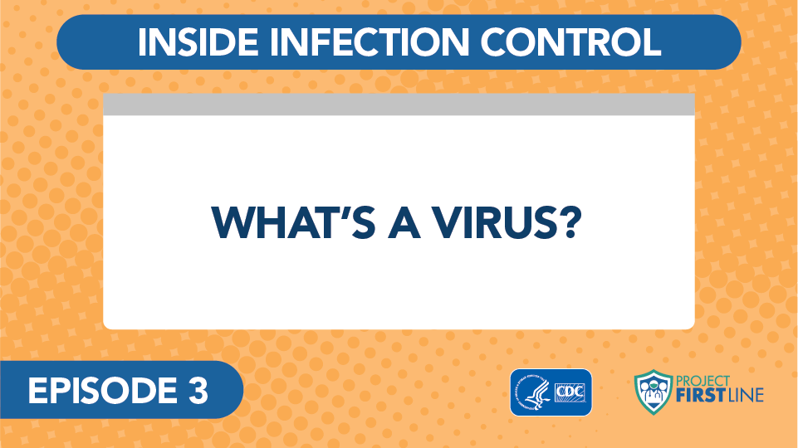
Video: What’s a Virus?
Notes:
Access the video here:
CDC Website: https://www.cdc.gov/infectioncontrol/projectfirstline/videos/Ep3-Virus-LowRes-New.mp4
OR
Project Firstline YouTube Playlist:
https://www.youtube.com/watch?v=iKfG15U8nVo

Slide 10
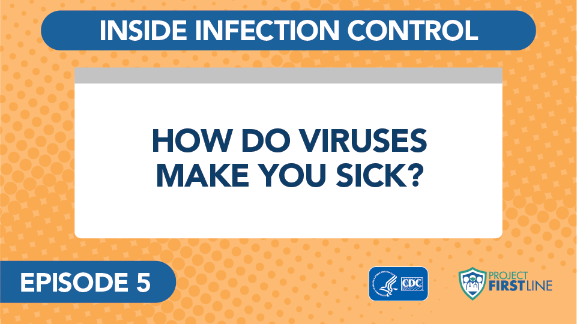
Video: How do Viruses Make You Sick?
Notes:
Access the video here:
CDC Website : https://www.cdc.gov/infectioncontrol/projectfirstline/videos/Ep5-How-LowRes-New.mp4
OR
Project Firstline YouTube Playlist:
https://www.youtube.com/watch?v=pIAH2l9Eg6g

Slide 11
Breakout Groups
With the concept you were given, identify an analogy from everyday life that you could use to explain it to a patient, coworker, or family member who’s never studied this before.
Be ready to share your answer with the broader group.
Notes:
Sample Script
“Thank you for this great discussion. To take it one step further, I’d like you to think about how you could share this content with a patient, coworker, or family member who’s never studied this before. We’re going to break into groups, and I’m going to give each group a specific concept to focus on. In your group, with the concept you were given, identify an analogy from everyday life. You will have 10 minutes. Be ready to share your answer with the broader group when we reconvene. Raise your hand if you’d like help in identifying an analogy.”

Slide 12
Let’s Reconvene
Differentiate between SARS-CoV-2 and COVID-19.
Identify the 3 main parts of a virus.
Describe how viruses use the cells of living things to make more copies of themselves.
Explain why infection control actions focus on keeping respiratory droplets out of the air and away from other people.
Notes:
Sample Script
“Ok. We had 4 different groups each assigned a different statement, as shown on the slide. Can I have a volunteer from one of the groups addressing the first topic to share your analogy?
[Wait for answer]
“Thank you. What made you decide on this approach [if not already addressed in group’s initial response]?
[Wait for answer, and continue with each of the remaining groups]
“These are all great ideas. I hope you will try to use some of these analogies on the job, the next time you’re interacting with a patient or having a discussion with coworkers. You can even wow your friends and family.”

Slide 13
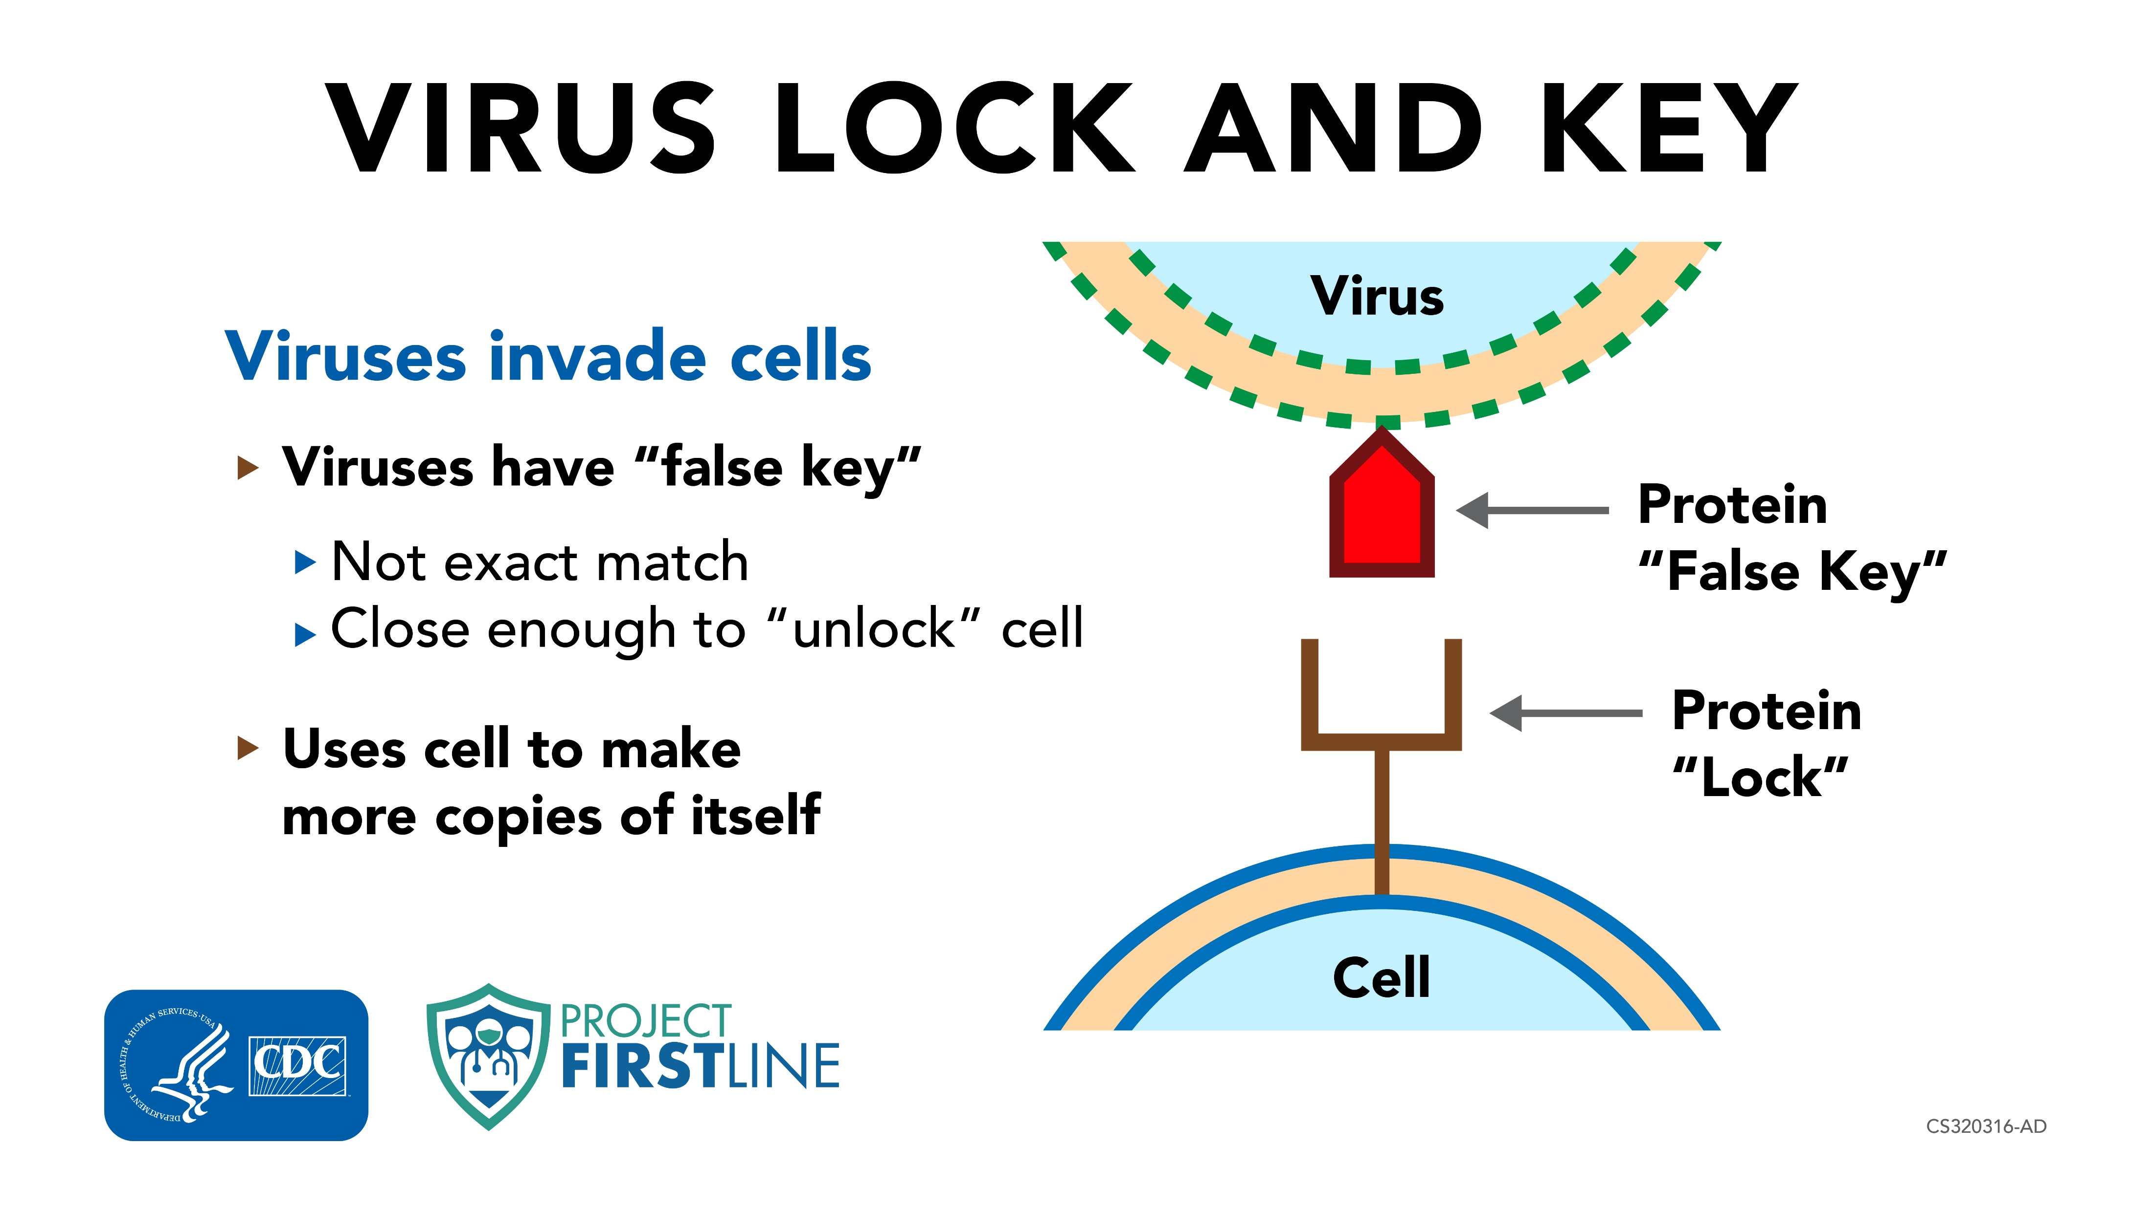
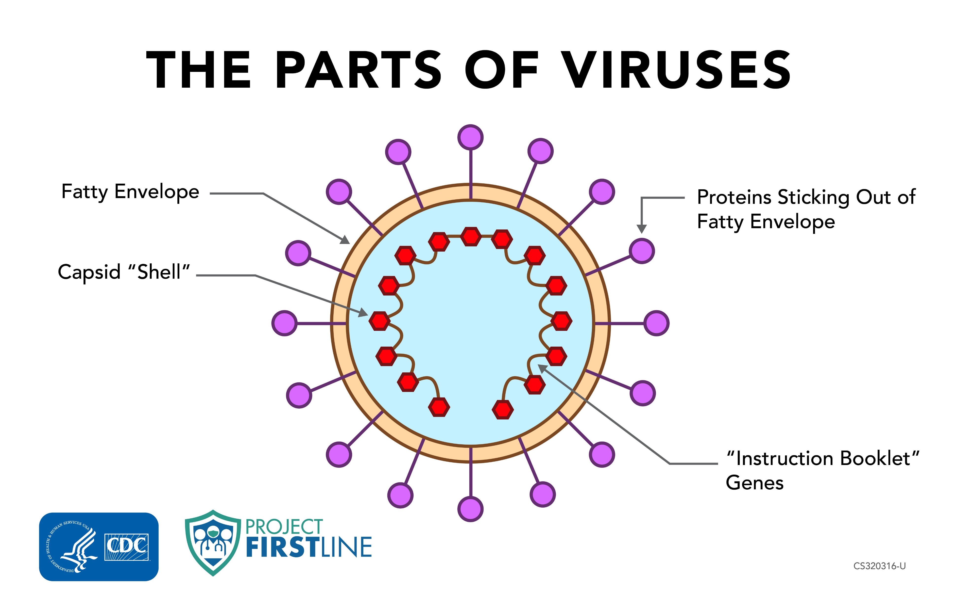
Job Aids
Notes:
Sample Script
“To make your job easier, we’ve also prepared for you the following job aids: “Virus Lock and Key” and “The Parts of Viruses”.

Slide 14
Reflection
Can you imagine a realistic, every-day occasion when you could practice using this job aid or explain this concept to others?
Notes:
Sample Script
Are there things you’ve learned today that help you understand infection control better? Can you imagine a realistic, every-day occasion when you could practice using these job aids or explain this concept to others? Is there somewhere you can display it at work? I’m going to pause for a minute to give you a chance to reflect. Please use your participant booklet to write down your thoughts.”

Slide 15
Key Messages
What was the most important element of today’s session for you?
SARS-CoV-2 is the official, scientific name of the virus, the germ that causes the disease COVID-19
COVID-19 is the name of the disease – the fever, cough, chills and other symptoms that people have when they are infected with the virus SARS-CoV-2.
Notes:
Sample Script
“Thank you all for coming today. I enjoyed our discussion together. Before we adjourn, I’d like to ask. What was the most important takeaway for you from today’s session?”
[After answers, advance slide to show key messages]
“I’ve collected here the key messages from today’s session for future reference.”

Slide 16
Key Messages Continued
What was the most important element of today’s session for you?
All viruses have two parts:
  Genes that contain all the information needed to make more virus copies
  Proteins that protect the genes and help the virus spread
Some viruses – SARS-CoV-2 is one of them – also have a third part: an envelope made of special fats that protects the genes and proteins

Slide 17
Key Messages Continued
What was the most important element of today’s session for you?
Viruses are able to use cells in living things, including people, to make copies of themselves. It’s how viruses spread within a body, and from person to person.
When enough viruses have been able to get into our cells and make copies of themselves, the body recognizes that there’s an infection, and our immune system revs up to fight off the virus.
It is the activity of our immune system fighting the virus that makes us feel sick.

Slide 18
Resources and Future Training sessions
Project Firstline on CDC:
https://www.cdc.gov/infectioncontrol/projectfirstline/index.html
Project Firstline on Facebook:
https://www.facebook.com/CDCProjectFirstline/
Twitter:
https://twitter.com/CDC_Firstline
Youtube:
https://www.youtube.com/playlist?list=PLvrp9iOILTQZQGtDnSDGViKDdRtIc13VX
To sign up for Project Firstline e-mails, click here: https://tools.cdc.gov/campaignproxyservice/subscriptions.aspx?topic_id=USCDC_2104
Notes:
Sample Script
“Next time, we will start talking about the ways that viruses move between people.
“In the meantime, you can keep exploring these topics on your own, using the resources on this slide. You can also follow us on social media.”

Slide 19
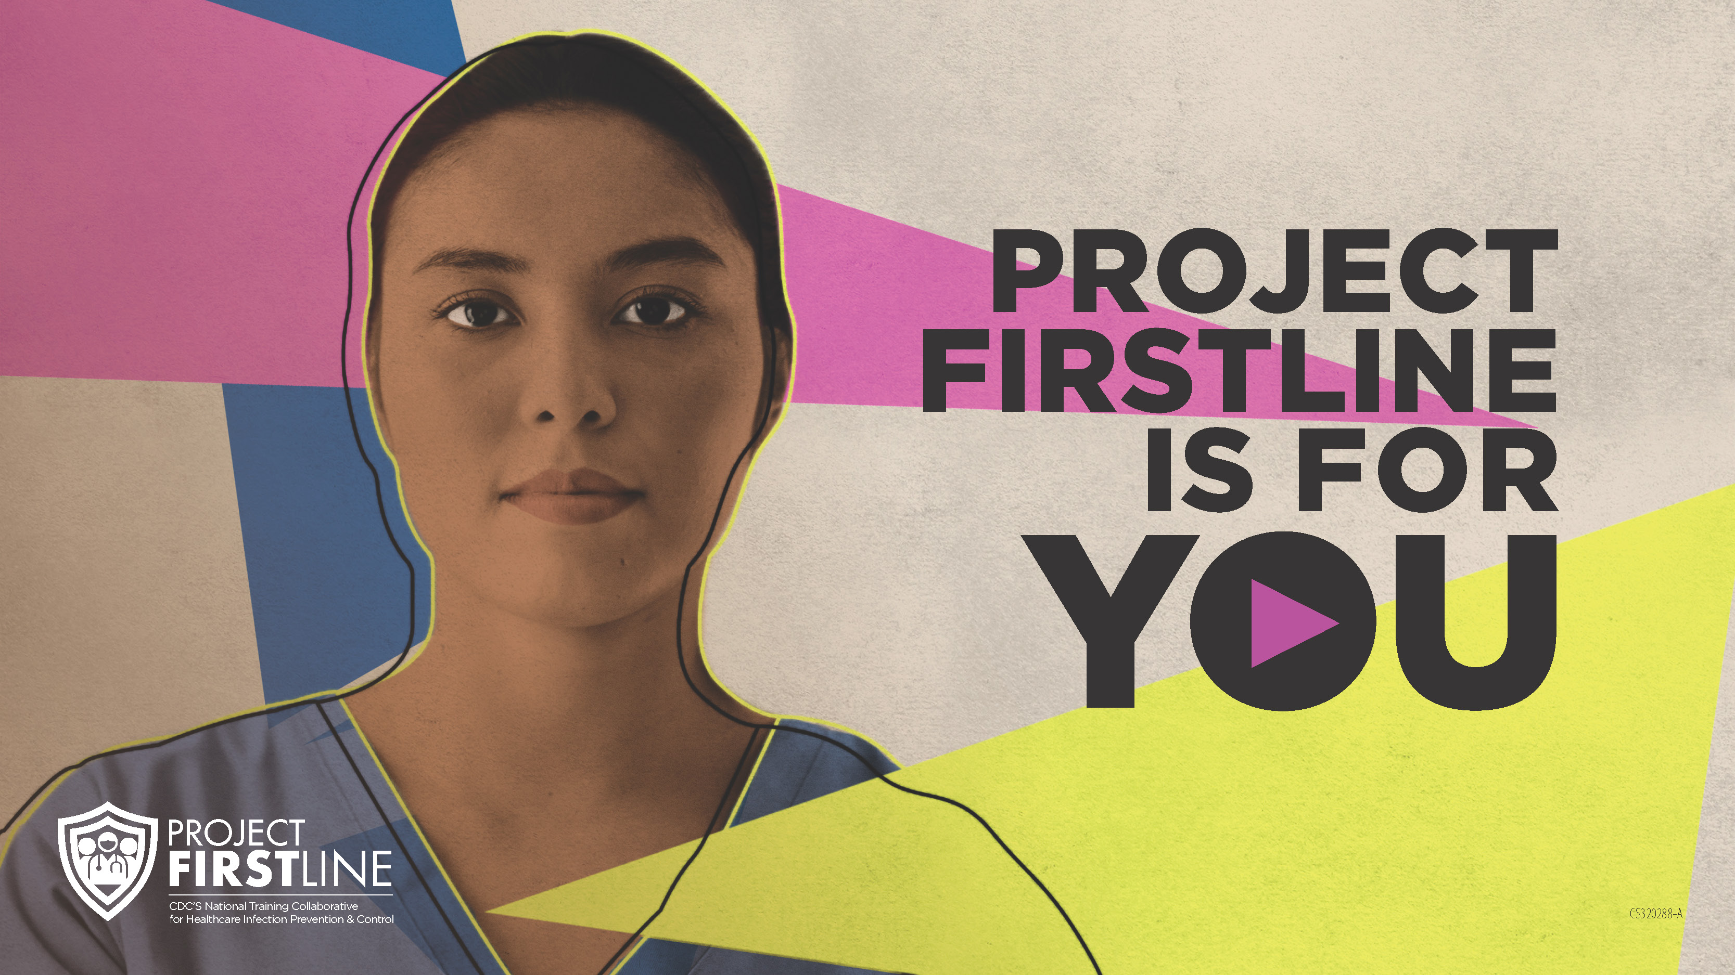
Feedback form
Notes:
[Facilitator should add information about how to access form]
Sample Script
“And finally, please let us know how you enjoyed today’s session by completing the following feedback form. Thanks again for joining us today.”

