Slide 1

Topic 2: The Basic Science of Viruses
[Date of training]
Notes:
Participants log in and get settled.

Slide 2

Agenda:
Introduction
The Basic Science of Viruses
  Video
  Discussion and reflection
Session feedback form and next steps
Notes:
Sample Script
“Welcome! Thank you for joining us. We’re so glad to have this time together to discuss infection control on the frontlines. Today’s meeting segment will focus on the basic science of viruses.”

Slide 3
Learning Objectives:
Differentiate one (1) core difference between SARS-CoV-2 and COVID-19.
Identify, and explain to others, the three (3) main parts of a virus.
Describe three (3) steps showing how viruses use of the cells of living things to make more copies of themselves.
Explain one (1) reason why infection control actions focus on keeping respiratory droplets out of the air and away from other people.

Slide 4
As you watch, consider the following questions:
Did you learn something new from these videos, or were you reminded of something important that especially resonates with you? Can you think of someone you know who would benefit from these concepts?
Have you ever received questions from patients or coworkers on these topics? Do these videos give you any ideas of how you could explain these concepts to others?
Notes:
[Please note that the toolkit topics are presented in sequence, with the expectation that participants will progress through the series. You may, however, mix and match content to meet participant needs and you will need to adjust the sample script below.]
Sample Script
“Last session, we discussed that the ultimate goal of everything we do in infection control is to prevent people from getting sick. In order to do that, the first thing we need to understand is how people get sick with COVID-19.
“In order to answer that question, we have to talk about the virus that causes COVID-19. We also have to understand how viruses work inside the body and what we can do to protect ourselves.
“Let’s check in with Dr. Carlson to see what she has to say on these topics. We’re going to watch 3 short videos back-to-back. Here are some questions to consider as you watch.”

Slide 5
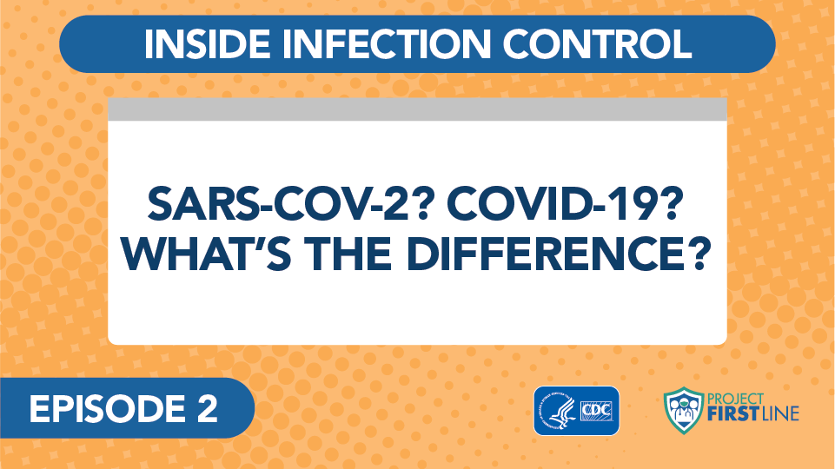
Video: SARS-COV-2? COVID-19? What’s the Difference?
Notes:
Access the video here:
CDC Website: https://www.cdc.gov/infectioncontrol/projectfirstline/videos/Ep2-Difference-LowRes-New.mp4
OR
Project Firstline YouTube Playlist:
https://www.youtube.com/watch?v=s2k1IPSdLgk

Slide 6
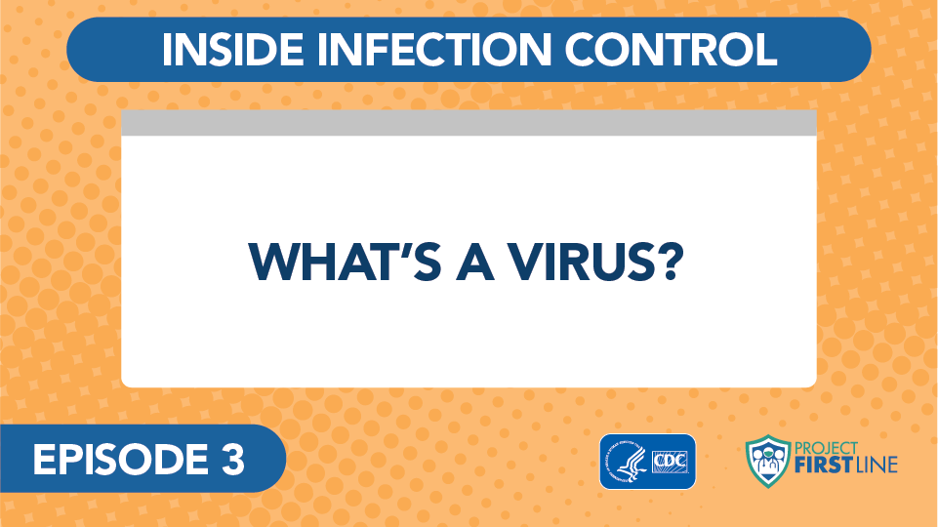
Video: What’s a Virus?
Notes:
Access the video here:
CDC Website: https://www.cdc.gov/infectioncontrol/projectfirstline/videos/Ep3-Virus-LowRes-New.mp4
Or
Project Firstline YouTube Playlist:
https://www.youtube.com/watch?v=iKfG15U8nVo

Slide 7
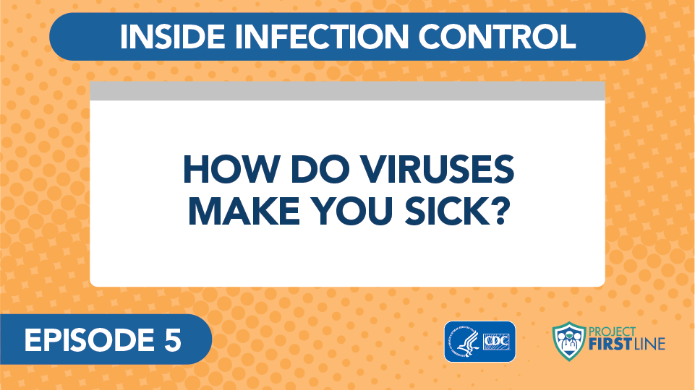
Video: How Do Viruses Make You Sick?
Notes:
Access the Video Here:
CDC Website: https://www.cdc.gov/infectioncontrol/projectfirstline/videos/Ep5-How-LowRes-New.mp4
OR
Project Firstline YouTube Playlist:
https://www.youtube.com/watch?v=pIAH2l9Eg6g

Slide 8
Let’s Discuss
Did you learn something new from these videos, or were you reminded of something important that especially resonates with you? Can you think of someone you know who would benefit from these concepts?
Have you ever received questions from patients or coworkers on these topics? Do these videos give you any ideas of how you could explain these concepts to others?
Notes:
Sample Script
“Would anyone like to share thoughts about one of the questions on this slide? Please feel free to go off mute or respond via the chat.”

Slide 9
Reflection
Can you imagine a realistic, every-day occasion when you could practice using this job aid or explain this concept to others?
Notes:
Sample Script
“In order to help you discuss these topics with patients and coworkers, we’d like to share with you these job aids.
“Can you imagine a realistic, every-day occasion when you could practice using this job aid or explain this concept to others? Is there somewhere you can display it at work? I’m going to pause for one full minute to give you a chance to reflect. Please use your participant booklet to write down your thoughts.”
[Give participants one full minute to reflect]

Slide 10
Key Messages
SARS-CoV-2 is the official, scientific name of the virus, the germ that causes the disease COVID-19
COVID-19 is the name of the disease – the fever, cough, chills and other symptoms that people have when they are infected with the virus SARS-CoV-2.
Notes:
Sample Script
“Thank you all for coming today. I’ve captured today’s key messages on these slides. They are also included in your participant booklet.”

Slide 11
Key Messages Continued
All viruses have two parts:
  Genes that contain all the information needed to make more virus copies
  Proteins that protect the genes and help the virus spread
Some viruses – SARS-CoV-2 is one of them – also have a third part: an envelope made of special fats that protects the genes and proteins

Slide 12
Key Messages cont.
Viruses are able to use cells in living things, including people, to make copies of themselves. It’s how viruses spread within a body, and from person to person.
When enough viruses have been able to get into our cells and make copies of themselves, the body recognizes that there’s an infection, and our immune system revs up to fight off the virus.
It is the activity of our immune system fighting the virus that makes us feel sick.

Slide 13
Resources and Future Training sessions
Project Firstline on CDC:
https://www.cdc.gov/infectioncontrol/projectfirstline/index.html
Project Firstline on Facebook:
https://www.facebook.com/CDCProjectFirstline/
Twitter:
https://twitter.com/CDC_Firstline
Youtube:
https://www.youtube.com/playlist?list=PLvrp9iOILTQZQGtDnSDGViKDdRtIc13VX
To sign up for Project Firstline e-mails, click here: https://tools.cdc.gov/campaignproxyservice/subscriptions.aspx?topic_id=USCDC_2104
Notes:
Sample Script
“Next time, we will start talking about the ways that viruses move between people.
“In the meantime, you can keep exploring these topics on your own, using the resources on this slide. You can also follow us on social media.”

Slide 14

Feedback Form
Notes:
[Facilitator should add information about how to access form]
Sample Script
“And finally, please let us know how you enjoyed today’s session by completing the following feedback form. Thanks again for joining us today.”

