Slide 1


Topic 2: The Basic Science of Viruses, Part 2
[Date of training]
Notes:
Participants log in and get settled.

Slide 2

Agenda:
Introduction
The Basic Science of Viruses
  Video
  Discussion and reflection
Session feedback form and next steps
Learning Objectives:
Describe three (3) steps showing how viruses use of the cells of living things to make more copies of themselves.
Explain one (1) reason why infection control actions focus on keeping respiratory droplets out of the air and away from other people.
Notes:
Sample Script
“Welcome! Thank you for joining us. We’re so glad to have this time together to discuss infection control on the frontlines. This is the second of two meeting segments in our discussion of the basic science of viruses.
“Last session, we started talking about viruses and distributed a job aid showing the anatomy of a virus.”

Slide 3
As you watch, consider the following questions
Did you learn something new from this video, or were you reminded of something important that especially resonates with you? Can you think of someone you know who would benefit from these concepts?
Have you ever received questions from patients or coworkers on these topics? Does this video give you any ideas of how you could explain these concepts to others?
Notes:
Sample Script
“Today we’re going to take a closer look at what viruses actually do inside the body.
“Let’s check in with Dr. Carlson. Here are some questions to consider as you watch.”

Slide 4
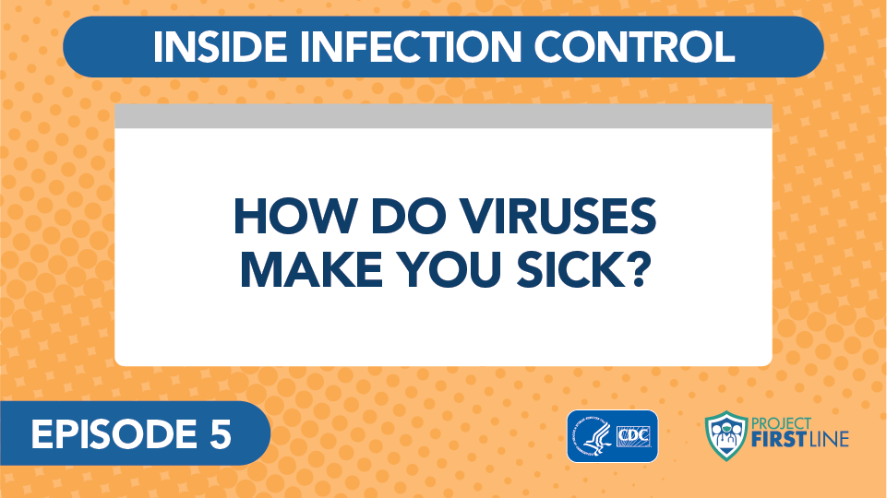
Video: How Do Viruses Make You Sick?
Notes:
Access the Video Here:
CDC Website: https://www.cdc.gov/infectioncontrol/projectfirstline/videos/Ep5-How-LowRes-New.mp4
OR
Project Firstline YouTube Playlist:
https://www.youtube.com/watch?v=pIAH2l9Eg6g

Slide 5
Let’s Discuss
Did you learn something new from this video, or were you reminded of something important that especially resonates with you? Can you think of someone you know who would benefit from these concepts?
Have you ever received questions from patients or coworkers on these topics? Does this video give you any ideas of how you could explain these concepts to others?
Notes:
Sample Script
“Would anyone like to share thoughts about one of the questions on this slide? Please feel free to go off mute or respond via the chat.”

Slide 6
Reflection
Did you learn something today (or remind yourself of something you already knew) that could help you discuss infection control in your day-to-day interactions with patients and coworkers?
Notes:
Sample Script
“Take a moment to reflect on today’s session. Did you learn something today (or remind yourself of something you already knew) that could help you discuss infection control in your day-to-day interactions with patients and coworkers? Please use your participant booklet to write down your thoughts.”
[Give participants one full minute to reflect]

Slide 7
Key Messages
Viruses are able to use cells in living things, including people, to make copies of themselves. It’s how viruses spread within a body, and from person to person.
When enough viruses have been able to get into our cells and make copies of themselves, the body recognizes that there’s an infection, and our immune system revs up to fight off the virus.
It is the activity of our immune system fighting the virus that makes us feel sick.
Notes:
Sample Script
“Thank you all for coming today. I’ve captured today’s key messages on this slide. They are also included in your participant booklet.”

Slide 8
Resources and Future Training sessions
Project Firstline on CDC:
https://www.cdc.gov/infectioncontrol/projectfirstline/index.html
Project Firstline on Facebook:
https://www.facebook.com/CDCProjectFirstline/
Twitter:
https://twitter.com/CDC_Firstline
Youtube:
https://www.youtube.com/playlist?list=PLvrp9iOILTQZQGtDnSDGViKDdRtIc13VX
To sign up for Project Firstline e-mails, click here: https://tools.cdc.gov/campaignproxyservice/subscriptions.aspx?topic_id=USCDC_2104
Notes:
Sample Script
“Next time, we will start talking about the ways that viruses move between people.
“In the meantime, you can keep exploring these topics on your own, using the resources on this slide. You can also follow us on social media.”

Slide 9
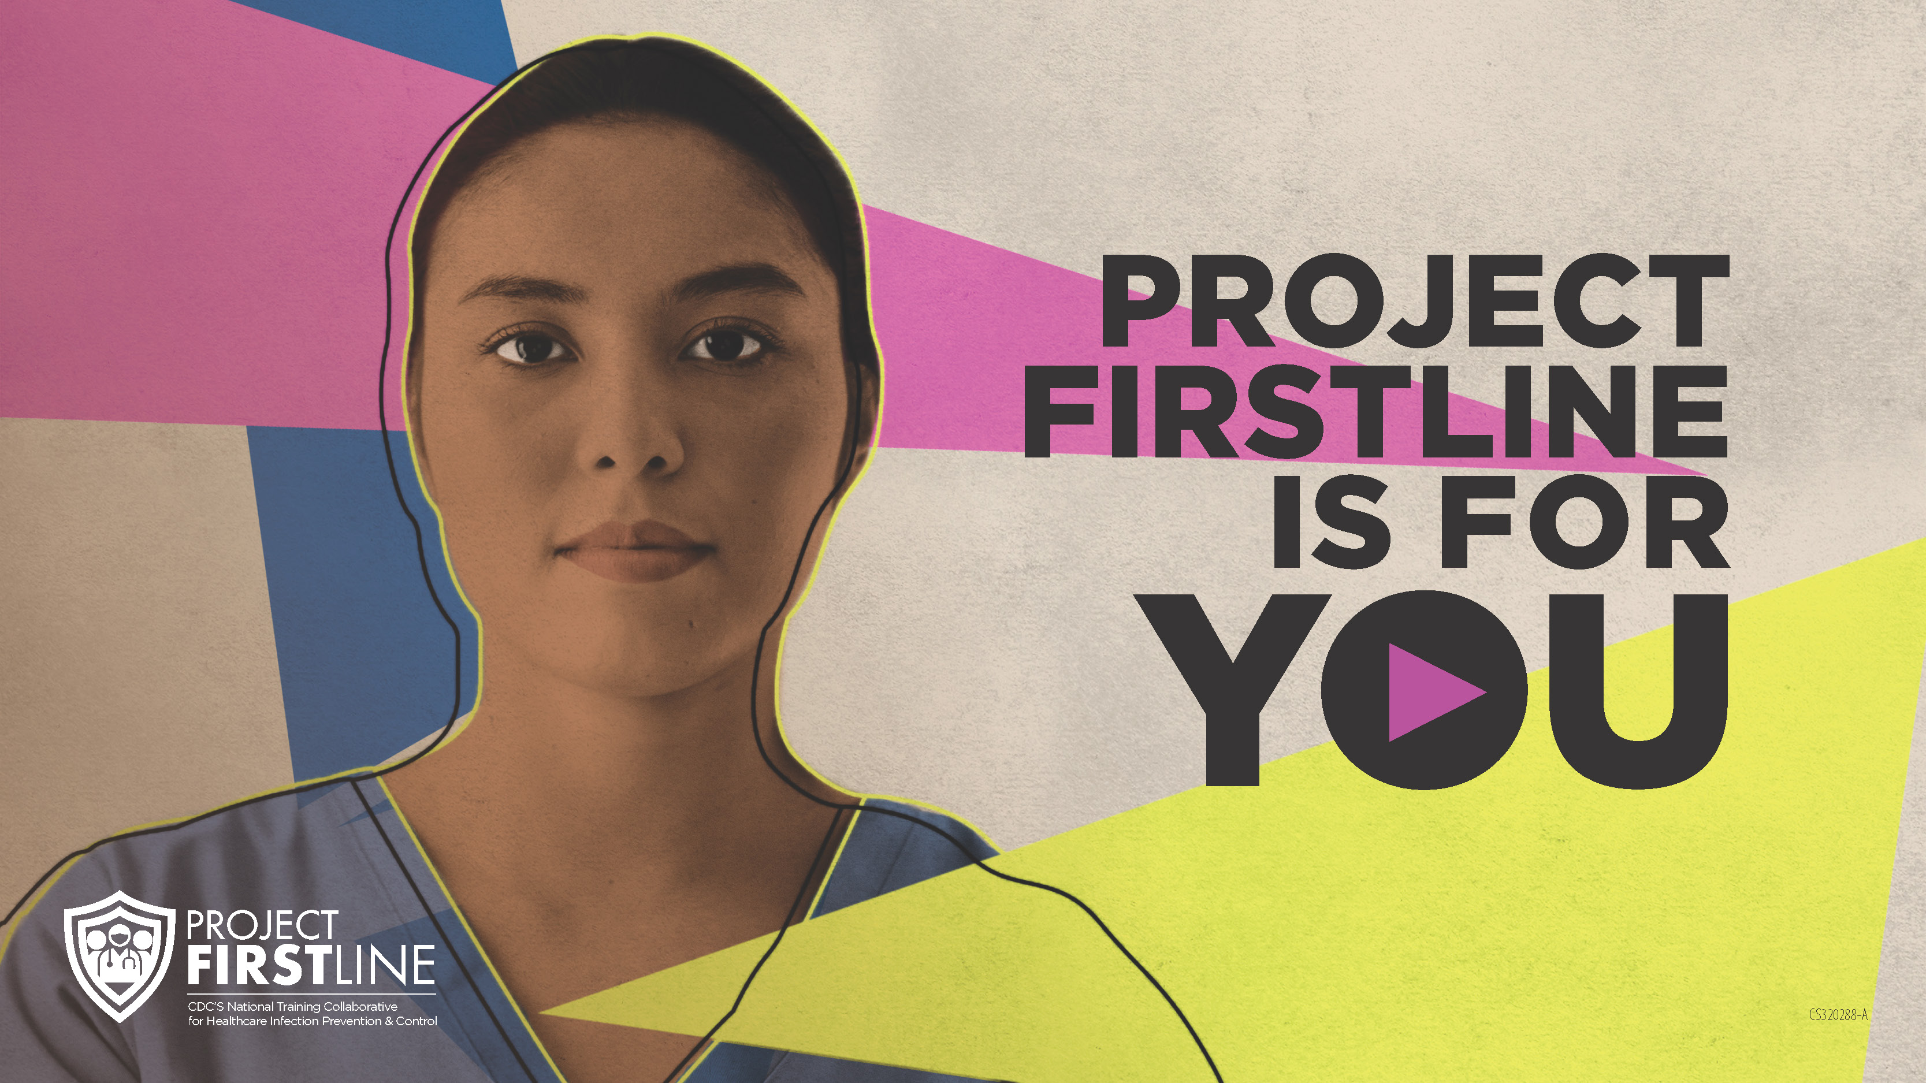
Feedback form
Notes:
[Facilitator should add information about how to access form]
Sample Script
“And finally, please let us know how you enjoyed today’s session by completing the following feedback form. Thanks again for joining us today.”

