Slide 1
Topic 15: Ventilation
[Date of Training]
Notes:
Facilitator Notes
Participants log in and get settled.

Slide 2
Agenda
Introductions
How Does Ventilation Work?
Why Does Ventilation Matter?
Reflection
Notes:
Facilitator Notes
Welcome the group and add a greeting to the chat box.
If this session is part of an ongoing series, you may choose to say “welcome back,” “thank you for joining us again,” etc.
Announce housekeeping notes, either orally or via chat.
If needed, provide additional notes specific to the platform you’re using (e.g., how to “raise your hand,” how to post questions).
Provide an overview of the agenda.
Adapt this section of the session as needed: for instance, you may choose to spend additional time on introductions if there are new faces, or if participants do not know each other.
Sample Script
“Welcome to Project Firstline. Over the next hour, we’ll focus on ventilation in healthcare. Please keep your videos on, to the extent possible, and keep your microphone muted when you are not contributing to the discussion. It’s great to see you all here today!
“Our discussion will include what ventilation is, how it works, why it matters for infection control, and how we use it.”

Slide 3
Learning Objectives
Discuss why good ventilation is important for infection control in healthcare.
Discuss one (1) way that ventilation works to reduce the amount of germs in the air.
Describe one (1) reason why it is important not to take steps to improve ventilation yourself, without working with the staff in your facility in charge of air handling and ventilation.
Notes:
Facilitator Notes
Provide an overview of the session’s learning objectives.
Sample Script
“Here is what we expect to learn today. By the end of today’s training, you will be able to describe why good ventilation is important for infection control in healthcare, how ventilation works to reduce germs in the air, and why it’s important to work with the people in your facility who are in charge of air handling and ventilation if you think changes should be made to the ventilation in a room.”

Slide 4
Introductions
Please introduce yourself with:
Your name
Your role (e.g., organization, unit)
Whether your job has responsibilities related to ventilation
Notes:
Facilitator Notes
These questions will give you a better understanding of your participants’ backgrounds, experience, and level of knowledge.
Tailor your slide delivery for the virtual format and platform, and the number of participants:
You may wish to call on participants individually.
You may wish to add role- or facility-specific questions to the introductions.
If you have a large group, you may decide to skip oral introductions and use the chat.
If your group meets regularly, you may wish to skip or shorten the introductions, or use a different “icebreaker” approach.
Be sure to introduce yourself and anyone who is assisting you.
Sample Script
“Let’s take a minute to get to know each other. Please share in 30 seconds or less your name and your role, and whether you think your job has responsibilities related to ventilation.”

Slide 5
How does ventilation play a role in our lives?
Notes:
Facilitator Notes
Invite participants to describe, either orally or in the chat, how ventilation is part of their daily lives.
Affirm examples, which could include:
Opening windows in the house if you burn something in the kitchen and the smoke detector goes off
Rolling down the windows in the car
Hood vents over stoves, dryer vents
You may wish to note that the term can be used figuratively, as in “vent your feelings”
Connect the discussion to responses to the introductory question, in which they indicated whether their jobs explicitly involve ventilation, and ask participants to define, either orally or in the chat, “ventilation.”
Sample Script
“Let’s think about ventilation outside of healthcare. How does ventilation play a role in our lives? What are some specific examples?”
(Pause for responses.)
“Those are great examples. So, what does ‘ventilation’ mean? Could someone define ventilation in plain language?”
(Pause for responses.)

Slide 6
Definition
Ventilation | The movement of air in and out of an enclosed space. For example, the circulation of fresh air to a room or building.
Notes:
Facilitator Notes
Either allow time for participants to read the definition themselves or read it aloud.
“The movement of air in and out of an enclosed space. For example, the circulation of fresh air to a room or building.”
Sample Script
“Before we move on, let’s review a definition of ventilation.”

Slide 7
HOW DOES ventilation work?
Notes:
Facilitator Notes
Transition to video or demonstration of how ventilation works.
Sample Script
“Now that we all know what ventilation is, let’s learn about how ventilation works.”

Slide 8
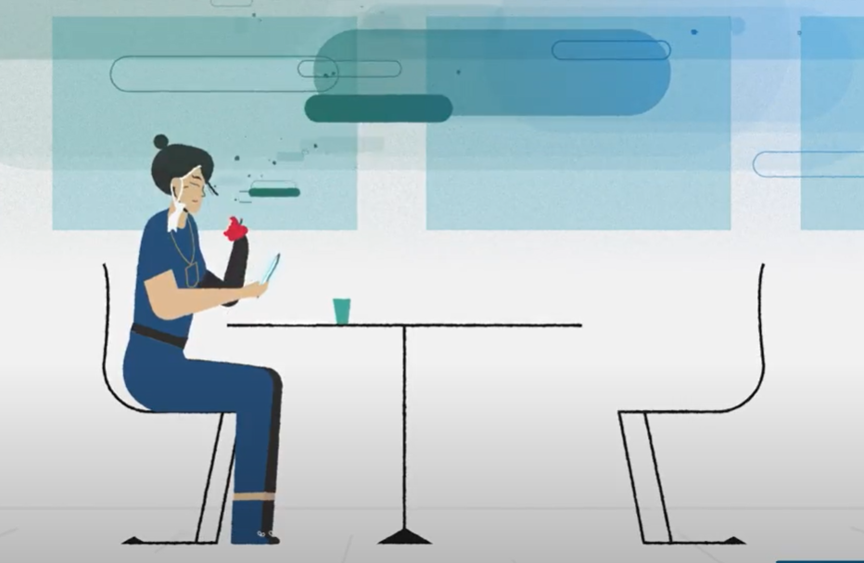
How does ventilation work?
Notes:
Facilitator Notes
Establish the importance of ventilation in healthcare: Good ventilation in healthcare is important to help reduce the spread of respiratory infections.
There are three options for this section:
a live demonstration and discussion,
a brief animated video and discussion, or
an episode of Inside Infection Control and discussion.
The following slides and sample script provide guidance for a live demonstration and showing of the animated video, and they may be adapted according to your plan for sharing the content.
If you choose to provide this demonstration live, stop sharing your slides so that participants can see you in full-screen mode.
Make sure you have all the materials you need within reach and ready to use.
The Content Outline of Episode 17 provides additional talking points that you may wish to incorporate into your demonstration.
If you choose to show the brief animated video or the Inside Infection Control episode, delete the other image on this slide and enlarge image from the video that you will be showing.
The brief animated video shows a space without ventilation. It can be viewed here: https://www.youtube.com/watch?v=zOFA05orOlc
If you choose to show Episode 17: Inside Infection Control: What Is Ventilation? you may do so here:
CDC Website: https://www.cdc.gov/infectioncontrol/projectfirstline/videos/EP17-Vent-LowRes.mp4
OR
Project Firstline YouTube Playlist: https://www.youtube.com/watch?v=Tos-eccft_A
Sample Script for Live Demonstration
“In healthcare settings, good ventilation is really important. It helps remove air that contains things we don’t want to breathe in, like small particles that can contain virus. Good ventilation improves air quality and reduces the risk of germs spreading.”
(Hold up jar filled with water, and food coloring.) “Let’s imagine that this jar represents a room, and that this food coloring represents respiratory droplets carrying germs.”
(Place one drop of food coloring in jar and allow the color to spread.)
“When we place a drop of food coloring in the jar, it spreads through the water. Look at how that one drop of food coloring spreads throughout the entire jar.
“In this demonstration, the jar is like a room without ventilation. Like the food coloring in the jar, respiratory droplets that are breathed out will spread into the space, because they don’t have anywhere else to go. Respiratory droplets will linger in the air for a little while. Over time, the particles will settle and the virus in them will die, if it doesn’t get picked up by another person.”
Sample Script for Brief Animated Video “In healthcare settings, good ventilation is really important. It helps remove air that contains things we don’t want to breathe in, like small particles that can contain virus. Good ventilation improves the air quality and reduces the risk of germs spreading. This brief video shows what happens to respiratory droplets in an enclosed space without ventilation.
“Let’s watch.”
(Play video).
“As you can see, without ventilation, respiratory droplets will linger in the air for a little while. Over time, the particles will settle and the virus in them will die, if it doesn’t get picked up by another person.”
Sample Script for Inside Infection Control Episode
“In healthcare settings, good ventilation is really important. It helps remove air that contains things we don’t want to breathe in, like small particles that can contain virus. Good ventilation improves the air quality and reduces the risk of germs spreading. In this episode of Inside Infection Control, CDC’s Dr. Abby Carlson will describe how ventilation works.”
(Play video).
“As we just heard, good ventilation matters so much in healthcare because it can help move germs out of the air. Without ventilation, respiratory droplets will linger in the air for a little while. Over time, the particles will settle and the virus in them will die, if it doesn’t get picked up by another person.”

Slide 9
What would good ventilation do?
Notes:
Facilitator Notes
Lead the group in a discussion of what good ventilation would do, in the context of the live demonstration, animated video, or Inside Infection Control episode.
You may choose to ask participants to share thoughts orally, in the chat, or both.
Affirm and emphasize the following points:
(If you showed the live demonstration): A system for the jar that pulls out old water and pushes in new water would eventually remove all the color, and the jar would have nice, clear water again.
When ventilation pulls old air out of a room and pushes new, clean air in, eventually the room is “cleared.”
Sample Script for Live Demonstration
“Imagine what good ventilation would do in this example. What if there were a system that pulls the old water out and pushes new water in?”
(Pause for responses.)
“That’s right. Depending on how fast the new water comes in and the old water goes out, the color will go away. Eventually, we’ll have clear water again.”
Sample Script for Brief Animated Video
“Imagine what good ventilation would do in this example. What if there were a system that pulls the old air in the room out and pushes new air in?”
(Pause for responses.)
“That’s right. As the new air replaces the old air, eventually we’ll have entirely new air in this room.”
Sample Script for Inside Infection Control Episode
“So, as we heard from Dr. Carlson, ventilation removes things we don’t want to breathe in from the air, such as respiratory droplets. In an enclosed space, such as a healthcare setting, ventilation can remove the old air, which may have respiratory droplets in it, and replace it with clean, new air.”

Slide 10
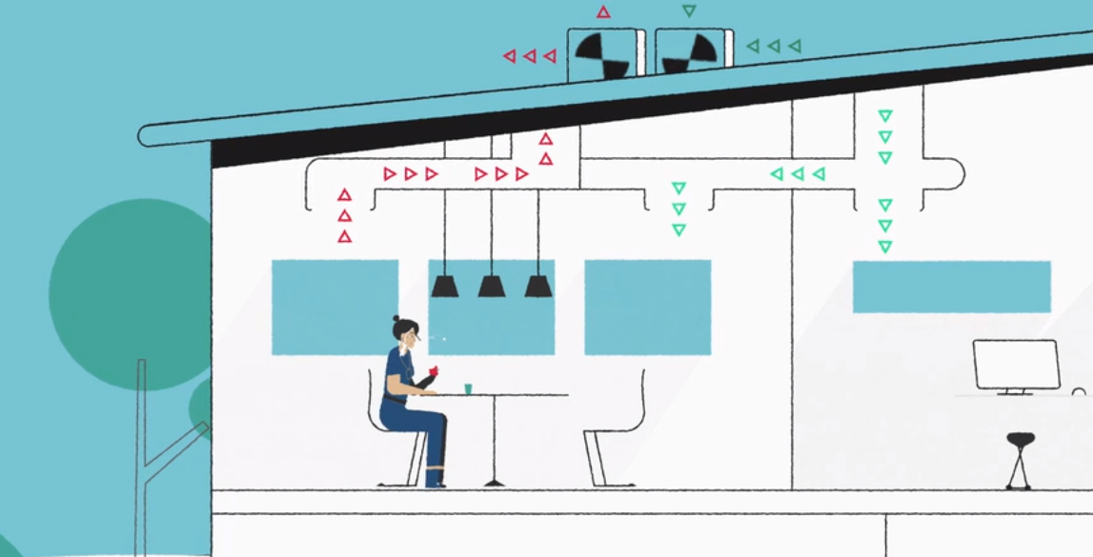
Good ventilation
Notes:
Facilitator Notes
Emphasize why good ventilation in healthcare is important for infection control.
Show a brief animated video that shows how ventilation replaces air in a room: https://www.youtube.com/watch?v=WQcRZHyxlwE
Sample Script
“Great discussion! Just to reiterate, ventilation is the movement of air in and out of spaces. Let’s take a quick look at a video to see how that happens.”
(Play video).
“Good ventilation is important in healthcare because it can help remove things that we don’t want to breathe in, like small virus particles. That’s why it’s important that healthcare settings have good air movement. It can help reduce the spread of respiratory infections.”
“Let’s keep exploring air quality and ventilation in healthcare.”

Slide 11
How is ventilation handled at your workplace?
Notes:
Facilitator Notes
Lead a discussion of other ventilation strategies in place in healthcare, noting that:
Ventilation systems can improve air quality in ways other than moving air.
Some tools, like high-efficiency particulate air (HEPA) filters, improve air quality by filtering air instead of removing it before people breathe it in.
If you choose to do a live demonstration, connect to the example of food coloring in the jar: filtering would be like using something to pull coloring out of the water in order to achieve clear water.
Reinforce the point that doing things to improve air quality and air movement will help keep viruses from spreading: the fewer virus particles in the air, the less likely you’ll breathe them in, or that they’ll land on your eyes, nose, mouth, or a surface that you might touch.
You may wish to use the Content Outlines for Episodes 17 and 18 of Inside Infection Control for reference.
Sample Script
“Air movement is important for having good air quality, but there are other ways to improve air quality. Some ventilation systems filter the air instead of removing it before it’s breathed in. Do any of you work at facilities that filter the air using a tool like a high-efficiency particulate air filter, or HEPA filter?”
(Pause for responses.)
“That’s great.”
(If you choose to do a live demonstration with the jar of water):
“With our example of the jar, it would be like using something that pulls the coloring out of the water in the jar, rather than—or in addition to—replacing the water to make sure it’s clean.
“All of these strategies to improve air quality will help keep respiratory infections from spreading: the fewer virus particles in the air, the less likely you’ll breathe them in, or that they’ll land on your eyes, nose, mouth, or a surface that you might touch.”

Slide 12
Why Does Ventilation Matter?
Notes:
Facilitator Notes
Link prior discussion to the upcoming video, and to concepts regarding how to improve ventilation.
Sample Script
“Now let’s spend some time thinking about good ventilation at work. We’ve been talking a lot about what ventilation is and why it matters, but it’s not always easy to know what we can do about it.”

Slide 13
Instructions
While watching the video:
Think about your workday.
Jot down instances when your actions at work may impact ventilation.
Notes:
Facilitator Notes
You may choose to show Episode 18 of Inside Infection Control, or you may choose to show the animated ventilation demonstration video and use the Content Outline for Episode 18 to support discussion.
Encourage participants, while they watch the video or animation, to think about their workday and instances when their actions may impact ventilation.
Sample Script
“As you watch this video [or animation], start thinking about your workday. Jot down in your Participant Booklet some instances when your actions at work impact ventilation.”

Slide 14
Why Does Ventilation Matter Episode 18
Notes:
Facilitator Notes
Access the Inside Infection Control video here:
CDC Website: https://www.cdc.gov/infectioncontrol/projectfirstline/videos/EP18-Ventilation-LowRes.mp4
OR
Project Firstline YouTube Playlist: https://www.youtube.com/watch?v=FY7FiJDoqhE
Alternatively, if less time is available, you may choose to show a 1-minute ventilation demonstration video here: https://www.youtube.com/watch?v=KTjtYVw0Sj4

Slide 15
What actions do you take at work that may impact ventilation?
Notes:
Facilitator Notes
Invite participants to review the notes they wrote down during the video and share, either orally or in the chat, actions that they take at work that may impact ventilation.
When appropriate, ask follow-up questions and prompt additional discussion regarding why they take these actions, and what they achieve.
You may wish to use the Content Outline for Episode 18 to reinforce key points for either video.
Sample Script
“As you were watching the video, what occurred to you about your work? What actions do you take at work that may impact ventilation?”
(Pause for responses and encourage additional discussion.)

Slide 16
Ventilation in Healthcare
What do you need to know about ventilation?
Notes:
Facilitator Notes
Invite participants to share ideas about what is important to know about ventilation in healthcare and how to put that knowledge into action.
You may wish to call on participants who have not yet shared during the session.
Important points to reinforce include:
An air change means the air in a room is replaced with new or filtered air.
Air changes are usually measured by the hour, as in air changes per hour (ACH).
In healthcare facilities, nearly every type of room has a recommended number of air changes. For example, 12 ACHs are recommended for emergency department waiting rooms.
Rooms used to care for patients with respiratory diseases like COVID-19 should be assessed and maintained by maintenance and facilities engineering staff to ensure correct ACHs.
The ACH will tell you how long the room should sit empty after that patient leaves and before another person can come in without the recommended PPE, such as a fit-tested respirator.
It is okay to enter a room with the recommended PPE before the air is completely cleared, including while the patient is still there.
Acknowledge the responses and invite additional discussion.
You may choose to capture high-level summaries of their responses on a slide or in the chat.
Sample Script
“Let’s talk a bit more about what’s important to know about ventilation, and what we can do about it. What do you need to know about ventilation?”
(Pause for responses.)
“That’s right – it’s important to know what an air change is. Using COVID-19 as an example, it’s important to know how long a room should sit empty after a patient with COVID-19 leaves it before you can enter the room without the recommended PPE, and that depends on how many air changes the room gets each hour. Of course, it’s okay to enter a room before the air is completely cleared, even if the patient is still there, if you use the recommended PPE, including a fit-tested respirator.”

Slide 17
STEPS TO SUPPORT GOOD VENTILATION
Know how long it takes for the air in certain rooms, such as patient rooms, to clear.
If you’re entering a room without recommended PPE, make sure the air in the room is cleared first.
Don’t take actions on your own to change how air is handled.
Have questions? Ask the person with responsibility for air filtration and ventilation at your facility.
Notes:
Facilitator Notes
Encourage participants to think about how they can use their knowledge about ventilation at work.
Know how long it takes for the air in certain rooms, such as patient rooms, to clear.
If you’re entering a room without recommended PPE, make sure the air in the room is cleared first.
It is important not to take steps to improve ventilation on your own, because actions like opening windows, or blocking or redirecting vents, can change the balance of air pressure and the ventilation in other spaces in the facility.
Always check with the people in your facility who are in charge of air handling and ventilation before making changes to the ventilation in a room.
Their titles may vary, but they could include people who work in building engineering, maintenance, HVAC, or Facilities Managers.
Sample Script
“Those are excellent points. Let’s talk about how to put what we know about ventilation into action. What are some things we can do, and some things we shouldn’t do?”
(Pause for responses.)
“That’s right, it’s important to know the ACH for certain rooms, and to wait until a room has cleared before you enter without the recommended PPE.”
“You can always work with the staff at your facility who are in charge of air handling if you have questions about the ventilation in a room or think changes should be made. It’s important, though, not to open a window or do anything else to change the ventilation in a room without asking. It seems simple enough, but opening a window, or blocking a vent because you’re cold, can change the air pressure and ventilation in other places in the building.”

Slide 18
Breakout Groups
Rehearse what you would say when
You’re concerned about the ventilation and need to seek help.
Who would you speak to?
What would you say? What questions would you ask?
You wish to express appreciation for solving a ventilation problem in your facility.
Who would you speak to?
What would you say?
Notes:
Facilitator Notes
Use breakout rooms appropriate to your virtual platform to divide participants into pairs or small groups, ideally no more than 3-5 participants each.
Task the groups with exploring scenarios involving ventilation in healthcare and rehearsing what they might say in the situations.
As needed, provide instructions related to the breakout room format, such as how to ask questions.
Inform the groups that they have 5 minutes to work together, and that they will discuss the scenarios as a large group after they reconvene.
If applicable and possible, try to create groupings of participants who haven’t yet had an opportunity to speak together during the training.
Read the scenarios on the slide, and you may wish to provide them in the chat:
You’re concerned about the ventilation in your facility and need to seek help.
Who would you speak to?
What would you say? What questions would you ask?
You wish to express appreciation for solving a ventilation problem in your facility.
Who would you speak to?
What would you say?
After the small groups have gathered, depending on your virtual platform, you may use the broadcast message feature or another means to send reminders of the scenarios, how much time is remaining, etc. You may also choose to “visit” each group to encourage conversation and to hear their thoughts.
Use your chime or timekeeper to warn participants when they have 1 minute remaining.
Sample Script
“We’re going to take a few minutes to split into small groups and practice how to handle some scenarios related to ventilation. In your group, I’d like you to discuss what you would do if you were concerned about the ventilation in your facility and wanted help. Who would you talk to? What would you say, and what questions would you ask?
“Also, think about who you would speak to, and what you would say when you want to say thanks for solving a ventilation problem in our facility.”
“Let’s take 5 minutes to talk about these questions. Then we will come back together to share and discuss.”

Slide 19
Discussion
Do you know who to go to at your facility to share concerns or ask questions about ventilation?
What did your group identify as a potential concern or question about ventilation?
What questions would you ask?
Is there anything related to ventilation at your facility that is going particularly well?
Notes:
Facilitator Notes
After 5 minutes, reconvene the groups.
Lead a discussion of the whole group, encouraging them to share strategies for addressing the scenarios that they discussed in their small groups.
If participants are all at one facility, they may name a specific individual whom they would speak to or thank.
If you are at the same facility, consider identifying the correct point of contact before this training so that you can share the person’s name and contact information.
If participants seem to have first-hand knowledge, potential follow-up questions could be:
Have you had a situation where you needed to ask a question or share a concern about ventilation?
Can you tell us about it and how you handled it?
You may wish to prompt discussion by suggesting potential questions to ask a facility’s air handling or maintenance staff:
Are there any places in our facility where we can open windows?
What do we do if the vents are making noises?
What do we do if we notice people without PPE entering rooms that haven’t fully cleared?
Sample Script
“Thanks for coming back together. I hope you had good discussions in your groups! Let’s share some of your thinking with the larger group.
“First, I’d love to know if anyone knows who at your facility to go to in order to share concerns or ask questions about ventilation.”
(Pause for responses and encourage additional discussion.)
“Were your groups able to identify situations that would be a potential concern for you?”
(Pause for responses.)
“What about questions you’d ask?”
(Pause for responses and encourage additional discussion.)
“Lastly, does anyone have examples of ventilation going well?”
(Pause for responses.)
“I’m so glad to hear that things seem to be working well!”

Slide 20
Reflection
Notes:
Facilitator Notes
Invite participants to share what they learned during the session.
Sample Script
“Let’s use our last few minutes together to reflect on what we’ve learned and think about how we can put what we’ve learned into practice.”

Slide 21
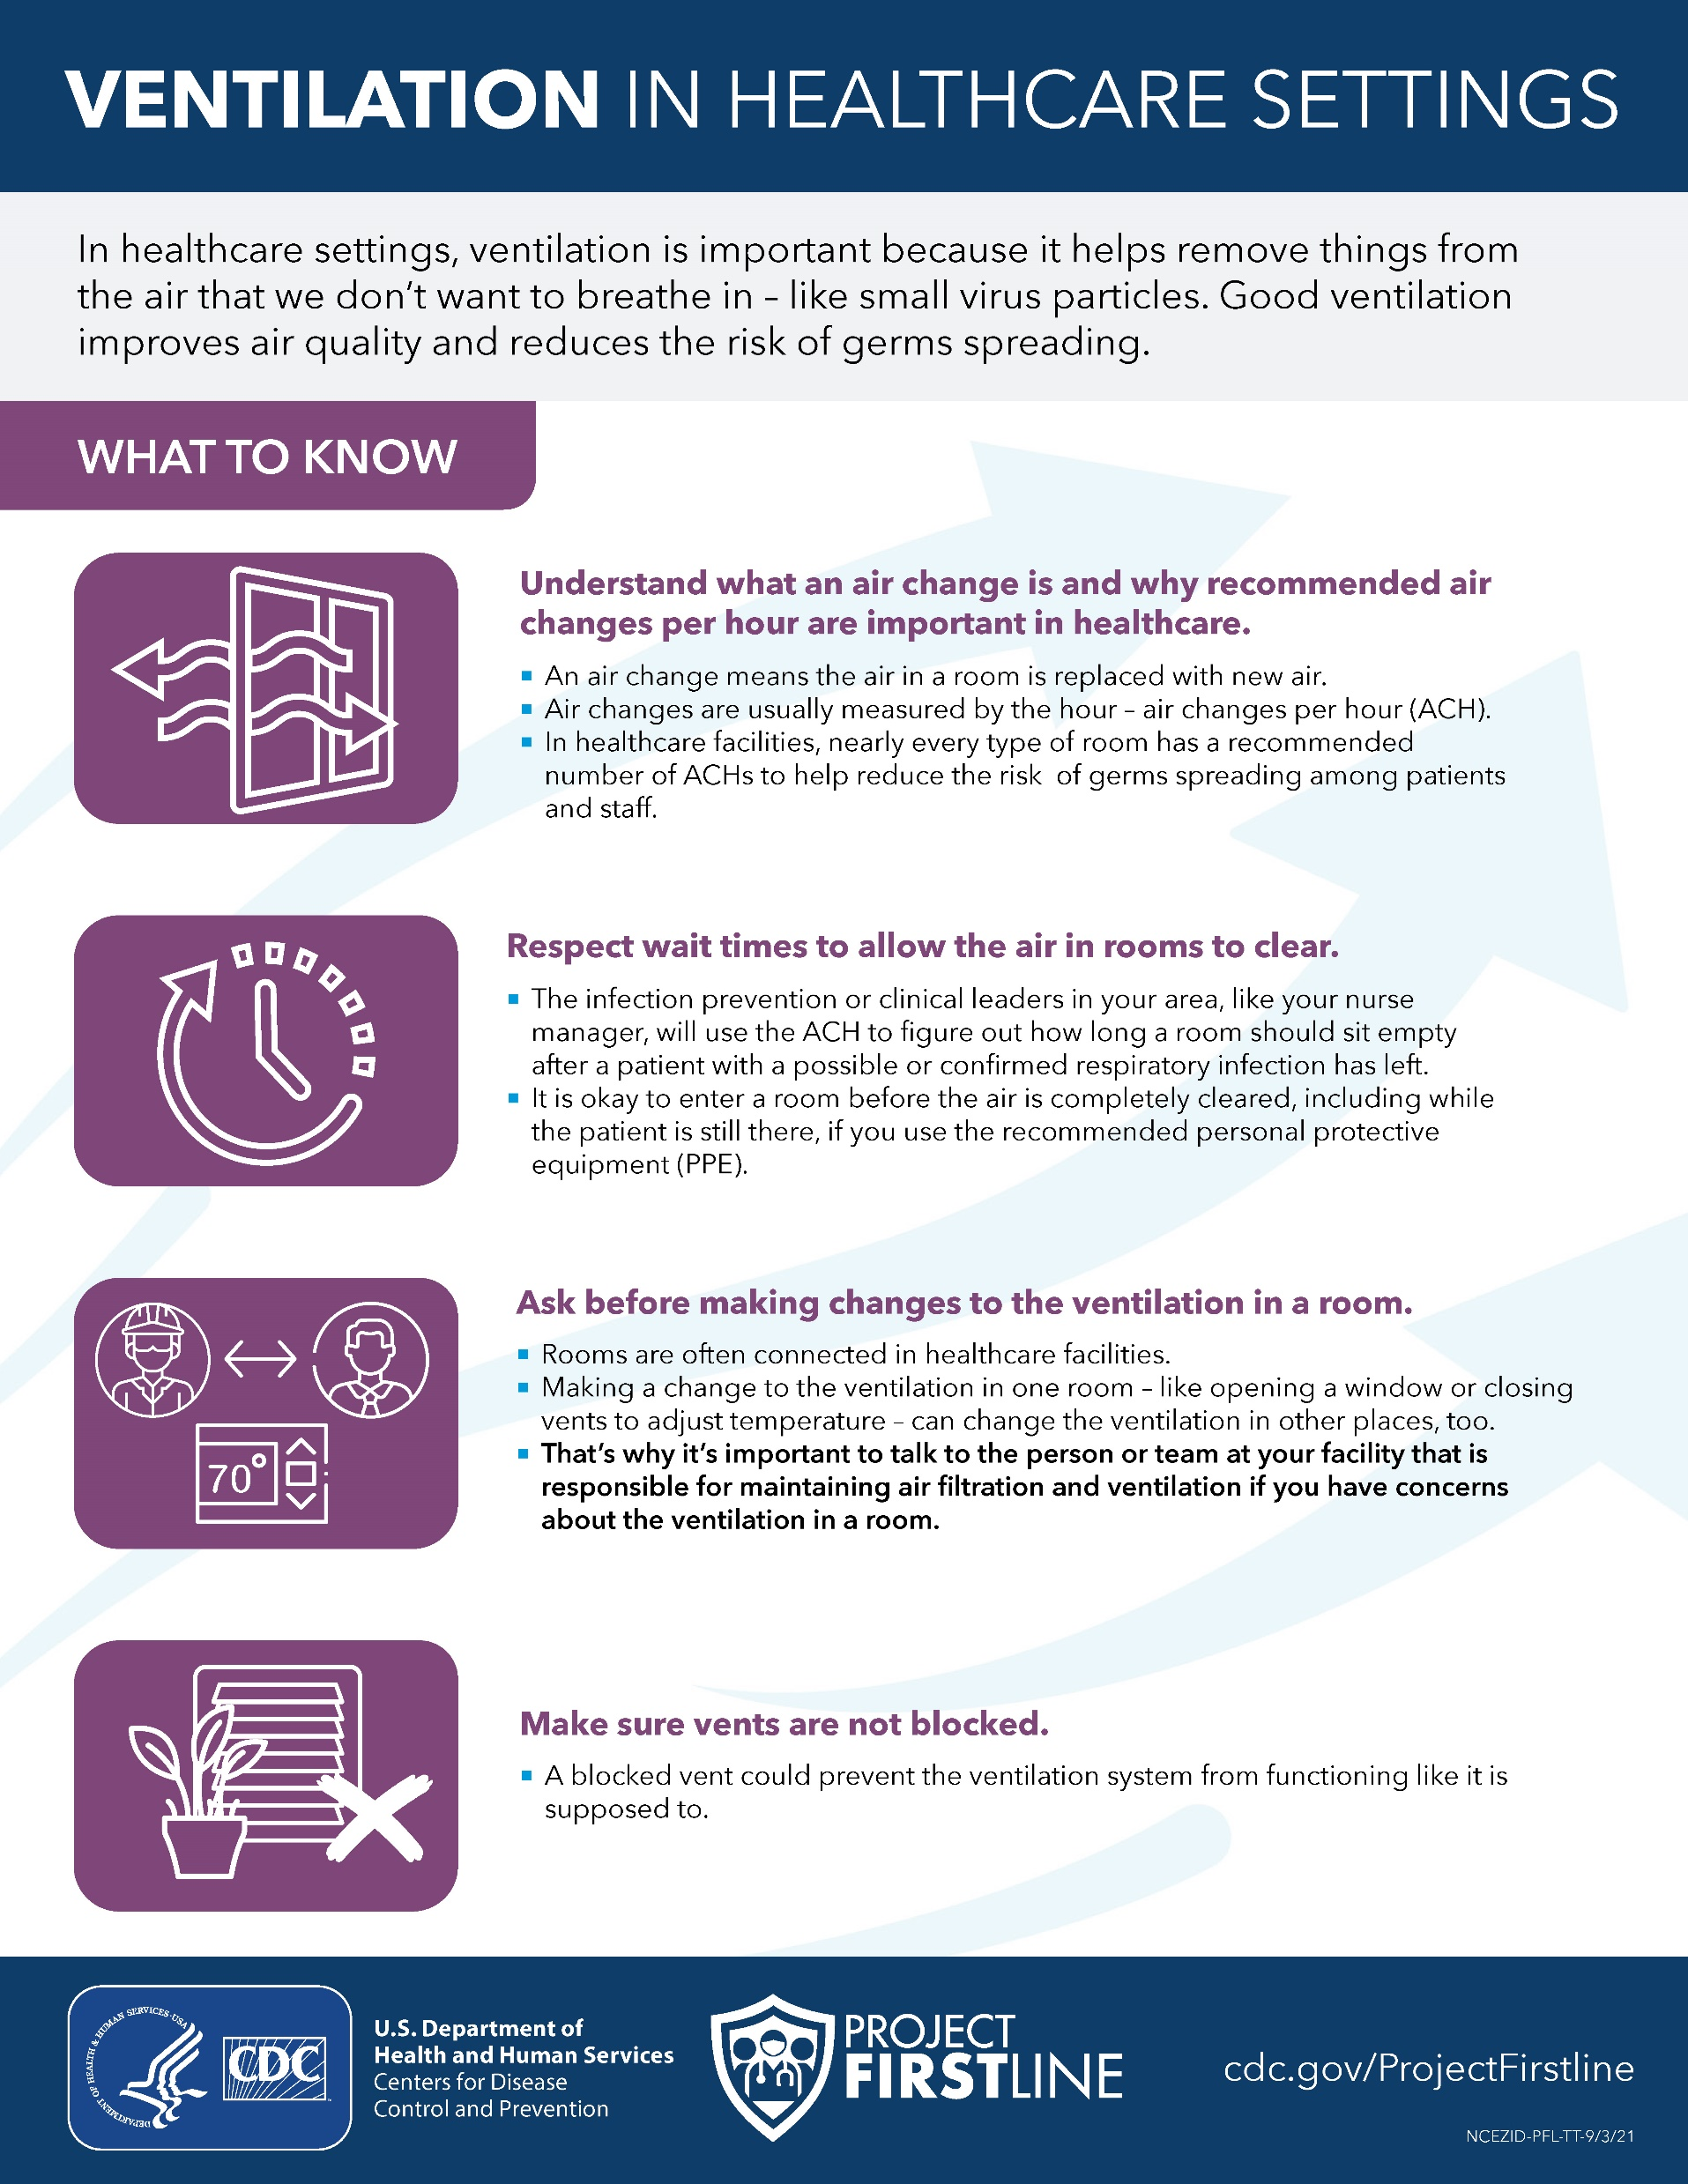
Reflection, Continued
What is one action that you could take to support good ventilation in your workplace?
Type one action in the chat.
Notes:
Facilitator Notes
Encourage participants to think about how they can put their knowledge about ventilation to use in their work.
You may choose for participants to respond orally or in the chat.
Acknowledge responses and consider reading them aloud if they are in the chat.
Distribute the job aid as appropriate for your platform (e.g., a link in the chat, PDF).
Sample Script
“I hope this training gave you some good information about ventilation that you can use in your work.
“Now, please take a minute to think about one action that you could take to support good ventilation in your workplace. Please type the action in the chat.”
(Pause for responses.)
“That’s great – I’m glad to hear that you’ll be putting this knowledge to use! I’m also putting a link into the chat for a handout that you can take and share to remind you of the key points we discussed today.”

Slide 22
Questions?
Questions?
Notes:
Facilitator Notes
Invite additional, remaining questions.
If the answers are information that is already included in this session, please respond.
If the questions address content that is not covered in this session, please do not attempt to answer. Instead, take note of the questions and consult with CDC resources to follow up with answers after the session.
Sample Script
“Thank you all for your time today! Does anyone have any questions still remaining?”
(Address questions as appropriate.)
“Thank you for sharing those questions. Project Firstline is actively collecting your questions to help inform more training resources as they’re developed. I’ve written them down, and I will get back to you with responses.”

Slide 23
Resources and Future Training sessions
Project Firstline on CDC:
https://www.cdc.gov/infection control/projectfirstline/index.html
Project Firstline on Facebook:
https://www.facebook.com/CDCProjectFirstline/
Twitter:
https://twitter.com/CDC_Firstline
YouTube:
https://www.youtube.com/playlist?list=PLvrp9iOILTQZQGtDnSDGViKDdRtIc13VX
To sign up for Project Firstline e-mails, click here: https://tools.cdc.gov/campaignproxyservice/subscriptions.aspx?topic_id=USCDC_2104
Notes:
Facilitator Notes
Share additional resources from Project Firstline and CDC.
Explain how participants can reach you, by the means of your choosing, and how they can reach Project Firstline.
If this session is part of a series, you may choose to describe the themes of upcoming sessions.
Sample Script
“We covered a lot today, and there is still more to learn. You can keep exploring these topics on your own using the resources on this slide. You can also follow us on social media. I will stay on the line for a few minutes after our session ends and will be happy to discuss any other questions!”
(If this session is part of a series) “Next time, we will cover [insert next training topic].”

Slide 24
Feedback Form
Notes:
Facilitator Notes
Explain how to access the feedback form.
Sample Script
“And, finally, please let us know how you enjoyed today’s session by completing the feedback form. Thanks again for joining us today.”

