Slide 1
Topic 15:
Ventilation
[Date of Training]
Notes:
Facilitator Notes
Participants log in and get settled.

Slide 2
Agenda
Welcome
How Does Ventilation Work?
Why Does Ventilation Matter?
Reflection
Notes:
Facilitator Notes
Welcome the group and add a greeting to the chat box.
If this session is part of an ongoing series, you may choose to say “welcome back,” “thank you for joining us again,” etc.
Announce housekeeping notes, either orally or via chat.
If needed, provide additional notes specific to the platform you’re using (e.g., how to “raise your hand,” how to post questions).
Provide an overview of the agenda.
Adapt this section of the session as needed: for instance, you may choose to spend additional time on introductions if there are new faces, or if participants do not know each other.
Sample Script
“Welcome to Project Firstline. Over the next 20 minutes, we’ll focus on ventilation in healthcare. Please keep your videos on, to the extent possible, and keep your microphone muted when you are not contributing to the discussion. It’s great to see you all here today!
“Our discussion will include what ventilation is, how it works, why it matters for infection control, and how we use it.”

Slide 3
Learning Objectives
Discuss why good ventilation is important for infection control in healthcare.
Discuss one (1) way that ventilation works to reduce the amount of germs in the air.
Describe one (1) reason why it is important not to take steps to improve ventilation yourself, without working with the staff in your facility in charge of air handling and ventilation.
Notes:
Facilitator Notes
Provide an overview of the session’s learning objectives.
Sample Script
“Here is what we expect to learn today. By the end of today’s training, you will be able to describe why good ventilation is important for infection control in healthcare, how ventilation works to reduce germs in the air, and why it’s important to work with the people in your facility who are in charge of air handling and ventilation if you think changes should be made to the ventilation in a room.”

Slide 4
How does ventilation play a role in our lives?
Notes:
Facilitator Notes
Invite participants to describe, either orally or in the chat, how ventilation is part of their daily lives. This may include indicating whether their jobs explicitly involve ventilation.
Affirm examples, which could include:
Opening windows in the house if you burn something in the kitchen and the smoke detector goes off
Rolling down the windows in the car
Hood vents over stoves, dryer vents
You may wish to note that the term can be used figuratively, as in “vent your feelings”
Ask participants to define, either orally or in the chat, “ventilation.”
Sample Script
“But first, let’s think about ventilation outside of healthcare. How does ventilation play a role in our lives? What are some specific examples?”
(Pause for responses.)
“Those are great examples! Now let’s review a definition of ventilation.”

Slide 5
Definition
Ventilation | The movement of air in and out of an enclosed space. For example, the circulation of fresh air to a room or building.
Notes:
Facilitator Notes
Either allow time for participants to read the definition themselves or read it aloud.
“The movement of air in and out of an enclosed space. For example, the circulation of fresh air to a room or building.”
Sample Script
“Please review this definition of ventilation.”

Slide 6
HOW DOES ventilation work?
Notes:
Facilitator Notes
Transition to video or demonstration of how ventilation works.
Sample Script
“Now that we all know what ventilation is, let’s learn about how ventilation works.”

Slide 7
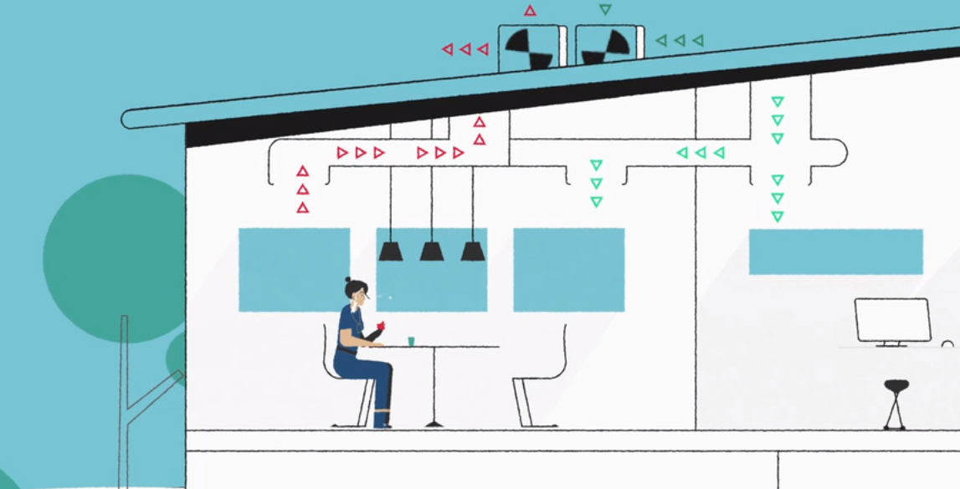
How does ventilation work?
Notes:
Facilitator Notes
Establish the importance of ventilation in healthcare: Good ventilation in healthcare is important to help reduce the spread of respiratory infections.
Show this animated ventilation demonstration video: https://www.youtube.com/watch?v=WQcRZHyxlwE
For additional information (and if time allows), you may choose to show Episode 17: Inside Infection Control: What Is Ventilation? here:
CDC Website: https://www.cdc.gov/infectioncontrol/projectfirstline/videos/EP17-Vent-LowRes.mp4
OR
Project Firstline YouTube Playlist: https://www.youtube.com/watch?v=Tos-eccft_A
Review the Content Outline of Episode 17 for additional talking points.
Sample Script
“In healthcare settings, good ventilation is really important. It helps remove air that contains things we don’t want to breathe in, like small particles that can contain virus. Good ventilation improves the air quality and reduces the risk of germs spreading.”
(Play animation.)
“As we can see in the video, when there is no ventilation in a room, the respiratory droplets that a person breathes out will spread into the space because they don’t have anywhere else to go. Respiratory droplets will linger in the air for a little while. Over time, the particles will settle and the virus in them will die, if it doesn’t get picked up by another person.
“But, with ventilation, the respiratory droplets are pulled out of the space along with the rest of the air in the room. The ventilation system also pushes new, clean air into the room. Eventually, the room will have entirely clear air. When that happens, the room is considered cleared.”

Slide 8
Why Does Ventilation Matter?
Notes:
Facilitator Notes
Link prior discussion to the upcoming video and to concepts regarding how to improve ventilation.
Sample Script
“Now let’s spend some time thinking more about why ventilation matters at work and what we can do about it.”

Slide 9
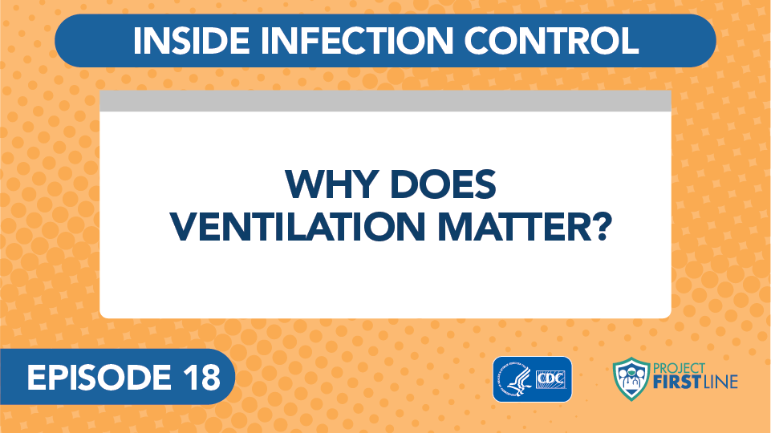
Inside infection control: why does ventilation matter?
Notes:
Facilitator Notes
Access the video here:
CDC Website: https://www.cdc.gov/infectioncontrol/projectfirstline/videos/EP18-Ventilation-LowRes.mp4
OR
Project Firstline YouTube Playlist: https://www.youtube.com/watch?v=FY7FiJDoqhE
Alternatively, if less time is available, you may choose to show a 1-minute ventilation demonstration video here: https://www.youtube.com/watch?v=KTjtYVw0Sj4
Sample Script
“First let’s hear from Dr. Abby Carlson about why ventilation matters.”

Slide 10
Ventilation in Healthcare
What do you need to know about ventilation?
Notes:
Facilitator Notes
Invite participants to share ideas about what is important to know about ventilation in healthcare and how to put that knowledge into action.
You may wish to call on participants who have not yet shared during the session.
Important points to reinforce include:
An air change means the air in a room is replaced with new or filtered air.
Air changes are usually measured by the hour, as in air changes per hour (ACH).
In healthcare facilities, nearly every type of room has a recommended number of air changes. For example, 12 ACHs are recommended for emergency department waiting rooms.
Rooms used to care for patients with respiratory diseases like COVID-19 should be assessed and maintained by maintenance and facilities engineering to ensure correct ACHs.
The ACH will tell you how long the room should sit empty after that person leaves and before another person can come in without the recommended PPE, such as a fit-tested respirator.
It is okay to enter a room with the recommended PPE before the air is completely cleared, including while the patient is still there.
Acknowledge the responses and invite additional discussion.
You may choose to capture high-level summaries of their responses on a slide or in the chat.
Sample Script
“Good ventilation is important in healthcare because it can help remove things that we don’t want to breathe in, like small virus particles. That’s why it’s important that healthcare settings have good air movement. It can help reduce the spread of respiratory infections.
“Let’s talk a bit more about what’s important to know about ventilation, and what we can do about it. What do you need to know about ventilation?”
(Pause for responses.)
“That’s right – it’s important to know what an air change is. Using COVID-19 as an example, it’s important to know how long a room should sit empty after a patient with COVID-19 leaves it before you can enter the room without the recommended PPE, and that depends on how many air changes the room gets each hour. Of course, it’s okay to enter a room before the air is completely cleared, including while the patient is still there, if you use the recommended PPE, including a fit-tested respirator.”

Slide 11
STEPS TO SUPPORT GOOD VENTILATION
Know how long it takes for the air in certain rooms, such as patient rooms, to clear.
If you’re entering a room without recommended PPE, make sure the air in the room is cleared first.
Don’t take actions on your own to change how air is handled.
Have questions? Ask the person with responsibility for air filtration and ventilation at your facility.
Notes:
Facilitator Notes
Encourage participants to think about how they can use their knowledge about ventilation at work.
Know how long it takes for the air in certain rooms, such as patient rooms, to clear.
If you’re entering a room without recommended PPE, make sure the air in the room is cleared first.
It is important not to take steps to improve ventilation on your own, because actions like opening windows, or blocking or redirecting vents, can change the balance of air pressure and the ventilation in other spaces in the facility.
Always check with the people in your facility who are in charge of air handling and ventilation before making changes to the ventilation in a room.
Their titles may vary, but they could include people who work in building engineering, maintenance, HVAC, or Facilities Managers.
Sample Script
“Let’s talk about how to put what we know about ventilation into action. What are some things we can do, and some things we shouldn’t do?”
(Pause for responses.)
“That’s right, it’s important to know the ACH for certain rooms, and to wait until a room has cleared before you enter without the recommended PPE.”
“You can always work with the staff at your facility who are in charge of air handling if you have questions about the ventilation in a room or think changes should be made. It’s important, though, not to open a window or do anything else to change the ventilation in a room without asking. It seems simple enough, but opening a window, or blocking a vent because you’re cold, can change the air pressure and ventilation in other places in the building.”

Slide 12
Reflection
Notes:
Facilitator Notes
Invite participants to share what they learned during the session.
Sample Script
“Let’s use our last few minutes together to reflect on what we’ve learned and think about how we can put what we’ve learned into practice.”

Slide 13
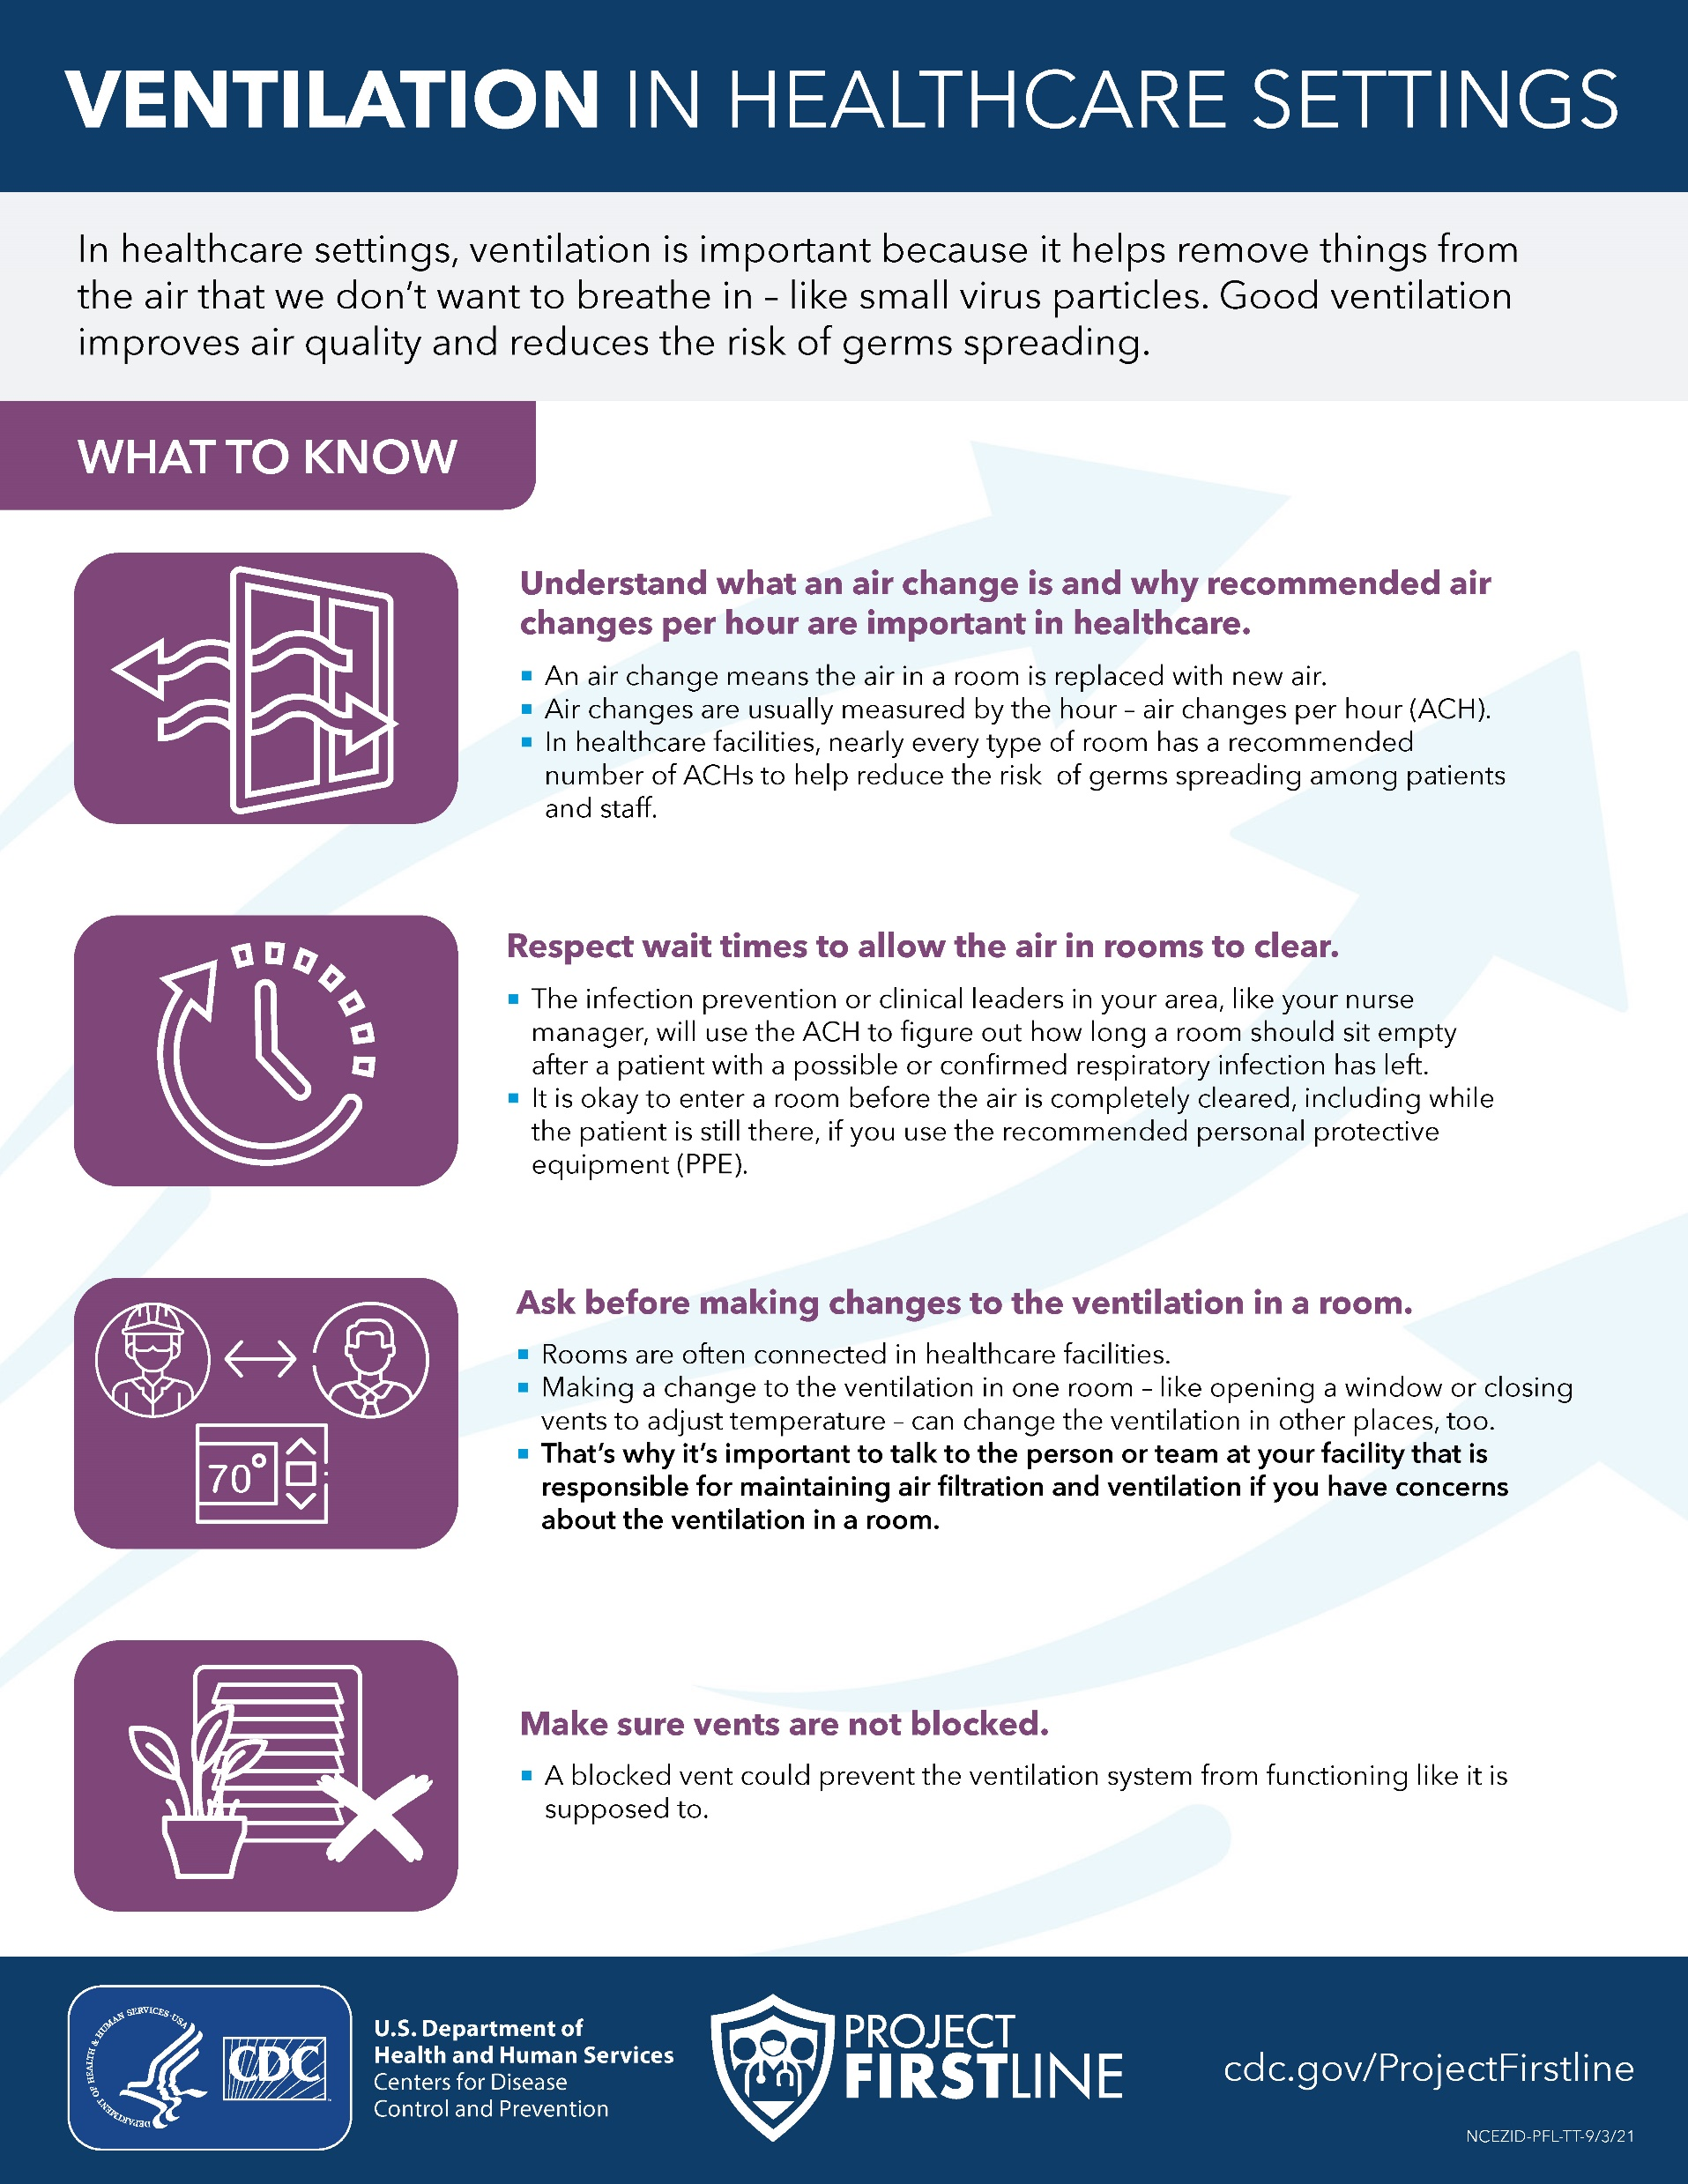
Questions?
Do you have remaining questions about ventilation?
Notes:
Facilitator Notes
Encourage participants to think about how they can put their knowledge about ventilation to use in their work.
You may choose for participants to respond orally or in the chat.
Acknowledge responses and consider reading them aloud if they are in the chat.
Distribute the job aid as appropriate for your platform (e.g., a link in the chat, PDF).
Invite additional, remaining questions.
If the answers are information that is already included in this session, please respond.
If the questions address content that is not covered in this session, please do not attempt to answer. Instead, take note of the questions and consult with CDC resources to follow up with answers after the session.
Sample Script
“I hope this training gave you some good information about ventilation that you can use in your work.
“I’m putting a link into the chat for a handout that you can take and share to remind you of the key points we discussed today.
“Does anyone have any questions still remaining?”
(Address questions as appropriate.)
“Thank you for sharing those questions. Project Firstline is actively collecting your questions to help inform more training resources as they’re developed. I’ve written them down, and I will get back to you with responses.”

Slide 14
Resources and Future Training sessions
Project Firstline on CDC:
https://www.cdc.gov/infection control/projectfirstline/index.html
Project Firstline on Facebook:
https://www.facebook.com/CDCProjectFirstline/
Twitter:
https://twitter.com/CDC_Firstline
YouTube:
https://www.youtube.com/playlist?list=PLvrp9iOILTQZQGtDnSDGViKDdRtIc13VX
To sign up for Project Firstline e-mails, click here: https://tools.cdc.gov/campaignproxyservice/subscriptions.aspx?topic_id=USCDC_2104
Notes:
Facilitator Notes
Share additional resources from Project Firstline and CDC.
Explain how participants can reach you, by the means of your choosing, and how they can reach Project Firstline.
If this session is part of a series, you may choose to describe the themes of upcoming sessions.
Sample Script
“We covered a lot today, and there is still more to learn. You can keep exploring these topics on your own using the resources on this slide. You can also follow us on social media. I will stay on the line for a few minutes after our session ends and will be happy to discuss any other questions!”
(If this session is part of a series) “Next time, we will cover [insert next training topic].”

Slide 15
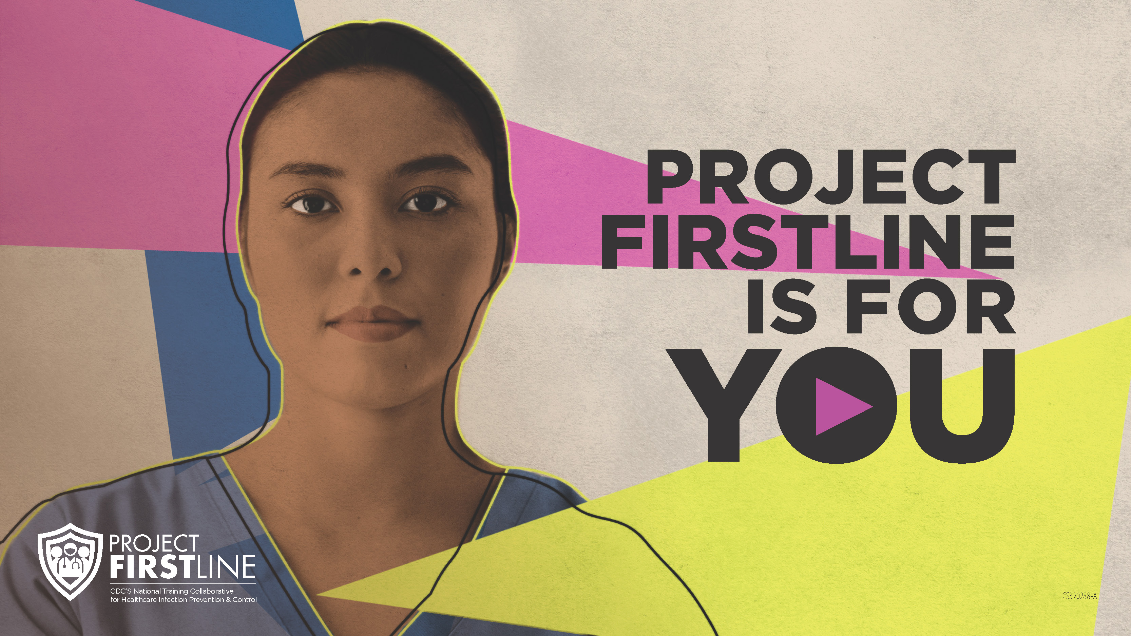
Feedback Form
Notes:
Facilitator Notes
Explain how to access the feedback form.
Sample Script
“And, finally, please let us know how you enjoyed today’s session by completing the feedback form. Thanks again for joining us today.”
After the Session
Send list of participant questions compiled during this session to ProjectFirstline@cdc.gov.

