Slide 1

TOPIC 14: asymptomatic spread of COVID-19
Date of Training
Notes:
Facilitator Notes
Participants log in and get settled.

Slide 2
Agenda
Introductions
Review: How Do Viruses Work?
How Can Viruses Spread From Someone Who Doesn’t
Feel Sick?
Reflection
Notes:
Facilitator Notes
Welcome
Housekeeping, either orally or via chat
If needed, additional notes specific to the platform you’re using (e.g., how to “raise your hand,” how to post questions)
Overview of agenda
If this session is part of an ongoing series, you may choose to say, “welcome back,” “thank you for joining us again,” etc.
Sample Script
“Welcome to Project Firstline. Thank you for joining us! Before we begin, a few housekeeping notes. We’ll meet today for one hour. Please keep your videos on, to the extent possible, and keep your microphone muted when you are not contributing to the discussion. It’s great to see you all here today!
“Today, we’re going to review how viruses work, and how they can be spread, even when an infected person doesn’t feel sick. We’ll have an opportunity to discuss and reflect together before we wrap up for the day.”

Slide 3
Learning Objectives
Explain how a person can be infected with SARS-CoV-2 and not feel sick but can still spread the virus to others.
Discuss one (1) reason why infection control recommendations for COVID-19, such as masking for source control, are in place in healthcare settings.
Notes:
Facilitator Notes
Provide an overview of the session’s learning objectives.
Sample Script
“After today, you’ll be able to explain how a person can be infected with SARS-CoV-2 and not feel sick but can still spread the virus to others and discuss why infection control recommendations like masking for source control are in place in healthcare settings.”

Slide 4
INTRODUCTIONS
Your Name
Your Role
Notes:
Facilitator Notes
These questions will give you a better understanding of your participants’ backgrounds, experience, and level of knowledge.
Tailor your slide delivery for the virtual format and platform, and the number of participants:
You may wish to add role- or facility-specific questions to the introductions.
If you have a large group, you may decide to skip introductions and use the chat or poll feature for introductions.
Be sure to introduce yourself and anyone who is assisting you.
Sample Script
“Please share in 30 seconds or less your name and your role.”

Slide 5
POLL
Answer the question considering your experiences in your work life. Select all that apply:
I work in a facility that has treated
People with COVID-19 who were very sick (e.g., fever, fatigue, difficulty breathing),
People with COVID-19 who had mild symptoms (e.g., cold symptoms), or
People with COVID-19 who had no symptoms.
Notes:
Facilitator Notes
Use the poll feature for your virtual platform to ask participants about their experiences with COVID-19 at the workplace.
I work in a facility that has treated:
People with COVID-19 who were very sick (e.g., fever, fatigue, difficulty breathing),
People with COVID-19 who had mild symptoms (e.g., cold symptoms), or
People with COVID-19 who had no symptoms.
If the platform you are using does not have a poll feature, you may choose to ask participants to enter their responses in the chat.
Sample Script
“Thank you, and welcome again! Now, let’s think about our own experience at work. Please select all that apply.“
(Pause for participants to respond to poll options, then display poll results.)
“So, it looks like many of us have worked in a facility that has treated people with COVID-19, with different symptoms or no symptoms at all. We’re going to talk more about this today. Thank you for sharing!”

Slide 6
How Do Viruses Work?
Viruses use living things, including people, to make copies of themselves.
When enough virus gets into a person’s cells and starts making copies of itself, the immune system revs up to fight the virus.
SARS-CoV-2, the virus that causes COVID-19, is spread by respiratory droplets that are released into the air when an infected person talks, breaths, coughs, or sings.
Notes:
Facilitator Notes
This slide provides a review of information delivered in Inside Infection Control Episode 3: “What’s a Virus?”
If time allows, you can show that episode (https://www.youtube.com/watch?v=iKfG15U8nVo) or share the link with participants to view on their own after the session for more information.
You may also choose to refer to the Content Outline for Episode 3 to help guide discussion.
Sample Script
“Let’s briefly review some basic information about viruses.”
“Viruses are able to use cells in living things, including people, to make copies of themselves. When enough virus gets into a person’s cells and starts making copies of itself, the body can recognize that there’s an infection, and the immune system revs up to fight off the virus.”
“If a person is infected with SARS-CoV-2, the virus that causes COVID-19, it can be spread by their respiratory droplets. Those droplets, with virus in them, are released into the air when the infected person talks, breathes, coughs, or otherwise blows air out of their nose or mouth. The respiratory droplets can then land on someone else’s eyes, nose, or mouth, or someone can breathe them into their throat or lungs, where the virus in the droplets can start attacking the person’s cells.”

Slide 7
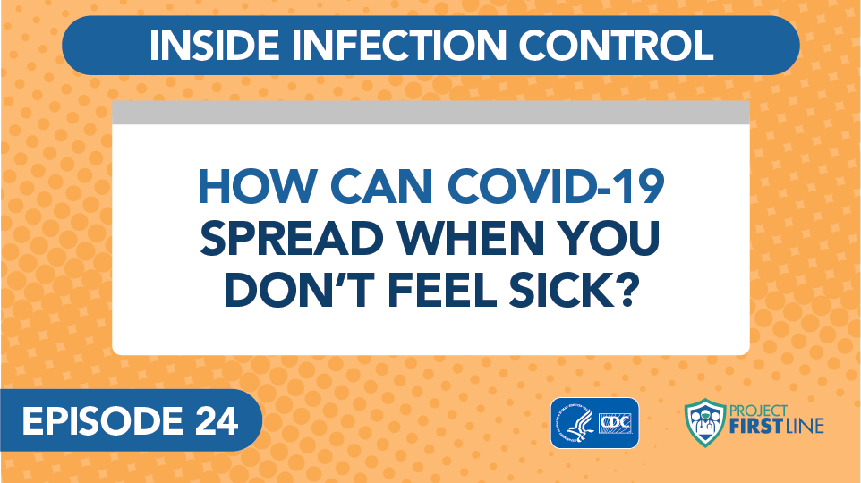
Inside Infection Control, Episode 24: How Can COVID-19 Spread When You Don’t Feel Sick?
Notes:
Facilitator Notes
Access the video here:
CDC Website: https://www.cdc.gov/infectioncontrol/projectfirstline/videos/EP24-NoSymptoms-LowRes.mp4
OR
Project Firstline YouTube Playlist: https://www.youtube.com/watch?v=GPahzFodDU8&feature=youtu.be
Encourage participants to make note of the two ways that people who are infected with virus, but who don’t feel sick, can spread virus.
Sample Script
“Let’s hear from the CDC’s Dr. Abby Carlson and find out more about how viruses like SARS-CoV-2 can spread, even from someone who is infected but who doesn’t feel sick. Dr. Carlson mentions two ways this can happen. Jot down what you hear in your participant booklet, and we’ll discuss the two ways after the video.”

Slide 8
People who don’t feel sick can spread virus
People can be infected with a virus and their immune system can be working – and they might not feel sick.
Even if they don’t feel sick, they can spread the virus to others.
Notes:
Facilitator Notes
Link the information about viruses to the video content.
You may also choose to refer to the Content Outline for Episode 24 of Inside Infection Control to help guide discussion.
Participants may have questions about whether people who are fully vaccinated against COVID-19 can still transmit virus. You may choose to direct them to CDC resources:
When You’ve Been Fully Vaccinated: https://www.cdc.gov/coronavirus/2019-ncov/vaccines/fully-vaccinated.html
Science Brief: COVID-19 Vaccines and Vaccination: https://www.cdc.gov/coronavirus/2019-ncov/science/science-briefs/fully-vaccinated-people.html
Sample Script
“As we heard in the video, people can be infected with a virus and their immune system can be working – and they might not feel sick. Even if they don’t feel sick, they can spread the virus to others. It’s important to know and remember this when you’re thinking about infection control.”

Slide 9
Definitions
Pre-symptomatic Infection
When a person has been infected with a virus and hasn’t started feeling sick yet but will develop symptoms.
Asymptomatic Infection
When a person is infected with a virus and will never feel any symptoms at all.
Notes:
Facilitator Notes
Review the definitions of “pre-symptomatic infection” and “asymptomatic infection.”
Pre-symptomatic infection is when a person has been infected with a virus and hasn’t started feeling sick yet but will develop symptoms.
Asymptomatic infection is when a person is infected with a virus and will never feel any symptoms at all.
Sample Script
“Let’s review the two ways people can be infected and not feel sick that Dr. Carlson mentioned in the video. ‘Pre-symptomatic infection’ means that a person is infected with a virus but hasn’t started feeling sick yet – but they probably will soon. ‘Asymptomatic infection’ means that a person is infected with a virus but does not feel any symptoms at all. As you heard from Dr. Carlson, this can make it harder to control the spread of infectious diseases, because people don’t always know that they have an infection, or that they’re contagious and can spread it to others.”

Slide 10

Recognizing people who are contagious
Can you
tell who has COVID-19?
No, even people who appear healthy and show no symptoms may have COVID-19 and may be able
to spread the
SARS-CoV-2 virus.
Notes:
Facilitator Notes
This slide has animation. When you advance to the slide, only the pictures of people will appear.
Ask participants to look at the people on the slide and see if they can tell who is infected with COVID-19.
Encourage participants to guess, either orally or in the chat, or both.
After participants have had a chance to respond, trigger animation to clarify that even people who seem healthy and exhibit no symptoms might have COVID-19 and be able to spread the SARS-CoV-2 virus.
Sample Script
“Now let’s do a little detective work. Can you guess which of these people has COVID-19 and may be contagious?”
(Pause for responses.)
“We can’t tell, can we? Lots of people are infected with the virus, but don’t show symptoms!”

Slide 11
Did you know?
The flu can also be spread by people who are pre-symptomatic or asymptomatic.
People with flu are most contagious 3-4 days after their illness begins.
Some otherwise healthy adults may be able to infect others beginning 1 day before symptoms develop and up to 5-7 days after becoming sick.
Some people, especially young children and people with weakened immune systems, might be able to infect others with flu viruses for an even longer time.
Notes:
Facilitator Notes
This slide has animation. When you advance to the slide, only the first column will appear.
After participants have had a chance to respond, trigger animation for the content in the second column to appear:
People with flu are most contagious in the first 3-4 days after their illness begins.
Some otherwise healthy adults may be able to infect others beginning 1 day before symptoms develop and up to 5 to 7 days after becoming sick.
Some people, especially young children and people with weakened immune systems, might be able to infect others with flu viruses for an even longer time.
You may wish to refer to CDC resources for additional discussion points:
How Flu Spreads: https://www.cdc.gov/flu/about/disease/spread.htm
Flu Symptoms & Diagnosis: https://www.cdc.gov/flu/symptoms/index.html
Sample Script
“Dr. Carlson mentioned that people can spread diseases other than COVID-19 without showing any symptoms. This also happens with the flu. Does that seem to match with your personal experience?”
(Pause for responses.)
“That’s right. You may be able to pass on flu to someone else before you know you are sick, as well as while you are sick. And not everyone with flu will get a fever or have the symptoms you may be used to looking for.”

Slide 12
Controlling the spread
People who are
pre-symptomatic or asymptomatic don’t have symptoms, but they can still spread COVID-19.
Why It Matters
We can’t tell who may be infected and able to infect others, so all our infection control actions are still important.
Notes:
Facilitator Notes
This slide has animation. When you advance to the slide, only the first column will appear.
Encourage participants, either orally or in the chat, to link their knowledge to action:
We know that people who are infected with SARS-CoV-2, but who do not show symptoms, can still spread virus.
What actions should we take?
When appropriate, advance the slide to reveal the second column.
Sample Script
“So, let’s review. People who are pre-symptomatic or asymptomatic – who aren’t feeling any symptoms, but who are infected with virus – can still spread COVID-19. Why does this matter? How can we use this information in our work?”
(Pause for responses. When appropriate, trigger animation.)
“Right! Because we can’t tell who may be infected and able to infect others, all our infection control actions are still important – including masking for source control.”

Slide 13
Breakout Groups
Instructions
Think about your day.
  How many people did you come into contact with?
  How many of those interactions occurred when you and the other person were masked? When one of you was masked and the other wasn’t? When neither of you was masked?
Notes:
Facilitator Notes
Transition to small-group breakouts and discussion.
Invite participants to think through, on a typical day, how many people they come into contact with – at work, and in the community and at home.
Then, ask participants to think about how many of those interactions happened when both persons were masked, when one was masked and not the other, and when both were not masked.
You may wish to reframe this discussion, depending upon your context and audience.
Sample Script
“Let’s take a few minutes split into groups for some deeper discussion. Before we divide up, I want you to take 3 minutes to think about your day and how many people you come into contact with. This should include your family or other people you live with, people you encounter on your commute, your co-workers, and others you encounter in your workday, such as patients and families.
“Once you have that number, think about how many of those interactions occurred when you and the other person were masked, when one of you was masked and the other wasn’t, and when neither of you was masked. Try to come up with a number for each. Feel free to jot down your thoughts in your Participant Booklet.”
(Pause for 3 minutes.)
“Does everyone have their number? Great!”

Slide 14
Breakout groups, continued
Instructions
Discuss your reactions and thoughts in your group.
Think about the effects of all your interactions.
Identify a spokesperson to report out when the group reconvenes.
Notes:
Facilitator Notes
Use breakout rooms appropriate to your virtual platform to divide participants into small groups, and task them with discussing the numbers of interactions, and types of interactions, that they observed in their own experiences, as well as the implications of their interactions: if you cross paths with 10 people, and each of them has crossed paths with 10 people, what does that mean for potential exposures?
The number and size of the groups will vary, but it is best if there are no more than five people in each small group.
If applicable and possible, try to create groupings of participants who haven’t yet had an opportunity to speak together during the training.
As needed, provide instructions related to the breakout room format, such as how to ask questions.
Inform the groups that they have 10 minutes to work together. Use your chime or timekeeper to warn participants when they have 1 minute remaining.
Ask each group to identify a spokesperson who will share the group’s ideas when everyone reconvenes.
After the small groups have gathered, depending on your virtual platform, you may use the broadcast message feature or another means to send reminders of the scenarios, how much time is remaining, etc. You may also choose to “visit” each group to encourage conversation and to hear their thoughts.
If groups appear to need additional guidance, you could choose to prompt them with questions about whether they were surprised by their own or others’ numbers, how their numbers may vary from day to day, what factors may contribute to their numbers, etc.
Sample Script
“With that, we’re going to move into breakout groups. Once you’re there, I’d like to you to share your answers with your group and discuss your reactions and thoughts. I’d also like you to think about the effects of all your interactions – what does it mean if you’ve interacted with 10 people, and each of them has interacted with 10 people, who have interacted with 10 people?
“We’ll come back together in 10 minutes to report to the whole group. Please choose one person in your small group to be your spokesperson.”
(Allow 10 minutes for the groups to discuss their numbers, giving a warning when there is 1 minute left. Reconvene the groups from their breakout rooms.)

Slide 15
REPORT OUT
Notes:
Facilitator Notes
When the entire group has reconvened, ask a spokesperson from each group to report on their discussion. You may wish to capture high-level points on a separate slide or in the chat.
You may wish to lead discussion by:
Asking each group to share their highest number of interactions
For the highest number of all, ask that group to share why the number was so high (e.g., do they live with a lot of people? Take crowded public transportation to work? Work in a setting where they interact with a lot of people?)
Asking whether they were surprised, or not, by their groups’ numbers
Asking them to reflect on contributing factors that made the number higher or lower, and whether there is variety in their daily routines
Asking them to discuss the effects of their interactions: What does it mean if you’ve interacted with 10 people, and each of them has interacted with 10 people, who have interacted with 10 people? What would it mean if you were in a room with all those people?
Asking them to think about times they, or someone they know, has gotten a cold or the flu but can’t remember being around someone who was sick
After each group’s report has been shared, lead the entire group in discussion:
What points were raised often?
Were any points raised by other groups that surprised you?
How are you thinking about your interactions in the community and at home differently since the pandemic? At work?
Depending upon the context and the makeup of your audience, you may choose to incorporate points from CDC guidance related to source control and physical distancing at work for vaccinated healthcare workers from CDC’s Updated Healthcare Infection Prevention and Control Recommendations in Response to COVID-19 Vaccination page: https://www.cdc.gov/coronavirus/2019-ncov/hcp/infection-control-recommendations.html
Sample Script
“Welcome back! I’m looking forward to hearing what everyone had to say. Group 1, can we hear from your spokesperson?”
(Ask a spokesperson from each group, in turn, to share the group’s observations. Acknowledge the responses as appropriate and encourage additional conversation and reflection.)
“Thank you all so much for your thoughtful comments. Let’s discuss some of the points that were raised. Did any of the points raised surprise you?”
(Acknowledge responses and encourage additional discussion as appropriate.)

Slide 16
Questions?
Notes:
Facilitator Notes
Invite additional, remaining questions.
If the answers are information that is already included in this session, please respond.
If the questions address content that is not covered in this session, please do not attempt to answer the questions. Instead, take note of the questions and consult with CDC resources to follow up with answers after the session.
Sample Script
“Thank you for sharing! Does anyone have any questions still remaining?”
(Address questions as appropriate.)
“Thank you for sharing those questions. Project Firstline is actively collecting your questions to help inform more training resources as they’re developed. I’ve written them down and I will get back to you with responses.”

Slide 17
Reflection
Notes:
Facilitator Notes
Encourage participants to reflect on the content of the session and how they will put their knowledge into practice.
Sample Script
“Thank you all so much for that thoughtful discussion! Let’s use our last few minutes together to reflect on what we’ve learned and think about how we can put what we’ve learned into practice.”

Slide 18
WHAT DID YOU LEARN TODAY?
Notes:
Facilitator Notes
Invite participants to share what they learned during the session, and what they appreciated or found interesting.
Sample Script
“I’d love to hear from you about what you learned today about asymptomatic spread and what you found most interesting. Would anyone like to share?”
(Acknowledge and address responses.)

Slide 19
Key Takeaways
People can be infected with a virus and their immune system can be working – and they might not feel sick.
People who may not feel sick or show symptoms can still spread viruses.
That’s why infection control recommendations for
COVID-19, such as masking for source control, are in
place in healthcare settings.
Notes:
Facilitator Notes
Review key takeaways.
You may choose to revisit discussion points or questions that arose during the session.
Sample Script
“I hope you enjoyed today’s conversation. I’ve captured some key takeaways here, which you can review at your leisure after the session today.”

Slide 20
APPLYING WHAT YOU’VE LEARNED
Identify one thing you’ll need to do, or continue to do, in your work to protect yourself and others from diseases that can spread when people are infected but may not look or feel sick.
Notes:
Facilitator Notes
Encourage participants to identify one thing they will need to do, or continue to do, in their work to protect themselves and others from diseases that can spread when people are infected but may not look or feel sick. They may come off mute and speak, or type in the chat, or both.
Acknowledge responses, as appropriate.
As appropriate, make connections between participants’ responses and the material from the session.
Sample Script
“As we just heard, you’ve learned a lot today. I’d like you to identify one thing you’ll need to do, or continue to do, in your work to protect yourself and others from diseases that can spread when people are infected but may not look or feel sick. Please feel free to come off mute or share in the chat.”
(Pause for responses and acknowledge them.)

Slide 21
Resources and Future Training sessions
Project Firstline on CDC:
www.cdc.gov/ProjectFirstline
CDC’s Project Firstline on Facebook:
https://www.facebook.com/CDCProjectFirstline
CDC’s Project Firstline on Twitter:
https://twitter.com/CDC_Firstline
Project Firstline Inside Infection Control on YouTube:
https://www.youtube.com/playlist?list=PLvrp9iOILTQZQGtDnSDGViKDdRtIc13VX
To sign up for Project Firstline e-mails, click here: https://tools.cdc.gov/campaignproxyservice/subscriptions.aspx?topic_id=USCDC_2104
Notes:
Facilitator Notes
Share additional resources from Project Firstline and CDC.
Explain how participants can reach you, by the means of your choosing, and how they can reach Project Firstline.
If this session is part of a series, you may choose to describe the themes of upcoming sessions.
Sample Script
“That’s great, thank you. We covered a lot today, and there is still more to learn. You can keep exploring these topics on your own using the resources on this slide. You can also follow us on social media.
(If this session is part of a series) “Next time, we will cover [insert next training topic].”

Slide 22
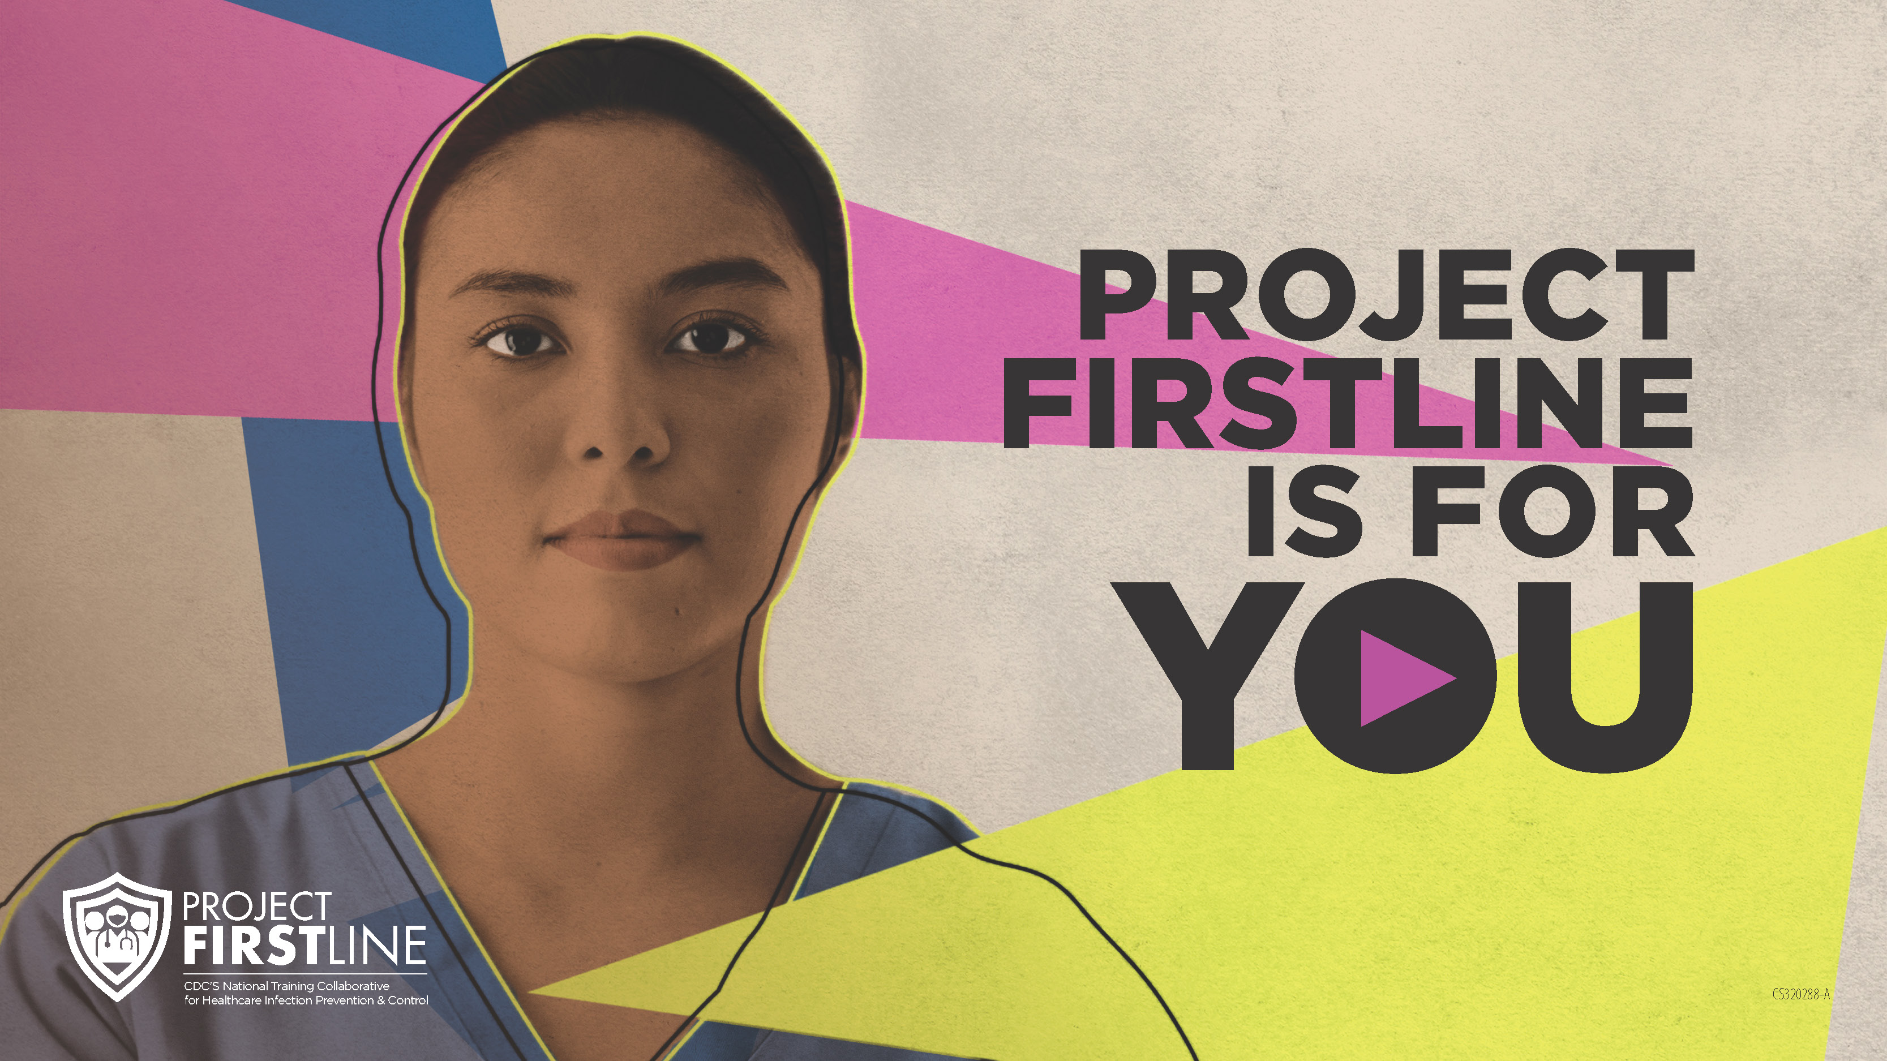
Feedback Form
Notes:
Facilitator Notes
Explain how to access the feedback form.
Sample Script
“And, finally, please let us know how you enjoyed today’s session by completing the following feedback form. Thanks again for joining us today.”
After the Session
Send list of participant questions compiled during this session to ProjectFirstline@cdc.gov.

