Slide 1

TOPIC 14: asymptomatic spread of COVID-19
Date of Training
Notes:
Facilitator Notes
Participants log in and get settled.

Slide 2
Agenda
Welcome
Review: How Do Viruses Work?
How Can Viruses Spread From Someone Who Doesn’t
Feel Sick?
Reflection
Notes:
Facilitator Notes
Welcome
Housekeeping, either orally or via chat
If needed, additional notes specific to the platform you’re using (e.g., how to “raise your hand,” how to post questions)
Overview of agenda
If this session is part of an ongoing series, you may choose to say, “welcome back,” “thank you for joining us again,” etc.
Sample Script
“Welcome to Project Firstline. Thank you for joining us! Before we begin, a few housekeeping notes. We’ll meet today for 20 minutes. Please keep your videos on, to the extent possible, and keep your microphone muted when you are not contributing to the discussion. It’s great to see you all here today!
“Today, we’re going to review how viruses work, and how they can be spread, even when an infected person doesn’t feel sick. We’ll have an opportunity to discuss and reflect together before we wrap up for the day.”

Slide 3
Learning Objectives
Explain how a person can be infected with SARS-CoV-2 and not feel sick but can still spread the virus to others.
Discuss one (1) reason why infection control recommendations for COVID-19, such as masking for source control, are in place in healthcare settings.
Notes:
Facilitator Notes
Provide an overview of the session’s learning objectives.
Sample Script
“After today, you’ll be able to explain how a person can be infected with SARS-CoV-2 and not feel sick but can still spread the virus to others and discuss why infection control recommendations like masking for source control are in place in healthcare settings.”

Slide 4
POLL
Answer the question considering your experiences in your work life. Select all that apply:
I work in a facility that has treated
People with COVID-19 who were very sick (e.g., fever, fatigue, difficulty breathing),
People with COVID-19 who had mild symptoms (e.g., cold symptoms), or
People with COVID-19 who had no symptoms.
Notes:
Facilitator Notes
Use the poll feature for your virtual platform to ask participants about their experiences with COVID-19 at the workplace.
I work in a facility that has treated
People with COVID-19 who were very sick (e.g., fever, fatigue, difficulty breathing),
People with COVID-19 who had mild symptoms (e.g., cold symptoms), or
People with COVID-19 who had no symptoms.
If the platform you are using does not have a poll feature, you may choose to ask participants to enter their responses in the chat.
Sample Script
“Now, let’s think about our own experience at work. Please select all that apply.”
(Pause for participants to respond to poll options, then display poll results.)
“So, it looks like many of us have worked in a facility that has treated people with COVID-19 with different symptoms or no symptoms at all. We’re going to talk more about this today. Thank you for sharing!”

Slide 5
How Do Viruses Work?
Viruses use living things, including people, to make copies of themselves.
When enough virus gets into a person’s cells and starts making copies of itself, the immune system revs up to fight the virus.
SARS-CoV-2, the virus that causes COVID-19, is spread by respiratory droplets that are released into the air when an infected person talks, breaths, coughs, or sings.
Notes:
Facilitator Notes
This slide provides a review of information delivered in Inside Infection Control Episode 3: “What’s a Virus?”
If time allows, you can show that episode (https://www.youtube.com/watch?v=iKfG15U8nVo) or share the link with participants to view on their own after the session for more information.
You may also choose to refer to the Content Outline for Episode 3 to help guide discussion.
Sample Script
“Let’s briefly review some basic information about viruses.
“Viruses are able to use cells in living things, including people, to make copies of themselves. When enough virus gets into a person’s cells and starts making copies of itself, the body can recognize that there’s an infection, and the immune system revs up to fight off the virus. It’s the activity of the immune system fighting the virus that generally makes us feel sick.
“If a person is infected with SARS-CoV-2, the virus that causes COVID-19, it can be spread by their respiratory droplets. Those droplets, with virus in them, are released into the air when the infected person talks, breathes, coughs, or otherwise blows air out of their nose or mouth. The respiratory droplets can then land on someone else’s eyes, nose, or mouth, or someone can breathe them into their throat or lungs, where the virus in the droplets can start attacking the person’s cells.”

Slide 6
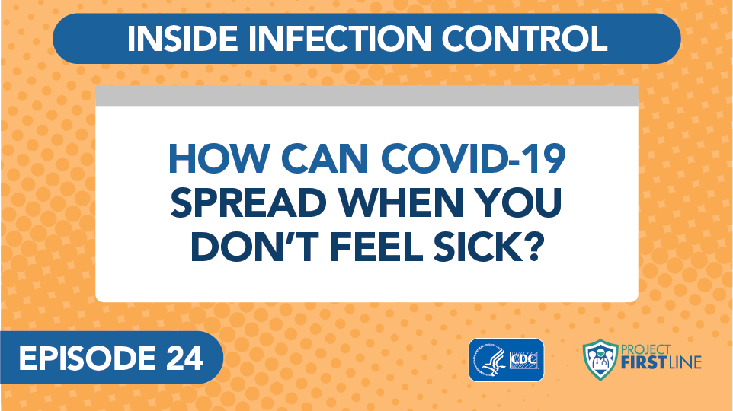
Inside Infection Control, Episode 24: How Can COVID-19 Spread When You Don’t Feel Sick?
Notes:
Facilitator Notes
Access the video here:
CDC Website: https://www.cdc.gov/infectioncontrol/projectfirstline/videos/EP24-NoSymptoms-LowRes.mp4
OR
Project Firstline YouTube Playlist: https://www.youtube.com/watch?v=GPahzFodDU8&feature=youtu.be
Encourage participants to make note of the two ways that people who are infected with virus, but who don’t feel sick, can spread virus.
Sample Script
“Let’s hear from the CDC’s Dr. Abby Carlson and find out more about how viruses like SARS-CoV-2 can spread, even from someone who is infected but who doesn’t feel sick. Dr. Carlson mentions two ways this can happen. Jot down in your participant booklet what you hear, and we’ll discuss the two ways after the video.”

Slide 7
People who don’t feel sick can spread virus
People can be infected with a virus, and their immune system can be working – and they might not feel sick.
Even if they don’t feel sick, they can spread the virus to others.
Notes:
Facilitator Notes
Link the information about viruses to the video content.
You may also choose to refer to the Content Outline for Episode 24 of Inside Infection Control to help guide discussion.
Participants may have questions about whether people who are fully vaccinated against COVID-19 can still transmit virus. You may choose to direct them to CDC resources:
When You’ve Been Fully Vaccinated: https://www.cdc.gov/coronavirus/2019-ncov/vaccines/fully-vaccinated.html
Science Brief: COVID-19 Vaccines and Vaccination: https://www.cdc.gov/coronavirus/2019-ncov/science/science-briefs/fully-vaccinated-people.html
Sample Script
“As we heard in the video, people can be infected with a virus, and their immune system can be working – and they might not feel sick. Even if they don’t feel sick, they can spread the virus to others. It’s important to know and remember this when you’re thinking about infection control.”

Slide 8
Definitions
Pre-symptomatic Infection
When a person has been infected with a virus and hasn’t started feeling sick yet but will develop symptoms.
Asymptomatic Infection
When a person is infected with a virus and will never feel any symptoms at all.
Notes:
Facilitator Notes
Review the definitions of “pre-symptomatic infection” and “asymptomatic infection.”
Pre-symptomatic infection is when a person has been infected with a virus and hasn’t started feeling sick yet but will develop symptoms.
Asymptomatic infection is when a person is infected with a virus and will never feel any symptoms at all.
Sample Script
“Let’s review the two ways people can be infected and not feel sick that Dr. Carlson mentioned in the video. ‘Pre-symptomatic infection’ means that a person is infected with a virus but hasn’t started feeling sick yet – but they probably will soon. ‘Asymptomatic infection’ means that a person is infected with a virus but does not feel any symptoms at all. As you heard from Dr. Carlson, this can make it harder to control the spread of infectious diseases, because people don’t always know that they have an infection, or that they’re contagious and can spread it to others.”

Slide 9

Recognizing people who are contagious
Can you
tell who has COVID-19?
No, even people who appear healthy and show no symptoms may have COVID-19 and may be able to spread the
SARS-CoV-2 virus.
Notes:
Facilitator Notes
This slide has animation. When you advance to the slide, only the pictures of people will appear.
Ask participants to look at the people on the slide and see if they can tell who is infected with COVID-19.
Encourage participants to guess, either orally or in the chat, or both.
After participants have had a chance to respond, trigger animation to clarify that even people who seem healthy and exhibit no symptoms might have COVID-19 and be able to spread the SARS-CoV-2 virus.
Sample Script
“Now let’s do a little detective work. Can you guess which of these people has COVID-19 and may be contagious?”
(Pause for responses.)
“We can’t tell, can we? Lots of people are infected with the virus, but don’t show symptoms!”

Slide 10
Did you know?
The flu can also be spread by people who are pre-symptomatic or asymptomatic.
People with flu are most contagious 3-4 days after their illness begins.
Some otherwise healthy adults may be able to infect others beginning 1 day before symptoms develop and up to 5-7 days after becoming sick.
Some people, especially young children and people with weakened immune systems, might be able to infect others with flu viruses for an even longer time.
Notes:
Facilitator Notes
This slide has animation. When you advance to the slide, only the first column will appear.
After participants have had a chance to respond, trigger animation for the content in the second column to appear:
People with flu are most contagious in the first 3-4 days after their illness begins.
Some otherwise healthy adults may be able to infect others beginning 1 day before symptoms develop and up to 5 to 7 days after becoming sick.
Some people, especially young children and people with weakened immune systems, might be able to infect others with flu viruses for an even longer time.
You may wish to refer to CDC resources for additional discussion points:
How Flu Spreads: https://www.cdc.gov/flu/about/disease/spread.htm
Flu Symptoms & Diagnosis: https://www.cdc.gov/flu/symptoms/index.html
Sample Script
“Dr. Carlson mentioned that people can spread diseases other than COVID-19 without showing any symptoms. This also happens with the flu. Does that seem to match with your personal experience?”
(Pause for responses.)
“That’s right. You may be able to pass on flu to someone else before you know you are sick, as well as while you are sick. And not everyone with flu will get a fever or have the symptoms you may be used to looking for.”

Slide 11
Controlling the spread
People who are
pre-symptomatic or asymptomatic don’t have symptoms, but they can still spread COVID-19.
Why It Matters
We can’t tell who may be infected and able to infect others, so all our infection control actions are still important.
Notes:
Facilitator Notes
This slide has animation. When you advance to the slide, only the first column will appear.
Encourage participants, either orally or in the chat, to link their knowledge to action:
We know that people who are infected with SARS-CoV-2, but who do not show symptoms, can still spread virus.
What actions should we take?
When appropriate, advance the slide to reveal the second column.
Sample Script
“So, let’s review. People who are pre-symptomatic or asymptomatic – who aren’t feeling any symptoms, but who are infected with virus – can still spread COVID-19. Why does this matter? How can we use this information in our work?”
(Pause for responses. When appropriate, trigger animation.)
“Right! Because we can’t tell who may be infected and able to infect others, all our infection control actions are still important – including masking for source control.”

Slide 12
Reflection
Notes:
Facilitator Notes
Encourage participants to reflect on the content of the session and how they will put their knowledge into practice.
Sample Script
“Thank you all so much for that thoughtful discussion! Let’s use our last few minutes together to reflect on what we’ve learned and think about how we can put what we’ve learned into practice.”

Slide 13
WRAP-UP
What did you learn today about asymptomatic spread?
What is one thing you’ll need to do, or continue to do, in your work to protect yourself and others from diseases that can spread when people are infected but may not look or feel sick?
Does anyone have any questions still remaining?
Notes:
Facilitator Notes
Invite participants to share what they learned during the session and one thing they’ll need to do, or continue to do, in their work to protect themselves and others from diseases that can spread when people are infected but may not look or feel sick. They may come off mute and speak, or type in the chat, or both.
As appropriate, make connections between participants’ responses and the material from the session.
Invite additional, remaining questions.
If the answers are information that is already included in this session, please respond.
If the questions address content that is not covered in this session, please do not attempt to answer the questions. Instead, take note of the questions and consult with CDC resources to follow up with answers after the session.
Sample Script
“I’d love to hear from you about what you learned today about asymptomatic spread, and if you have identified one thing you’ll need to do, or continue to do, in your work, to protect yourself and others from diseases that can spread when people are infected but may not look or feel sick. Would anyone like to share?”
(Acknowledge and address responses.)
“Thank you for sharing! Does anyone have any questions still remaining?”
(Address questions as appropriate.)
“Thank you for sharing those questions. Project Firstline is actively collecting your questions to help inform more training resources as they’re developed. I’ve written them down and I will get back to you with responses.”

Slide 14
Key Takeaways
People can be infected with a virus and their immune system can be working – and they might not feel sick.
People who may not feel sick or show symptoms can still spread viruses.
That’s why infection control recommendations for
COVID-19, such as masking for source control, are in
place in healthcare settings.
Notes:
Facilitator Notes
Review key takeaways.
You may choose to revisit discussion points or questions that arose during the session.
Sample Script
“I hope you enjoyed today’s conversation. I’ve captured some key takeaways here, which you can review at your leisure after the session today.”

Slide 15
Resources and Future Training sessions
Project Firstline on CDC:
www.cdc.gov/ProjectFirstline
CDC’s Project Firstline on Facebook:
https://www.facebook.com/CDCProjectFirstline
CDC’s Project Firstline on Twitter:
https://twitter.com/CDC_Firstline
Project Firstline Inside Infection Control on YouTube:
https://www.youtube.com/playlist?list=PLvrp9iOILTQZQGtDnSDGViKDdRtIc13VX
To sign up for Project Firstline e-mails, click here: https://tools.cdc.gov/campaignproxyservice/subscriptions.aspx?topic_id=USCDC_2104
Notes:
Facilitator Notes
Share additional resources from Project Firstline and CDC.
Explain how participants can reach you, by the means of your choosing, and how they can reach Project Firstline.
If this session is part of a series, you may choose to describe the themes of upcoming sessions.
Sample Script
“We covered a lot today, and there is still more to learn. You can keep exploring these topics on your own using the resources on this slide. You can also follow us on social media.”
(If this session is part of a series) “Next time, we will cover [insert next training topic].”

Slide 16
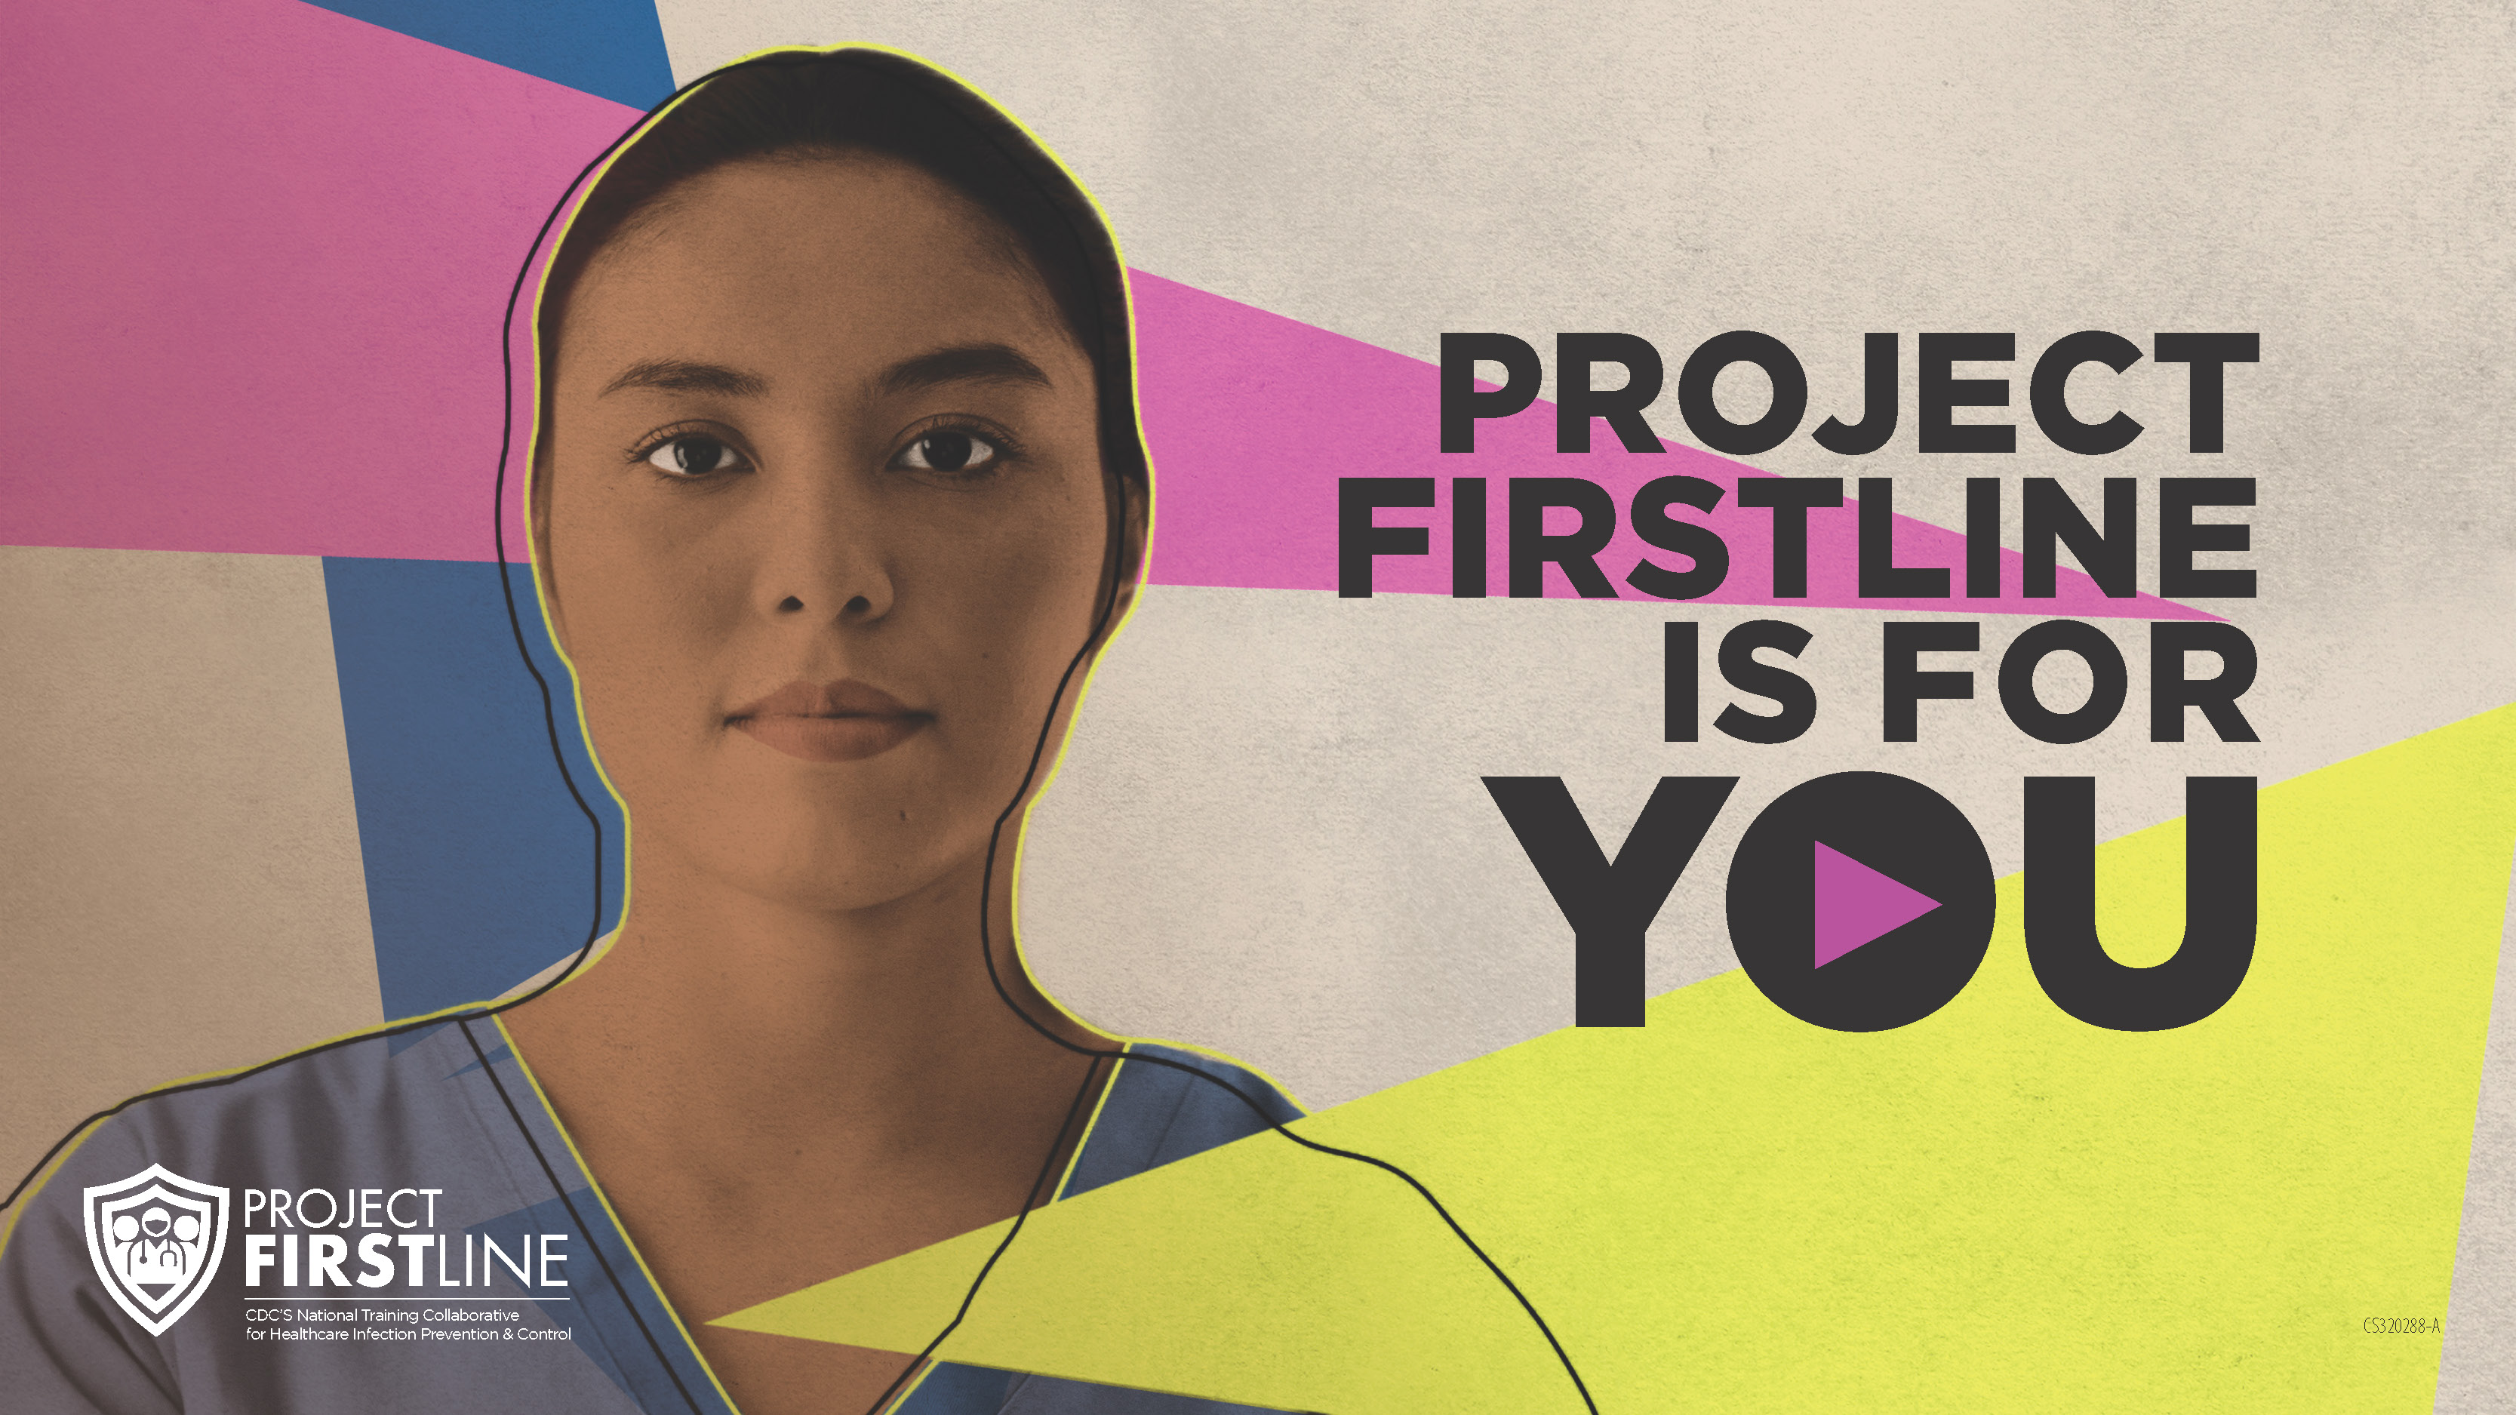
Feedback Form
Notes:
Facilitator Notes
Explain how to access the feedback form.
Sample Script
“And, finally, please let us know how you enjoyed today’s session by completing the following feedback form. Thanks again for joining us today.”
After the Session
Send list of participant questions compiled during this session to ProjectFirstline@cdc.gov.

