Slide 1

TOPIC 14: asymptomatic spread of COVID-19
Date of Training
Notes:
Facilitator Notes
Participants log in and get settled.

Slide 2
Agenda
Welcome
How Can Viruses Spread From Someone Who Doesn’t
Feel Sick?
Reflection
Notes:
Facilitator Notes
Welcome
Housekeeping, either orally or via chat
If needed, additional notes specific to the platform you’re using (e.g., how to “raise your hand,” how to post questions)
Overview of agenda
If this session is part of an ongoing series, you may choose to say, “welcome back,” “thank you for joining us again,” etc.
Sample Script
“Welcome to Project Firstline. Thank you for joining us! Before we begin, a few housekeeping notes. We’ll meet today for 10 minutes. Please keep your videos on, to the extent possible, and keep your microphone muted when you are not contributing to the discussion. It’s great to see you all here today!
“Today, we’re going to review how viruses can spread, even when an infected person doesn’t feel sick. We’ll have an opportunity to discuss and reflect together before we wrap up for the day.”

Slide 3
Learning Objectives
Explain how a person can be infected with SARS-CoV-2 and not feel sick but can still spread the virus to others.
Discuss one (1) reason why infection control recommendations for COVID-19, such as masking for source control, are in place in healthcare settings.
Notes:
Facilitator Notes
Provide an overview of the session’s learning objectives.
Sample Script
“After today, you’ll be able to explain how a person can be infected with SARS-CoV-2 and not feel sick but can still spread the virus to others and discuss why infection control recommendations like masking for source control are in place in healthcare settings.”

Slide 4
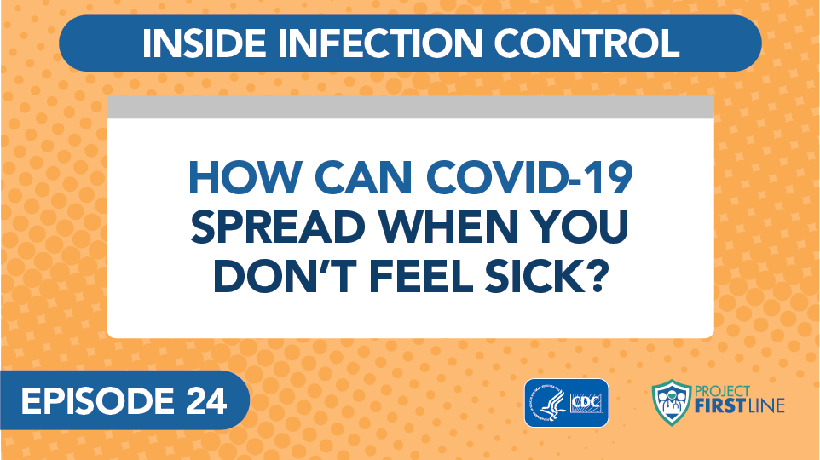
Inside Infection Control, Episode 24: How Can COVID-19 Spread When You Don’t Feel Sick?
Notes:
Facilitator Notes
Access the video here:
CDC Website: https://www.cdc.gov/infectioncontrol/projectfirstline/videos/EP24-NoSymptoms-LowRes.mp4
OR
Project Firstline YouTube Playlist: https://www.youtube.com/watch?v=GPahzFodDU8&feature=youtu.be
Encourage participants to make note of the two ways that people who are infected with virus but who don’t feel sick can spread virus.
Sample Script
“Let’s hear from the CDC’s Dr. Abby Carlson and find out more about how viruses like SARS-CoV-2 can spread, even from someone who is infected but who doesn’t feel sick. Dr. Carlson mentions two ways this can happen. Jot down in your participant booklet what you hear, and we’ll discuss the two ways after the video.”

Slide 5
Definitions
Pre-symptomatic Infection
When a person has been infected with a virus and hasn’t started feeling sick yet but will develop symptoms.
Asymptomatic Infection
When a person is infected with a virus and will never feel any symptoms at all.
Notes:
Facilitator Notes
Review the definitions of “pre-symptomatic infection” and “asymptomatic infection.”
Pre-symptomatic infection is when a person has been infected with a virus and hasn’t started feeling sick yet but will develop symptoms.
Asymptomatic infection is when a person is infected with a virus and will never feel any symptoms at all.
Sample Script
“Let’s review the two ways people can be infected and not feel sick that Dr. Carlson mentioned in the video. ‘Pre-symptomatic infection’ means that a person is infected with a virus but hasn’t started feeling sick yet – but they probably will soon. ‘Asymptomatic infection’ means that a person is infected with a virus but does not feel any symptoms at all. As you heard from Dr. Carlson, this can make it harder to control the spread of infectious diseases, because people don’t always know that they have an infection, or that they’re contagious and can spread it to others.”

Slide 6

Recognizing people who are contagious
Can you
tell who has COVID-19?
No, even people who appear healthy and show no symptoms may have COVID-19 and may be able to spread the SARS-CoV-2 virus.
Notes:
Facilitator Notes
This slide has animation. When you advance to the slide, only the pictures of people will appear.
Ask participants to look at the people on the slide and see if they can tell who is infected with COVID-19.
Encourage participants to guess, either orally or in the chat, or both.
After participants have had a chance to respond, trigger animation to clarify that even people who seem healthy and exhibit no symptoms might have COVID-19 and be able to spread the SARS-CoV-2 virus.
Sample Script
“Now let’s do a little detective work. Can you guess which of these people has COVID-19 and may be contagious?”
(Pause for responses.)
“We can’t tell, can we? Lots of people are infected with the virus, but don’t show symptoms!
“As we heard in the video, people can be infected with a virus and their immune system can be working – and they might not feel sick. Even if they don’t feel sick, they can spread the virus to others. It’s important to know and remember this when you’re thinking about infection control.”

Slide 7
Controlling the spread
People who are
pre-symptomatic or asymptomatic don’t have symptoms, but they can still spread COVID-19.
Why It Matters
We can’t tell who may be infected and able to infect others, so all our infection control actions are still important.
Notes:
Facilitator Notes
This slide has animation. When you advance to the slide, only the first column will appear.
Encourage participants, either orally or in the chat, to link their knowledge to action:
We know that people who are infected with SARS-CoV-2, but who do not show symptoms, can still spread virus.
What actions should we take?
When appropriate, advance the slide to reveal the second column.
Sample Script
“So, let’s review. People who are pre-symptomatic or asymptomatic – who aren’t feeling any symptoms, but who are infected with virus – can still spread COVID-19. Why does this matter? How can we use this information in our work?”
(Pause for responses. When appropriate, trigger animation.)
“Right! Because we can’t tell who may be infected, and able to infect others, all our infection control actions are still important – including masking for source control.”

Slide 8
Reflection
Notes:
Facilitator Notes
Encourage participants to reflect on the content of the session and how they will put their knowledge into practice.
Sample Script
“Let’s use our last few minutes together to reflect on what we’ve learned and think about how we can put what we’ve learned into practice.”

Slide 9
WRAP-UP
What did you learn today about asymptomatic spread?
What is one thing you’ll need to do, or continue to do, in your work to protect yourself and others from diseases that can spread when people are infected but may not look or feel sick?
Does anyone have any questions still remaining?
Notes:
Facilitator Notes
Invite participants to share what they learned during the session and one thing they’ll need to do, or continue to do, in their work to protect themselves and others from diseases that can spread when people are infected may not look or feel sick.”
As appropriate, make connections between participants’ responses and the material from the session.
Invite additional, remaining questions.
If the answers are information that is already included in this session, please respond.
If the questions address content that is not covered in this session, please do not attempt to answer the questions. Instead, take note of the questions and consult with CDC resources to follow up with answers after the session.
Participants may have questions about whether people who are fully vaccinated against COVID-19 can still transmit virus. You may choose to direct them to CDC resources:
When You’ve Been Fully Vaccinated: https://www.cdc.gov/coronavirus/2019-ncov/vaccines/fully-vaccinated.html
Science Brief: COVID-19 Vaccines and Vaccination: https://www.cdc.gov/coronavirus/2019-ncov/science/science-briefs/fully-vaccinated-people.html
Sample Script
“I’d love to hear from you about what you learned today about asymptomatic spread, and if you have identified one thing you’ll need to do, or continue to do, in your work to protect yourself and others from diseases that can spread when people are infected but may not look or feel sick. Would anyone like to share?”
(Acknowledge and address responses.)
“Thank you for sharing! Does anyone have any questions still remaining?”
(Address questions as appropriate.)
“Thank you for sharing those questions. Project Firstline is actively collecting your questions to help inform more training resources as they’re developed. I’ve written them down and I will get back to you with responses.”

Slide 10
Key Takeaways
People can be infected with a virus and their immune system can be working – and they might not feel sick.
People who may not feel sick or show symptoms can still spread viruses.
That’s why infection control recommendations for
COVID-19, such as masking for source control, are in
place in healthcare settings.
Notes:
Facilitator Notes
Review key takeaways.
You may choose to revisit discussion points or questions that arose during the session.
Sample Script
“I hope you enjoyed today’s conversation. I’ve captured some key takeaways here, which you can review at your leisure after the session today.”

Slide 11
Resources and Future Training sessions
Project Firstline on CDC:
www.cdc.gov/ProjectFirstline
CDC’s Project Firstline on Facebook:
https://www.facebook.com/CDCProjectFirstline
CDC’s Project Firstline on Twitter:
https://twitter.com/CDC_Firstline
Project Firstline Inside Infection Control on YouTube:
https://www.youtube.com/playlist?list=PLvrp9iOILTQZQGtDnSDGViKDdRtIc13VX
To sign up for Project Firstline e-mails, click here: https://tools.cdc.gov/campaignproxyservice/subscriptions.aspx?topic_id=USCDC_2104
Notes:
Facilitator Notes
Share additional resources from Project Firstline and CDC.
Explain how participants can reach you, by the means of your choosing, and how they can reach Project Firstline.
If this session is part of a series, you may choose to describe the themes of upcoming sessions.
Sample Script
We covered a lot today, and there is still more to learn. You can keep exploring these topics on your own using the resources on this slide. You can also follow us on social media.”
(If this session is part of a series) “Next time, we will cover [insert next training topic].”

Slide 12
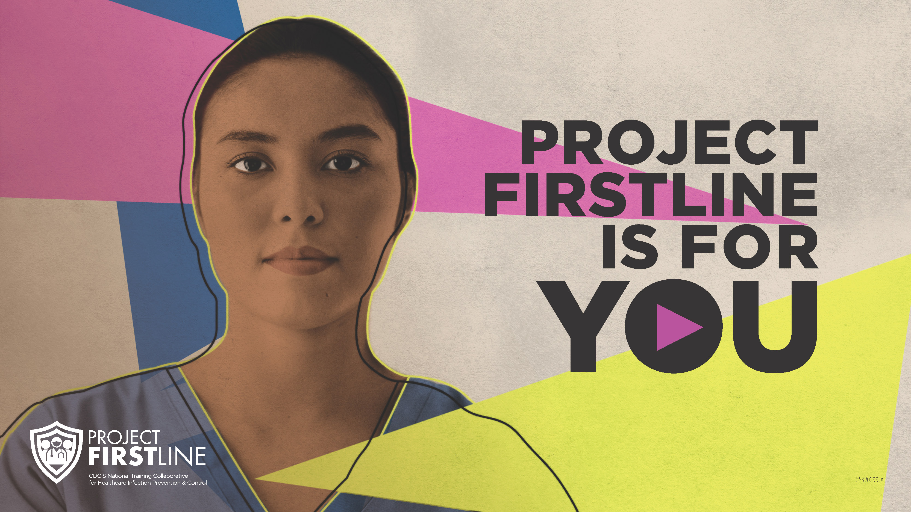
Feedback Form
Notes:
Facilitator Notes
Explain how to access the feedback form.
Sample Script
“And, finally, please let us know how you enjoyed today’s session by completing the following feedback form. Thanks again for joining us today.”
After the Session
Send list of participant questions compiled during this session to ProjectFirstline@cdc.gov.

