Slide 1
Topic 10: virus straINs
Notes:
Facilitator Notes
Participants log in and get settled.

Slide 2
agenda
Introductions
Virus Strains
  Understanding and protecting yourself from variants
  Communicating about variants
Reflection & Next Steps
Notes:
Facilitator Notes
Welcome
Housekeeping, either orally or via chat
If needed, additional notes specific to the platform you’re using (e.g., how to “raise your hand,” how to post questions)
Overview of agenda
If this session is part of an ongoing series, you may choose to say “welcome back,” “thank you for joining us again,” etc.
Sample Script
“Welcome to Project Firstline. Thank you for joining us! Before we begin, a few housekeeping notes. We’ll meet today for one hour. Please keep your videos on, to the extent possible, and keep your microphone muted when you are not contributing to the discussion. It’s great to see you all here today!
“Today, we’ll discuss how new virus strains, or variants, develop, and what that means for infection control. We’ll have an opportunity to reflect before we wrap up for the day.”

Slide 3
Learning Objectives
Describe one (1) way that new virus strains develop.
Discuss why the infection control actions recommended for COVID-19 work for new strains of SARS-CoV-2, and why they are even more important.
Notes:
Facilitator Notes
Provide an overview of the session’s learning objectives.
Sample Script
“After today, you will be able to describe how new virus strains develop. You’ll be able to discuss why the infection control actions recommended for COVID-19 work for new strains of SARS-CoV-2, and why they are even more important.”

Slide 4
Introductions
Your name
Your role
If anyone has ever asked you about virus variants
Notes:
Facilitator Notes
These questions will give you a better understanding of your participants’ backgrounds, experience, and level of knowledge.
Tailor your slide delivery for the virtual format and platform, and the number of participants:
You may wish to add role- or facility-specific questions to the introductions.
If your virtual platform has poll functionality, you may use a poll for the third bullet on the slide, which asks whether anyone has ever been asked about virus variants. This approach is advised if you have more than 15 participants.
If you have a large group, you may decide to skip introductions and use the chat or poll feature for introductions.
Be sure to introduce yourself and anyone who is assisting you.
Sample Script
“Please share in 30 seconds or less your name, your role, and whether anyone has ever asked you about virus variants, or mutations.”

Slide 5
POLL
Which of the following are examples of viruses with variant strains? Check all that apply.
Influenza (flu) viruses
Rhinoviruses
Coronaviruses
Enteroviruses
Notes:
Facilitator Notes
If the webinar platform you are using has a polling feature, set up this poll, and after giving participants time to respond, display the poll results:
Which of the following are examples of viruses with variant strains? Check all that apply.
Influenza (flu) viruses
Rhinoviruses
Coronaviruses
Enteroviruses
If the webinar platform doesn’t have a polling feature, ask participants to respond to the question in the chat or via the “raise your hand” or “thumbs-up” feature.
Sample Script
“We’ve all heard a lot recently about the emergence of new strains of SARS-CoV-2, the virus that causes COVID-19. But do other viruses have different strains?”
(Pause to allow participants to respond. Show poll results, if your platform has that feature, and reveal the correct answer.)
“That’s right, all these virus types have variant strains. And there are many more. Viruses have new strains, variations, or mutations all the time.”

Slide 6
Clarifying terms
You may hear different words used to describe new variants of SARS-CoV-2:
Mutations
Variants
Strains
Mutation describes the process through which the SARS-Cov-2 virus changes.
Variants describes the version of the virus that has changed, through mutation, from the original virus.
Strains is used in the same way as the word variants.
Notes:
Facilitator Notes
Clarify the terms used to describe how viruses change.
Sample Script
“You may be hearing many different terms used when it comes to strains, or variants. Let’s take a minute to talk about these terms and what they mean.
“When a virus makes copies of itself and small mistakes occur, that is called a mutation. We often talk about mutating or mutations to describe the process through which a virus changes.
“The changed virus itself is the new variant. The word ‘strain’ is often used the same way as the word ‘variant.’ For the rest of this session, we’ll use the word ‘strain.’”

Slide 7
Understanding and Protecting Yourself from Virus Strains
As you watch the video, write down three interesting or important takeaways that stand out to you.
Notes:
Facilitator Notes
Thank participants for responding to the question.
Introduce video episode of Inside Infection Control.
Ask participants to write down at least three important takeaways from the episode.
Sample Script
“Thank you for sharing! We’re now going to dive into learning about strains themselves, as well as how we can protect ourselves and each other from new virus strains.
“First, we’ll check in with the CDC’s Dr. Abby Carlson and then discuss together what we’ve learned. As you watch this video, please make note in your Participant Booklet of at least three important takeaways. Dr. Carlson is going to use a particular analogy to explain the concept of variants. We’ll talk about it more after the video.”

Slide 8
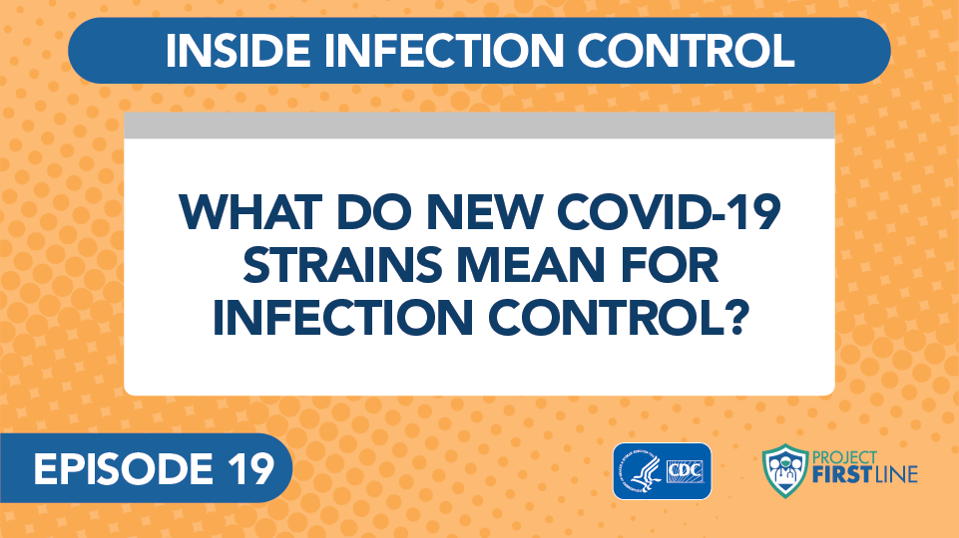
Episode 19: What do new COVID Strains mean for Infection control?
Notes:
Facilitator Notes
Access the video here:
CDC Website: https://www.cdc.gov/infectioncontrol/projectfirstline/videos/EP19- Strains-LowRes.mp4
OR
Project Firstline YouTube Playlist: https://www.youtube.com/watch?v=U1CmOFG5GJM

Slide 9
Discussion
What are the interesting or important takeaways you noted?
Notes:
Facilitator Notes
After the episode, ask the group to discuss:
What is interesting and important about this episode?
What is worth noting?
You may choose to ask participants to share their reactions orally, via chat, or both.
You may wish to use the following talking points to confirm or correct key information, and you may also wish to refer to the Content Outline for this video episode:
Viruses have new strains, variations, or mutations all the time.
Even though new strains are around, the basic pieces of the virus are still the same. This means that the recommended infection control actions still work and are still needed to help stop the spread of COVID-19.
Infection control actions recommended for COVID-19, like using recommended PPE, masking, physical distance, good ventilation, hand hygiene, and environmental cleaning and disinfection, are designed to work on all strains.
Some of the new strains of SARS-CoV-2 spread more easily, so it is even more important to continue using the recommended infection control actions.
If the dog analogy is not mentioned, ask participants if the analogy made sense to them. Why or why not?
Sample Script
“After watching that video, what stands out to you as especially important and interesting? What do you see as the most important points to remember?”
(Pause to allow for responses. Encourage additional discussion.)
“There were several key points in the video. What about the dog analogy? Did that make sense to you?”

Slide 10
Viruses regularly create new strains
Viruses regularly create new strains.
New strains are created when viruses make copies of themselves. When replicating, sometimes mistakes are made. Those mistakes create a slightly different version of the virus – the variant.
Notes:
Facilitator Notes
Review main messages.
You may wish to refer to the Content Outline of Episode 19 of Inside Infection Control for additional discussion points.
Sample Script
“We hit many of the key messages in the video through our discussion, but let’s review them one more time. First, Dr. Carlson shared that viruses have new strains, variations, or mutations all the time. This isn’t something unique or special for COVID-19. Strains in viruses are why we can get sick from them more than once. For example, you’ve probably had a cold or the flu more than once in your life.
“Viruses have genes that carry instructions for making new copies of themselves, and every new copy contains those instructions as well. Sometimes mistakes are made during the copying process. When the instructions are copied wrong, the new viruses come out slightly different, with the mistake included in the instruction genes. Some mistakes make the virus not work anymore, so it’s a dead end. When the new virus is still able to function even with the mistake, that’s how a new strain is created, since all of the copies from that virus will carry that mistake.”

Slide 11
Infection control actions work
Infection control actions work, and they work against the new strains of SARS-CoV-2. These include following recommendations for use of
PPE
Source control
Physical distance
Ventilation
Hand hygiene
Cleaning and disinfection
Notes:
Facilitator Notes
Ask participants, either orally or via chat, to recall different recommended infection control actions for COVID-19 and to explain how they work to protect us:
PPE: The recommended PPE hasn’t changed – an N95 will still prevent you from breathing in virus that’s in respiratory droplets.
Source control: Masking keeps respiratory droplets out of the air so they can’t be breathed in by others.
Physical distance: Physical distance helps people avoid breathing in each other’s respiratory droplets.
Ventilation: Good air handling in healthcare settings can reduce the risk of respiratory infections, including COVID-19, spreading among patients and staff.
Hand hygiene: Cleaning your hands is important – soap and water and alcohol-based hand sanitizer break apart the envelope that holds the virus together.
Environmental cleaning and disinfection: Similarly, for cleaning and disinfection of the environment, the cleaning products on EPA’s list N are known to kill SARS-CoV-2, including the new strains.
If one of the above actions is not mentioned, add it to the discussion.
Depending on your audience and context, the topic of vaccines may arise in the discussion. You may choose to refer to CDC resources for information:
Key Things to Know About COVID-19 Vaccines: https://www.cdc.gov/coronavirus/2019-ncov/vaccines/keythingstoknow.html
Updated Healthcare Infection Prevention and Control Recommendations in Response to COVID-19 Vaccination: https://www.cdc.gov/coronavirus/2019-ncov/hcp/infection-control-after-vaccination.html
Emphasize that the recommended actions for preventing the spread of COVID-19 are designed to work on all strains, and that infection control is more important than ever as some of the new strains spread more easily among people.
Sample Script
“Another important point from the video is that, even though we are still learning about the new strains, our infection control actions are designed to work on all strains. That means one of the best things we can do to keep ourselves and our patients safe is to follow infection control recommendations. Can anyone recall one of the infection control actions from the video and how it helps stop the spread of the virus?”
(Pause for responses.)
“We all must remember that, because we are seeing strains of the SARS-CoV-2 virus that spread more easily among people, we have even less margin for error. It’s even more important to continue using the recommended infection control actions.”

Slide 12
Sharing your knowledge
Notes:
Facilitator Notes
Transition to discussion about how participants can put their knowledge into practice and share their knowledge with others.
Sample Script
“Now that you have a good understanding of what virus strains are, how they are created, and how we can protect ourselves, let’s talk about how we can use that information and share it with others.”

Slide 13
Your Experience
Who has had experience explaining the concept of strains to patients?
Notes:
Facilitator Notes
Either orally or via chat, invite participants to share their experiences, if any, communicating about virus strains.
When possible, make connections between the participants’ experiences.
Follow-up questions could include the following:
What was the disease and patient context?
What was the question and how did you answer it?
Did you use any analogies to help explain the concept? Do you think the analogy of the dog breeds would be helpful?
Sample Script
“Let’s hear from some of you. Have you had to explain the new virus strains to anyone at work? Maybe a patient or their family, or a coworker? How did that go?”
(Pause for responses and ask follow-up questions as appropriate.)

Slide 14
Breakout groups
In your groups:
  Design a realistic 1- to 2- minute skit or role play addressing your scenario.
  Assign roles (e.g., yourself, a patient, a coworker).
  Practice your skit or role play.
When we return, share your skit with the group.
Breakout Groups 1 & 2
Scenario: A patient asks: “I’ve heard that some of the new COVID-19 strains are more serious. Should I be concerned?”
Breakout Groups 3 & 4
Scenario: A coworker comments: “I may be vaccinated, but some of these new COVID-19 strains still seem scary. I’m worried we aren’t taking the appropriate precautions at work.”
Notes:
Facilitator Notes
In small breakout groups, participants will consider a scenario related to new strains of the virus that causes COVID-19 and create a brief skit or role play of the scenario.
This activity is intended to continue encouraging participants to apply the training concepts to their daily work.
Depending on the makeup of your group, you may wish to adjust the scenarios.
Breakout Groups 1 and 2 scenario: “I’ve heard that some of the new COVID-19 strains are more serious. Should I be concerned?”
Breakout Groups 3 and 4 scenario: A coworker comments: “I may be vaccinated, but some of these new COVID-19 strains still seem scary. I’m worried we aren’t taking the appropriate precautions at work.”
Use breakout rooms appropriate to your virtual platform to divide participants into groups.
If your webinar platform allows for it, you may invite participants to choose their own breakout room.
Ideally, the groups should have no more than 4 or 5 people each.
If your group is large, you may need to have more than four breakout groups.
If possible, try not to place participants in breakout rooms according to their job responsibilities or experience. A mix of people considering a scenario will make for richer discussion.
As needed, provide instructions related to the breakout room format, such as how to ask you questions.
Inform the groups that they have 10 minutes to discuss the scenario and role play within their group, taking turns in the roles so that everyone has a chance to participate.
Ask each to identify people who will be willing to “perform” their skit or role play for the broader group.
After the small groups have gathered, depending on your virtual platform, you may use the broadcast message feature or another means to send reminders of the scenarios, how much time is remaining, etc. You may also choose to “visit” each group to encourage conversation and to hear their thoughts.
Sample Script
“Now let’s consider some scenarios in which we might need to explain these concepts to others. We’re going to break into small groups. In your groups, you’ll be given a specific scenario. Please design a realistic 1- to 2-minute skit or role play of this scenario. Be sure to take turns so everyone has a chance to role play! You will have 10 minutes, and then we will share our skits with the broader group.”
“Scenario 1, for Breakout Groups 1 and 2: A patient asks: ‘I’ve heard that some of the new COVID-19 strains are more serious. Should I be concerned?’
“Scenario 2, for Breakout Groups 3 and 4: A coworker comments: ‘I may be vaccinated, but some of these new COVID-19 strains still seem scary. I’m worried we aren’t taking the appropriate precautions at work.’”

Slide 15
Presentation
Share your skit!
Notes:
Facilitator Notes
After 10 minutes, and giving groups a “warning” when they have a few minutes left, reconvene the groups.
Invite the groups to share their skits in turn.
Be encouraging and appreciative of their work and willingness to volunteer.
Lead a discussion of the question: What strategies can we learn from these scenarios?
As needed, correct and clarify information using these talking points and other relevant points from the Content Outline for the video episode:
Viruses have new strains, variations, or mutations all the time.
Even though new SARS-CoV-2 strains are around, the basic pieces of the virus are still the same, and this means that the recommended infection control actions still work.
Some of the new strains of SARS-CoV-2 spread more easily, so it is even more important to continue using the recommended infection control actions.
The tools we use for infection control are designed to work on all strains, and it’s important to keep using those tools to prevent COVID-19 from spreading.
The recommended PPE hasn’t changed – an N95 respirator will still prevent you from breathing in virus that’s in respiratory droplets.
Wearing a mask keeps respiratory droplets out of the air, so the germs in them can’t spread to other people or the environment.
Physical distance also helps people avoid breathing in each other’s respiratory droplets.
Good indoor ventilation is important for clearing air that might have respiratory droplets in it.
Cleaning your hands often with soap and water or an alcohol-based hand sanitizer is important.
Disinfecting products on EPA’s list N are known to kill SARS-CoV-2, including the new strains.
Although COVID-19 vaccines are not addressed in the video, it is likely that the issue will be raised in discussion. You may wish to consult CDC resources for additional information:
Key Things to Know About COVID-19 Vaccines: https://www.cdc.gov/coronavirus/2019-ncov/vaccines/keythingstoknow.html
Updated Healthcare Infection Prevention and Control Recommendations in Response to COVID-19 Vaccination: https://www.cdc.gov/coronavirus/2019-ncov/hcp/infection-control-after-vaccination.html
Sample Script
“Welcome back! I’m excited to see what you all have come up with! Group 1, let’s start with you!”
(Allow each group to present their skit.)
“That was great, you all did a great job of working through these scenarios. Let’s talk now about what we can learn from the role playing, and what you learned from the other groups.”

Slide 16
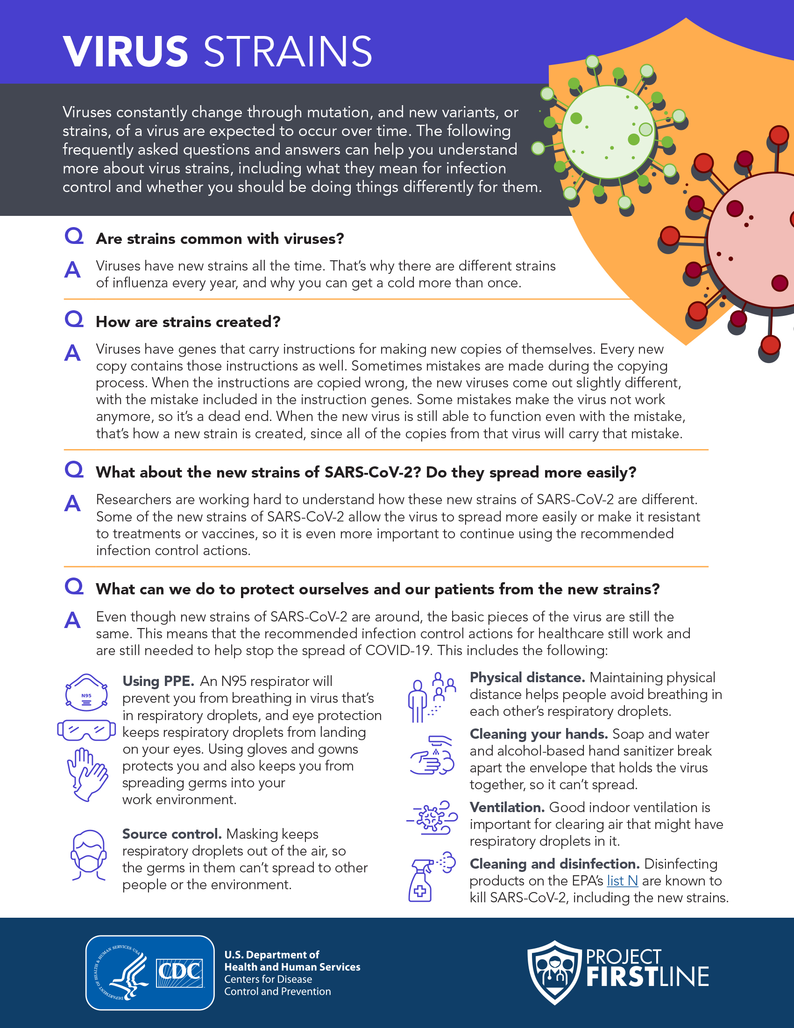
Frequently Asked Questions
Reference the FAQs to prepare to communicate about virus strains.
Notes:
Facilitator Notes
Share, either in the chat or with a link, the Frequently Asked Questions About Virus Strains document.
Sample Script
“There is a lot to think about when we’re thinking about new strains of viruses. I’m putting a link to a Frequently Asked Questions About Virus Strains document into the chat. You can share it and print it for reference.”

Slide 17
Reflection: What did you learn today?
Notes:
“Facilitator Notes
Transition to the session wrap-up.
Sample Script
“I hope that, after today, you know more about new virus strains, and you feel confident sharing your knowledge with others. Let’s use our last few minutes together to reflect and wrap up.”

Slide 18
Questions?
Do you have any remaining questions about strains?
Notes:
Facilitator Notes
Invite additional, remaining questions.
If the answers are information that is already included in this session, please respond.
If the questions address content that is not covered in this session, please do not attempt to answer the question. Instead, take note of the questions and consult with CDC resources to follow up with answers after the session.
Please document questions and share back with CDC at ProjectFirstline@cdc.gov for responses.
Sample Script
“But first, does anyone have any remaining questions about virus strains?”

Slide 19
REFLECTION: using your knowledge
Our patients and their families may ask questions about new COVID-19 strains. What do you think is important for patients and families to know about virus strains?
Write in the chat one action you could take to protect yourself and others.
Notes:
Facilitator Notes
Encourage participants to describe actions that they can take to use what they have learned. They may come off mute and speak, type in the chat, or both.
Sample Script
“Let’s apply what we discussed today to your real life. Our patients and their families may ask questions about new COVID-19 strains. What do you think is important for patients and families to know about virus strains? Write in the chat one action you could take to protect yourself and others.”
(Pause for responses.)

Slide 20
Resources and Future Training sessions
Project Firstline on CDC:
https://www.cdc.gov/infection control/projectfirstline/index.html
Project Firstline on Facebook:
https://www.facebook.com/CDCProjectFirstline/
Twitter:
https://twitter.com/CDC_Firstline
YouTube:
https://www.youtube.com/playlist?list=PLvrp9iOILTQZQGtDnSDGViKDdRtIc13VX
To sign up for Project Firstline e-mails, click here: https://tools.cdc.gov/campaignproxyservice/subscriptions.aspx?topic_id=USCDC_2104
Notes:
Facilitator Notes
Share additional resources from Project Firstline and CDC.
If this session is part of a series, you may choose to describe the themes of upcoming sessions.
Sample Script
“That’s great, thank you. We covered a lot today, and there is still more to learn. You can keep exploring these topics on your own using the resources on this slide. You can also follow us on social media.”
(If this session is one in a series) “Next time, we will cover [insert next training topic].”

Slide 21
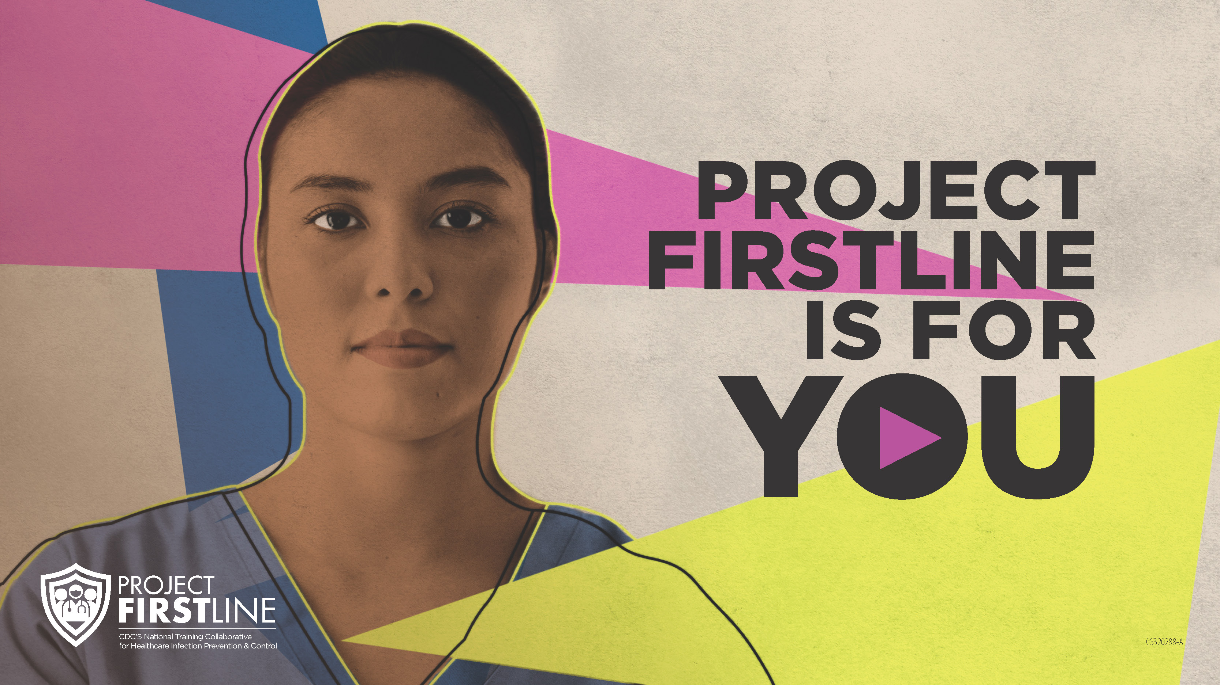
Feedback Form
Notes:
Facilitator Notes
Explain how to access the Feedback Form.
Sample Script
“And, finally, please let us know how you enjoyed today’s session by completing the following feedback form. Thanks again for joining us today.”
After the Session
Send list of participant questions compiled during this session to ProjectFirstline@cdc.gov.

