Slide 1
Topic 10: virus straINs
Notes:
Facilitator Notes
Participants log in and get settled.

Slide 2
agenda
Introductions
Virus Strains
Understanding and protecting yourself from variants
Communicating about variants
Reflection & Next Steps
Notes:
Facilitator Notes
Welcome
Housekeeping, either orally or via chat
If needed, additional notes specific to the platform you’re using (e.g., how to “raise your hand,” how to post questions)
Overview of agenda
If this session is part of an ongoing series, you may choose to say “welcome back,” “thank you for joining us again,” etc.
Sample Script
“Welcome to Project Firstline. Thank you for joining us! Before we begin, a few housekeeping notes. We’ll meet today for twenty minutes. Please keep your videos on, to the extent possible, and keep your microphone muted when you are not contributing to the discussion. It’s great to see you all here today!
“Today, we’ll discuss how new virus strains, or variants, develop, and what that means for infection control. We’ll have an opportunity to reflect before we wrap up for the day.”

Slide 3
Learning Objectives
Describe one (1) way that new virus strains develop.
Discuss why the infection control actions recommended for COVID-19 work for new strains of SARS-CoV-2, and why they are even more important.
Notes:
Facilitator Notes
Provide an overview of the session’s learning objectives.
Sample Script
“After today, you will be able to describe how new virus strains develop. You’ll be able to discuss why the infection control actions recommended for COVID-19 work for new strains of SARS-CoV-2, and why they are even more important.”

Slide 4
Clarifying terms
You may hear different words used to describe new variants of SARS-CoV-2:
Mutations
Variants
Strains
Mutation describes the process through which the SARS-Cov-2 virus changes.
Variants describes the version of the virus that has changed, through mutation, from the original virus.
Strains is used in the same way as the word variants.
Notes:
Facilitator Notes
Clarify the terms used to describe how viruses change.
Sample Script
“You may be hearing many different terms used when it comes to strains, or variants. Let’s take a minute to talk about these terms and what they mean.
“When a virus makes copies of itself and small mistakes occur, that is called a mutation. We often talk about mutating or mutations to describe the process through which a virus changes.
“The changed virus itself is the new variant. The word ‘strain’ is often used the same way as the word ‘variant.’ For the rest of this session, we’ll use the word ‘strain’.”

Slide 5
Understanding and Protecting Yourself from Virus Strains
As you watch the video, write down three interesting or important takeaways that stand out to you.
Notes:
Facilitator Notes
Thank participants for responding to the question.
Introduce video episode of Inside Infection Control.
Ask participants to write down at least three important takeaways from the episode.
Sample Script
“We’re now going to dive into learning about strains themselves, as well as how we can protect ourselves and each other from new virus strains.
“First, we’ll check in with the CDC’s Dr. Abby Carlson and then discuss together what we’ve learned. As you watch this video, please make note in your Participant Booklet of at least three important takeaways. Dr. Carlson is going to use a particular analogy to explain the concept of strains. We’ll talk about it more after the video.”

Slide 6
Episode 19: What do new COVID Strains mean for Infection control?
Notes:
Facilitator Notes
Access the video here: CDC Website: https://www.cdc.gov/infectioncontrol/projectfirstline/videos/EP19- Strains-LowRes.mp4
OR Project Firstline YouTube Playlist: https://www.youtube.com/watch?v=U1CmOFG5GJM

Slide 7
Discussion
What are the interesting or important takeaways you noted?
Notes:
Facilitator Notes
After the episode, ask the group to discuss:
What is interesting and important about this episode?
What is worth noting?
You may choose to ask participants to share their reactions orally, via chat, or both.
You may wish to use the following talking points to confirm or correct key information, and you may also wish to refer to the Content Outline for this video episode:
Viruses have new strains, variations, or mutations all the time.
Even though new strains are around, the basic pieces of the virus are still the same. This means that the recommended infection control actions still work and are still needed to help stop the spread of COVID-19.
Infection control actions recommended for COVID-19, like using recommended PPE, masking, physical distance, good ventilation, hand hygiene, and environmental cleaning and disinfection, are designed to work on all strains.
Some of the new strains of SARS-CoV-2 spread more easily, so it is even more important to continue using the recommended infection control actions.
If the dog analogy is not mentioned, ask participants if the analogy made sense to them. Why or why not?
Sample Script
“After watching that video, what stands out to you as especially important and interesting? What do you see as the most important points to remember?”
(Pause to allow for responses. Encourage additional discussion.)
“There were several key points in the video. What about the dog analogy? Did that make sense to you?”

Slide 8
Viruses regularly create new strains
Viruses regularly create new strains.
New strains are created when viruses make copies of themselves. When replicating, sometimes mistakes are made. Those mistakes create a slightly different version of the virus – the variant.
Notes:
Facilitator Notes
Review main messages.
You may wish to refer to the Content Outline of Episode 19 of Inside Infection Control for additional discussion points.
Sample Script
“We hit many of the key messages in the video through our discussion, but let’s review them one more time. First, Dr. Carlson shared that viruses have new strains, variations, or mutations all the time. This isn’t something unique or special for COVID-19. Strains in viruses are why we can get sick from them more than once. For example, you’ve probably had a cold or the flu more than once in your life.”
“Viruses have genes that carry instructions for making new copies of themselves, and every new copy contains those instructions as well. Sometimes mistakes are made during the copying process. When the instructions are copied wrong, the new viruses come out slightly different, with the mistake included in the instruction genes. Some mistakes make the virus not work anymore, so it’s a dead end. When the new virus is still able to function even with the mistake, that’s how a new strain is created, since all of the copies from that virus will carry that mistake.”

Slide 9
Infection control actions work
Infection control actions work, and they work against the new strains of SARS-CoV-2. These include the following recommendations for use of
PPE
Source control
Physical distance
Ventilation
Hand hygiene
Cleaning and disinfection
Notes:
Facilitator Notes
Ask participants, either orally or via chat, to recall different recommended infection control actions for COVID-19 and to explain how they work to protect us:
PPE: The recommended PPE hasn’t changed – an N95 will still prevent you from breathing in virus that’s in respiratory droplets.
Source control: Masking keeps respiratory droplets out of the air so they can’t be breathed in by others.
Physical distance: Physical distance helps people avoid breathing in each other’s respiratory droplets.
Ventilation: Good air handling in healthcare settings can reduce the risk of respiratory infections, including COVID-19, spreading among patients and staff.
Hand hygiene: Cleaning your hands is important – soap and water and alcohol-based hand sanitizer break apart the envelope that holds the virus together.
Environmental cleaning and disinfection: Similarly, for cleaning and disinfection of the environment, the cleaning products on EPA’s list N are known to kill SARS-CoV-2, including the new strains.
If one of the above actions is not mentioned, add it to the discussion.
Depending on your audience and context, the topic of vaccines may arise in the discussion. You may choose to refer to CDC resources for information:
Key Things to Know About COVID-19 Vaccines: https://www.cdc.gov/coronavirus/2019-ncov/vaccines/keythingstoknow.html
Updated Healthcare Infection Prevention and Control Recommendations in Response to COVID-19 Vaccination: https://www.cdc.gov/coronavirus/2019-ncov/hcp/infection-control-after-vaccination.html
Emphasize that the recommended actions for preventing the spread of COVID-19 are designed to work on all strains, and that infection control is more important than ever as some of the new strains spread more easily among people.
Sample Script
“Another important point from the video is that, even though we are still learning about the new strains, our infection control actions are designed to work on all strains. That means one of the best things we can do to keep ourselves and our patients safe is to follow infection control recommendations. Can anyone recall one of the infection control actions from the video and how it helps stop the spread of the virus?”
(Pause for responses.)
“We all must remember that, because we are seeing strains of the SARS-CoV-2 virus that spread more easily among people, we have even less margin for error. It’s even more important to continue using the recommended infection control actions.”

Slide 10
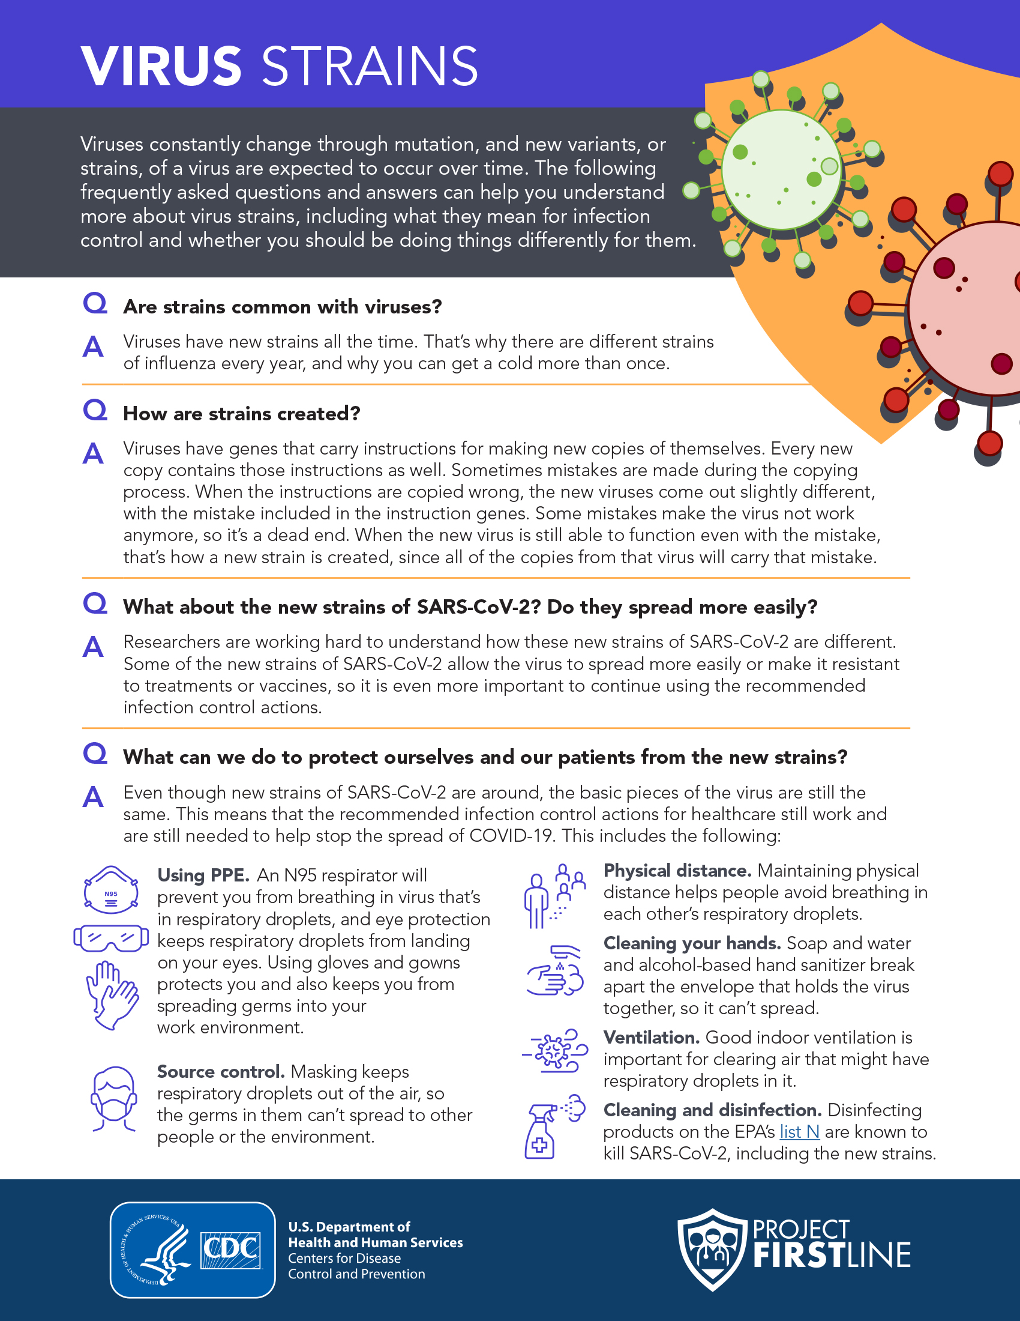
Frequently Asked Questions
Reference the FAQs to prepare to communicate about virus strains.
Notes:
Facilitator Notes
Share, either in the chat or with a link, the Frequently Asked Questions About Virus Strains document.
Sample Script
“There is a lot to think about when we’re thinking about new strains of viruses. I’m putting a link to a Frequently Asked Questions About Virus Strains document into the chat. You can share it and print it for reference.”

Slide 11
Reflection: What did you learn today?
Notes:
Facilitator Notes
Encourage participants to reflect on the content of the session and how they will put their knowledge into practice.
Sample Script
“Let’s use our last few minutes together to reflect on what we’ve learned and think about how we can put what we’ve learned into practice.”

Slide 12
Questions?
Do you have any remaining questions about virus strains?
Notes:
Facilitator Notes
Invite additional, remaining questions.
If the answers are information that is already included in this session, please respond.
If the questions address content that is not covered in this session, please do not attempt to answer the question. Instead, take note of the questions and consult with CDC resources to follow up with answers after the session.
Please document questions and share back with CDC at ProjectFirstline@cdc.gov for responses.
Sample Script
“Does anyone have any remaining questions about virus strains?”

Slide 13
Resources and Future Training sessions
Project Firstline on CDC:
https://www.cdc.gov/infection control/projectfirstline/index.html
Project Firstline on Facebook:
https://www.facebook.com/CDCProjectFirstline/
Twitter:
https://twitter.com/CDC_Firstline
YouTube:
https://www.youtube.com/playlist?list=PLvrp9iOILTQZQGtDnSDGViKDdRtIc13VX
To sign up for Project Firstline e-mails, click here: https://tools.cdc.gov/campaignproxyservice/subscriptions.aspx?topic_id=USCDC_2104
Notes:
Facilitator Notes
Share additional resources from Project Firstline and CDC.
If this session is part of a series, you may choose to describe the themes of upcoming sessions.
Sample Script
“That’s great, thank you. We covered a lot today, and there is still more to learn. You can keep exploring these topics on your own using the resources on this slide. You can also follow us on social media.”
(If this session is one in a series) “Next time, we will cover [insert next training topic].”

Slide 14
Feedback Form
Notes:
Facilitator Notes
Explain how to access the Feedback Form
Sample Script
“And, finally, please let us know how you enjoyed today’s session by completing the following feedback form. Thanks again for joining us today.”
After the Session
Send list of participant questions compiled during this session to ProjectFirstline@cdc.gov.

