Slide 1


Topic 1: The Concept of Infection Control
[Date of training]
Notes:
Participants log in and get settled

Slide 2

Agenda:
Introduction
Project Firstline and the concept of infection control
  Video
  Discussion and reflection
Session feedback form and next steps
Learning Objectives:
Articulate at least one (1) primary goal of infection control
Notes:
Sample Script
“Welcome! Thank you for joining us. We’re so glad to have this time together to discuss infection control on the frontlines. As you see on the slide, today we’ll introduce Project Firstline, and we’ll begin discussing the concept of infection control as it relates to our day-to-day work. We’ll have time to explore these topics together, in smaller groups, and individually. Today’s session will be more general in nature, but in future sessions we’ll get deeper into the details of infection control.
“I’d also like to discuss some housekeeping matters. We’ll meet today for one hour. We ask you to keep your videos on, to the extent possible. This helps us have a more authentic discussion. You may use your mute/unmute button at any time to contribute to the discussion, but when you’re not speaking, please keep your microphone muted.”

Slide 3
Introductions
Please be prepared to introduce yourself, answering the questions below:
  Name, title, affiliation
  What brings you here today?
  Is there something you’re especially hoping to discuss?
Notes:
Sample Script
“Before we get started, let’s take some time to get to know each other. I’d love to learn who you are and what your professional role is. I’d also like to learn if you have special interests or questions that we can address today and over the course of this training series.
“I’ll start by introducing myself, and then invite you to do the same. On the slide, you’ll find a brief prompt. When I call on you, please answer as much of this as you feel comfortable sharing.”
[After audience introductions]
“Thank you, it’s wonderful to learn who’s in the room and I look forward to getting to know you further as we continue these sessions together. We have so much experience in this room. I’ve taken notes on the questions and topics that most interest you, and we’ll be sure to address these during our time together. We may not be able to cover all of these important topics in our time together today, but we’ll be sure to do so in future sessions. As you come up with additional questions or ideas, please share them with us [in chat or other preferred means]. We want this session to be as interactive as possible, and we want it to answer your questions. So, keep the questions coming.”

Slide 4
Why do we do infection control?
Notes:
Sample Script
“Let’s get started. I’d like to begin with a question. In your opinion, why do you personally do infection control? What’s the goal? What’s the point?
[After participants answer]
“Great answers. Infection control is important for all these reasons. I’d like to play a brief video for you from a CDC doctor who talks about this.”

Slide 5
As you watch, consider the following questions:
What does Dr. Carlson highlight as the goal of infection control? How closely does it match our own personal reasons for engaging in infection control?
What is Project Firstline?
What ideas from this video seem most important to you? Why?
Dr. Carlson talks about several challenges we face working in healthcare right now. Which of these issues are most important to you?
Notes:
Sample Script
“As you watch, I’d like you to think about these questions [on slide]
“Consider jotting down your thoughts as you watch.”

Slide 6
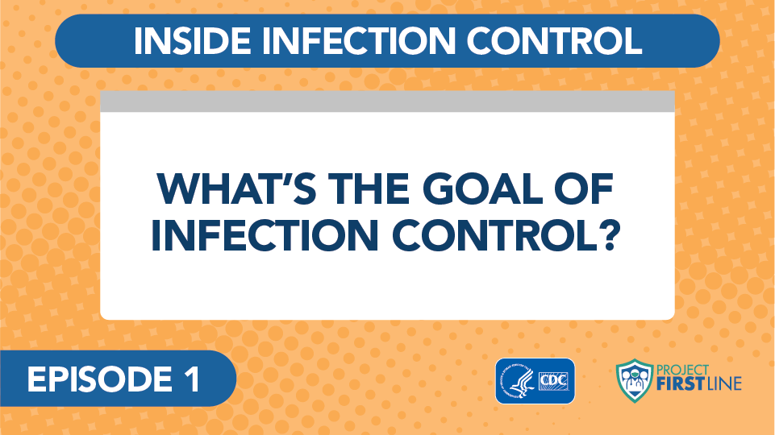
Video: What’s the Goal of Infection Control?
Notes:
Access the video here:
CDC website: https://www.cdc.gov/infectioncontrol/projectfirstline/videos/Ep1-Goal-LowRes-New.mp4
OR
Project Firstline YouTube Playlist:
https://www.youtube.com/watch?v=atLgq4fsVvo

Slide 7
Breakout Session (with group)
Reintroduce yourselves (if needed) and decide who will take notes and be your spokesperson when we reconvene
What does Dr. Carlson highlight as the goal of infection control? How closely does it match our own personal reasons for engaging in infection control?
What is Project Firstline?
What concepts from this video seem most important to you? Why?
Dr. Carlson talks about several challenges we face working in healthcare right now. Which of these issues are most important to you?
Notes:
Sample Script
“Now I’d like to break us into four groups to share our thoughts. With your group, please share your answers and spend some time developing group answers to each question. Please be ready to share the highlights of your discussion with the broader group when we reconvene. I am especially interested in your perspectives on questions three and four. Since this is our first session together, be sure to take some time at the beginning to reintroduce yourselves (if needed) and decide who wants to take notes and be the spokesperson for your group.”

Slide 8
Let’s Reconvene
What does Dr. Carlson highlight as the goal of infection control? How closely does it match our own personal reasons for engaging in infection control?
What is Project Firstline?
What concepts from this video seem most important to you? Why?
Dr. Carlson raises several challenges related to working in healthcare right now. Which of these issues are most important to you?
Notes:
Sample Script
“I hope you enjoyed getting a chance to discuss together in groups. I’d like to go through these questions. The first two are more straightforward. Would any of the groups like to volunteer your answers for these two questions?
[Wait for answer]
“Great, thank you. Did any other group have a different answer, or other points to add about those questions? Spokespeople, please let us know. You can write in chat or go off mute.
[Wait for answers. No need to spend a lot of time on this, but make sure you get confirmation that the other groups don’t wish to say anything further.]
“Thank you for sharing these important thoughts. We’re going to work on addressing these challenges in our time together, over a series of sessions together. Project Firstline aims to explain the ‘whys’ of infection control, to explain the reasons for the current guidance, and to give us all a chance to get our own questions answered.
“Now let’s talk about the next two questions, which are really important. Group 1, could you get us started?”
[Wait for answer]
“Thank you. Group 2, what would you like to add?
[Wait for answer, and then continue with Groups 3 and 4. Cultivate broader group discussion about the core points that are raised. Invite others not serving as a “spokesperson” to share further thoughts.]
“Thank you for sharing these important thoughts. Before we talk about actions we can take, today, to make a difference in our daily work lives, I’d like to show you what’s coming up in this session series.”

Slide 9
Upcoming Session Topics
Coming Up Next:
The Basic Science of Viruses
How Respiratory Droplets Spread COVID-19
How Viruses Spread from Surfaces to People
How COVID-19 Spreads: A Review
Broader Themes and Topics:
  Infection Control: The Basics
  Source Control
  PPE: Basics
  PPE: Donning and Doffing
  Hand Hygiene
  Crisis Standards of Care
  Triage
  Standard and Transmission-Based Precautions
  Microbiology Basics
  Recognizing Risk
  Environmental Cleaning and Disinfection
Notes:
Sample Script
“As you can see, we have a lot to cover together. In the left-hand column, I’ve listed the specific topics that will be coming up right away. In the right-hand column, I’ve listed the broader themes that are woven into these upcoming sessions, as well as future sessions from Project Firstline. We’re going to focus on understanding the reasons behind the infection control actions we take at work.”

Slide 10
Questions Covered
SARS-CoV-2 is a virus. What’s a virus?
How do viruses make you sick?
How does a virus like SARS-CoV-2 get from one person to another: what is a respiratory droplet?
What happens when we breathe in these droplets?
What happens when these droplets get in our eyes?
Exposure does not always mean infection: why?
What makes us feel sick?
…and many more
Notes:
Sample Script
“Here, you can see some of the specific questions the Project Firstline team has received, and will address, in these upcoming sessions.
“At the beginning of today’s session, we generated a list of our own questions. Does anyone see their question on this list, or see a question you’re especially interested in? Please go off mute or respond in chat.”
[Wait for answers]
“As I mentioned before, one of the exciting things about Project Firstline is its interactive nature. After today’s session, I’m going to submit our own list of questions to the Project Firstline team. We want to make sure your voices get heard, and your questions get answered. In the chat, I’m going to share the list we compiled at the beginning of today’s session. Please take a moment to review this list and make sure we captured your ideas correctly.”

Slide 11
What’s one action you can take to support infection control in the workplace?
Is it something you can do for yourself? Does it build on something you already do?
Is it something you can do for others?
Is it thanking some else for something that makes your job easier?
Notes:
Sample Script
“Before we close today, let’s pause and reflect. We have a lot of questions and challenges to cover in upcoming sessions, but we already know that infection control involves all of us. I have a question on this slide, and I’d like us each to reflect individually. Is there something you can do today, now, to support infection control? Maybe it’s taking time for yourself, so you can recharge. Maybe it’s thanking your team members. Maybe it’s encouraging each other to wear our masks on break. We need to support each other in infection control, every day. I’m going to pause for one minute to give everyone a chance to reflect.
[Give participants one full minute to reflect.]
“You don’t have to share your answers, but please write it down somewhere you will see it. I’m going to ask you to share how it went the next time we meet.”

Slide 12
Key Messages
The goal of everything we do in infection control, for any disease, is to keep people from getting sick.
The goal of Project Firstline is to make sure you have the infection control knowledge that you need and deserve to keep yourself, your patients, your colleagues, and your family safe.
Notes:
Sample Script
“Thank you all for coming today. I enjoyed our discussion together. On this slide, I’ve collected the key messages from today’s session. “

Slide 13
Resources and Future Training Sessions
Project Firstline on CDC:
https://www.cdc.gov/infectioncontrol/projectfirstline/index.html
Project Firstline on Facebook:
https://www.facebook.com/CDCProjectFirstline/
Project Firstline on Twitter:
https://twitter.com/CDC_Firstline
Project Firstline YouTube Playlist:
https://www.youtube.com/playlist?list=PLvrp9iOILTQZQGtDnSDGViKDdRtIc13VX
To sign up for Project Firstline e-mails from CDC, click here: https://tools.cdc.gov/campaignproxyservice/subscriptions.aspx?topic_id=USCDC_2104
Notes:
Sample Script
“Next time, we will dig into some basic microbiology, how viruses work, and how COVID-19 makes us sick. In the meantime, you can keep exploring these topics on your own using the resources on this slide. You can also follow us on social media. Finally, I’d like to share a small welcome gift as a thank you for participating today.”
[Digitally distribute “Project Firstline Is for You” poster.]

Slide 14
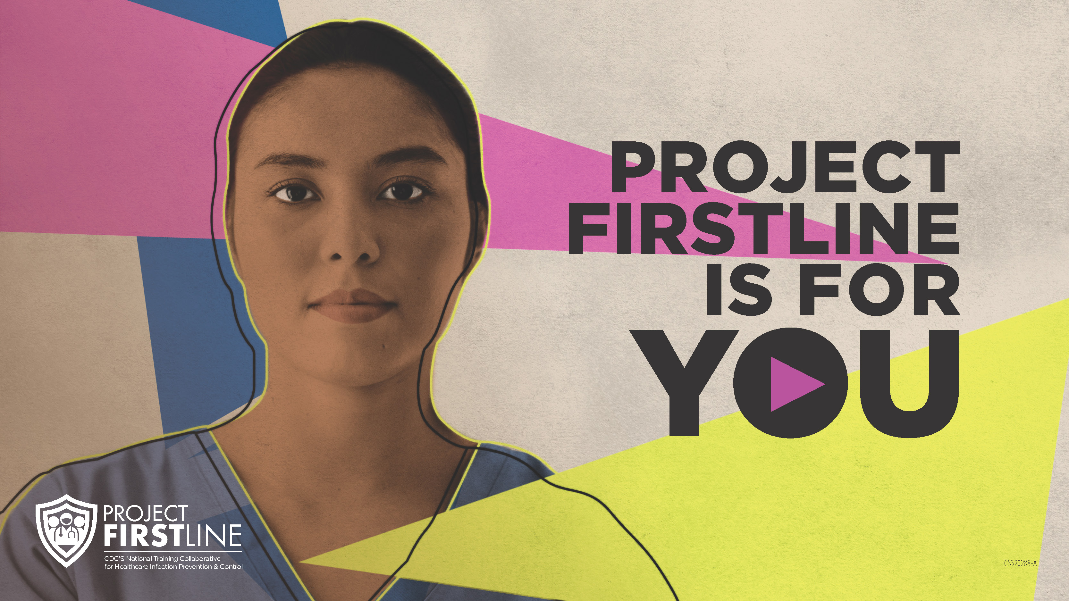
Feedback Form
Notes:
[Facilitator should add information about how to access form]
Sample Script
“And finally, please let us know how you enjoyed today’s session by completing the following feedback form. Thanks again for joining us today.”

