Slide 1

Prevalence of Obesity Based on Self-Reported Weight and Height Among US Adults by Race/Ethnicity, State and Territory,
BRFSS, 2022–2024
Definitions
Obesity: Body mass index (BMI) of 30 kg/m² or higher.
Body mass index (BMI): A calculated measure of weight relative to height, defined as body weight in kilograms divided by height in meters squared.

Slide 2
Prevalence of Obesity Based on Self-Reported Weight and Height Among US Adults by Race/Ethnicity, State and Territory,
BRFSS, 2022–2024
Method
The data were collected through the Behavioral Risk Factor Surveillance System (BRFSS), an ongoing, state-based, telephone interview survey conducted by state health departments with assistance from CDC.
Height and weight data used in the BMI calculations were self-reported.
Three years of data were combined to ensure sufficient sample size.

Slide 3
Prevalence of Obesity Based on Self-Reported Weight and Height Among US Adults by Race/Ethnicity, State and Territory,
BRFSS, 2022–2024
Exclusion Criteria
Records with the following were excluded:
Height: <3 feet or ≥8 feet
Weight: <50 pounds or ≥650 pounds
BMI: <12 kg/m² or ≥100 kg/m²
Pregnant women

Slide 4
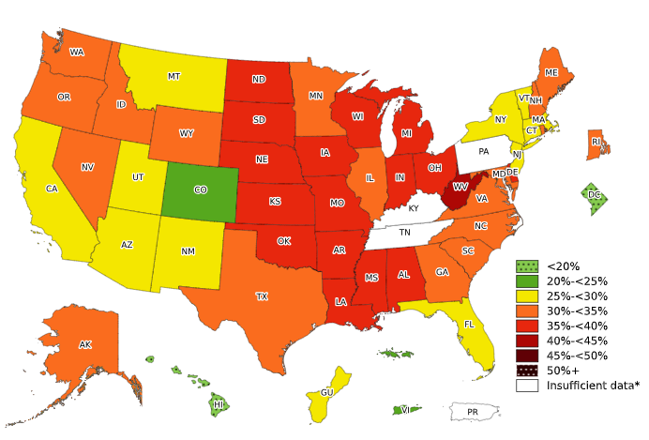
Prevalence of Obesity Based on Self-Reported Weight and Height Among Non-Hispanic White Adults, by State and Territory, BRFSS, 2022–2024
*Sample size <50, the relative standard error (dividing the standard error by the prevalence) ≥30%, or no data in a specific year.

Slide 5
Prevalence of Obesity Based on Self-Reported Weight and Height Among Non-Hispanic White Adults, by State and Territory, BRFSS, 2022–2024
State | Prevalence | 95% Confidence Interval
Alabama | 35.8 | (34.5, 37.1)
Alaska | 32.9 | (31.7, 34.1)
Arizona | 29.3 | (28.2, 30.4)
Arkansas | 37.4 | (36.3, 38.5)
California | 25.7 | (24.7, 26.8)
Colorado | 23.6 | (22.9, 24.3)
Connecticut | 28.9 | (27.8, 29.9)
Delaware | 35.6 | (34.1, 37.1)
District of Columbia | 14.7 | (13.3, 16.1)
Florida | 29.1 | (28.1, 30.2)
Georgia | 33.4 | (32.3, 34.5)
Guam | 27.5 | (21.6, 34.2)
Hawaii | 19.4 | (18.1, 20.8)
Idaho | 31.9 | (30.8, 32.9)
Illinois | 33.6 | (32.4, 34.9)
Indiana | 38.2 | (37.5, 39.0)
Iowa | 37.5 | (36.7, 38.3)
Kansas | 36.0 | (35.3, 36.8)
Kentucky | Insufficient data* | Insufficient data*
Louisiana | 36.6 | (35.4, 37.8)
Maine | 33.0 | (32.3, 33.8)
Maryland | 30.7 | (29.9, 31.6)
Massachusetts | 27.1 | (26.2, 27.9)
Michigan | 35.0 | (34.1, 35.8)
Minnesota | 33.2 | (32.5, 33.8)
Mississippi | 36.5 | (34.8, 38.2)
Missouri | 35.0 | (34.0, 35.9)
State | Prevalence | 95% Confidence Interval
Montana | 29.7 | (28.8, 30.5)
Nebraska | 36.9 | (36.1, 37.8)
Nevada | 31.3 | (29.4, 33.3)
New Hampshire | 31.8 | (30.8, 32.9)
New Jersey | 27.4 | (26.3, 28.4)
New Mexico | 28.2 | (26.4, 30.0)
New York | 28.9 | (28.2, 29.6)
North Carolina | 31.8 | (30.5, 33.2)
North Dakota | 35.7 | (34.7, 36.8)
Ohio | 37.1 | (36.3, 37.9)
Oklahoma | 37.6 | (36.6, 38.6)
Oregon | 32.6 | (31.6, 33.6)
Pennsylvania | Insufficient data* | Insufficient data*
Puerto Rico | Insufficient data* | Insufficient data*
Rhode Island | 30.3 | (29.1, 31.5)
South Carolina | 32.4 | (31.3, 33.4)
South Dakota | 36.3 | (34.2, 38.3)
Tennessee | Insufficient data* | Insufficient data*
Texas | 33.5 | (32.2, 34.8)
Utah | 29.8 | (29.0, 30.5)
Vermont | 28.3 | (27.4, 29.3)
Virgin Islands | 21.3 | (14.6, 30.0)
Virginia | 33.1 | (32.0, 34.2)
Washington | 31.9 | (31.4, 32.4)
West Virginia | 41.4 | (40.4, 42.5)
Wisconsin | 36.9 | (36.1, 37.7)
Wyoming | 32.4 | (31.3, 33.5)
*Sample size <50, the relative standard error (dividing the standard error by the prevalence) ≥30%, or no data in a specific year.
Source: Behavioral Risk Factor Surveillance System, CDC.

Slide 6
Prevalence of Obesity Based on Self-Reported Weight and Height Among Non-Hispanic White Adults, by State and Territory, BRFSS, 2022–2024
Summary
Hawaii and the District of Columbia had a prevalence of obesity less than 20%.
Colorado, and Virgin Islands had a prevalence of obesity between 20% and <25%.
11 states and Guam had a prevalence of obesity between 25% and <30%.
17 states had a prevalence of obesity between 30% and <35%.
16 states had a prevalence of obesity between 35% and <40%.
West Virginia had a prevalence of obesity 40% or greater.

Slide 7
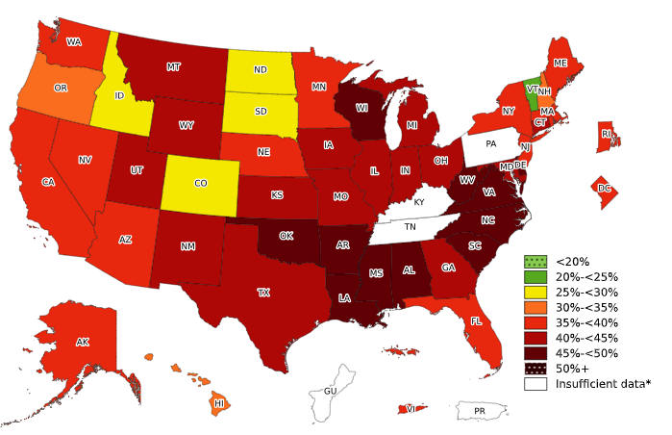
Prevalence of Obesity Based on Self-Reported Weight and Height Among Non-Hispanic Black Adults, by State and Territory, BRFSS, 2022–2024
*Sample size <50, the relative standard error (dividing the standard error by the prevalence) ≥30%, or no data in a specific year.

Slide 8
Prevalence of Obesity Based on Self-Reported Weight and Height Among Non-Hispanic Black Adults, by State and Territory, BRFSS, 2022–2024
State | Prevalence | 95% Confidence Interval
Alabama | 49.1 | (46.8, 51.3)
Alaska | 38.7 | (32.1, 45.8)
Arizona | 35.6 | (30.6, 40.8)
Arkansas | 47.6 | (44.3, 50.9)
California | 38.1 | (34.7, 41.5)
Colorado | 28.4 | (24.8, 32.2)
Connecticut | 40.4 | (37.1, 43.7)
Delaware | 46.2 | (42.8, 49.6)
District of Columbia | 37.3 | (35.0, 39.7)
Florida | 39.5 | (36.3, 42.9)
Georgia | 44.2 | (42.2, 46.2)
Guam | Insufficient data* | Insufficient data*
Hawaii | 34.9 | (27.1, 43.8)
Idaho | 26.2 | (16.0, 40.0)
Illinois | 43.1 | (40.2, 46.0)
Indiana | 44.4 | (41.8, 46.9)
Iowa | 40.3 | (35.3, 45.4)
Kansas | 41.9 | (38.0, 45.8)
Kentucky | Insufficient data* | Insufficient data*
Louisiana | 47.3 | (45.2, 49.5)
Maine | 36.9 | (29.1, 45.5)
Maryland | 41.3 | (39.8, 42.9)
Massachusetts | 35.4 | (32.2, 38.7)
Michigan | 43.4 | (40.9, 46.0)
Minnesota | 35.6 | (32.8, 38.6)
Mississippi | 47.4 | (45.0, 49.8)
Missouri | 42.5 | (39.5, 45.6)
State | Prevalence | 95% Confidence Interval
Montana | 41.7 | (26.9, 58.2)
Nebraska | 36.7 | (32.5, 41.2)
Nevada | 37.4 | (31.8, 43.3)
New Hampshire | 32.1 | (22.3, 43.8)
New Jersey | 37.7 | (35.1, 40.5)
New Mexico | 42.2 | (32.1, 53.0)
New York | 36.2 | (34.5, 38.0)
North Carolina | 45.3 | (42.6, 48.1)
North Dakota | 27.6 | (21.7, 34.4)
Ohio | 42.8 | (40.0, 45.6)
Oklahoma | 45.8 | (42.1, 49.6)
Oregon | 31.0 | (24.2, 38.8)
Pennsylvania | Insufficient data* | Insufficient data*
Puerto Rico | Insufficient data* | Insufficient data*
Rhode Island | 36.8 | (31.6, 42.3)
South Carolina | 45.2 | (43.1, 47.4)
South Dakota | 29.1 | (17.9, 43.7)
Tennessee | Insufficient data* | Insufficient data*
Texas | 43.7 | (40.6, 46.9)
Utah | 40.2 | (31.7, 49.3)
Vermont | 22.6 | (16.1, 30.7)
Virgin Islands | 36.3 | (31.8, 41.0)
Virginia | 45.8 | (43.4, 48.2)
Washington | 36.3 | (33.6, 39.1)
West Virginia | 45.1 | (38.8, 51.6)
Wisconsin | 45.1 | (41.6, 48.6)
Wyoming | 40.5 | (25.6, 57.2)
*Sample size <50, the relative standard error (dividing the standard error by the prevalence) ≥30%, or no data in a specific year.
Source: Behavioral Risk Factor Surveillance System, CDC.

Slide 9
Prevalence of Obesity Based on Self-Reported Weight and Height Among Non-Hispanic Black Adults, by State and Territory, BRFSS, 2022–2024
Summary
Vermont had a prevalence of obesity less than 25%.
4 states had a prevalence of obesity between 25% and <30%.
3 states had a prevalence of obesity between 30% and <35%.
13 states, Virgin Islands, and the District of Columbia had a prevalence of obesity between 35% and <40%.
15 states had a prevalence of obesity between 40% and <45%.
11 states had a prevalence of obesity between 45% and <50%.
No state or territory had a prevalence of obesity 50% or greater.

Slide 10
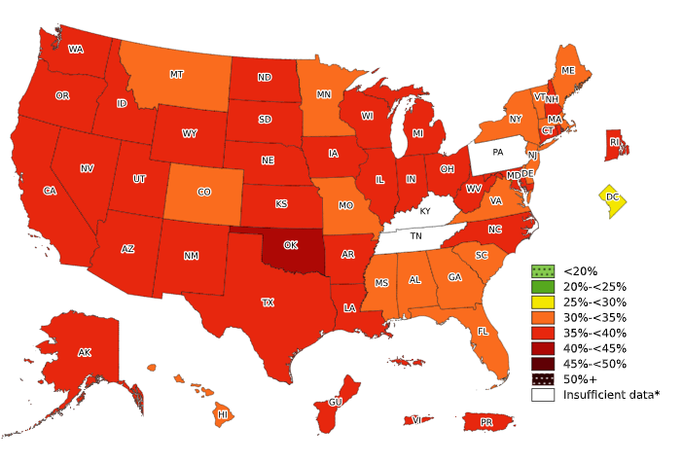
Prevalence of Obesity Based on Self-Reported Weight and Height Among Hispanic Adults, by State and Territory, BRFSS, 2022–2024
*Sample size <50, the relative standard error (dividing the standard error by the prevalence) ≥30%,
or no data in a specific year.

Slide 11
Prevalence of Obesity Based on Self-Reported Weight and Height Among Hispanic Adults, by State and Territory, BRFSS, 2022–2024
State | Prevalence | 95% Confidence Interval
Alabama | 33.2 | (26.9, 40.1)
Alaska | 36.1 | (31.2, 41.4)
Arizona | 39.1 | (36.9, 41.3)
Arkansas | 35.6 | (30.8, 40.8)
California | 36.5 | (35.1, 38.0)
Colorado | 31.2 | (29.5, 32.9)
Connecticut | 37.1 | (34.6, 39.7)
Delaware | 31.7 | (27.5, 36.1)
District of Columbia | 26.9 | (22.6, 31.8)
Florida | 30.7 | (28.3, 33.3)
Georgia | 34.7 | (31.2, 38.4)
Guam | 35.9 | (25.5, 47.8)
Hawaii | 33.5 | (30.4, 36.7)
Idaho | 35.7 | (32.6, 39.0)
Illinois | 38.7 | (36.4, 41.1)
Indiana | 38.3 | (35.5, 41.2)
Iowa | 38.1 | (35.2, 41.0)
Kansas | 39.0 | (36.0, 42.0)
Kentucky | Insufficient data* | Insufficient data*
Louisiana | 39.0 | (33.9, 44.4)
Maine | 34.2 | (28.3, 40.7)
Maryland | 36.5 | (34.2, 38.9)
Massachusetts | 34.3 | (32.0, 36.7)
Michigan | 39.8 | (35.5, 44.2)
Minnesota | 34.6 | (31.9, 37.3)
Mississippi | 34.7 | (26.8, 43.6)
Missouri | 34.8 | (30.1, 39.8)
State | Prevalence | 95% Confidence Interval
Montana | 34.3 | (29.3, 39.7)
Nebraska | 37.9 | (35.6, 40.3)
Nevada | 36.9 | (33.4, 40.6)
New Hampshire | 38.7 | (32.0, 46.0)
New Jersey | 33.6 | (31.6, 35.6)
New Mexico | 38.5 | (36.2, 40.9)
New York | 33.5 | (32.2, 34.9)
North Carolina | 35.7 | (32.3, 39.3)
North Dakota | 35.6 | (29.6, 42.1)
Ohio | 35.9 | (31.4, 40.6)
Oklahoma | 42.1 | (39.0, 45.2)
Oregon | 37.9 | (35.1, 40.9)
Pennsylvania | Insufficient data* | Insufficient data*
Puerto Rico | 35.4 | (34.2, 36.6)
Rhode Island | 36.1 | (33.2, 39.1)
South Carolina | 33.7 | (29.7, 38.0)
South Dakota | 37.1 | (28.6, 46.5)
Tennessee | Insufficient data* | Insufficient data*
Texas | 37.6 | (35.9, 39.4)
Utah | 36.6 | (34.5, 38.7)
Vermont | 32.1 | (26.1, 38.6)
Virgin Islands | 35.3 | (26.4, 45.4)
Virginia | 32.2 | (28.7, 35.9)
Washington | 37.8 | (36.4, 39.4)
West Virginia | 36.5 | (28.2, 45.6)
Wisconsin | 37.3 | (34.3, 40.5)
Wyoming | 38.0 | (33.7, 42.5)
*Sample size <50, the relative standard error (dividing the standard error by the prevalence) ≥30%, or no data in a specific year.
Source: Behavioral Risk Factor Surveillance System, CDC.

Slide 12
Prevalence of Obesity Based on Self-Reported Weight and Height Among Hispanic Adults, by State and Territory, BRFSS, 2022–2024
Summary
No state or territory had a prevalence of obesity less than 25%.
The District of Columbia had a prevalence of obesity between 25% and <30%.
17 states had a prevalence of obesity between 30% and <35%.
29 states, Guam, Puerto Rico, and Virgin Islands had a prevalence of obesity between 35% and <40%.
Oklahoma had a prevalence of obesity between 40% and <45%.
No state or territory had a prevalence of obesity 45% or greater.

Slide 13
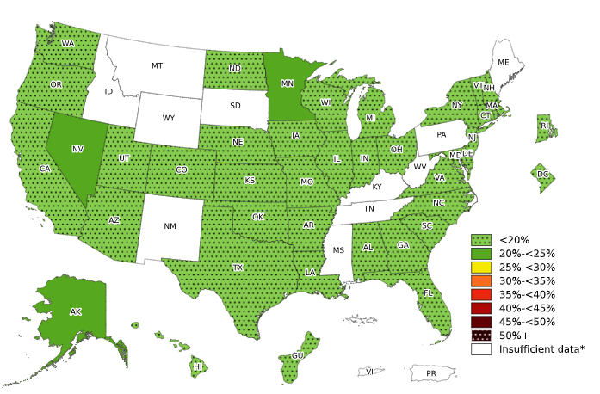
Prevalence of Obesity Based on Self-Reported Weight and Height Among Non-Hispanic Asian Adults, by State and Territory, BRFSS, 2022–2024
*Sample size <50, the relative standard error (dividing the standard error by the prevalence) ≥30%,
or no data in a specific year.

Slide 14
Prevalence of Obesity Based on Self-Reported Weight and Height Among Non-Hispanic Asian Adults, by State and Territory, BRFSS, 2022–2024
State | Prevalence | 95% Confidence Interval
Alabama | 11.6 | (6.4, 20.3)
Alaska | 21.8 | (16.5, 28.2)
Arizona | 14.5 | (10.6, 19.7)
Arkansas | 13.7 | (7.9, 22.8)
California | 12.7 | (10.9, 14.8)
Colorado | 11.0 | (8.1, 14.9)
Connecticut | 11.8 | (8.6, 16.0)
Delaware | 16.0 | (10.7, 23.4)
District of Columbia | 11.0 | (7.3, 16.1)
Florida | 13.1 | (8.3, 20.0)
Georgia | 14.9 | (10.8, 20.2)
Guam | 17.8 | (14.2, 22.0)
Hawaii | 18.7 | (17.3, 20.2)
Idaho | Insufficient data* | Insufficient data*
Illinois | 11.6 | (9.2, 14.6)
Indiana | 11.0 | (7.7, 15.6)
Iowa | 12.4 | (8.4, 17.7)
Kansas | 13.2 | (9.4, 18.2)
Kentucky | Insufficient data* | Insufficient data*
Louisiana | 13.4 | (8.2, 21.0)
Maine | Insufficient data* | Insufficient data*
Maryland | 12.7 | (10.5, 15.4)
Massachusetts | 11.6 | (9.3, 14.4)
Michigan | 11.3 | (8.3, 15.4)
Minnesota | 20.3 | (17.4, 23.6)
Mississippi | Insufficient data* | Insufficient data*
Missouri | 14.4 | (9.8, 20.8)
State | Prevalence | 95% Confidence Interval
Montana | Insufficient data* | Insufficient data*
Nebraska | 14.8 | (10.2, 21.1)
Nevada | 22.5 | (15.4, 31.7)
New Hampshire | 9.0 | (5.7, 14.1)
New Jersey | 14.0 | (11.7, 16.8)
New Mexico | Insufficient data* | Insufficient data*
New York | 14.5 | (12.7, 16.6)
North Carolina | 11.6 | (7.7, 17.1)
North Dakota | 17.2 | (10.6, 26.8)
Ohio | 13.7 | (9.7, 18.8)
Oklahoma | 10.5 | (6.9, 15.6)
Oregon | 14.7 | (11.2, 19.2)
Pennsylvania | Insufficient data* | Insufficient data*
Puerto Rico | Insufficient data* | Insufficient data*
Rhode Island | 15.2 | (10.6, 21.2)
South Carolina | 7.7 | (4.5, 12.9)
South Dakota | Insufficient data* | Insufficient data*
Tennessee | Insufficient data* | Insufficient data*
Texas | 13.6 | (10.2, 17.8)
Utah | 11.8 | (8.7, 15.9)
Vermont | 11.4 | (6.6, 19.2)
Virgin Islands | Insufficient data* | Insufficient data*
Virginia | 11.8 | (8.7, 15.7)
Washington | 12.7 | (11.4, 14.0)
West Virginia | Insufficient data* | Insufficient data*
Wisconsin | 16.0 | (12.2, 20.7)
Wyoming | Insufficient data* | Insufficient data*
*Sample size <50, the relative standard error (dividing the standard error by the prevalence) ≥30%, or no data in a specific year.
Source: Behavioral Risk Factor Surveillance System, CDC.

Slide 15
Prevalence of Obesity Based on Self-Reported Weight and Height Among Non-Hispanic Asian Adults, by State and Territory, BRFSS, 2022–2024
Summary
36 states, the District of Columbia, and Guam had a prevalence of obesity less than 20%.
3 states (Alaska, Nevada, and Minnesota) had a prevalence of obesity between 20% and <25%.
No state had a prevalence of obesity 25% or greater

Slide 16
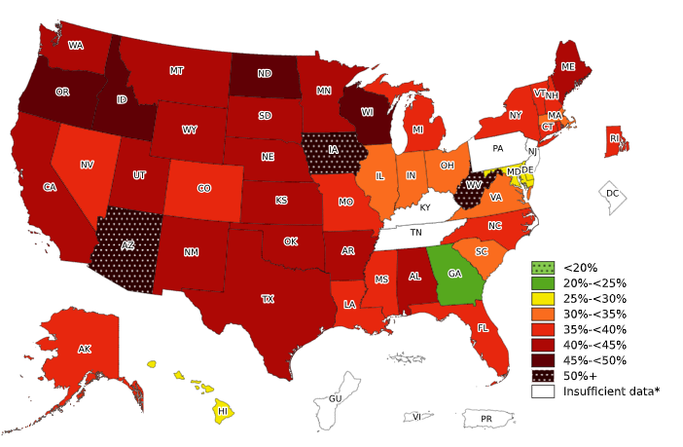
Prevalence of Obesity Based on Self-Reported Weight and Height Among Non-Hispanic American Indian or Alaska Native Adults, by State and Territory, BRFSS, 2022–2024
*Sample size <50, the relative standard error (dividing the standard error by the prevalence) ≥30%,
or no data in a specific year.

Slide 17
Prevalence of Obesity Based on Self-Reported Weight and Height Among Non-Hispanic American Indian or Alaska Native Adults, by State and Territory, BRFSS, 2022–2024
State | Prevalence | 95% Confidence Interval
Alabama | 42.7 | (31.4, 54.8)
Alaska | 38.3 | (35.1, 41.6)
Arizona | 50.5 | (45.7, 55.3)
Arkansas | 42.7 | (34.7, 51.2)
California | 41.8 | (33.0, 51.3)
Colorado | 35.5 | (28.2, 43.5)
Connecticut | 35.5 | (22.8, 50.7)
Delaware | 25.1 | (13.5, 41.9)
District of Columbia | Insufficient data* | Insufficient data*
Florida | 36.73079763 | (26.7, 48.1)
Georgia | 22.3 | (13.6, 34.3)
Guam | Insufficient data* | Insufficient data*
Hawaii | 25.68891266 | (13.7, 42.9)
Idaho | 45.3 | (35.4, 55.7)
Illinois | 34.6 | (23.3, 48.0)
Indiana | 30.4 | (22.5, 39.7)
Iowa | 50.6 | (37.9, 63.3)
Kansas | 43.2 | (36.4, 50.3)
Kentucky | Insufficient data* | Insufficient data*
Louisiana | 36.5 | (28.3, 45.5)
Maine | 42.1 | (34.7, 49.8)
Maryland | 29.7 | (21.9, 39.0)
Massachusetts | 33.0 | (22.4, 45.7)
Michigan | 37.1 | (27.6, 47.8)
Minnesota | 44.6 | (38.2, 51.2)
Mississippi | 38.5 | (24.6, 54.5)
Missouri | 36.2 | (27.2, 46.2)
State | Prevalence | 95% Confidence Interval
Montana | 41.2 | (37.4, 45.2)
Nebraska | 41.8 | (33.8, 50.2)
Nevada | 35.5 | (24.0, 48.9)
New Hampshire | 37.0 | (23.5, 52.8)
New Jersey | Insufficient data* | Insufficient data*
New Mexico | 40.9 | (35.9, 46.1)
New York | 35.9 | (26.5, 46.5)
North Carolina | 35.7 | (27.9, 44.2)
North Dakota | 46.6 | (40.8, 52.5)
Ohio | 33.1 | (23.5, 44.3)
Oklahoma | 42.9 | (39.8, 46.2)
Oregon | 45.6 | (36.1, 55.4)
Pennsylvania | Insufficient data* | Insufficient data*
Puerto Rico | Insufficient data* | Insufficient data*
Rhode Island | 39.2 | (26.6, 53.5)
South Carolina | 31.8 | (23.6, 41.2)
South Dakota | 41.3 | (34.6, 48.2)
Tennessee | Insufficient data* | Insufficient data*
Texas | 43.8 | (31.3, 57.1)
Utah | 40.5 | (33.0, 48.4)
Vermont | 36.2 | (25.3, 48.7)
Virgin Islands | Insufficient data* | Insufficient data*
Virginia | 33.2 | (23.3, 44.9)
Washington | 44.1 | (39.7, 48.6)
West Virginia | 52.7 | (40.0, 65.0)
Wisconsin | 48.2 | (41.0, 55.5)
Wyoming | 44.1 | (34.6, 54.0)
*Sample size <50, the relative standard error (dividing the standard error by the prevalence) ≥30%, or no data in a specific year.
Source: Behavioral Risk Factor Surveillance System, CDC.

Slide 18
Prevalence of Obesity Based on Self-Reported Weight and Height Among Non-Hispanic American Indian or Alaska Native Adults, by State and Territory, BRFSS, 2022–2024
Summary
No state or territory had a prevalence of obesity less than 20%.
Georgia had a prevalence of obesity between 20% and <25%.
3 states had a prevalence of obesity between 25% and <30%.
6 states had a prevalence of obesity between 30% and <35%.
14 states had a prevalence of obesity between 35% and <40%.
15 states had a prevalence of obesity between 40% and <45%.
4 states had a prevalence of obesity between 45% and <50%.
Arizona, Iowa and West Virginia had a prevalence of obesity 50% or greater.

