Slide 1
Prevalence of Obesity Based on Self-Reported Weight and Height Among US Adults by Race/Ethnicity, State and Territory, BRFSS, 2021–2023
Definitions
Obesity: Body mass index (BMI) of 30 kg/m² or higher.
Body mass index (BMI): A calculated measure of weight relative to height, defined as body weight in kilograms divided by height in meters squared.

Slide 2
Prevalence of Obesity Based on Self-Reported Weight and Height Among US Adults by Race/Ethnicity, State and Territory, BRFSS, 2021–2023
Method
The data were collected through the Behavioral Risk Factor Surveillance System (BRFSS), an ongoing, state-based, telephone interview survey conducted by state health departments with assistance from CDC.
Height and weight data used in the BMI calculations were self-reported.
Three years of data were combined to ensure sufficient sample size.

Slide 3
Prevalence of Obesity Based on Self-Reported Weight and Height Among US Adults by Race/Ethnicity, State and Territory, BRFSS, 2021–2023
Exclusion Criteria
Records with the following were excluded:
Height: <3 feet or ≥8 feet
Weight: <50 pounds or ≥650 pounds
BMI: <12 kg/m² or ≥100 kg/m²
Pregnant women

Slide 4
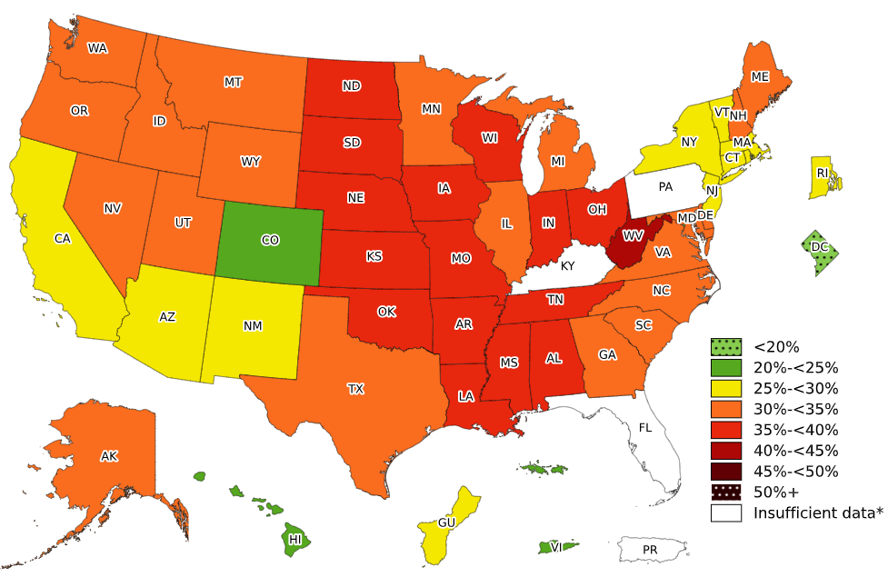
Prevalence of Obesity Based on Self-Reported Weight and Height Among Non-Hispanic White Adults, by State and Territory, BRFSS, 2021–2023
*Sample size <50, the relative standard error (dividing the standard error by the prevalence) ≥30%, or no data in a specific year.

Slide 5
Prevalence of Obesity Based on Self-Reported Weight and Height Among Non-Hispanic White Adults, by State and Territory, BRFSS, 2021–2023
State | Prevalence | 95% Confidence Interval
Alabama | 36.0 | (34.6, 37.3)
Alaska | 32.4 | (31.2, 33.6)
Arizona | 28.8 | (27.8, 29.7)
Arkansas | 37.4 | (36.2, 38.6)
California | 25.7 | (24.6, 26.8)
Colorado | 23.7 | (23.0, 24.5)
Connecticut | 28.2 | (27.2, 29.3)
Delaware | 34.1 | (32.7, 35.6)
District of Columbia | 13.5 | (12.1, 15.0)
Florida | Insufficient data* | Insufficient data*
Georgia | 32.6 | (31.5, 33.7)
Guam | 25.5 | (20.1, 31.8)
Hawaii | 20.1 | (18.8, 21.6)
Idaho | 31.3 | (30.4, 32.2)
Illinois | 33.3 | (31.9, 34.8)
Indiana | 37.0 | (36.3, 37.8)
Iowa | 37.4 | (36.6, 38.2)
Kansas | 35.5 | (34.8, 36.2)
Kentucky | Insufficient data* | Insufficient data*
Louisiana | 36.6 | (35.4, 37.9)
Maine | 32.4 | (31.7, 33.2)
Maryland | 31.1 | (30.3, 32.0)
Massachusetts | 27.1 | (26.2, 28.0)
Michigan | 34.4 | (33.6, 35.3)
Minnesota | 33.3 | (32.7, 34.0)
Mississippi | 35.2 | (33.7, 36.8)
Missouri | 35.9 | (35.0, 36.9)
State | Prevalence | 95% Confidence Interval
Montana | 30.0 | (29.2, 30.9)
Nebraska | 36.3 | (35.5, 37.1)
Nevada | 30.9 | (29.1, 32.8)
New Hampshire | 31.7 | (30.6, 32.7)
New Jersey | 28.1 | (27.0, 29.2)
New Mexico | 27.9 | (26.3, 29.5)
New York | 28.7 | (28.0, 29.4)
North Carolina | 31.8 | (30.5, 33.2)
North Dakota | 35.3 | (34.3, 36.3)
Ohio | 37.2 | (36.5, 37.9)
Oklahoma | 38.2 | (37.1, 39.3)
Oregon | 31.3 | (30.4, 32.3)
Pennsylvania | Insufficient data* | Insufficient data*
Puerto Rico | Insufficient data* | Insufficient data*
Rhode Island | 29.8 | (28.7, 31.0)
South Carolina | 32.6 | (31.7, 33.6)
South Dakota | 36.5 | (34.6, 38.5)
Tennessee | 35.7 | (34.6, 36.9)
Texas | 32.5 | (31.3, 33.8)
Utah | 30.0 | (29.2, 30.7)
Vermont | 28.3 | (27.4, 29.3)
Virgin Islands | 20.1 | (13.6, 28.6)
Virginia | 33.7 | (32.7, 34.7)
Washington | 30.9 | (30.3, 31.5)
West Virginia | 41.0 | (40.0, 42.0)
Wisconsin | 35.4 | (34.5, 36.3)
Wyoming | 32.2 | (31.0, 33.4)
*Sample size <50, the relative standard error (dividing the standard error by the prevalence) ≥30%, or no data in a specific year.
Source: Behavioral Risk Factor Surveillance System, CDC.

Slide 6
Prevalence of Obesity Based on Self-Reported Weight and Height Among Non-Hispanic White Adults, by State and Territory, BRFSS, 2021–2023
Summary
The District of Columbia had a prevalence of obesity less than 20%.
Colorado, Hawaii, and Virgin Islands had a prevalence of obesity between 20% and <25%.
9 states and Guam had a prevalence of obesity between 25% and <30%.
20 states had a prevalence of obesity between 30% and <35%.
15 states had a prevalence of obesity between 35% and <40%.
West Virginia had a prevalence of obesity 40% or greater.

Slide 7
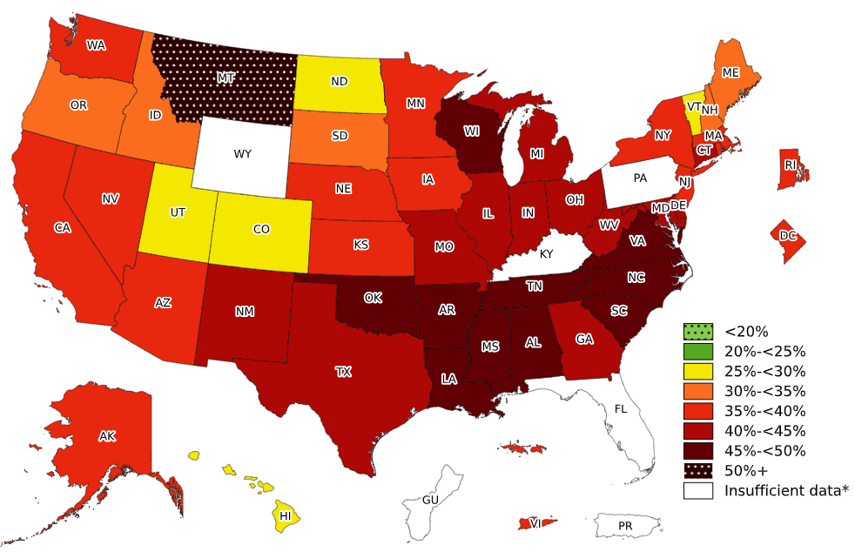
Prevalence of Obesity Based on Self-Reported Weight and Height Among Non-Hispanic Black Adults, by State and Territory, BRFSS, 2021–2023
*Sample size <50, the relative standard error (dividing the standard error by the prevalence) ≥30%, or no data in a specific year.

Slide 8
Prevalence of Obesity Based on Self-Reported Weight and Height Among Non-Hispanic Black Adults, by State and Territory, BRFSS, 2021–2023
State | Prevalence | 95% Confidence Interval
Alabama | 49.6 | (47.3, 52.0)
Alaska | 38.7 | (32.0, 46.0)
Arizona | 39.9 | (35.2, 44.7)
Arkansas | 48.2 | (44.6, 51.9)
California | 37.5 | (34.0, 41.1)
Colorado | 29.5 | (25.8, 33.4)
Connecticut | 41.9 | (38.5, 45.4)
Delaware | 44.9 | (41.5, 48.3)
District of Columbia | 37.0 | (34.7, 39.5)
Florida | Insufficient data* | Insufficient data*
Georgia | 43.8 | (41.8, 45.9)
Guam | Insufficient data* | Insufficient data*
Hawaii | 28.1 | (21.2, 36.3)
Idaho | 31.0 | (20.5, 43.9)
Illinois | 42.5 | (39.1, 46.0)
Indiana | 44.7 | (42.1, 47.4)
Iowa | 39.4 | (34.5, 44.7)
Kansas | 39.5 | (35.9, 43.2)
Kentucky | Insufficient data* | Insufficient data*
Louisiana | 47.1 | (44.9, 49.4)
Maine | 31.9 | (23.5, 41.6)
Maryland | 42.5 | (41.0, 44.0)
Massachusetts | 35.1 | (31.7, 38.6)
Michigan | 42.5 | (40.0, 45.0)
Minnesota | 35.7 | (32.9, 38.6)
Mississippi | 47.1 | (44.9, 49.4)
Missouri | 43.1 | (40.0, 46.2)
State | Prevalence | 95% Confidence Interval
Montana | 50.7 | (34.5, 66.7)
Nebraska | 36.2 | (31.9, 40.9)
Nevada | 36.3 | (30.9, 42.1)
New Hampshire | 33.7 | (23.0, 46.3)
New Jersey | 36.6 | (34.0, 39.3)
New Mexico | 43.3 | (33.9, 53.2)
New York | 36.5 | (34.7, 38.3)
North Carolina | 48.1 | (45.4, 50.8)
North Dakota | 27.1 | (21.0, 34.2)
Ohio | 43.6 | (41.0, 46.2)
Oklahoma | 47.5 | (43.5, 51.6)
Oregon | 31.1 | (24.3, 38.8)
Pennsylvania | Insufficient data* | Insufficient data*
Puerto Rico | Insufficient data* | Insufficient data*
Rhode Island | 38.9 | (33.8, 44.2)
South Carolina | 45.6 | (43.6, 47.7)
South Dakota | 31.0 | (20.0, 44.7)
Tennessee | 47.4 | (44.2, 50.7)
Texas | 43.8 | (40.7, 47.0)
Utah | 29.5 | (21.5, 39.1)
Vermont | 25.9 | (18.7, 34.8)
Virgin Islands | 35.8 | (31.1, 40.7)
Virginia | 46.6 | (44.3, 48.9)
Washington | 36.8 | (33.6, 40.1)
West Virginia | 42.8 | (36.8, 49.0)
Wisconsin | 48.4 | (43.6, 53.2)
Wyoming | Insufficient data* | Insufficient data*
*Sample size <50, the relative standard error (dividing the standard error by the prevalence) ≥30%, or no data in a specific year.
Source: Behavioral Risk Factor Surveillance System, CDC.

Slide 9
Prevalence of Obesity Based on Self-Reported Weight and Height Among Non-Hispanic Black Adults, by State and Territory, BRFSS, 2021–2023
Summary
No state or territory had a prevalence of obesity less than 25%.
5 states had a prevalence of obesity between 25% and <30%.
5 states had a prevalence of obesity between 30% and <35%.
13 states, Virgin Islands, and the District of Columbia had a prevalence of obesity between 35% and <40%.
12 states had a prevalence of obesity between 40% and <45%.
10 states had a prevalence of obesity between 45% and <50%.
Montana had a prevalence of obesity 50% or greater.

Slide 10
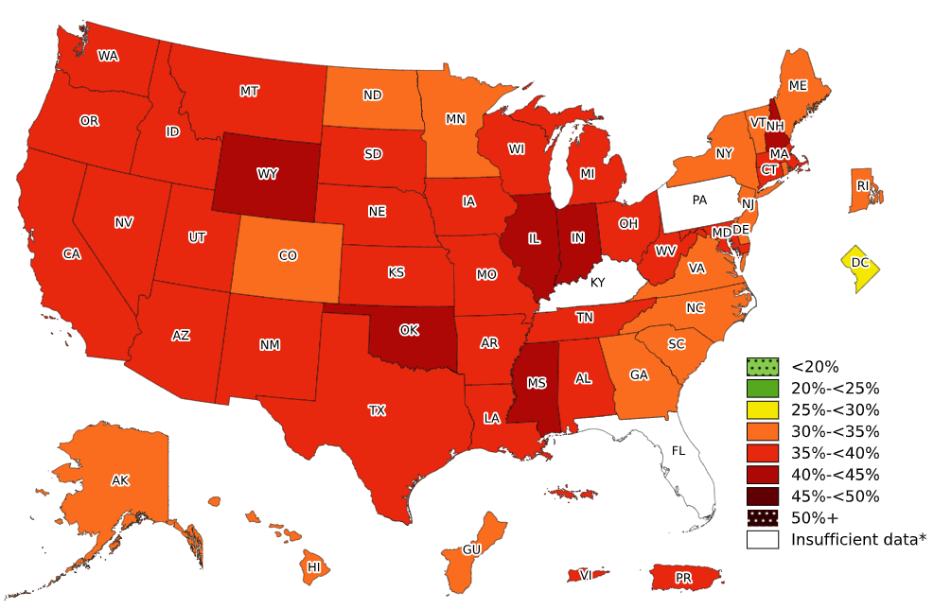
Prevalence of Obesity Based on Self-Reported Weight and Height Among Hispanic Adults, by State and Territory, BRFSS, 2021–2023
*Sample size <50, the relative standard error (dividing the standard error by the prevalence) ≥30%,
or no data in a specific year.

Slide 11
Prevalence of Obesity Based on Self-Reported Weight and Height Among Hispanic Adults, by State and Territory, BRFSS, 2021–2023
State | Prevalence | 95% Confidence Interval
Alabama | 36.1 | (28.8, 44.1)
Alaska | 34.6 | (29.7, 39.9)
Arizona | 38.1 | (36.2, 40.0)
Arkansas | 35.6 | (30.4, 41.2)
California | 35.9 | (34.5, 37.4)
Colorado | 30.9 | (29.2, 32.6)
Connecticut | 36.0 | (33.6, 38.6)
Delaware | 34.0 | (29.5, 38.7)
District of Columbia | 28.3 | (23.6, 33.4)
Florida | Insufficient data* | Insufficient data*
Georgia | 33.5 | (30.0, 37.3)
Guam | 30.8 | (22.9, 40.0)
Hawaii | 32.1 | (29.1, 35.3)
Idaho | 36.2 | (33.2, 39.4)
Illinois | 41.3 | (37.9, 44.8)
Indiana | 40.5 | (37.4, 43.7)
Iowa | 37.5 | (34.5, 40.5)
Kansas | 39.0 | (36.2, 42.0)
Kentucky | Insufficient data* | Insufficient data*
Louisiana | 36.8 | (31.3, 42.7)
Maine | 34.8 | (28.6, 41.6)
Maryland | 35.7 | (33.3, 38.1)
Massachusetts | 35.3 | (32.8, 37.9)
Michigan | 39.3 | (34.9, 43.9)
Minnesota | 33.9 | (31.2, 36.7)
Mississippi | 41.2 | (32.0, 51.0)
Missouri | 37.7 | (32.8, 42.9)
State | Prevalence | 95% Confidence Interval
Montana | 38.5 | (32.9, 44.3)
Nebraska | 37.1 | (34.6, 39.7)
Nevada | 35.5 | (32.0, 39.1)
New Hampshire | 40.4 | (33.5, 47.6)
New Jersey | 33.6 | (31.6, 35.6)
New Mexico | 37.9 | (35.9, 40.0)
New York | 33.0 | (31.6, 34.5)
North Carolina | 33.7 | (30.2, 37.3)
North Dakota | 33.8 | (27.8, 40.4)
Ohio | 36.4 | (32.2, 40.8)
Oklahoma | 42.4 | (38.9, 45.9)
Oregon | 38.6 | (35.6, 41.8)
Pennsylvania | Insufficient data* | Insufficient data*
Puerto Rico | 35.4 | (34.2, 36.5)
Rhode Island | 34.9 | (32.0, 37.9)
South Carolina | 32.7 | (28.7, 36.9)
South Dakota | 37.0 | (28.6, 46.4)
Tennessee | 36.8 | (31.3, 42.8)
Texas | 39.2 | (37.4, 41.1)
Utah | 36.2 | (34.1, 38.4)
Vermont | 32.9 | (26.5, 40.0)
Virgin Islands | 37.8 | (29.5, 46.9)
Virginia | 32.1 | (28.8, 35.6)
Washington | 37.6 | (35.8, 39.5)
West Virginia | 37.1 | (28.5, 46.5)
Wisconsin | 35.6 | (31.7, 39.8)
Wyoming | 40.7 | (36.0, 45.7)
*Sample size <50, the relative standard error (dividing the standard error by the prevalence) ≥30%, or no data in a specific year.
Source: Behavioral Risk Factor Surveillance System, CDC.

Slide 12
Prevalence of Obesity Based on Self-Reported Weight and Height Among Hispanic Adults, by State and Territory, BRFSS, 2021–2023
Summary
No state or territory had a prevalence of obesity less than 25%.
The District of Columbia had a prevalence of obesity between 25% and <30%.
15 states and Guam had a prevalence of obesity between 30% and <35%.
26 states, Puerto Rico, and Virgin Islands had a prevalence of obesity between 35% and <40%.
6 states had a prevalence of obesity between 40% and <45%.
No state or territory had a prevalence of obesity 45% or greater.

Slide 13
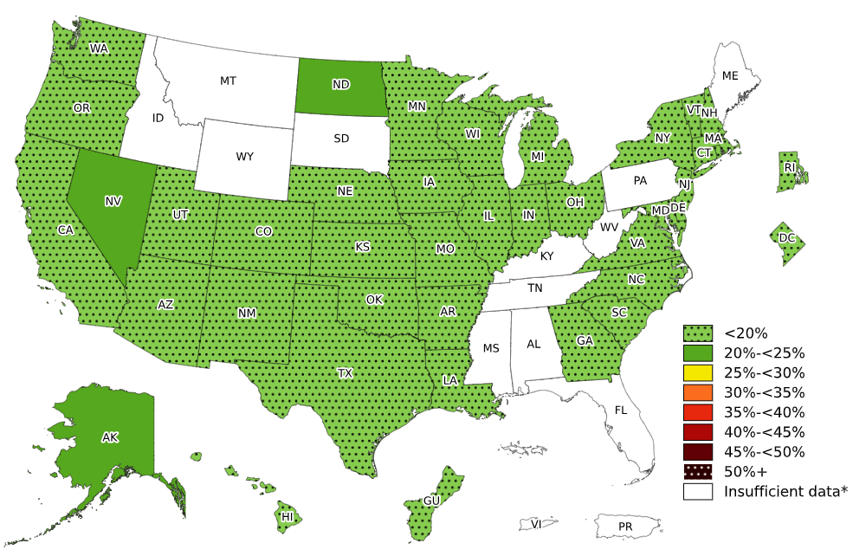
Prevalence of Obesity Based on Self-Reported Weight and Height Among Non-Hispanic Asian Adults, by State and Territory, BRFSS, 2021–2023
*Sample size <50, the relative standard error (dividing the standard error by the prevalence) ≥30%,
or no data in a specific year.

Slide 14
Prevalence of Obesity Based on Self-Reported Weight and Height Among Non-Hispanic Asian Adults, by State and Territory, BRFSS, 2021–2023
State | Prevalence | 95% Confidence Interval
Alabama | Insufficient data* | Insufficient data*
Alaska | 23.9 | (18.3, 30.5)
Arizona | 13.1 | (9.8, 17.4)
Arkansas | 15.2 | (8.6, 25.4)
California | 11.6 | (9.9, 13.6)
Colorado | 11.6 | (8.5, 15.6)
Connecticut | 13.3 | (10.0, 17.4)
Delaware | 15.6 | (10.1, 23.3)
District of Columbia | 11.5 | (7.5, 17.1)
Florida | Insufficient data* | Insufficient data*
Georgia | 16.0 | (11.4, 22.0)
Guam | 17.5 | (14.3, 21.2)
Hawaii | 17.8 | (16.5, 19.2)
Idaho | Insufficient data* | Insufficient data*
Illinois | 10.0 | (7.3, 13.6)
Indiana | 10.3 | (6.7, 15.3)
Iowa | 13.0 | (8.8, 18.7)
Kansas | 12.1 | (9.0, 16.2)
Kentucky | Insufficient data* | Insufficient data*
Louisiana | 17.3 | (11.3, 25.5)
Maine | Insufficient data* | Insufficient data*
Maryland | 14.3 | (11.8, 17.1)
Massachusetts | 11.2 | (8.8, 14.2)
Michigan | 10.2 | (7.4, 13.7)
Minnesota | 19.7 | (17.0, 22.8)
Mississippi | Insufficient data* | Insufficient data*
Missouri | 11.6 | (7.5, 17.5)
State | Prevalence | 95% Confidence Interval
Montana | Insufficient data* | Insufficient data*
Nebraska | 15.3 | (10.5, 21.8)
Nevada | 20.8 | (14.3, 29.1)
New Hampshire | 9.4 | (6.0, 14.4)
New Jersey | 13.3 | (11.1, 16.0)
New Mexico | 15.5 | (8.6, 26.3)
New York | 14.1 | (12.2, 16.2)
North Carolina | 11.4 | (7.6, 16.8)
North Dakota | 23.0 | (15.1, 33.4)
Ohio | 13.7 | (10.1, 18.4)
Oklahoma | 13.4 | (8.2, 21.0)
Oregon | 13.4 | (9.9, 17.9)
Pennsylvania | Insufficient data* | Insufficient data*
Puerto Rico | Insufficient data* | Insufficient data*
Rhode Island | 14.0 | (9.8, 19.7)
South Carolina | 12.2 | (7.1, 20.1)
South Dakota | Insufficient data* | Insufficient data*
Tennessee | Insufficient data* | Insufficient data*
Texas | 13.0 | (9.6, 17.4)
Utah | 10.6 | (7.6, 14.7)
Vermont | 11.0 | (6.1, 19.0)
Virgin Islands | Insufficient data* | Insufficient data*
Virginia | 13.2 | (10.1, 17.0)
Washington | 11.7 | (10.3, 13.3)
West Virginia | Insufficient data* | Insufficient data*
Wisconsin | 15.9 | (10.7, 23.0)
Wyoming | Insufficient data* | Insufficient data*
*Sample size <50, the relative standard error (dividing the standard error by the prevalence) ≥30%, or no data in a specific year.
Source: Behavioral Risk Factor Surveillance System, CDC.

Slide 15
Prevalence of Obesity Based on Self-Reported Weight and Height Among Non-Hispanic Asian Adults, by State and Territory, BRFSS, 2021–2023
Summary
35 states, the District of Columbia, and Guam had a prevalence of obesity less than 20%.
3 states (Alaska, Nevada, and North Dakota) had a prevalence of obesity between 20% and <25%.
No state had a prevalence of obesity 25% or greater

Slide 16
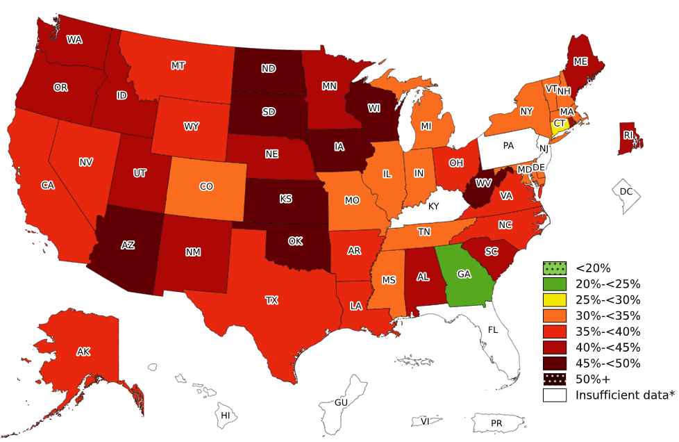
Prevalence of Obesity Based on Self-Reported Weight and Height Among Non-Hispanic American Indian or Alaska Native Adults, by State and Territory, BRFSS, 2021–2023
*Sample size <50, the relative standard error (dividing the standard error by the prevalence) ≥30%,
or no data in a specific year.

Slide 17
Prevalence of Obesity Based on Self-Reported Weight and Height Among Non-Hispanic American Indian or Alaska Native Adults, by State and Territory, BRFSS, 2021–2023
State | Prevalence | 95% Confidence Interval
Alabama | 43.1 | (31.1, 56.0)
Alaska | 37.3 | (34.1, 40.7)
Arizona | 48.1 | (43.9, 52.2)
Arkansas | 35.4 | (27.5, 44.3)
California | 36.2 | (27.7, 45.7)
Colorado | 33.6 | (26.4, 41.7)
Connecticut | 29.1 | (18.6, 42.4)
Delaware | 34.4 | (20.9, 51.0)
District of Columbia | Insufficient data* | Insufficient data*
Florida | Insufficient data* | Insufficient data*
Georgia | 23.4 | (14.7, 35.1)
Guam | Insufficient data* | Insufficient data*
Hawaii | Insufficient data* | Insufficient data*
Idaho | 44.5 | (35.6, 53.9)
Illinois | 32.4 | (20.0, 47.7)
Indiana | 34.7 | (26.4, 44.0)
Iowa | 48.1 | (37.2, 59.2)
Kansas | 45.6 | (39.0, 52.3)
Kentucky | Insufficient data* | Insufficient data*
Louisiana | 38.3 | (29.6, 47.9)
Maine | 41.2 | (33.6, 49.3)
Maryland | 31.9 | (23.7, 41.4)
Massachusetts | 31.0 | (20.4, 44.1)
Michigan | 31.9 | (23.0, 42.2)
Minnesota | 42.1 | (35.9, 48.6)
Mississippi | 30.9 | (18.0, 47.6)
Missouri | 32.7 | (24.3, 42.4)
State | Prevalence | 95% Confidence Interval
Montana | 39.0 | (35.3, 42.9)
Nebraska | 40.4 | (32.9, 48.4)
Nevada | 37.5 | (26.3, 50.2)
New Hampshire | 33.1 | (20.6, 48.5)
New Jersey | Insufficient data* | Insufficient data*
New Mexico | 42.3 | (37.7, 47.1)
New York | 34.2 | (24.9, 44.8)
North Carolina | 37.5 | (30.3, 45.4)
North Dakota | 47.1 | (41.6, 52.7)
Ohio | 35.9 | (26.5, 46.4)
Oklahoma | 45.2 | (41.9, 48.6)
Oregon | 43.3 | (34.1, 52.9)
Pennsylvania | Insufficient data* | Insufficient data*
Puerto Rico | Insufficient data* | Insufficient data*
Rhode Island | 42.4 | (30.0, 55.8)
South Carolina | 42.3 | (33.5, 51.6)
South Dakota | 46.1 | (38.8, 53.7)
Tennessee | 33.2 | (23.7, 44.4)
Texas | 39.6 | (26.4, 54.5)
Utah | 43.2 | (35.2, 51.5)
Vermont | 33.7 | (24.2, 44.7)
Virgin Islands | Insufficient data* | Insufficient data*
Virginia | 35.3 | (24.9, 47.3)
Washington | 43.2 | (37.8, 48.8)
West Virginia | 48.9 | (36.5, 61.5)
Wisconsin | 48.5 | (40.3, 56.9)
Wyoming | 39.5 | (30.4, 49.5)
*Sample size <50, the relative standard error (dividing the standard error by the prevalence) ≥30%, or no data in a specific year.
Source: Behavioral Risk Factor Surveillance System, CDC.

Slide 18
Prevalence of Obesity Based on Self-Reported Weight and Height Among Non-Hispanic American Indian or Alaska Native Adults, by State and Territory, BRFSS, 2021–2023
Summary
No state or territory had a prevalence of obesity less than 20%.
Georgia had a prevalence of obesity between 20% and <25%.
Connecticut had a prevalence of obesity between 25% and <30%.
13 states had a prevalence of obesity between 30% and <35%.
11 states had a prevalence of obesity between 35% and <40%.
11 states had a prevalence of obesity between 40% and <45%.
8 states had a prevalence of obesity between 45% and <50%.
No state or territory had a prevalence of obesity 50% or greater.

