Slide 1
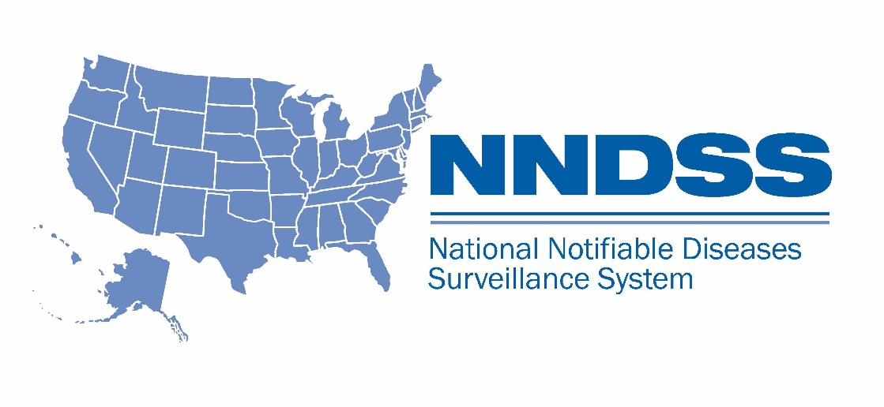
NNDSS eSHARE July Webinar
July 20, 2021

Slide 2

Agenda
  Welcome and Announcements (CDC)
  Highlights from 2021 Council of State and Territorial Epidemiologists (CSTE) Annual Conference (CSTE)
  Questions and Answers

Slide 3
NNDSS Updates and Announcements
Michele Hoover, MS
Data Standardization and Assistance Team

Slide 4
NNDSS eSHARE Webinar
Highlights from the 2021 CSTE Virtual Conference
Tuesday, July 20, 2021
Kate Goodin
Becky Lampkins
Shaily Krishan
Meredith Lichtenstein Cone

Slide 5
Agenda
Overview of 2021 CSTE Annual Conference- Shaily Krishan
Recap of S/I Conference Workshop - Kate Goodin
Review of Approved 2021 CSTE Position Statements - Meredith Lichtenstein Cone
Surveillance/ Informatics Steering Committee Roundtable Summary - Kate Goodin
CSTE Workgroups and Projects - Becky Lampkins
2021- 2022 Surveillance/ Informatics Priorities- Kate Goodin
Q & A

Slide 6
Overview of 2021 CSTE Annual Conference -
Shaily Krishan

Slide 8
Attendance and Sessions
Attendance
2,587 Registered attendees
State Health Agency: 56%
Local Health Agency: 13%
Federal Agency: 18%
Student: 2%
Tribal Agency: 1%
Conference Workshops
Sunday, June 13
14 Workshops
1,204 attendees
Conference Sessions
Mon-Wed, June 14-16
8 tracks
653 total presentations
  104 Breakouts
  136 Posters
  55 Roundtables
8 Sponsor Roundtables
7 Networking

Slide 9
CSTE Annual Business Meeting (Thursday, June 17)
Review of Voting Rights and Council Audit
State of CSTE Address
Presentation of proposed Bylaws
  The size of the Executive Board has changed from ten members to up to 13 active members, including up to nine Executive Board members who will no longer represent topic-specific Steering Committees
  Added 3 Standing Committees: Program and Policy; Governance and Nominating; and Finance and Audit
  Clarified types of membership; defined CSTE and Council; updated/clarified grammatical errors and language out of legal compliance; and revised passages to align with organizational practice
Presentation of 2021 Position Statements
New Business and Installation of New President and Executive Board

Slide 10
2021-2022 CSTE Executive Board
Officers
President: Ruth Lynfield – Minnesota
Chairs
Chronic Disease / Maternal and Child Health / Oral Health: Caitlin Pizzonia – Maine
Environmental Health / Occupational Health / Injury: Melissa Jordan – Florida
Infectious Disease: Catherine Brown – Massachusetts
Surveillance/Informatics Steering Committee: Kate Goodin – Tennessee
Members-at-Large
Cross Cutting I Steering Committee: Stephanie Ayers-Millsap – Alabama
Cross Cutting II Steering Committee: Ken Komatsu – Arizona
Vice President: Sherri Davidson – Alabama
President-Elect: Angela Dunn – Utah
Secretary-Treasurer: Kathryn Turner – Idaho

Slide 11
NNDSS-Related Sessions
Roundtables
Developing Data Quality Reports or Tools at CDC for Jurisdictions to Use to Monitor Data Submitted to NNDSS
Increasing Efficiency of Onboarding for State and Local Public Health Agencies Sending NNDSS HL7 Case Notifications
Developing Visualization Tools for CDC Disease Programs and Jurisdictions to Monitor Diseases Using the National Notifiable Diseases Surveillance System
Presentations (Recordings available)
NNDSS Progress and Future Directions
Working Together to Promote Jurisdiction Efficiencies to Send COVID-19 NNDSS Case Notifications

Slide 12
For more information..
2021 Virtual Conference Presentation Recordings
On-demand recordings of the Surveillance/ Informatics Workshop and certain presentations are available for up to three (3) months
Recordings may be accessed by logging into the conference platform: https://event-app5.eventpower.com/event_app/user/login/21CSTE
2021 Position Statements
Position Statement Archive: https://www.cste.org/page/PositionStatements
NNDSS-Related Sessions at the 2021 Virtual Conference
Case Surveillance Newsletter: https://www.cdc.gov/nndss/trc/news/issues/case-surveillance-news-202107.html

Slide 13
Recap of S/I Conference Workshop- Kate Goodin

Slide 14
2021 Surveillance/ Informatics Workshop: Interoperability- Building Bridges to the Future
Virtual workshop on Sunday, June 13
190 attendees
Workshop session themes:
  Provide examples and use cases to demonstrate adoption of technology and standards to facilitate interoperability across systems and applications.
  Opportunities to address trust barriers, privacy issues, and regulations around sharing public health data with internal and external partners.
  Current and evolving data integration needs to enhance public health’s ability to access relevant data sources and use it meaningfully.

Slide 15
2021 Surveillance/ Informatics Workshop:
Featured Presentations
Data Modernization Initiative (DMI): Opportunity for Change- Alan Sim (CDC)
Just-In-Time Integration and Interoperability: Leveraging Multiple Resources to Address COVID Data Demands – Tim Powell (VA)
Interoperability with IIS: The Landscape Within and Beyond Public Health – Mary Beth Kurilo (AIRA)
Public Data Sets and the COVID-19 Pandemic – Ben Silk (CDC)
Making the Case for Privacy Preserving Record Linkage in Public Health – Adi Gundlapalli (CDC)
A Landscape Survey of Public Health Interoperability – Craig Newman (Altarum)
Working toward birth certificate interoperability in Michigan – Jim Kamp (Altarum)

Slide 16
Review of Approved 2021 CSTE Position Statements- Meredith Lichtenstein Cone

Slide 17
Approved 2021 Position Statements
21-ID-01: Update to the standardized surveillance case definition and national notification for 2019 novel coronavirus disease (COVID-19)
21-ID-02: Revision to the Standardized Case Definition, Case Classification, and Public Health Reporting for Acute Flaccid Myelitis
21-ID-03: CSTE recommendations for modernization of laws to prevent HIV criminalization

Slide 18
Approved 2021 Position Statements
21-ID-04: Update to Public Health Reporting and National Notification of Viral Hemorrhagic Fever (VHF) caused by Ebola or Marburg viruses, Old World arenaviruses (Lassa and Lujo viruses), New World arenaviruses (Guanarito, Machupo, Junin, Sabia, and Chapare viruses), or Crimean-Congo hemorrhagic fever virus
21-ID-05: Modification of Lyme Disease Case Definition
21-ID-06: Public Health Reporting and National Notification for Infection Caused by Chlamydia trachomatis
21-ID-07: Standardized Case Definition for Alpha-Gal Syndrome

Slide 19
Surveillance/ Informatics Steering Committee Roundtable Summary- Kate Goodin

Slide 20
2021 Surveillance/ Informatics Steering Committee Roundtable
Workforce, workforce, workforce
  Learn from each other without directly competing for scarce resources
  Shared support
  Regional, by application, by topic
Data science competencies networking session
  Data governance
  Technical skills
  Data preparation and management
  Progressive, right fit, documentation

Slide 21
CSTE Workgroups and Projects- Becky Lampkins

Slide 22
CSTE Subcommittees and Workgroups
Surveillance Practice & Implementation Subcommittee
  Data Standardization Workgroup (to reconvene in August 2021)
    Workgroup Mission: Improve data quality through the development and application of consensus definitions for the core data elements for disease surveillance
    CSTE Staff Contact: Shaily Krishan (skrishan@cste.org)
  NMI Evaluation Workgroup
    Workgroup Charge: To convene epidemiologists, informaticians, and surveillance experts from state, local and territorial jurisdictions participating in NMI Message Mapping Guide (MMG) implementation activities, and other key stakeholders to evaluate and identify improvements in processes related to MMG implementation, MMG onboarding, MMG maintenance, and Technical Assistance (TA)
    CSTE Staff Contact: Shaily Krishan (skrishan@cste.org)
  Interjurisdictional Notifications Workgroup [short-term]

Slide 23
CSTE Subcommittees and Workgroups
Surveillance Policy Subcommittee
  *new* Data Release, Suppression, and Presentation Workgroup
    Inter-state data sharing
    Expanded/ interactive presentation of NNDSS data
    Tribal Epi Centers (TEC) data sharing at state and federal levels
    Data re-release
    CSTE Staff Contact: Shaily Krishan (skrishan@cste.org)
Electronic Laboratory and Disease Reporting Subcommittee
  National ELR Workgroup

Slide 24
CSTE Projects
Reportable Conditions Knowledge Management System (RCKMS)
  RCKMS Community of Practice
COVID-19 Data Preparedness
State Reportable Conditions Assessment
Syndromic Surveillance

Slide 25
2021-2022 Surveillance/ Informatics Priorities-
Kate Goodin

Slide 27
CSTE National Office
2635 Century Parkway NE, Suite 700
Atlanta, Georgia 30345
770.458.3811
770.458.8516
skrishan@cste.org

Slide 28

Subscribe to the monthly NNDSS newsletter Case Surveillance News (formerly NMI Notes) at https://www.cdc.gov/nndss/trc/news/index.html
Access the NNDSS Technical Assistance and Training Resource Center at
https://www.cdc.gov/nndss/trc/index.html
Request NNDSS technical assistance or onboarding at
edx@cdc.gov
Next NNDSS eSHARE is August 10, 2021 – details to come at
https://www.cdc.gov/nndss/trc/onboarding/eshare.html

