Slide 1
NNDSS eSHARE November 2024 Webinar
Centers for Disease Control and Prevention
Office of Public Health Data, Surveillance, and Technology
November 19, 2024

Slide 2
Agenda
Overview of Mumps, Pertussis, and Varicella Message Mapping Guides (MMGs)
Questions and Answers

Slide 3
Introduction to the Mumps, Pertussis, and Varicella Message Mapping Guides (MMGs)
November 19, 2024
Sandy Roush, MT, MPH
Amy Rubis, MPH
Jessica Leung, MPH
Jamie Tappe, MPH, CPH

Slide 4
NNDSS Data Collection for Mumps, Pertussis, and Varicella
Currently, NCIRD receives National Notifiable Diseases Surveillance System (NNDSS) data from most jurisdictions via the National Electronic Telecommunications System for Surveillance (NETSS) format.
NETSS format includes core and extended data developed in the 1990’s.
Important changes in surveillance, epidemiology and laboratory testing since the 1990’s:
- New lab testing (e.g., PCR)
- New vaccines and target populations (e.g., Tdap, 3rd mumps dose)
- Updated case definitions and case report forms
- Data collection methods
MMGs developed to improve the collection, transmission, and analysis of data needed at the national level for public health surveillance
4

Slide 5
Message Mapping Guide (MMG) Implementation for NCIRD Conditions
DISEASE-SPECIFIC MMGs (HL7®)
MMG Developed:
COVID-19
Mumps
Pertussis
Varicella
H. influenzae (RIBD)
N. meningitidis (RIBD)
IPD (RIBD)
Legionellosis
Measles
Rubella
CRS
Requirement Review:
12. Diphtheria
Tetanus
Pediatric Influenza Deaths
Novel Flu A
NCIRD provides technical and programmatic support for 23 conditions for which data is received through NNDSS.
MMG data – HL7®
8 planned to use only the Generic v2 MMG.
15 NNCs will use the Generic v2 MMG and a disease-specific MMG.
NETSS
Includes all 23 conditions for which NCIRD provides support and receives data through NNDSS.
GENERIC-V2 MMG ONLY (HL7®)
Planned to use only Generic v2:
Poliomyelitis, paralytic
Poliovirus infection, non paralytic
STSS
SARS-CoV
AFM
MIS
RSV-associated deaths
Psittacosis
FHIR® is the registered trademark of HL7 and is used with the permission of HL7.
5

Slide 6
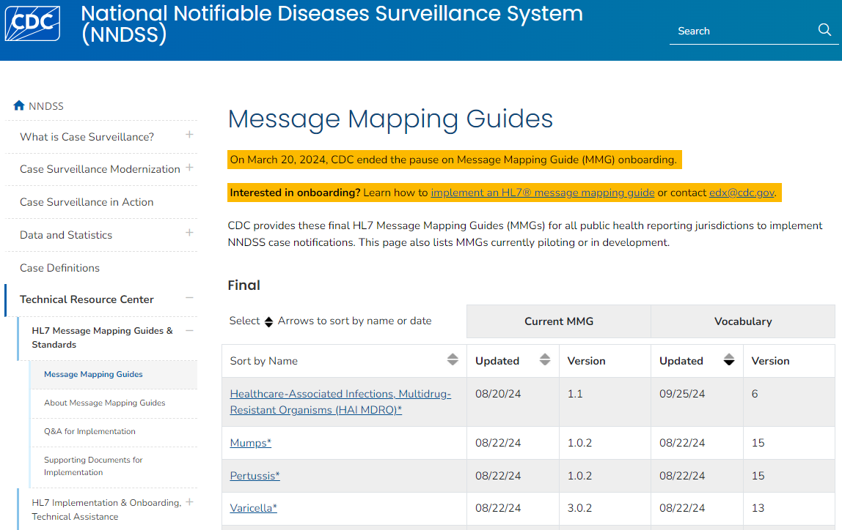
Introduction
Message Mapping Guides
6

Slide 7
Mumps Message Mapping Guide (MMG)

Slide 8
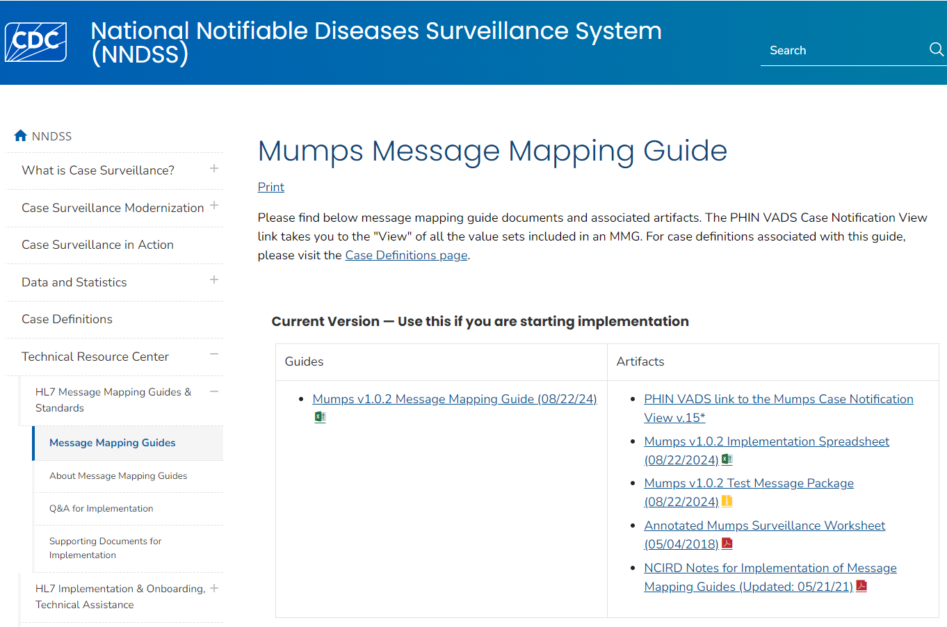
Welcome to the Mumps MMG
Mumps Message Mapping Guide ; NCIRD-Notes-for-Implementation-of-MMGs
8

Slide 9
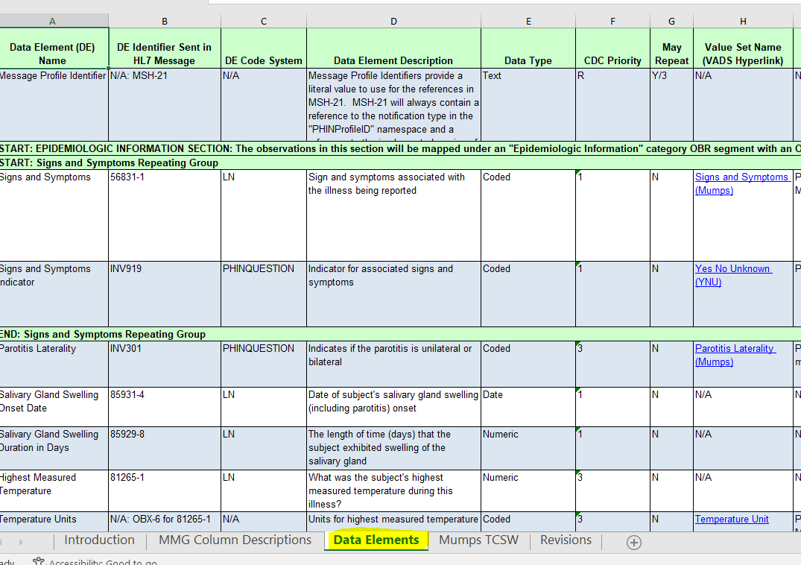
Mumps MMG
Mumps Message Mapping Guide
9

Slide 10
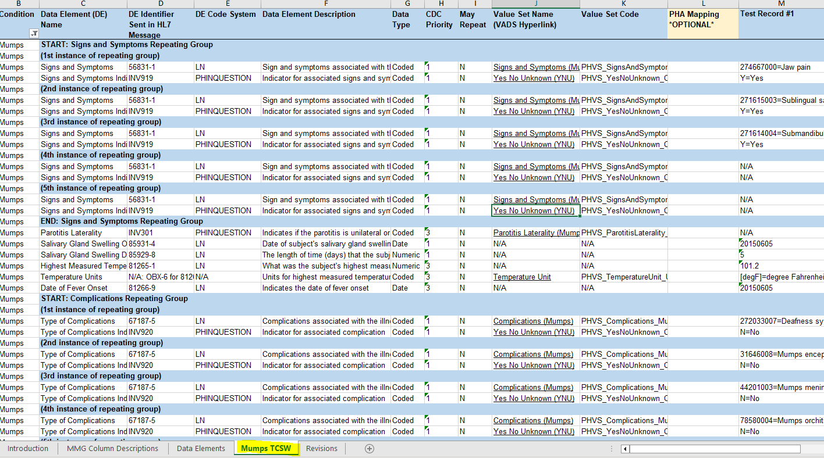
Test Case Scenario Worksheet
https://ndc.services.cdc.gov/mmgpage/mumps-message-mapping-guide/
10

Slide 11
Mumps MMG Overview
The Mumps MMG should be used in conjunction with the GenV2 MMG to construct a complete case notification.
There are 58 mumps-specific data elements:
28 are divided into 6 repeating groups.
30 are non-repeating data elements.
Of the 58 mumps-specific data elements:
1 is required.
33 are priority 1 (highest priority).
14 are priority 2 (high priority).
10 are priority 3 (low priority).
11

Slide 12
Mumps MMG Data Element Harmonization
Among the 47 Mumps MMG priority 1 and priority 2 data elements:
- 36 (77%) are in the Pertussis MMG.
- 34 (72%) are in the Varicella MMG.
12

Slide 13
Pertussis Message Mapping Guide (MMG)

Slide 14
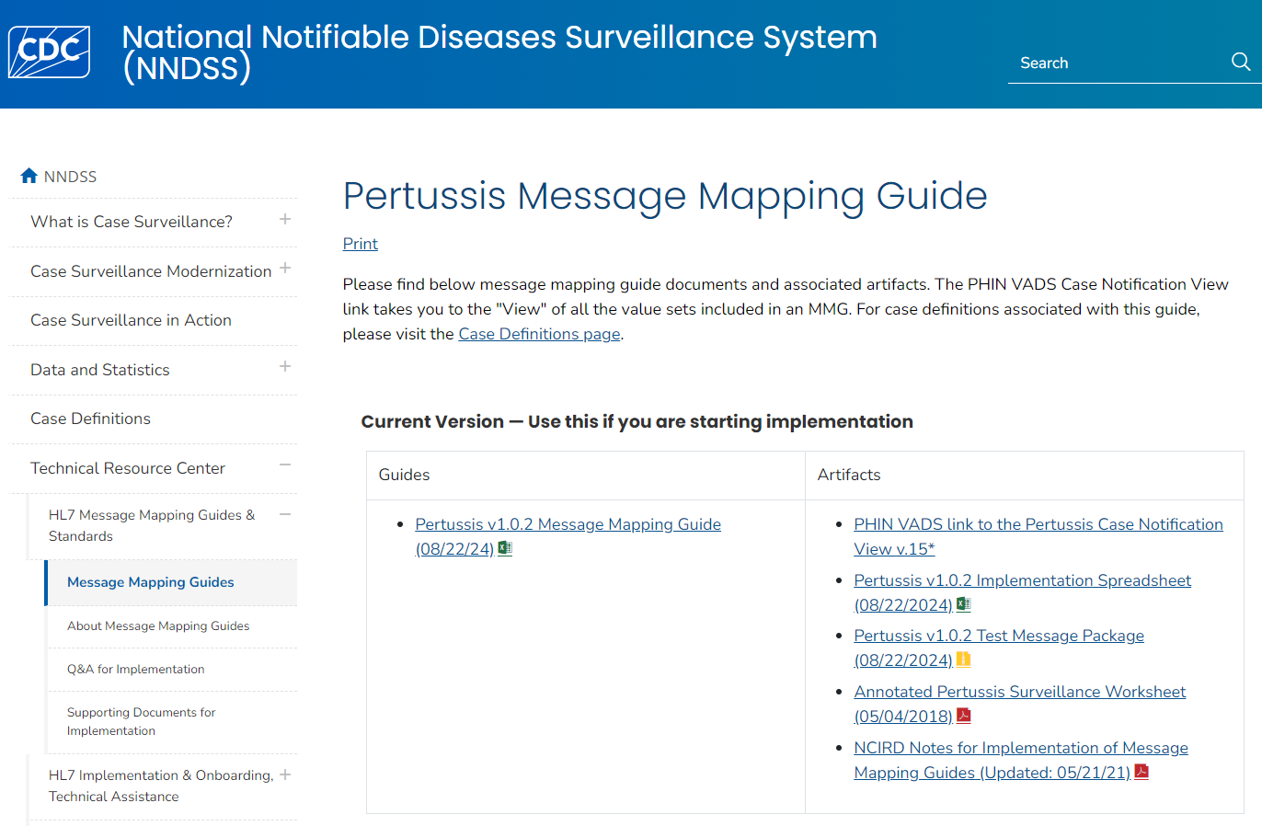
Welcome to the Pertussis MMG
Pertussis Message Mapping Guide; NCIRD-Notes-for-Implementation-of-MMGs
14

Slide 15
Pertussis MMG Overview
The Pertussis MMG should be used in conjunction with the GenV2 MMG to construct a complete case notification.
There are 70 pertussis-specific data elements:
36 are divided into 8 repeating groups.
34 are non-repeating data elements.
Of the 70 pertussis-specific data elements:
1 is required.
35 are priority 1 (highest priority).
16 are priority 2 (high priority).
18 are priority 3 (low priority).
15

Slide 16
Pertussis MMG Data Element Harmonization
Among the 51 Pertussis MMG priority 1 and priority 2 data elements:
36 (71%) are in the Mumps MMG.
38 (75%) are in the Varicella MMG.
16

Slide 17
Varicella Message Mapping Guide (MMG)

Slide 18
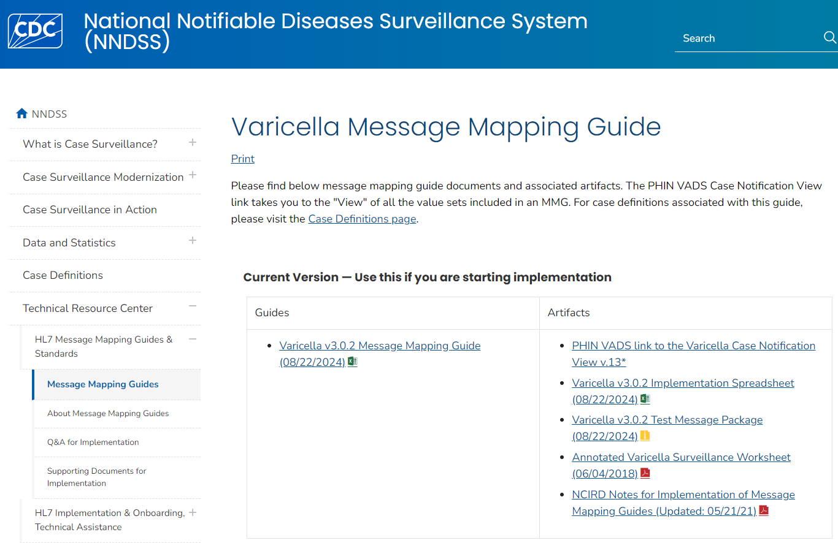
Welcome to the Varicella MMG
Varicella Message Mapping Guide; NCIRD-Notes-for-Implementation-of-MMGs
18

Slide 19
Varicella MMG Overview
The Varicella MMG should be used in conjunction with the GenV2 MMG to construct a complete case notification.
There are 73 varicella-specific data elements:
29 are divided into 6 repeating groups.
44 are non-repeating data elements.
Of the 73 varicella-specific data elements:
1 is required.
35 are priority 1 (highest priority).
22 are priority 2 (high priority).
15 are priority 3 (low priority).
19

Slide 20
Varicella MMG Data Element Harmonization
Among the 57 Varicella MMG priority 1 and priority 2 data elements:
35 (61%) are in the Mumps MMG.
34 (60%) are in the Pertussis MMG.
20

Slide 21
Benefits of MMG Data Element Harmonization

Slide 22
Results for Harmonization of Disease Specific MMGs by Condition*
* Data do not include Gen V2 variables.
** ”Total” column also contains variables which do not fit within the four categories on this slide (e.g., system variables)
22

Slide 23
Benefits of Onboarding
When considering jurisdiction workload for pre-onboarding activities (e.g., mapping data elements from jurisdiction NNDSS system to MMGs):
Among the 47 Mumps MMG priority 1&2 data elements:
- 36 (77%) are in the Pertussis MMG.
- 34 (72%) are in the Varicella MMG.
Among the 51 Pertussis MMG priority 1&2 data elements:
36 (71%) are in the Mumps MMG.
38 (75%) are in the Varicella MMG.
Among the 57 Varicella MMG priority 1&2 data elements:
35 (61%) are in the Mumps MMG.
34 (60%) are in the Pertussis MMG.
Two NCIRD resources for mapping to HL7 data elements:
NCIRD-Notes-for-Implementation-of-MMGs on web page for each NCIRD MMG.
Appendices for VPD Surveillance Manual presents annotated surveillance worksheets that show mapping to HL7 data elements (e.g., the mumps annotated worksheet).
23

Slide 24
Benefits of Onboarding, continued
Implementation of the guides will reduce the reporting burden on jurisdictions and improve data transmission and efficiency.
NCIRD provides timely data validation reports and feedback to reduce the time needed to fully implement MMGs.
NCIRD is supportive of jurisdictions’ preferences to onboard any disease-specific MMG in the order they prefer.
24

Slide 25
NEW! Mumps, Pertussis, and Varicella Cohort
Kickoff: Monday, November 18th
Cohort meets on Mondays at 3:00PM-4:00PM ET
Accepting new jurisdictions to join cohort. If you would like to join, please email edx@cdc.gov with subject line, “Interest in MPV MMG Cohort”.
Winter 2024 / Spring 2025 Cohorts
Currently gathering jurisdictions’ MMG interests
If there are any MMGs of interest that you would like to work on in a cohort, please email edx@cdc.gov with the subject line, “Interest in MMG Cohorts: [insert MMG name(s) here]”.
25

Slide 26
Questions?
Email: NCIRDsurvData@cdc.gov

Slide 27
Thank you! Next NNDSS eSHARE: January 21, 2025
Subscribe to Case Surveillance News
Access NNDSS’ Technical Resource Center
Email edx@cdc.gov for technical help
Learn about case surveillance modernization

Slide 28
Appendix

Slide 29
Mumps MMG Data Elements

Slide 30
Mumps MMG Data Element Summary
There are 58 mumps-specific data elements:
28 are divided into 6 repeating groups.
Signs and Symptoms
Complications
Industry and Occupation
VPD Lab Linkage
Epidemiology Laboratory
Preferred Vaccine History
30 are non-repeating data elements.
30

Slide 31
Mumps MMG Repeating Groups

Slide 32
Mumps Repeating Groups
Signs and Symptoms (n=2)
Signs and Symptoms (56831-1)
Signs and Symptoms Indicator (INV919)
Complications (n=2)
Type of Complication (67187-5)
Type of Complications Indicator (INV920)
Industry and Occupation (n=4)
Current Occupation (85658-3)
Current Occupation Standardized (85659-1)
Current Industry (85078-4)
Current Industry Standardized (85657-5)
32

Slide 33
Mumps Repeating Groups, continued
VPD Lab Linkage (n=3)
VPD Lab Message Reference Laboratory (LAB143)
VPD Lab Message Patient Identifier (LAB598)
VPD Lab Message Specimen Identifier (LAB125)
Epidemiology Laboratory (n=8)
Test Type (INV290)
Test Result (INV291)
Test Result Quantitative (LAB628)
Result Units (LAB115)
Specimen Source (31208-2)
Specimen Collection Date/Time (68963-8)
Date Specimen Sent to CDC (85930-6)
Performing Lab Type (82771-7)
33

Slide 34
Mumps Repeating Groups, continued
Preferred Vaccine History (n=9)
Vaccine Type (30956-7)
Vaccine Administered Date (30952-6)
Vaccine Dose Number (30973-2)
Vaccine Manufacturer (30957-5)
Vaccine Lot Number (30959-1)
Vaccine Expiration Date (VAC109)
National Drug Code (VAC153)
Vaccination Record Identifier (VAC102)
Vaccine Event Information Source (VAC147)
34

Slide 35
Mumps MMG Non-Repeating Data Elements

Slide 36
Mumps Non-Repeating Data Elements
Epidemiologic Information (n=20)
Message Profile Identifier (MSH-21)
Parotitis Laterality (INV301)
Salivary Gland Swelling Onset Date (85931-4)
Salivary Gland Swelling Duration in Days (85929-8)
Highest Measured Temperature (81265-1)
Temperature Units (OBX-6 for 81265-1)
Date of Fever Onset (81266-9)
Type of Deafness (INV307)
Length of Time in the US (DEM225)
Length of Time in the US Units (OBX-6 for DEM225)
International Destination(s) of Recent Travel (82764-2)
US Acquired (INV516)
Date of Return from Travel (TRAVEL08)
Patient Address City (PID -11.3)
Case Investigation Status Code (INV109)
Detection Method (INV159)
Transmission Setting (81267-7)
Age and Setting Verified (85700-3)
Epi-Linked (INV217)
Import Status (INV293)
36

Slide 37
Mumps Non-Repeating Data Elements, continued
Interpretive Lab Questions (n=3)
Laboratory Testing Performed (LAB630)
Laboratory Confirmed (INV164)
Specimen Sent to CDC (82314-6)
Interpretive Vaccine History Questions (n=7)
Did the Subject Ever Receive a Vaccine Against This Disease (VAC126)
Number of Doses Received On or After 1st Birthday (VAC129)
Date of Last Dose Prior to Illness Onset (VAC142)
Vaccination Doses Prior to Onset (82745-1)
Vaccinated per ACIP Recommendations (VAC148)
Reason Not Vaccinated Per ACIP Recommendations (VAC149)
Vaccine History Comments (VAC133)
37

Slide 38
Pertussis MMG Data Elements

Slide 39
Pertussis MMG Data Element Summary
There are 70 pertussis-specific data elements
36 are divided into 8 repeating groups:
Signs and Symptoms
Complications
Antibiotics
Suspected Sources
Industry and Occupation
VPD Lab Linkage
Epidemiology Laboratory
Preferred Vaccine History
34 are non-repeating data elements.
39

Slide 40
Pertussis MMG Repeating Groups

Slide 41
Pertussis Repeating Groups
Signs and Symptoms (n=2)
Signs and Symptoms (56831-1)
Signs and Symptoms Indicator (INV919)
Complications (n=2)
Type of Complication (67187-5)
Type of Complications Indicator (INV920)
Antibiotics (n=3)
Medication Administered (29303-5)
Date Treatment or Therapy Started (86948-7)
Treatment Duration (67453-1)
41

Slide 42
Pertussis Repeating Groups, continued
Suspected Sources (n=5)
Suspected Source Age (PRT074)
Suspected Source Age Units (OBX-6 for PRT074)
Suspected Source Sex (PRT076)
Suspected Source Relationship to Case (PRT077)
Suspected Source Cough Onset Date (PRT088)
Industry and Occupation (n=4)
Current Occupation (85658-3)
Current Occupation Standardized (85659-1)
Current Industry (85078-4)
Current Industry Standardized (85657-5)
42

Slide 43
Pertussis Repeating Groups, continued
VPD Lab Linkage (n=3)
VPD Lab Message Reference Laboratory (LAB143)
VPD Lab Message Patient Identifier (LAB598)
VPD Lab Message Specimen Identifier (LAB125)
Epidemiology Laboratory (n=8)
Test Type (INV290)
Test Result (INV291)
Test Result Quantitative (LAB628)
Result Units (LAB115)
Specimen Source (31208-2)
Specimen Collection Date/Time (68963-8)
Date Specimen Sent to CDC (85930-6)
Performing Lab Type (82771-7)
43

Slide 44
Pertussis Repeating Groups, continued
Preferred Vaccine History (n=9)
Vaccine Type (30956-7)
Vaccine Administered Date (30952-6)
Vaccine Dose Number (30973-2)
Vaccine Manufacturer (30957-5)
Vaccine Lot Number (30959-1)
Vaccine Expiration Date (VAC109)
National Drug Code (VAC153)
Vaccination Record Identifier (VAC102)
Vaccine Event Information Source (VAC147)
44

Slide 45
Pertussis MMG Non-Repeating Data Elements

Slide 46
Pertussis Non-Repeating Data Elements
Epidemiologic Information (n=26)
Message Profile Identifier (MSH-21)
Date of Final Interview (INV555)
Cough at Final Interview (PRT008)
Cough Onset Date (85932-2)
Total Cough Duration (85933-0)
Age at Cough Onset (85934-8)
Age Units (OBX-6 for INV902)
Chest X-ray for Pneumonia (INV923)
Antibiotics Given (INV559)
Case Patient a Healthcare Worker (223366009)
Mother's Age at Infant's Birth (85724-3)
Gestational Age (18185-9)
Birth Weight (56056-5)
Birth Weight Units (OBX-6 for 56056-5)
46

Slide 47
Pertussis Non-Repeating Data Elements, continued
Epidemiologic Information, continued
Setting (Outside Household) of Further Documented Spread From This Case (INV561)
Number of Contacts Recommended Prophylaxis (INV562)
Did Mother Receive Tdap (MTH172)
Timing of Mother's Tdap Administration (MTH173)
Date of Mother's Tdap Administration (MTH174)
One or More Suspected Sources (PRT070)
Number of Suspected Sources (PRT071)
Patient Address City (PID-11.3)
Case Investigation Status Code (INV109)
Detection Method (INV159)
Transmission Setting (81267-7)
Epi-Linked to a Laboratory Confirmed Case (INV217)
47

Slide 48
Pertussis Non-Repeating Data Elements, continued
Interpretive Lab Questions (n=3)
Laboratory Testing Performed (LAB630)
Laboratory Confirmed (INV164)
Specimen Sent to CDC (82314-6)
Interpretive Vaccine History Questions (n=5)
Did the Subject Ever Receive a Vaccine Against This Disease (VAC126)
Date of Last Dose Prior to Illness Onset (VAC142)
Vaccination Doses Prior to Onset (82745-1)
Vaccinated per ACIP Recommendations (VAC148)
Reason Not Vaccinated Per ACIP Recommendations (VAC149)
48

Slide 49
Varicella MMG Data Elements

Slide 50
Varicella MMG Data Element Summary
There are 73 varicella-specific data elements:
29 are divided into 6 repeating groups:
Complications
Antiviral Treatment
Industry and Occupation
VPD Lab Linkage
Epidemiology Laboratory
Preferred Vaccine History
44 are non-repeating data elements.
50

Slide 51
Varicella MMG Repeating Groups
7

Slide 52
Varicella Repeating Groups
Complications (n=2)
Type of Complication (67187-5)
Type of Complications Indicator (INV920)
Antiviral Treatments (n=3)
Medication Administered (29303-5)
Date Treatment or Therapy Started (86948-7)
Treatment Duration (67453-1)
Industry and Occupation (n=4)
Current Occupation (85658-3)
Current Occupation Standardized (85659-1)
Current Industry (85078-4)
Current Industry Standardized (85657-5)
52

Slide 53
Varicella Repeating Groups, continued
VPD Lab Linkage (n=3)
VPD Lab Message Reference Laboratory (LAB143)
VPD Lab Message Patient Identifier (LAB598)
VPD Lab Message Specimen Identifier (LAB125)
Epidemiology Laboratory (n=8)
Test Type (INV290)
Test Result (INV291)
Test Result Quantitative (LAB628)
Result Units (LAB115)
Specimen Source (31208-2)
Specimen Collection Date/Time (68963-8)
Date Specimen Sent to CDC (85930-6)
Performing Lab Type (82771-7)
53

Slide 54
Varicella Repeating Groups, continued
Preferred Vaccine History (n=9)
Vaccine Type (30956-7)
Vaccine Administered Date (30952-6)
Vaccine Dose Number (30973-2)
Vaccine Manufacturer (30957-5)
Vaccine Lot Number (30959-1)
Vaccine Expiration Date (VAC109)
National Drug Code (VAC153)
Vaccination Record Identifier (VAC102)
Vaccine Event Information Source (VAC147)
54

Slide 55
Varicella MMG Non-Repeating Data Elements
7

Slide 56
Varicella Non-Repeating Data Elements
Epidemiologic Information (n=13)
Message Profile Identifier (MSH-21)
Diagnosed with Varicella Before (VAR150)
Age at Previous Diagnosis (INV934)
Age Units (OBX-6 for INV934)
Previous Case Diagnosed By (VAR152)
Is this case epi-linked to another confirmed or probable case (VAR154)
Type of Case This Case is Epi-linked to (VAR155)
Transmission Setting (81267-7)
Case Patient a Healthcare Worker (223366009)
Number of Weeks Gestation at Onset of Illness (81270-1)
Trimester at Onset of Illness (81271-9)
Patient Address City (PID-11.3)
Case Investigation Status Code (INV109)
56

Slide 57
Varicella Non-Repeating Data Elements, continued
Treatment Questions (n=1)
Antiviral Medication (VAR139)
Clinical Questions (n=21)
Total Number of Lesions (300579006)
Specify Number of Lesions (246206008)
Rash Onset Date (81268-5)
Was the Rash Generalized (725119006)
Body Region(s) of Rash (364402001)
Character of Lesions (364637009)
Hemorrhagic Lesions (INV911)
Itchy Lesions (418290006)
Lesions Appear as Crops or Waves (INV912)
Crusted Lesions (INV913)
Rash Duration (81269-3)
57

Slide 58
Varicella Non-Repeating Data Elements, continued
Clinical Questions, continued
Fever (386661006)
Date of Fever Onset (81266-9)
Highest Measured Temperature (81265-1)
Temperature Units (OBX-6 for 81265-1)
Fever Duration (81264-4)
Patient Immunocompromised (370388006)
Immunocompromised Associated Condition or Treatment (INV933)
Did the Patient Visit a Healthcare Provider During This Illness (VAR128)
Reason for Hospitalization (86947-9)
Chest X-ray for Pneumonia (INV293)
58

Slide 59
Varicella Non-Repeating Data Elements, continued
Interpretive Lab Questions (n=3)
Laboratory Testing Performed (LAB630)
Laboratory Confirmed (INV164)
Specimen Sent to CDC (82314-6)
Interpretive Vaccine History Questions (n=6)
Did the Subject Ever Receive a Vaccine Against This Disease (VAC126)
Number of Doses Received On or After 1st Birthday (VAC129)
Date of Last Dose Prior to Illness Onset (VAC142)
Vaccination Doses Prior to Onset (82745-1)
Vaccinated per ACIP Recommendations (VAC148)
Reason Not Vaccinated Per ACIP Recommendations (VAC149)
59

