Slide 1
Caring for Yourself While Caring for Others
Module 6: Tips for Setting
Healthy and Safe
Boundaries to Reduce Stress
Presenter’s Name
Host Organization

Slide 2


Slide 3
Session Goals
Participants will be able to do the following:
Describe what causes stress in your work lives.
Define the many aspects of stress.
Outline personal strategies for handling
and reducing stress.
Explain the safe and healthy boundaries needed between you and your clients.

Slide 4
How Stressed Do You Get When...
Not at all
A bit
Somewhat
Very!
Quite
Listen to the scenarios as they are presented.
Place yourselves along the spectrum from “not at all stressed” to “very stressed!” to indicate how the scenario would tend to affect you.
Introduce yourselves.
Explain why you would feel the level of stress you indicate.

Slide 5
What is Job Stress?
When the requirements of the job are too much for you and result in physical and emotional distress.
Job stress can lead to poor health, and even injury.
Illustration by ®Mary Ann Zapalac

Slide 6

The Effect of Stress on Our Bodies
When we are stressed, our:
Blood pressure rises.
Breathing becomes more rapid.
Digestive system slows down.
Heart rate (pulse) rises.
Immune system goes down.
Muscles become tense.
Sleeping can be more of a problem.
Photo by ®Thinkstock

Slide 7



Stress Affects Us in Many Ways
Our behavior
and interactions.
Our bodies.
Photo by ®Thinkstock
Photo by ®Thinkstock
Our thoughts and feelings.
Photo by ®Thinkstock

Slide 8
Setting Healthy and Safe Boundaries
Pair Activity
Rank your assigned scenarios from 1 to 3:
1—This is healthy and safe boundary setting.
2—This is less safe and healthy.
3—This is unsafe and unhealthy.
Discuss with your partner why you are ranking the scenarios as you do.
You have 5 minutes for your discussion!

Slide 9
Healthy and Safe Boundaries:
Worker Responsibilities
Come to work without friends or family.
Do not discuss your life problems that might worry
or concern clients.
Do not give out your phone number to clients.
Never take money or gifts from clients.

Slide 10
Healthy and Safe
Boundaries—Speak Up
Speak up if a client is treating you in ways
that are stressful to you.
  Don’t work hours you aren’t paid for.
  Don’t perform tasks you are not trained to do!
  Report concerns to your supervisor.
  Ask for training and tools you need.

Slide 11
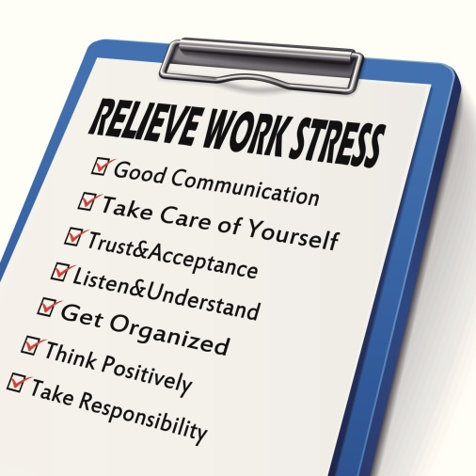
Tips and Strategies for Speaking Up
Be assertive! Take steps to solve the problems that cause you stress at work …
Make a list of the issues. Come up with
ideas of ways to reduce these problems.
Select one or two issues to work on—don’t overwhelm yourself.
Talk with others who can help give you ideas and solve problems.
Prepare to speak up!
Photo by ®Thinkstock

Slide 12
Tips and Strategies for Managing Stress
Exercise—find what you like to do.
Eat well and nutritiously.
Talk with a friend or counselor.
Get enough sleep.
Keep up-to-date on vaccinations, such as flu shots.
Avoid alcohol, drugs, and caffeine.
Make time each day to relax, laugh, and reflect.
Illustration by ®Mary Ann Zapalac

Slide 13
Thanks for participating!
Additional Resources:
Homecare workers’ handbook: Caring for Yourself While Caring
for Others .
http://www.cdc.gov/niosh/docs/2015-103/pdf/2015-103.pdf
NIOSH Hazard Review: “Occupational Hazards and Home Health Care.”
http://www.cdc.gov/niosh/docs/2010-125/pdfs/2010-125.pdf
Home and Community Health Worker Handbook, British Columbia, Canada, OHSAH.
http://www.phsa.ca/NR/rdonlyres/6C69D638-8587-4096-A8AA-7D2B0141C3B2/59614/HandbookHomeandCommunityHealthcareWorkersHandbook.pdf
Safety Manual for Homecare Workers, Oregon Homecare Commission. http://apps.state.or.us/Forms/Served/de9062.pdf

Slide 14
Credits
[Insert trainer and/or training organization’s name(s), and contact information here.]

