Slide 1
Caring for Yourself While Caring for Others
Module 2: Tips for Reducing
Strains, Sprains, and Falls While Doing
Housekeeping and Caring for Clients
Presenter’s Name
Host Organization

Slide 2


Slide 3
Session Goals
Participants will be able to do the following:
Outline the possible risks from reaching, pushing,
and carrying while housekeeping and caring for clients.
Describe strategies and tools to reduce risks.
Explain safe moving and transfer techniques.
Demonstrate positive problem solving with clients.

Slide 4

Staying Safe While Housekeeping and Providing Personal Care
Housekeeping:
Mopping.
Vacuuming.
Dusting.
Washing, scrubbing.
Laundry.
Cooking.
Personal Care:
Dressing.
Bathing.
Toileting.
Illustration by ®Mary Ann Zapalac
Illustrations by ®Mary Ann Zapalac

Slide 5
Tips and Tools to Reduce Strains and Sprains While Scrubbing
Cushion your knees
with a towel, pad, or rug.
Keep supplies near,
so you don’t have to reach.
Limit bending and twisting—use long-handled scrub brushes.
Illustration by ®Mary Ann Zapalac

Slide 6
Tips and Tools to Reduce Strains and Sprains While Housekeeping
Avoid reaching, bending, stretching,
and twisting:
  Use long-handled dusters and mops.
  Use a step-stool.
  Move as close as possible to the task, such as around the bed sides.
Don’t try anything you think might
be unsafe—get help from another person.
Illustration by ®Mary Ann Zapalac

Slide 7
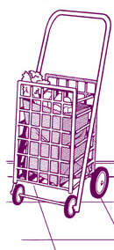
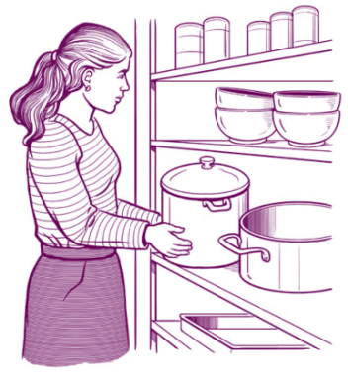
Tips and Tools to Reduce
Strains and Sprains While Lifting
Use a cart to carry items.
Break heavy loads into
small ones.
Keep your line of sight clear.
Keep heavy items at waist height.
Illustrations by ®Mary Ann Zapalac

Slide 8
Tips and Tools to Reduce Strains and Sprains While Providing Care
Have all supplies ready and
nearby before beginning.
Limit bending and twisting—use
a stool at the bath.
Make bathing easier by using:
  Handrails.
  A shower chair.
  A hand-held shower hose.
  Long-handled brush.
Get as close to the client as possible.
Illustration by ®Mary Ann Zapalac

Slide 9
Trip and Fall Hazards in and Around Homes
Loose carpet rugs.
Electrical cords.
Clutter.
Open drawers.
Pets.
Poorly maintained steps and floors.
Wet or slippery floors.
Poor lighting.
Stairs without railings.
Icy pavement or steps.
Illustration by ®Mary Ann Zapalac

Slide 10
Strategies to Reduce
Trip, Slip, and Fall Hazards
Ensure good lighting throughout house.
Wear sturdy, flat, slip-resistant shoes.
Walk slowly on icy or wet surfaces.
Remove or securely tape down rugs.
Clear walkways of clutter, electrical cords, and other hazards.
Use handrails.
Turn on outside lights before leaving.
Clean up spills as soon as they happen.
Have flashlights handy.
Illustration by ®Mary Ann Zapalac

Slide 11
Tips for Safely Moving and Transferring Clients
Don’t!
Do!
Use gait belt
Do not twist
Slide or transfer board
Don’t bend your back—do bend
your knees
Illustration by ®Mary Ann Zapalac
Illustration by ®Mary Ann Zapalac
Don’t lift a client if he can’t
partially support his own weight
One foot forward, one foot back

Slide 12
Safe Transferring and Moving Practices
Don’t try anything you think might be unsafe—
get help from another person.
If the client can’t partially support his or her own weight,
it is not safe to lift or transfer the client by yourself.
Talk with your client as you’re doing each step.
Keep the client close to your body while you help.
Bend your knees—not your back—while moving.

Slide 13
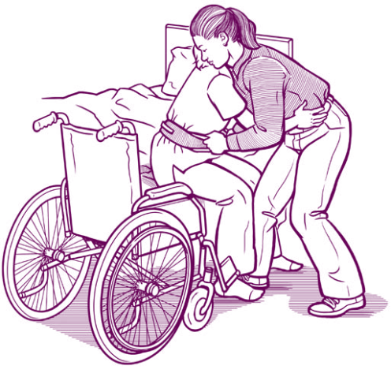
More Safe Lifting Practices
Turn your feet and whole body—
do not twist at the waist.
Have client’s arms around your body, not your neck.
Put one foot forward, the other back.
Use a draw sheet to move a client
in bed and move along the bed side to avoid reaching.
Make sure bed or wheelchair wheels are locked before moving client.
Illustrations by ®Mary Ann Zapalac
Keep your back straight

Slide 14
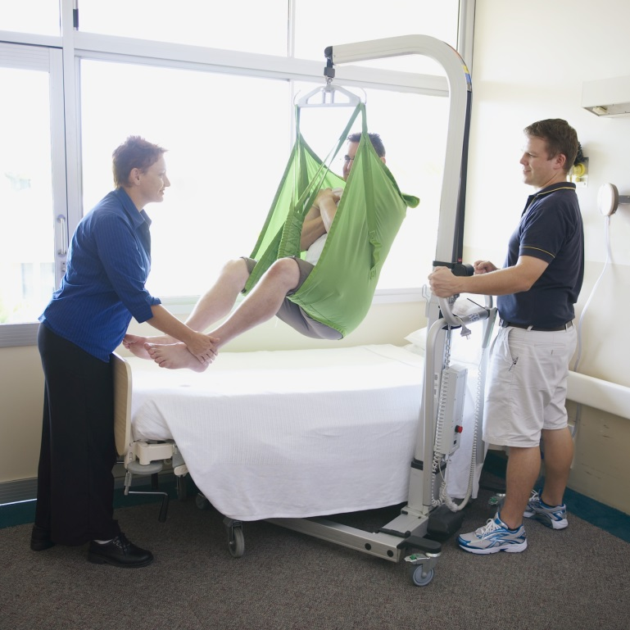
Tools Can Make
Transfers and Moves Safer
Mechanical or electric hoists or slings—especially if the client can’t support his or her own weight.
Photo by ®Thinkstock

Slide 15
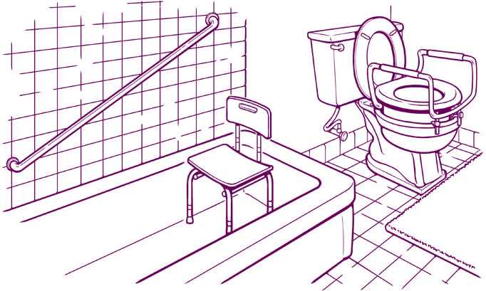
Tools Can Make
Transfers and Moves Safer
Gait belts.
Slide or transfer boards.
Draw sheets.
Handrails.
Shower chairs.
Toilet seats with support arms.
Illustration by ®Mary Ann Zapalac

Slide 16
Talk it Over!
Bring up
health and safety issues as soon as possible.
Plan the discussion.
Be respectful—make a request,
not a demand.
Use “I” statements. Describe your health and safety concern, how it affects you, and what the impact might be on you and the client.
Listen. See the issue from the client’s point of view.
Consider several solutions beyond your first choice.
Know your bottom line.

Slide 17
Thanks for participating!
Additional Resources:
Homecare workers’ handbook: Caring for Yourself While Caring for Others .
http://www.cdc.gov/niosh/docs/2015-103/pdf/2015-103.pdf
NIOSH Hazard Review: “Occupational Hazards and Home Health Care.”
http://www.cdc.gov/niosh/docs/2010-125/pdfs/2010-125.pdf
NIOSH Publication: Safe Lifting and Movement of Nursing Home Residents http://www.cdc.gov/niosh/docs/2006-117
Safe Patient Handling for Nursing Schools (NIOSH) http://www.cdc.gov/niosh/docs/2009-127
NIOSH Publication: Slip, Trip, and Fall Prevention for Healthcare http://www.cdc.gov/niosh/docs/2011-123
Home and Community Health Worker Handbook, British Columbia, Canada, OHSAH.
http://www.phsa.ca/NR/rdonlyres/6C69D638-8587-4096-A8AA-7D2B0141C3B2/59614/HandbookHomeandCommunityHealthcareWorkersHandbook.pdf
Safety Manual for Homecare Workers, Oregon Homecare Commission. http://apps.state.or.us/Forms/Served/de9062.pdf

Slide 18
Credits
[Insert trainer and/or training organization’s name(s), and contact information here.]

