Slide 1

Emergency Escape
& Refuge Alternatives
National Institute for Occupational Safety and Health
Office of Mine Safety and Health Research
626 Cochrans Mill Road, PO Box 18070
Pittsburgh, PA 15236
Erica E. Hall and Katherine A. Margolis, Ph.D.
Email: ehall@cdc.gov
Phone: (412) 386-4075

Slide 2
Reasons to Evacuate the Mine
Fire
Explosion
Ground Movement
Flood
Gas Inundation

Slide 3
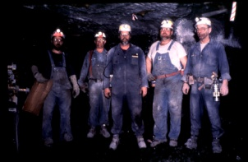
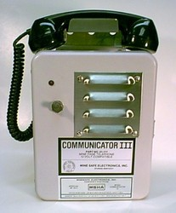
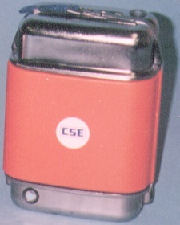
Remember, When Escaping…
Assemble at the meeting place
Call the surface
Don an SCSR and take a back-up
Take a map
Seek refuge only as a last resort!

Slide 4
Refuge Alternatives Can Save Lives
From 1970 - 2006
Of those who did not die immediately
  67 of 99 miners died while escaping.
    A refuge alternative may have saved 85% of those who died trying to escape.
  17 of 99 miners died while barricaded.
    A refuge alternative may have saved 100% of those who died barricading.

Slide 5
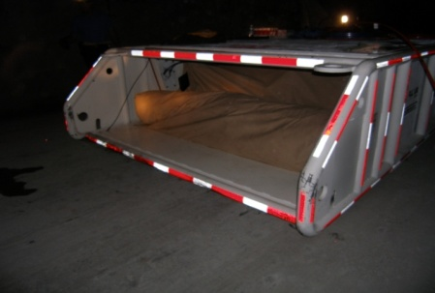
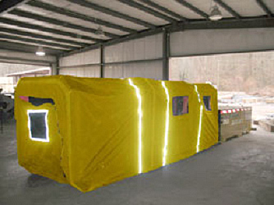
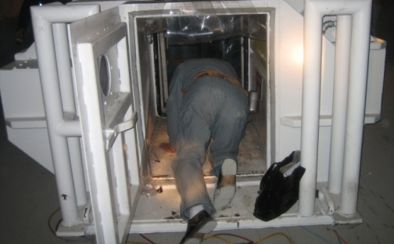
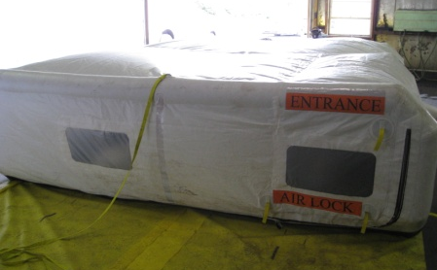
What is a Refuge Alternative?
An Airtight Safe Haven With
  Light
  Food
  Water
  Breathable Air
  Phone
  Toilet
  First Aid Kit

Slide 6
Types of Refuge Alternatives
Refuge Chambers
Within 1,000 ft from nearest working face
Outby Refuges
Within 1-hour travel distance from the nearest working face
Other Names
Rescue chambers
Rescue shelters
Refuge shelters
Ex., Every other SCSR cache
Other Names
Hardened rooms
Outby shelters
In-place shelters

Slide 7
When To Enter a Refuge Alternative
All escape attempts have failed
Smoke should never prevent escape
Due to physical limitation
Minor injuries should never prevent escape.
ALWAYS try to ESCAPE!

Slide 8
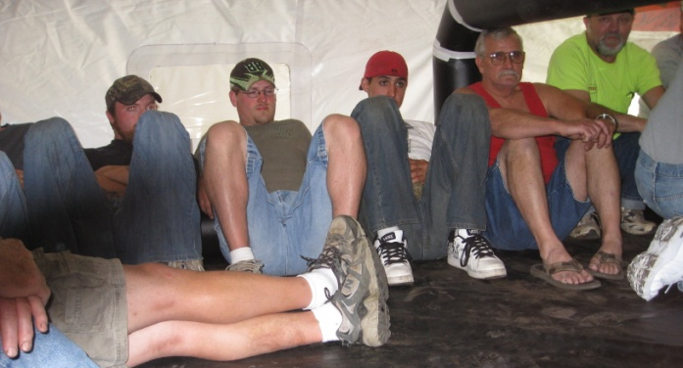
What It Will Be Like
Inside a Refuge Alternative
Hot and humid
Cramped – may have to sit or lie down, depending on space
Condensation will develop
Not much privacy
Every miner will react differently, some may be anxious

Slide 9
What To Do While Inside a Refuge Alternative
Communicate
Monitor
The environment inside of the chamber
Talk to each other
Conserve
Cap lamps
Supplies – food, water, air, etc.
The health of others
Call to the surface

Slide 10
Remember…
In an emergency escape, refuge alternatives provide additional resources to miners.
REMAIN CALM.
Use all your skills & available resources.
Others are working to rescue you.

