Slide 1

How to Operate a Refuge Chamber: A Quick Start Guide
National Institute for Occupational Safety and Health
Office of Mine Safety and Health Research
626 Cochrans Mill Road, PO Box 18070
Pittsburgh, PA 15236
Erica E. Hall and Katherine A. Margolis
Email: ehall@cdc.gov
Phone: (412) 386-4075

Slide 2
Refuge Chambers
Can seem complicated
    The secret is to learn the basics
    Detailed manuals
    In every refuge chamber underground
    Details can be looked up later
4 Easy steps
    Breakdown the process
    Isolate the critical steps

Slide 3
The Main Steps: D-POS
Deploy
Purge
Oxygen
Scrubber

Slide 4
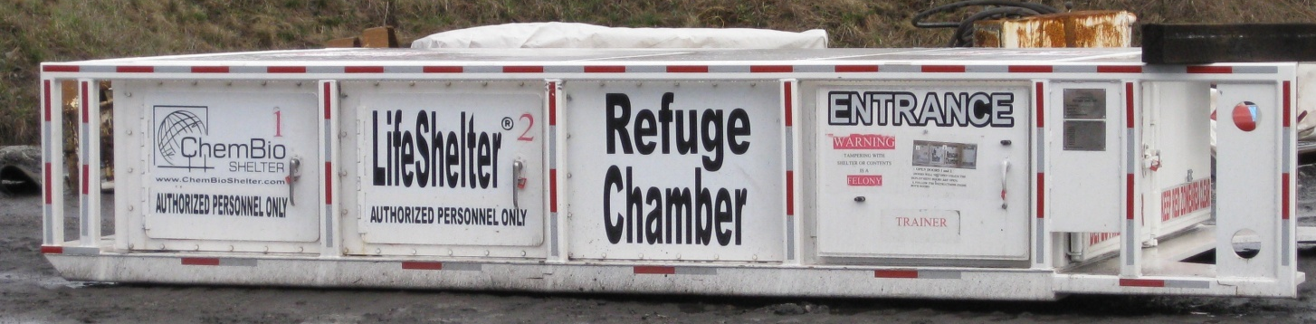
Quick Start Guide
DPOS
1. Deploy Unit
2. Purge
3. Activate Oxygen Flow
4. Hang Scrubber Curtains

Slide 5
deploy
DPOS Step 1

Slide 6
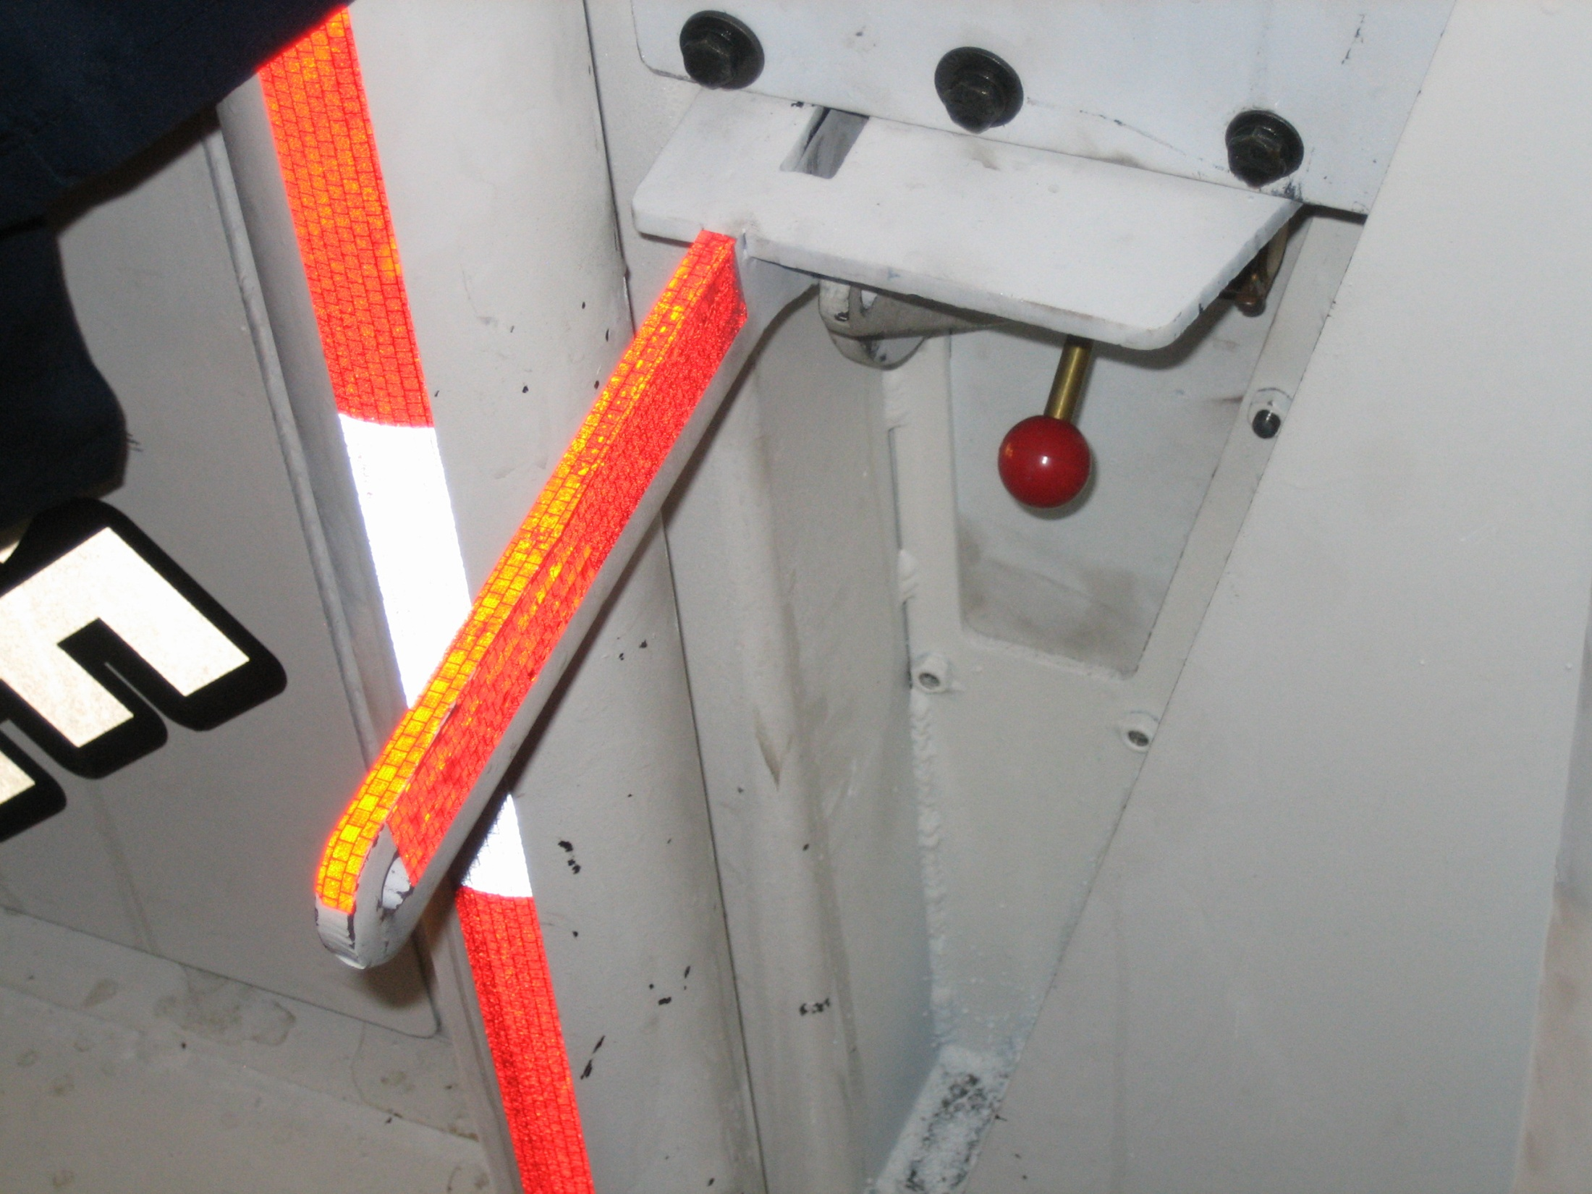

Slide 7
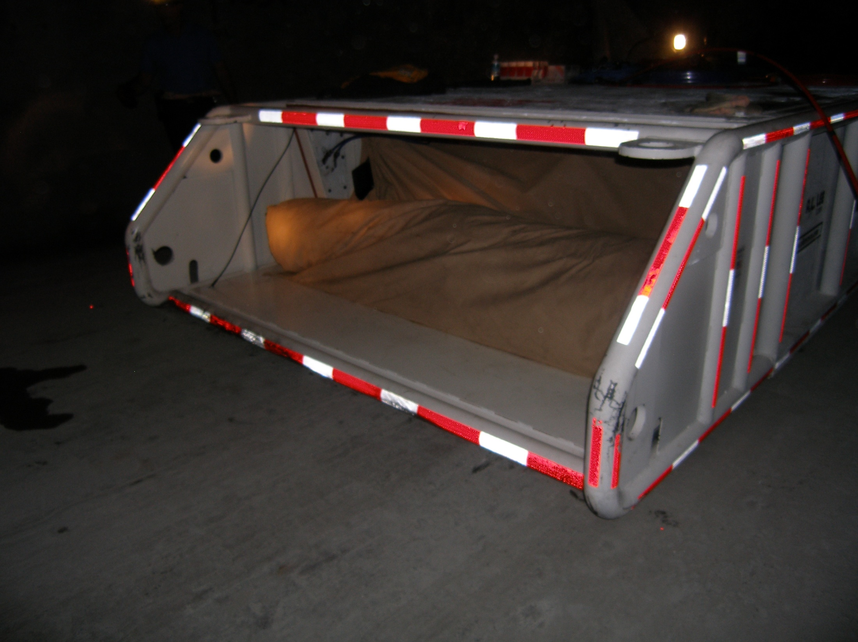

Slide 8
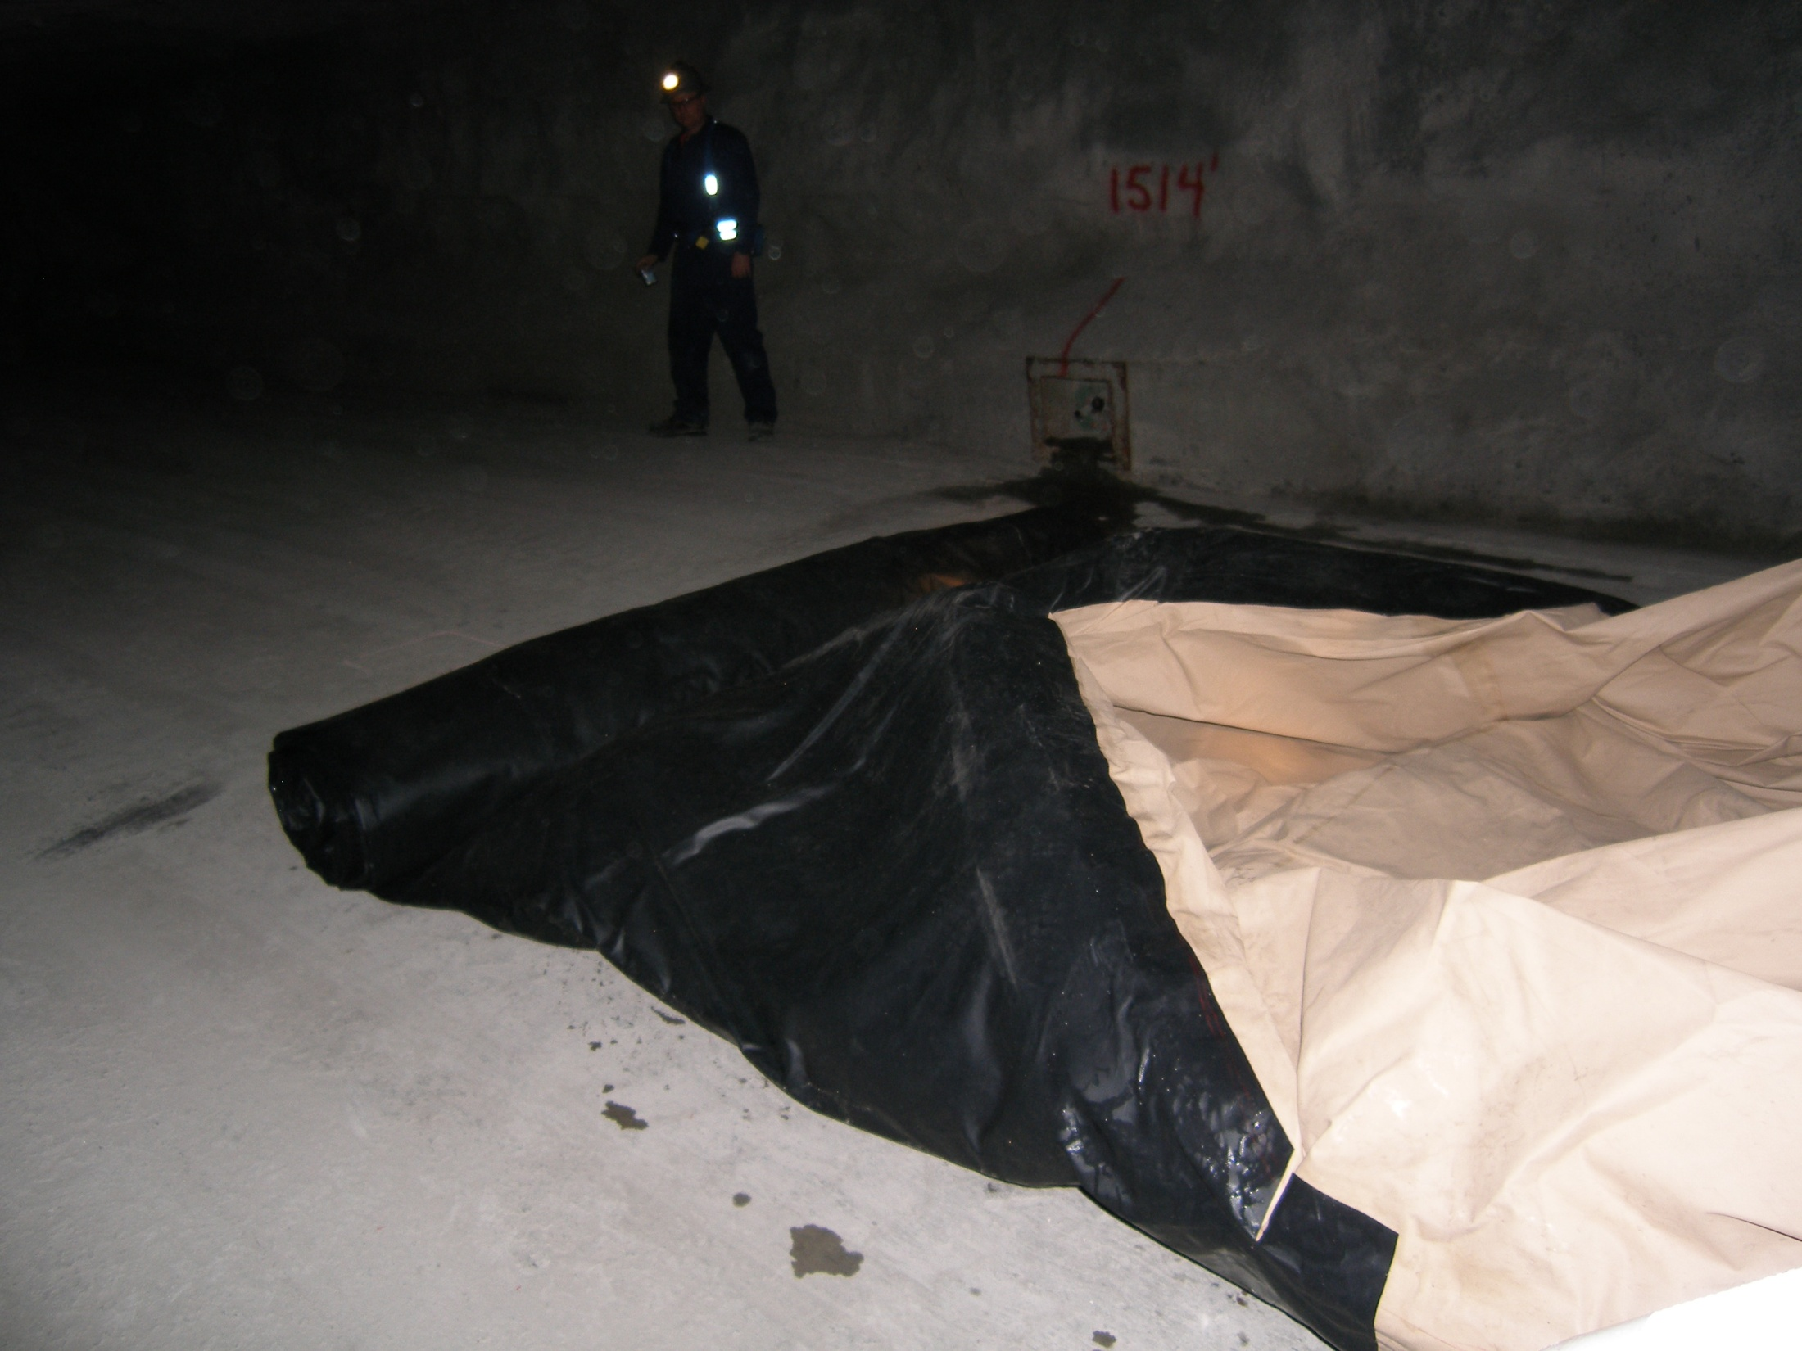

Slide 9
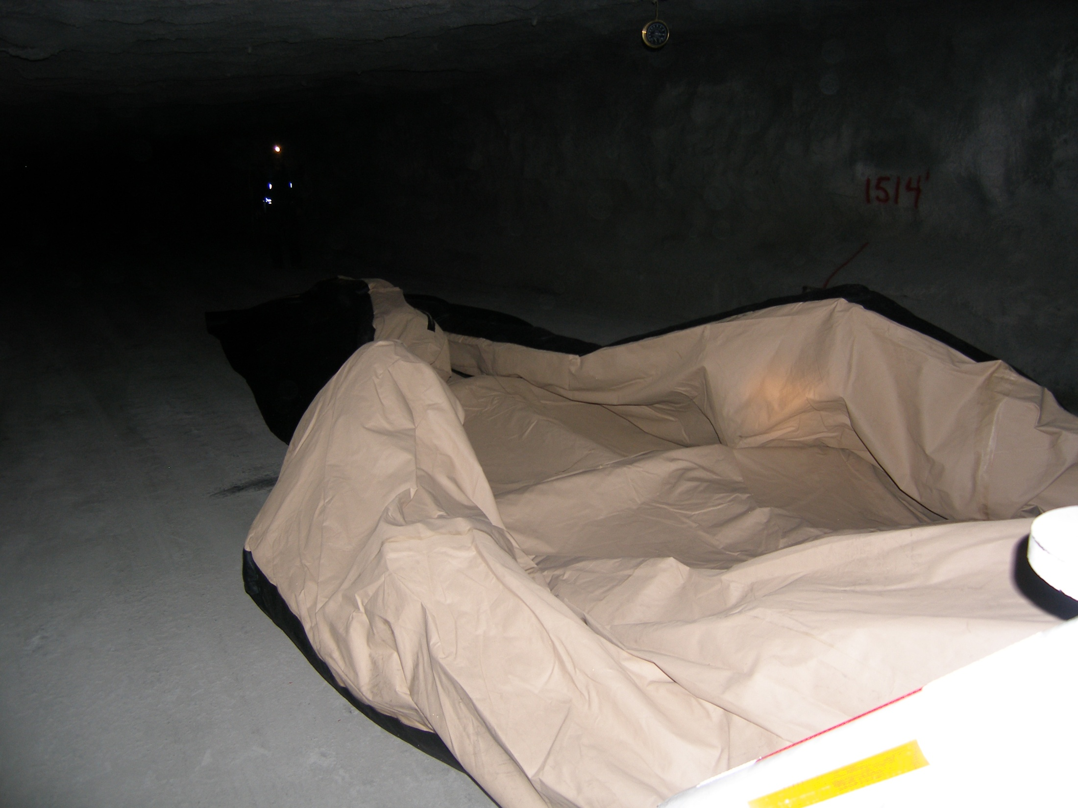

Slide 10
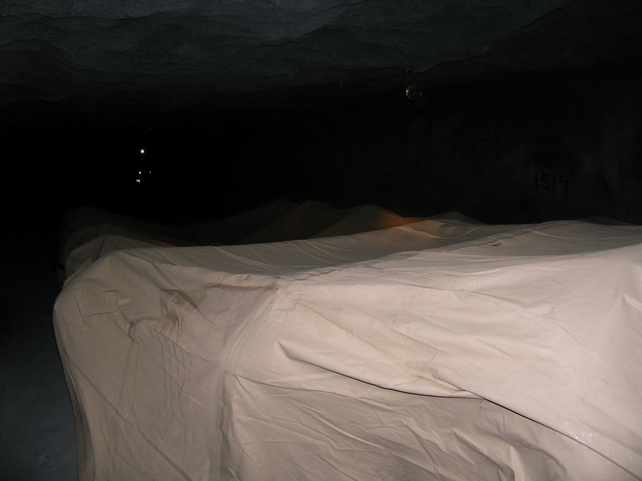

Slide 11
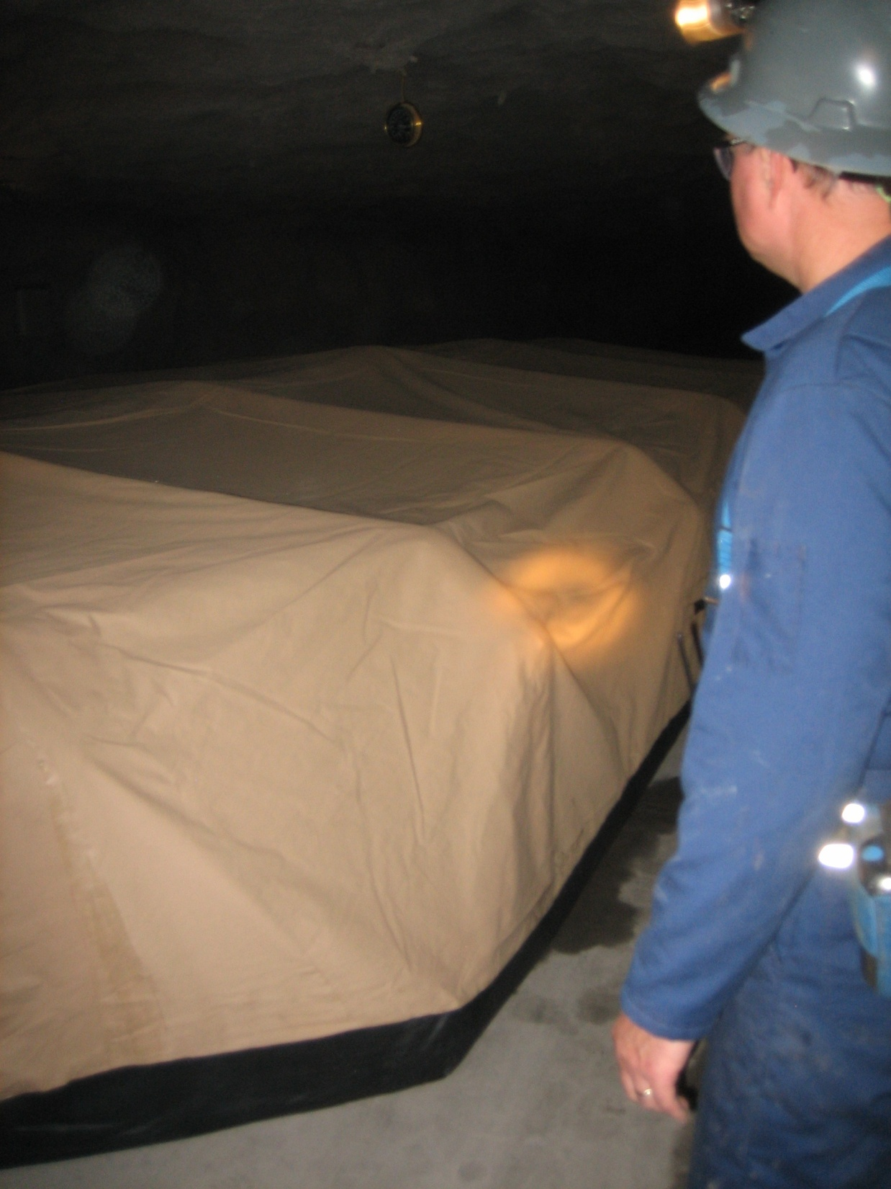

Slide 12
Purge
DPOS Step 2

Slide 13
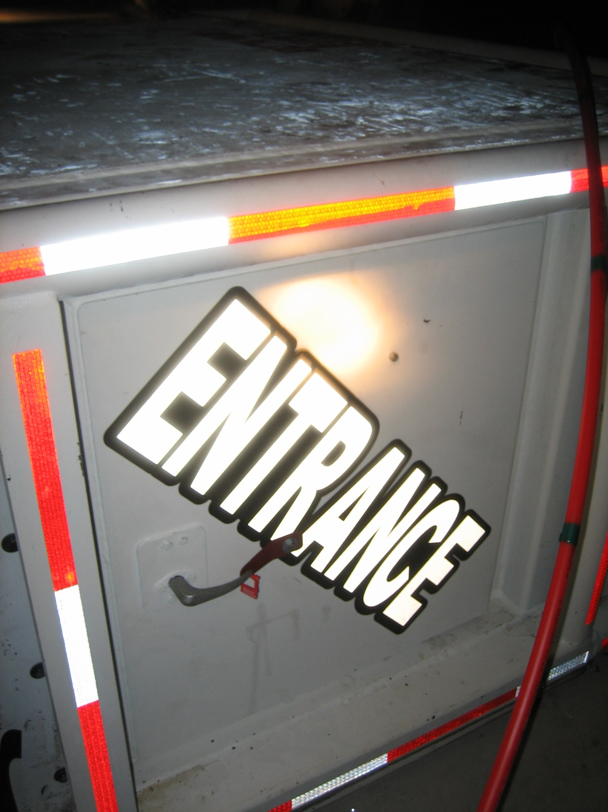

Slide 14
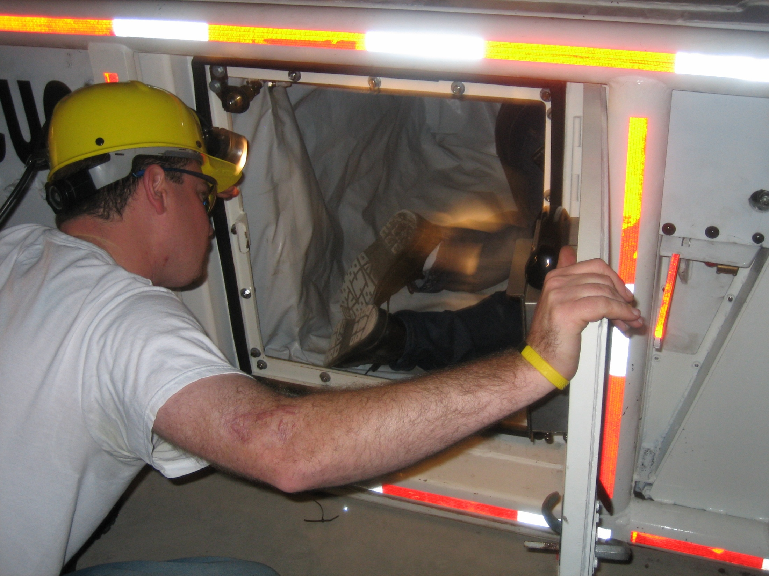

Slide 15
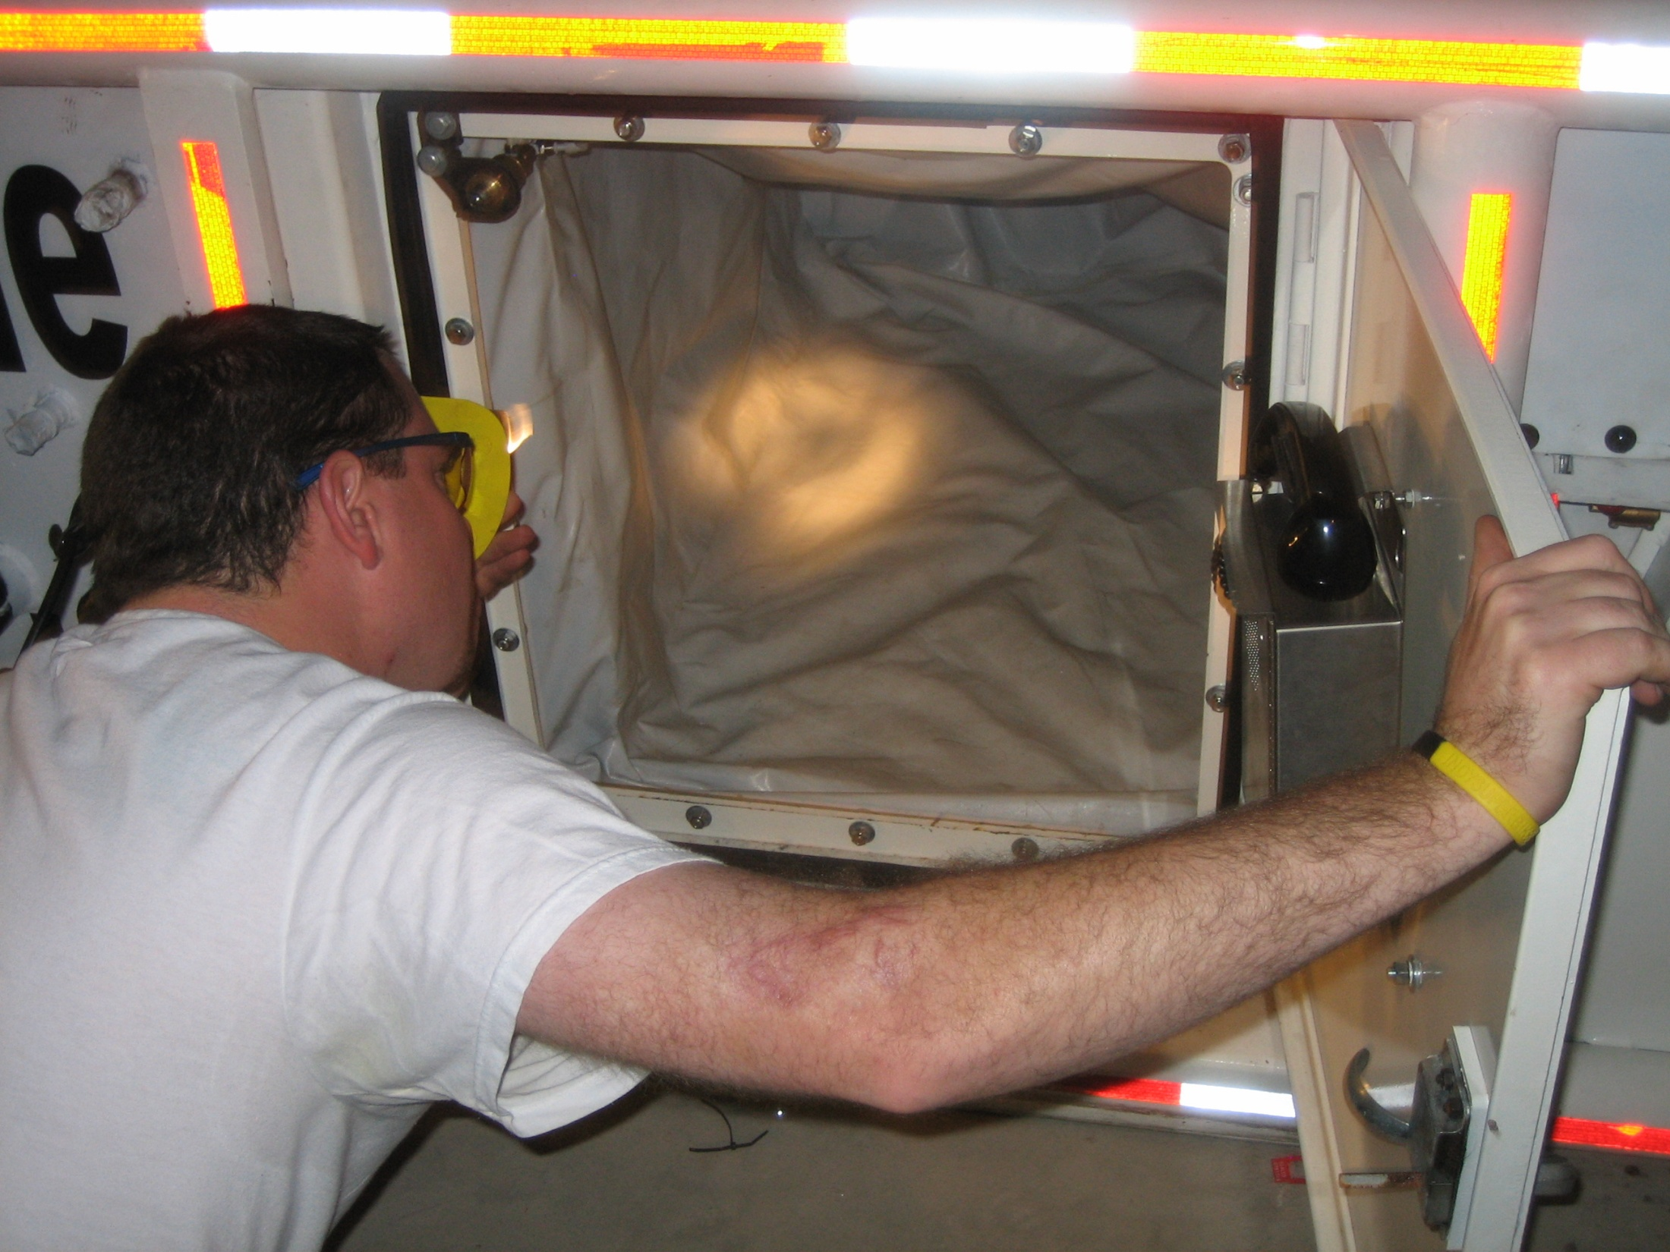

Slide 16
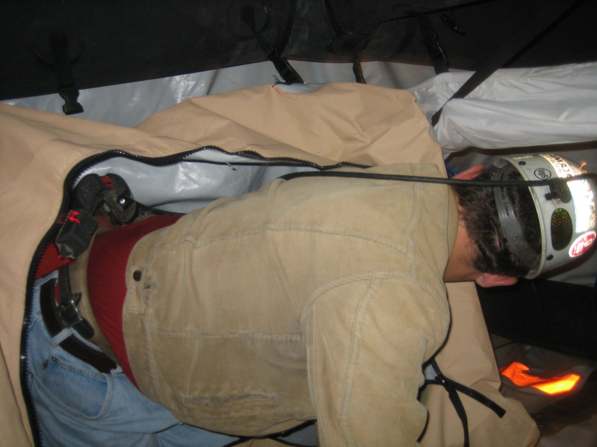

Slide 17
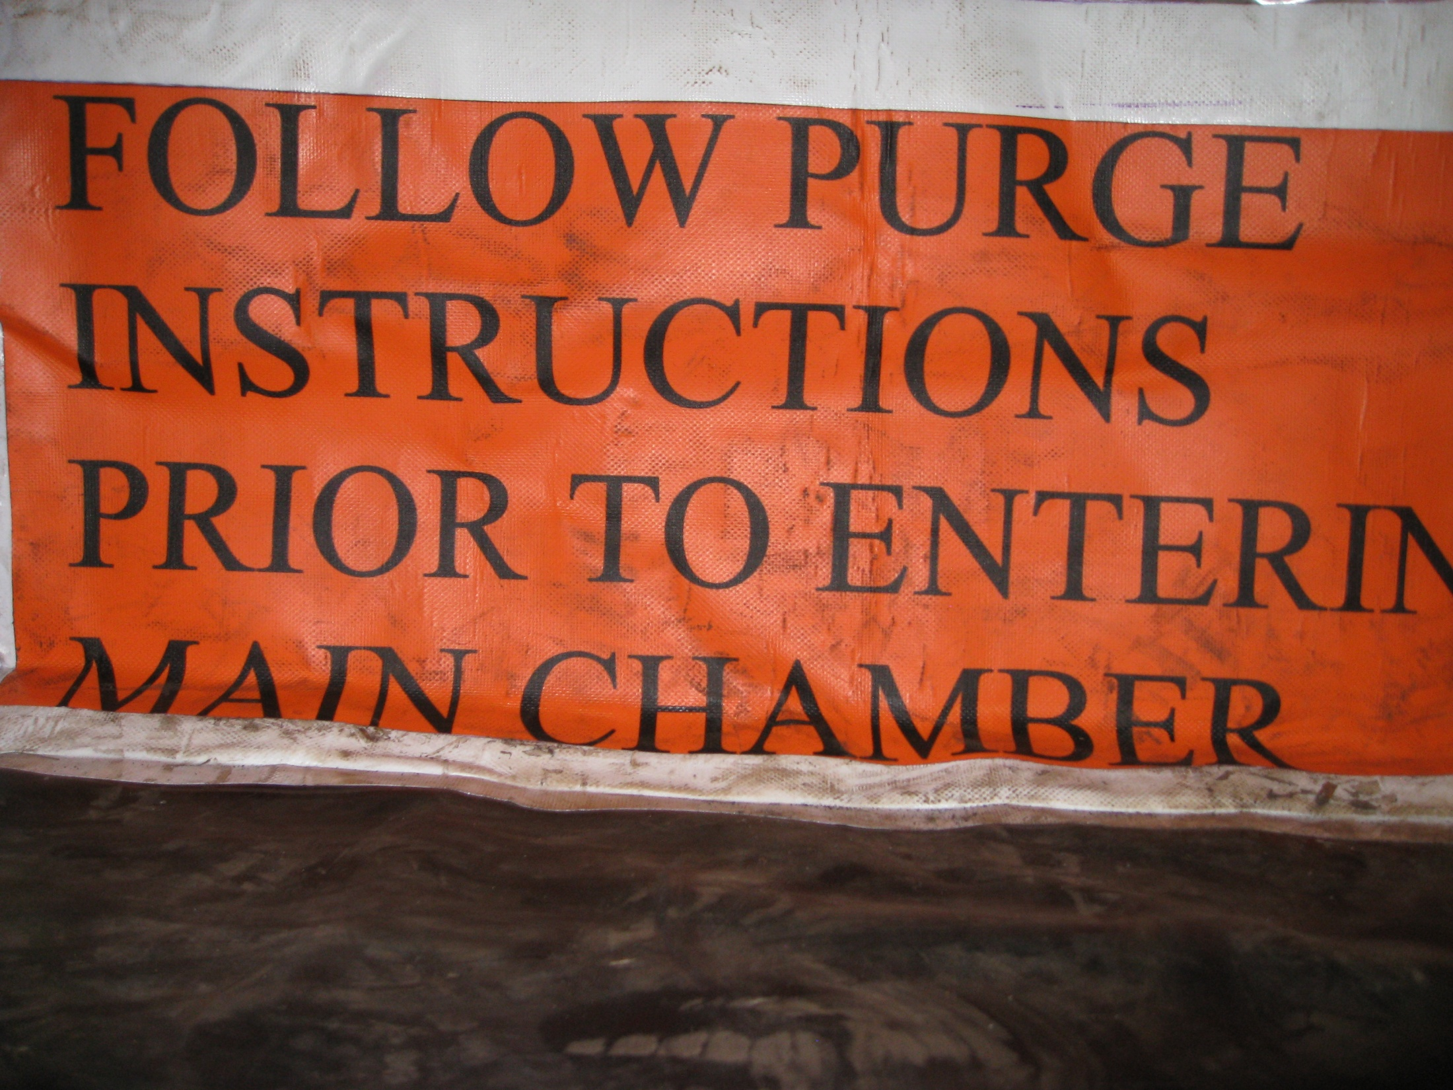

Slide 18
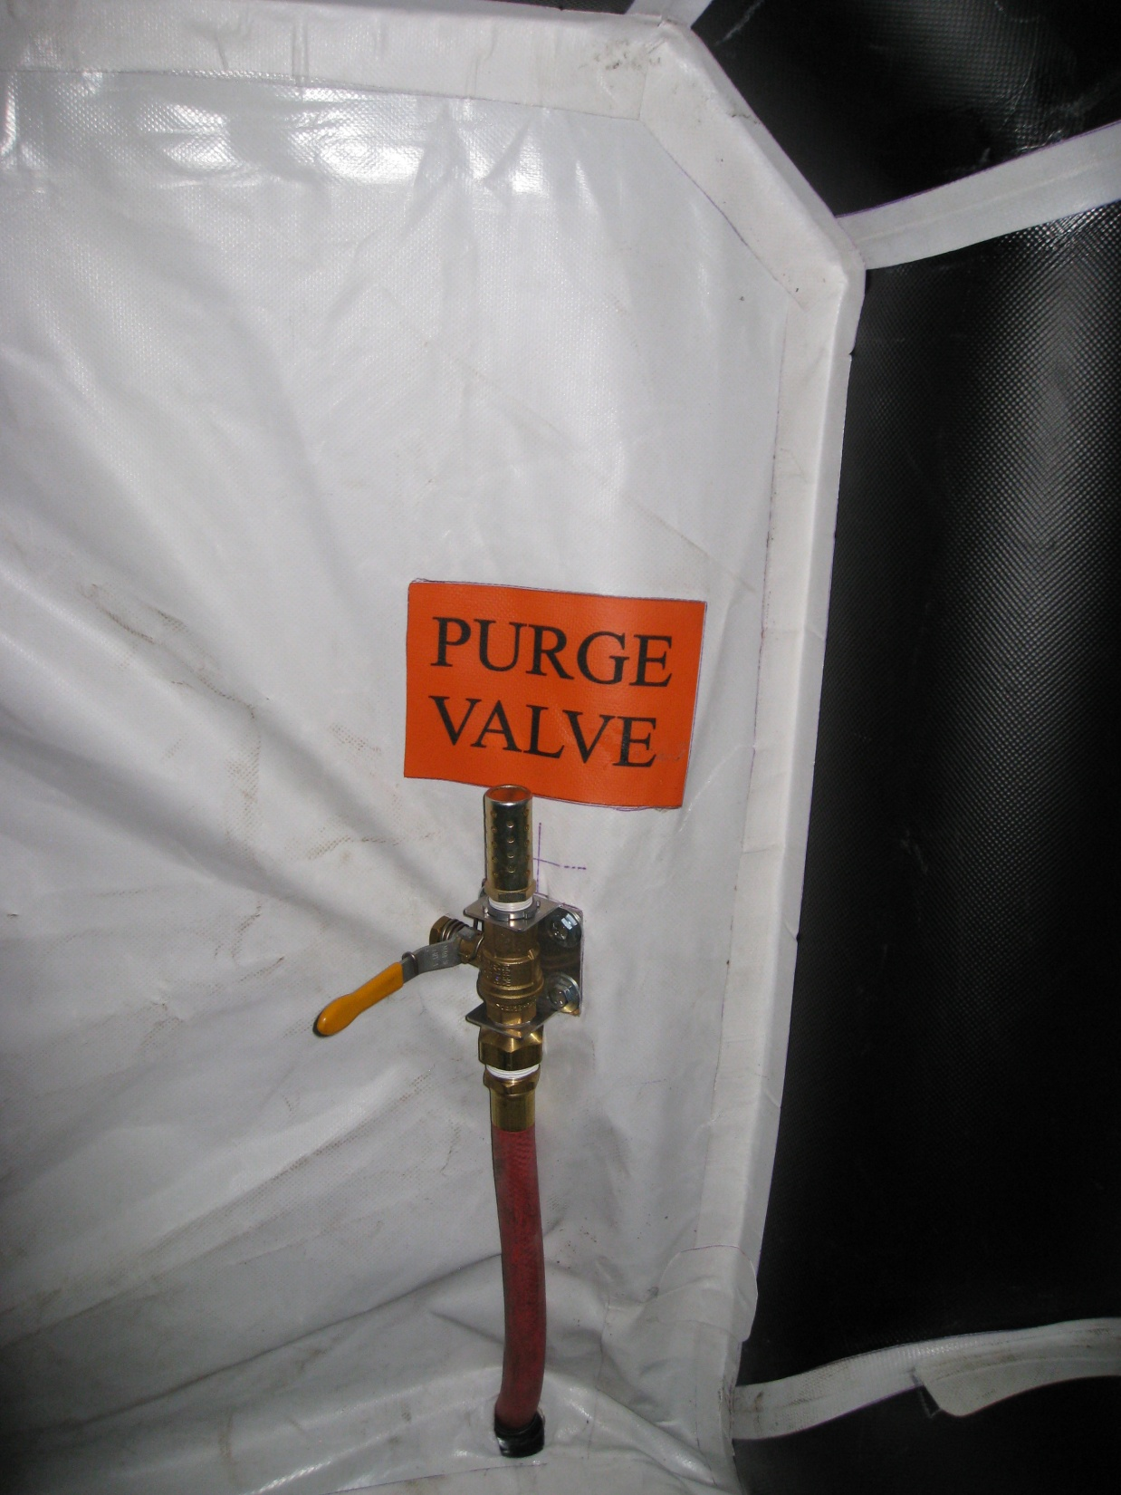

Slide 19
Oxygen
DPOS Step 3

Slide 20
Oxygen Flow Meter Chart
# of Men | Flow Meter Setting
1 | 0.5 LPM
2 | 1..0 LPM
3 | 1..5 LPM
4 | 2.0 LPM
5 | 2.5 LPM
6 | 3.0 LPM
7 | 3.5 LPM
8 | 4.0 LPM
9 | 4.5 LPM
10 | 5.0 LPM
11 | 5.5 LPM
12 | 6.0 LPM
13 | 6.5 LPM
14 | 7.0 LPM
15 | 7.5 LPM
16 | 8.0 LPM
Set flow meter accurately. Too much O₂ is just as bad as not enough.

Slide 21
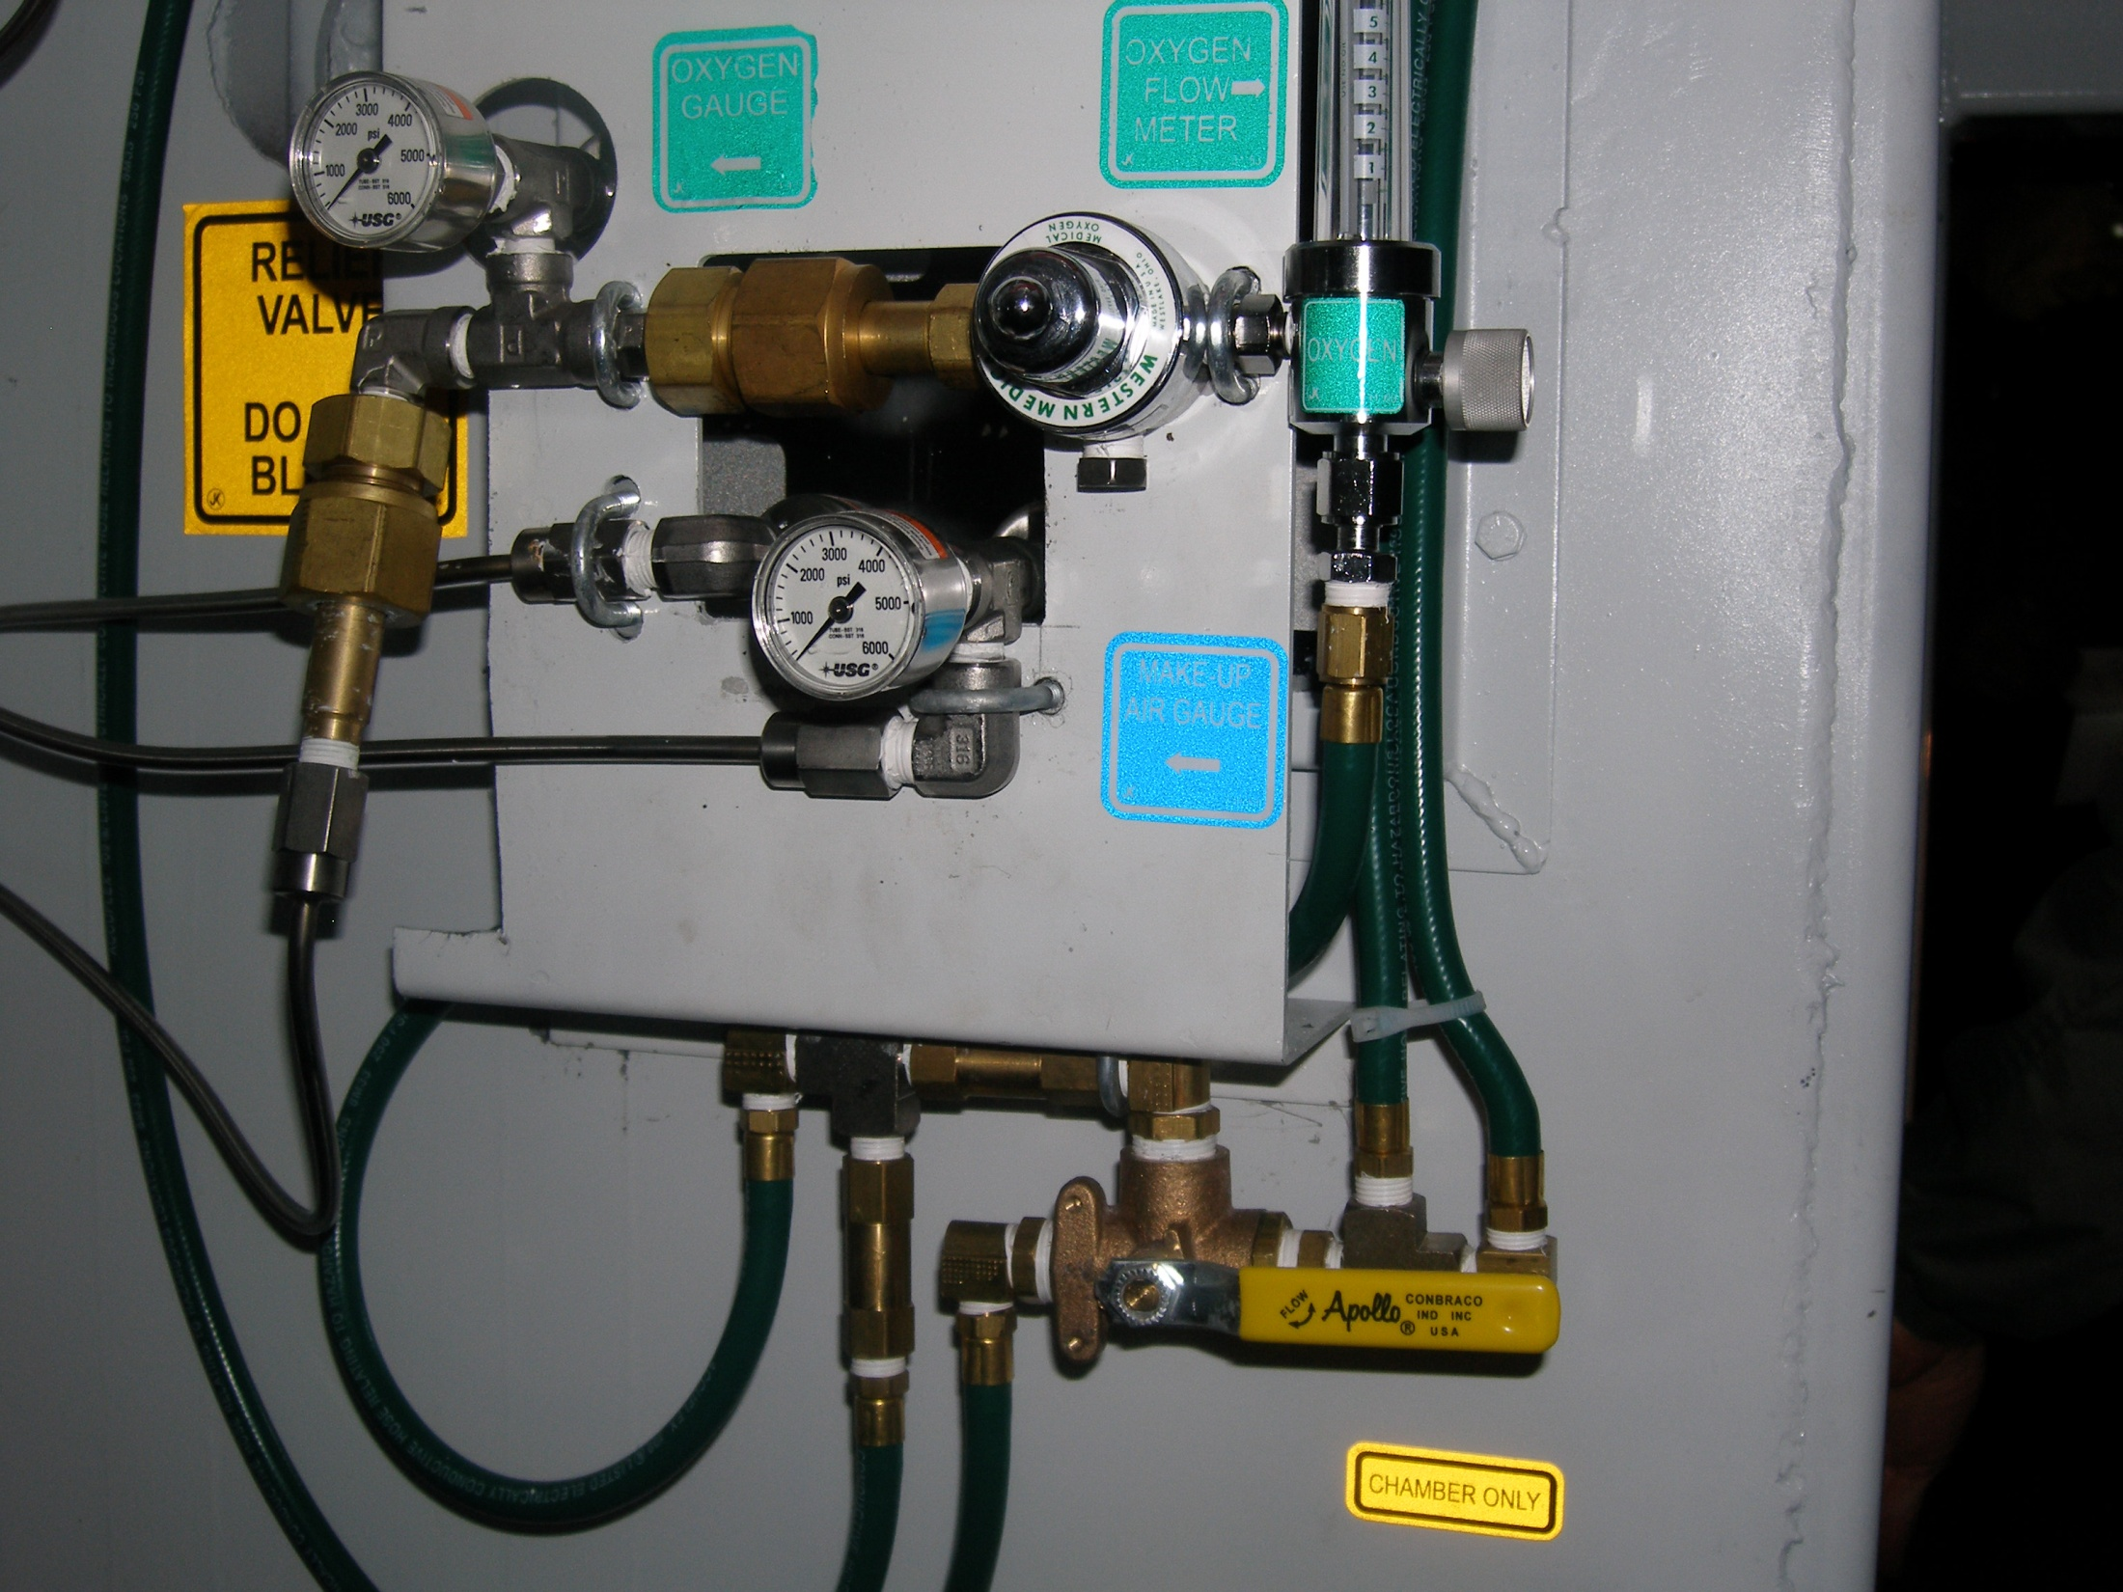

Slide 22
Scrubber
DPOS Step 4

Slide 23
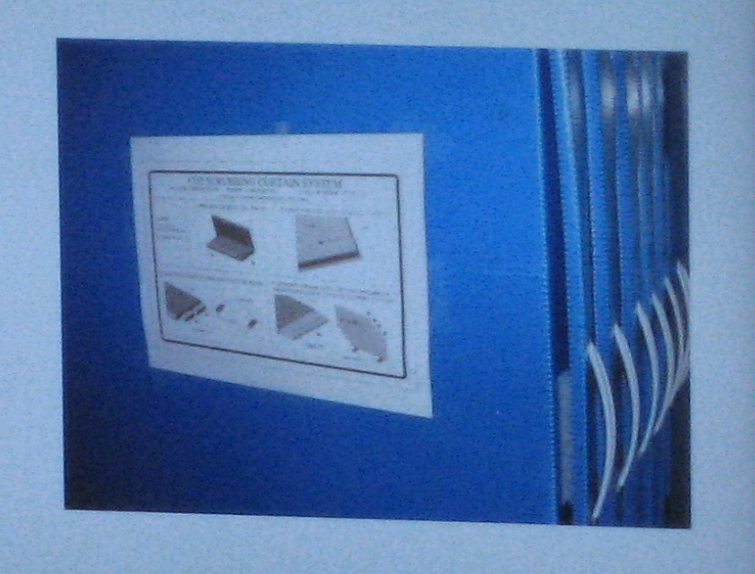

Slide 24
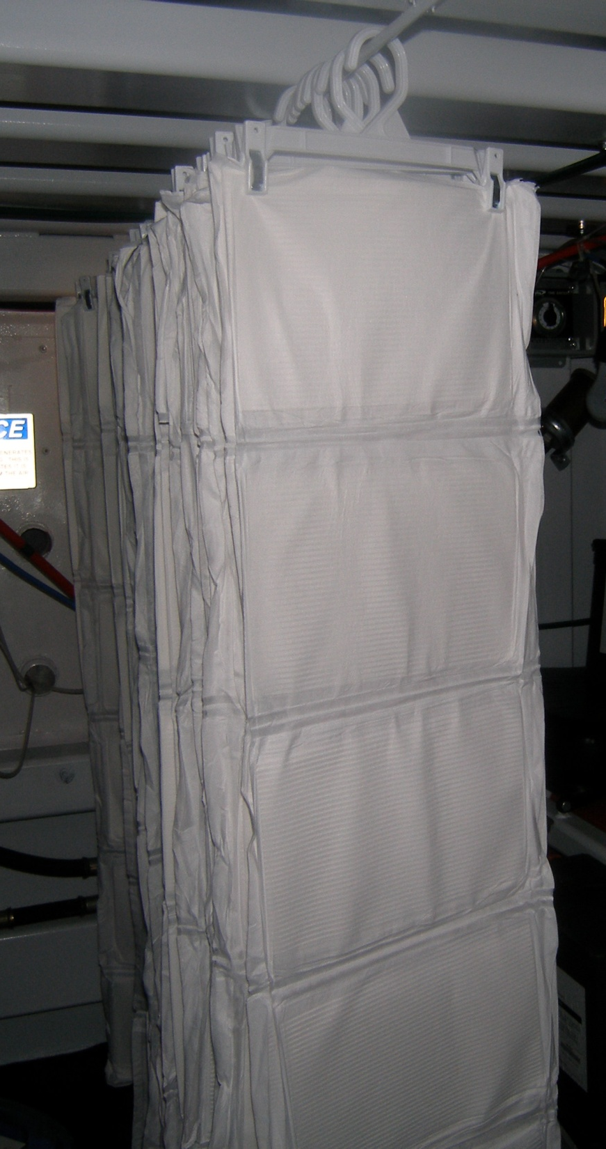
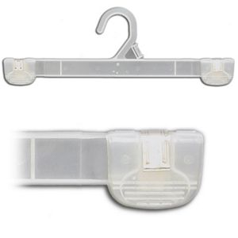

Slide 25
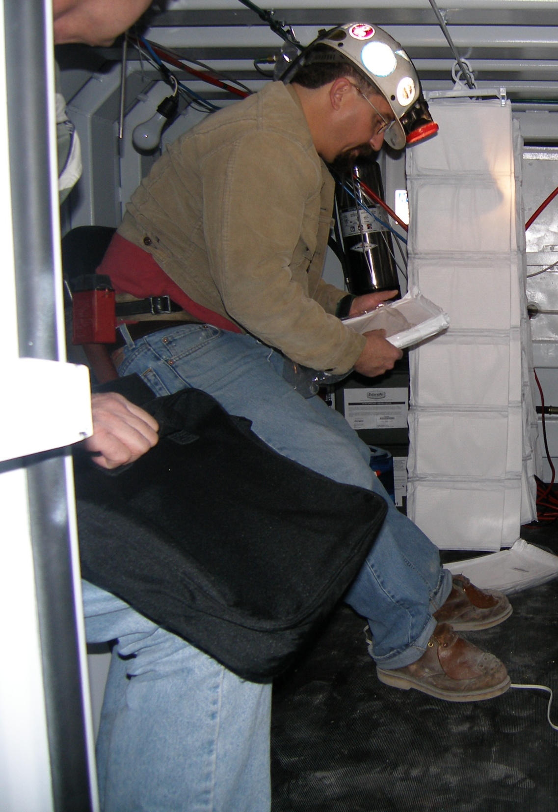

Slide 26
Your refuge chamber will have detailed instructions, but in an emergency remember your
QUICK START!
Deploy
Purge
Oxygen
Scrubber

