Slide 1
NHIS-TEEN
Aaron Maitland
Amanda Ng
Ben Zablotsky
Jessica Jones
Jonaki Bose
Lindsey Black
Stephen Blumberg

Slide 2
BACKGROUND
There is a dearth of surveys on the health of adolescents in the United States, both self-reported and parent-reported.
Surveys which rely on parental report for adolescent health have greater measurement error on items parents are less knowledgeable about.
Few adolescent self-reported health surveys are linked to robust parent-reported data.

Slide 3
GOALS OF NHIS-TEEN
Determine feasibility of adolescent-report and online data collection for the NHIS.
01
Obtain information about adolescent health directly from adolescents.
02
Evaluate concordance between parent and adolescent-report on health topics.
03

Slide 4
study DESIGN
Study Period: July 1st 2021 – December 31st 2022
Sample: Adolescents between the ages of 12-17 whose parents or guardians completed the Sample Child interview and provided permission (in-person or over telephone) for their adolescent to be contacted
Target Completed Interviews: 3,600
Mode: Web
Length: 95 questions, ~15 minutes to complete
Language: English
Incentive: $5

Slide 5
TOPIC AREAS
Physical activity and sleep
Injuries
Mental health
Social and emotional supports
Doctor visits and content of care
Meditation and yoga
Stressful life events
Bullying and discrimination

Slide 6
PARENTAL RECRUITMENT
Hand Postcard to Parent;
Leave Initial Letter for Teen
Parent Permission to Contact
Teen
Request Teen’s Cell Number and Email
In-person interview
Mail Postcard to Parent;
Mail Initial
Letter to Teen
Front of
English Postcard
Phone interview

Slide 7
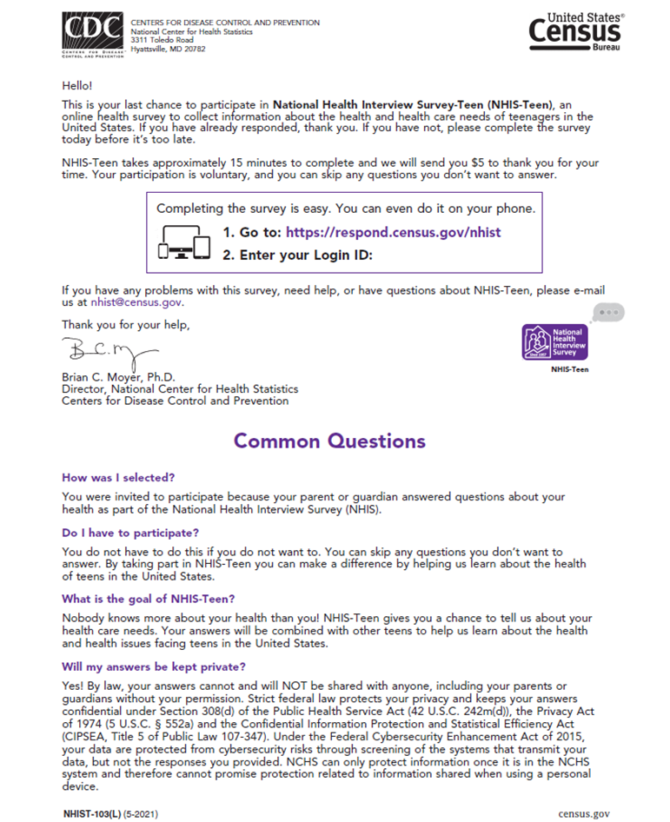
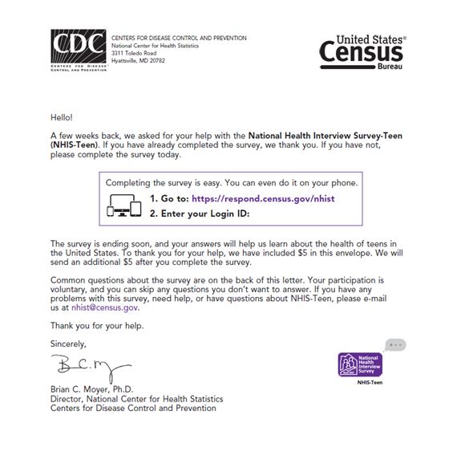
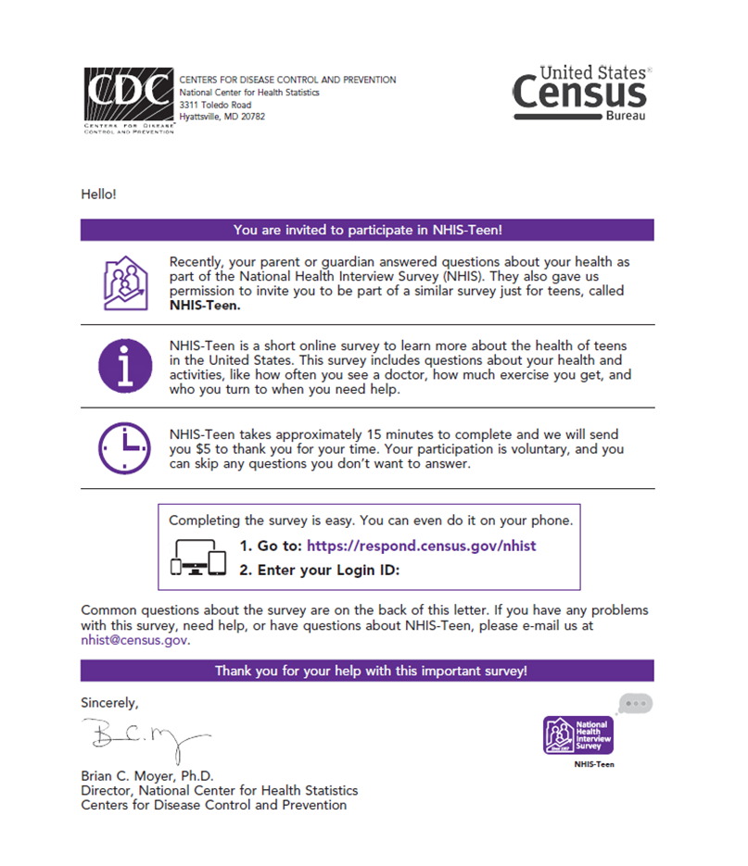
TEEN RECRUITMENT
Physical mailings – JULY START
Initial letter
Non-responder reminder letter
Final postcard reminder
E-mail messages – SEPTEMBER START
Initial invitation and first reminder
Two additional reminders
Text messages – COMING SOON
Initial invitation and first reminder
Two additional reminders

Slide 8
EARLY RESULTS (1)
Permission rate (parents): 65%
Higher for Sample Child in-person interviews
Half give permission to e-mail and/or text
Survey submission rate (teenagers): 38%
Higher among those receiving e-mails
Half complete with a smart phone
through October 5th

Slide 9
EARLY RESULTS (2)
NHIS-Teen statistics
Median interview length: 16 minutes
Completion rate: 96%
Average item non-response: 0.45%
Half submit answers within 7 days
through October 5th

Slide 10
challenges
Obtaining parental permission
In-person vs. telephone Sample Child interviews
Parental assumptions
Obtaining teenager participation
Inability to e-mail and text at the time of launch
Teenagers with disabilities

Slide 11
ThANK YOU! QUESTIONS: BZABLOTSKY@CDC.GOV

