Slide 1
Innovation in Data Dissemination: Provisional Data
Paul D. Sutton, Ph.D.
Deputy Director, Division of Vital Statistics
Board of Scientific Counselors Meeting | May 19, 2021

Slide 2
Proportion of U.S. Mortality Records Received Within 10 Days of the Date of the Event by Year

Slide 3
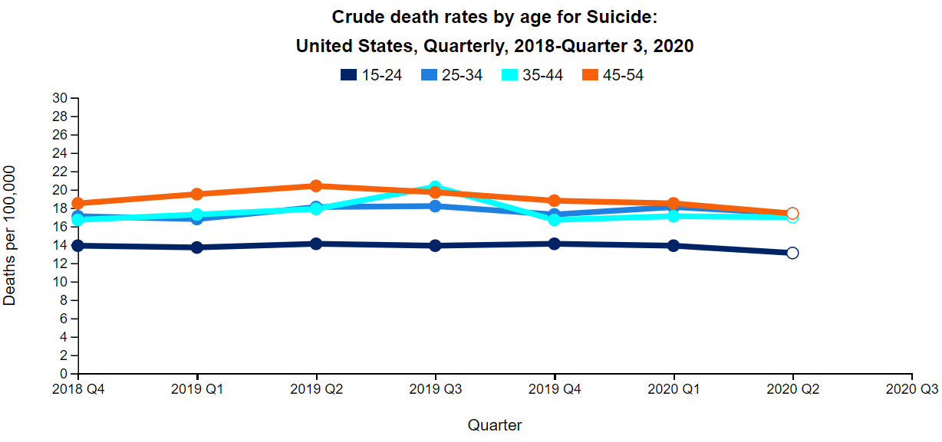
Quarterly Provisional Estimates: Mortality
https://www.cdc.gov/nchs/nvss/vsrr/mortality-dashboard.htm#

Slide 4
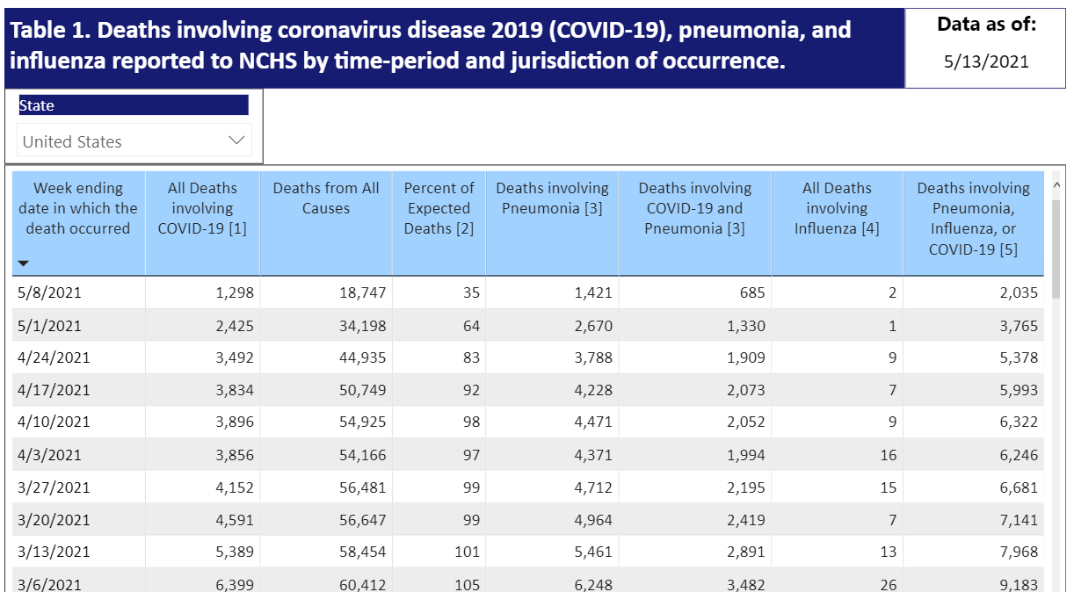
COVID-19 Provisional Data – Updated Daily

Slide 5
Provisional COVID-19 Death Counts: Demographic and Geographic Detail
Tabulated Data (counts and/or percentages)
COVID-19
Pneumonia and Influenza
Other Causes of Death (with and without COVID-19)
Demographic Detail
Sex
Age
Race/Hispanic origin
Geographic Detail
National
Jurisdiction/state
County
Counts 1-9 suppressed

Slide 6
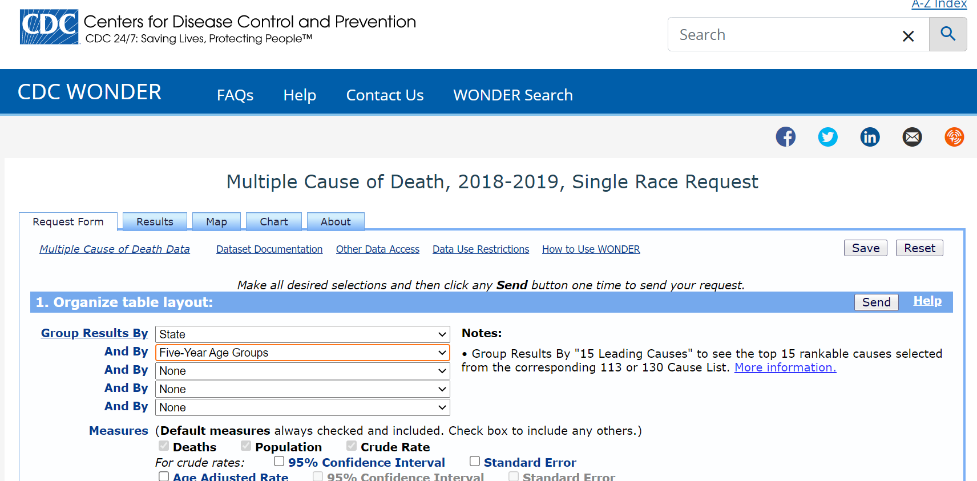
CDC WONDER - https://wonder.cdc.gov/

Slide 7
CDC WONDER and Provisional Data
New query screen similar to those used for final mortality data
Add week of death
Add state of death occurrence (currently only by residence)
Improved Boolean logic for queries
Modernized and enhanced API

Slide 8
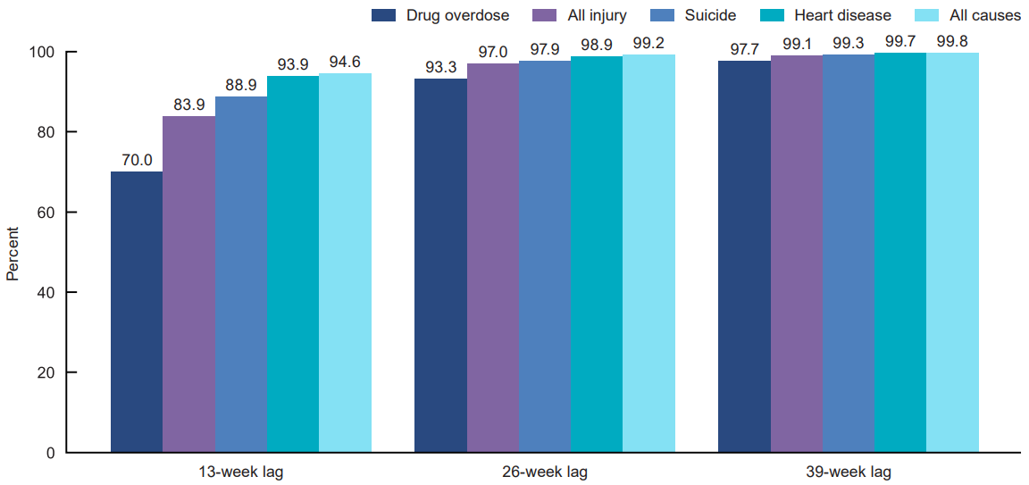
Mean percentage of death certificate records available for analysis, by cause of death: United States, 2017
Ahmad FB, Dokpesi P, Escobedo L, Rossen L. Timeliness of death certificate data by sex, age, and geography. Vital Statistics Rapid Release; no 9. Hyattsville, MD: National Center for Health Statistics. June 2020. Available from: https://www.cdc.gov/nchs/data/vsrr/vsrr009-508.pdf

Slide 9
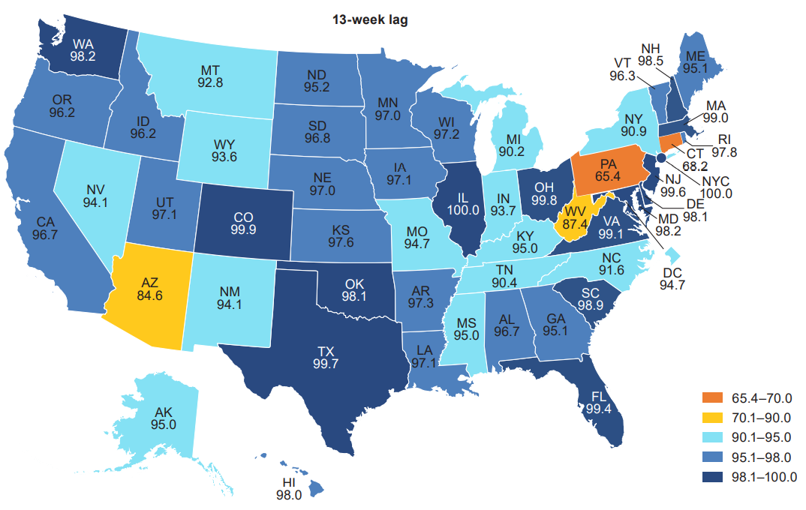
Mean percentage of death certificate records available for analysis, by jurisdiction: United States, 2017
Ahmad FB, Dokpesi P, Escobedo L, Rossen L. Timeliness of death certificate data by sex, age, and geography. Vital Statistics Rapid Release; no 9. Hyattsville, MD: National Center for Health Statistics. June 2020. Available from: https://www.cdc.gov/nchs/data/vsrr/vsrr009-508.pdf

Slide 10
What we are still thinking about…
Reporting lags generally… provisional data are incomplete.
Reporting lags differ by Jurisdiction and Cause of Death
Optimum update frequency
Provisional data have had limited quality review and will have higher levels of unknowns, pendings, and other errors than final data
How much descriptive analysis is needed to accompany provisional data releases
Other issues

