Slide 1
NCHS Strategic Planning
Brian C. Moyer, Ph.D., NCHS Director
Kiana C. Morris, Acting Director, Office of Planning, Budget, and Legislation
May 19, 2021

Slide 2
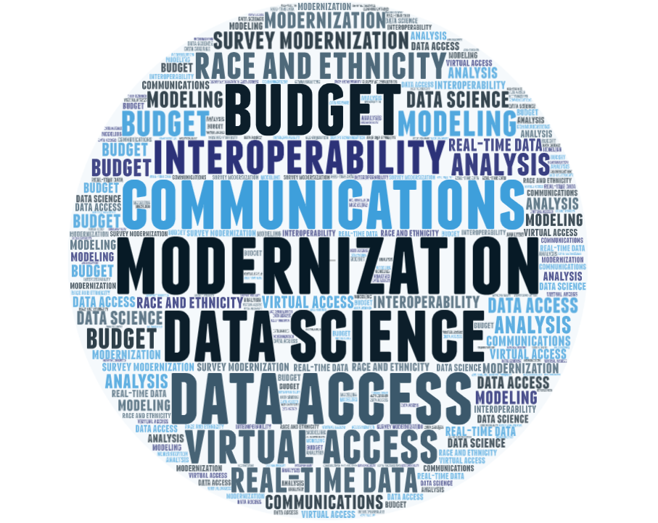
Strategic Planning Overview

Slide 3
Strategic Plan Framework: Development
Mission, Vision, Core Values
Staff engagement
NCHS mission revision

Slide 4
Vision
To be a world-class innovator and provider of health statistics

Slide 5
NCHS collects, analyzes, and disseminates timely, relevant, and accurate health statistics. Our statistics inform the public and guide program and policy decisions to improve our nation’s health.

Slide 6
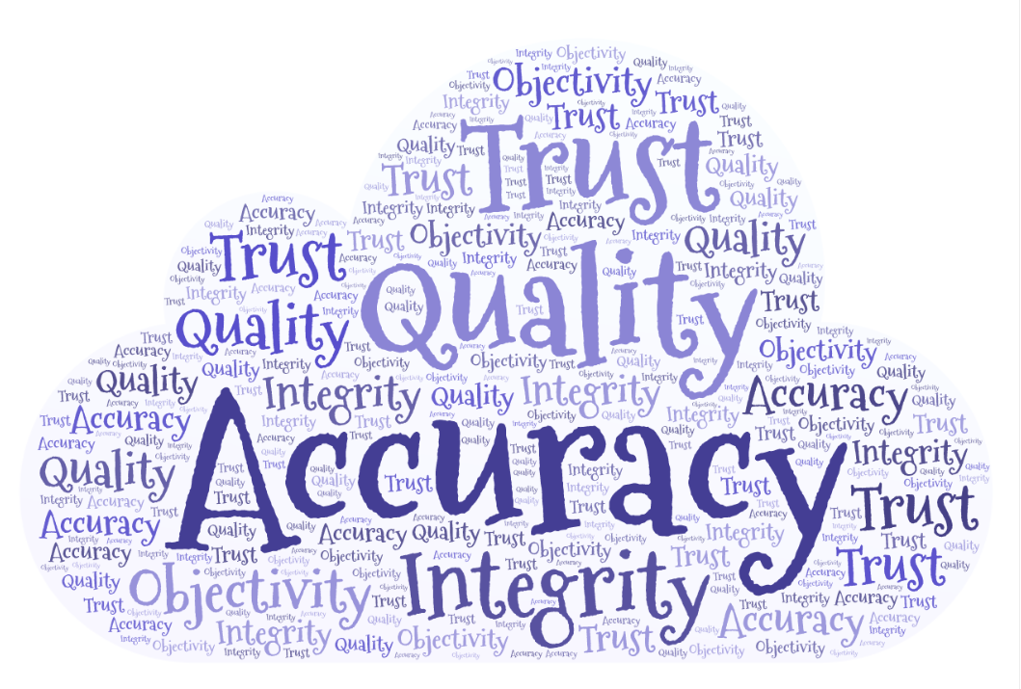
Core Values
Accuracy
Quality
Trust
Integrity
Objectivity

Slide 7
SWOT Analysis
Strengths What are NCHS’ top strengths? What does NCHS do best to carry out its mission? | Weaknesses What are NCHS’ top weaknesses? Which weaknesses require immediate attention?
Opportunities Which opportunities excite and motivate you? How can we integrate these opportunities to advance NCHS? | Threats What are external threats to achieving our vision and mission? What are some internal threats that inhibit the implementation of the NCHS mission?

Slide 8
Conducting the SWOT Analysis
Input sought from across NCHS at the division level
Results discussed with NCHS Senior Staff during regular strategic planning discussions
Identification of common themes across divisions
Development of key findings in the results from the SWOT Analysis

Slide 9
Results from SWOT Analysis
Build on history of quality, independence
Improve timeliness
Improve adaptability and agility in decision-making
Expand the use of data science, innovation
Improve data access
Expand external awareness, stakeholder engagement

Slide 10
Results from SWOT Analysis (cont.)
Build on strong staff commitment and expertise
Improve diversity, inclusion, and trust across NCHS
Increase collaboration and integration across NCHS
Improve internal communications
Streamline bureaucratic burdens
Improve budget process

Slide 11
Goals
Build on NCHS workforce excellence
Build on scientific and program excellence in data quality and accuracy
Amplify NCHS’ relevance and external engagement
Strengthen operational excellence in processes, communication, and collaboration

Slide 12
Objectives
Goals | Build on NCHS workforce excellence | Strengthen operational excellence in processes, communication, and collaboration | Build on scientific and program excellence in data quality and accuracy | Amplify NCHS’ relevance and external engagement
Objectives | Improve diversity and inclusion in staff and leadership. Increase professional development activities and succession planning enterprise wide Improve technical competencies and leadership capacity of staff | Improve internal communications Improve speed and agility of systems & processes Improve internal collaboration | Expand the use of data from other sources (e.g., electronic health records, other Federal data under Evidence Act) Improve the performance of core surveys and data systems Advance innovation in statistical and survey methods | Improve service to users by increasing understanding of their needs Build and maintain strategic partnerships with public and private entities Improve user awareness of, access to, and use of NCHS data (including the public, research community, state and local governments, other CIOs, HHS, congress)

Slide 13
Engaging NCHS Staff
Employee Viewpoint Survey
Key Performance Indicator development
Staff surveys
Updates at All Hands Meetings
Feedback sessions with the Director

Slide 14
Next Steps
Vision: Defines the optimal desired future state.
Mission: Defines the purpose of the organization.
Goal: A broad statement of what you wish to accomplish; goals are broad, general, intangible and abstract.
Objective: Objectives represents a step toward accomplishing goals; an objective is narrow, precise, tangible and concrete.
Strategies: Identifies what will be done to achieve the objective; must be clear and measurable.
Activities: Specific sequence of steps that must be taken for a strategy to be successful.
KPIs: Quantifiable metrics that assist an organization to define and measure progress toward organizational goals, objectives, and strategies. They have a baseline and target.
Strategies phase

Slide 15
Questions for the Board
Strategies describe how to get things done to accomplish the objectives. What strategies would you suggest be added to support these objectives?
What are the gaps or opportunities to help ensure success?

Slide 16
Questions for the Board (Cont.)
How can NCHS better engage partners and data users?
NCHS may create an addendum to this plan to track internal goals and objectives. The overarching plan will be externally focused. What additional goals should be added to better serve our external audiences?
How can we best address priorities, like health equity, into our plan?
How do we balance the importance of new data sources with NCHS’ reputation for high data quality?

