Slide 1
Health Equity Science at NCHS
Amy M. Branum, Ph.D.
Associate director for science
Acting deputy director for programs

Slide 2
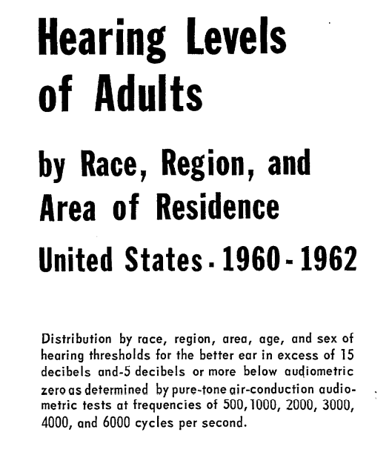
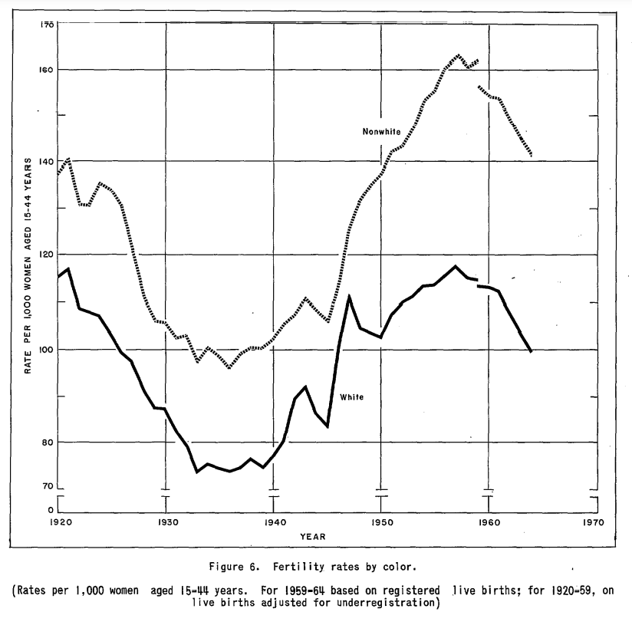
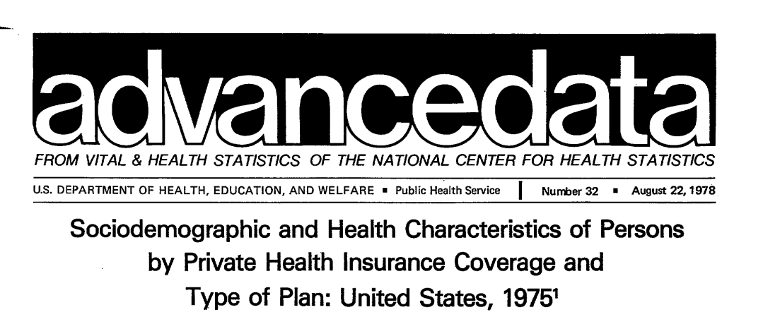
NCHS has a long history of measuring disparities

Slide 3
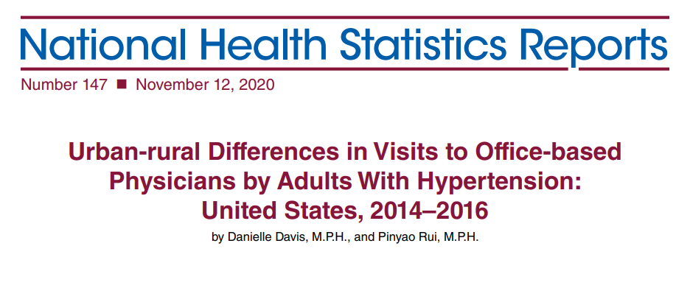
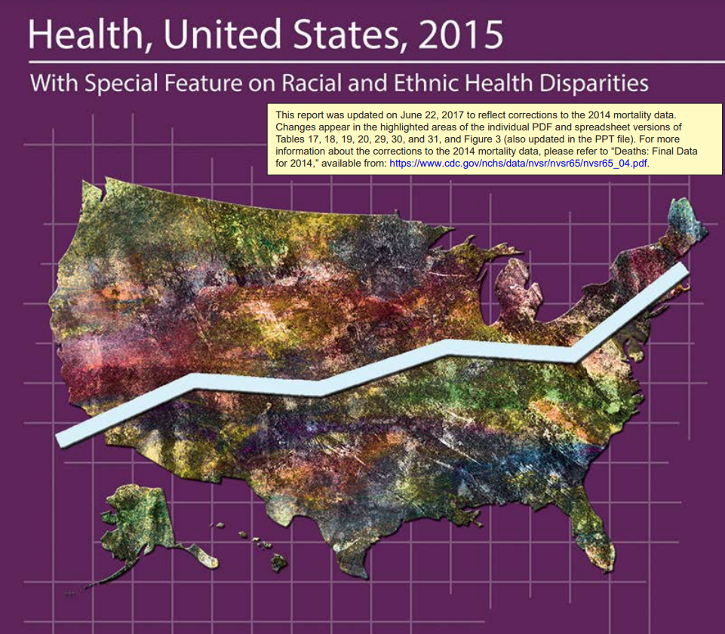
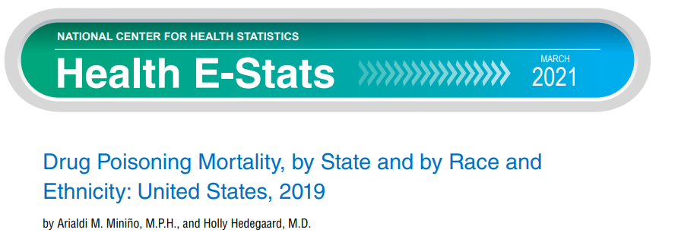
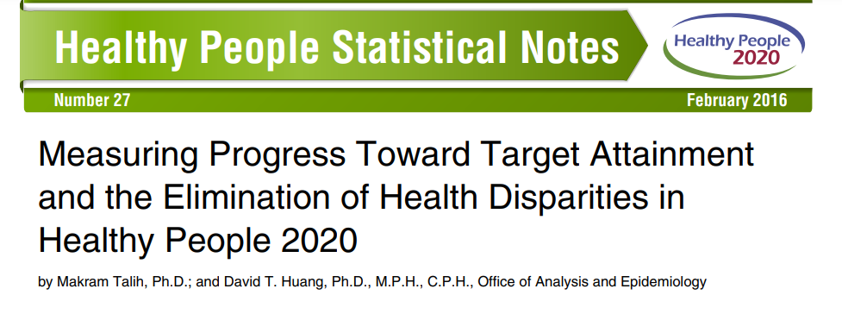
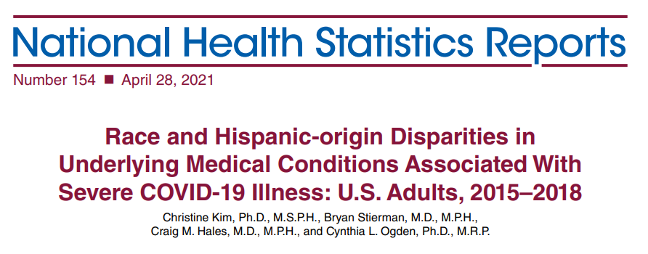
Still going!

Slide 4
1982-84 Hispanic Health and Nutrition Survey 2014 NHPI National Health Interview Survey

Slide 5
NCHS COVID-19 data and health disparities
Need and impact

Slide 6
NCHS COVID-19 data:
8 releases of provisional or novel data over last year
All releases include age and sex at minimum but most include race/ethnicity
Pulse also includes sexual orientation and gender identity
Most include measures of locality, namely urbanicity

Slide 7
Providing data for action: COVID-19 mortality data and health disparities

Slide 8
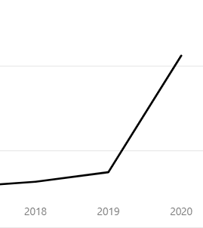
Impact
NCHS web page visits
100 M
50 M

Slide 9
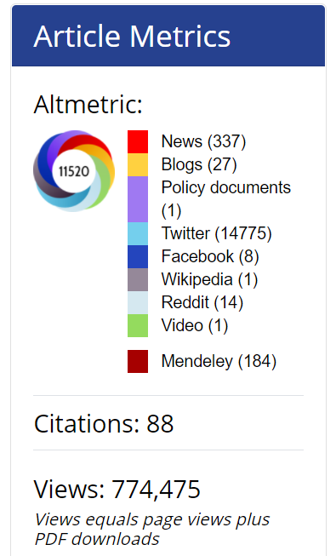

Slide 10
CDC’s Health Equity Strategy and NCHS
Where are we headed?

Slide 12
CORE goal considerations
Evolve
Don’t keep doing more of the same thing
Move
Shift from markers of health disparity and health equity to drivers
Innovate
Think boldly!

Slide 13
CORE goal process
NCHS submitted 19 goals across 6 divisions
We received feedback from CORE team review and adjusted
Next steps involve goal implementation and tracking

Slide 14
Improving data on drivers of disparities
2021
Measures of social support added to NHIS in July, 2020 and continued for 2021
Industry and occupation information will be released on the final 2020 mortality data file
2022
2022 NHIS will include questions on nonfinancial barriers to care
NPALS will add questions on cultural sensitivity training received by personal care aides in adult day and residential care settings
2023
NHIS and NHANES are considering adding content on perceived discrimination
NHANES will evaluate and include new laboratory biomarker of inflammation and stress

Slide 15
Gender identity data collection
By July 2023, using a range of methodologies, NCHS will identify and evaluate various question sets related to health equity
January 1, 2022 – NHIS will include questions on gender identity among sample adults
First year in NHIS will be experimental, testing various question approaches
NHIS 2022 Split Ballot Experiment
Sex: What sex were you assigned at birth, on your original birth certificate?
Gender 1: Do you currently describe yourself as male, female, or transgender?
Gender 2: Do you currently describe yourself as a man, as a woman, or in some other way?

Slide 16
Gender identity question evaluation
Led by NCHS’s Collaborating Center for Questionnaire Design and Evaluation
Cognitive testing with at least 60 adults and 80 teenagers
Online field tests
Measurement issues include:
Question wording
Placement of the questions within the questionnaire
Differences between self and proxy reporting
Impact of the mode of administration
Translations and item functioning in non-English interviews

Slide 17
Other CORE goal activities
Expanded collection and dissemination of data
Data linkage
Statistical modeling and analytics

Slide 18
Other activities
NCHS Diversity Committee Health Equity Research Day - July, 2021
Reconstitution of NCHS Health Equity Interest Group - September, 2021
DMI projects
Participation and representation on various HHS and CDC subcommittees

Slide 19
Questions or input?

