Slide 1
National Center for Health Statistics’ Data Linkage Program
Lisa B. Mirel and Irma Arispe
Office of Analysis and Epidemiology
National Center for Health Statistics
https://www.cdc.gov/nchs/data-linkage/index.htm
Presentation to the NCHS Board of Scientific Counselors
May 9, 2019

Slide 2
Outline
NCHS Data Linkage Program
History of NCHS Data Linkages
Current Linkages
Recent Work: Dissemination of Linked Products
Current Areas of Focus
Challenges and Opportunities Moving Forward

Slide 3
NCHS Data Linkage Program
Cross-cutting program housed in OAE
Supports the Center and its mission as a statistical agency
Standardizes linkage algorithms to link the Center’s population based health survey data with vital and administrative records
Creates datasets that are curated and can be used for repeat analyses to confirm findings
Ensures consistent quality of linked datasets
Documentation
Analytic guidelines
Applications of methodology

Slide 4
NCHS Data Linkage Program (cont.)
Augments available information for major diseases, risk factors, and health service utilization
Links exposures to outcomes
Provides longitudinal component to survey data
Expands detail of data difficult to collect in surveys
Benefit periods
Health care utilization
Reduces cost burden: follow-up surveys can be expensive

Slide 5
Types of Linkages: NCHS Data Linkage Program
Contextual data
Addresses are geocoded to standard Census geo-areas
Person or patient-level
Person/patient level survey data linked with administrative data (e.g., Medicare)

Slide 6
Examples of Research with NCHS Linked Data
Aging
Risk factors for poor health outcomes (e.g., hip fractures, stroke)
Health services
Health care utilization and costs for previously uninsured
Disability
Effects of chronic illness and obesity on disability and mortality
Disparities
Mortality patterns by race/ethnicity
Methodology Studies
Validation of self-report vs. administrative records

Slide 7
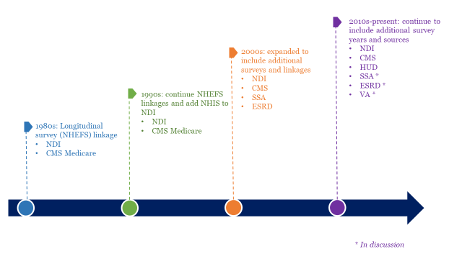
History of NCHS Data Linkage

Slide 8
Vital and Administrative Data Sources
National Death Index (NDI)
centralized database of U.S. death records gathered from states’ vital statistics offices
Centers for Medicare & Medicaid Services (CMS)
provides health insurance and health care coverage for age 65+ and some vulnerable populations in the U.S., including low-income children and the aged or disabled poor
Housing and Urban Development (HUD)
responsible for overseeing and managing domestic housing programs and policies, including specialized programs for high-needs populations (e.g., the elderly, homeless, and disabled) in the U.S.
Social Security Administration (SSA)
administers retirement and disability benefits for elderly and disabled populations in the U.S.

Slide 9
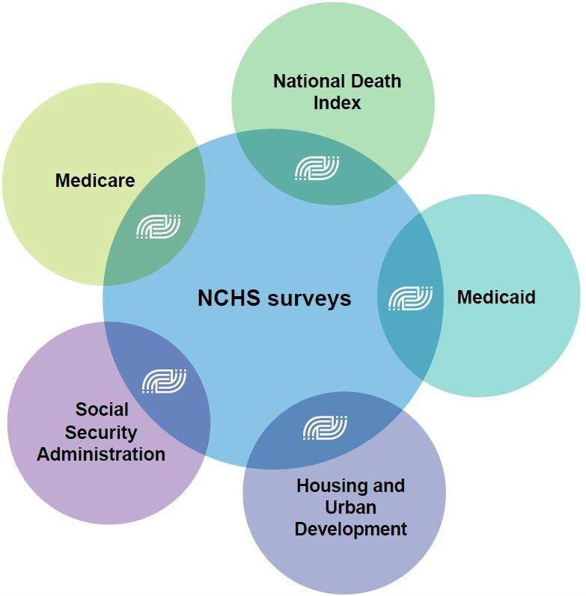
Current NCHS Data Linkages
NDI:
up to 30 years of follow-up
Medicare: up to 25 years of follow-up
Medicaid: up to 25 years of follow-up
SSA:
up to 20 years of follow-up
HUD:
up to 15 years of follow-up
A summary of the available linkages can be found at: https://www.cdc.gov/nchs/data/datalinkage/linkagetable.pdf

Slide 10
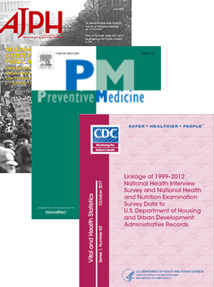
Recent Work: Dissemination of Linked Products
Linked Mortality Data
Deaths Associated with Underweight, Overweight, and Obesity
Air Pollution Exposure and Heart Disease Mortality
Educational Differentials in US Adult Mortality
Linked NCHS-CMS Data
Characteristics of Those who Chose MA Upon Medicare Enrollment at Age 65
Health Service Use among the Previously Uninsured
Concordance between Survey Reported Childhood Asthma and Linked Medicaid
Linked NCHS-HUD Data
Housing Assistance and Blood Lead Levels
Cigarette smoking and adverse health outcomes among adults receiving federal housing assistance
Linkage of 1999-2012 NHIS and NHANES data to HUD administrative records

Slide 11
Current Areas of Focus
Improved linkage algorithms and quality
Public-use files
Periodicity of linkages
New linkage opportunities

Slide 12
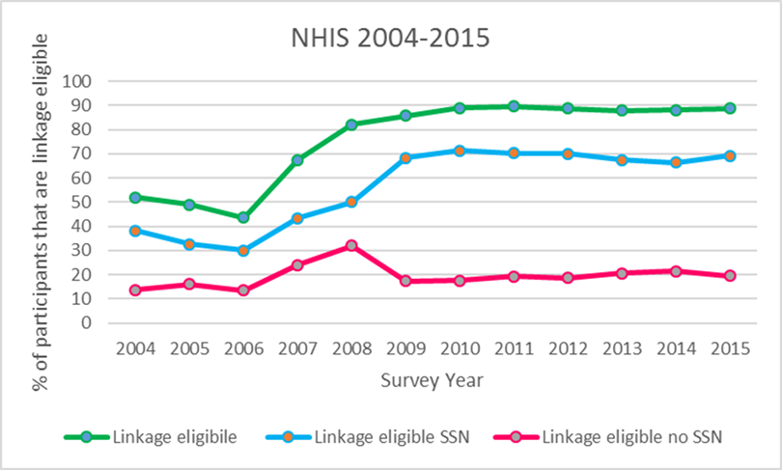
Improved Linkage Algorithms I
NHIS linkage eligibility changed in 2007
PII collection changed with NHIS only collecting last 4 digits of Social Security Number (SSN) instead of 9
If participants refused SSN, asked a specific question about permission to link without SSN

Slide 13
Improved Linkage Algorithms II
Potential linkage bias
Algorithms designed to match with SSN4
Medicaid linkage
Algorithms designed to match no SSN
National Hospital Care Survey (NHCS) data linkage

Slide 14
Improved Linkage Algorithms III
Linkage of NHCS data to NDI and CMS’ Medicare files
Claims and electronic health records
New and improved probabilistic based algorithms
Use of machine learning to define blocking
Linkage error estimates

Slide 15
Public-use Files
There are two types of public-use files released by the NCHS Data Linkage Program:
Public-use feasibility data files
Developed to help interested researchers determine the maximum available sample sizes to assess the feasibility of conducting analyses utilizing the restricted-use linked files in the NCHS RDC.
Available online for linked CMS and SSA data
Public-use microdata files
Available online for linked NDI data only

Slide 16
Public-use Files
New public-use Linked Mortality Files (LMF) in February, 2019
Most utilized linked file
Literature review assessment: at least two thirds of papers rely on the public-use file
Public-use LMF
Only adults, limited number of causes of death, some records perturbed
Comparison analysis: public-use vs. restricted use file survival analysis estimates

Slide 17
Periodicity
Develop a schedule for core set of linkages on a recurrent basis
Help research community plan for projects and obtain funding
Produce updated linked files every two to three years:
National Death Index
Centers for Medicare & Medicaid Services
Housing and Urban Development

Slide 18
New Linkages
In progress:
PCORTF 2017: link NHCS data to NDI and CMS records
PCORTF 2019: link NHCS data to HUD and CMS
In discussion: link NCHS survey data to
Veteran’s Administration Health Care
End Stage Renal Disease data
Social Security Administration data

Slide 19
The Future of NCHS’ Data Linkage Program
Opportunities | Challenges
Increased interest in linkage | Negotiation of agreements
Interagency collaboration | Ownership and use
Linking new data sources | Releasing updates on a timely predictable schedule
Diversifying linkages to augment survey content, context | Protecting privacy, minimizing disclosure risk
Protecting privacy | Promoting use
Developing new data | Creating tools and conducting analyses to facilitate use

Slide 20
Foundations for Evidence-Based Policymaking Act of 2018 (PL115-435)
Official Title: To amend titles 5 and 44, United States Code, to require Federal evaluation activities, improve Federal data management, and for other purposes.
Title I – Federal Evidence-Building Activities
Title II – Open Government Data Act
Title III – Confidential Information Protection and Statistical Efficiency
Title IV – General Provisions

Slide 21
Some key sections, potential NCHS contributions
Agency development of evidence building and evaluation plans (§312); Advisory Committee on Data for Evidence Building recommendations (§315)
Monitor policy-relevant and evaluation questions, planned data to be used or collected, stakeholder engagements, recommended linkages
Conduct outreach about data availability, data quality, methodologies, or analogous policy-relevant analyses
Strategic plans include assessment of the coverage, quality, methods, effectiveness, and independence of the statistics, evaluation, research, and analysis efforts of the agency
Criteria for assessing coverage, quality, effectiveness, independence
Data inventory (§3511)
Approaches for storing information about data sets

Slide 22
Increasing communication, managing expectations
PL 115-435 will | Potential implications
Increase number of statistical officials; Information about the need for data; Evidence plans | Increase linkage opportunities; Demand for expertise (statistical, statistical agency, and technical expertise); Use linked data for policy
Increased access to CIPSEA data | Increased need for education about CIPSEA
Expanded provision of data to qualified users | Increased interest in customization, technical consultation

Slide 23
Negotiating Interagency Agreements
There are agency differences in legislative mandates and requirements to protect data and survey participants’ confidentiality
NCHS is working within federal statistical system to work on standard approaches
Managing expectations means thinking about…
Can a public use file be created?
Where will linked data reside?
Who will control access?
Will analysts from outside NCHS be required to become designated agents?
How long should the data file be kept?
Who will conduct disclosure review?

Slide 24
Increasing Data Access
Public use files: possible but challenging
Assess disclosure risk
Develop synthetic public-use micro data files that are analytically useful and valid
Resources for users
E-learning tools (e.g., web tutorial)
Compiling examples of use, conducting analyses
Outreach and increasing user base
Federal partners
Policy groups, academia

Slide 25
What’s Involved in Using Linked Data for Policy?
Identify and collect information on policy interests and use of policy levers
Regulation, deregulation, taxation, spending, tort liability
Understand how the data we have can be enhanced to address questions (through new or existing linkages)

Slide 26
Ten Greatest Public Health Achievements, 2000-2010
Childhood Lead Poisoning Prevention
Mandating that schools test water for lead
Occupational Safety
Inspecting worksites to ensure they follow safety guidelines
Tobacco Control
Cardiovascular Disease Prevention
Implementing Complete Streets programs to encourage exercise
Raising the minimum legal age of tobacco use to prevent youth initiation
Creating data agreements to share workers’ compensation data with public health surveillance systems
Emergency Preparedness and Response
Joining mutual aid compacts, like the Emergency Medical Assistance Compact, to share resources across jurisdictions
Issuing emergency declarations
Enforcing smoke-free air laws and extending them to more places
Addressing liability issues to encourage schools to make playgrounds available after hours
Requiring landlords to disclose if housing units have lead-based paint
Vaccine-Preventable Diseases
Requiring children who enter schools to have certain vaccinations
Funding the Vaccines for Children Program
Cancer Prevention
Creating the Breast and Cervical Cancer Early Detection Program
Prevention and Control of Infectious Diseases
Motor Vehicle Safety
Enacting child restraint laws
Establishing ignition interlock programs to address DUI offenses in the court system
Requiring hospitals to report central line infection rates
Requiring schools to provide information about HPV vaccines
Maternal and Infant Health
Adding new conditions to newborn screening programs
Requiring that certain foods be fortified with folate
Creating MOUs among state agencies to respond to foodborne disease outbreaks
Source: https://www.cdc.gov/mmwr/preview/mmwrhtml/mm6019a5.htm

Slide 27
Using Linked Data for Policy
How can the linked data be used for policy analyses?
Lead exposure and mortality
Bipartisan Policy Center (BPC) chapter in Evidence Works
BPC efforts and others to raise awareness of the potential of the linked data to support Evidence Based Policymaking

