Slide 1
Incorporating an Enhanced-Linkage Algorithm for Household Survey Data Linked to the NDI
Lisa B. Mirel
Board of Scientific Counselors
January 9, 2020

Slide 2
Introduction
Proposing to use an enhanced algorithm and document changes with the next release of the linked mortality data for all NCHS surveys (expected release date Q3 2020)
New files will include:
Detailed information on enhanced linkage algorithm
Comparative analyses using the old and new algorithms

Slide 3
Background I
NDI algorithm was calibrated using NHANES I Epidemiologic Follow-up study (NHEFS)
For past linked mortality files, the linkage group used a slightly modified NDI algorithm for linking NCHS survey data (NHIS and NHANES) to NDI
Accommodate SSN 4 data collection
Hispanic and Asian name alternate records
2017 PCORTF project to link NHCS to NDI resulted in development of enhanced linkage algorithm

Slide 4
Background II
Enhanced algorithm was developed and applied to the 2014 and 2016 NHCS data linked to the NDI
Same enhanced algorithm was applied to household survey data linkage to NDI
Resulted in changes in assigned vital status for survey participants compared to previously conducted linkages by linkage group
Larger number of decedents are no longer deceased

Slide 5
Enhanced Linkage Approach
Linkage conducted in two passes:
Deterministic match using SSN collected in the survey
Identifier fields such as name, state of residence, and date of birth are compared to validate
This dataset becomes the “test deck”
Probabilistic matching techniques used to identify likely pairs using other identifiers (not SSN)
SSN is not used to create the match pool instead it is used to measure linkage accuracy

Slide 6
Specifics: Probabilistic Techniques
Possible pairs are scored according to Fellegi-Sunter (F-S) paradigm
For each identifier, first name, year-of-birth, etc., M- and U- probabilities are computed
M-probabilities: rate of identifier agreement for matched pairs
U-probabilities: likeliness of a spurious agreement
Rare values (e.g., unusual names) have lower U-probabilities
M- and U- probabilities are used to algebraically determine agreement and non-agreement weights according to F-S theory
Weights for all identifiers summed to produce total pair weight

Slide 7
Probability of a Match P(Match)
Pair weights used to estimate P(Match): the probability that a given pair is an actual match (i.e., paired records represent same person)
Pairs with estimated P(Match) above a threshold were considered matches all those below were assumed alive

Slide 8
Selection of Best Pair as a Match
When a survey record has been linked to multiple NDI records
The linked pair having the highest probability of being a match is accepted
Deterministic links are assumed to have probability of 1 and are always selected over links established from probabilistic search

Slide 9
Assess Quality of Matches
Type I (false positive) and Type II (false negative) errors were calculated using the test deck in order to assess quality of matches developed
Results: Highly accurate linkage results (low type I and type II errors)
Deterministic matches (pass 1) represent 2/3 of total matches (assume a zero error rate with deterministic approach)
For all surveys combined:
Type I error rate = 1%
Type II error rate = 2%

Slide 10
Comparing the Two Approaches

Slide 11
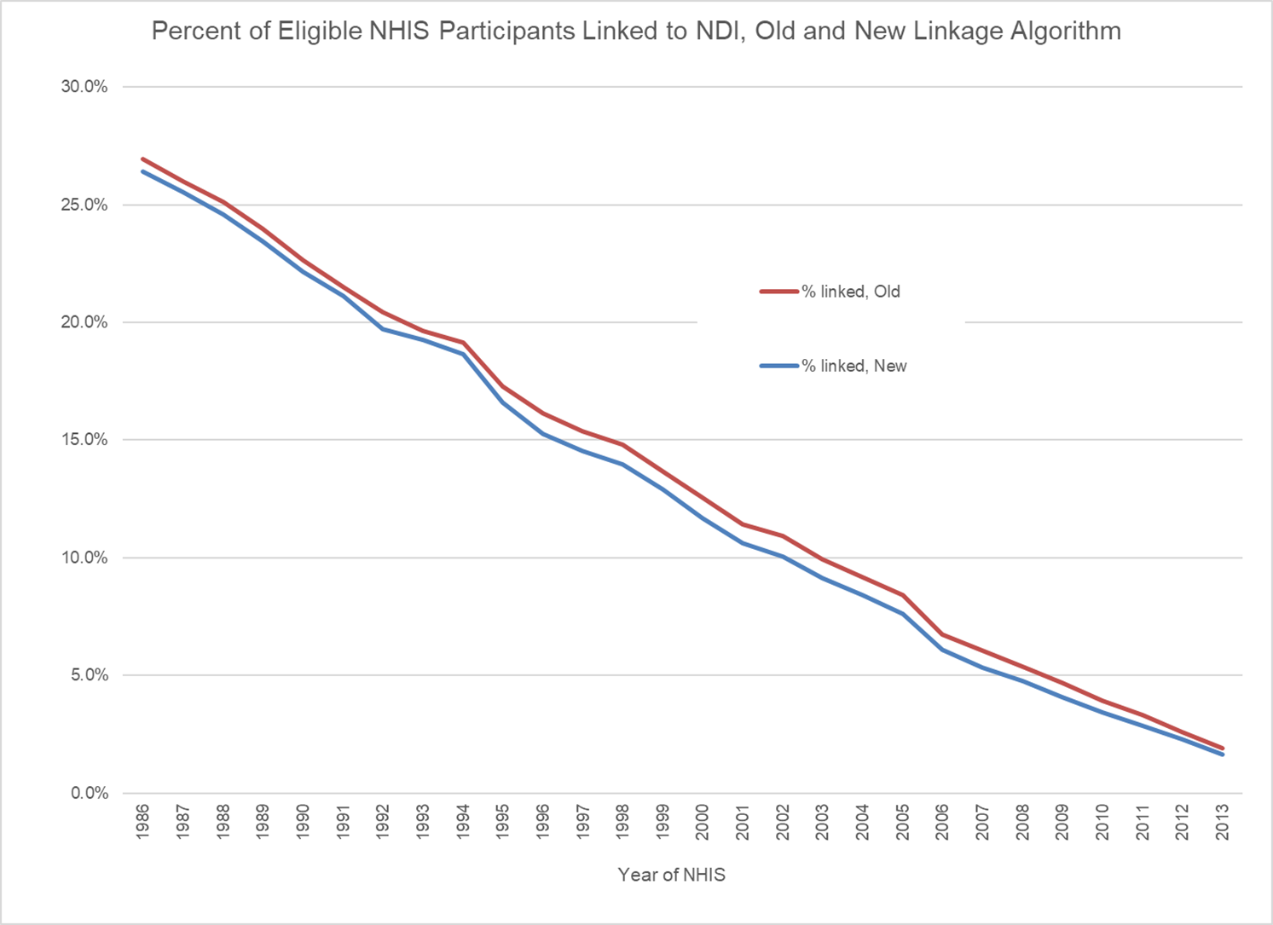
Percent of Eligible NHIS Participants Linked to NDI: Old and New Linkage Algorithm

Slide 12
All NHIS years combined: 1986-2013
68,769 out of 4,637,576 (1.5%) will have a different outcome with the new algorithm compared to old
93.2 % of old matches (676,355/725,217) in concordance with new matches
97.1% of new matches (676,355/696,262) in concordance with old matches

Slide 13
Percent of Eligible NHIS Participants Linked to NDI: Old and New Algorithm

Slide 14
NHIS: SSN9 Results
31,763 out of 2,012,574 (1.6%) will have a different outcome with the new algorithm compared to old
93.6 % of old matches (328,634/351,022) in concordance with new matches
97.2% of new matches (328,634/338,009) in concordance with old matches

Slide 15
NHIS: SSN4 Results
5,243 out of 612,428 (0.7%) will have a different outcome with the new algorithm compared to old
82.4 % of old matches (19,087/23,173) in concordance with new matches
94.3% of new matches (19,087/20,244) in concordance with old matches
Note: starting in 2007 only the last 4 digits of SSN were collected from the Sample Adult. All eligible participants were linked.

Slide 16
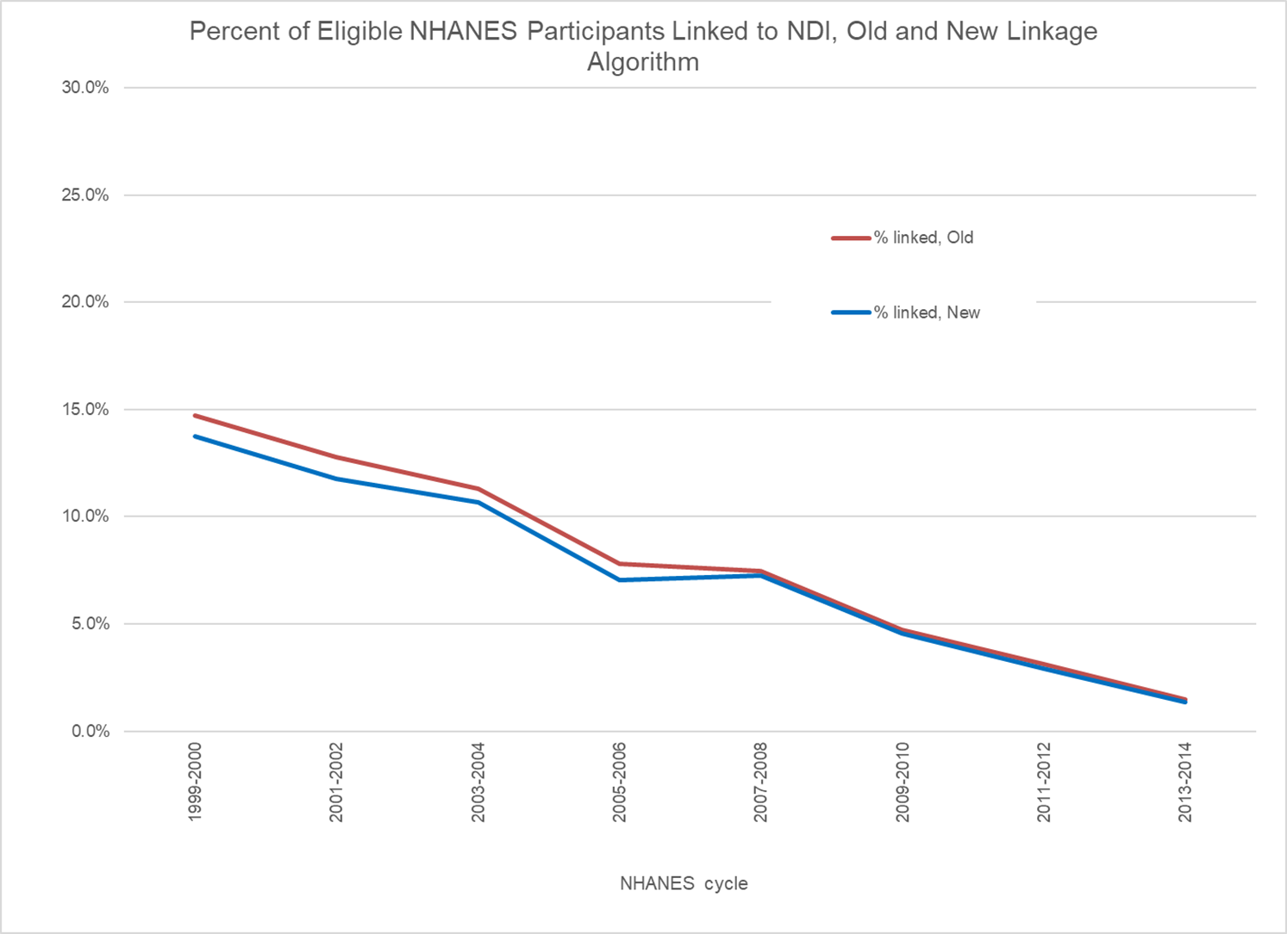
Percent of Eligible NHANES Participants Linked to NDI: Old and New Linkage Algorithm
Notes:
New slide 16

Slide 17
Continuous NHANES: 1999-2014
608 out of 81,904 (0.6%) will have a different outcome with the new algorithm compared to old
92.1 % of old matches (6,013/6,526) in concordance with new matches
98.4% of new matches (6,013/6,108) in concordance with old matches

Slide 18
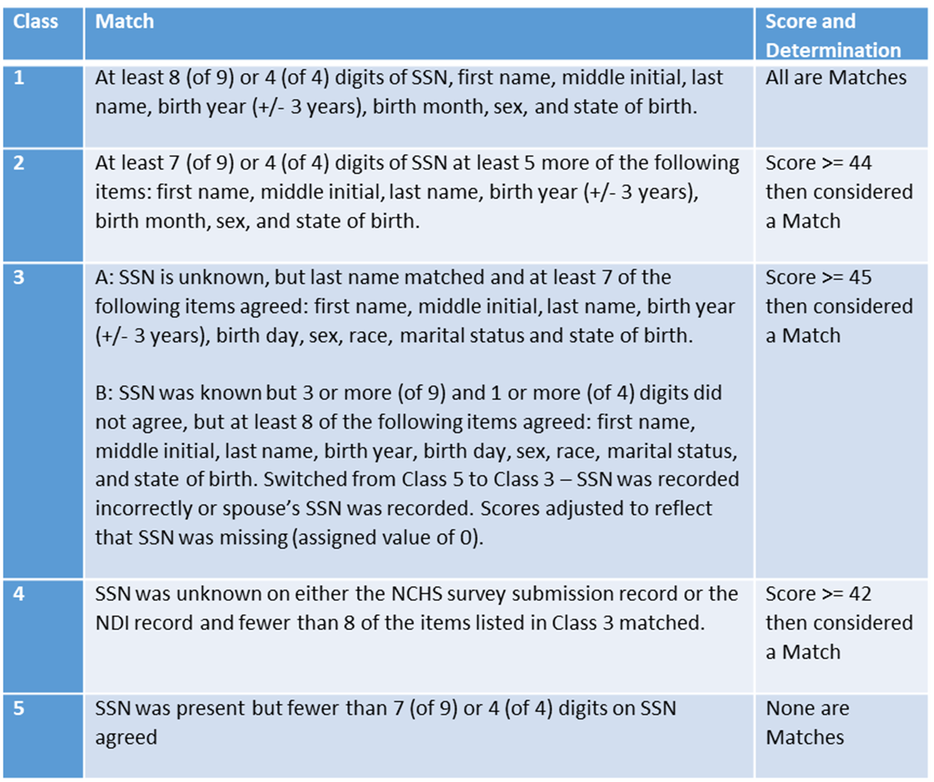
Class and Score
How were the previous
links selected?
Defining Class and Score:
Old algorithm
Notes:
New slide 18

Slide 19
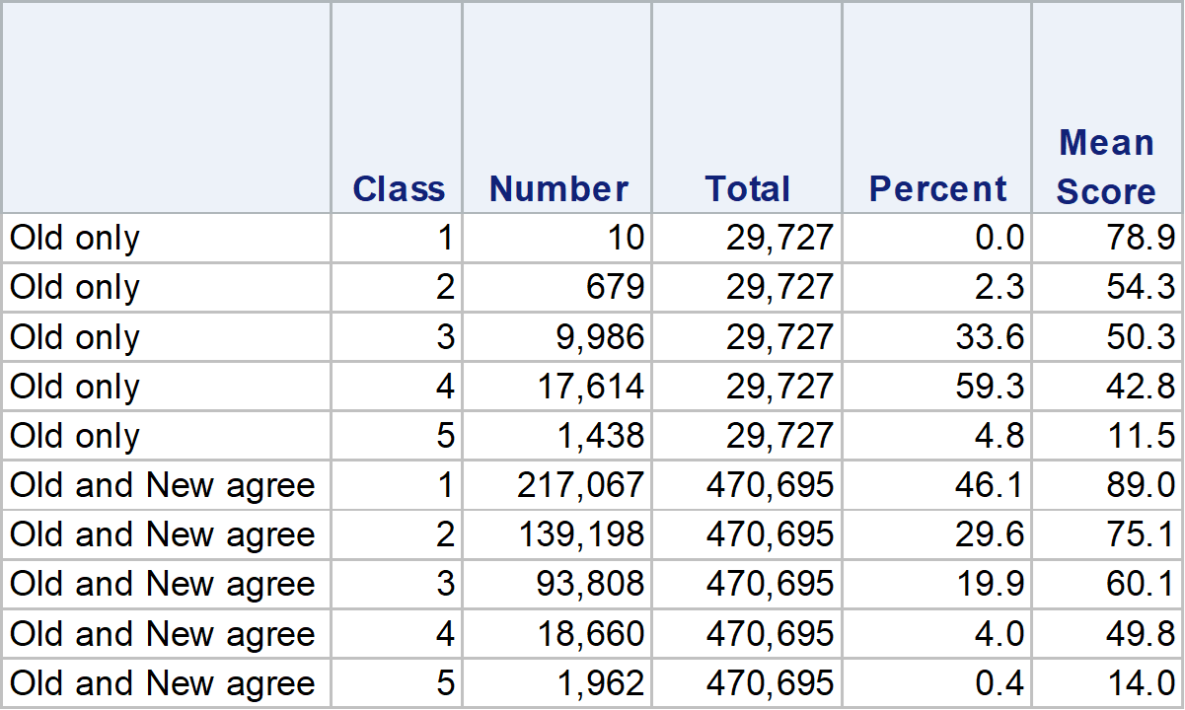
Class and Score: All Surveys Combined
~93% of old only are class 3 and 4
Class 5 deaths indicate death from a non-NDI source
Notes:
Note: what’s not on this table is that *New algorithm adds 12,137 new links
Class 3 and 4: Common names, don’t have SSN or didn’t match, alternative birth dates

Slide 20
Effects on Inference: Old and New Linkage Algorithms
Survival models run using old and new algorithm
Models included age, sex, race/ethnicity, education, marital status and region
Compared hazard rates from two approaches
For all cause and cause specific mortality the % differences of hazard rates from the survival models were <=5% except for Hispanics which were greater than 10%

Slide 21
Validation Checks for New Algorithm

Slide 22
Medical Expenditure Panel Survey (MEPS) Analysis
Current NCHS mortality linkage doesn’t have a “gold standard” available for assessment
Survey-reported death data are an ideal comparator
Assessment of mortality linkage algorithm possible using the MEPS

Slide 23
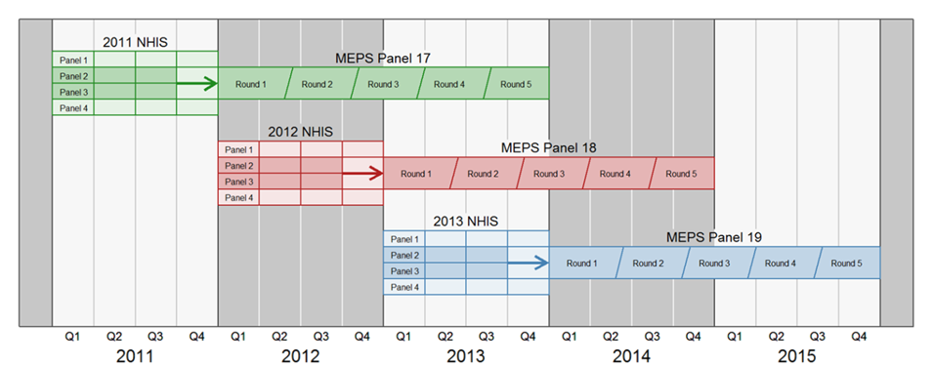
MEPS Analysis (cont.)
MEPS follows NHIS participants over time; during MEPS data collection may determine that a participant has died and in what year

Slide 24
MEPS Analysis (cont.)
If the participant died, the mortality status as reported in MEPS, becomes a proxy for “gold standard”
If the date of death was greater than the MEPS round date the participant was censored (assumed alive for the kappa calculation) for that year of NHIS

Slide 25
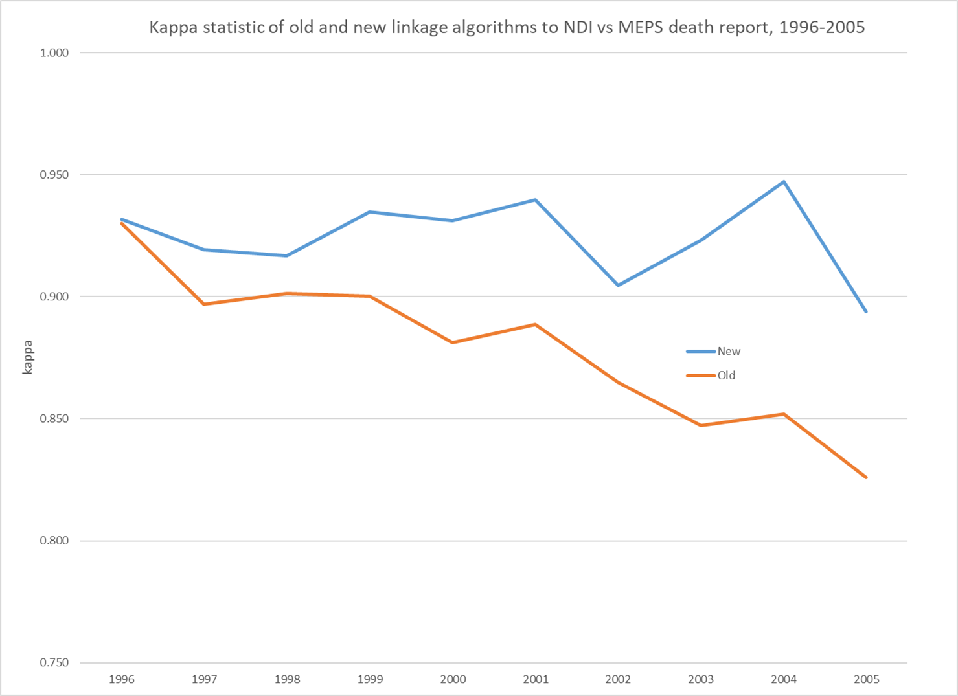
Kappa Statistic of Old and New Linkage Algorithm: NDI vs MEPS death report: 1996-2005

Slide 26
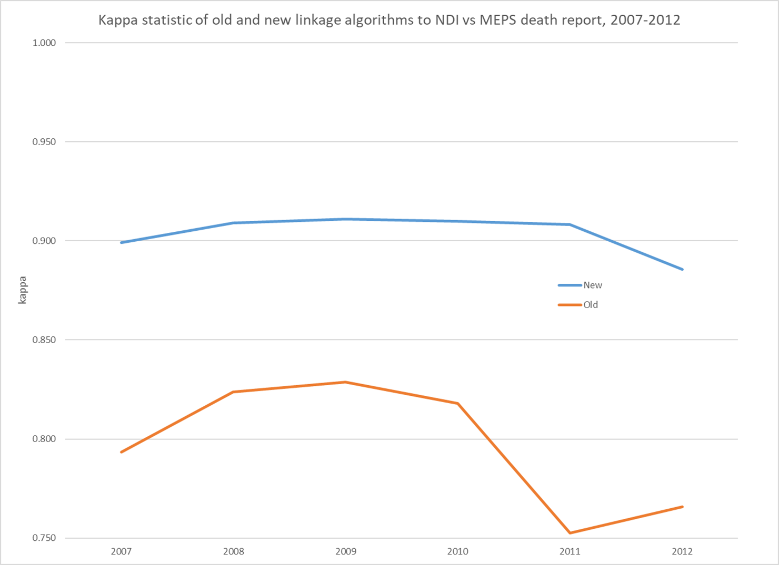
Kappa Statistic of Old and New Linkage Algorithm: NDI vs MEPS death report: 2007-2012

Slide 27
2014 NHCS Linkage: Standard NDI Algorithm* vs New Algorithm
21,694 out of 3,558,286 (0.6%) have a different outcome with the new algorithm compared to NDI
97.4 % of old matches (149,941/153,898) in concordance with new matches
89.4% of new matches (149,941/167,678) in concordance with old matches
Note: of the 3,957 NDI-only links, 97.6% were class 4 (0.13% were class 3)
*2014 NHCS was run through the standard NDI algorithm prior to 2017 PCORTF project

Slide 28
QC check 2014 NHCS
32,763 patients in the 2014 NHCS had a discharge status of deceased on their hospital record
Of the 32,763 with a discharge status of deceased:
New algorithm linked 31,723 (96.8%)
NDI algorithm linked 30,530 (93.2%)

Slide 29
Conclusions
For HH surveys: concordance between the two methods is high overall (~94%)
New deaths for previously matched years – explained by improved matching techniques. Relatively small numbers when compared with total eligible (1986-2013 NHIS=19,907 (0.4%), 1999-2014 NHANES =95 (0.1%), NHANES III=48 (0.1%))
Previous decedents no longer considered deceased – explained by improved matching techniques. Larger numbers when compared with total eligible (1986-2013 NHIS=48,862 (1.1%), 1999-2014 NHANES =513 (0.6%), NHANES III=616 (1.8%))

Slide 30
Conclusions (cont.)
Old algorithm was based on what we knew at the time (NHEFS was used for validation)
New algorithm
Aligns with outside sources for validation (MEPS and NHCS discharge status)
Improves shortcoming with certain demographic groups

Slide 31
Implications for Dissemination
For HH surveys linked to NDI: plan to use newly enhanced algorithm for updated linked mortality file production, beginning in January 2020 with 2018 NDI data
Mitigate user concern over different results from previous mortality releases by publishing comparative analyses of the two approaches
Question for the BSC:
How should we proactively communicate with new and current users about the changes?

Slide 32
Appendix

Slide 33
NHANES III: 1988-1994
664 out of 33,959 (2.0%) will have a different outcome with the new algorithm compared to old
92.6 % of old matches (7,735/8,351) in concordance with new matches
99.4% of new matches (7,735/7,783) in concordance with old matches

Slide 34
NHANES Feasibility Longitudinal Study
Old algorithm falsely assigned deceased status to 5 people in the NHANES feasibility longitudinal study
NHANES interviewed these 5 as part of the longitudinal study
New algorithm assigned assumed alive status to all 5 of these people

