Slide 1
Board of Scientific Counselors Update from the NCHS Director
Brian C. Moyer, Ph.D., NCHS Director
January 27, 2021

Slide 2
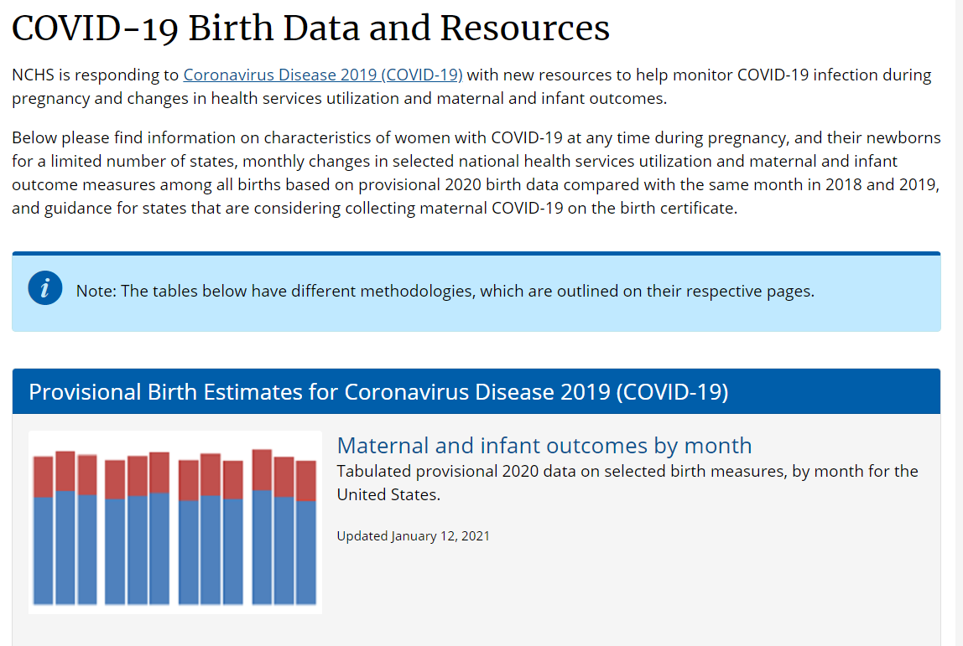
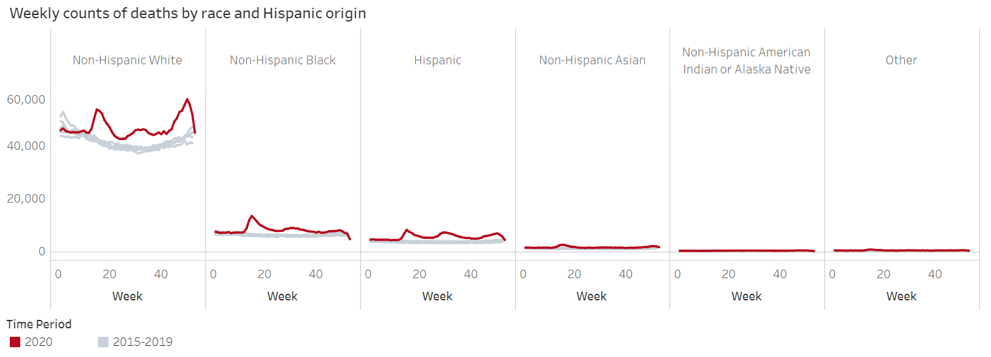
Recent Data on COVID-19
https://www.cdc.gov/nchs/covid19/index.htm

Slide 3
Recently Published Reports in Dec/Jan 2021
Final Death Data for 2018
Upcoming Reports in Feb 2021
Secondhand Smoke Exposure Among Nonsmoking Adults, 2015 – 2018
Respiratory Illness Emergency Department Visits
Mortality in the United States, 2019
Drug Overdose Deaths in the United States, 1999 – 2019
Multiple Chronic Conditions Among Veterans and Nonveterans, 2015 – 2018
https://www.cdc.gov/nchs/pressroom/calendar/2021_schedule.htm

Slide 4
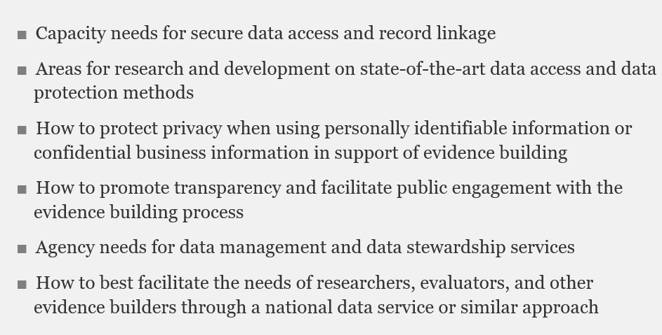
To make recommendations on issues of access to data, how to facilitate data sharing, data linkage, and privacy enhancing techniques.

Slide 5
NCHS Budget Update
FY 2021 Estimate, Final TBD
Realignment of $14 million plus increase of $1 million in FY 2021
“Additional Resources” include reimbursables from CDC and other agencies.

Slide 6
New CDC Director: Dr. Rochelle Walensky
Professor of Medicine at Harvard Medical School and a practicing Infectious Disease physician at Massachusetts General Hospital and Brigham and Women's Hospital
Chair of the Office of AIDS Research Advisory Council (NIH) and a member of the HHS Panel on Antiretroviral Guidelines for Adults and Adolescents
Research has focused on
model-based analyses of the cost-effectiveness of HIV testing, care, and prevention strategies
COVID infection prevention and control strategies
analyses of the impact of the pandemic on healthcare workers
recent co-author on JAMA article analyzing excess deaths

Slide 7
Data Modernization Initiative (DMI) Thematic Areas
Data Sharing Across the Public Health Ecosystem
CDC Systems and Service Enhancements for Ongoing Data Modernization
New Standards and Approaches for Public Health Reporting

Slide 8
CDC’s DMI Roadmap of Activities and Expected Outcomes

Slide 9
NCHS Theme 1 Activities: Data Sharing Across the Public Health Ecosystem
Modernize NVSS
Fully support FHIR based bi-directional messaging
Enhance existing data quality review tool
Develop and enhance automated cause of death coding systems
Improve NVSS Data Quality and Consistency
Develop consistent processes, standards, systems, and training for investigating, certifying, and reporting

Slide 10
NCHS Theme 2 Activities: CDC Systems and Service Enhancements for Ongoing Data Modernization
Facilitate data source identification
Improve ability of users to identify data sources
Develop enterprise-wide access tools to guide users to data
Simplify access and use of microdata
Simplify and facilitate access to and use of microdata
Build a repository with standardized metadata on sources and uses, searchable catalogues, and linkages to external sources
Integrate and streamline access to NCHS' enterprise data assets
Improve access to nonpublic data
Provide controlled access to data files that cannot be released broadly
Develop a new remote access mechanism

