Slide 1
Board of Scientific Counselors
Jennifer Madans, PhD
Acting Director, National Center for Health Statistics
September 5, 2019

Slide 2
Administrative and Budget Updates

Slide 3
New BSC Members
Welcome to our new BSC Members
Kennon R. Copeland, Ph.D.
Scott H. Holan, Ph.D.
John R. Lumpkin, M.D., M.P.H.
Sally C. Morton, Ph.D.
Our new/continuing Chair: Linette Scott, M.D., M.P.H.

Slide 4
NCHS Budget
$5.397 million reduction
*Amount includes $15.397 million in Budget Authority for administrative and business services through the CDC Working Capital Fund.
**Amount includes funding for administrative and business services through the CDC Working Capital Fund.
Not included: NCHS relies on an additional transfer from CDC’s Public Health and Scientific Services Account, about $14 million annually.

Slide 5
Additional Funding (ORCU + PCOR)
Funding Type | FY 2018 | FY 2019
Patient-Centered Outcomes Research (PCOR) Initiative* | $4,826,561 | $1,556,845
Opioid Response Coordinating Unit (ORCU) | $7,830,000 | $11,500,000
TOTAL | $12,656,561 | $13,056,845
*Total PCOR funding received supports work beyond opioids projects

Slide 6
Percentage of NCHS Data Collections Funded by Reimbursable Dollars in FY2018

Slide 7
Congressional Visit
May Visit to House Appropriators on the Hill
July Appropriators Visit to NCHS
Funding for stabilizing current programs and surveys
Data modernization

Slide 8
Program updates

Slide 9
Division of Vital Statistics (DVS)
Closing the gap on jurisdictions without Electronic Death Registration (EDR) Systems
6 jurisdictions just awarded funding to build new EDR systems
8 jurisdictions funded to complete building-out systems
5 jurisdictions funded to expand interoperability with medical examiner/coroner systems
More jurisdictions submitted proposals than could be funded
Upcoming Implementers meeting in Atlanta in September 2019
An opportunity to test and demonstrate interoperability in medical examiner/coroner systems, NCHS, and registries – the intent is to create a seamless flow of data between state surveillance systems
Implementer states: California, Florida, Georgia, Michigan, New Hampshire, New York
Notes:
The EDRS awards are all ORCU funded

Slide 10
Division of Health Interview Statistics (DHIS)
2018 NHIS
Public use data files released June 24, 2019
2019 NHIS
January-June sample adult response rates (60.0%) remain stronger than 2018 (53.1%)
January-June data are being cleaned, optimized, processed, and carefully reviewed
Comparisons of estimates from the old and new questionnaire designs are ongoing
Nonresponse bias analyses for Q1 2019 recently completed
2020 NHIS
Rotating content new for 2020:
Industry and occupation; Injuries; Physical activity; Walking; Sleep; Fatigue; Smoking history and cessation; Alcohol use; Neighborhood characteristics
Sponsored content new for 2020:
Diabetes (NCCDPHP); Opioid use and pain management (NCIPC); Age-of-onset of disability (ACL)
Sponsored content ongoing in 2020:
Cancer control and prevention (NCI and NCCDPHP); Immunizations (NCIRD); Non-cigarette tobacco product use (FDA); Food security (USDA)
Notes:
**Talking point for the nonresponse bias analyses: DHIS is seeking peer reviewers for this analyses – we welcome BSC members helping to review.

Slide 11
Division of Health and Nutrition Examination Survey (DHANES)
DHANES Director Update
Recruitment underway for new DHANES Director
Ryne Paulose, PhD, Acting Director
Planning NHANES 2021 – 2022
Decisions on content
Planning NHANES 2023+
Determining core content and key covariates
Continuing market research
Evaluating options to decluster
Exploring requirements for in-home phlebotomy
Assessing a range of innovations to improve data collection
NHANES Data Release
Currently evaluating NHANES 17-18 data quality
Making adjustments to the sample weights
Public release of NHANES 17-18 data files will be delayed

Slide 12
Division of Health Care Statistics (DHCS)
National Ambulatory Medical Care Survey (NAMCS) - Physician:
Last data release: 2016 NAMCS (released 01/2019)
Next expected release: 2018 NAMCS (release expected 2nd quarter 2020)
2017 NAMCS undergoing further data processing due to the addition of EHR data, requiring additional time
National Hospital Ambulatory Medical Care Survey (NHAMCS) Emergency Department (ED):
Last data release: 2016 NHAMCS ED (released 11/2018)
Next expected release: 2017 NHAMCS ED (release expected end of 2019 or 1st quarter of 2020)
National Electronic Health Records Survey (NEHRS):
Last data release: 2017 NEHRS (released 12/2018)
Next expected release: 2017 NEHRS Supplement (release expected 4th quarter 2019)
2018 NEHRS RDC file should also be released in 4th quarter 2019 + public release in Q2 2020 – the first time to be released to the public
Long-Term Care Surveys Update:
National Study of Long-Term Care Providers (NSLTCP), 2017-2018, survey redesign:
First time person-level sampling and data collection
Completed data collection February 2019
Plan for survey data in RDC October 2019 and public-use files July 2020
National Post-Acute and Long-Term Care Study (NPALS, formerly NSLTCP), 2019-2020:
Plan to award surveys contract in September 2019
Adding 2 sectors to reflect spectrum of post-acute care (inpatient rehab and long-term care hospitals)
Obtaining multiple administrative data files from CMS
No person-level data collection
Notes:
IF ASKED: the 2017 NAMCS office-based physician is being held back. Because of the way the sample was drawn that year, EHR data component of 2017 must be processed with the abstracted data component before the entire year's worth of data can be publicly released. Due to delays in EHR data processing, we decided to prioritize 2018 NAMCS since 2018 only has abstracted data. DHCS will give a better projection of 2017 NAMCS physician data release at the next BSC meeting.
2017 NEHRS had a base survey and a follow-up supplement (two rounds of data collection). 2017 base was released in the RDC in Dec 2018. 2017 follow up will be released to the RDC in Q4 2019. 2018 NEHRS is the first time such data will be released to the public; it will be first released in the RDC in Q4 2019 and publicly released Q2 2020.

Slide 13
Division of Analysis and Epidemiology (DAE)
What is Health, United States?
Legislatively mandated report on the health status of the nation submitted to the President and the Congress
Provides an overview of national trends in key health indicators
Health, United States 2018 – latest report coming soon!
Expected release in October 2019
Printed and PDF 20-figure Chartbook on the Health of Americans
47 detailed trend tables available as an online-only supplement
Undergoing redesign exploration, gathering input from:
Government and academic stakeholders
Reports and websites for best practices in dissemination

Slide 14
Federal Interagency Forum on Child and Family Statistics
New Report out in September 2019!
Founded in 1994 with a focus on coordination across federal agencies working on child and family programs and data
Comprised of 23 agencies that produce or use statistical data on children
NCHS administers the Forum’s work, provides data and statistical expertise
Includes data from the National Vital Statistics System (natality, mortality, linked births/deaths), National Health Interview Survey, National Health and Nutrition Examination Survey, National Hospital Ambulatory Medical Care Survey – Emergency Department

Slide 15
NCHS Awarded the CDC Shepard Award in Data Methods and Study Design
Cross-Division collaboration at NCHS from colleagues in DRM, DAE, and DVS:
Diba Khan
Lauren M. Rossen
Holly Hedegard
Margaret Warner
A Bayesian Spatial and Temporal Modeling Approach to Mapping Geographic Variation in Mortality Rates for Subnational Areas with R-INLA
Diba Khan, Lauren M. Rossen, Holly Hedegaard, and Margaret Warner. A Bayesian Spatial and Temporal Modeling Approach to Mapping Geographic Variation in Mortality Rates for Subnational Areas with R-INLA. J Data Sci 2018; 16(1): 147-182

Slide 16
NCHS Publications by Fiscal Year
Publications Type | Fiscal Year
 | 2010 | 2011 | 2012 | 2013 | 2014 | 2015 | 2016 | 2017 | 2018 | 2019*
Data Briefs | 22 | 30 | 31 | 23 | 37 | 50 | 42 | 28 | 34 | 28
Early Release | 11 | 11 | 15 | 14 | 12 | 9 |  |  | 9 | 11
Fact Sheets | 2 |  |  |  | 1 | 10 | 4 | 16 | 29 | 23
Health E-Stats | 6 | 5 | 6 | 3 | 5 | 4 | 8 | 1 | 6 | 1
Health, United States | 3 | 2 | 2 | 2 | 2 | 2 | 2 | 1 | 1
Healthy People, 2020 |  |  |  |  |  |  |  | 1
Misc. Reports |  | 1 |  | 2 | 1
NHSR | 9 | 16 | 15 | 11 | 9 | 7 | 13 | 9 | 12 | 7
NVSR | 23 | 8 | 13 | 8 | 10 | 17 | 7 | 8 | 8 | 13
Series Reports | 14 | 10 | 11 | 13 | 10 | 6 | 4 | 7 | 10 | 3
Statistical Note |  |  |  |  |  |  | 1
Vital Statistics Rapid Release Special Report |  |  |  |  |  |  |  | 1 | 4 | 1
Vital Statistics Reporting Guidance (VSRG) |  |  |  |  |  |  |  |  | 1 | 1
TOTALS | 90 | 83 | 93 | 76 | 87 | 105 | 81 | 72 | 114 | 88
Released by NCHS Office of Information Services
*As of August 31, 2019

Slide 17
Publications using NHANES Data
Publications Type | 2014 | 2015 | 2016 | 2017 | 2018 | Total
Government publications (Data briefs, NHSR, etc.) | 16 | 15 | 12 | 8 | 9 | 60
Health e-Stats | 0 | 5 | 1 | 7 | 0 | 13
QuickStats | 5 | 7 | 5 | 5 | 3 | 25
Journals | 320 | 738 | 1,038 | 1,044 | 2,002 | 5,142
Total | 341 | 765 | 1,056 | 1,064 | 2,014 | 5,240

Slide 18
NCHS Publications Since Last BSC
Publication Type | Number Released*
TOTAL | 34
Data Briefs | 16
Early Release | 3
Rapid Release | 1
Reports | 8
Reporting Guidance | 1
Data Visualizations | 2
Web Tables | 2
E-Stat | 1
*Released by NCHS Office of Information Services

Slide 19
Select Data Briefs Since Last BSC
Strategies Used by Adults Aged 65 and Over to Reduce Their Prescription Drug Costs, 2016-2017
Regional Variation in Private Dental Coverage and Care among Dentate Adults Aged 18-64 in the United States, 2014-2017
Opioids Prescribed at Discharge or Given During Emergency Department Visits Among Adults in the United States, 2016
Contribution of Whole Grains to Total Grains Intake Among Adults Aged 20 and Over: United States, 2013–2016
Unintentional Injury Death Rates in Rural and Urban Areas: United States, 1999–2017
Eye Disorders and Vision Loss among U.S. Adults Aged 45 and Over With Diagnosed Diabetes
Births in the United States, 2018
Urban-Rural Differences in Drug Overdose Death Rates, by Sex, Age, and Type of Drugs Involved, 2017
Prescription Drug Use Among Adults Aged 40–79 in the United States and Canada

Slide 20
Upcoming NCHS Reports
Cognitive Performance in Adults Aged 60 Years of Age and Over: National Health and Nutrition Examination Survey, 2011–2014
Characteristics of Asthma Visits to Physician Offices in the United States: 2012-2015, National Ambulatory Medical Care Survey
Trends in Apolipoprotein B, non-High Density Lipoprotein Cholesterol, and Low Density Lipoprotein Cholesterol for Adults 20 Years and Older in the U.S., 2005–2016
Maternal Characteristics and Infant Outcomes in Appalachia and the Delta
Design and Operation of the 2013 National Survey of Children in Nonparental Care and the 2014 National Survey of the Diagnosis and Treatment of ADHD and Tourette Syndrome

Slide 21
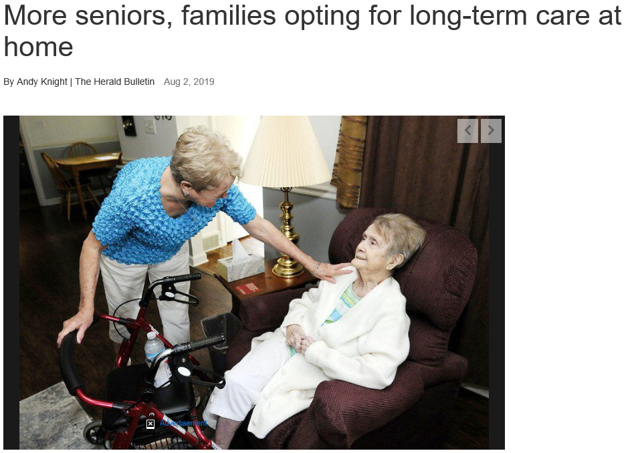
NCHS in the News

