Slide 1
FY17 PCORTF Project: Enhancing Data Resources for Studying Patterns and Correlates of Mortality in Patient-Centered Outcomes Research: Project 1 – Adding Cause-Specific Mortality to NCHS’ National Hospital Care Survey by Linking to the National Death Index
Carol DeFrances, Ph.D.
Deputy Director
Division of Health Care Statistics
Lisa Mirel, M.S.
Director, Data Linkage Program
Division of Analysis and Epidemiology
and
NCHS Board of Scientific Counselors Meeting
September 6, 2019

Slide 2
Project Overview
Advance Patient-Centered Outcomes Research (PCOR) by linking and leveraging multisource clinical and administrative public health data.
Leverage data from the National Center for Health Statistics (NCHS) and Centers for Medicare & Medicaid Services (CMS) to create new data infrastructures for PCOR.
Advance understanding on mortality following hospital care, an important patient-centered outcome.

Slide 3
Problem
Mortality (and its reciprocal, survival) is the only health outcome relevant to all patients, settings, and disorders.
The major population-based data platforms used for PCOR are generally not linked to data on cause and manner of death, nor in many cases even to data on fact of death.

Slide 4
Project Purpose
Link health care administrative claims and electronic health record (EHR) data from the National Hospital Care Survey (NHCS) to death record information from the National Death Index (NDI); and separately to administrative data from the Centers for Medicare & Medicaid Services (CMS) Master Beneficiary Summary File (MBSF).
CMS MBSF
NHCS
NDI

Slide 5
Data Sources
NHCS is an establishment survey, when fully implemented will provides nationally representative statistics, from claims and EHRs, on health and health care utilization from hospital inpatient stays and outpatient and emergency department visits;
NDI is a centralized database of death record information on file in state vital statistics offices; and
MBSF includes information on beneficiary demographic characteristics, reason for Medicare entitlement, and program enrollment type (Original Medicare vs. Medicare Advantage).

Slide 6
NCHS Data Linkage Program
Cross-cutting program housed in Division of Analysis and Epidemiology
Supports the Center and its mission as a statistical agency
Links health survey data with data collected from vital and administrative records
Designed to maximize the scientific value of the NCHS population-based surveys
Allow for analyses that would not be possible with each data source alone

Slide 7
Why Link?
Augment available information for major diseases, risk factors, and health service utilization
Link exposures to outcomes
Provide longitudinal component
Expand detail of information collected
Benefit periods
Health care utilization
Reduce cost burden: follow-up surveys can be expensive

Slide 8
Data Linkage Methods for NHCS to NDI and MBSF
Identifiers used in the NHCS-NDI linkage were: SSN, first name, last name, middle initial, month of birth, day of birth, year of birth, date of death (according to the discharge information on the hospital record), state of residence, and sex.
Identifiers used in the NHCS-CMS linkage were: SSN, Medicare Health Insurance Claim Number (HICN), first name, last name, middle initial, month of birth, day of birth, year of birth, zip code of residence, state of residence, and sex.
The linkages between the NHCS records and NDI records and CMS records were based on both deterministic and probabilistic approaches.
The probabilistic approach performs weighting and link adjudication following the Fellegi-Sunter method, which is the foundational methodology used for record linkage. It estimates the likeliness that each pair is a match before selecting the most probable match above a defined threshold between the two sources.

Slide 9
2014 NHCS linked to 2014/2015 CMS Data

Slide 10
2016 NHCS linked to 2016/2017 NDI

Slide 11
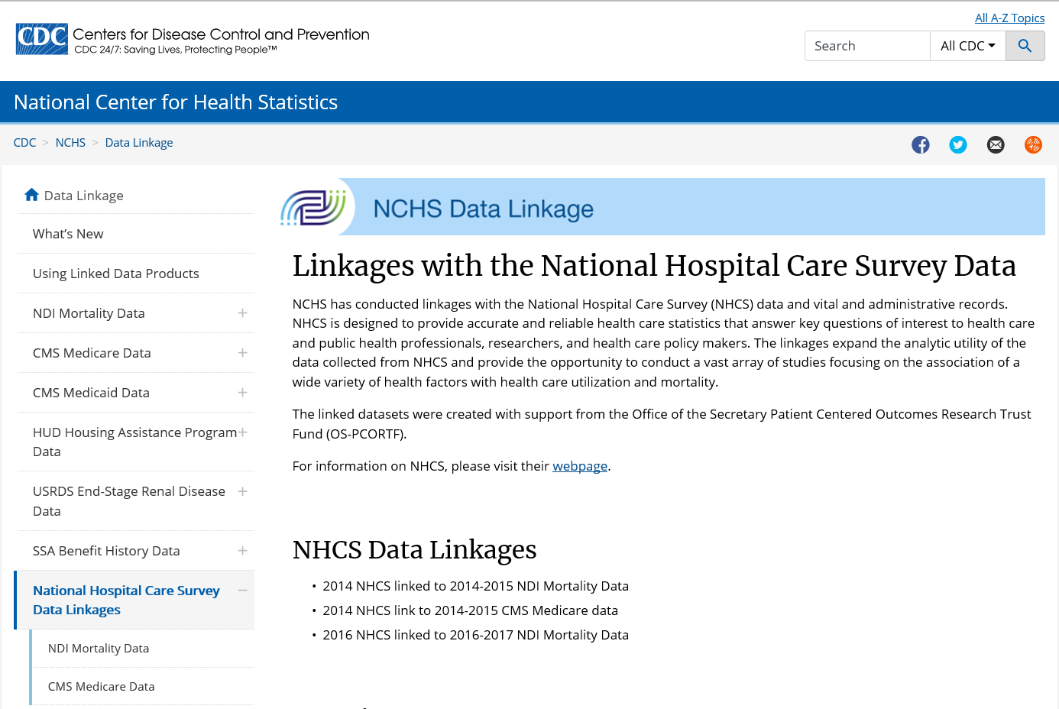
Project Products – New linked datasets
Available through the
NCHS Research Data Center
2014 NHCS data linked to the 2014/2015 NDI
2014 NHCS data linked to the 2014/2015 CMS MBSF
2016 NHCS data linked to the 2016/2017 NDI

Slide 12
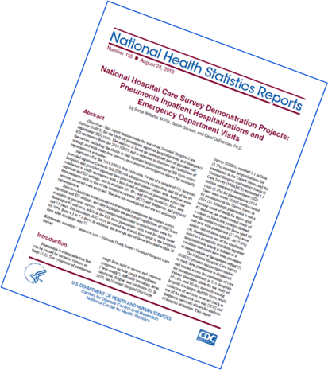
Project Products: Analytic Guidelines, Reports, and Presentations
NHCS-NDI data linkage methodology analytic https://www.cdc.gov/nchs/data/datalinkage/NHCS14_NDI14_15Methodology_Analytic_Consider.pdf
https://www.cdc.gov/nchs/data/datalinkage/NHCS16_NDI16_17_Methodology_Analytic_Consider.pdf
NHCS-CMS MBSF data linkage https://www.cdc.gov/nchs/data/datalinkage/NHCS-CMS-Medicare-Llinkage-Methods-and-Analytic-Considerations.pdf
NHCS Alzheimer demonstration National Health Statistics Report (NHSR)
https://www.cdc.gov/nchs/data/nhsr/nhsr121-508.pdf
NHCS Pneumonia demonstration NHSR https://www.cdc.gov/nchs/data/nhsr/nhsr116.pdf
Presentations at:
- 2018 Federal Committee on Statistical Methodology
- 2018 Academy Health Annual Research Meeting
- 2019 American College of Preventive Medicine Annual Meeting

Slide 13
Enhancements
Allows for tracking mortality 30, 60, and 90 days following hospital visits for patient conditions and even 1-year survival rates.
Allows for leveraging information on comorbidities (e.g., CMS’ Chronic Conditions Data Warehouse) and Medicare coverage that may be associated with hospital-related service outcomes and health outcomes.
Creates the infrastructure to sustain the data linkage for future years of NHCS data collection.

Slide 14
Lessons Learned
Linkage is an inference with different methods producing different results. Transparency is very important so detailed documentation is crucial.
Good quality PII data are critical to the linkage process.
The successful link to the NDI and CMS MBSF indicates that the NHCS data (claims and EHR) potentially can be linked to other external data sources in the future.

Slide 15
Impact of FY17 PCORTF Project
NDI
NVSS-M-DO
CMS MBSF
National Hospital Care Survey
Examine post acute mortality and cause of death.
Identify opioid hospitalizations and deaths and specific drugs involved.
Identify opioid and co-occurring mental health disorders.
Examine comorbidities and coverage that may be associated with hospital-related services and health outcomes for linked Medicare enrollees.
CMS Part D and Assessment Data
HUD Data
Examine adherence to prescription drug recommendations post hospital discharge.
Examine federal housing assistance impact on re-admissions and mortality.

Slide 16
Acknowledgement to the project team
Cordell Golden, DAE
Jennifer Sayers, DAE
Geoffrey Jackson, DHCS
Scott Campbell, NORC
Chris Cox, NORC
Shawn Linman, NORC
Dean Resnick, NORC

Slide 17
Thank you!

