Slide 1
NONRESPONSE BIAS ANALYSES FOR THE
REDESIGNED NATIONAL HEALTH INTERVIEW SURVEY
Stephen Blumberg, PhD
Director, Division of Health Interview Statistics
NCHS Board of Scientific Counselors Meeting
September 5, 2019

Slide 2
Why Did We Redesign the Questionnaire?
Most recent major content redesign was 1997
Respondent burden increasing and response rates decreasing

Slide 3
Length of Completed Interviews, by Quarter:
NHIS, 2006, Q1 -- 2018, Q4 (October)

Slide 4
NHIS Family, Child, and Adult Response Rates,
NHIS 1997-2017

Slide 5
Goals of the 2019 Questionnaire Redesign
Improve the relevance of covered health topics, better meeting the needs of the Department of Health and Human Services and other data users
Harmonize overlapping content with other federal heath surveys
Reduce respondent burden and improve data quality
Shorten questionnaire and reduce variation in interview times
Eliminate or reduce content better covered by other methods

Slide 6
Annual Content
Plan 2019-2027
Annual core
  Key measures
  Sociodemographics
Rotating core
  Newer topic areas
  Expanded detail
  Varying periodicity
Sponsored supplements
  “Sustaining” sponsors
  1- or 2-year modules
  5 min or less
One adult and one child randomly selected from each household
  Demographics for all HH members
  Family info collected from sample adult and parent of sample child

Slide 7
Impact on Response and Nonresponse
Average length of a household interview now less than 60 minutes
Sample adult response rates are up by about 6 percentage points
Nonresponse to the family interview is no longer a factor
Less information available for nonresponse adjustments at the Sample Adult and Sample Child level

Slide 8
Current (Pre-Redesign) NHIS Weighting
Weighting class adjustment approach to correct for nonresponse
  Applied at the geographic area unit
Ratio adjustment to independent population estimates
  Applied by sex, age groups, and race/ethnicity groups
Does not employ any nonresponse prediction or use any appended data that could provide correlates of nonresponse and nonresponse bias

Slide 9

NHIS Nonresponse Bias Analysis Goals
Quantify nonresponse bias present in the redesigned NHIS
Evaluate current NHIS weighting against other weighting methods
  Focus on bias reduction in key health indicators
  Take advantage of improvements in:
    Auxiliary data and paradata
    Machine learning methods and other advanced statistical models
Obtain evidence for whether to implement a new weighting approach
Contract awarded to ICF

Slide 10
Stage 1: Nonresponse Bias Modeling
Separate prediction models for household, adult and child response
Data sources included:
  Contact History Instrument, Neighborhood Observations Instrument
  Census Planning Database, Area Health Resources Files
Predictors selected based on:
  Bivariate relationship with response in Q1/2019
  Significant association with key health indicators
Models selected based on performance metrics (AUC and Brier score)
  Moved forward with best logistic model and machine learning model

Slide 11
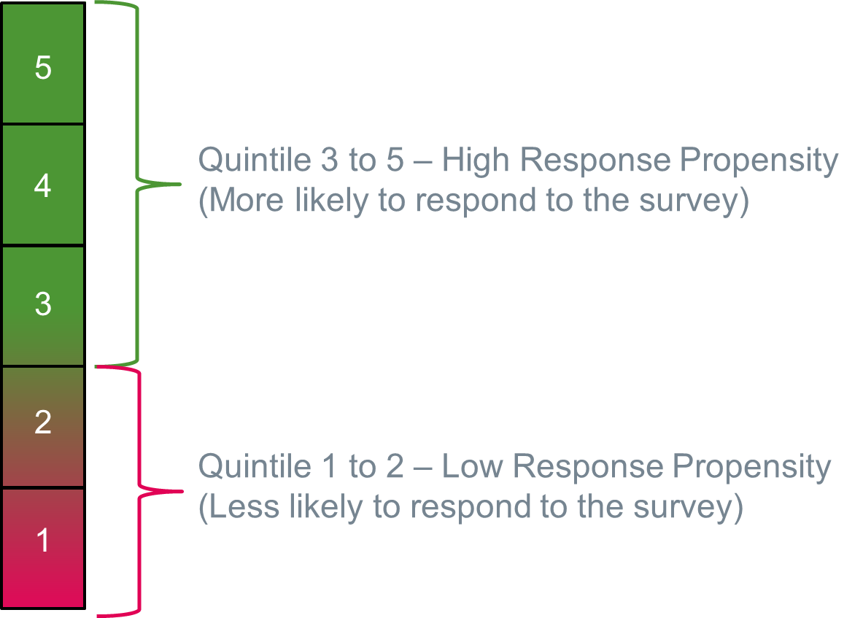
Stage 2: Nonresponse Bias Estimates
Propensity scores based on the models were divided into quintiles
Estimates for key health indicators compared between two groups defined by response quintiles
Significant difference indicates nonresponse bias

Slide 12
Stage 3: Development of Alternative Weights
Explored modifications to the NHIS weighting procedures designed to reduce the potential for nonresponse bias
  Adjusting for nonresponse by using predictive models for the response propensity
  Calibrating to additional population estimates: education, employment, and MSA status (urban vs. non-urban)
Assessed characteristics of the nonresponse adjustment weights and the final calibrated weights

Slide 13
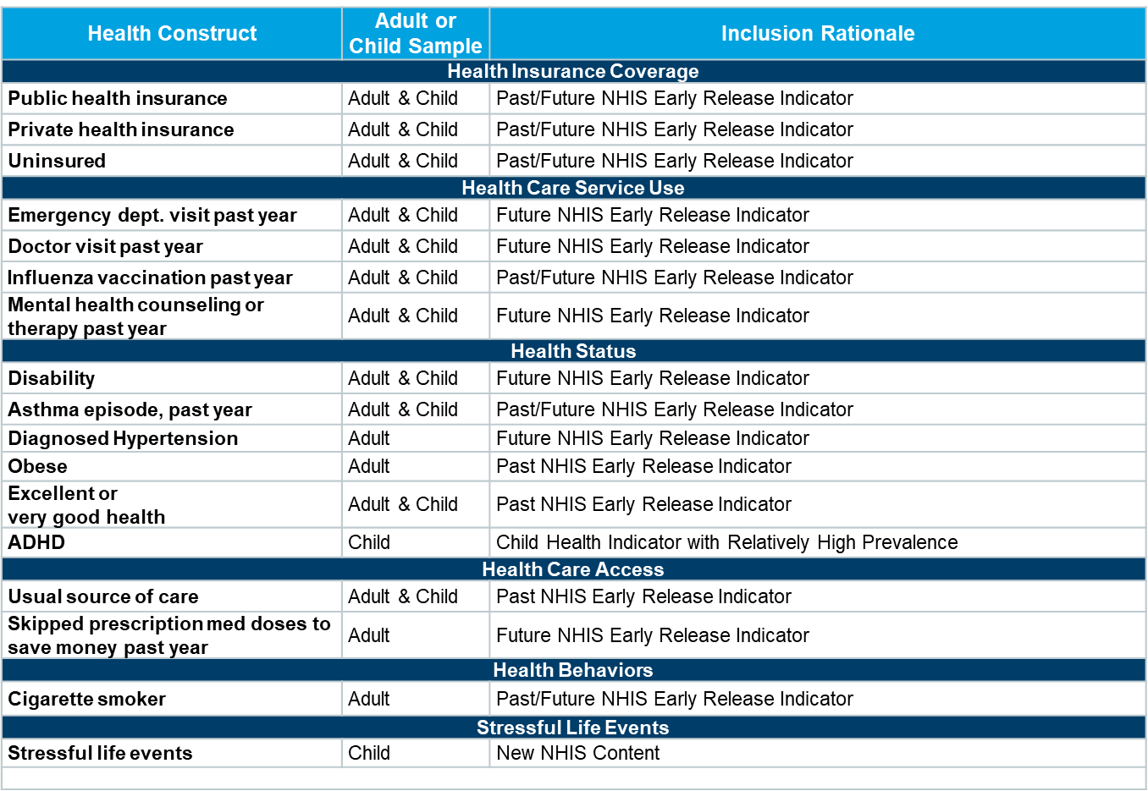
Stage 4: Comparing Fully-Weighted NHIS Estimates
Considered point estimates and standard errors for 28 health indicators

Slide 14
Stage 5: Evaluating Tradeoffs
Substantial reduction in nonresponse bias comes at a cost
  Increased variance and design effects
  Decreased effective sample size and reduced power
  Increased complexity of application and replication
  Reduced transparency in weighting process

Slide 15
How the BSC Can Help
Review the results
  What do the results suggest about the need for NCHS to implement a new weighting approach?
  Are the results sufficient to draw conclusions about the best weighting strategy?
Share your conclusions
  Given these results, what advice do you have regarding weighting?
  Are there additional analyses that we should conduct?
  How should the results of those new analyses guide NCHS decision-making regarding weighting?

Slide 16
For More Information About the Redesign
https://www.cdc.gov/nchs/nhis/2019_quest_redesign.htm

