Slide 1
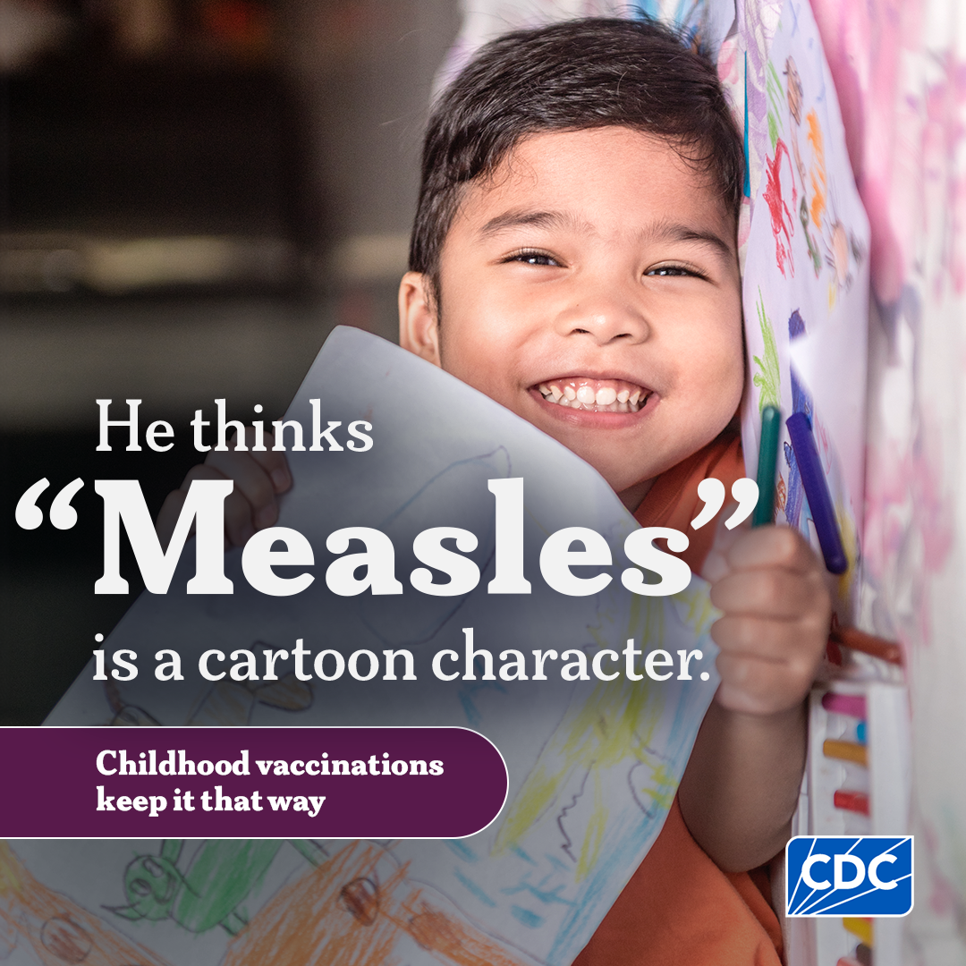
Measles 101 for School Administrators
This slide deck is intended for school administrators to help educate their district, schools and staff about measles. Schools are encouraged to adapt the content as appropriate to meet their local needs.
Notes:
Purpose: This presentation equips school administrators and/or school nurses with clear, accurate information about measles. Presenters can share this information with district schools and classroom teachers and staff.
Goal of presentation: Build shared understanding of measles symptoms, transmission, prevention, and preparedness measures, so schools can respond consistently, communicate confidently with families, and help protect student health during potential outbreaks. The content is designed to be adaptable, allowing presenters to tailor examples and protocols to reflect local conditions, policies, and community needs.

Slide 2
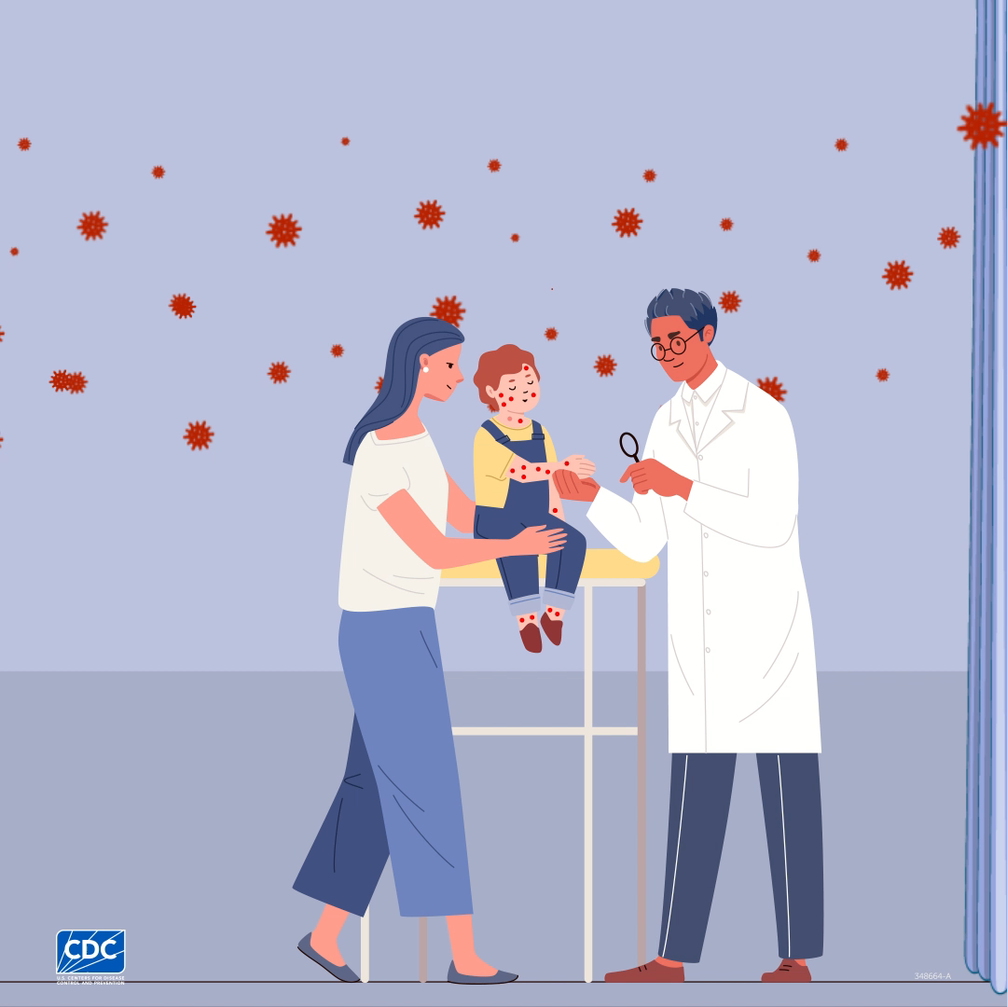
Measles is very contagious.
If one person has it, up to 9 out of 10 people nearby will become infected if they are not protected.
Measles spreads through the air and can remain in the air for up to 2 hours after an infected person leaves the area.
Click the image to start the video file.
cdc.gov/measles/causes/index.html

Slide 3
Measles can be serious.
Measles can lead to severe complications, such as
    Hospitalization: About 1 in 5 unvaccinated people in the U.S. who get measles is hospitalized.
    Pneumonia (infection of the lungs): As many as 1 out of every 20 children with measles gets pneumonia.
    Encephalitis (swelling of the brain): About 1 child out of every 1,000 who gets measles develops encephalitis.
  Death: Nearly 1-3 out of every 1,000 children with measles die from respiratory and neurologic complications.
Anyone who is not protected against measles is at risk.
cdc.gov/measles/signs-symptoms/index.html

Slide 4
Measles can cause longer-term harm.
Pregnancy complications: If you are pregnant and have not had the MMR vaccine, measles may cause premature birth or delivery of a low-birth-weight baby. It can also cause congenital measles infection in the newborn.
Immune amnesia is a temporary weakening of the immune system, reducing the body's ability to recognize and fight infections it was previously protected against.
Subacute sclerosing panencephalitis (SSPE) is a very rare, but fatal disease of the central nervous system that may develop 7 to 10 years after a person has recovered from measles.
cdc.gov/measles/signs-symptoms/index.html

Slide 5
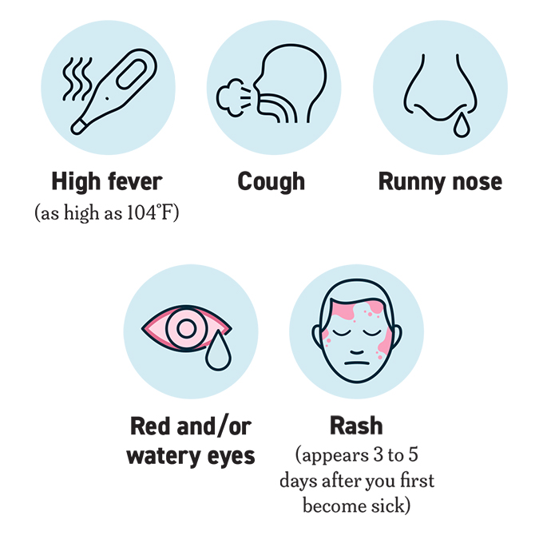
Measles Symptoms
Symptoms appear 7 to 14 days after contact with the virus. Common measles symptoms include:
High fever (may spike to more than 104⁰F)
Cough
Runny nose (coryza)
Red, watery eyes (conjunctivitis)
Rash
A person is infectious and can spread measles to other people from 4 days before through 4 days after the rash appears.

Slide 6
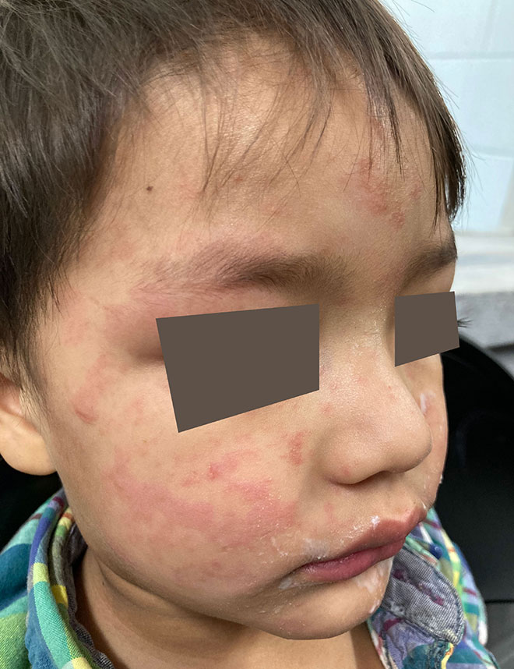
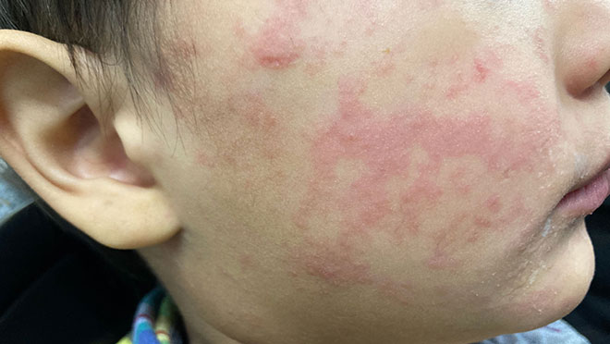
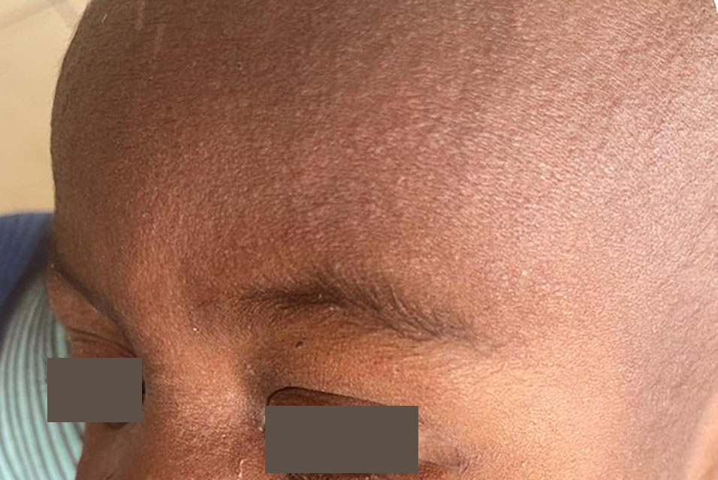
Measles Skin Rash Examples
Below are examples of measles rashes on the human body. They usually begin as flat red spots that appear on the face at the hairline and spread downward to the neck, trunk, arms, legs, and feet.
Photos of Measles | Measles (Rubeola) | CDC

Slide 7
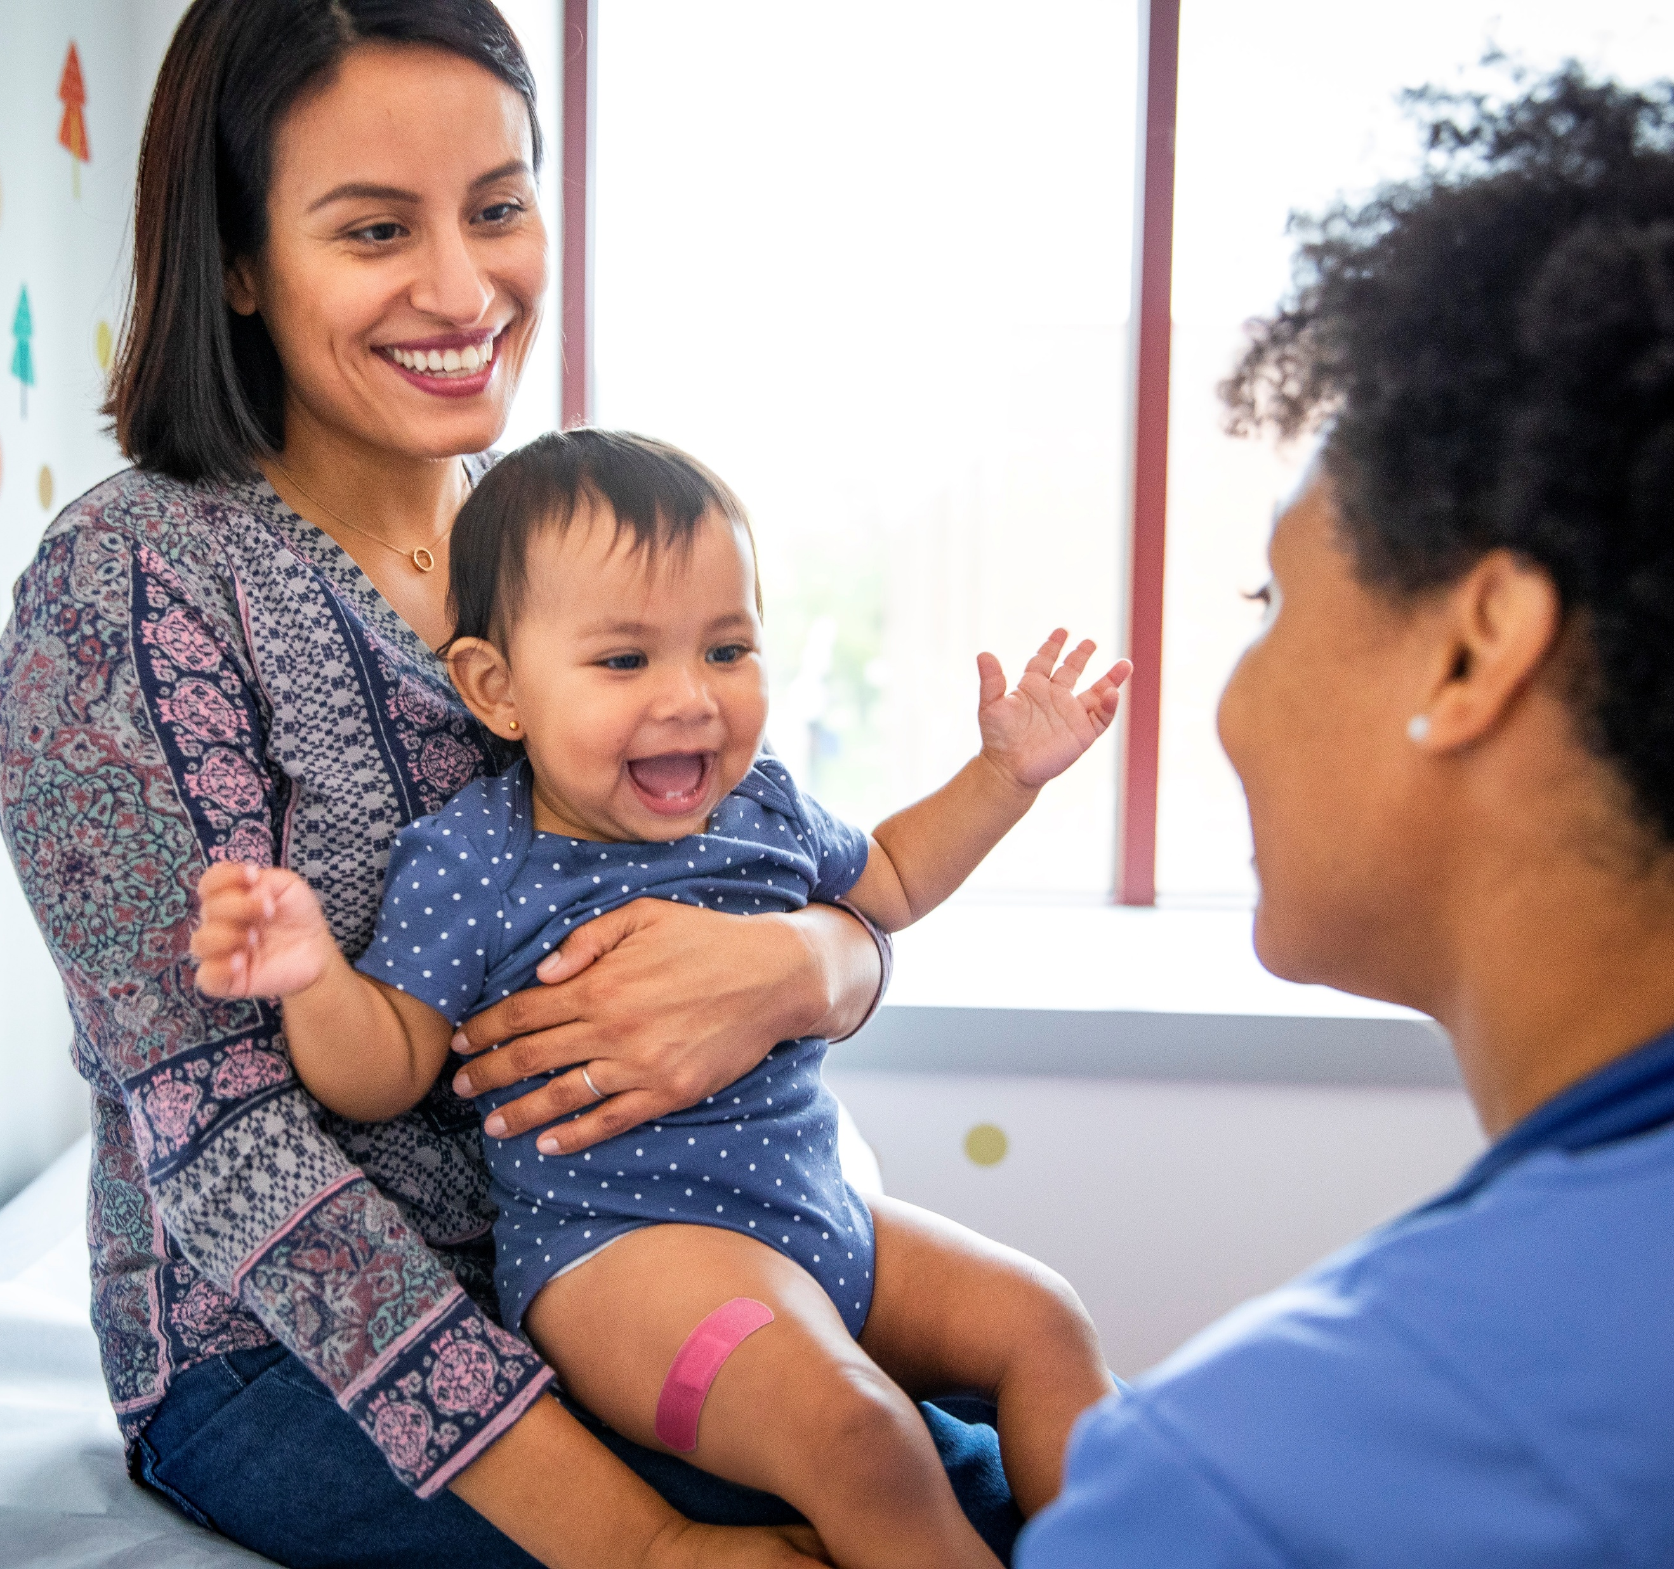
MMR vaccination is the best protection against measles.
The risk for widespread measles in the United States generally remains low, especially in communities with high MMR vaccination coverage.
[Add school/community coverage, if available]
The best way to protect yourself, your family, and your community against measles is with MMR vaccination.
  Two doses of MMR vaccine provide better protection (97%) against measles than one dose (93%).
Measles: Plan for Travel cdc.gov/measles/travel/index.html

Slide 8
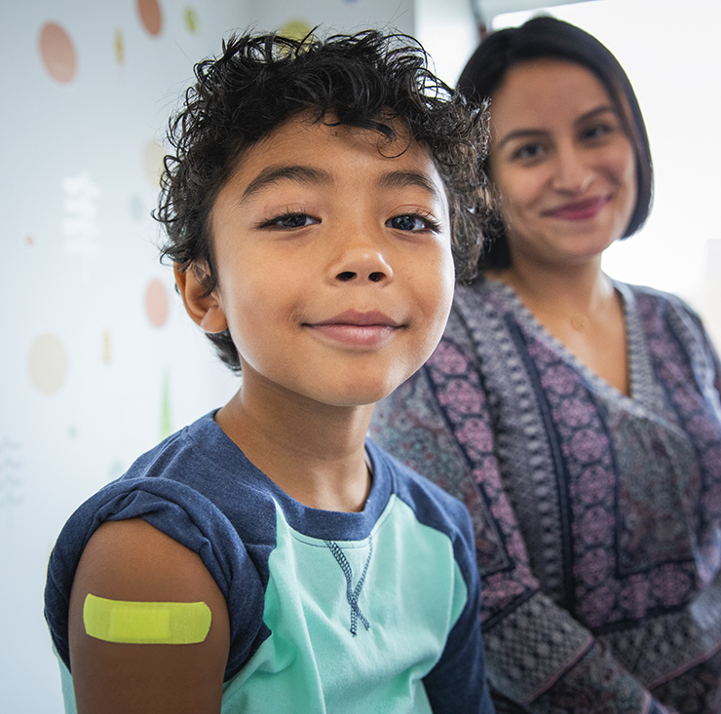
Vaccination
Recommendations

Slide 9
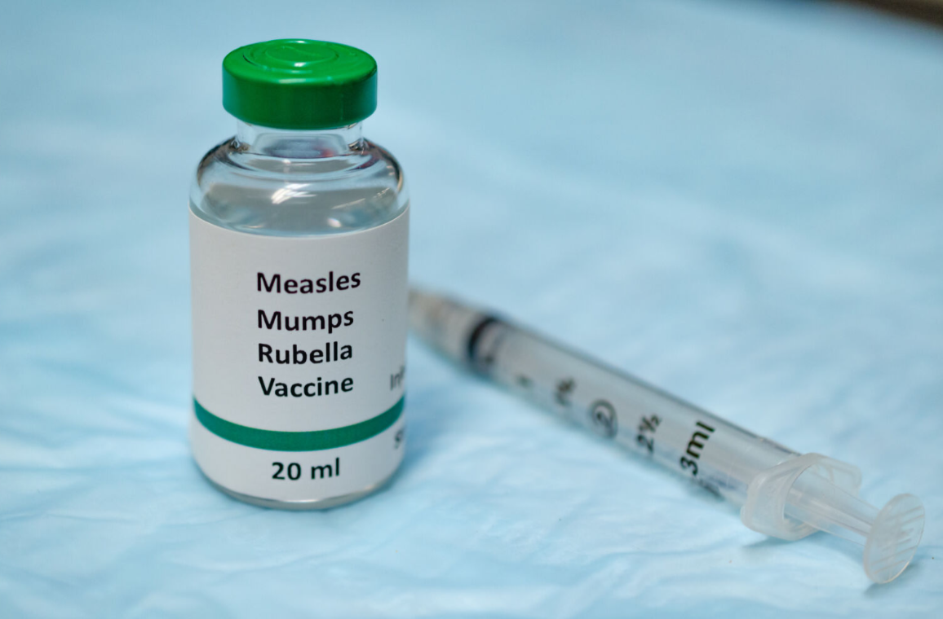
Measles Vaccination Recommendations
Older children, adolescents, and adults need 1 or 2 doses of MMR vaccine if they don't have evidence of immunity.
Anyone traveling internationally or to an area with an outbreak should be fully vaccinated before traveling.
  Infants 6–11 months old should get 1 dose of the MMR vaccine before travel. Then, they should get 2 more doses after their first birthday.
During an outbreak, if you already have 2 doses of MMR, it's not necessary to seek out vaccination.
Children need:
12–15 MONTHS OLD
1st dose
4–6 YEARS OLD
2nd dose
cdc.gov/measles/vaccines/index.html

Slide 10
School Measles Preparedness: Action Items

Slide 11

Prepare Before a Measles Case Occurs
Review your school's measles response procedures and ensure emergency plans are up to date, in collaboration with your health department.
Key Actions for School Leaders
Establish a point of contact with your local or state health department before the school year begins.
Understand state and local requirements related to measles and MMR vaccination.
Plan ahead so staff know their roles if a measles case is identified.

Slide 12
Communicate Expectations Early
Encourage students and staff to stay home when sick.
Share information about the signs and symptoms of measles and when to seek medical care.
Explain school procedures if a student develops measles symptoms, including:
  Wearing a mask, when possible
  Immediate isolation from others
  Prompt pick-up by a caregiver
  Medical evaluation before returning to school

Slide 13
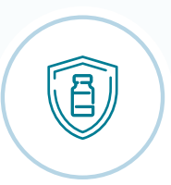
Promote Prevention
Help ensure students and staff are up to date on MMR vaccination or have evidence of immunity.
Review school vaccination records and applicable requirements.
Consider partnering with:
  Local health departments
  Pediatric practices
  Pharmacies
  Explore school-based vaccination clinics when appropriate
Vaccination

Slide 14

Train School Health Staff
Ensure school nurses and healthcare staff can recognize measles symptoms.
Early symptoms include:
  Fever
  Cough
  Runny nose
  Red, watery eyes
  Tiny white spots inside the mouth
Rash:
  Usually appears 3–5 days after symptoms begin
  Starts on the face and behind the ears before spreading down the body

Slide 15
Prepare Your School
Keep masks available for anyone with suspected measles.
Designate an isolation room (or safe outdoor space if needed) for students with symptoms while waiting to be picked up.
Develop a plan to continue learning for students who must stay home due to isolation or quarantine.

Slide 16
Maintain Immunization Records
Keep accurate records of measles immunity and vaccine exemptions for all students and staff.
Ensure records are current and comply with privacy laws.
Immunization records help health departments quickly identify people who may need vaccination or other preventive treatment after exposure.

Slide 17
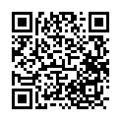
Tools for School Settings
Checklists for
  K-12 Schools
  Institutions of Higher Education
  Early Care & Education Centers
  Summer Camps
To visit the Be Ready for Measle Toolkit, scan the QR code
or visit the link: cdc.gov/measles/php/toolkit/index.html

Slide 18
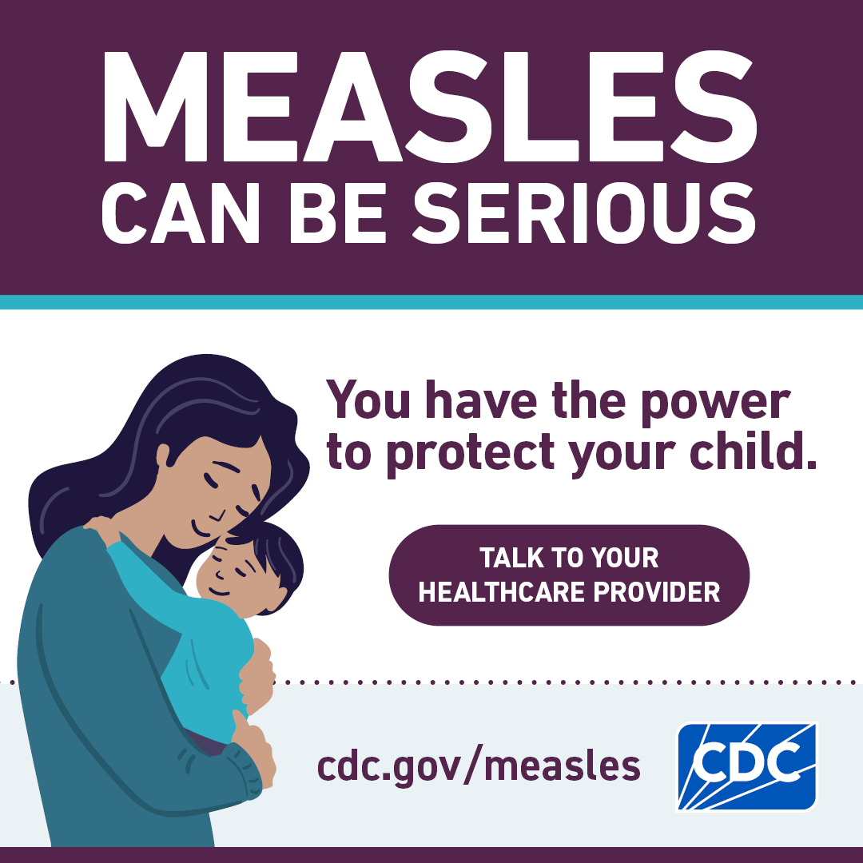
Need additional materials?
Communication materials for the public are available in additional languages and as editable or printer-friendly versions upon request.
To request these, please email measlesresources@cdc.gov.
To visit the Be Ready for Measle Toolkit, scan the QR code
or visit the link: cdc.gov/measles/php/toolkit/index.html

