Slide 1
IPC for Marburg Virus Disease (MVD): Waste Management Part 2: Final Waste Disposal
Healthcare Settings with Limited to Intermediate Resources
Updated: March 2023
Notes:
Intended Audience: This presentation focuses on what facilities management staff should know about proper waste disposal for medical facilities during a Marburg virus disease outbreak. This is the second in a two-part series on waste management. The first part <Facilities Mgmt Slide Deck 4: Waste Management Part 1 – WM Process> [link] focuses on the all the steps in the process of waste management while this part takes an in-depth look at the final step: waste disposal.
Please note that the IPC for Marburg Virus Disease topics are presented in sequence, with the expectation that participants will progress through the series. You may, however, mix and match content to meet participant needs, and you will need to adjust the sample script below.
Script:
Welcome! In the last session, we focused on an overview of the waste management process. Today we'll be taking an in-depth look at the last step in that process: final waste disposal for medical facilities during a Marburg virus disease outbreak and how proper waste disposal can keep you and your community safe. If you’d like to review the steps in the process of proper waste management, you can find the slides for the first session here <Facilities Mgmt Slide Deck 4: Waste Management Part 1 – WM Process> [link]

Slide 2
Learning Objectives
After this presentation, participants will be able to
Explain why proper waste disposal during a Marburg virus disease outbreak is important
Identify ways to improve final waste disposal at their own facilities.
Notes:
Script:
We have two learning objectives for today. By the end of our time together today, you should be able to explain why proper waste disposal during a Marburg virus disease outbreak is important and identify ways to improve final waste disposal at your own facilities.

Slide 3
Discuss
Once waste has been collected from the waste bins in your facility, how is waste disposed of?
Does waste disposal differ for general waste, infectious waste, or other kinds of waste collected? If so, how?
Notes:
Script:
Let’s start with a question. Once waste has been collected from the waste bins in your facility, how is waste disposed of?
Does waste disposal differ for general waste, infectious waste, or other kinds of waste collected? If so, how?
[Give participants two minutes to share.]

Slide 4
Waste Disposal
Notes:
Script:
We are going to talk in detail today about appropriate ways to dispose of waste, and as you listen, I want you to think about how these considerations compare to your facility’s current practices.
But before we get into HOW to dispose of waste, let’s talk about WHY proper waste disposal is so important during a Marburg virus disease outbreak.

Slide 5
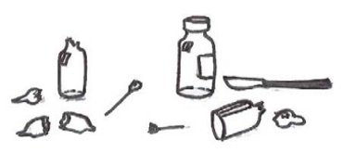
Why Is Waste Disposal Important?
Inappropriate waste management poses potential health risks to you, your patients and other staff in your facility, as well as to your community.
Potential risks:
Exposure to items contaminated with Marburg virus (e.g., contaminated gloves)
Exposure to sharp items that pose a risk of physical injury as well as exposure to Marburg virus (e.g., used needles)
Notes:
Script:
Remember from our first session on waste management that inappropriate waste management poses potential health risks to you, your patients, and other staff at your healthcare facility, as well as to your community. Potential risks might include exposure to items contaminated with Marburg virus, such as contaminated gloves, or exposure to sharp items such as used needles that pose a risk of physical injury as well as exposure to Marburg virus.
Knowing why waste disposal is so important at medical facilities during a Marburg virus disease outbreak, let’s get into the details of how to dispose of waste safely.

Slide 6
Waste Disposal
Healthcare facilities must have a functional system for the final disposal of waste
Infectious and potentially infectious waste must be:
Incinerated
OR
Treated with non-burn treatment (autoclaving/grinding or other alternative treatment) before being placed in regular waste stream
OR
Buried
Notes:
Script:
To review from our last training, every facility must have a functional device for the final disposal of waste including an incinerator with ash pit or a non-burn system such as an autoclaving and grinding process for infectious waste. If infectious waste is autoclaved and grinded, it can be then added to the regular waste stream for landfill disposal.
In some very low-resource settings, a temporary burning pit may also be an option for treating and then burying infectious waste on-site while longer term improvements are being made. It is also common to have a placenta or organic waste pit on site, as other methods of treatment for these may not be culturally acceptable.

Slide 7
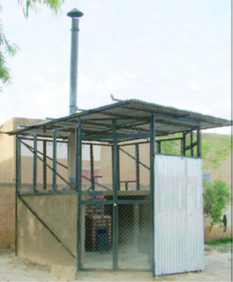
Incinerator Placement
On the healthcare facility property
Away from flow of patients
In an area where they will NOT disturb people
Notes:
Script:
First, let’s talk about incinerating waste. Incinerators should be located on the healthcare facility property, away from the flow of patients, and in an area where they will not disturb people. This means that they should be in a place as far away from patients, visitors, and community members as possible.

Slide 8
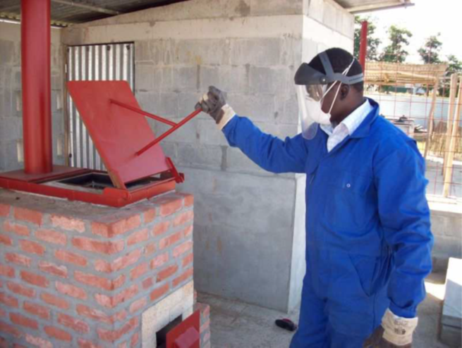
Incinerators Options
Best Option
High temperature incinerators
De Montfort brick (double-chamber) incinerators
Allows for higher temperatures = more effective waste incineration and reduced toxic emissions
Drum incinerators (not recommended)
A better option than open burning
Not Recommended
Notes:
Script:
Different types of incinerators may be available at your facility. The best incinerators for disposing of waste during a Marburg virus disease outbreak are high temperature incinerators. Higher temperatures allow for more effective waste incineration and reduced toxic emissions.
If a high temperature incinerator is not available, the next best option is a de Montfort brick double-chamber incinerator (pictured). Compared to single-chamber incinerators, de Montfort brick incinerators allow for higher temperatures.
Drum incinerators are not recommended for disposing of waste during a Marburg virus disease outbreak, but if they are all that is available, they are a better option than open burning in a burning pit.
Sometimes facilities have incinerators, but they’re not functioning because they need maintenance. This leads to waste piling up, which is something we want to avoid. So, not just having an incinerator, but having a functional incinerator is very important.

Slide 9
Interim Option: Burn Pits
Generally, it is best to avoid open burning of healthcare waste
releases toxic gases
does not reach high enough temperatures to fully destroy infectious waste
In emergencies, burn pits can be used until incinerators or other treatment methods (such as autoclaves) become available.
Notes:
Script:
It’s generally best to avoid open burning of healthcare waste because it can release toxic gases and does not reach a high enough temperature to fully destroy infectious waste. However, in emergencies, burn pits can be used until incinerators or other treatment methods such as autoclaves become available.

Slide 10
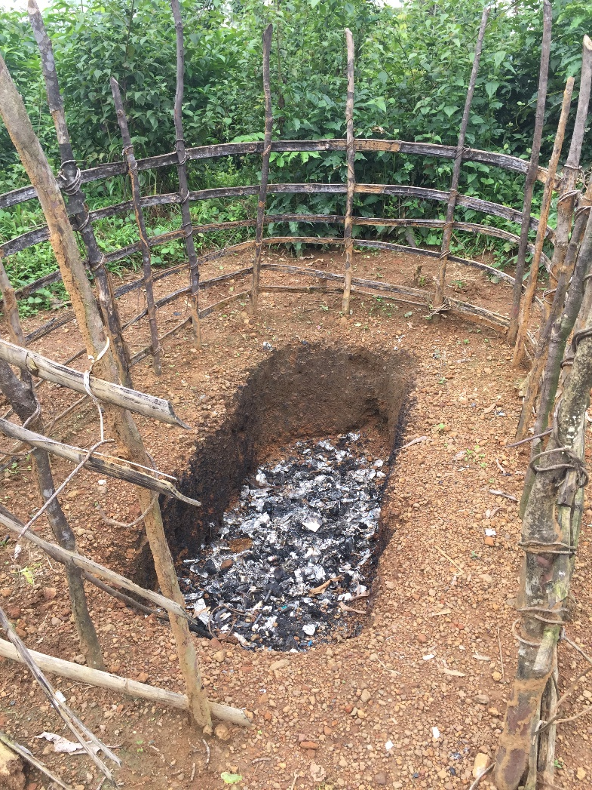
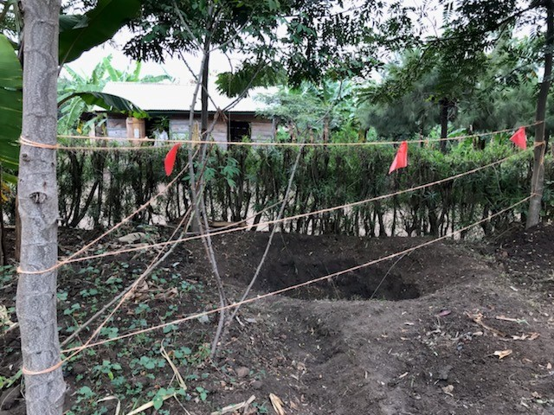
Interim Option: Burn Pits (continued)
Burn pits should be
away from patient flow
dug deep
marked off
Notes:
Script:
If your facility has to use a burn pit to dispose of medical waste, it should meet certain requirements. As with incinerators, burn pits should be located
On the healthcare facility property,
Away from the flow of patients,
And in an area where they will NOT attract people.
They should be dug deep and marked off. Particularly in the context of Marburg virus disease, we don’t want burn pits being in a place where people might come to sift through to see if they can find anything useful.
These pictures are good examples of what safe burn pits can look like.

Slide 11
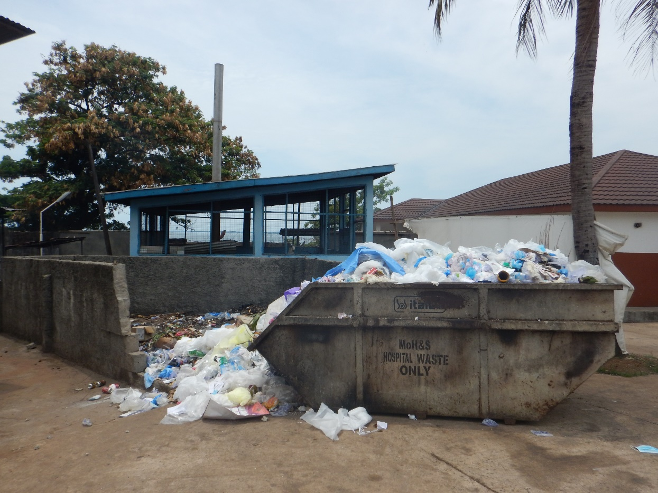
Other Considerations
Avoid situations where
Waste isn’t segregated
Waste is overflowing because the final disposal option needs maintenance
Notes:
Script:
We want to avoid situations such as what you see here, where waste isn’t segregated or where it’s overflowing because the final disposal option needs maintenance.

Slide 12
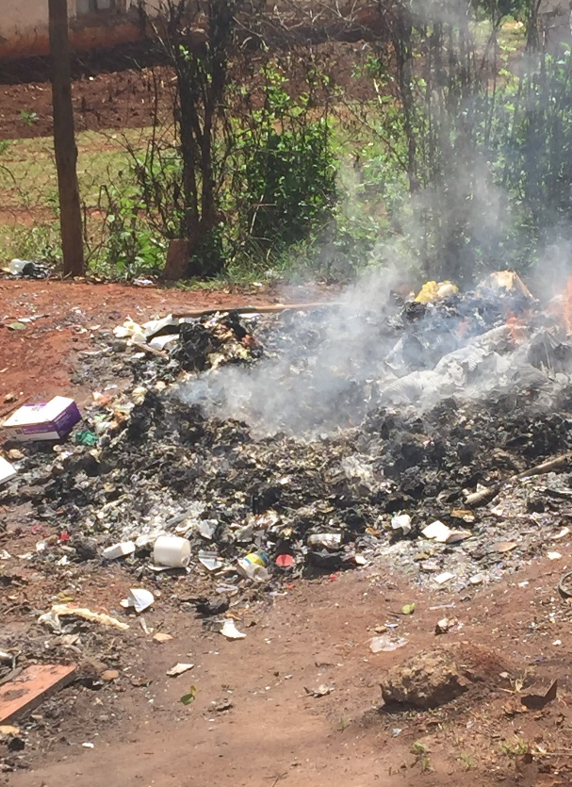
Knowledge Check: Waste Disposal
While visiting a healthcare facility, you observe this example of waste disposal.
What suggestions could you give?
Notes:
Script:
Now that we’ve talked about proper waste disposal, let’s put that knowledge to work. Imagine that you are visiting a healthcare facility, and you observe this example of waste disposal. What suggestions could you give to help make waste disposal safer at this facility?
[Allow a few minutes for discussion. Possible answers are on the next slide.]

Slide 13
Knowledge Check: Feedback
Assist the facility to identify solutions to deal with current load of waste
Use an incinerator if available.
If no incinerator available, dig sufficiently wide and deep burn pit
Carefully and safely (wearing appropriate PPE and using a shovel) transfer waste to burn pit and burn in sections
Notes:
[You may wish to adapt this script based on what participants discussed on the previous slide.]
Script:
This facility needs some assistance identifying solutions to deal with current waste load. They should be using an incinerator if it’s available. If they have no incinerator available, their burn pit needs to be sufficiently wide and deep and should be marked off so that people won’t enter either intentionally or unintentionally.
After they have constructed a sufficient burn pit, they will need to move this waste to the burn pit. To do so safely and carefully, they would need to use a shovel for this task and wear appropriate PPE, which includes heavy duty gloves, gown or coveralls, face mask, eye protection, and foot covers or boots. They should transfer the waste in sections and burn each section.

Slide 14
Reflection
Where is final waste disposal at your facility?
What maintenance might be needed?
Is there capacity to take on additional waste (e.g., isolation units, additional PPE waste)?
What resources, such as fuel for burning waste and transport equipment, might be needed?
Notes:
Reflection: Encourages participants to apply, analyze, and/or evaluate what they’ve learned, helps them to deepen their understanding of the topic and also allows you to check their comprehension of what they learned.
Personalization: Helps participants think about how what they have learned applies to their specific situations. Connecting learning to personal experiences helps learners to better understand and remember the ideas taught.
This exercise might be performed differently depending on who your audience is. If only one person per facility is in attendance, this discussion could be done in small groups with time for sharing with the large group afterwards or as a whole-group discussion (depending on the size of the group and time available). If the audience consists of several members each from different facilities, you might give them time to discuss with the others from their facility and then share as a large group afterwards.
Script:
Let’s think now about how waste disposal happens at your facility and about how the facility’s waste disposal could be improved for safer functioning during a Marburg virus disease outbreak.
First, where is the final waste disposal at your facility. Is it on-site or off-site?
If it’s on-site
Does it meet the requirements of being far from the flow of patients and being in an area that won’t disturb people?
If not, what could be changed to help it been meet these requirements?
Is there maintenance needed? If so, what kinds of maintenance? What resources would be needed for this?
Is there capacity to take on additional waste, for example, if an isolation unit is set up?
What resources, such as fuel for burning waste and transport equipment such as a wheel barrow, might be needed for the waste management process at your facility?
If it’s off-site, what resources might be needed to help facilitate the waste disposal process?

Slide 15
Key Takeaways
Proper medical waste disposal during a Marburg virus disease outbreak is crucial to keep you, others at your facility, and your community safe.
A high temperature incinerator is the best option for incinerating medical waste.
If a burn pit must be used as an interim option, it should be away from patient flow, dug deep, and marked off.
Notes:
Script:
As we conclude for today, there are some key things I hope you’ll take away from today’s session:
First, proper medical waste disposal during a Marburg virus disease outbreak is crucial to keep you and your community safe.
When it comes to waste disposal in the context of Marburg virus disease, a high temperature incinerator is the best option for incinerating medical waste, but if a burn pit must be used as an interim option, it should be away from patient flow, dug deep, and marked off.

Slide 16
Thank you!

