Slide 1
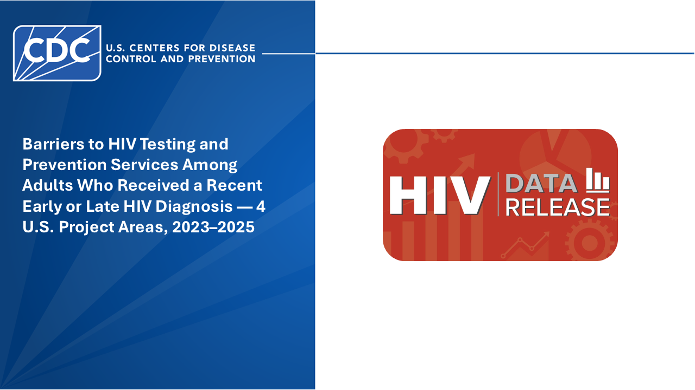
Notes:
This data release provides data describing demographic and behavioral characteristics, access to healthcare services, and use of HIV testing and prevention services among adults who received an early (stage 0) or late (stage 3) HIV diagnosis in selected areas of the United States.
Numbers might not add to total because of “don’t know” and skipped (missing) responses. Percentages might not sum to 100 because of rounding. Percentages based on <12 participants should be interpreted with caution due to small cell size. All material contained in this data release is in the public domain and may be used and reprinted without special permission; however, citation as to source is appreciated.
Barriers to HIV Testing and Prevention Services Among Adults Who Received a Recent Early or Late HIV Diagnosis — 4 U.S. Project Areas, 2023-2025. Centers for Disease Control and Prevention. Published July 2026. Accessed [date]. https://www.cdc.gov/hiv-data/shield/barriers-hiv-testing-and-prevention-services.html.
You are also free to adapt and revise these slides; however, you must remove the CDC name and logo if changes are made.

Slide 2
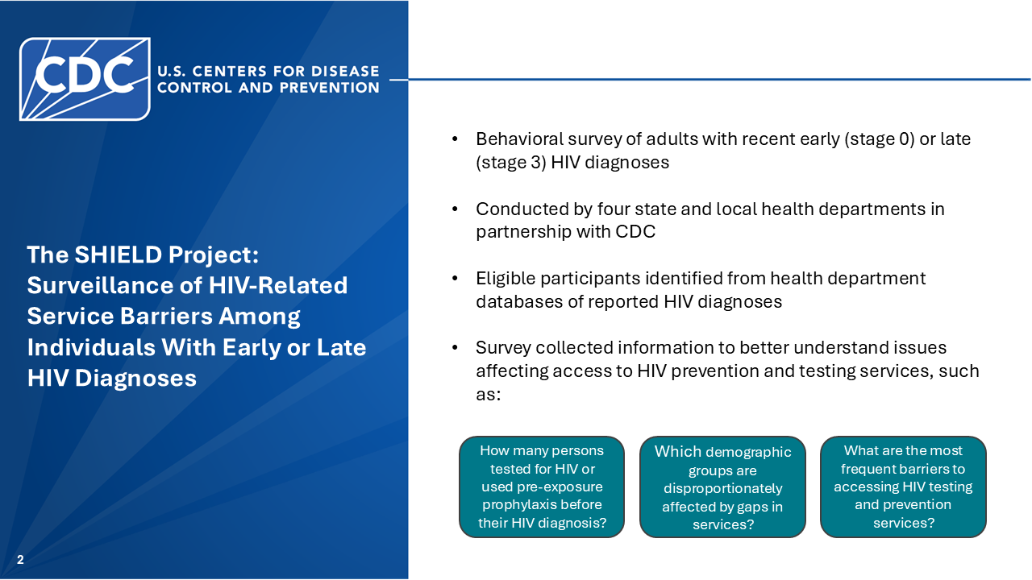
Notes:
The data in this release were collected by the Surveillance of HIV-related Service Barriers Among Individuals with Early or Late HIV Diagnoses (SHIELD) project, which is the only surveillance project that collects information exclusively from people with a recent stage 0 or stage 3 diagnosis. These data can be used to inform planning and resource allocation that may improve HIV prevention and testing services.
SHIELD was conducted by four state and local health departments in partnership with CDC, drawing from their local Enhanced HIV/AIDS Reporting System (eHARS) databases. All findings in this data release were based on data collected by these four health departments.
SHIELD administered a behavioral survey that asked questions about barriers to HIV prevention and testing services that participants encountered before their HIV diagnosis.

Slide 3
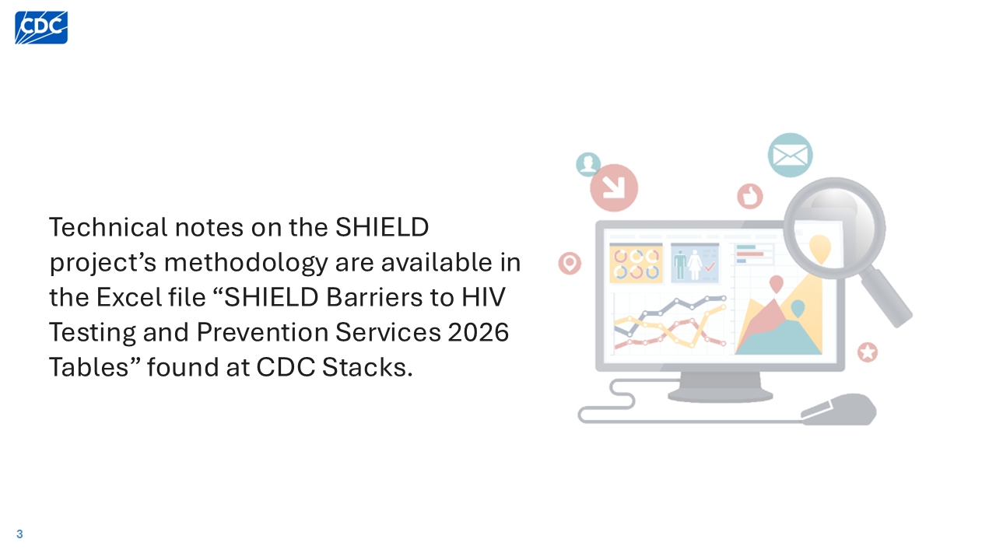
Notes:
Technical notes on the SHIELD project’s methodology, including data definitions and sampling methodology, are available in the Excel file “SHIELD Barriers to HIV Testing and Prevention Services 2026 Tables” found at CDC Stacks.

Slide 4
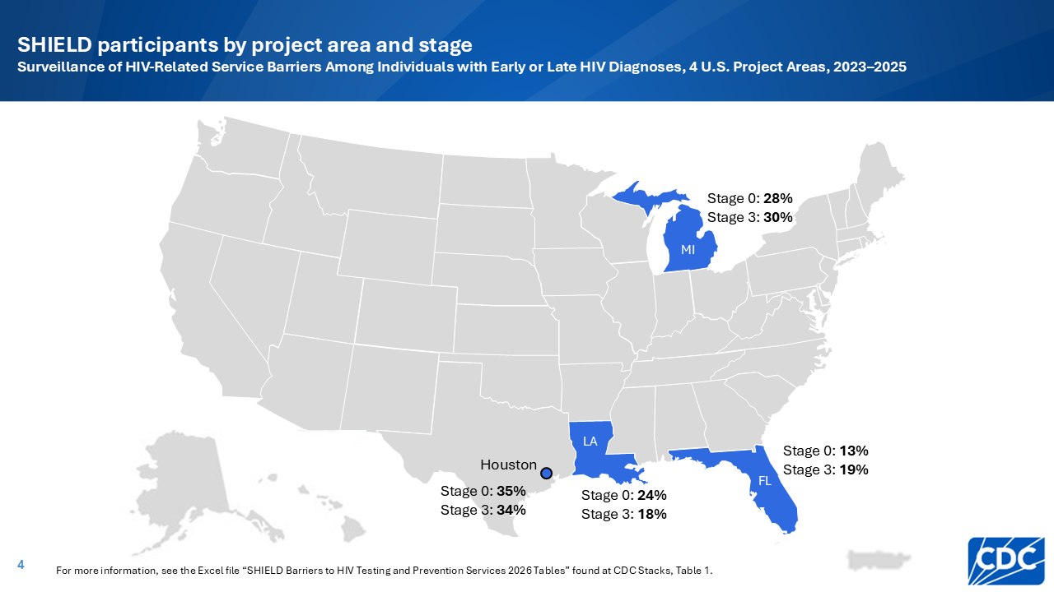
Notes:
Four health departments were funded to conduct SHIELD activities locally: Florida, Louisiana, Michigan, and Houston, Texas.
In total, 3,360 persons were sampled, and 462 completed the SHIELD survey.
Florida accounted for 13% of total participants with a stage 0 diagnosis and 19% of total participants with a stage 3 diagnosis.
Louisiana accounted for 24% of total participants with a stage 0 diagnosis and 18% of total participants with a stage 3 diagnosis.
Michigan accounted for 28% of total participants with a stage 0 diagnosis and 30% of total participants with a stage 3 diagnosis.
Houston accounted for 35% of total participants with a stage 0 diagnosis and 34% of total participants with a stage 3 diagnosis.

Slide 5
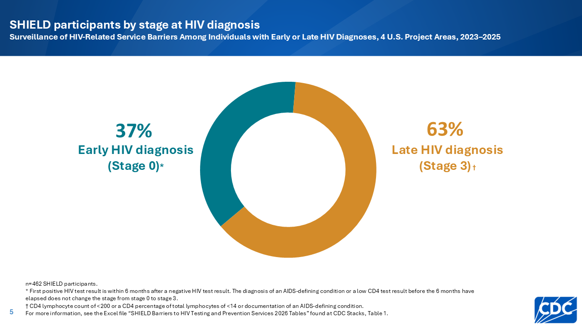
Notes:
Among the 462 SHIELD participants, 37% received a stage 0 diagnosis and 63% received a stage 3 diagnosis.

Slide 6


Slide 7
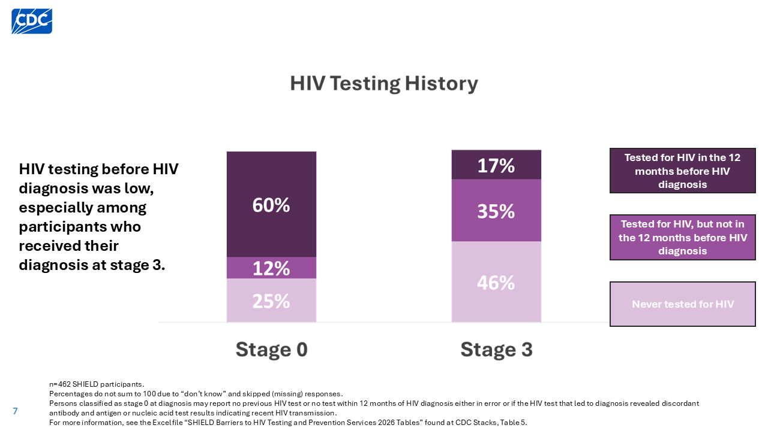
Notes:
SHIELD findings highlight that HIV testing uptake and frequency were low before HIV diagnosis, especially among those who received their diagnosis at stage 3. Twenty-five percent of participants with a stage 0 diagnosis and 46% of participants with a stage 3 diagnosis reported never testing for HIV before their HIV diagnosis. Only 60% of participants with a stage 0 diagnosis and 17% of participants with a stage 3 diagnosis had tested for HIV within the 12 months before their HIV diagnosis (not including the test that led to diagnosis). More consistent and routine testing could have prevented many of these late diagnoses.
Routine testing for HIV supports earlier HIV diagnosis. Earlier diagnosis improves health outcomes for people with HIV and reduces HIV transmission. CDC recommends at least annual HIV screening for people with behaviors that increase their chances of getting or transmitting HIV.
Note: Persons classified as stage 0 at diagnosis may report no previous HIV test or no test within 12 months of HIV diagnosis either in error or if the HIV test that led to diagnosis revealed discordant antibody and antigen or nucleic acid test results indicating recent HIV transmission.

Slide 8
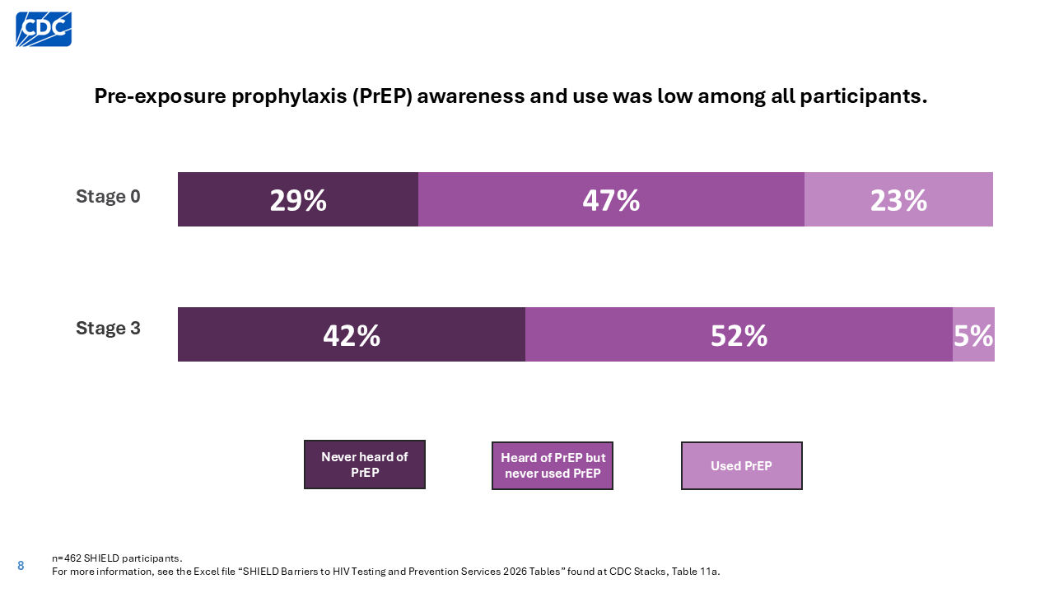
Notes:
PrEP (pre-exposure prophylaxis) is medicine (pills or shots) that reduces the chance of getting HIV. CDC recommends that people with certain behaviors that increase the risk of HIV transmission should be offered PrEP to prevent HIV.
Among participants who received their HIV diagnosis at stage 0, nearly one-third (29%) had never heard of pre-exposure prophylaxis (PrEP), nearly half (47%) had heard of but never used PrEP, and nearly one-quarter (23%) had ever used PrEP before their diagnosis.
Among participants who received their HIV diagnosis at stage 3, nearly half (42%) had never heard of pre-exposure prophylaxis (PrEP) before their diagnosis, approximately half (52%) had heard of PrEP but never used it before their diagnosis, and only 5% had ever used PrEP before their diagnosis.

Slide 9
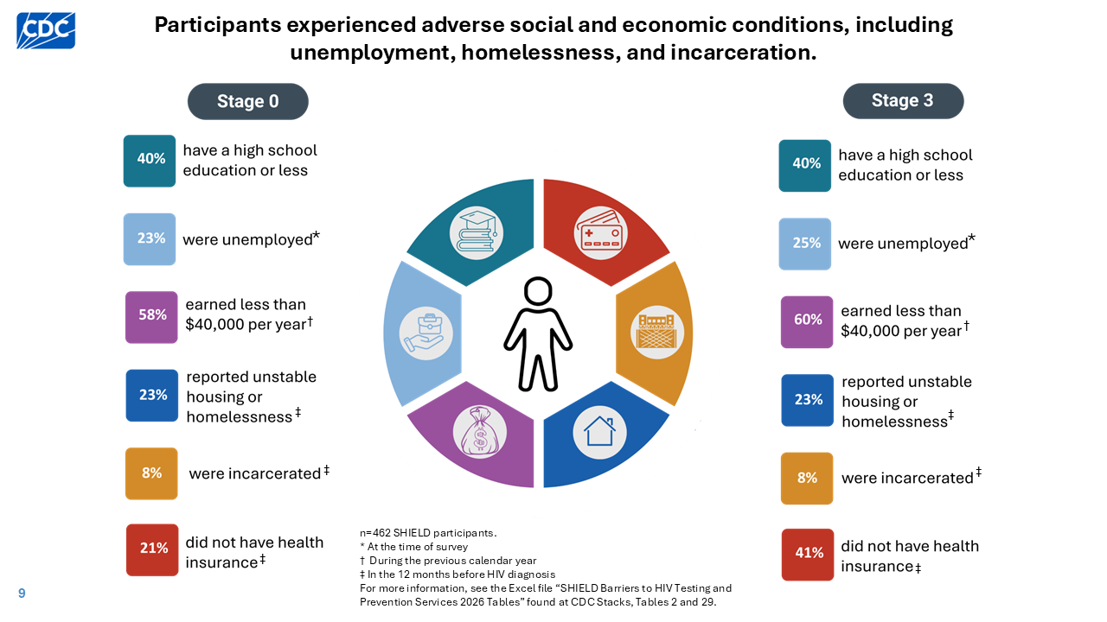
Notes:
Social and economic context refers to the environment in which people are born, grow, work, live, and age that influences health outcomes. These social and economic conditions can affect access to HIV testing and prevention services. Many SHIELD participants had a high school education or less, experienced unemployment, earned less than $40,000 per year, lacked health insurance, and experienced unstable housing or homelessness, which can make it more difficult to access critical HIV prevention and testing services. Additionally, nearly 1 in 10 participants had been in jail or prison for more than 24 hours during the 12 months before their HIV diagnosis, which could have delayed their diagnosis or prevented them from using HIV prevention tools such as pre-exposure prophylaxis (PrEP). Routine HIV screening programs can be implemented in correctional settings to provide opportunities for HIV testing for people who might otherwise not have access to testing.
Unstable housing or homelessness included participants who reported living in one of the following housing types in the 12 months before HIV diagnosis: shelter, safe haven, transitional housing, institutional housing (hospital, jail, juvenile detention, long-term facility, nursing home, or drug treatment facility), other peoples’ homes for a short period of time, or a place other than a home.

Slide 10


Slide 11
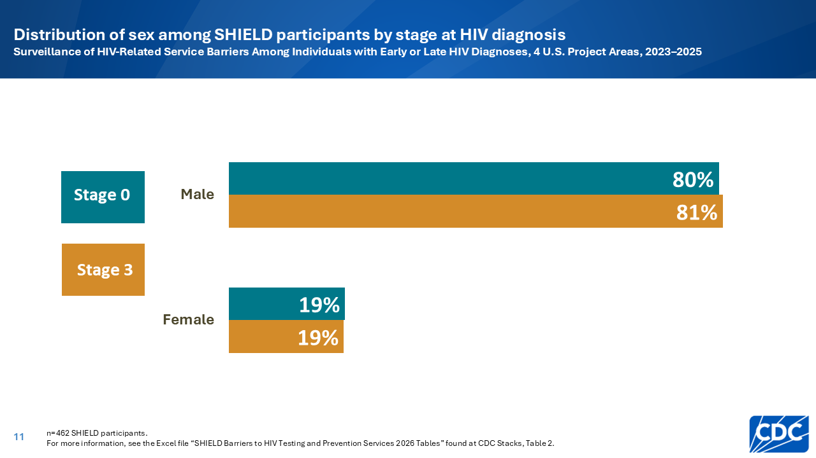
Notes:
The majority of participants who received their HIV diagnosis at stage 0 (80%) and stage 3 (81%) were male.

Slide 12
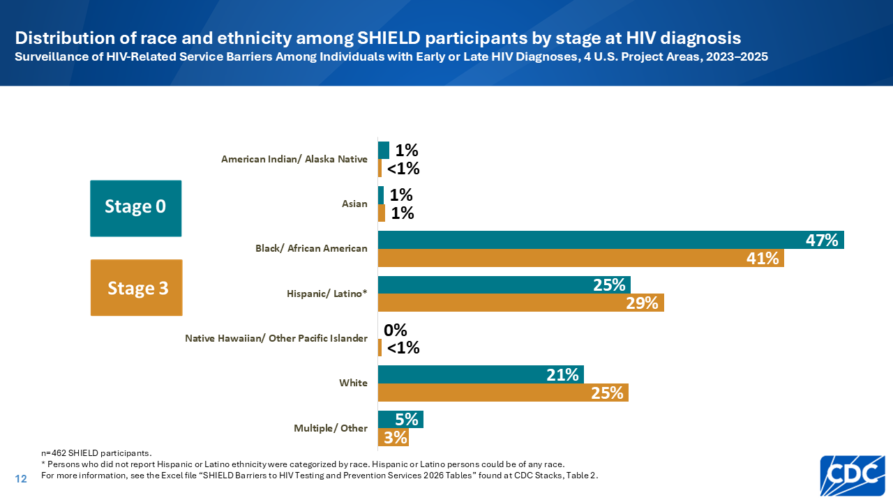
Notes:
A plurality of participants who received their HIV diagnosis at stage 0 (47%) and stage 3 (41%) identified as Black/African American. Approximately one-quarter (25% and 29%) were Hispanic/Latino.

Slide 13
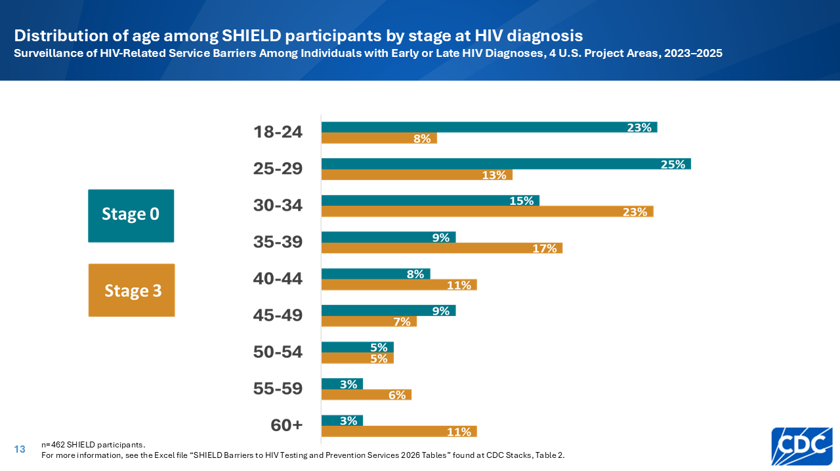
Notes:
By age group, the highest proportion of participants with a stage 0 diagnosis were aged 25-29 years. The highest proportion of participants with a stage 3 diagnosis were aged 30-34 years.

Slide 14
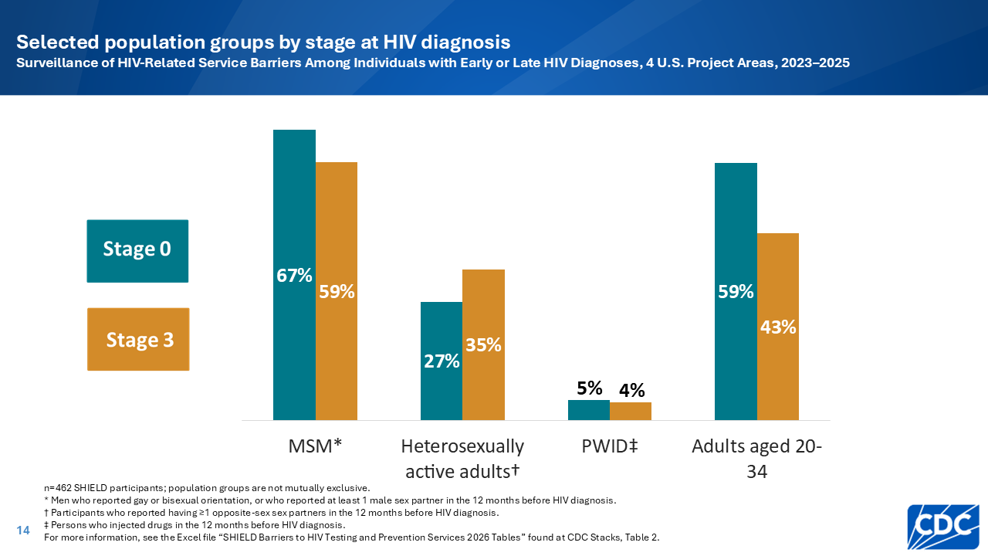
Notes:
Of 173 participants with a stage 0 diagnosis, 67% were gay, bisexual, or other men who have sex with men (MSM); 27% were heterosexually active; 5% were persons who injected drugs in the 12 months before their HIV diagnosis (PWID); and 59% were aged 20-34 years.
Of 289 participants with a stage 3 diagnosis, 59% were MSM, 35% were heterosexually active adults, 4% were PWID, and 43% were aged 20-34 years. These groups are not mutually exclusive.
MSM were defined as male participants who reported either 1) gay or bisexual orientation or 2) ≥1 male sex partners in the 12 months before HIV diagnosis. This group was selected as a population group of interest in this data release because MSM accounted for approximately two-thirds of all new HIV diagnoses in the United States in 2023 [1].
Heterosexually active adults were defined as participants who reported ≥1 opposite-sex sex partners in the 12 months before HIV diagnosis. Participants who reported both male and female sex partners in the 12 months before HIV diagnosis were not included in this category.
PWID were defined as participants who reported injecting drugs not prescribed by a doctor in the 12 months before their HIV diagnosis. This group was selected as a population group of interest in this data release because injection drug use is associated with HIV infection. Percentages reported for PWID are based on <12 participants and should be interpreted with caution due to small cell size.
Adults aged 20-34 years included participants who reported their age at the time of the survey as 20-34 years. This was selected as a population group of interest because this age group accounted for more than half of all new HIV diagnoses in the United States in 2023 [1].
References:
Centers for Disease Control and Prevention. HIV Diagnoses, Deaths, and Prevalence. Published April 29, 2025. Accessed September 16, 2025. https://www.cdc.gov/hiv-data/nhss/hiv-diagnoses-deaths-prevalence.html.

Slide 15


Slide 16
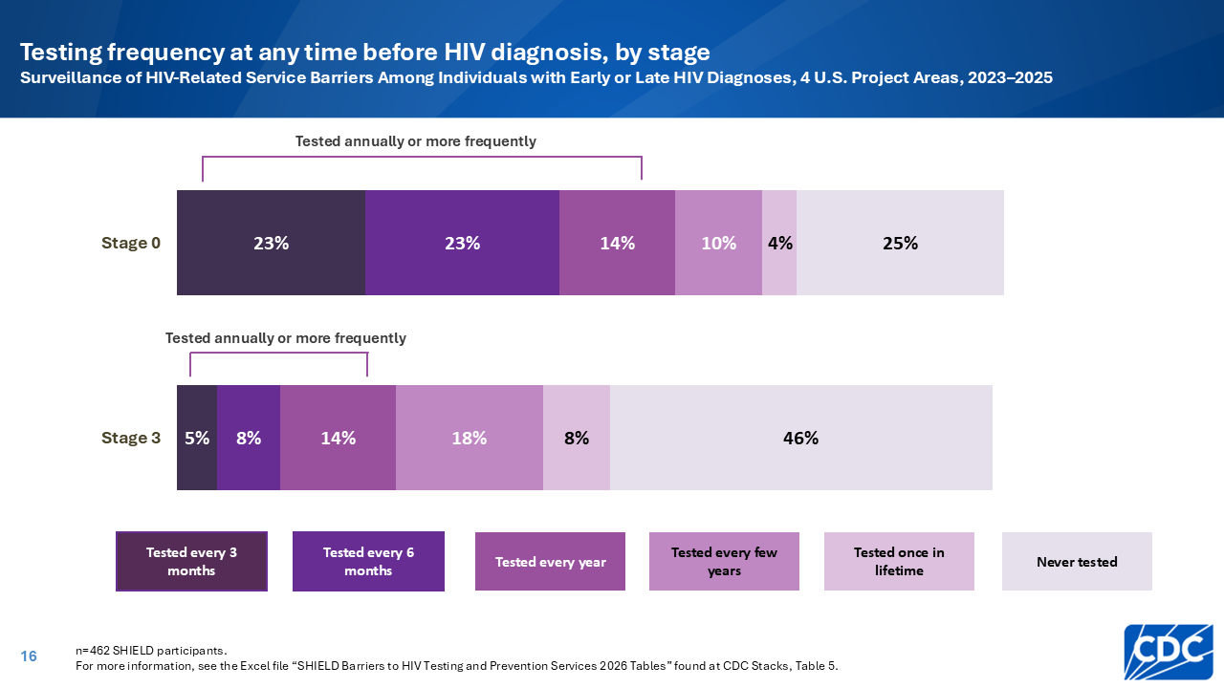
Notes:
CDC recommends at least annual HIV screening for people with behaviors that increase their chances of getting or transmitting HIV. These behaviors include injection drug use or having a sex partner who injects drugs, exchanging sex for money or drugs, having a sex partner with HIV, and
having more than one sex partner since the last HIV test or having a sex partner with more than one sex partner since their last HIV test [1].
Only 27% of participants who received their diagnosis at stage 3 reported testing for HIV annually or more frequently before their diagnosis, which may have contributed to these late diagnoses. Among participants with a stage 0 diagnosis, 60% reported testing for HIV annually or more frequently before their diagnosis.
References:
Branson BM, Handsfield HH, Lampe MA, et al. Revised recommendations for HIV testing of adults, adolescents, and pregnant women in health-care settings. MMWR Recomm Rep 2006; 55(RR-14): 1-17.

Slide 17
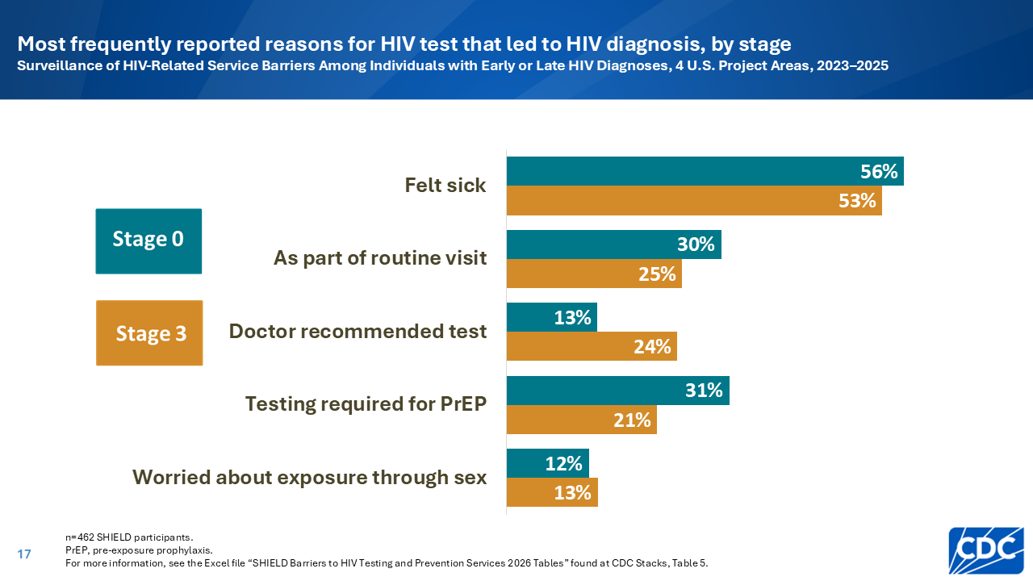
Notes:
Feeling sick was the most frequently reported reason for getting the HIV test that led to diagnosis among participants with a stage 0 diagnosis (56%) and a stage 3 diagnosis (53%).
The five most frequently reported reasons were consistent across stage at diagnosis, with minor variations in rank. Participants reported main reasons for the test that led to HIV diagnosis as feeling sick, the test being part of a routine clinical visit, doctor recommendation, required testing for PrEP, and feeling worried about HIV exposure through sex.
The finding that much of the HIV testing in this sample was motivated by illness or routine doctor visits suggests that many SHIELD participants were either unable to test regularly, chose not to test regularly, or were unaware that they should test regularly. Routine testing as recommended by CDC could prevent late diagnoses.

Slide 18
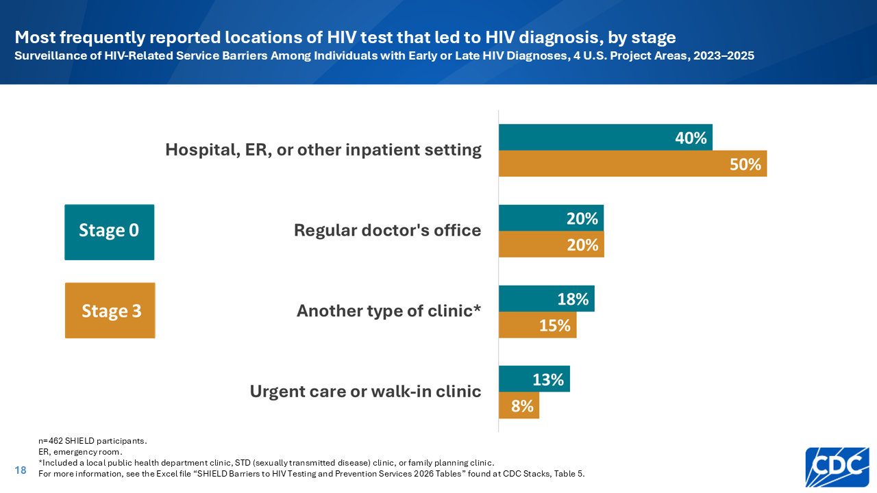
Notes:
The most frequently reported location of the HIV test leading to diagnosis was a hospital, emergency room, or other inpatient setting among participants who received a stage 0 (40%) or stage 3 (50%) diagnosis. This finding highlights the importance of routine, opt-out screening in hospital and ER settings, as these settings may be the only accessible point of care for some people with socio-contextual factors or behaviors that might increase their chances of getting or transmitting HIV.
Other frequently reported locations of the HIV test leading to diagnosis included a regular doctor’s office, another type of clinic like a local public health department clinic, STD clinic, or family planning clinic, or an urgent care or walk-in clinic.

Slide 19
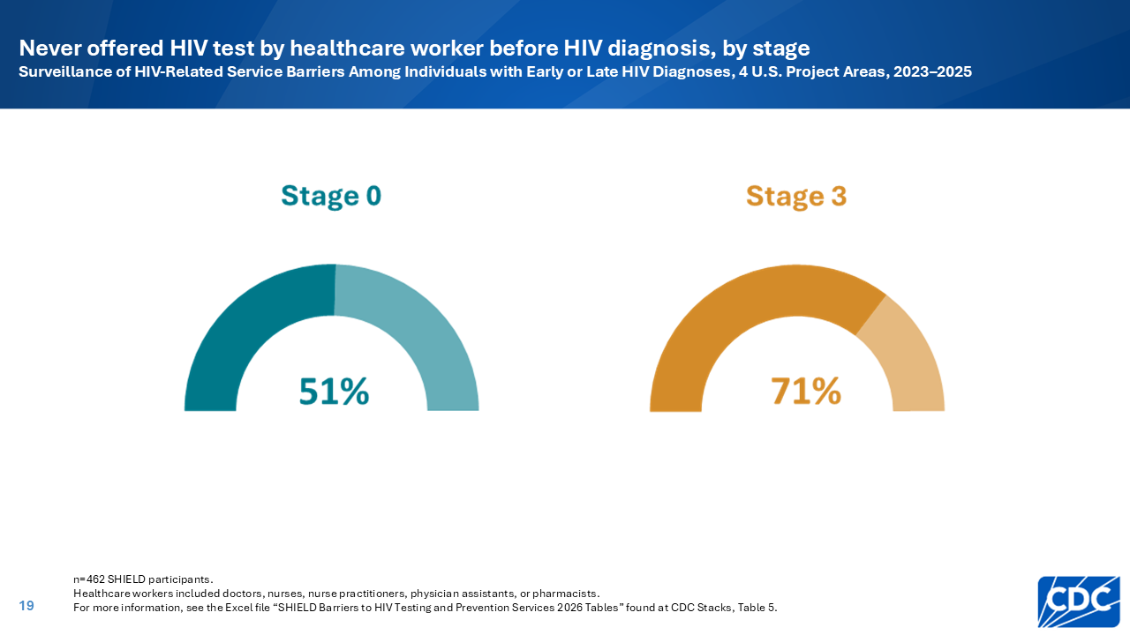
Notes:
Encounters with a healthcare worker provide an important opportunity to get tested for HIV. However, more than half (51%) of participants who received a stage 0 diagnosis and nearly three-quarters (71%) of participants who received a stage 3 diagnosis reported that they had never been offered an HIV test by a healthcare worker before their HIV diagnosis. To the extent that these participants accessed healthcare, this finding suggests critical missed opportunities for earlier diagnosis.
CDC recommends that healthcare providers perform routine opt-out HIV screening for all persons aged 13-64 years at least once in their lifetime, and at least annual rescreening for all persons with behaviors that increase the chances of getting or transmitting HIV.

Slide 20
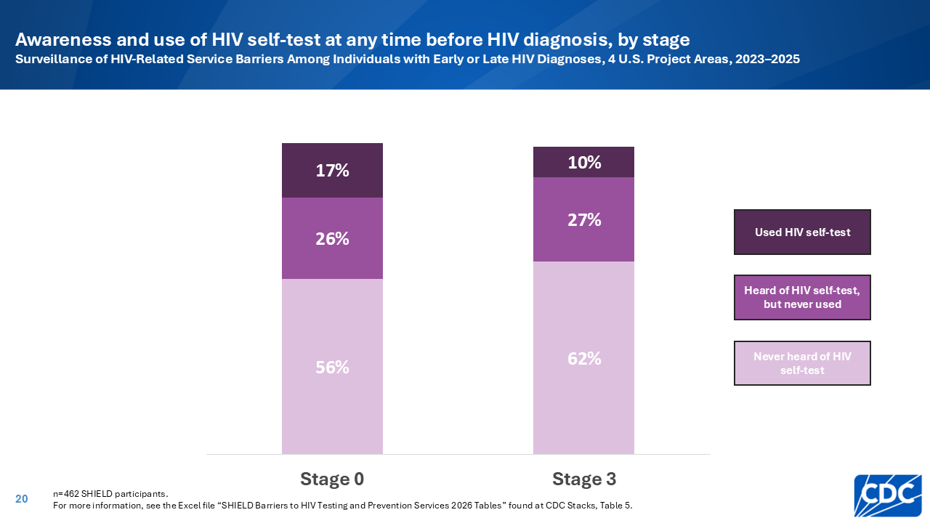
Notes:
An HIV self-test (or rapid self-test) is a test that can be used at home or in a private location. This may be a convenient option for people with limited access to healthcare services or those who do not wish to get tested in a clinical setting. Self-testing has the potential to reach people who have never previously been tested. However, awareness and use of HIV self-tests was low among SHIELD participants regardless of stage at diagnosis.
Promotion and distribution of self-tests is an important strategy to encourage routine testing and improve early diagnosis.

Slide 21
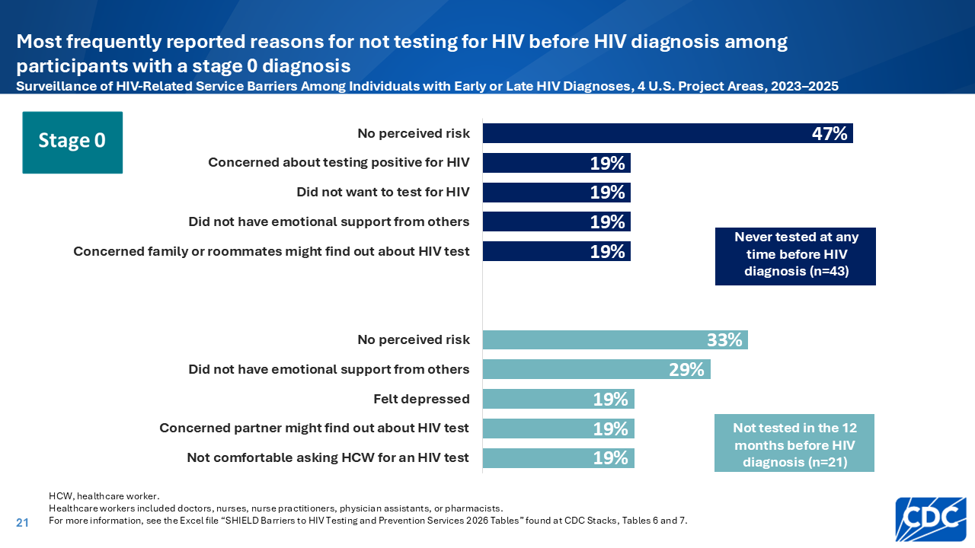
Notes:
Among participants with a stage 0 diagnosis, lack of perceived risk for HIV was the reason most frequently reported by participants in each of two mutually exclusive subgroups : those who 1) never tested for HIV before diagnosis (47%) and 2) did not test for HIV during the 12 months before diagnosis (33%). This finding highlights the importance of routine, opt-out HIV screening.
Other frequently reported reasons for not testing before diagnosis included concerns about testing positive, not wanting to test for HIV, not having emotional support from others, concerns about family or roommates finding out about the HIV test, concerns about a partner finding out about the HIV test, not feeling comfortable to ask a healthcare worker for an HIV test, and feeling depressed.

Slide 22
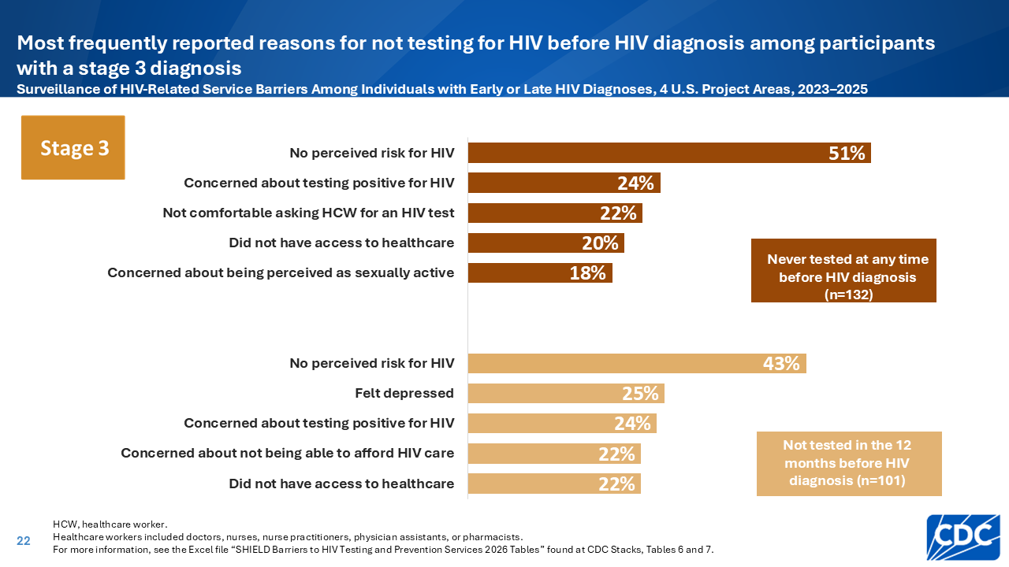
Notes:
Among participants with a stage 3 diagnosis, lack of perceived risk for HIV was the reason most frequently reported by participants in each of two mutually exclusive subgroups: those who 1) never tested for HIV before diagnosis (51%) and 2) did not test for HIV during the 12 months before diagnosis (43%). Lack of perceived risk could indicate a lack of knowledge about HIV or a lack of awareness of sex partners’ behaviors. This finding highlights the need to improve HIV-related knowledge among persons who engage in behaviors that increase the risk of HIV transmission, as well as the importance of routine, opt-out HIV screening for those who may not have accurate risk perceptions.
Other frequently reported reasons for not testing before diagnosis included feeling depressed, concerns about testing positive, concerns about not being able to afford HIV care, lacking access to healthcare, concerns about being perceived by others as sexually active, and not feeling comfortable to ask a healthcare worker for an HIV test.

Slide 23
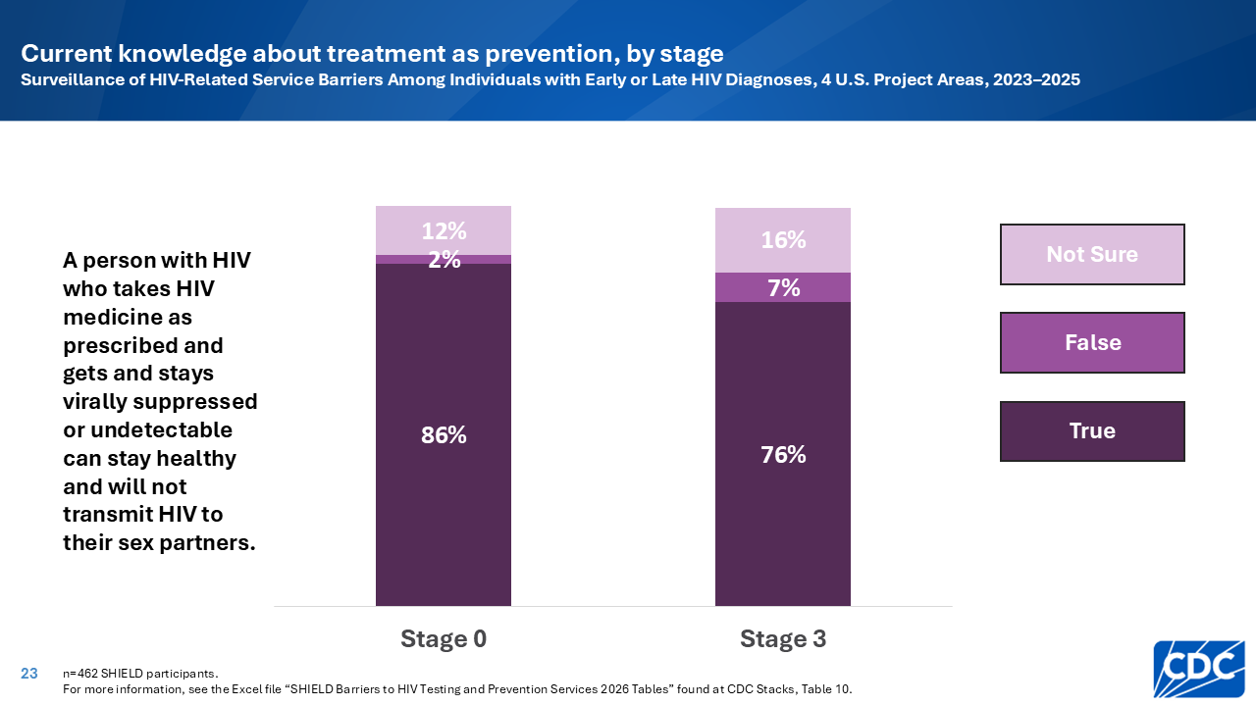
Notes:
SHIELD findings highlight suboptimal knowledge about HIV and viral suppression, even after HIV diagnosis. Participants were asked if they believe the following statement is true or false: “A person with HIV who takes HIV medicine as prescribed and gets and stays virally suppressed or undetectable can stay healthy and will not transmit HIV to their sex partners.”
Twenty-three percent of participants who received a stage 3 diagnosis and 14% of participants who received a stage 0 diagnosis were not aware at the time of the survey that people who are virally suppressed can stay healthy and will not transmit HIV to their sex partners.

Slide 24


Slide 25
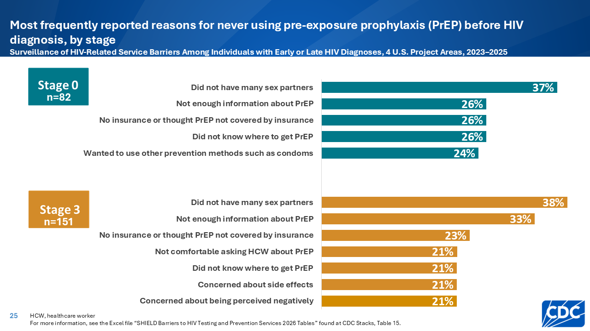
Notes:
PrEP (pre-exposure prophylaxis) is medicine (pills or shots) that reduces the chance of getting HIV. CDC recommends that people with certain behaviors that increase the risk of HIV transmission should be offered PrEP to prevent HIV.
Among participants who never used PrEP before HIV diagnosis, not having many sex partners and thinking PrEP was not needed was the reason most frequently reported by participants with a stage 0 diagnosis (37%) and participants with a stage 3 diagnosis (38%). This finding highlights the importance of increasing public awareness of how HIV is transmitted and prevented and offering PrEP to all persons with indications for PrEP.
Other frequently reported reasons for never using PrEP before diagnosis included not having enough information about PrEP, not having insurance or thinking PrEP would not be covered by insurance, not knowing where to get PrEP, wanting to use other prevention methods such as condoms, not feeling comfortable to ask a healthcare worker for an HIV test, concerns about side effects, and concerns about being perceived negatively.

Slide 26


Slide 27
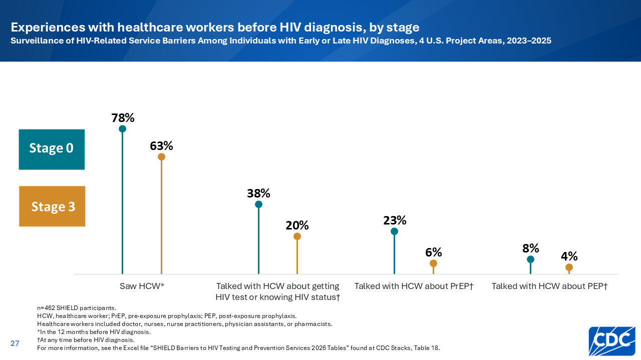
Notes:
The majority of participants who received an HIV diagnosis at stage 0 (78%) or stage 3 (63%) had seen a healthcare worker in the 12 months before their HIV diagnosis; however, few participants ever had conversations about knowing their HIV status or accessing testing and prevention services before their HIV diagnosis.
Only 38% and 20% of participants, respectively, ever had a conversation with a healthcare worker about getting an HIV test or knowing their status.
Only 23% and 6% of participants, respectively, ever had a conversation with a healthcare worker about pre-exposure prophylaxis (PrEP).
Only 8% and 4% of participants, respectively, ever had a conversation with a healthcare worker about post-exposure prophylaxis (PEP).
Healthcare workers should initiate these conversations about HIV testing and prevention because they help ensure timely testing, early treatment, and reductions in transmission for people with behaviors that increase their chances of getting or transmitting HIV.

Slide 28
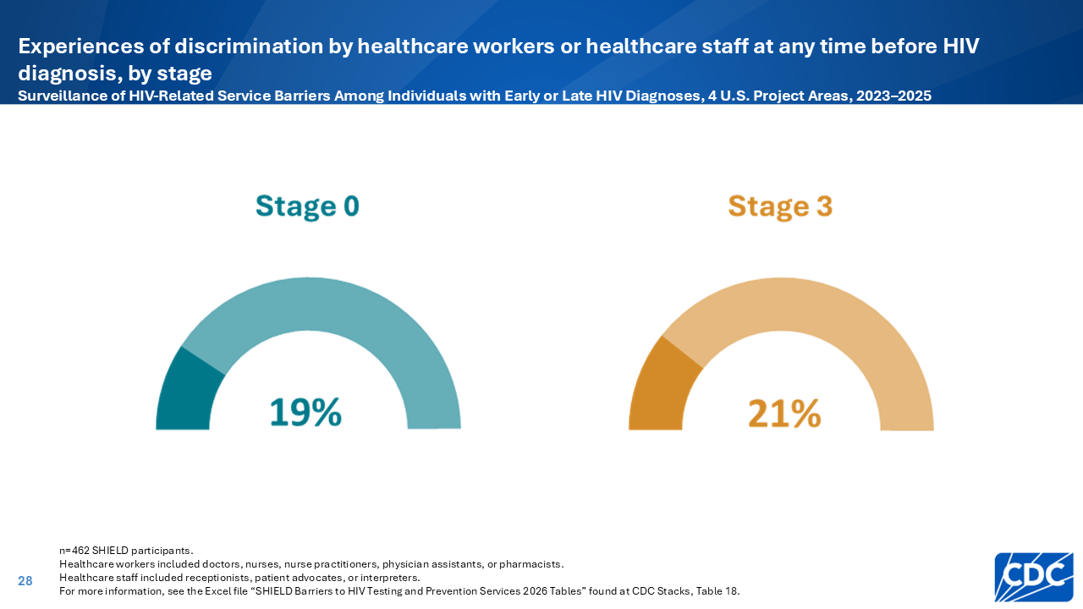
Notes:
Experiences of discrimination by HCWs or staff included HCWs using a disrespectful or rude tone or not listening in the 12 months before HIV diagnosis. Discrimination from a healthcare worker before HIV diagnosis was reported by approximately one-fifth of all SHIELD participants.
Perceived discrimination during a healthcare encounter can foster mistrust and discourage conversations about risk factors and needed services. Furthermore, it may deter people from seeking future HIV testing or prevention services.
Healthcare workers and staff can provide culturally competent, stigma-free services so every patient is met with respect, safety, and trust. This can help reduce barriers to HIV testing and prevention.

Slide 29
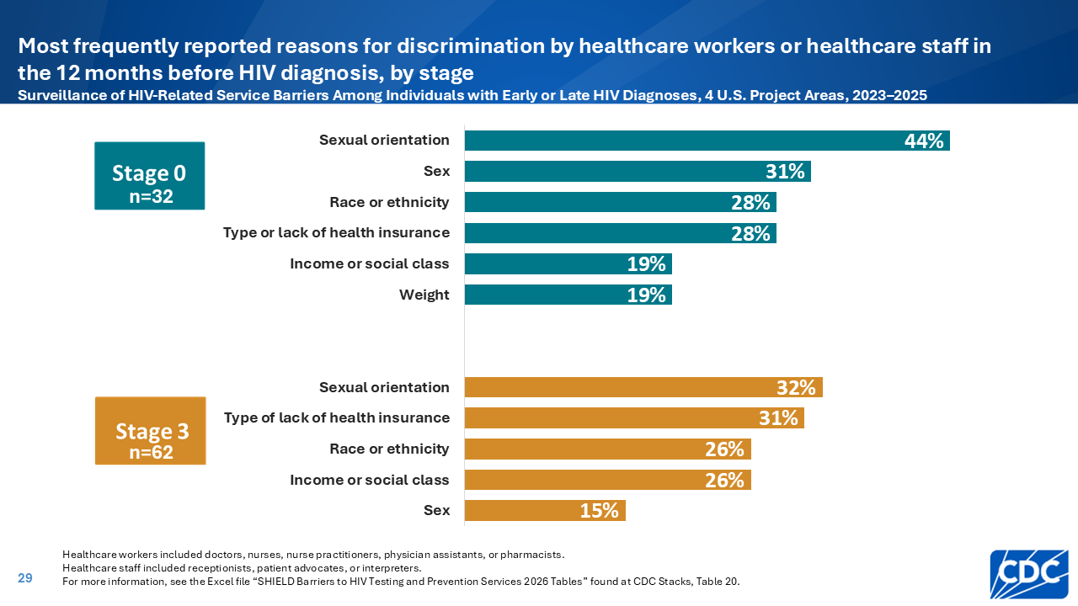
Notes:
Sexual orientation was most frequently reported as the reason for discrimination by a healthcare worker among participants with a stage 0 diagnosis (44%) and participants with a stage 3 diagnosis (32%).
Perceived discrimination during a healthcare encounter can foster mistrust and discourage conversations about risk factors and needed services. Furthermore, it may deter people from seeking future HIV testing or prevention services.
Healthcare workers and staff can provide culturally competent, stigma-free services so every patient is met with respect, safety, and trust. This can help reduce barriers to HIV testing and prevention.

Slide 30
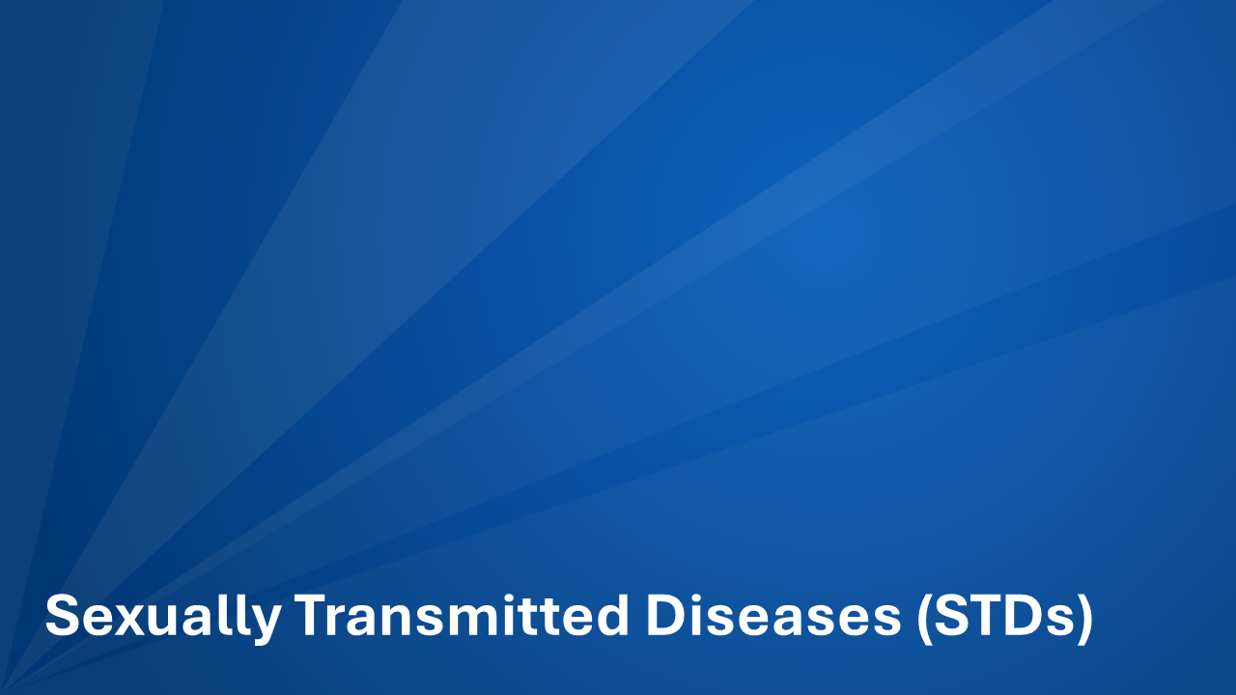

Slide 31
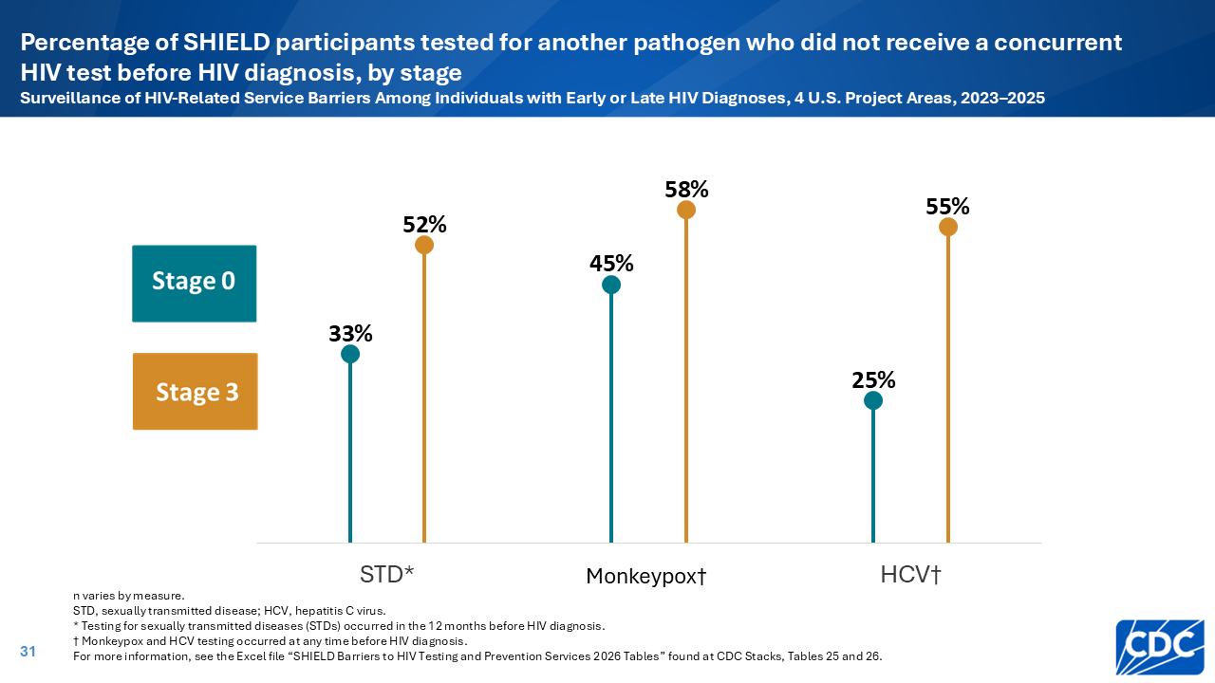
Notes:
STD testing provides an important opportunity to test for HIV, given similar risk factors and routes of transmission. However, many SHIELD participants reported testing for STDs, Monkeypox, or hepatitis C (HCV) before their HIV diagnosis without also being tested for HIV, indicating widespread missed opportunities for earlier HIV diagnosis.
Healthcare workers should integrate routine HIV testing with all STD evaluations to provide complete, high-quality care and reduce missed diagnoses.
Participants self-reported testing for STDs other than HIV, including gonorrhea, chlamydia, syphilis, genital herpes, human papillomavirus, or trichomoniasis, before their HIV diagnosis.

Slide 32


Slide 33
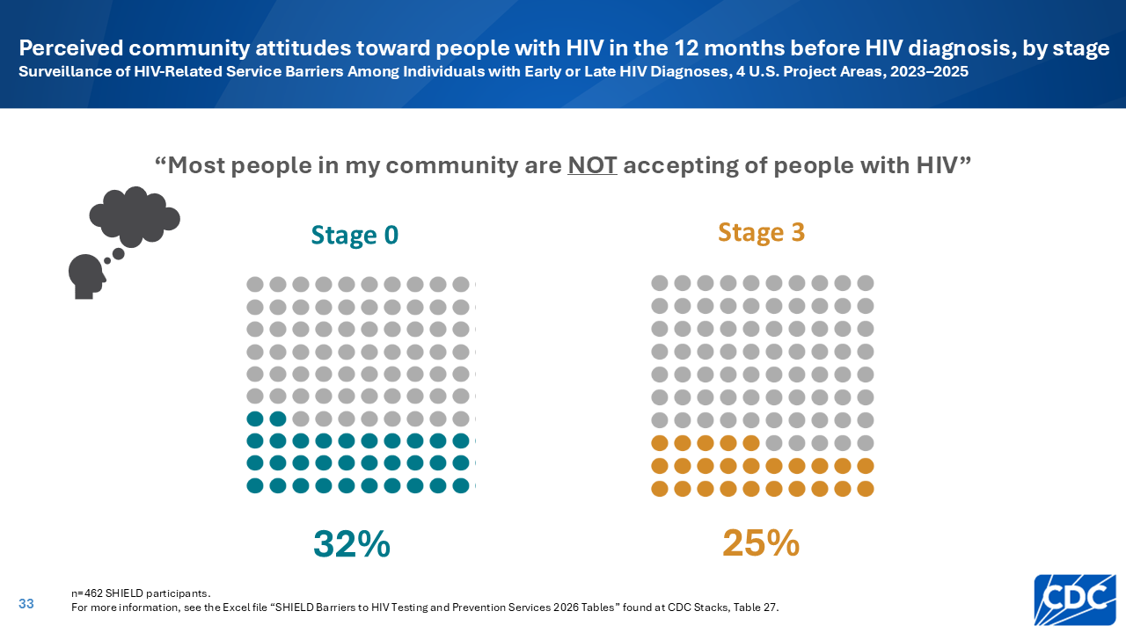
Notes:
Nearly a third of all SHIELD participants, regardless of stage, reported perceiving that people with HIV were not accepted by the community where participants spent the majority of their time in the 12 months before HIV diagnosis using a 5-point Likert scale.
Community stigma creates fear and spreads misinformation that keeps people from testing or knowing their status. Community leaders, healthcare workers, and neighbors should use respectful language, challenge misinformation, and normalize HIV testing. Reducing stigma will help create a community where everyone feels safe to get tested.

Slide 34
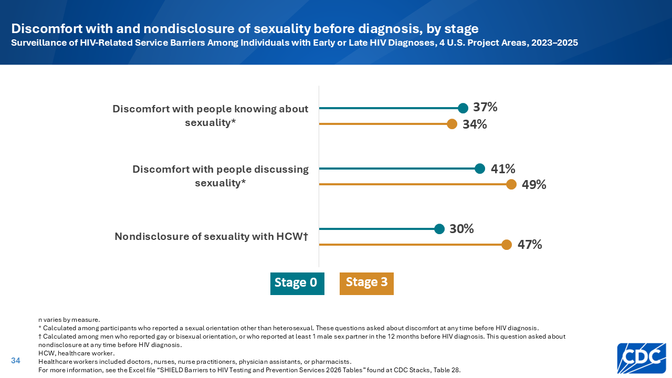
Notes:
Many SHIELD participants with a sexual minority identity reported feeling uncomfortable with other people knowing or discussing the participant’s sexuality at any time before HIV diagnosis. Sexual minority identity included people who identified as gay, lesbian, bisexual, or another sexual orientation other than heterosexual.
Social pressure, stigma, and internalized shame can make people feel unsafe about sexuality and less likely to access HIV testing or prevention services. Healthcare workers, educators, families, and community members must respect privacy, avoid assumptions, and create safe spaces where everyone can confidently access HIV testing and prevention services on their own terms.
Many gay, bisexual, or other men who have sex with men (MSM) reported not discussing their same-sex attraction or behavior with a healthcare worker at any time before HIV diagnosis.
Stigma, privacy concerns, and past experiences may prevent men from sharing this information, which can limit access to appropriate HIV testing and prevention services.
Healthcare workers should offer HIV testing and prevention services without judgment or assumptions. Ensuring confidentiality and using respectful language will help create a safe space where men feel comfortable sharing their sexual orientation and behaviors.

Slide 35


Slide 36
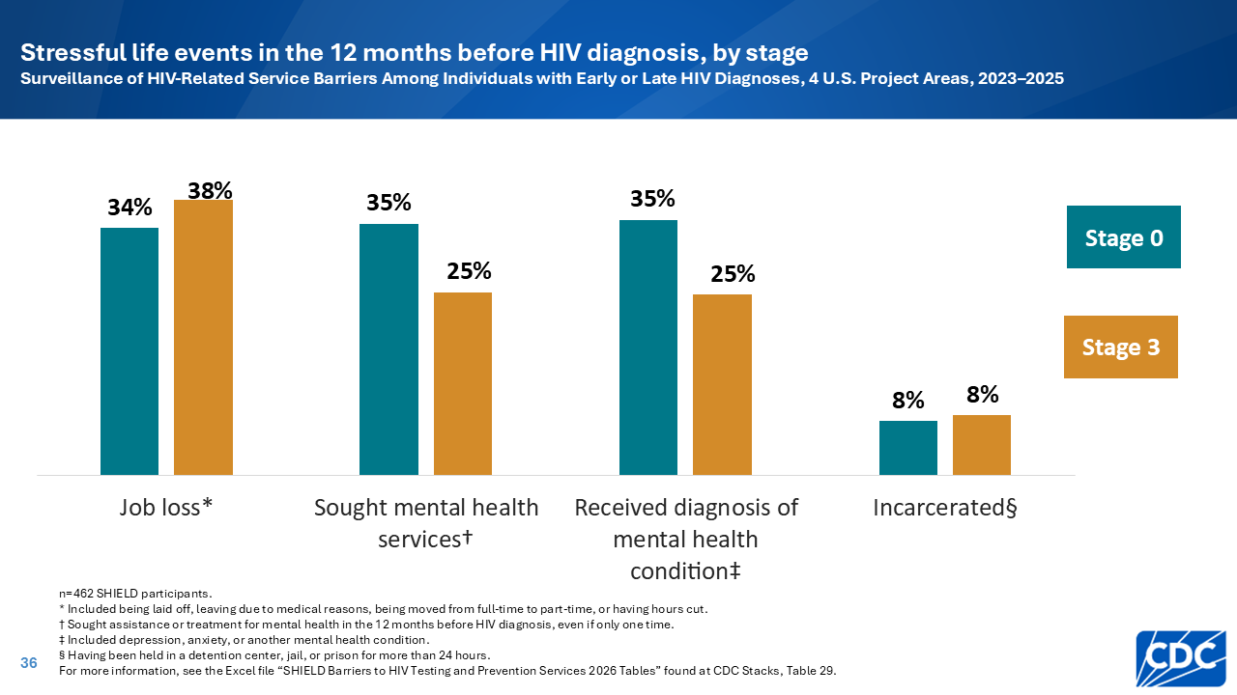
Notes:
Many SHIELD participants reported experiencing job loss or incarceration or managing mental health conditions in the 12 months before HIV diagnosis. These experiences can make it harder for people to access or prioritize HIV testing and prevention services; however, this does not imply that persons who engage in behaviors that increase the risk of HIV transmission experience these stressful life events more frequently than persons who do not engage in such behaviors.
Community organizations and healthcare workers should recognize the impact of these stressful life events. Integrating HIV prevention and testing services with accessible and low-cost mental health and other ancillary services will help improve early diagnosis and reduce new HIV infections. Routine HIV screening programs can be implemented in correctional settings to provide opportunities for HIV testing for people who might otherwise not have access to testing.

Slide 37
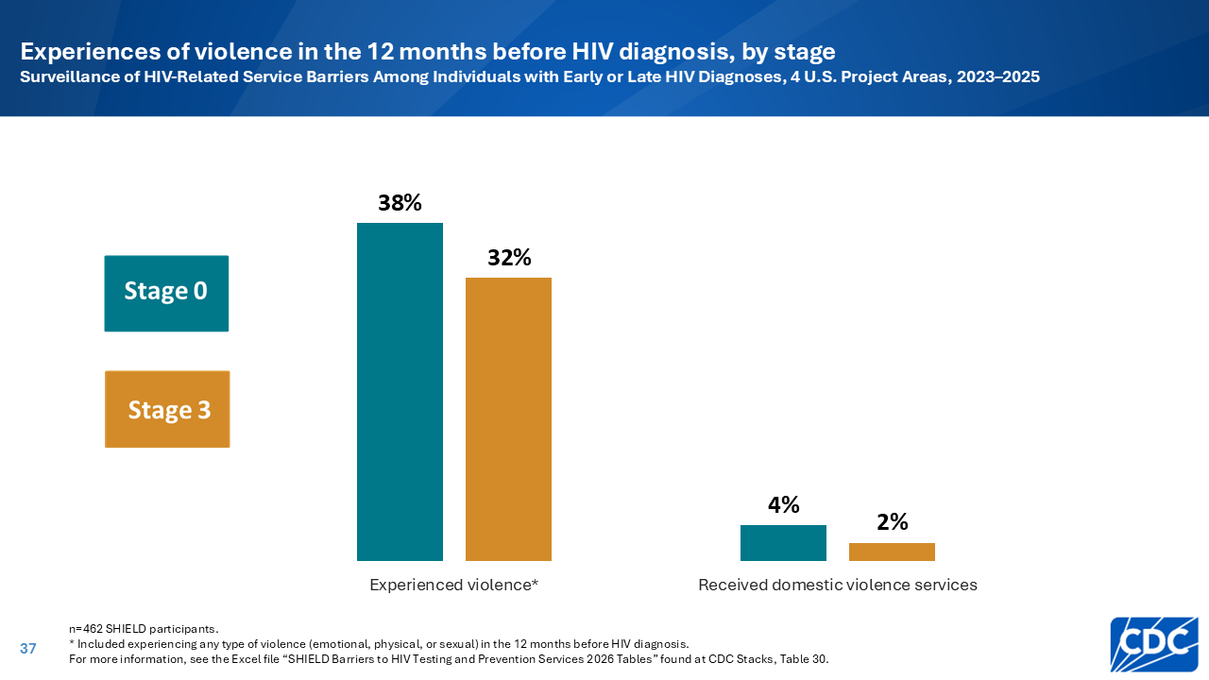
Notes:
About a third of SHIELD participants, regardless of stage, reported experiencing emotional, physical, or sexual violence in the 12 months before HIV diagnosis; however, less than 5% of participants at each stage reported receiving domestic violence services. In addition to increasing physical risk for HIV, violence creates psychological, social, and practical barriers that keep people from getting tested and accessing prevention. This does not imply that persons who engage in behaviors that increase the risk of HIV transmission experience violence more frequently than persons who do not engage in such behaviors.
Community organizations and healthcare workers should screen for and respond to all forms of violence with compassion and confidentiality. Integrating HIV prevention and testing services with trauma-informed care in supportive environments can help people overcome barriers to access.

Slide 38
