Slide 1
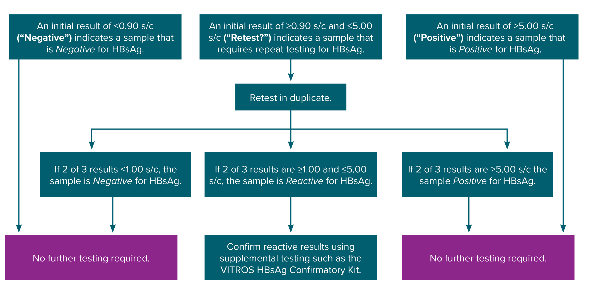
Figure 6-1. Testing algorithm for the Ortho VITROS hepatitis B surface antigen initial assay
Obtained from https://www.utmb.edu/policies_and_procedures/IHOP/Supporting_Documents/IHOP%20-%2009.13.15%20-%20Serological%20Testing%20for%20 Syphilis,%20Hepatitis%20B,%20and%20HIV%20during%20Pregnancy%20and%20Delivery%20(HBsAg_Screening).pdf.
Notes:
Figure 6-1 depicts the hepatitis B surface antigen testing algorithm for the Ortho VITROS hepatitis B surface antigen initial assay based on signal-to-cutoff value and indicates when retesting and supplemental confirmatory, or neutralization, testing should be performed.

