Slide 1
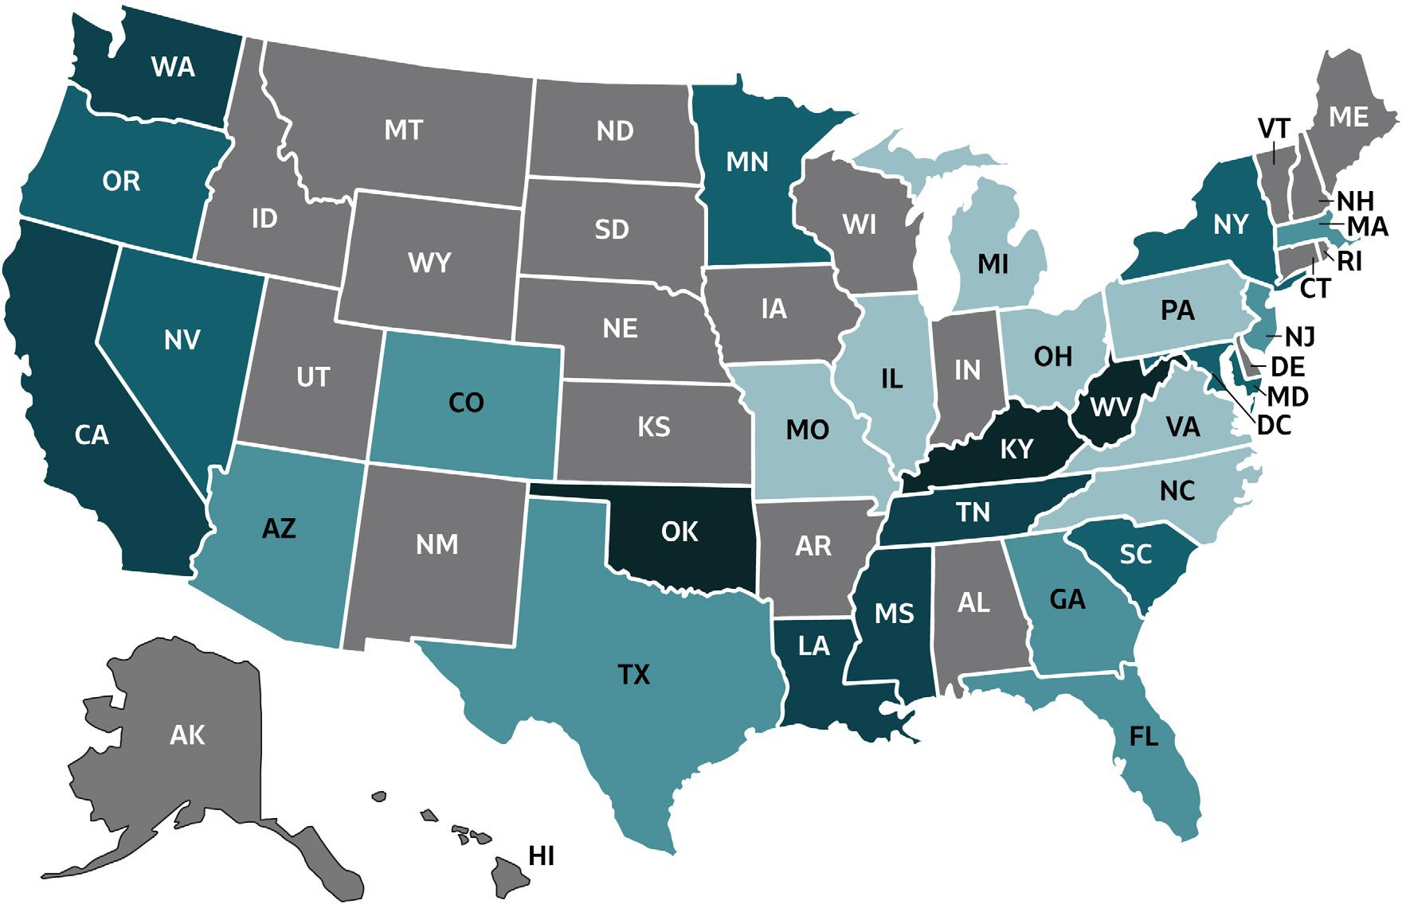
VIRAL HEPATITIS
SURVEILLANCE
Figure 2.8. Rate of deaths with hepatitis B listed as a cause of death among U.S. residents, by jurisdiction and year — United States, 2018
Color Key | Cases/100,000 Population | States
 | 0-0.33 | IL, MI, MO, NC, OH, PA, VA
 | >0.33-0.41 | AZ, CO, FL, GA, MA, NJ, TX
 | >0.41-0.52 | MD, MN, NV, NY, OR, SC
 | >0.52-0.68 | CA, LA, MS, TN, WA
 | >0.68-1.26 | KY, OK, WV
 | Unreliable rate | AL, AK, AR, CT, DE, DC, HI, ID, IN, IA, KS, ME, MT, NE, NH, NM, ND, RI, SD, UT, VT, WI, WY
Source: CDC, National Center for Health Statistics, Multiple Cause of Death 2018 on CDC WONDER Online Database. Unreliable rates where death counts were less than 20 were not displayed due to the instability associated with those rates.

