Slide 1
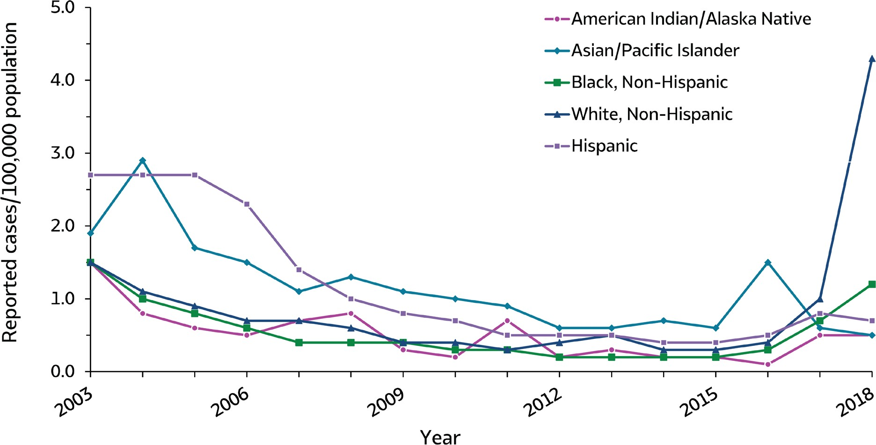
VIRAL HEPATITIS
SURVEILLANCE
Figure 1.6. Rates of reported hepatitis A, by race/ethnicity — United States, 2003–2018
Source: CDC, National Notifiable Diseases Surveillance System.

Slide 2
VIRAL HEPATITIS
SURVEILLANCE
Figure 1.6. Rates of reported hepatitis A, by race/ethnicity — United States, 2003–2018
Race/ Ethnicity | 2003 | 2004 | 2005 | 2006 | 2007 | 2008 | 2009 | 2010 | 2011 | 2012 | 2013 | 2014 | 2015 | 2016 | 2017 | 2018
American Indian/ Alaska Native | 1.5 | 0.8 | 0.6 | 0.5 | 0.7 | 0.8 | 0.3 | 0.2 | 0.7 | 0.2 | 0.3 | 0.2 | 0.2 | 0.1 | 0.5 | 0.5
Asian/Pacific Islander | 1.9 | 2.9 | 1.7 | 1.5 | 1.1 | 1.3 | 1.1 | 1.0 | 0.9 | 0.6 | 0.6 | 0.7 | 0.6 | 1.5 | 0.6 | 0.5
Black, Non-Hispanic | 1.5 | 1.0 | 0.8 | 0.6 | 0.4 | 0.4 | 0.4 | 0.3 | 0.3 | 0.2 | 0.2 | 0.2 | 0.2 | 0.3 | 0.7 | 1.2
White, Non-Hispanic | 1.5 | 1.1 | 0.9 | 0.7 | 0.7 | 0.6 | 0.4 | 0.4 | 0.3 | 0.4 | 0.5 | 0.3 | 0.3 | 0.4 | 1.0 | 4.3
Hispanic | 2.7 | 2.7 | 2.7 | 2.3 | 1.4 | 1.0 | 0.8 | 0.7 | 0.5 | 0.5 | 0.5 | 0.4 | 0.4 | 0.5 | 0.8 | 0.7
Source: CDC, National Notifiable Diseases Surveillance System.

