Slide 1
Early-Onset Breast Cancer Education for Women’s Health Care Providers
Julia O’Hara, MPH
Program Manager
American College of Obstetricians and Gynecologists (ACOG)
August 20, 2019

Slide 2
Agenda
ACOG overview
Early-onset breast cancer (EOBC) provider education project overview
Overall goals and target audience
Phases of project
Looking forward
Questions?

Slide 3
ACOG Overview

Slide 4
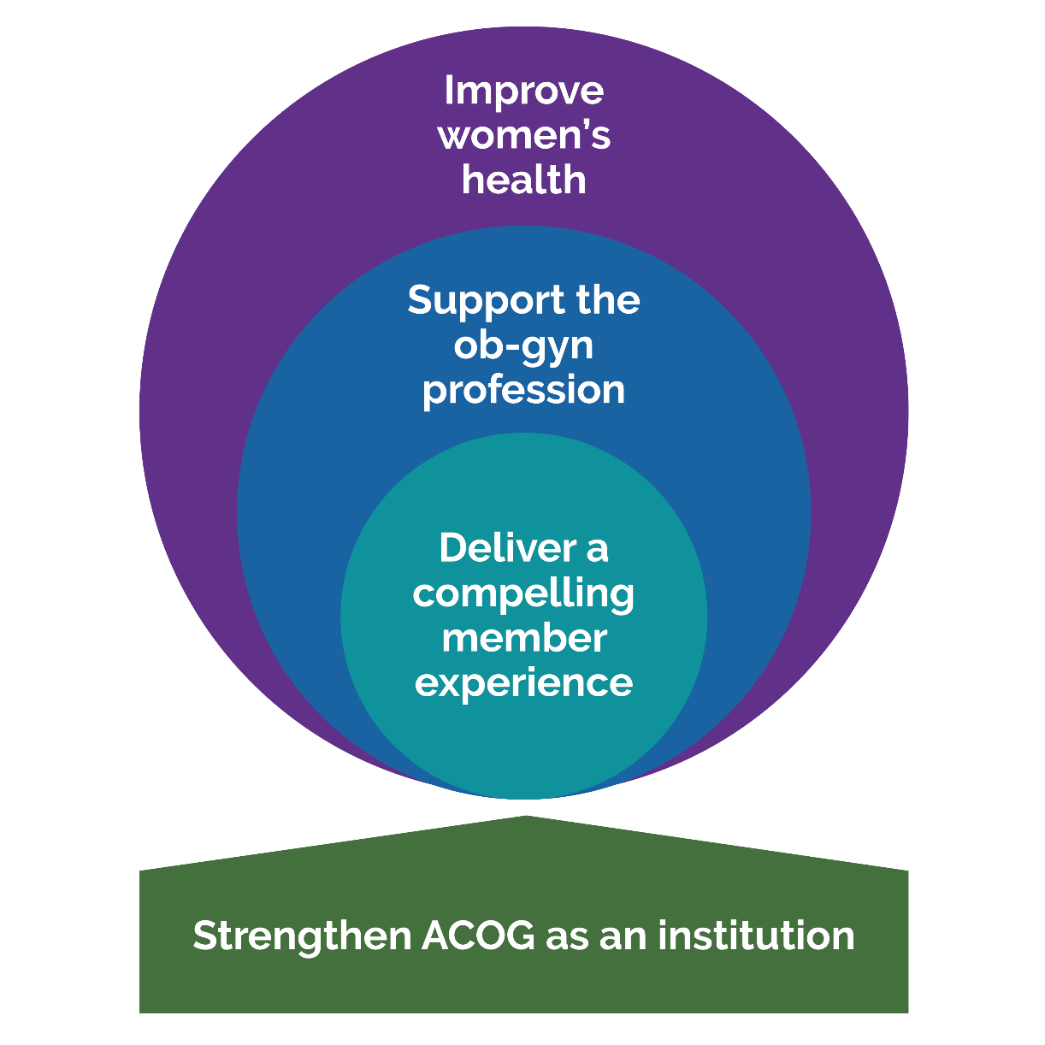
ACOG Overview
Operational Mission Statement
The American Congress of Obstetricians and Gynecologists is a membership organization dedicated to the advancement of women’s health care and the professional and socioeconomic interests of its members through continuing medical education, practice, research, and advocacy.

Slide 5
Early-Onset Breast Cancer (EOBC) Provider Education Project Overview

Slide 6
Project Overview
Funded by CDC Cooperative Agreement
Provider-focused branch of CDC’s Bring Your Brave patient education campaign
Target audience:
Ob-gyns
Nurses
NPs
PAs
Internists
Allied health professionals

Slide 7
Project Overview, Cont.
Literature Review, Evidence Review Conference, Stakeholder Input
Marketing Campaign & Promotion of Educational Materials
Development of CME/CEU Accredited
e-Modules
Goal is to develop innovative, evidence-based provider education materials
Increase knowledge among women’s healthcare providers about early-onset breast cancer

Slide 8
Formative Research
Literature Search, Evidence Review, Stakeholder Input

Slide 9
Formative Research Process
Panel Convened & Outline Created
Literature Search
Primary & Secondary Literature Review
Evidence Review Conference
Tertiary & Chair Review & Revisions
FINAL DOCUMENT & E-MODULE CURRICULUM
Second Literature Search
STAKEHOLDER INPUT

Slide 10
Workgroup Stakeholders

Slide 11
Formative Research Insights
Self-identified provider education needs:
Risk-assessment tools
Risk-reduction strategies
Risk communication
Genetic risk factors
Health disparities
Preferred education delivery methods:
Evidence-based clinical guidance*
CME/CEU-accredited e-module*
Patient education materials

Slide 12
Formative Research Insights, Cont.
Provider Insights & Lit Search Takeaways:
Need for evidence-based clinical guidance
Need for consistent guidance across providers/specialties
Need for efficient and effective evidence-based risk assessment tools
Gaps in evidence specific to EOBC (18-45 age range)

Slide 13
How will we use these insights?
Published literature review outlining current evidence and recommendations
Develop CME/CEU-accredited e-module to operationalize evidence-based best practices

Slide 14
E-Module Curriculum Outline
Part 1: Risk Factors for EOBC
Genetic risk factors
Part 2: Assessing and Mitigating Risk for EOBC
Health disparities
Dense breasts
Family history
Prior history
Tools for assessing risk for EOBC
Communicating risk to patients
Understanding genetic counseling and testing
Risk reduction measures
Special considerations in EOBC

Slide 15
What is Our Marketing Message?
Pulling it all together

Slide 16
MEET THEIR BRAVE
Patients are bringing their brave into your office. Learn how to effectively meet their brave, and assess their risk, without bias.
Bring Your Brave equips young women with the tools needed to take control of their health and talk to providers about their risk for EOBC.

Slide 17
MEET THEIR BRAVE
Start the Conversation Early
Treat Family History as a Symptom

Slide 18
START THE
CONVERSATION EARLY
The majority of cases of EOBC are detected by women themselves,
and have a higher mortality rate
The continuum of care should start earlier with the conversation about
breast health and risk factors

Slide 19
Does your patient know that the family history of cancer in female and male relatives are important red flags for their risk?
You already know how to take a family history, but are you asking the right questions to get the most thorough and accurate details possible?
FAMILY HISTORY IS
A SYMPTOM

Slide 20
Meet Providers in Person
Attend a variety of Annual Meetings to meet providers where they are and raise awareness of the upcoming educational opportunities and resources:
Pre-CME launch
Post-CME launch

Slide 21
Reaching Target HCP Audiences Through Paid Digital Ads and Partnerships

Slide 22
Looking Forward
Remainder of 2019:
Attend various annual meetings to raise awareness of upcoming educational materials
Develop and produce e-module
Develop marketing campaign
Early 2020:
E-module goes live
Integrated marketing campaign
Measurement and reporting of metrics

Slide 23
Questions?

Slide 24
Contact Information
Nancy O’Reilly, MHS, PMP
Senior Director, Gyn Practice
Email: noreilly@acog.org
Julia O’Hara, MPH
Program Manager, Gyn Practice
Email: johara@acog.org
Emily Greenwood
Program Specialist, Gyn Practice
Email: egreenwood@acog.org

Slide 25
Supplemental Slides

Slide 26
Marketing Strategy
Drive engagement and discussion within the professional women’s health community on early onset breast cancer risk strategies
Ensure screeners of high risk BC patients know the right questions to ask
Build awareness among practitioners with the capacity to screen with up-to-date guidance and education
…by ensuring the voice of stakeholders engaged in breast cancer screening discussions are involved in the formation of a provider-focused campaign
…by leveraging the existing Bring Your Brave campaign and elements that are successful as voiced by patients and physicians
…by developing a marketing plan that resonates with women’s health providers when they’re already looking for information

Slide 27
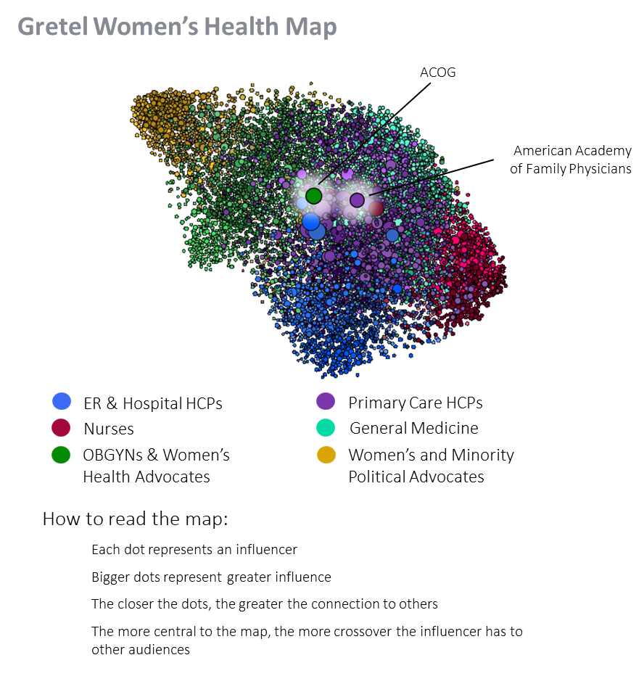
GRETEL Insights
Conversations on EOBC and genetic testing are mainly taking place within the oncology subgroup of the ob-gyn discussion
The ob-gyn oncologist audience is the least likely to engage with family physicians.
Family Physicians have an extreme tendency to only pay attention to each other.

