Slide 1



A Public Health Approach to
Alzheimer’s and Other Dementias
Dementia Capable Systems and dementia friendly communities
Notes:
DISCLAIMERS
This publication was supported by Cooperative Agreement Number 5U58DP002945-05, funded by the Centers for Disease Control and Prevention. Its contents are solely the responsibility of the authors and do not necessarily represent the official views of the Centers for Disease Control and Prevention or the Department of Health and Human Services.
The mark "CDC” is owned by the US Dept. of Health and Human Services and is used with permission. Use of this logo is not an endorsement by HHS or CDC of any particular product, service, or enterprise.
Talking Points:
This presentation entitled, Dementia Capable Systems and Dementia Friendly Communities, is part of a curriculum for public health students entitled, A Public Health Approach to Alzheimer’s and Other Dementias. It was developed by the Emory Centers for Training and Technical Assistance for the Alzheimer’s Association with funding from the Centers for Disease Control and Prevention.
This presentation addresses the public health response to the Alzheimer’s epidemic at the state and community levels, and the importance of dementia capable systems and dementia friendly communities.

Slide 2
Learning Objectives
Define “dementia capable”
Explain how public health can contribute to dementia capable systems through: research and translation, support services/programs, workforce training, and dementia-friendly communities
List at least 3 services that may benefit someone with Alzheimer’s/dementia
List at least 2 services that may benefit a caregiver
Identify at least 3 professions that would benefit from workforce training
Describe at least 2 components of a dementia friendly community
Notes:
By the end of the presentation, you will be able to:
Define “dementia capable”
Explain how public health can contribute to dementia capable systems through: research and translation, support services/programs, workforce training, and dementia-friendly communities
List at least 2 services that may benefit a caregiver
Identify at least 3 professions that would benefit from workforce training
Describe at least 2 components of a dementia-friendly community

Slide 3
COmpetencies
Association of Schools and Programs of Public Health:
• Domain 1: Appreciate the role of community collaborations in promoting population health.
• Domain 2: Discuss the interconnectedness among the physical, social, and environmental aspects of community health.
Council on Linkages Between Academia and Public Health Practice:
• 1A1. Describes factors affecting the health of a community (e.g., equity, income, education, environment)
• 1A11. Describes assets and resources that can be used for improving the health of a community (e.g., Boys & Girls Clubs, public libraries, hospitals, faith-based organizations, academic institutions, federal grants, fellowship programs)
• 8A3. Describes the ways public health, health care, and other organizations can work together or individually to impact the health of a community
Notes:
(This slide can be edited as needed or removed)
The content in this presentation supports the development of the following competencies:
Association of Schools and Programs of Public Health:
• Domain 1: Appreciate the role of community collaborations in promoting population health.
• Domain 2: Discuss the interconnectedness among the physical, social, and environmental aspects of community health.
Council on Linkages Between Academia and Public Health Practice:
• 1A1. Describes factors affecting the health of a community (e.g., equity, income, education, environment)
• 1A11. Describes assets and resources that can be used for improving the health of a community (e.g., Boys & Girls Clubs, public libraries, hospitals, faith-based organizations, academic institutions, federal grants, fellowship programs)
• 8A3. Describes the ways public health, health care, and other organizations can work together or individually to impact the health of a community

Slide 4
Competencies cont.
Council on Linkages Between Academia and Public Health Practice (cont.):
• 8A4. Contributes to development of a vision for a healthy community (e.g., emphasis on prevention, health equity for all, excellence and innovation)
• 8A6. Describes needs for professional development (e.g., training, mentoring, peer advising, coaching)
National Association of Chronic Disease Directors (NACDD):
• Domain 7: Articulate evidence-based approaches to chronic disease prevention and control.
National Commission for Health Education Credentialing, Inc. (NCHEC):
• 1.7.4 Identify emerging health education needs.
• 3.3.2 Identify training needs.
Notes:
(This slide can be edited as needed or removed)
Council on Linkages Between Academia and Public Health Practice (cont.):
• 8A4. Contributes to development of a vision for a healthy community (e.g., emphasis on prevention, health equity for all, excellence and innovation)
• 8A6. Describes needs for professional development (e.g., training, mentoring, peer advising, coaching)
National Association of Chronic Disease Directors (NACDD):
• Domain 7: Articulate evidence-based approaches to chronic disease prevention and control.
National Commission for Health Education Credentialing, Inc. (NCHEC):
• 1.7.4 Identify emerging health education needs.
• 3.3.2 Identify training needs.

Slide 5
Introduction: Dementia & Alzheimer’s Disease
Dementia is a decline in mental ability severe enough to interfere with daily life
  Caused by damage to brain cells, primarily affects older adults
Alzheimer’s disease is the most common type of dementia
  Progressive loss of memory and brain function, behavior and personality changes
  No cure and limited treatment options
  Caregivers provide increasing assistance
Huge impact on individuals, families, caregivers, and the health care system
Public health plays important role in addressing Alzheimer’s disease through surveillance, prevention, detection, and support of dementia-capable systems
¹ Alzheimer’s Association. 2016 Alzheimer’s Disease Facts and Figures.
Notes:
Before we begin discussing dementia capable systems and dementia friendly communities in addressing Alzheimer’s disease, it may be helpful to know a little more about Alzheimer’s and dementia.
The term dementia is a general term for a decline in mental abilities that is severe enough to interfere with daily life. Dementia, which is not a disease but a syndrome, is characterized by damage to the brain cells due to age, brain injury, other conditions or diseases or heredity.
There are several types of dementia and most occur in those over 65; however, there are types of dementia that occur in those younger than 65.
Alzheimer’s disease is the most common type of dementia. Alzheimer’s is a progressive disease that ranges from mild to severe cognitive impairment that occurs over the course of several years.
There is no cure for Alzheimer’s. While there are approved drug treatments, the goal of treatment is to delay or reduce symptoms, not to cure or reverse the course of the disease.
As the person with Alzheimer’s loses memory and function, caregivers, who are most often family members, are needed to provide increasing amounts of assistance. This assistance can range from helping to manage finances and household tasks to hands-on care, such as bathing, dressing, feeding and other activities of daily living.
Given the nature of the disease and its increasing prevalence, there is a huge financial, emotional and physical impact on people with Alzheimer’s, their families, caregivers, and the health care system as a whole.
Public health plays an important role in addressing Alzheimer’s disease through surveillance, prevention, detection, and support of dementia-capable systems.
In this presentation, we will be focusing on dementia capable systems and dementia friendly communities, both of which involve government and health care agencies, organizations and communities accommodating the needs of people with dementia and their caregivers through providing education, services and support within their community.
Video supplements: “What is Alzheimer's disease?” TedEd. (run time: 3:49 mins)
Link: https://www.youtube.com/watch?v=yJXTXN4xrI8
Or, “Inside the Brain: Unraveling the Mystery of Alzheimer Disease”. National Institutes of Health, NIH Senior Health. (run time: 4 mins.) http://nihseniorhealth.gov/alzheimersdisease/whatisalzheimersdisease/video/a2_na.html?intro=yes

Slide 6

Alzheimer’s: A Larger Context
States/communities play
significant role
  Assessing burden
  Risk reduction
  Care services: health care, support services, government agencies
  Public and private resources: transportation, grocery stores, places of worship, financial institutions, law enforcement
Notes:
Alzheimer’s and dementia are often considered in terms of the toll these conditions take on individuals, families, and caregivers.
As an epidemic, Alzheimer’s and dementia also need to be addressed within a larger context. States and communities have many people living with Alzheimer’s and other dementias, as well as many others who are at risk for developing these conditions.
States must assess the burden of Alzheimer’s and dementia and take steps to reduce risk and provide support to affected populations.
At a community level, individuals with Alzheimer’s and dementia and their caregivers rely on many care services, including health care, support services (in-home, community, and long-term care), and government agencies for their daily care needs.
They also interact with and depend on public and private resources such as transportation, grocery stores, places of worship, financial institutions, and law enforcement.
A public health response to the epidemic must therefore take into consideration the unique needs of people with Alzheimer’s and dementia on state and local levels, within institutions, and across communities.

Slide 7
Dementia Capable Systems
Accommodate needs of population with:
  Memory loss
  Physical, cognitive, behavioral symptoms
  Co-morbidities
Knowledgeable workforce/residents:
  Identify people with dementia
  Work effectively with them
  Inform/refer to services
³ Alzheimer’s Association and Centers for Disease Control and Prevention. (2013) The Healthy Brain Initiative: The Public Health Road Map for State and National Partnerships, 2013-2018.
⁴ U.S. Administration on Aging. (2011) Dementia Capability Toolkit.
⁵ Tilly, J, Weiner, J, Gould, E, and O’Keefe, J. (2011) Making the Long-Term Services and Supports System Work for People with Dementia and Their Caregivers.
Notes:
During this presentation, we will discuss both dementia capable systems and dementia friendly communities. Each has an important part to play in helping people with dementia and their loved ones navigate the journey with dementia. First, we will discuss dementia capable systems.
Dementia capable means being able to help people with dementia and their caregivers. This definition applies both to dementia capable systems and dementia friendly communities. More specifically, being dementia capable means being skilled in identifying people with possible dementia and working effectively with them and their caregivers, being knowledgeable about the kinds of services needed, and being able to inform or refer to agencies and individuals that provide such services.
A dementia capable system is a system that accommodates the needs of a population that, in addition to memory loss, experiences a variety of physical, cognitive, and behavioral symptoms resulting from dementia, in addition to other co-morbidities.
Dementia capable systems can be implemented at different levels, such as within a care system, a business or organization, or within a community or state. The focus of dementia capable systems is often on:
increasing knowledge and skills of those who will help care for or interact with people who have dementia and their loved ones
addressing service gaps and specialized assistance needs
providing long term services and support systems to fulfill the needs of people with dementia and their caregivers
Public health must take an active role in fostering dementia capable systems and helping to bridge the gap between the needs of individuals and caregivers and the larger establishments within states and communities that can best meet those needs.

Slide 8
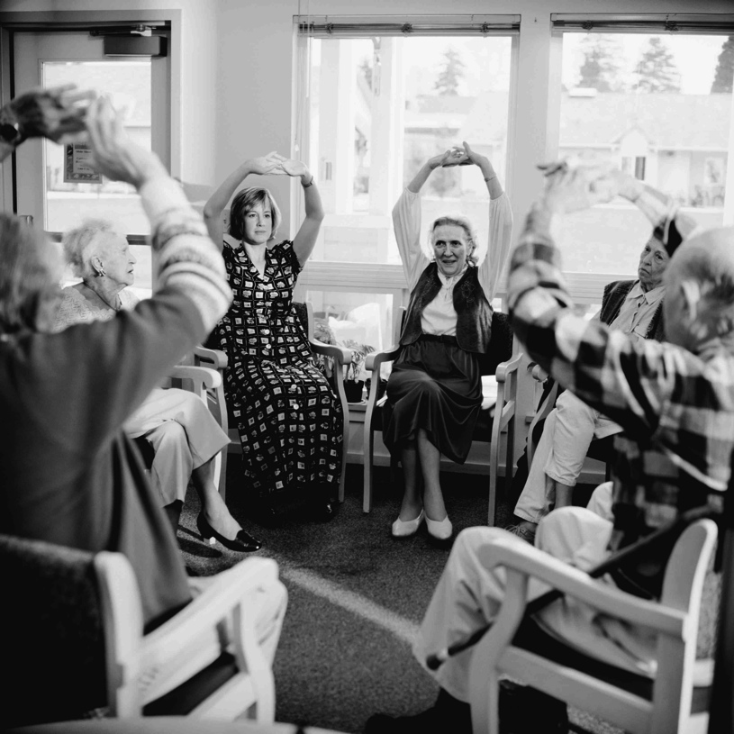
Dementia Capable: Public Health
Public health research
and translation
Support services and
programs
Workforce training
Dementia friendly
communities
Notes:
Public health may play a role in developing and supporting dementia capable systems by:
Conducting public health research and translating the findings through policy, programs, and best practices
Serving to provide, inform and connect individuals and caregivers to support services and programs
Designing and implementing workforce training to ensure workers across a wide range of professions are able to identify and meet the needs of people with Alzheimer’s and dementia
Supporting the creation of dementia friendly communities that help people with Alzheimer’s and dementia remain safe and as independent as possible within their community
Each of these will be discussed in more detail.

Slide 9
Public health research
Dementia Capable Systems and dementia friendly communities
Notes:
We will start with public health research.
Public health plays an important role in both conducting research and translating the findings from such research into practice.

Slide 10
Discussion Question
What is public health research?
What does it mean to translate findings?
Notes:
Ask: What is public health research?
What does it mean to translate findings?

Slide 11

Public Health Research & Translation
Public health research: generalizable knowledge to improve practice
Translation: evidence-based practice
Sources:
  Published peer-reviewed articles
  Authoritative guidelines, recommendations
  Surveillance systems
Notes:
Public health research is conducted with the goal of developing or contributing to generalizable knowledge to improve public health practice. “Generalizable” means that the information or knowledge that is gained may be widely applied to populations.
Translating the information or knowledge gained through public health research means applying it in practice – such as through policy, the development of programs or interventions, or the development of best practices. When programs and policies are built on a framework of research findings they are referred to as being evidence-based.
Sources for public health research and translation include:
Published peer-reviewed articles
Established best practices or guidelines from authoritative sources including government agencies (such as NIH, CDC, state health departments, state department of aging services), and nongovernmental organizations (such as the Alzheimer’s Association)
Surveillance systems such as the Behavioral Risk Factor Surveillance System (BRFSS)

Slide 12
Discussion Question
How can public health research and translation be used to reduce the burden of Alzheimer’s disease?
Notes:
Ask: How can public health research and translation be used to reduce the burden of Alzheimer’s disease?

Slide 13

Public Health Research & Translation
  Measure burden
  Create policies
  Identify/design practices and interventions
  Promote risk reduction and cognitive health
  ⁸ Centers for Disease Control and Prevention. (2010) Distinguishing Public Health Research and Public Health Nonresearch.
  ⁹ CDC & Alzheimer’s Association. (2013) The Healthy Brain Initiative: The Public Health Road Map for State and National Partnerships, 2013-2018.
Notes:
For Alzheimer’s and dementia, public health research may be applied to:
Measuring the burden of cognitive impairment on populations
Creating state and local policies that benefit and support people with Alzheimer’s disease and their caregivers
Identifying and designing effective practices and interventions to support the needs of individuals and their caregivers
Promoting risk reduction and cognitive health

Slide 14
Support services & programs
Dementia Capable Systems and dementia friendly communities
Notes:
Public health research may be used to inform the design of support services and programs for people with Alzheimer’s and other dementias.

Slide 15
Discussion Question
What kinds of support services might people with Alzheimer’s and their caregivers need?
Notes:
Ask: What kinds of support services might people with Alzheimer’s and their caregivers need?

Slide 16
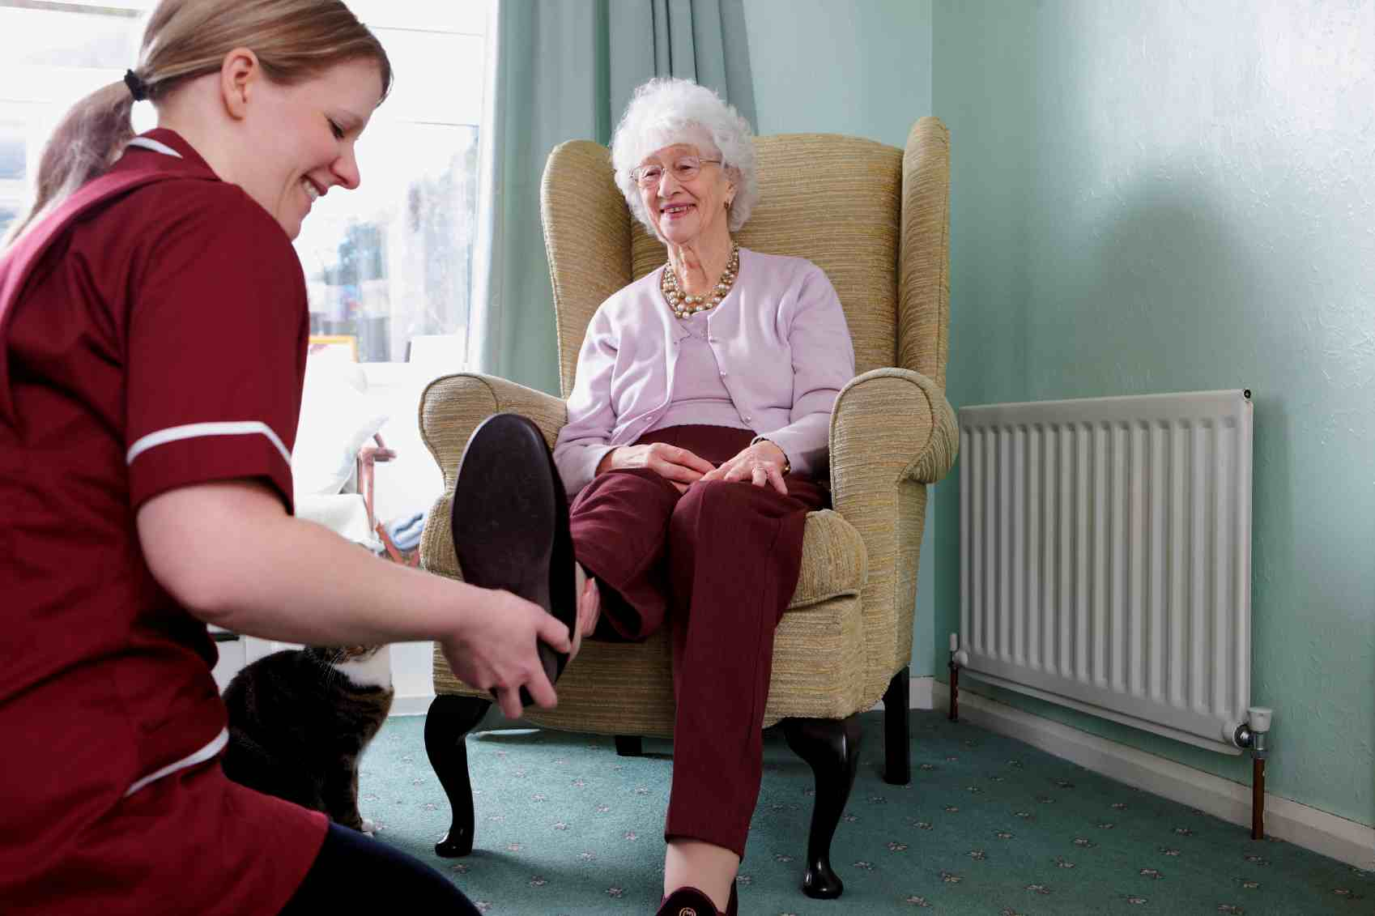
Support Services: Alzheimer’s
Support groups
Wellness programs
Care services
Legal, financial services
Residential care
Transportation
Adult day care
¹⁰ U.S. Administration on Aging. (2011) Dementia Capability Toolkit.
¹¹ ACT on Alzheimer’s. Dementia Capable Community: Key Elements & Resources. Accessed August 4, 2015 from website: http://www.actonalz.org/elements-and-resources
Notes:
Individuals with Alzheimer’s and dementia may require varying levels of care and support from numerous sources, including:
Support groups and socialization programs: aimed at persons with mild (early) stage Alzheimer’s disease, these groups can help with planning for future needs and provide general guidance and support for individuals and caregivers
Wellness programs: includes nutrition and physical activity programs, physical/occupational/speech therapy; may also include opportunities for cognitive activity, such as creative arts or intergenerational connections
Care services: includes care managers, chore services, home safety, personal care assistant
Legal or financial services: financial, health care, and end-of-life planning
Residential care: includes living options with varying levels of care, such as independent living communities, assisted living residences, and nursing homes tailored to people with dementia
Transportation: includes safe driving supports and individual and group transportation options
Adult day care: care for individuals who require regular supervision: allowing people to socialize, participate in activities, and provide opportunities for caregivers to work or fulfill other responsibilities

Slide 17
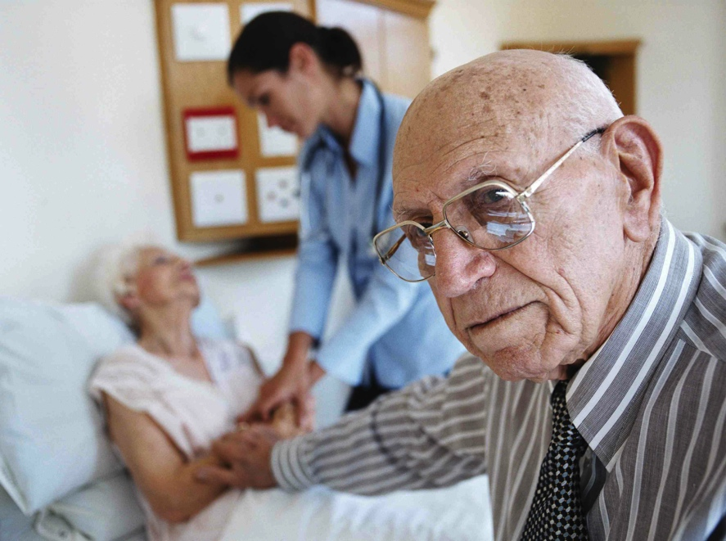
Support Services: Caregivers
Education/information/training
  Alzheimer’s/dementia
  Behavioral management
  Available resources
  Self-care
Counseling/support
groups
Care management
Respite services
¹² ACT on Alzheimer’s. (2014). Alzheimer’s Disease Curriculum, Module X: Caregiver Support.
Notes:
Support services and programs that have been found to be most effective for caregivers include multiple components to address different needs:
Education/information/training:
Alzheimer’s and dementia and its effects on behavior
Behavioral management/problem solving training: designed to train caregivers to use specific techniques to manage behaviors that can be challenging (such as agitation, repetition, aggression, wandering)
Information on the availability of resources
Self-care, such as stress management, using respite services
Counseling/support groups:
Individual and family counseling
Support groups that have been found to have the most positive outcomes focus on specific objectives, such as teaching certain skills or strategies
Care management: helping to identify and manage care needs, coordinate across care systems and providers
Respite services: provides care for a person with Alzheimer’s disease on a temporary basis, providing time off for a family caregiver

Slide 18
Evidence-based Practice
Reducing Disability in Alzheimer’s Disease (RDAD) – University of Washington
  Focus on teaching family caregivers strategies
Minds in Motion (MIM)
  Focus on improving function in early stages with mild cognitive impairment
Skills2Care – Thomas Jefferson University
  Focus on occupational therapy based strategies for caregivers
  ¹³ Alliance for Aging Research. (2012) Translating Innovation to Impact: Evidence-based Interventions to Support People with Alzheimer’s Disease and their Caregivers at Home and in the Community.
Notes:
There are many examples of evidence-based programs for people with Alzheimer’s and dementia and their caregivers.
Reducing Disability in Alzheimer’s Disease (RDAD): The primary aims of the RDAD program are to teach family caregivers:
Strategies to decrease challenging behaviors related to Alzheimer’s and dementia, such as depression, anxiety, agitation, and aggression
Methods to engage in and encourage physical activity in order to reduce the physical disabilities that often results in a loss of independence
RDAD consists of 12 hourly sessions, conducted in participants’ homes over three months.
Minds in Motion (MIM): MIM is designed to improve or sustain cognitive and physical functioning in persons with mild (early) stage dementia or mild cognitive impairment (MCI). The group-based program, delivered in community settings, includes a variety of evidence-based components, including:
Cognitive training exercises
Physical exercises (Tai Chi and Qi Gong)
Creative/community involvement activities (writing, art, photography, etc.)
Skills2Care: An occupational therapy based intervention for caregivers and individuals with dementia living at home. The intervention is designed to reduce caregiver burden, improve caregiver ability to manage daily care challenges, and reduce behavioral symptoms and functional dependence in individuals with dementia. Caregivers are trained in five types of strategies:
Communication techniques
Environmental modification
Task simplification
Use of activities to engage individuals with dementia
Self-care

Slide 19
Discussion Question
What is the role of public health in connecting people to the services they need?
Notes:
Ask: What is the role of public health in connecting people to the services they need?

Slide 20
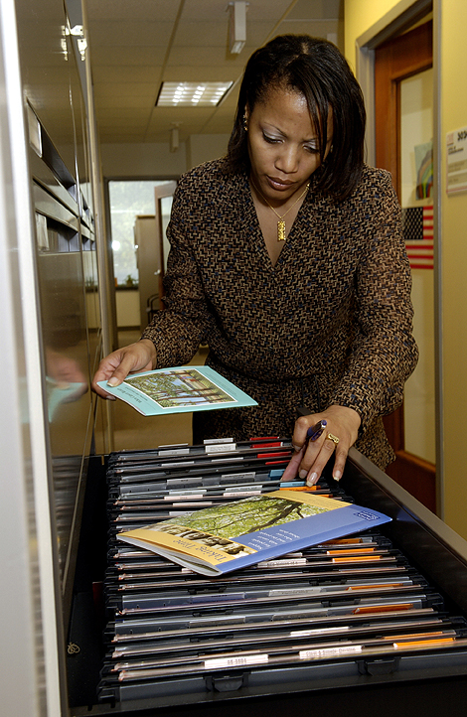
Support Services: Public Health
Evidence-based programs
and interventions
Information and referrals
Identifying service needs
Funding, space, expertise
Notes:
Public health may serve to provide, connect, and inform individuals, families, and caregivers about support services within clinical and community settings.
Public health agencies and organizations can:
Developing and disseminating evidence-based programs and interventions
Offer information and referrals to specific support services, programs, and sources of information
Assist in identifying service needs, helping people understand what is available and how they may use different services throughout the course of the disease
Provide funding, space, expertise, or other support for needed programs

Slide 21
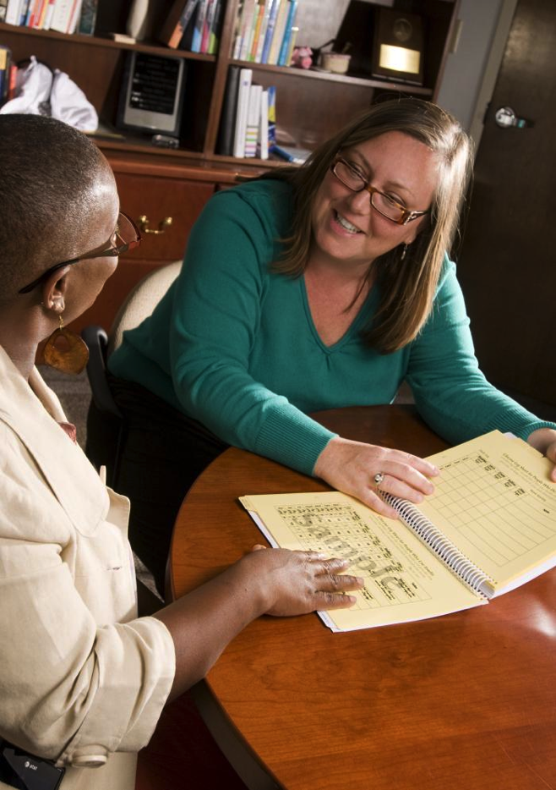
Support Services: Partnerships
Offices on Aging / Aging and Disability Resource Centers/ Area Agencies on Aging
  Education
  Cognitive assessments
  Support programs
  Resources
Non-profit organizations
Residential care facilities
¹⁵ ACT on Alzheimer’s. (2014). Alzheimer’s Disease Curriculum, Module X: Caregiver Support.
Notes:
Public health is also in a unique position to strengthen partnerships within the community to build dementia capable systems and ensure that needed services and resources are available.
Offices on Aging/Aging and Disability Resource Centers/Area Agencies on Aging can partner with local public health departments to assess community needs, develop programs and supports, and provide referrals.
Staff may be knowledgeable about Alzheimer’s and dementia, offer cognitive assessments and family caregiver supports, and have information about resources and programs available in the community for individuals with dementia and their families.
Non-profit organizations such as the Alzheimer’s Association have experts in the field of dementia care with a wide variety of information and educational materials and programs to support individuals, families and caregivers.
Other non-profits, such as faith-based organizations and civic groups, can be partners that may co-sponsor educational events, distribute information, offer services, provide a place for caregiver support groups to meet, etc.
Residential care facilities may be able to reach out to other health care and business partners in the community to promote awareness, support program development, and initiate dementia friendly policies.

Slide 22
Workforce training
Dementia Capable Systems and dementia friendly communities
Notes:
Public health may also play a key role in training the workforce – professionals in health related fields as well as others – to better understand, identify, and respond to individuals with Alzheimer’s and dementia and their caregivers.

Slide 23
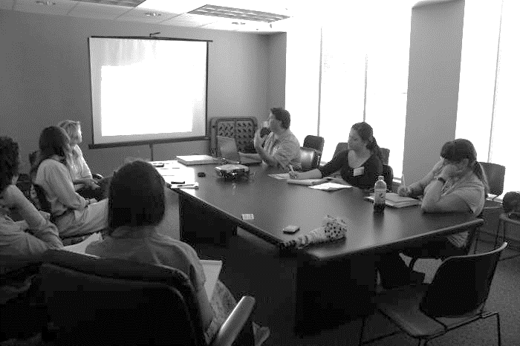
Workforce Training
Health care
Direct care
Public health
First responders
Other support services: transportation, customer service, faith-based organizations
Notes:
Certain professions may provide service and support to people with Alzheimer’s disease and their caregivers in a variety of ways.
The workforces that would benefit from training and education include:
Health care workforce: including primary care physicians, specialists (neurologists, geriatricians, psychiatrists), nurses, community health workers, social workers, psychologists, pharmacists, dentists, etc.
Direct care professionals: the workforce that provides the majority of the paid daily care (such as helping with bathing, dressing, housekeeping, food preparation, etc.) for people with Alzheimer’s and dementia; includes nurse aides, home health aides, and personal and home-care aides
Public health workforce
First responders: including law enforcement, fire, emergency response teams, emergency medical technicians (EMTs), and adult protective services
Other professions: including transportation, customer service, and faith-based or spiritual communities
Each of these will be discussed in more detail.

Slide 24
Discussion Question
What training should health care and direct care professionals receive?
Notes:
Ask: What training should health care and direct care professionals receive?

Slide 25

Workforce Training:
Health Care & Direct Care
Basics of dementia
Benefits of early diagnosis
How to address physical,
cognitive, emotional,
behavioral symptoms
Assisting caregivers
Managing co-morbidities
Use of validated assessment tools (health care)
Notes:
The health care and direct-care workforces need training and education on identifying and caring for someone with Alzheimer’s and dementia including:
The basics of dementia, including recognizing early warning signs
The benefits of early diagnosis
How to address the physical, cognitive, emotional, and behavioral symptoms of the disease
How to assist caregivers as they cope with the physical and emotional aspects of their caregiving responsibilities
Management of co-morbidities (such as arthritis, diabetes, and heart disease)
The availability and use of tools and guidelines to identify dementia, including validated cognitive assessment tools (health care providers)

Slide 26
Discussion Question
What training should public health professionals receive?
Notes:
Ask: What training should public health professionals receive?

Slide 27

Workforce Training: Public Health
Alzheimer’s as a public health priority
Importance of early detection
Cognitive health and risk reduction
Caregiver needs and burden
Surveillance
Health disparities
Unique issues (stigma, abuse, advance planning)
Notes:
Public health plays a key role in surveillance, education, and prevention related to Alzheimer’s disease.
Training and education priorities for public health include:
Understanding Alzheimer’s disease as a public health priority
The importance of early detection
Cognitive health and risk reduction for Alzheimer’s
Types and availability of resources and supports for individuals with Alzheimer’s and dementia
Needs and burden of caregivers
Tracking surveillance data on cognitive decline and caregiving
Health disparities related to Alzheimer’s and dementia
Issues unique to Alzheimer’s and dementia, including stigma, potential for abuse, and the need for advance planning

Slide 28
Discussion Question
What training should first responders receive?
Notes:
Ask: What training should first responders receive?

Slide 29
Workforce Training: First Responders
Situations involving stress or fear
Training needs:
  Identifying Alzheimer’s and dementia
  Interaction/communication
  Resources
  Registries, technologies
Notes:
First responders such as police, emergency medical personnel, and fire fighters may have first-hand contact with individuals with Alzheimer’s and other dementias during situations that involve stress or fear, such as:
Wandering, being lost or disoriented
Natural or other disasters that may displace individuals with Alzheimer’s and/or separate them from their usual caregivers
Being subjected to physical or financial abuse
Being reported to law enforcement for improper behavior, such as leaving a place of business after forgetting to pay for purchase
First responders and law enforcement need training on:
How to identify someone with Alzheimer’s and dementia
How to interact and communicate with people with Alzheimer’s in various situations (especially ones that are stressful for the person)
Resources to call upon for assistance or information
Existence of special needs registries or other technologies that may assist in locating individuals or their places of residence

Slide 30
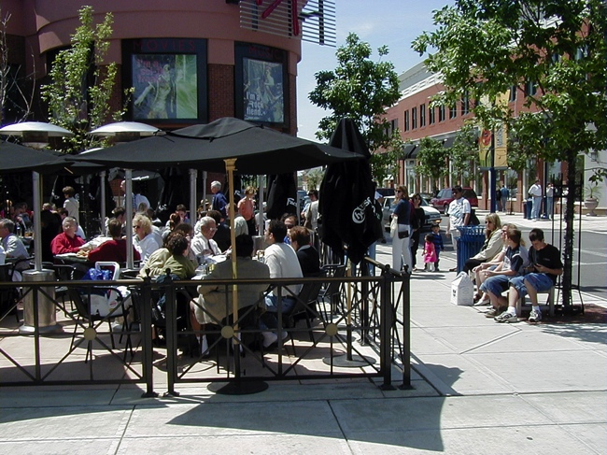
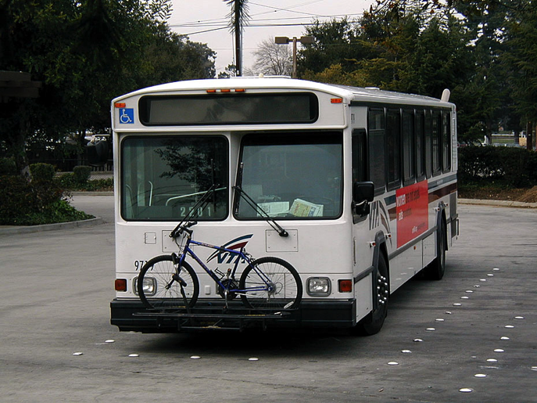
Workforce Training: Other Professions
Public transportation, customer service, faith or spiritual communities, etc.
  Awareness
  Recognizing need for help
  Resources
  Communication
  Ways to assist and support
Notes:
Many other professions come into contact with people with Alzheimer’s disease and require different levels of information:
Public transportation: For individuals with dementia, navigating public transportation can be very challenging.
Operators and drivers need to be aware of the special challenges faced by individuals with dementia, as well as how to recognize the signs that someone may need help.
Customer service: Those in service positions may be trained to recognize when they are dealing with someone with possible Alzheimer’s and dementia and how to best communicate with them and meet their needs.
Faith or spiritual communities: These communities can be an important source of support and engagement for people with dementia, their families, and their caregivers.
Church liaisons and volunteers may be trained to assist and support community members living with dementia.

Slide 31
Dementia friendly communities
Dementia Capable Systems and dementia friendly communities
Notes:
Many of the issues discussed in this module tie into the concept of dementia friendly communities.
This is growing movement in which communities in the U.S. and around the world are intentionally making changes to ensure that their communities are not only safe for and accessible to people with Alzheimer’s and dementia, but also that they can support and empower people with Alzheimer’s and dementia to continue living high-quality lives with as much independence as possible.

Slide 32
Discussion Questions
Imagine you or someone you care about has Alzheimer’s or dementia.
What might be some of your concerns or fears about going out in your community?
How could those be addressed at a community level?
Notes:
Ask: Imagine you or someone you care about has Alzheimer’s or dementia.
What might be some of your concerns or fears about going out in your community?
How could those be addressed at a community level?
Open responses.

Slide 33

Dementia Friendly Communities
Health care, community services, resources
Safety and accessibility
  Transportation
  Mobility
Respectful and supportive
Public education and
workforce training
Technology
  GPS, GIS
  Registry
²¹ U.S. Administration for Community Living/Administration on Aging. (2014) Dementia-Capable States and Communities: The Basics.
²² The Gerontological Society of America. (2015) Dementia Friendly, Dementia Capable, and Dementia Positive: Concepts to Prepare for the Future.
Notes:
In dementia friendly communities, people with dementia and their family and caregivers are understood, respected and supported, and able to continue to engage with and contribute to their community. The effort to become dementia friendly is made on a community-wide basis and requires planning and participation from all sectors as well as the general public. While overlap exists between the concepts of dementia capable (discussed previously) and dementia friendly, a dementia friendly community encompasses a broader goal of supporting a higher quality of life for people with dementia beyond simply meeting their physical and health needs. Elements of a dementia friendly community include:
Access to quality health care and community services. While encompassing the same aspects of dementia capable systems, dementia friendly communities offer:
Resources and supports that are geographically, financially, and culturally available and accessible.
Support services and activities, such as education sessions regarding symptoms, disease processes, self-care, and providing care, as well as support groups and dementia friendly social events that are readily available throughout the community.
Ensure safety and accessibility: People can live safely, with as much independence as possible.
This concept includes public transportation, walkability for leisure and to complete daily tasks, minimizing confusion when moving from place to place, and ensuring safety.
Mobility considerations may include:
Age-friendly pavements
Adequate signage
Safe pedestrian crossings
Trained safety personnel
Welcoming open spaces, including squares, parks, and playgrounds
Public education and workforce development: In these communities, residents, agencies, businesses, health care facilities, places of worship, and general service providers are learning about dementia through education and awareness efforts, and providing assistance to people with the condition and their caregivers as they go about their daily lives.
Technology may also play a role in the creation of dementia-friendly communities:
Geographic Information Systems (GIS) and Global Positioning Systems (GPS) can help people navigate their community while still allowing family or caregivers to track their whereabouts.
Community registry: Law enforcement can also create a voluntary registry for individuals with dementia.
The registry provides the name, home address, and contact information for family members or care partners should the individual with dementia need help or become involved with law enforcement.
International community models differ slightly from those in the U.S. in that internationally, a more holistic approach is often taken, while in the U.S., communities lean more on a practical and structural approach, gradually ensuring all systems and services within the community are designed to support members living with dementia and their care partners. In the following slides, we will look at some examples of communities and organizations working to become dementia friendly

Slide 34
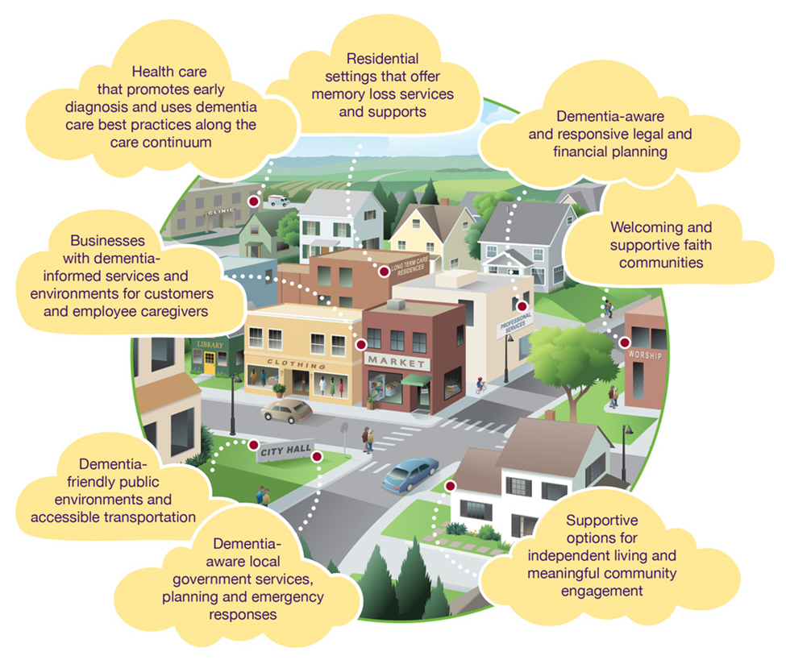
Dementia Friendly Communities
Reproduced from ACT on Alzheimer's® developed tools and resources.
Notes:
ACT on Alzheimer’s is a state-wide collaboration in Minnesota. We will learn more about the organization a few slides later. Here is an infographic that illustrates ACT on Alzheimer’s view on what a dementia-friendly community involves:
Raising awareness about Alzheimer’s, transforming attitudes, and moving people to action
Supporting family and friend caregivers by providing accessible information, resources, and in-person support
Promoting meaningful participation in community life for everyone
Including communities that experience inequities because of race, ethnicity, culture, language, sexual orientation, gender identity, mental illness, hearing/sensory differences, intellectual or physical abilities, and economic status

Slide 35
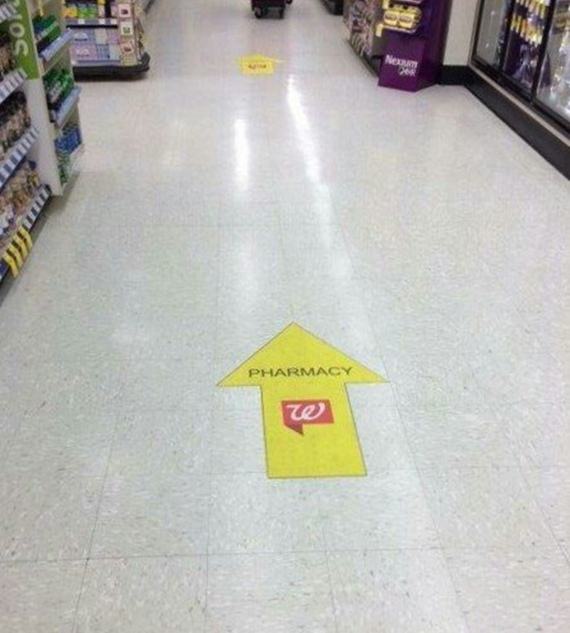
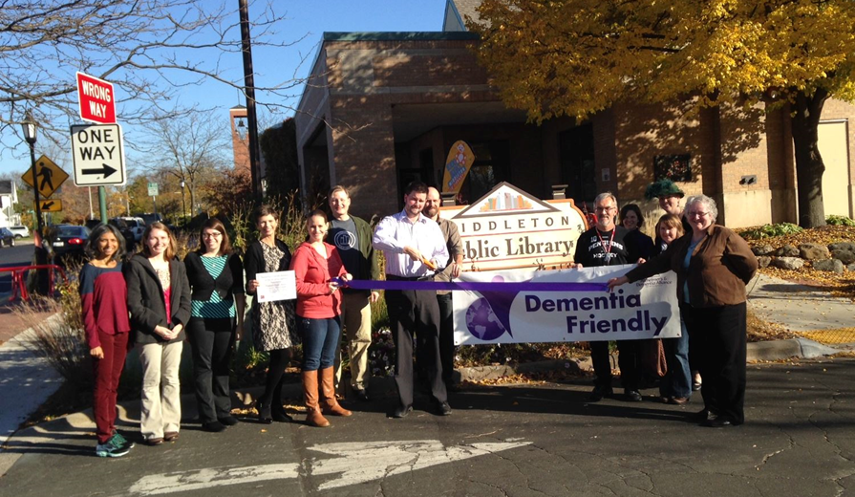
Dementia Friendly: Middleton, WI
Business trainings
Business promotions
Memory trail/park
Evaluation criteria
²⁴ Wisconsin Healthy Brain Initiative. A Tool Kit for Building Dementia-Friendly Communities
²⁵ Alzheimer’s and Dementia Alliance of Wisconsin. Dementia Friendly Community. http://www.alzwisc.org/Dementia%20Friendly.html
Notes:
The Alzheimer’s & Dementia Alliance of Wisconsin (ADAW) started a pilot dementia friendly program in Middleton, Wisconsin, in January 2014.
They brought together a group of citizens, business members, and city staff to launch the program, where they developed guidelines for businesses and organization to meet in order to be designated “dementia friendly”:
Complete DFC training for management and 50% of their front-line employees
Designate a team leader to be liaison between their organization and the DFC task force
Be open to discussions regarding environment changes (e.g. lighting, signage, layout, etc.)
Be willing to share DFC training materials with any new hires and all employees that did not attend training
Undergo an on-site visit/follow-up training on an annual basis to recertify its dementia friendly status
Dementia friendly organizations are given a window decal depicting a purple angel to display, allowing residents to easily identify participating locations. All city management departments are involved in the effort, including first responders. Middleton’s local library, one establishment that has taken the steps to become designated dementia friendly, offers dementia-focused community programs such as a Music and Memory class. The local Walgreens also earned the dementia-friendly label and has improved signage throughout their stores as well as trained their employees on how to interact successfully with their customers with dementia. Banks, restaurants, local shops, and groceries are also trained. ADAW is looking forward to expanding their dementia friendly training to personal service providers, such as beauticians and barbers, and even dentists. They are now working with other communities in Wisconsin to support them as they become dementia friendly.
Visit: http://www.alzwisc.org/Dementia%20Friendly.html for more information

Slide 36

Dementia Friendly: ACT on Alzheimer’s
Minnesota’s statewide,
volunteer-driven collaboration
Community toolkit
  Form action team
  Assess community strengths and gaps
  Analyze needs and develop action plan
  Pursue priority goals
  ²⁶ ACT on Alzheimer’s. (2013). Is Your Community Prepared?
Notes:
ACT on Alzheimer’s is a statewide, volunteer-driven collaboration in Minnesota focused on preparing communities to respond to the growth of their populations with Alzheimer’s and dementia. The goal is to create a community that raises awareness about Alzheimer’s, transforms attitudes, and moves people to action; supports family and friend caregivers by providing accessible information, resources, and in-person support; promotes meaningful participation in community life for everyone; and includes communities that experience inequities because of race, ethnicity, culture, language, sexual orientation, gender identity, mental illness, hearing/sensory differences, intellectual or physical abilities, and economic status. Currently, 35 communities across the state participate in the initiative.
The process follows four action phases:
Convene key community leaders and members to form an action team
Assess strengths and gaps within the community related to dementia-friendly aspects
Analyze community needs and develop action plans to respond
Launch action plans
ACT on Alzheimer’s released a toolkit that is available for use by communities to create dementia-friendly environments. The toolkit includes sector specific training guides, such as those targeted toward businesses, finance, legal, and local government entities. Additionally, ACT offers a “Dementia Friendly @ Work” in-person training session to teach businesses and organizations about dementia and how they can take action to create an environment that is safe, respectful and welcoming for those with dementia. Those who complete the training are given posters, media materials and window stickers recognizing them as “dementia friendly”.
Visit: http://actonalz.org/ for more information

Slide 37

Dementia Friendly America (DFA)
Raising awareness about dementia
Supportive options that foster quality of life
Supporting caregivers and families
Meaningful participation in community life
Reaching the underserved
²⁷ Dementia Friendly America press release, Dementia Friendly America Initiative Launches in Communities Across the U.S., from Maryland to California, July 13, 2015.
Notes:
The Dementia Friendly America (DFA) initiative is a national effort to equip all sectors of the community to support people with dementia and their caregivers and family.
The focus of DFA includes:
Raising awareness about dementia and transforming attitudes and understanding of the conditions
Having supportive options that foster quality of life on a community level
Supporting caregivers and families
Promoting meaningful participation in the community by people with dementia and their caregivers
Reaching those in the community who are underserved
DFA is modeled after the community process developed by Minnesota’s ACT on Alzheimer’s. They provide a “Dementia Friendly Toolkit”, sector specific guides, healthcare provider practice tools, and training videos for their partner communities to utilize as those communities work to become dementia-friendly. In 2015, 7 communities launched DFA’s initiative, and another 80 communities across 30 states are looking to join them in 2016.
Visit: http://www.dfamerica.org for more information

Slide 38
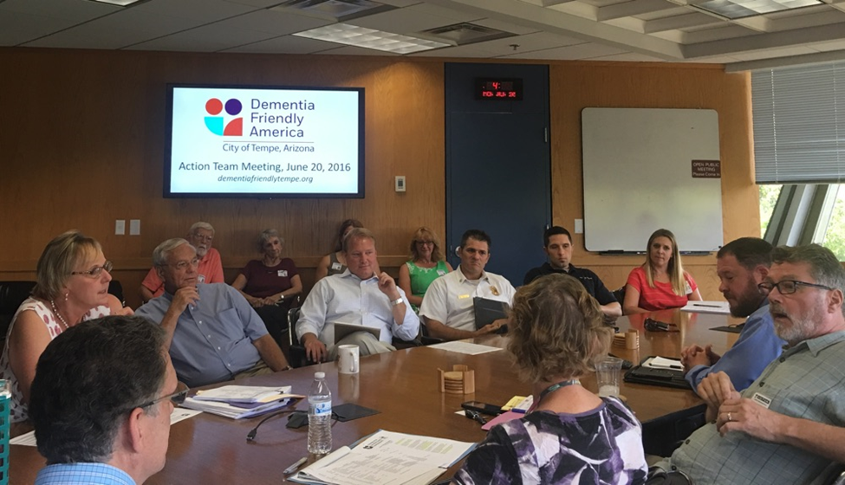
Dementia Friendly TEMPE
Arizona’s first dementia friendly city
Formed Action Team led by Chamber of Commerce
Weekly Memory Café at library where people with dementia and caregivers can meet others
“Dementia Friends” training to
educate community on how
to support dementia friendly efforts
²⁸ Dementia Friendly America press release, Dementia Friendly America Initiative Launches in Communities Across the U.S., from Maryland to California, July 13, 2015.
Notes:
Dementia Friendly Tempe (DFT), an initiative utilizing the Dementia Friendly America framework, is Arizona’s first dementia-friendly city. The effort was initiated in 2015 by Tempe’s mayor, Mark Mitchell, after his mother was diagnosed with Alzheimer’s, and has since gained community-wide and legislative support. While still in the planning stages, Tempe has made significant progress:
Held a successful kickoff summit in the community (see YouTube video below)
Held Action Team meetings led by the Chamber of Commerce, where they are reviewing results of a survey given to sectors across the community to assess needs. Once the data review is completed, the Action Team will develop a strategic plan. Additionally, the Action Team is expecting to conduct environmental assessments of public spaces.
Hired a coordinator for the DFT initiative to be housed in City Hall to more closely align with the Mayor’s office.
Launching a weekly Memory Café at the Tempe Library, where people with dementia and their care partners can meet others in the community in like situations. The Café will be staffed by a professional who can answer questions, provide/direct access to resources and learn what participants hope to get from attending. Additionally, a monthly arts engagement program will be offered within the Café setting. The City of Tempe is handling the promotion of the event.
Holding monthly community lectures at the Tempe Library that will include a variety of topics regarding dementia.
Plans in place to launch “Dementia Friends” training to educate community members on how they can contribute to the dementia friendly efforts.
Visit http://www.dementiafriendlytempe.org for more information
Video supplement: Video highlighting Tempe’s Initiative
https://www.youtube.com/watch?v=3zJOFQaUBAY

Slide 39
Conclusion: Dementia Capable and dementia friendly
States/communities play significant role
Dementia capable systems
  Public health research and translation
  Support services and programs
  Workforce training
Dementia friendly communities
Notes:
In conclusion, let’s review the key points from this presentation. States and communities play an active role in reducing the burden of the Alzheimer’s and dementia epidemic. Two approaches are by creating dementia capable systems and dementia friendly communities. The concepts are similar and can overlap, but the focus of both is on accommodating those with dementia and their caregivers through providing support and services within their communities.
Public health must take an active role in fostering dementia capable systems and dementia friendly communities through:
Conducting public health research on the burden of Alzheimer’s and dementia, and use findings to design effective programs, policies, and best practices
Serving to provide, inform and connect individuals and caregivers to support services and programs
Designing and implementing workforce training to ensure workers across a wide range of professions are able to identify and meet the needs of people with Alzheimer’s and dementia
Supporting the creation of dementia friendly communities that help people with Alzheimer’s and dementia remain safe and as independent as possible

Slide 40
For More Information
For more information, please visit the Alzheimer’s Association website at: http://www.alz.org
Notes:
For more information on the topics covered in this presentation, please go to the Alzheimer’s Association website at www.alz.org. There you can find resources, latest research and information.

