Slide 1
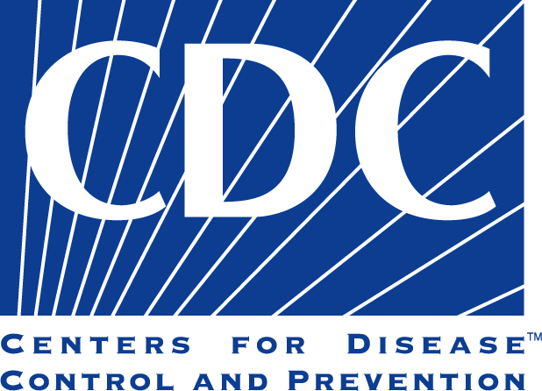
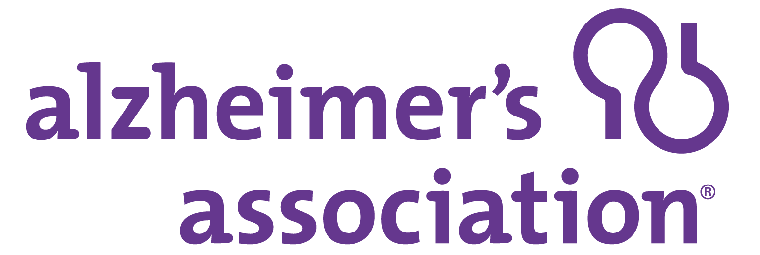
A Public Health Approach to Alzheimer’s and Other Dementias
Alzheimer’s Disease –
A Public Health Crisis
Notes:
DISCLAIMERS
This publication was supported by Cooperative Agreement Number 5U58DP002945-05, funded by the Centers for Disease Control and Prevention. Its contents are solely the responsibility of the authors and do not necessarily represent the official views of the Centers for Disease Control and Prevention or the Department of Health and Human Services.
The mark "CDC” is owned by the US Dept. of Health and Human Services and is used with permission. Use of this logo is not an endorsement by HHS or CDC of any particular product, service, or enterprise.
Talking Points:
This presentation entitled, Alzheimer’s Disease – A Public Health Crisis, is part of a curriculum for public health students entitled, A Public Health Approach to Alzheimer’s and Other Dementias. It was developed by the Emory Centers for Training and Technical Assistance for the Alzheimer’s Association with funding from the Centers for Disease Control and Prevention.
During this module we will discuss the epidemic of Alzheimer’s and other dementias, and why it is an important issue for public health to understand and act on.

Slide 2
Learning Objectives
Provide a general description of dementia and Alzheimer’s disease
Explain the current and projected scope of the epidemic
Discuss the cost burden of Alzheimer’s for federal/state governments and individuals/caregivers
Describe the care burden of Alzheimer’s, including caregivers and the health care system
Identify health disparities related to Alzheimer’s and other dementias
Explain why public health must play a role in addressing the Alzheimer’s epidemic
Notes:
By the end of the presentation, you will be able to:
Provide a general description of dementia and Alzheimer’s disease
Explain the current and projected scope of the epidemic
Discuss the cost burden of Alzheimer’s for federal/state governments and individuals/caregivers
Describe the care burden of Alzheimer’s, including caregivers and the health care system
Identify health disparities related to Alzheimer’s and other dementias
Explain why public health must play a role in addressing the Alzheimer’s epidemic

Slide 3
COMPETENCIes
Association for Gerontology in Higher Education (AGHE):
1.3.3 Demonstrate knowledge of signs, symptoms, and impact of common cognitive and mental health problems in late life (e.g., dementia, depression, grief, anxiety).
Association of Schools and Programs of Public Health (ASPPH):
Domain 1: Discuss major local, national, and global health challenges.
Council on Linkages Between Academia and Public Health Practice:
2A. Identifies current trends (e.g., health, fiscal, social, political, environmental) affecting the health of a community.
National Association of Chronic Disease Directors (NACDD):
Domain 7: Articulate key chronic disease issues.
National Commission for Health Education Credentialing, Inc. (NCHEC):
7.1.1 Identify current and emerging issues that may influence health and health education.
Notes:
The content in this presentation supports the development of the following competencies:
Association for Gerontology in Higher Education (AGHE):
1.3.3 Demonstrate knowledge of signs, symptoms, and impact of common cognitive and mental health problems in late life (e.g., dementia, depression, grief, anxiety).
Association of Schools and Programs of Public Health (ASPPH):
Domain 1: Discuss major local, national, and global health challenges.
Council on Linkages Between Academia and Public Health Practice:
2A. Identifies current trends (e.g., health, fiscal, social, political, environmental) affecting the health of a community.
National Association of Chronic Disease Directors (NACDD):
Domain 7: Articulate key chronic disease issues.
National Commission for Health Education Credentialing, Inc. (NCHEC):
7.1.1 Identify current and emerging issues that may influence health and health education.

Slide 4
Alzheimer’s – Public Health Crisis
Historically viewed as aging or medical issue
Impact at national, state, and local level
Multi-faceted approach needed
¹Alzheimer’s Association and Centers for Disease Control and Prevention. (2011) The CDC Healthy Brain Initiative: Progress 2006–2011.
Notes:
For many years after its discovery in 1906, Alzheimer’s disease was primarily viewed through the lenses of medical care and aging.
There are valid reasons for this. Medical care is an essential component of identifying and treating individuals with Alzheimer’s disease, which primarily affects older populations. Aging services such as nursing homes and programs aimed at assisting seniors are often a vital source of support for people with Alzheimer’s and other dementias.
Yet Alzheimer’s disease affects more than just the individual and his or her medical and support team.
The impact of Alzheimer’s disease is felt at national, state, and local levels – as well as a family and personal level – through financial burdens, resource needs, and professional requirements. It is a growing epidemic that has profound social and economic implications, especially given the current trends of an aging population.
As more is learned about Alzheimer’s disease and its impact, it becomes clear that a multi-faceted response by health care sector, government, public health and within communities is vitally important to address the growing crisis within the U.S. and throughout the world.

Slide 5
What Is Dementia?
General term for decline in mental ability severe enough to interfere with daily life
Affects memory, thinking ability, social ability
Many dementias are progressive
²Alzheimer’s Association. What is Dementia? Accessed June 8, 2015 from website: http://www.alz.org/what-is-dementia.asp#causes ³National Institute on Aging. (2015) Alzheimer’s Disease Fact Sheet.
Notes:
It is first important to understand what characterizes dementia.
Dementia is a general term for a decline in mental ability severe enough to interfere with daily life.
Dementia is not a specific disease. It is an overall term that describes a wide range of symptoms associated with a decline in memory or other thinking skills.
Many dementias are progressive, meaning that symptoms start out slowly and gradually get worse. In the most severe stages of dementia, a person must depend on others for basic activities of daily life.

Slide 6
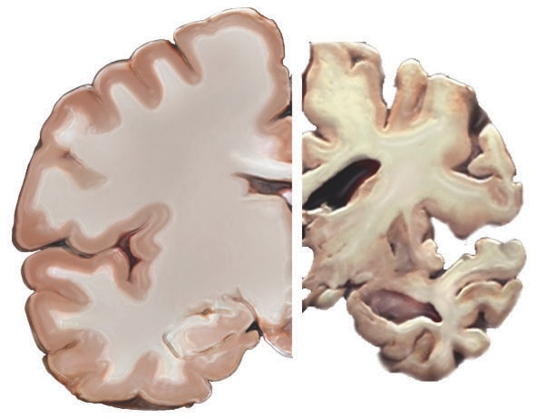
What Is Alzheimer’s Disease?
Most common type of dementia
Accounts for 60%-80% of cases
Irreversible, progressive brain disorder
Slowly destroys memory, thinking skills, and ability to carry out basic functions
⁴Alzheimer’s Association. What is Dementia? Accessed June 8, 2015 from website: http://www.alz.org/what-is-dementia.asp#causes ⁵National Institute on Aging. (2015) Alzheimer’s Disease Fact Sheet.
Notes:
Certain brain diseases and conditions cause dementia. Alzheimer’s disease is the most common type of dementia. It accounts for an estimated 60% to 80% of cases.
Alzheimer’s disease is an irreversible, progressive brain disorder that slowly destroys memory and thinking skills, and eventually the ability to carry out basic functions.
There are currently no known ways to prevent, cure, or slow the progression of Alzheimer’s disease.
*Note: The image on the slide shows a healthy brain (left side) as compared to a severe Alzheimer’s brain (right side). The Alzheimer’s brain is significantly smaller than the healthy brain.
Video supplement: “What is Alzheimer's disease?” TedEd.
Link: https://www.youtube.com/watch?v=yJXTXN4xrI8

Slide 7
Scope of the Epidemic
Alzheimer’s Disease – A Public Health Crisis
Notes:
Now that you have a basic understanding of Alzheimer’s and dementia, we will turn to how widespread these conditions are.

Slide 8
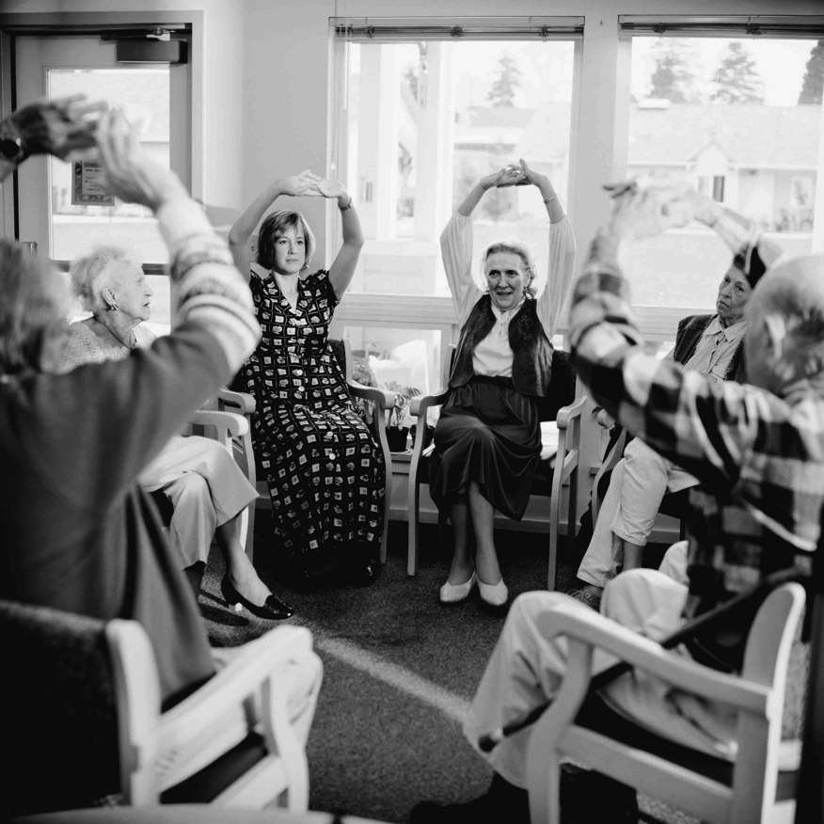
Scope of the Epidemic (U.S.)
Over 5 million adults
1 in 9 adults age ≥65
1 in 3 adults age ≥85
2/3 are women
⁶Alzheimer’s Association. 2016 Alzheimer’s Disease Facts and Figures.
Notes:
Alzheimer’s disease must be considered a public health crisis. There are many reasons for this.
First, the burden is large - and it is growing. Today, over 5 million adults in the U.S. are living with Alzheimer’s disease, including an estimated 200,000 under the age of 65.
One in nine adults age 65 and older (11%) currently has Alzheimer’s disease; approximately one in three (32%) people age 85 and older has the disease.
Women make up almost 2/3 of seniors living with Alzheimer’s disease in the U.S.

Slide 9
Health Disparities
African-Americans and Hispanics have higher rates:
African-Americans 2 times more likely
Hispanics 1.5 times more likely
⁵Alzheimer’s Association. (2013) Alzheimer’s and Public Health Spotlight: Race, Ethnicity & Alzheimer’s Disease.
Notes:
The rates of Alzheimer’s and other dementias also reveal certain health disparities.
In the U.S., African-Americans and Hispanics have higher rates of Alzheimer’s and other dementias than people of other races and ethnicities.
In the United States, older African-Americans are about two times more likely than older whites to have Alzheimer’s and other dementias.
Older Hispanics are about one and one-half times more likely than older whites to have these conditions.
Large proportional increases are also expected in both of these populations in the U.S., which will contribute significantly to the growth of the epidemic.
Limited data exists about the prevalence of Alzheimer’s disease in other racial and ethnic groups, including Asian Americans and American Indians.

Slide 10
Alzheimer’s Deaths
6th leading cause of death
5th leading cause among adults age ≥65
Deaths increased 71% from 2000-2013
Only cause of death among top 10 that cannot be prevented, cured, or slowed
⁷Alzheimer’s Association. 2016 Alzheimer’s Disease Facts and Figures.
Notes:
Alzheimer’s disease is the 6th leading cause of death in the United States and the 5th leading cause of death for those aged 65 and older.
Deaths from Alzheimer’s disease increased 71% from 2000 to 2013, while deaths from other major diseases (including stroke, breast and prostate cancer, and HIV/AIDS) decreased.
Alzheimer’s disease is the only cause of death among the top 10 in America that cannot currently be prevented, cured, or even slowed.

Slide 11
Changes in SELECTED Causes of Death (all Ages) between 2000-2013
⁸ Alzheimer’s Association. 2016 Alzheimer’s Disease Facts and Figures.
Notes:
Compared to other top causes of death in the U.S., deaths from Alzheimer’s have increased significantly, while deaths from others have declined.
From 2000 to 2013, the percentage changes in deaths are as follows:
HIV: declined by 52%
Stroke: declined by 23%
Heart disease: declined by 14%
Influenza/pneumonia: declined by 13%
Prostate cancer: declined by 11%
Breast cancer: declined by 2%
Alzheimer’s disease: increased by 71%

Slide 12
Growing Epidemic
By 2030, population age ≥65 expected to double
By 2050, 13.8 million with Alzheimer’s
Today, one new case every 67 seconds
By 2050, every 33 seconds
¹⁰Alzheimer’s Association. 2016 Alzheimer’s Disease Facts and Figures. ¹¹Alzheimer’s Association. (2011). Generation Alzheimer’s: The Defining Disease of the Baby Boomers.
Notes:
The number of people living with Alzheimer’s and other dementias will continue to grow each year, as the number and proportion of the U.S. population age 65 and older continues to increase rapidly.
The cause of the increase can be attributed to people living longer and the large increase in the number of people over age 65 (baby boomers).
By 2030, the U.S. population aged 65 and over is expected to double.
By 2050, the number of Americans living with Alzheimer’s disease is expected to total 13.8 million, and could be as high as 16 million.
Today, someone in the U.S. develops Alzheimer’s every 67 seconds. By 2050, that rate is expected to increase to one person every 33 seconds.

Slide 13
Worldwide Epidemic
Over 47 million with dementia (including Alzheimer’s) in 2015
Projected to double every 20 years:
76 million in 2030
145 million in 2050
New case of dementia every 4 seconds
¹²World Health Organization. (2016). Report by the Secretariat. EB139/3
Notes:
Worldwide, the total number of people with dementia (including Alzheimer’s disease) is estimated at over 47 million.
This number is projected to nearly double every 20 years to 76 million in 2030 and 145 million in 2050.
The total number of new cases of dementia each year worldwide is nearly 7.7 million, which equates to one new case every four seconds.

Slide 14
Financial burden
Alzheimer’s Disease – A Public Health Crisis
Notes:
The escalating Alzheimer’s disease epidemic has profound implications for government budgets.

Slide 15
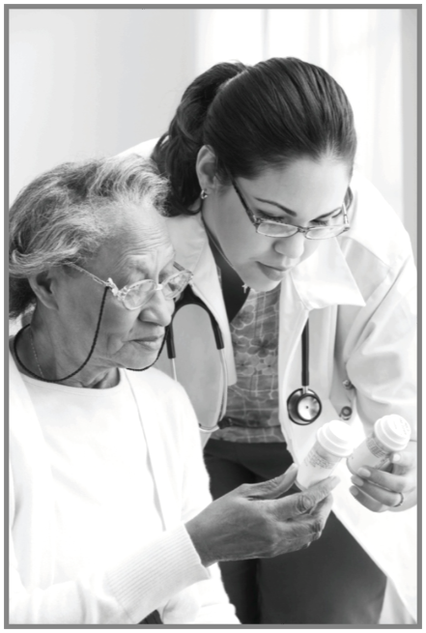
Financial Burden: U.S. & Worldwide
Alzheimer’s is the most expensive disease in US
Annual cost of direct care over $200 billion
Worldwide annual costs exceed $818 billion (2015)
¹³ Alzheimer’s Association. 2016 Alzheimer’s Disease Facts and Figures.
¹⁴ Alzheimer’s Disease International. World Alzheimer Report 2015: The Global Impact of Dementia: An analysis of prevalence, incidence, cost and trends
Notes:
Alzheimer’s disease is the most expensive disease to treat and provide care for in the U.S., costing more than heart disease and cancer.
In the U.S. the annual costs of direct care for people with Alzheimer’s disease exceed $200 billion. “Direct care” includes both paid health care and long-term care. It does not include caregiving (an essential part of Alzheimer’s care), which will be discussed later in the module.
Worldwide, the annual costs of Alzheimer’s and other dementias are estimated to be over $818 billion.

Slide 16
Discussion Question
What are Medicare and Medicaid?
Notes:
First, we’ll start by looking at the Alzheimer’s disease burden on two federally-funded health care programs. What are Medicare and Medicaid?

Slide 17
Medicare & Medicaid
Medicare: federally-funded health insurance
Any U.S. citizen or legal permanent resident age ≥65
People under age 65 with certain disabilities or End-Stage Renal Disease
Medicaid: funded by federal and state governments
Helps with medical costs for some people with limited income and resources
¹⁵Department of Health and Human Services. (2015) What’s Medicare? What’s Medicaid?
Notes:
Alzheimer’s disease imposes a significant cost on federal and state budgets through Medicare and Medicaid.
Medicare is federally funded health insurance for people age 65 and older who are U.S. citizens or legal permanent residents, or people under 65 with certain disabilities or with End-Stage Renal Disease (kidney failure that requires dialysis or a kidney transplant).
Medicaid is a program funded by both federal and state governments to help with medical costs for some people with limited income and resources.
Medicare does not cover the cost of long term care for assisted living, nursing homes, or in-home care such as sitters or certified nursing assistants. Medicaid will cover the cost of nursing home care for low income individuals or once an individual has little personal assets remaining and/or may require that the majority of the individual’s monthly income go to cover nursing home care expenses.

Slide 18
Alzheimer’s: Medicare & Medicaid
Programs pay 70% of health and long-term costs of Alzheimer’s disease
Nearly 1 in 5 Medicare dollars
Per-person spending for those with Alzheimer’s:
Medicare: 3 times higher than average
Medicaid: 19 times higher than average
¹⁶Alzheimer’s Association. 2016 Alzheimer’s Disease Facts and Figures. ¹⁷Alzheimer’s Association. (2015) Costs of Alzheimer’s to Medicare and Medicaid.
Notes:
These facts underscore the significant costs facing Medicare and Medicaid as a result of the Alzheimer’s disease epidemic:
About 70% of the health and long-term care costs of caring for those with Alzheimer’s disease are paid for by Medicare and Medicaid.
In 2016, the Medicare and Medicaid government programs will spend an estimated $160 billion caring for those with Alzheimer’s and other dementias – 68% of total annual costs of these conditions.
Nearly one in every five Medicare dollars is spent on people with Alzheimer’s and other dementias.
Average per-person Medicare spending for those with Alzheimer’s and other dementias is three times higher than average per-person spending across all other seniors. Medicaid payments are 19 times higher.
People with Alzheimer’s and other dementias have high out-of-pocket costs. These costs are for Medicare and other health insurance premiums and for deductibles, copayments and services not covered by Medicare, Medicaid or additional sources of support.

Slide 19
Alzheimer’s: Projected Costs (2050)
Annual costs (US): over $1.1 trillion
Annual costs to Medicare: $589 billion (over 400% increase)
Out-of-pocket costs: $198 billion (350% increase)
Cumulative costs between 2015 and 2050: $20.8 trillion
¹⁸Alzheimer’s Association. 2016 Alzheimer’s Disease Facts and Figures.
Notes:
Just as the number of people with Alzheimer’s disease is projected to dramatically increase, so will the costs associated with their care.
If current conditions go unchanged, in 2050 the annual costs of treating Alzheimer’s disease in the US will be over $1.1 trillion (in 2016 dollars). Annual costs to Medicare will increase over 400% to $589 billion. This would represent nearly one in three Medicare dollars.
Out-of-pocket costs for individuals and families affected by Alzheimer’s and other dementias will increase about 350% from $44 billion in 2015 to $198 billion in 2050.
Cumulatively between now and 2050, total costs of caring for people with Alzheimer’s and other dementias will be $20.8 trillion. Nearly 70% of those costs will be paid by federal and state governments.

Slide 20
Care burden
Alzheimer’s Disease – A Public Health Crisis
Notes:
The care burden associated with the Alzheimer’s disease epidemic is also a significant and growing challenge.

Slide 21
Care Workforce
Caregivers (family or friends)
Health care providers
Paid care providers
Notes:
People with Alzheimer’s and other dementias are generally cared for by a network of family or friend caregivers, health care providers, and paid care providers (such as those who help with daily tasks and self-care).
Most individuals with Alzheimer’s disease have a primary caregiver – often a family member – who is crucial to ensuring appropriate care.
The type and scope of the care needed by people with Alzheimer’s disease changes throughout the course of the illness.

Slide 22
Alzheimer’s & Dementia Caregivers
83% of the care provided to older adults come from family members, friends or other unpaid caregivers
60% of people with Alzheimer’s live in home settings
Over 15 million caregivers (family and friends)
18 billion hours of unpaid care annually
Unpaid care valued at $221 billion (2015)
²⁰Alzheimer’s Association. 2016 Alzheimer’s Disease Facts and Figures
Notes:
In the US, 83% of the care provided to older adults come from family members, friends or other unpaid caregivers.
About 60% of people with Alzheimer’s disease live in home settings with the vast majority of their care provided by family and friends.
Currently in the U.S., it is estimated that over 15 million family and friends provide nearly 18 billion hours of unpaid care annually.
In 2015, this care was valued at $221 billion. This is approximately 46% of the net value of Walmart annual sales which was $473.1 billion in 2014 and nearly eight times the total annual revenue of McDonald’s which was $27.4 billion in 2014.

Slide 23
Discussion Question
What might be the roles and responsibilities of a caregiver for someone with Alzheimer’s disease?
Notes:
Ask: What might be the roles and responsibilities of a caregiver for someone with Alzheimer’s disease?

Slide 24
Alzheimer’s & Dementia Caregivers
Caregiving responsibilities:
Help with dressing, bathing, toileting, feeding
Shopping, meal preparation, transportation
Medication management, financial management
Emotional support
Requires increasing levels of care
Results in complete dependence
²¹Alzheimer’s Association. 2016 Alzheimer’s Disease Facts and Figures.
Notes:
The term caregiver is used to describe a person who provides a level of care and support for another that exceeds typical responsibilities of daily life. This does not include hired help, such as home health aides which we’ll discuss in a few slides.
Caregiving responsibilities, especially in the moderate and severe stages of Alzheimer’s disease, often include:
Help with dressing, bathing, toileting, and feeding
Shopping, meal preparation, transportation
Medication management, financial management
Providing emotional support
People with Alzheimer’s require increasing levels of caregiving as the disease progresses; more severe stages may require constant supervision and result in complete dependence on caregivers (paid or unpaid).

Slide 25
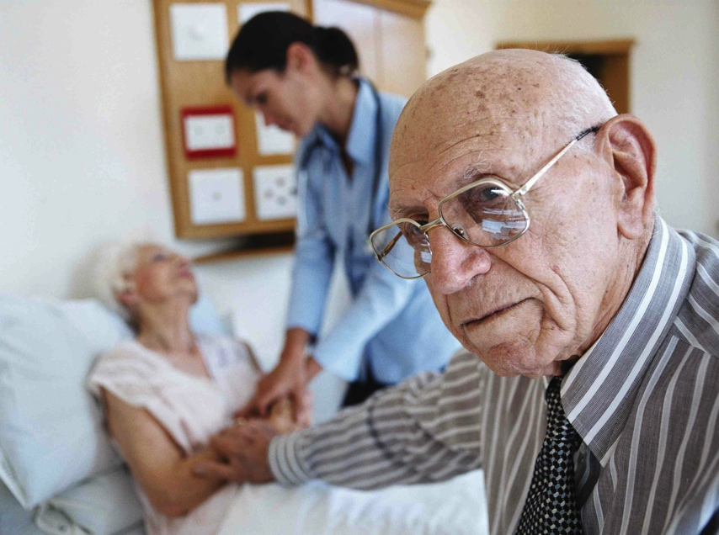
Caregivers: Challenges
Physical, psychological, social challenges
$10.2 billion additional health care costs (2015)
60% rate emotional stress as high or very high
40% suffer from depression
²²Alzheimer’s Association. (2016) Alzheimer’s Disease Caregivers.
Notes:
Caregivers of people with Alzheimer’s and other dementias often experience physical, psychological, and social challenges.
Several recent findings highlight these challenges:
Due to the physical and emotional toll of caring for someone with Alzheimer’s or other dementias, these caregivers had $10.2 billion in additional health care costs in 2015.
Nearly 60% of Alzheimer’s and dementia caregivers rate the emotional stress of caregiving as high or very high.
About 40% of Alzheimer’s and dementia caregivers suffer from depression.

Slide 26
Caregivers: Impact on Work
²³Alzheimer’s Association. (2016) Alzheimer’s Disease Caregivers.
Notes:
In many cases, caring for an individual with Alzheimer’s has a negative effect on employment, income, and financial security.
Among Alzheimer’s and dementia caregivers who are employed full or part time:
54% said they had to go in late, leave early, or take time off because of their caregiving responsibilities
15% had to take a leave of absence
13% had to go from working full time to part time
13% had to take a less demanding job
9% had to quit work entirely either to become a caregiver or because their caregiving duties became too burdensome
8% lost job benefits

Slide 27
Caregivers: Length of Care
75% had provided care at least one year
33% had provided care for five or more years
Average length of time: 4.6 years
May range from 4 - 20 years
²⁴Alzheimer’s Association. (2015) Alzheimer’s Disease Caregivers.
²⁵National Alliance for Caregiving & AARP (2009). Caregiving in the U.S.
Notes:
Caregivers of individuals with Alzheimer’s and other dementias spend much more time providing care than caregivers of individuals with other conditions.
In 2014, of the unpaid Alzheimer’s and dementia caregivers:
75% had been providing care for at least a year
33% had been providing care for five or more years
The average length of time caregivers in general report providing care is 4.6 years, but in the cases involving dementia, caregiving may range from 4 to 20 years.

Slide 28
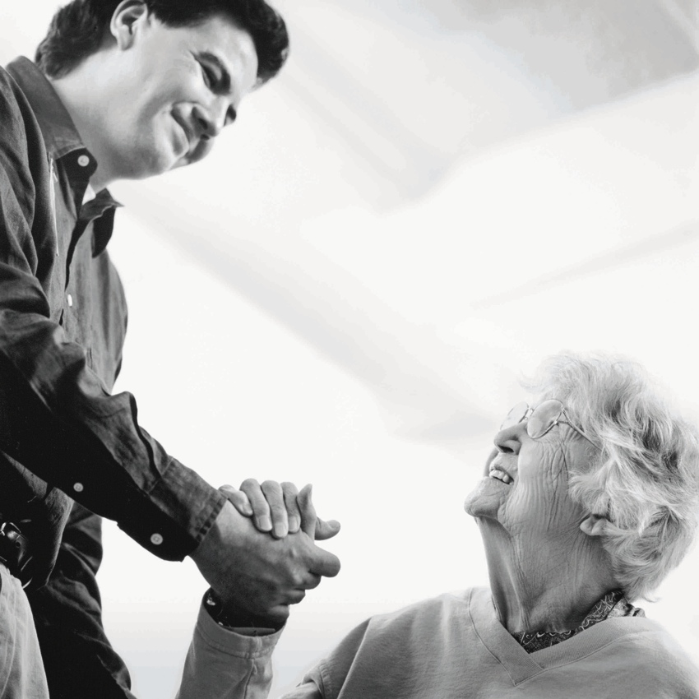
Caregivers: Critical Role
Health care system could not sustain costs of care
Support for caregivers is a public health issue
Notes:
The burden on caregivers is significant; they play a critical role in supporting individuals with Alzheimer’s and dementia.
Without caregivers, the health care system could not sustain the costs of care for persons with Alzheimer’s and other dementias.
Assuring caregivers receive needed support is a public health issue.

Slide 29
Health Professionals: Shortage
Shortage of health care professionals trained to treat older adults
Need additional 3.5 million by 2030
Currently have half the number of certified geriatricians needed
Less than 1% of RNs, PAs, and pharmacists identify as geriatric
Many not adequately trained for Alzheimer’s and dementia
²⁶Alzheimer’s Association. 2015 Alzheimer’s Disease Facts and Figures.
Notes:
With the growing number of older adults in the U.S. population (both with and without Alzheimer’s and other dementias), the country is facing a workforce shortage of health care professionals who are trained to meet the needs of older adults.
Furthermore, many professionals already in the workforce are not adequately trained on the needs of people with Alzheimer’s and other dementias.
Current estimations of workforce shortages include:
The U.S. will need an additional 3.5 million health care professionals by 2030 just to maintain the current ratio of health care professionals to the older population
The U.S. has approximately half the number of certified geriatricians than it currently needs
Less than 1% of registered nurses, physician assistants, and pharmacists identify themselves as specializing in geriatrics

Slide 30
Direct Care Workforce
Provide majority of care for Alzheimer’s (after caregivers)
Include nurse aides, home health aides, personal-care aides and home-care aides
Help with daily activities: bathing, dressing, eating
Typically cost $20/hour or $160/day
²⁷Alzheimer’s Association. 2015 Alzheimer’s Disease Facts and Figures. ²⁸American Elder Care Research Organization. (2015) Home Care Financial Assistance and Payment Options.
Notes:
Many older adults, including those with Alzheimer’s and other dementias, receive a large part of their care from direct-care workers, such as nurse aides, home health aides and personal-care aides and home-care aides.
These workers help with bathing, dressing, eating, and numerous other daily tasks, both at home and within institutions.
Paid caregivers typically cost $20 per hour (or $160 per day), an expense that most families pay out of pocket.

Slide 31
Direct Care Workforce: Challenges
Workforce shortage
Over 1 million additional needed by 2018
High turnover
Recruitment difficult
Limited training on Alzheimer’s and dementia
²⁹Paraprofessional Healthcare Institute (PHI). (2013). Fact Sheet: America’s Direct-Care Workforce.
Notes:
Challenges within the direct care workforce include workforce shortage and insufficient training.
According to one estimate, more than one million additional direct-care workers will be needed by 2018.
Turnover rates are high among direct-care workers, and recruitment and retention are persistent challenges.
Many direct-care workers receive little training on Alzheimer’s and dementia care. Average training is 75 hours, with little focus on Alzheimer’s and dementia.

Slide 32
Public health approach
Alzheimer’s Disease – A Public Health Crisis
Notes:
Fortunately, there are ways to intervene using public health tools and techniques. The public health approach can be used to improve the quality of life for those living with the disease, their caregivers, and to reduce the costs associated with the disease.

Slide 33
Healthy People 2020
Alzheimer’s and other dementias included in Healthy People 2020
Increasing diagnosis and awareness
Reducing preventable hospitalizations
³⁰Department of Health and Human Services. (2010) Healthy People 2020.
Notes:
For the first time, Alzheimer’s and other dementias are included in Healthy People 2020.
Healthy People – released every ten years by the U.S. Department of Health and Human Services – is a framework of goals and objectives that is used to guide national health promotion and disease prevention efforts in the U.S.
The new topic area – “Dementias, including Alzheimer’s” – contains specific objectives regarding increasing diagnosis and awareness and reducing preventable hospitalizations. Public health has a role to play in reaching those objectives.
Inclusion in Healthy People 2020 underscores the growing public health threat that Alzheimer’s and other dementias pose to the nation.

Slide 34
Role of Public Health
3 key public health intervention tools:
Surveillance/monitoring
Primary prevention (risk reduction)
Early detection and diagnosis
Notes:
Public health plays an important part in addressing Alzheimer’s. Three key public health intervention tools that can reduce the burden of Alzheimer’s disease:
Surveillance/monitoring that allows public health to compile data and use it to:
Develop strategies and interventions
Inform public policy
Guide research
Evaluate programs and policies
Educate populations
Promoting primary prevention can be used to promote risk reduction for Alzheimer’s disease, as well as promote cognitive health in general.
Public health may play an important role in efforts to increase early detection and diagnosis of Alzheimer’s disease, including
Educating the public about the warning signs of dementia, benefits of early detection and training to health care providers and newly diagnosed individuals, families, and caregivers.
Identifying and promoting strategies designed to promote early detection
Note to presenter: Module 3 addresses the three key public health intervention tools in more detail.

Slide 35
Dementia Capable Systems and dementia friendly communities
Dementia capable systems
Public health research and translation
Support services
Workforce training
Dementia friendly communities
Notes:
Public health also has a role to play in supporting dementia capable systems and dementia friendly communities. At a larger level, states and communities can become dementia capable and accommodate the needs of a population with Alzheimer’s and other dementias.
A dementia capable system is a system or infrastructure that works to meet the needs of a people with dementia and their caregivers through providing education, support and services.
Public health can contribute to a dementia capable system through:
Public health research and translation
Ensuring access to support services for people with dementia and their caregivers
Workforce training and education
Supporting the creation of dementia friendly communities which describes communities that have taken steps to make their community safe for and accessible to people with Alzheimer’s and other dementias as well as support and empower people with Alzheimer’s and dementia to continue living high-quality lives with as much independence as possible.
Note to presenter: Module 4 addresses dementia capable systems and dementia friendly communities.

Slide 36
For More Information
For more information, please visit the Alzheimer’s Association website at: http://www.alz.org
Notes:
For more information on the topics covered in this presentation, please go to the Alzheimer’s Association website at www.alz.org. There you can find resources, latest research and information.

