Slide 1
Update on AFM in 2020
Dr. Janell Routh
AFM and Domestic Polio Team Lead
National Center for Immunization and Respiratory Diseases
Centers for Disease Control and Prevention (CDC)
November 12, 2020
Notes:
Good afternoon everyone and thank you for joining our second parent session on AFM. It has been a very unprecedented year, given our current situation with the COVID-19 pandemic and now increasing COVID cases nationwide. In the midst of a massive agency-wide response to the pandemic, our AFM team has remained strong and dedicated to our mission to conduct surveillance for AFM, further our understanding of this disease, and expand awareness and education to providers. In addition, as burdened as our state and local heath departments have been responding to COVID, our dedicated surveillance coordinators have been working to ensure that all suspected cases are sent to CDC for classification.
I believe one of the silver linings of the COVID-19 pandemic is that we have not seen an increase in AFM this year, as we might have expected given the historical patterns that we have been tracking. I’d like to spend 10 – 15 minutes walking you through our surveillance data for AFM this year, discussing our efforts to promote the distinction between AFM diagnosis and the surveillance and classification process that we conduct at CDC, and then some of the research opportunities ongoing now for AFM. I’d then like to open it up to those listening in to ask any questions you may have.

Slide 2
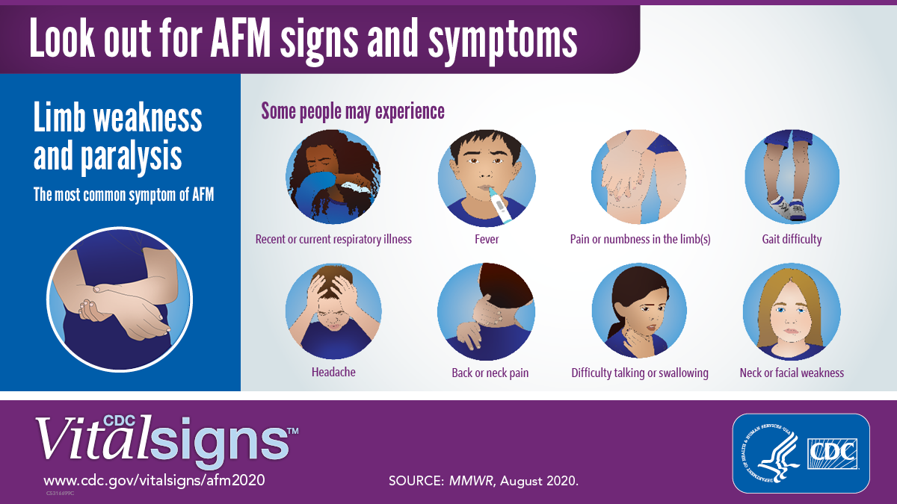
AFM Vital Signs
Released on August 4
Theme: Recognize symptoms. Hospitalize immediately.
Target audience: frontline clinicians (e.g., ED and urgent care providers, pediatricians)
Symptom and neurology assessment checklists
Primary products:
MMWR, fact sheet/graphics, website
Telebriefing and press release
Medical outreach and social media
See 2020 AFM Vital Signs at: www.cdc.gov/vitalsigns/afm2020
Notes:
I wanted to take a quick moment to talk about the AFM Vital Signs that we released in August, which we consider a success. Vital Signs was started in 2010 by CDC and is a monthly report on an important health threat. This report targets specific audiences to increase awareness about a particular topic. This was our second AFM Vital Signs, where we focused on symptom recognition and early hospitalization, targeted to pediatricians, emergency room and urgent care frontline providers. We urged providers remain vigilant for AFM, especially during COVID.

Slide 3
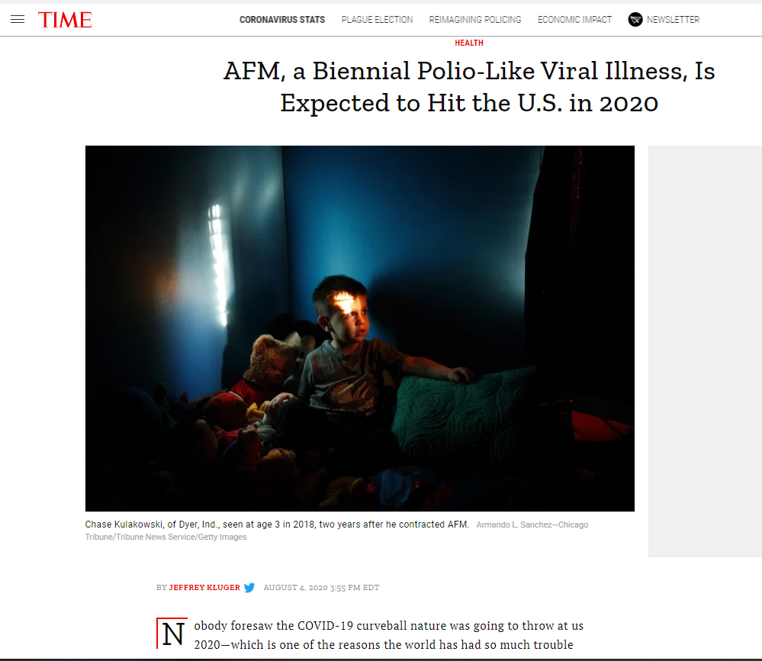
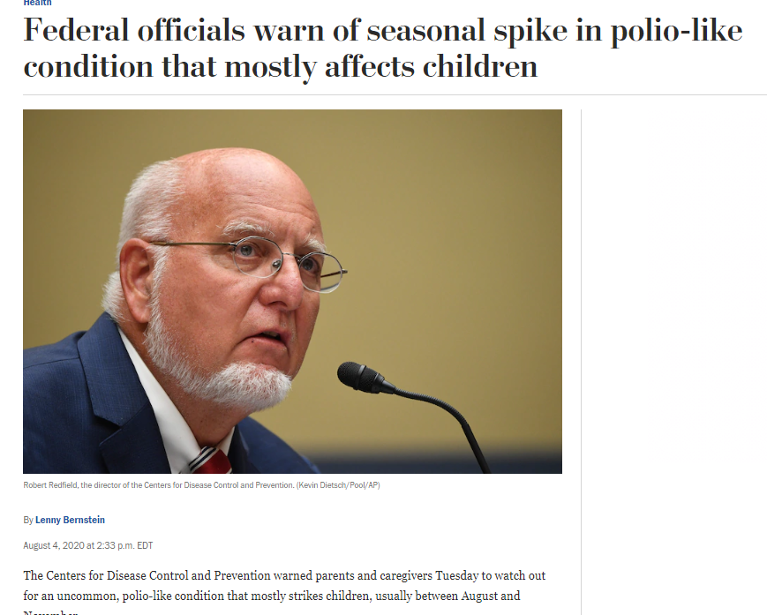
AFM CDC warnings
CDC Warns Parent to be on the Lookout for Acute Flaccid Myelitis in Children
Notes:
This vital signs report led to a huge number of media articles and media coverage across the US. Several articles featured families with AFM across the country and AFM experts at local hospitals. Our metrics report showed that it led to over 1600 media reports, including coverage by major networks such as TIME, Washington Post, CNN, The Hill, and others. We were told that this Vital Signs is one of the top performing reports since Vital Signs started in 2010 and we are thrilled that it received so much coverage and hopefully raised awareness among those frontline providers and the general public.

Slide 4
National increase in AFM cases every 2 years since 2014 Number of confirmed reported AFM cases, Aug 2014 – Oct 2020* (n=642)
2015:
22 cases
2016:
153 cases
2017:
38 cases
2018:
238 cases
2019:
46 cases
2020:
25 cases
Sept
Sept
Sept
Sept
Sept
Sept
https://www.cdc.gov/acute-flaccid-myelitis/cases-in-us.html Data current as of October 30, 2020.
Notes:
As you all probably know from our outreach earlier this year, we anticipated another peak year for AFM in 2020 based on the previous trends in the United States of increases cases every two years since 2014. As of October 30, 2020, there have been 25 confirmed cases in the US. These numbers are much lower than what we have seen in previous outbreak years. COVID-19 prevention measures such as social distancing and wearing of masks may have reduced the circulation of enteroviruses this fall. It is uncertain what this means for the remainder of 2020, but we do know that people are more likely to get infected with enteroviruses during the summer and fall months. When you look at previous outbreak years, our case numbers fall off rapidly from October to November. Despite this, given the unprecedented nature of what we have seen this year, we are continuing to focus intently on surveillance for possible cases of AFM and we do remain prepared to respond to an increase in cases should they occur.

Slide 5
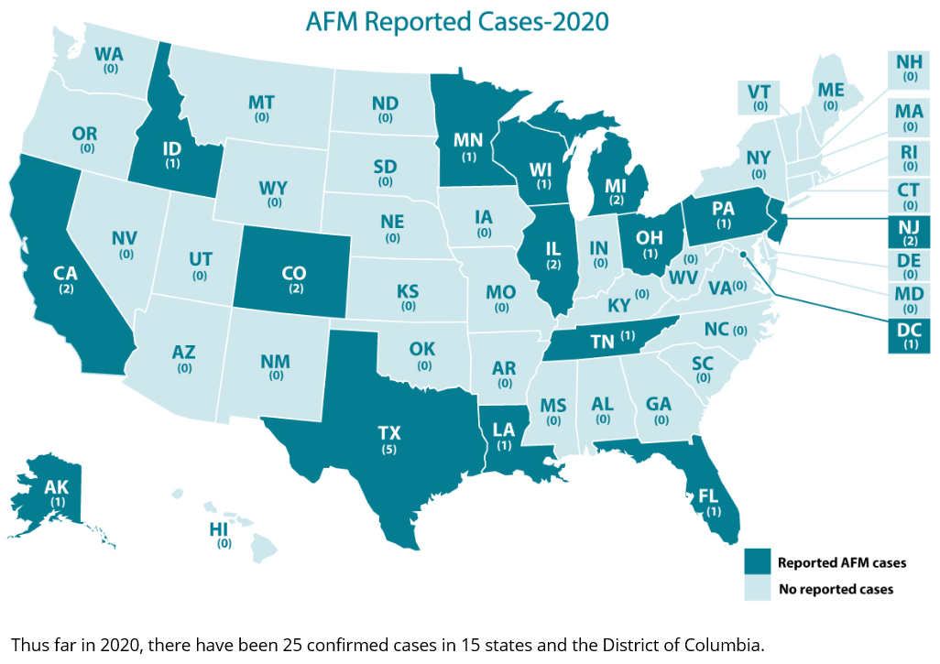
AFM in the US as of October 30, 2020
Notes:
Our national map shows the 25 confirmed AFM cases in 15 states. There appears to be no clear pattern to the cases, consistent with what we have seen in previous years.

Slide 6
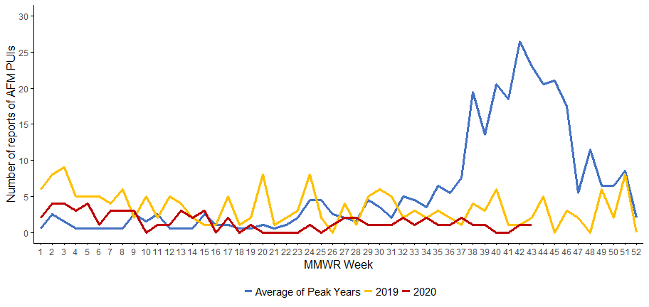
Monitoring number of suspect AFM cases reported to CDC to detect increases and trigger outbreak response
*Data as of 10/30/2020
Notes:
Another way we use our surveillance data is to monitor the number of reports of suspected AFM cases to help detect possible increases in cases. The reported increases are then used as our trigger for an outbreak response. An outbreak response is a term that we use at CDC for increasing and strengthening our staffing structure to respond specifically to an outbreak or emergency event.
I have showed this slide before in previous presentations this summer and wanted to show you an update today. This figure shows the average number of reports received by week during the peak years 2016 and 2018 in the blue line (you can see the increase in reports starting in week 37/38 which corresponds to the month of September, indicating we were moving into an AFM outbreak). The number of reports received by week in 2019 (a non-peak year used as a baseline) is shown in yellow. You can see that in a non-peak year, we do not get an increase in AFM case reports throughout the year. Finally, the current number of reports for 2020 so far is shown in RED. Reports are generally the same as what we see in a non-peak year.
I know the big question on everyone’s mind, including mine, is that if we don’t see an outbreak for 2020, what do we think might happen in 2021? I want to say up front that I don’t know. We might expect that it could be another non-outbreak year, if the pattern of a low number of cases in odd numbered years remains. Or, we might expect that there might be an outbreak next year, given there was not one this year. You can be sure that we will be monitoring the circulation of enteroviruses and EV-D68 very closely starting in the summer of next year to help give us some information about what might occur.

Slide 7
Clinicians Diagnose AFM. CDC Classifies AFM.
Diagnosis and classification are independent and used for different purposes.
Diagnosis
Done by a clinician
Based on full information (history, exam, testing)
Aims to be as accurate as possible to provide the best care and treatment
Happens while patient is in hospital
Surveillance and classification
Done by CDC
Uses patient’s medical records and MRI images
Applies a case definition for standardization
Measures impact of a disease and trends over time
Takes time, and review may be delayed
Notes:
I am going to leave our surveillance data now, to talk about diagnosis and classification of AFM. We have talked a lot this year about the difference between the diagnosis of AFM and classification of AFM. These processes can be confusing because they are done by different people, and at different times during the course of an AFM illness. I wanted to go through this again because I know that there are questions about why my child was diagnosed with AFM, but CDC did not classify my child as a case of AFM.
Clinicians diagnose AFM. When a child presents with limb weakness, it is the clinical team that goes to work. Diagnosis is based on full medical information (history, exam, testing including MRI and LP). The clinical team aims to be as accurate as possible so that they can provide the best care and treatment for their patient. The diagnostic process happens while the child is in the hospital, so that action can be taken urgently.
Classification is what our team does here at CDC, once we receive information about the child from the state health department via the clinical team. This information is coming more and more in real time, but there still can be delays in the receipt of information and then the classification process does take time. We use the information, including MRI and neurology notes and apply those to a case definition that is used to standardize case by case. Standardization is very important for surveillance data. It allows us to compare cases from year to year, and allows us to generate the graphs I showed you earlier, and to identify patterns that provide more and more information about this illness, like that every-other-year pattern, and its interruption this year. This surveillance process can take time, although we have made efforts to help improve the time between a report of a suspected case, and a case classification.
Standardization – a way to ensure consistency in order to accurately track AFM, detect outbreaks, and inform research
Impact of a disease (aka, disease burden)

Slide 8
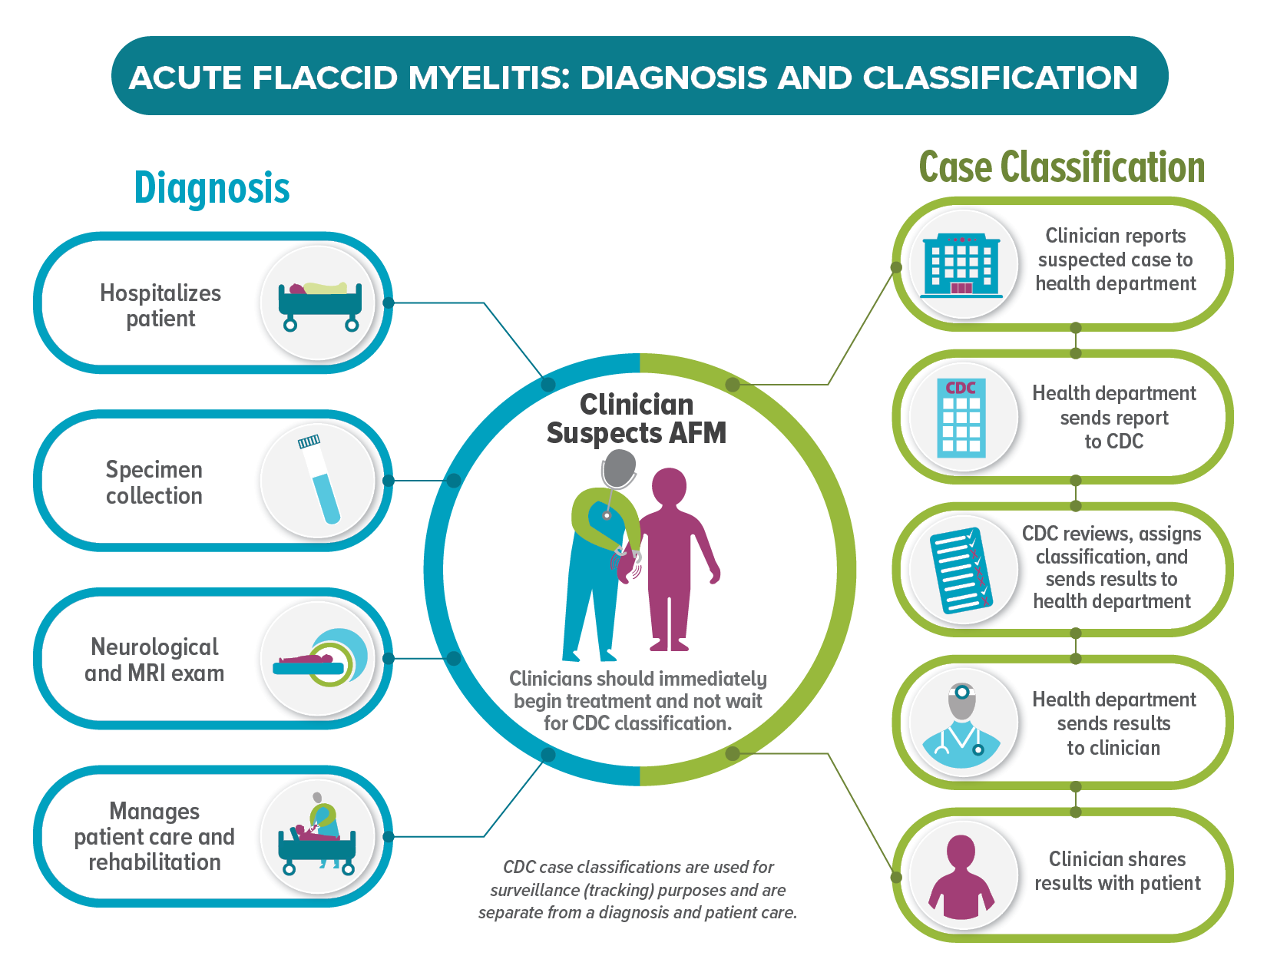
Case classification does not impact patient treatment or care.
Notes:
This is a new product designed by our communications team to help explain the difference between diagnosis and classification, and the separate processes that are used for Diagnosis, and for Classification. If you are like me, a visual learner, I sometimes find that an image can help to explain things better than just hearing an explanation. In the middle of the slide is an illustration of a clinician in blue and a patient depicted in purple. The clinician suspects AFM and should immediately hospitalize and begin a diagnostic workup, as shown on the left-hand side of the picture and represented by the blue/teal color. Clinicians should immediately begin treatment and not wait for the case classification. The right side of the picture shows the steps for case classification, of which steps are represented in green. After the clinician reports the case to the HD, the HD sends the information to CDC. At CDC, we review the information using two expert neurologists, assign a classification, and send the result back to the HD, who should communicate this to the clinician, who then communicates to the patient and family. Two very important reminders about the classification process. It should never impact patient care or treatment and it should never override a clinical diagnosis. It is for surveillance purposes only. I am curious to know if you think this is helpful-we’d like to post it to our website, and I would appreciate your feedback-you can put in the chatbox or send us an email at AFMquestions@cdc.gov.

Slide 9
Streamlined Case Classification Process
Added members to neurology classification review panel
Implemented electronic system to upload and distribute MRI images
Reduced the amount of information required for classification
Notes:
In preparation for the expected outbreak this year, and to improve our overall surveillance processes, we have worked to streamlined our case classification procedures to ensure improved accuracy and quicker turnaround. First, more neurologists were added to the review panel to increase the ability to classify cases in a timely manner when cases peak-we have a total of 7 now. Second, a more seamless online system is now in place for uploading MRI images. The system has cut down on the amount of time it takes to receive the images and submit them to the neurology panel. It also allows our neurologists to view the images and discuss their findings with each other if there is a discrepancy. Third, neurologists on the panel no longer have to review the entire medical record of patients to make a case classification. We are focusing on the neurological examination to confirm the acute flaccid limb weakness, and the MRI to confirm the grey matter lesion. The new process requires a reduced amount of medical information to classify cases and it means we can update our surveillance information in a more timely manner. Currently we update our case counts at the first of every month, but that would increase in frequency if an outbreak occurred.

Slide 10
AFM Research
The AFM Biorepository
Repository for anonymous samples of blood, stool, nasal/throat swabs, cerebrospinal fluid, and other clinical specimens
Samples will be used to better understand AFM and support future research studies to develop diagnostics, treatment, and prevention methods
The NIH Natural History Study
Repositories for anonymous data from participants including clinical specimens, clinical data, and diagnostic images
Data will help better characterize AFM’s patterns and progression, identify determinants of health outcomes, describe diagnostic evaluations and treatments, and describe signs and symptoms
https://www.cdc.gov/acute-flaccid-myelitis/parents/get-involved-afm-research.html
Notes:
For the last piece of my update, I wanted to outline all of the research opportunities that are currently ongoing, for both newly diagnosed patients and those who have been diagnosed in the past.
If you are interested in participating in research, there are several opportunities available. Participating in these studies may not directly benefit your child, but the information gained will help with future research that can lead to the development of diagnostic tools, treatments and preventive measures for AFM.
The two studies listed here are for children with new onset of acute limb weakness. Once hospitalized, their families may opt to participate in one of these opportunities, depending on the hospital where they are admitted. The first is the AFM Biorepository, which is helping to build an anonymous repository of samples of blood, stool, nasal and throat swabs, and cerebrospinal fluid. These specimens will be used to better understand AFM and support future research to develop diagnostic tools, treatments and prevention methods.
The second is the NIH Natural History Study. This was described very well in the JHU symposium from back in June, and it currently has enrolled 10 participants. This study will also contribute to a biorepository of specimens as well as collect clinical information and diagnostic images, like MRIs. These data will help us better understand the clinical patterns and progression of AFM, identify determinants of health outcomes-meaning are there any factors that contribute to improvement or severe disease, help us understand what diagnostic evaluations and treatments may be helpful and collect information on signs and symptoms of children with acute flaccid weakness.
More information about these studies and how to participate can be found on our AFM website at the address you can see now in the chat box: https://www.cdc.gov/acute-flaccid-myelitis/parents/get-involved-afm-research.html

Slide 11
AFM Research
Long-term Outcomes Project
AFM confirmed or probable cases diagnosed from 2014 – 2017
CDC funded McKing Corporation to assist some health departments
One-time phone interview survey with patients in some states
Tentative start date in early 2021
Help us understand long-term outcomes of AFM patients
Communications Research with Parents
CDC funded Porter Novelli to facilitate these surveys
Parents of children diagnosed with AFM
Two online surveys in 2021
First survey to identify information and resource needs
Second survey to gather feedback about how CDC talks about AFM in our materials
Notes:
Our team at CDC is conducting other research that I wanted to let you know about, as you may be contacted in the coming months and asked to participate. Participation is always voluntary and confidential, and we respect your wishes if you do not want to take part.
The first is a Long-Term Outcomes Project that I know many of you have been asking for. We started to look at outcomes from our more recent cases, and now are expanding to look back to cases, both confirmed and probable, from 2017 all the way back to 2014.
- CDC has funded McKing Corporation to assist some health departments with this project so that they will have help collecting this information while dealing with COVID.
- Parents will be contacted by McKing or the health department, depending on your state and asked to participate in a one-time phone interview. Our tentative start date for this project is early 2021.
The goal of this project is to help us understand long-term outcomes of patients with AFM
The second project is doing some communications research with parents of children with AFM. CDC has funded Porter Novelli to facilitate these surveys. There will be two online surveys in 2021, the first asking about information and resource needs for parents, and the second survey is to gather feedback about how CDC talks about AFM in our materials that you can see online. We want to make sure we are communicating effectively, and clearly, and are asking for your help to ensure we do this as well as we can.

Slide 12
AFM Research led by Partners
CAPTURE Study
Started in 2014 and goes until 2026, led by Dr. Greenberg of UTSW
Open to children 0-17 years at onset or within six months of diagnosis
Contact rwhitney@wearesrna.org or patricia.plumb@utsouthwestern.edu
CORE TM Study
Families and children post 6 months of AFM onset can share their data and long-term outcomes with the CORE TM study via the SRNA registry
Contact gdefiebre@wearesrna.org or CORETM@utsouthwestern.edu.
Notes:
Finally, there are two research studies are being led by some of our Partners that I did want to mention to make sure our list is complete.
- The CAPTURE study started in 2014 and is led by Dr. Benjamin Greenberg at UT Southwestern Medical Center, who many of you know very well. This is open to children 0-17 years of age at illness onset, or within six months of diagnosis. It is studying the long-term outcomes of pediatric transverse myelitis (TM) and acute flaccid myelitis (AFM) to guide future clinical trials for children with these diagnoses. This study is still enrolling patients.
They use imaging and treatment records from clinicians at diagnosis, and every four months, families and children continue to report outcomes via interviews, QOL surveys, and secure telemedicine portal to assess mobility.
Lastly there is the CORE TM Study, which is for families and children 6 months after their AFM onset to be able to share data and long term outcomes via the SRNA registry. Both Rebecca and Gigi from SRNA will have more information on these, or you can contact the study coordinator directly.

Slide 13
Thank you!
Have questions? Send an email to: AFMQuestions@cdc.gov
Visit CDC’s AFM website at www.cdc.gov/afm.
Notes:
So, as you can see from all that is happening, AFM remains a high priority for CDC. We are thankful that we have not seen many new cases this year as we anticipated, and certainly hope that continues moving forward. But our team is working hard to ensure we keep a careful eye on suspected cases and enteroviruses as the year comes to an end, and are always ready to respond if something changes. Thank you very much for your time this afternoon, and I hope that was helpful to provide an update of where we stand with AFM in 2020, through the month of October. I’d like to turn the presentation back over to Ana, who will lead us through the question and answer part of the update.

Slide 14
What is ahead for AFM this year and in 2021?
Biofire Syndromic Trends data: enteroviruses, 2019 – 2020
Sept 9, 2019: 35.3%
Oct 5, 2020: 21.2%
https://syndromictrends.com/metric/panel/rp/percent_positivity/organism/main
Notes:
Included if parents ask specifics of enteroviruses, but will not be presented if we aren’t asked.

Slide 15
Biofire Syndromic Trends data: all viruses, 2019 – 2020
COVID-19 mask recommendation (April 3, 2020)
https://syndromictrends.com/metric/panel/rp/percent_positivity/organism/main
Notes:
Included if parents ask specifics of enteroviruses, but will not be presented if we aren’t asked.

