Slide 1

Self-Study Modules
on Tuberculosis
Targeted Testing and
the Diagnosis of
Latent Tuberculosis
Infection and
Tuberculosis Disease
Notes:
Introduce Module 3

Slide 2
Module 3: Objectives
At completion of this module, learners will be able to:
  Identify high-risk groups for targeted testing
  Describe how to place, read, and interpret a Mantoux tuberculin skin test (TST)
  Describe how to interpret an interferon-
  gamma release assay (IGRA)
  Discuss considerations for using either the TST or IGRA for diagnosing latent tuberculosis infection (LTBI)
  Describe the components of a medical evaluation for diagnosing TB disease
Notes:
State objectives of presentation
Background and Objectives - Module 3, p. 1

Slide 3
Module 3: Overview
Targeted Testing
Diagnosis of latent tuberculosis infection (LTBI)
  TST
  IGRAs
  TB Testing Programs, the Booster Phenomenon, and Two-Step Testing
Diagnosis of TB Disease
Reporting TB Cases
Case Studies
Notes:
Review slide content

Slide 4
Targeted Testing
Notes:
Introduce section
Ask participants if they know what targeted testing is

Slide 5
Targeted Testing (1)
Targeted testing is a TB control strategy used to identify and treat persons:
  At high risk for latent TB infection (LTBI)
  At high risk for developing TB disease once infected with M. tuberculosis
Notes:
Review slide content
Targeted Testing – Module 3, p. 6

Slide 6
Targeted Testing (2)
Identifying persons with LTBI is an important goal of TB elimination because LTBI treatment can:
  Prevent the development of TB disease
  Stop the further spread of TB to others
Notes:
Review slide content
Targeted Testing – Module 3, p. 6

Slide 7
Targeted Testing (3)
A Decision to Test is a Decision to Treat
TB testing activities should be done only when there is a plan for follow-up care
Health care workers (HCWs) should identify and test persons who are at high risk
  People who are not at high risk generally should not be tested
Notes:
Review slide content
Explain that testing people who are not at high risk can take resources away from important activities. Also, positive test results in low-risk populations can be inaccurate.
Note that health care agencies and other facilities should consult with their local health department before starting a TB testing program
Targeted Testing – Module 3, p. 6

Slide 8
Targeted Testing (4)
High-Risk Groups
High-risk groups can be divided into two categories:
  People who are at high risk for exposure to or infection with M. tuberculosis
  People who are at high risk for developing TB disease once infected with M. tuberculosis
Notes:
Review slide content
Explain that these are the high-risk groups that should be tested for TB
Note that definition of high risk should be made at the local (city, county, state) level according to local demographics and TB epidemiology
Targeted Testing – Module 3, pp. 6-7

Slide 9
Targeted Testing (5)
High-Risk Groups for TB Infection
Contacts of people known or suspected to have TB disease
People who have come to U.S. within 5 years from areas of the world where TB is common
People who visit areas with a high prevalence of TB disease
People who live or work in high-risk congregate settings
Notes:
Review slide content
Tell participants that TB is more common in parts of Asia, Africa, Russia, Eastern Europe, and Latin America
Ask participants what settings they think could be considered “high-risk congregate settings” (examples include nursing homes, homeless shelters, and correctional facilities)
Groups at High Risk for TB Infection – Module 3, p. 7

Slide 10
Targeted Testing (6)
High-Risk Groups for TB Infection
HCWs who serve patients at increased risk for TB disease
Populations defined locally as having an increased incidence of LTBI or TB disease (e.g., medically underserved, low income, or people who abuse drugs or alcohol)
Infants, children, and adolescents exposed to adults in high-risk groups
Notes:
Review slide content
Groups at High Risk for TB Infection – Module 3, p. 7

Slide 11
Targeted Testing (7)
High-Risk Groups for TB Disease after Infection with M. tuberculosis
People living with HIV
Children younger than 5 years of age
People recently infected with M. tuberculosis (within the past 2 years)
People with a history of untreated or inadequately treated TB disease
People receiving immunosuppressive therapy
Notes:
Review slide content
Groups at High Risk for TB Disease – Module 3, p. 7

Slide 12
Targeted Testing (8)
High-Risk Groups for TB Disease after Infection with M. tuberculosis
Persons with silicosis, diabetes mellitus, chronic renal failure, leukemia, or cancer of the head, neck, or lung
Persons who have had a gastrectomy or jejunoileal bypass
Low body weight
Cigarette smokers and persons who abuse drugs and alcohol
Persons defined locally as having an increased incidence of disease due to M. tuberculosis
Notes:
Review slide content
Groups at High Risk for TB Disease – Module 3, p. 7

Slide 13
Diagnosis of Latent TB Infection (LTBI)
Notes:
Introduce section
Diagnosis of LTBI – Module 3, pp. 8-38

Slide 14
Diagnosis of LTBI
Available testing methods for M. tuberculosis infection:
  Mantoux tuberculin skin test (TST)
  Blood tests known as interferon-gamma release assays (IGRAs):
    QuantiFERON®-TB Gold In-Tube (QFT-GIT)
    T-SPOT®.TB test (T-Spot)
Notes:
Review slide content
Diagnosis of LTBI – Module 3, p. 8

Slide 15
Diagnosis of Latent TB Infection (LTBI)
Mantoux Tuberculin Skin Test
Administering the Test
Notes:
Introduce section
Ask who has had a Mantoux tuberculin skin test (TST)
Ask (if appropriate) how many participants have administered a TST to others
Ask if the TST can detect TB disease
Mantoux Tuberculin Skin Test – Module 3, pp. 8-24

Slide 16
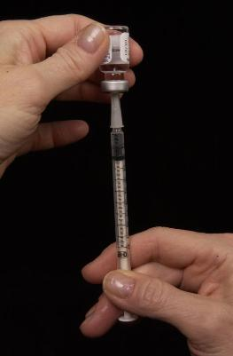
Mantoux Tuberculin Skin Test (1)
TST is administered by injection
Tuberculin is made from proteins derived from inactive tubercle bacilli
Most people who have TB infection will have a reaction at injection site
Syringe being filled with 0.1 ml of liquid tuberculin
Notes:
Review slide content
Explain that most people who have TB infection will have a reaction. Their immune system will recognize tuberculin because it is similar to tubercle bacilli.
Note that the tuberculin used for the skin test is also known as purified protein derivative, or PPD. TST is also sometimes called a PPD skin test.
Mantoux Tuberculin Skin Test – Module 3, p. 8

Slide 17
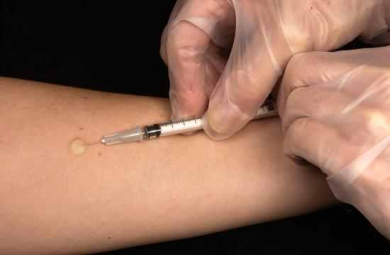
Mantoux Tuberculin Skin Test (2)
0.1 ml of 5 tuberculin units of liquid tuberculin are injected between the layers of skin on forearm
HCW administering Mantoux TST
Notes:
Explain that the TST is given by using a single dose disposable syringe
Review slide content
Explain that a tuberculin unit is a standard strength of tuberculin
State that tuberculin is NOT a vaccine
Mantoux Tuberculin Skin Test – Module 3, p. 8

Slide 18
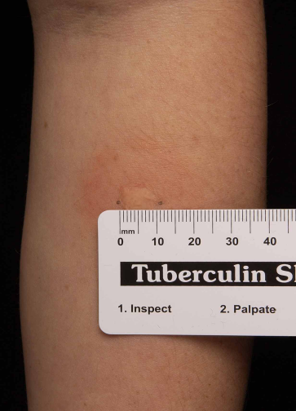
Mantoux Tuberculin Skin Test (3)
Forearm should be examined within 48 to 72 hours by HCW
Reaction is an area of induration (swelling) around injection site
  Induration is measured in millimeters
  Erythema (redness) is not measured
Only the induration is measured
Notes:
Review slide content
Explain that patients should NOT be asked to read their own skin test results
Explain that presence of erythema does NOT indicate a person has TB infection
State that if the patient does not return in 48-72 hours the test must be repeated
Mantoux Tuberculin Skin Test – Module 3, p. 8

Slide 19
Mantoux Tuberculin Skin Test Study Question 3.1
What is the TST used for?
The TST is used to determine whether a person has TB infection.
Notes:
Introduce study questions
Ask participants to turn to p. 10 (if participants have print-based modules)
Read question
Ask participants for answers
Answers – Module 3, p. 73

Slide 20
Mantoux Tuberculin Skin Test Study Question 3.2
How is the TST given?
The TST is given by a needle and syringe to inject 0.1 ml of 5 tuberculin units of liquid tuberculin between the layers of the skin, usually on the forearm.
Notes:
Read question
Ask participants for answers
Answers – Module 3, p. 73

Slide 21
Mantoux Tuberculin Skin Test
Study Question 3.3
With the TST, when is the patient’s arm examined?
  The patient’s arm is examined by a health care worker 48 to 72 hours after the tuberculin is injected.
Notes:
Read question
Ask participants for answers
Answers – Module 3, p. 73

Slide 22
Mantoux Tuberculin Skin Test
Study Question 3.4
How is the induration measured?
  The diameter of the indurated area is measured across the forearm; erythema (redness) around the indurated area is not measured.
Notes:
Read question
Ask participants for answers
Answers – Module 3, p. 73

Slide 23
Diagnosis of Latent TB Infection (LTBI)
Mantoux Tuberculin Skin Test
Interpreting the Reaction
Notes:
Introduce section

Slide 24
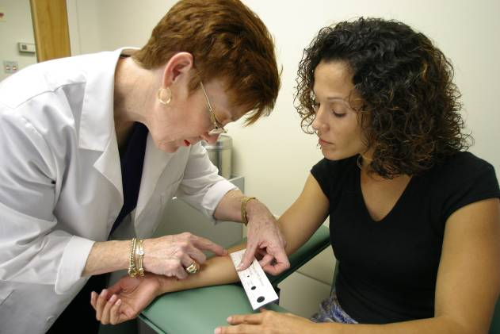
Mantoux Tuberculin Skin Test (4)
Interpreting the Reaction
Interpretation of TST reaction depends on size of induration and person’s risk factors for TB
Notes:
Review slide content
Interpreting the Reaction – Module 3, p. 12

Slide 25
Mantoux Tuberculin Skin Test (5)
Interpreting the Reaction
Induration of > 5 mm is considered positive for:
  People living with HIV
  Recent contacts of people with infectious TB
  People with chest x-ray findings suggestive of previous TB disease
  People with organ transplants
  Other immunosuppressed patients
Notes:
Review slide content
Interpreting the Reaction – Module 3, p. 12

Slide 26
Mantoux Tuberculin Skin Test (6)
Interpreting the Reaction
Induration of > 10 mm is considered a positive reaction for:
  People who have recently come to U.S. from areas where TB is common
  People who abuse drugs
  Mycobacteriology laboratory workers
  People who live or work in high-risk congregate settings
Notes:
Review slide content
Interpreting the Reaction – Module 3, p. 12

Slide 27
Mantoux Tuberculin Skin Test (7)
Interpreting the Reaction
Induration of > 10 mm is considered a positive reaction for:
  People with certain medical conditions that increase risk for TB (e.g., silicosis, diabetes mellitus, severe kidney disease, certain types of cancer, and certain intestinal conditions)
  Children younger than 5 years of age
  Infants, children, or adolescents exposed to adults in high-risk categories
Notes:
Review slide content
Interpreting the Reaction – Module 3, p. 12

Slide 28
Mantoux Tuberculin Skin Test (8)
Interpreting the Reaction
Induration of > 15 mm is considered a positive reaction for people who have no known risk factors for TB
Notes:
Review slide content
Reiterate that targeted testing should only be done in high-risk groups
Interpreting the Reaction – Module 3, p. 12

Slide 29
Occupational Exposure
For people who may be exposed to TB on the job (e.g., HCWs, staff of nursing homes or correctional facilities), interpretation of TST depends on:
  The employee’s individual risk factors for TB
  The risk of exposure to TB in the person’s job
Notes:
Review slide content
Interpreting the TST Reaction for Occupational Exposure – Module 3, p. 13

Slide 30
Mantoux Tuberculin Skin Test Study Question 3.5
What two factors determine the interpretation of a skin test reaction as positive or negative? What additional factor is considered for people who may be exposed to TB on the job?
    Size of induration and risk factors for TB
    An additional factor is the risk of exposure to TB in the person’s job
Notes:
Ask participants to turn to p. 14 (if participants have print-based modules)
Read question
Ask participants for answers
Answers – Module 3, p. 73

Slide 31
Mantoux Tuberculin Skin Test Study Question 3.6
Name 5 groups of people for which > 5 mm of induration is considered a positive reaction?
    People living with HIV
    Recent contacts of people with infectious TB
    People with chest x-ray findings suggestive of previous TB disease
    Patients with organ transplants
    Other immunosuppressed patients
Notes:
Read question
Ask participants for answers
Answers – Module 3, p. 73

Slide 32
Mantoux Tuberculin Skin Test Study Question 3.7
Name seven groups of people for which > 10 mm of induration is considered a positive reaction.
    People who have recently come to the U.S. (within the last 5 years) from areas where TB is common
    People who abuse drugs
    Mycobacteriology lab workers
    People who live or work in high-risk congregate settings
    People with certain medical conditions
    Children younger than 5 years of age
    Infants, children, and adolescents exposed to adults in high-risk categories
Notes:
Read question
Ask participants for answers
Answers – Module 3, p. 74

Slide 33
Mantoux Tuberculin Skin Test Study Question 3.8
For which group of people is > 15 mm of induration considered a positive reaction?
    People with no risk factors for TB.
Notes:
Read question
Ask participants for answers
Answers – Module 3, p. 74

Slide 34
Diagnosis of Latent TB Infection (LTBI)
Mantoux Tuberculin Skin Test
Factors that Affect the Reaction
Notes:
Introduce section

Slide 35
Mantoux Tuberculin Skin Test (9)
False-Positive Reaction
Factors that may cause people to have a positive reaction even if they do not have TB infection:
  Infection with nontuberculous mycobacteria (NTM)
  BCG vaccination
  Administration of incorrect antigen
  Incorrect measuring or interpretation of TST reaction
Notes:
Explain that the TST is a valuable tool, but it is not perfect
Review slide content
False-Positive Reaction – Module 3, p. 17

Slide 36
Mantoux Tuberculin Skin Test (10)
BCG Vaccine
People who have been vaccinated with BCG may have a false-positive TST reaction
  However, there is no reliable way to distinguish a positive TST reaction caused by BCG vaccination from a reaction caused by true TB infection
Individuals should always be further evaluated if they have a positive TST reaction
Notes:
Explain that BCG is a vaccine for TB that is used in many countries. However, it is rarely used in the U.S. because studies have shown that it is not completely effective
Review slide content
BCG Vaccine – Module 3, p. 17

Slide 37
Mantoux Tuberculin Skin Test (11)
False-Negative Reaction
Factors that may cause false-negative reactions:
  Anergy
  Recent TB infection (within past 8 to 10 weeks)
    It can take 2 to 8 weeks after TB infection for body’s immune system to react to tuberculin
  Very young age (younger than 6 months)
  Recent live-virus measles or smallpox vaccination
  Incorrect method of giving the TST
  Incorrect measuring or interpretation of TST reaction
Notes:
Review slide content
False-Negative Reaction – Module 3, p. 20

Slide 38
Mantoux Tuberculin Skin Test (12)
Anergy
Inability to react to skin tests due to weakened immune system
Anergy testing is no longer routinely recommended
Notes:
Review slide content
Note that HIV infection is an important cause of anergy, but other conditions, such as cancer, measles, or other viral infections can also weaken the immune system
Anergy – Module 3, p. 20

Slide 39
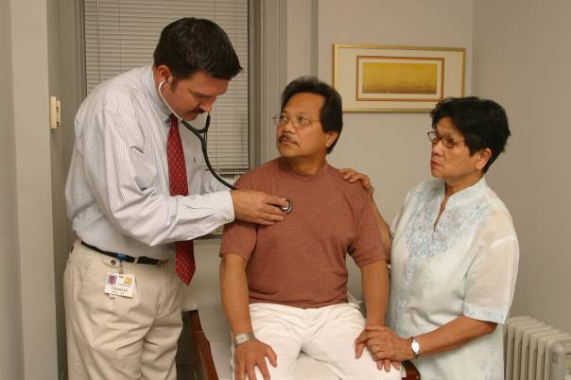
Mantoux Tuberculin Skin Test (13)
Any patient with symptoms of TB disease
should be evaluated for TB disease, regardless of his or her skin test reaction.
Notes:
Review slide content
Stress that people with symptoms of TB should be evaluated for TB disease right away
Mantoux Tuberculin Skin Test – Module 3, p. 21

Slide 40
Mantoux Tuberculin Skin Test
Study Question 3.9
Name four factors that may cause false-positive reactions to the TST.
    Infection with nontuberculous mycobacteria (NTM)
    BCG vaccination
    Administration of incorrect antigen
    Incorrect measuring or interpretation of TST reaction
Notes:
Ask participants to turn to p. 18 (if participants have print-based modules)
Read question
Ask participants for answers
Answers – Module 3, p. 74

Slide 41
Mantoux Tuberculin Skin Test Study Question 3.10
Is there a reliable way to distinguish a positive TST reaction caused by vaccination with BCG from a reaction caused by true TB infection?
No. Individuals who have had the BCG vaccine should be further evaluated for LTBI or TB disease the same as if they were not vaccinated with BCG.
Notes:
Read question
Ask participants for answers
Answers – Module 3, p. 74

Slide 42
Mantoux Tuberculin Skin Test
Study Question 3.11
Name 6 factors that may cause false-negative reactions to the TST.
    Anergy
    Recent TB infection (within past 8 to 10 weeks)
    Very young age (younger than 6 months)
    Recent live-virus measles or smallpox vaccination
    Incorrect method of giving the TST
    Incorrect measuring or interpretation of TST reaction
Notes:
Ask participants to turn to p. 22 (if participants have print-based modules)
Read question
Ask participants for answers
Answers – Module 3, p. 75

Slide 43
Mantoux Tuberculin Skin Test
Study Question 3.12
What is anergy?
The inability to react to skin tests because of a weakened immune system.
Notes:
Read question
Ask participants for answers
Answers – Module 3, p. 75

Slide 44
Mantoux Tuberculin Skin Test Study Question 3.13
After TB germs have been transmitted to someone, how long does it take before TB infection can be detected by the TST?
2 to 8 weeks
Notes:
Read question
Ask participants for answers
Answers – Module 3, p. 75

Slide 45
Mantoux Tuberculin Skin Test Study Question 3.14
What should be done if a patient has a negative TST result, but has symptoms of TB disease?
Any patient with symptoms of TB disease should be evaluated for TB disease, regardless of his or her skin test reaction.
Notes:
Read question
Ask participants for answers
Answers – Module 3, p. 75

Slide 46
Diagnosis of Latent TB Infection (LTBI)
Interferon-Gamma
Release Assays (IGRAs)
Notes:
Introduce section
Ask who has had an IGRA test before
Ask what an IGRA detects
Interferon-Gamma Release Assays – Module 3, pp. 25-31

Slide 47
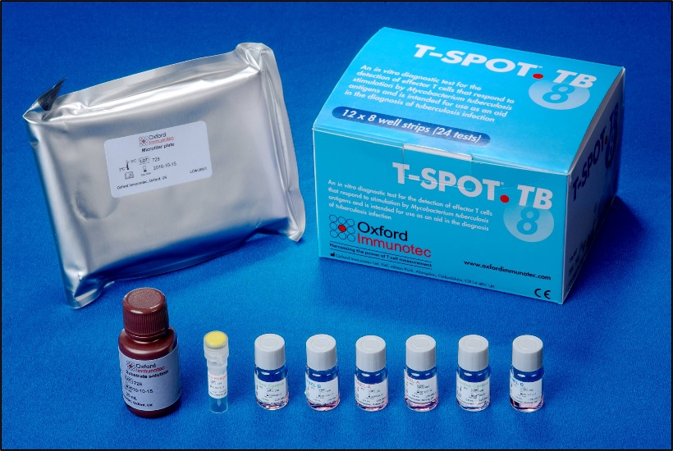
Types of IGRAs
QuantiFERON®-TB Gold In-Tube (QFT-GIT)
  Approved in 2007
T-Spot®.TB test (T-SPOT)
  Type of ELISpot assay
  Approved in 2008
CDC guidelines for IGRAs published in 2010
QFT-GIT testing materials
T-Spot®.TB testing materials
Notes:
Review slide content
Types of IGRAs – Module 3, p. 25

Slide 48
IGRAs (1)
Blood tests that help diagnose M. tuberculosis infection
Measures a person’s immune reactivity to M. tuberculosis
Notes:
Review slide content
IGRAs – Module 3, p. 25

Slide 49
IGRAs (2)
Conducting the Test
Confirm arrangements for testing in a qualified laboratory
Arrange for delivery of the blood sample to the laboratory in the time the laboratory specifies
Draw a blood sample from the patient according to the manufacturer’s instructions
Schedule follow-up appointment for patient to receive test results
Based on test results, provide follow-up evaluation and treatment as needed
Notes:
Review slide content
Conducting an IGRA – Module 3, p. 25

Slide 50
IGRAs (3)
How it Works
Blood samples are mixed with antigens (protein substances that can produce an immune response) and incubated
If the person is infected with M. tuberculosis, blood cells will recognize antigens and release interferon gamma (IFN-γ) in response
Notes:
Review slide content
How IGRAs Work – Module 3, p. 26

Slide 51
IGRAs (4)
Interpreting Results
QFT-GIT Results
  Based on amount of IFN-γ released in response to M. tuberculosis antigens and control substances
T-Spot Results
  Based on number of IFN-γ producing cells (spots) produced
Notes:
Review slide content
Interpreting IGRA Results – Module 3, pp. 26-27

Slide 52
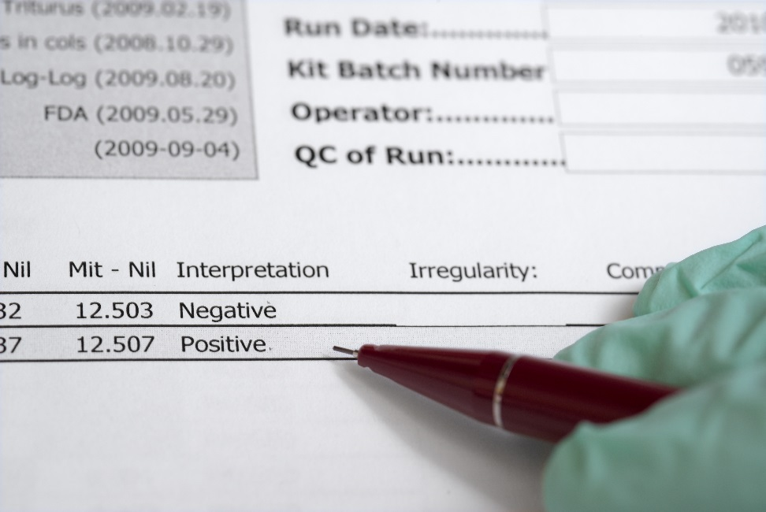
IGRAs (5)
Interpreting Results
Qualitative test interpretation and quantitative assay measurements should be reported
Laboratories use software provided by manufacturer to calculate results
QFT-GIT Results
Results are sent to requesting health care provider
Notes:
Review slide content
Note that qualitative interpretations include positive, negative, indeterminate, or borderline. Quantitative measurements are reported as numerical values and may be useful for clinical decision making in combination with the patient’s risk factors.
Interpreting IGRA Results – Module 3, pp. 26-27

Slide 53
IGRAs (6)
Report of Results
IGRA Result | Interpretation
Positive | M. tuberculosis infection likely
Negative | M. tuberculosis infection unlikely, but cannot be excluded especially if Patient has signs and symptoms of TB Patient has a high risk for developing TB disease once infected with M. tuberculosis
Indeterminate | The test did not provide useful information about the likelihood of M. tuberculosis infection. Repeating an IGRA or performing a TST may be useful.
Borderline (T-Spot only) | The test did not provide useful information about the likelihood of M. tuberculosis infection. Repeating an IGRA or performing a TST may be useful.
Notes:
Review slide content
Interpreting IGRA Results – Module 3, pp. 26-27

Slide 54
IGRA Recommendations (1)
IGRAs are the preferred method of testing in
  Groups of people who might be less likely to return for TST reading and interpretation
  Persons who have received the BCG vaccine
TST is the preferred method of testing for children younger than 5 years of age
Notes:
Review slide content
Explain that persons who may be less likely to return for a TST reading may include homeless persons or drug users
IGRA Recommendations – Module 3, p. 28

Slide 55
IGRA Recommendations (2)
Routine testing using both TST and IGRAs is NOT recommended
Certain situations where results from both tests may be useful:
  When the initial test is negative and:
    Risk for infection, progression to disease, or a poor outcome is high
    There is clinical suspicion for TB disease and confirmation of M. tuberculosis infection is desired
Notes:
Review slide content
Explain that the risk for infection, progression to disease, or poor outcome may be higher for persons living with HIV or children younger than 5 years of age who are exposed to a person with infectious TB
State that clinical suspicion for TB disease may include signs, symptoms, or radiographic evidence suggestive of TB disease
IGRA Recommendations – Module 3, p. 28

Slide 56
IGRA Recommendations (3)
Certain situations where results from both tests may be useful
  When the initial test is positive and:
    Additional evidence of infection is required to encourage the patient’s acceptance and adherence to treatment
    Person has a low risk of both infection and progression from infection to TB disease
Notes:
Review slide content
IGRA Recommendations – Module 3, p. 28

Slide 57
IGRA Advantages
Requires single patient visit to conduct test
Results can be available in 24 hours
Does not cause booster phenomenon which can happen with repeat TSTs
BCG vaccination does not affect IGRA results
Notes:
Review slide content
Explain that BCG vaccination does not affect IGRA results because the antigens used for IGRAs are not found in BCG vaccine strains
Note: Booster phenomenon is presented on slides 68-69
IGRA Advantages – Module 3, pp. 29-30

Slide 58
IGRA Disadvantages and Limitations (1)
Blood samples must be processed within 8 to 30 hours after collection
Errors in collecting or transporting blood specimens or in running and interpreting test can decrease accuracy
Limited data on its use in certain populations (e.g., children younger than 5, persons recently infected, immunocompromised persons, and serial testing)
Notes:
Review slide content
IGRA Disadvantages and Limitations – Module 3, p. 30

Slide 59
IGRA Disadvantages and Limitations (2)
Limited data on its use to predict who will progress to TB disease
Tests may be expensive
Notes:
Review slide content
IGRA Disadvantages and Limitations – Module 3, p. 30

Slide 60
IGRAs
Study Question 3.15
What are the steps for conducting an IGRA?
Confirm arrangements for testing in a qualified laboratory
Arrange for delivery of the blood sample to the laboratory
Draw a blood sample from the patient according to the manufacturer’s instructions
Schedule follow-up appointment for patient to receive test results
Based on test results, provide follow-up evaluation and treatment as needed
Notes:
Ask participants to turn to p. 32 (if participants have print-based modules)
Read question
Ask participants for answers
Answers – Module 3, p. 75

Slide 61
IGRAs
Study Question 3.16
How are IGRA results interpreted?
QFT-GIT results are based on the amount of IFN-γ that is released in response to the antigens and control substances
T-Spot results are based on the number of IFN-γ producing cells (spots) produced
Both the standard qualitative test interpretation and the quantitative assay measurements should be reported
Notes:
Read question
Ask participants for answers
Answers – Module 3, p. 76

Slide 62
IGRAs
Study Question 3.17
How should negative IGRA results be
interpreted?
If the result is negative, the patient is unlikely to have M. tuberculosis infection
Patient may not require further evaluation unless they have signs and symptoms of TB disease
Notes:
Read question
Ask participants for answers
Answers – Module 3, p. 76

Slide 63
IGRAs
Study Question 3.18
What are 5 advantages for using an IGRA as
compared to the TST?
Requires a single patient visit
Results can be available in 24 hours
Does not cause the booster phenomenon
Laboratory test not affected by health care worker perception or bias
BCG vaccine does not affect IGRA results
Notes:
Read question
Ask participants for answers
Answers – Module 3, p. 76

Slide 64
Diagnosis of Latent TB Infection (LTBI)
TB Testing Programs, the Booster Phenomenon, and Two-Step Testing
Notes:
Introduce section
TB Testing Programs, Booster Phenomenon, and Two-Step Testing – Module 3, pp. 33-36

Slide 65
TB Testing Programs (1)
Many residential facilities, health care settings, and other settings have TB testing programs
  Employees and residents are periodically given TSTs or IGRAs
Testing programs:
  Identify people who have LTBI or TB disease so they can be given treatment as needed
  Determine whether TB is being transmitted in facility
Notes:
Review slide content
Ask participants what types of TB testing programs are used where they work
TB Testing Programs – Module 3, pp. 33-36

Slide 66
TB Testing Programs (2)
Baseline Test
Employees or residents are given TSTs or IGRAs when they first enter facility
  If person is negative, they may be retested at regular intervals thereafter
Notes:
Review slide content
Baseline Test – Module 3, p. 33

Slide 67
TB Testing Programs (3)
Conversion
Persons whose TST or IGRA result converts from negative to positive may have been infected with M. tuberculosis
  TST or IGRA conversions may indicate that TB is being transmitted in facility
Notes:
Review slide content
Explain that people with skin test conversions are at high risk for developing TB disease because a conversion indicates that a person was infected relatively recently
Conversion – Module 3, p. 33

Slide 68
Booster Phenomenon
Phenomenon in which people who are skin tested many years after they became infected with TB have:
  Negative reaction to initial TST
  Positive reaction to subsequent TST given up to one year later
Occurs mainly in older adults
May affect accuracy of baseline skin test
TST can boost subsequent IGRA results
Notes:
Review slide content
Booster Phenomenon – Module 3, pp. 33-35

Slide 69
Person becomes infected with M. tuberculosis
Figure 3.6
The booster phenomenon with the TST
Person is skin tested years later
As years pass, person’s ability to react to tuberculin lessens
Person has negative reaction due to lessened ability to react to tuberculin
However, this skin test “jogs the memory” of the immune system to recognize and react to tuberculin
Person is skin tested again, up to 1 year later. For this example, we assume that the person was NOT exposed to TB during this time
Occurs mainly in previously infected, older adults whose ability to react to tuberculin has decreased over time
Person has a positive reaction. This is a boosted reaction due to TB infection that occurred a long time ago, not during the time between the two skin tests
Notes:
Explain the booster phenomenon using the flowchart
Booster Phenomenon – Module 3, p.34

Slide 70
Two-Step Testing
Only conducted when TST is used
Distinguishes between boosted reactions and reactions caused by recent infections
Should be used for initial skin testing of persons who will be retested periodically
If person’s initial skin test is negative, they should be given a second test 1 to 3 weeks later
  Second test positive: probably boosted reaction
  Second test negative: considered uninfected
Notes:
Review slide content
Two-Step Testing – Module 3, pp. 35-36

Slide 71
Figure 3.7
Two-step testing with the TST
Baseline skin test
Reaction
Negative
Positive
Retest 1-3 weeks later
Person probably has TB infection
Reaction
Negative
Positive
Person probably does NOT have TB infection
Reaction is considered a boosted reaction (due to TB infection that occurred a long time ago)
Repeat at regular intervals; a positive reaction will probably be due to a recent TB infection
Retesting not necessary
Notes:
Explain two-step testing using the flowchart
Two-Step Testing – Module 3, p. 35-36

Slide 72
Booster Phenomenon
Study Question 3.19
What is the booster phenomenon?
Phenomenon in which people who are skin tested many years after becoming infected with M. tuberculosis have a negative reaction to an initial skin test, followed by a positive reaction to a skin test given up to a year later
Occurs because the ability to react to tuberculin lessens over time in some people
Notes:
Introduce study questions
Ask participants to turn to p. 37 (if participants have print-based modules)
Read question
Ask participants for answers
Answers – Module 3, p. 76

Slide 73
Two-Step Testing
Study Question 3.20
  What is the purpose of two-step testing?
    To distinguish between boosted
    reactions and reactions caused by recent
    infection.
Notes:
Read question
Ask participants for answers
Answer – Module 3, p. 76

Slide 74
Two-Step Testing
Study Question 3.21
In what type of situation is two-step testing used?
It is used in many programs for skin testing employees when they start their job.
Notes:
Read question
Ask participants for answers
Answers – Module 3, p. 76

Slide 75
Two-Step Testing
Study Question 3.22
How is two-step testing done?
If a person has a negative reaction to an initial skin test, he or she is given a second test 1 to 3 weeks later.
    If reaction to second test is positive, it is considered a boosted reaction
    If reaction to second test is negative, person is considered to be uninfected
Notes:
Read question
Ask participants for answers
Answers – Module 3, p. 77

Slide 76
Diagnosis of TB Disease
Notes:
Introduce section
Diagnosis of TB Disease – Module 3, pp. 39-68

Slide 77
Medical Evaluation
Anyone with TB symptoms or positive TST or IGRA result should be medically evaluated for TB disease
Components of medical evaluation:
    Medical history
    Physical examination
    Test for TB infection
    Chest x-ray
    Bacteriological examination
Notes:
Review slide content
Note that they key to diagnosing TB is for clinicians to “think TB” when they see a patient with symptoms of TB or abnormal chest x-ray findings
Medical Evaluation – Module 3, p. 39

Slide 78
Diagnosis of TB Disease
Medical Evaluation
Medical History
Physical Examination
Test for TB Infection
Notes:
Introduce section
Medical History, Physical Examination, and Test for TB Infection – Module 3, pp. 39-44

Slide 79
1. Medical History (1)
Clinicians should ask patients if they have:
  Symptoms of TB disease
  Been exposed to a person with infectious TB or have risk factors for exposure to TB
  Any risk factors for developing TB disease
  Had LTBI or TB disease before
Notes:
Review slide content
Explain that patients who have had TB disease before should be asked when they had disease and if it was treated
Medical History – Module 3, pp. 39-41

Slide 80
1. Medical History (2)
General Symptoms of TB Disease
Fever
Chills
Night sweats
Weight loss
Appetite loss
Fatigue
Malaise
Notes:
Review slide content
Explain that people with TB disease may or may not have symptoms. However, most people with TB disease will have one or more symptoms.
Explain that usually when patients have symptoms, the symptoms have developed gradually and have been present for week or months
General Symptoms of TB Disease – Module 3, p. 40

Slide 81
1. Medical History (3)
Symptoms of Pulmonary TB Disease
Cough lasting 3 or more weeks
Chest pain
Coughing up sputum or blood
Notes:
Review slide content
Symptoms of Pulmonary TB Disease – Module 3, p. 40

Slide 82
1. Medical History (4)
Symptoms of Extrapulmonary TB Disease
Symptoms of extrapulmonary TB disease depend on part of body that is affected
For example:
  TB disease in spine may cause back pain
  TB disease in kidneys may cause blood in urine
Notes:
Review slide content
Symptoms of Extrapulmonary TB Disease – Module 3, p. 40

Slide 83
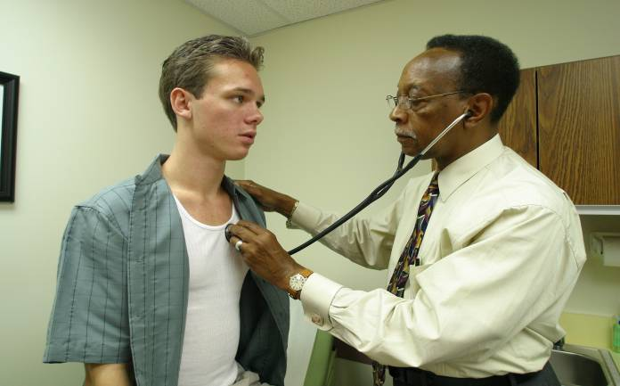
2. Physical Examination
A physical examination cannot confirm or rule out TB disease, but can provide valuable information
Notes:
Review slide content
Physical Examination – Module 3, p. 41

Slide 84
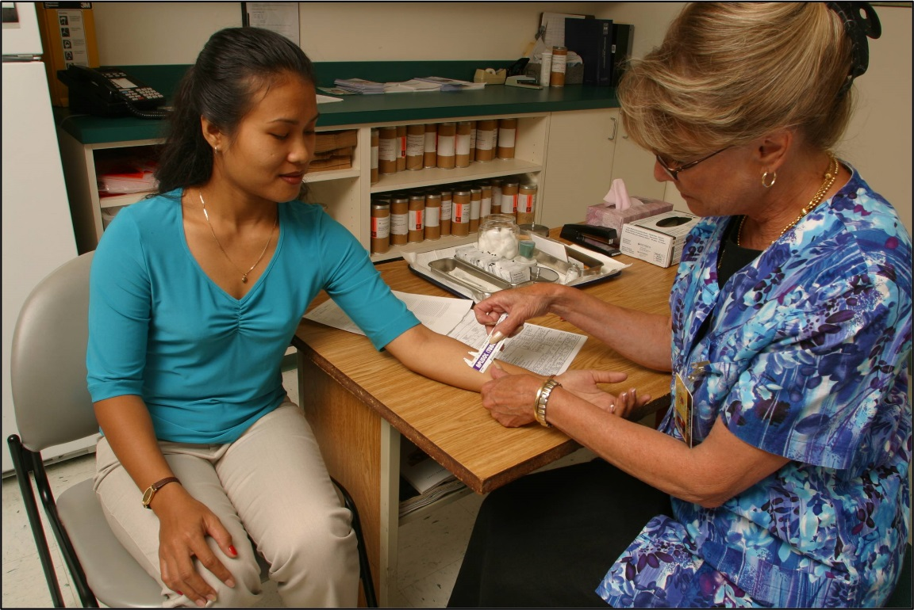
3. Test for TB Infection (1)
Types of tests available for diagnosing TB infection in U.S.:
  Mantoux TST
  IGRAs
    QFT-GIT
    T-SPOT
Notes:
Review slide content
Testing for TB Infection – Module 3, p. 42

Slide 85
3. Test for TB Infection (2)
Patients with symptoms of TB disease should always be evaluated for TB disease, regardless of their TST or IGRA test result
  Clinicians should not wait for TST or IGRA results before starting other diagnostic tests
  TST or IGRA should be given at the same time as other steps in the diagnosis of TB disease
Notes:
Review slide content
Explain that sometimes people with TB disease may have a negative test result
Testing for TB Infection – Module 3, p. 42

Slide 86
Diagnosis of TB Disease
Study Question 3.23
What are the 5 components for conducting a medical evaluation for diagnosing TB disease?
    Medical history
    Physical examination
    Test for TB infection
    Chest x-ray
    Bacteriologic examinations
Notes:
Introduce study questions
Ask participants to turn to p. 43 (if participants have print-based modules)
Read question
Ask participants for answers
Answers – Module 3, p. 77

Slide 87
Diagnosis of TB Disease
Study Question 3.24
What parts of a patient’s medical history should lead a clinician to suspect TB?
    Symptoms of TB disease
    Exposure to a person who has infectious TB or has other risk factors for exposure to TB
    Risk factors for developing TB disease
    TB infection or TB disease in the past
Notes:
Read question
Ask participants for answers
Answers – Module 3, p. 77

Slide 88
Diagnosis of TB Disease
Study Question 3.25
What are the symptoms of pulmonary TB disease? What are the symptoms of extrapulmonary TB disease?
    General symptoms of TB disease: Weight loss, fatigue, malaise, fever, and night sweats
    Pulmonary: Coughing, pain in chest, coughing up sputum or blood
    Extrapulmonary: Depends on the part of the body that is affected by the disease. For example, TB of the spine may cause pain in the back; TB of the kidney may cause blood in the urine.
Notes:
Read questions
Ask participants for answers
Answers – Module 3, p. 78

Slide 89
Diagnosis of TB Disease
Study Question 3.26
For patients with symptoms of TB disease, should clinicians wait for TST or IGRA results before starting other diagnostic tests?
    No, clinicians should not wait for TST or IGRA results before starting other diagnostic tests.
Notes:
Read question
Ask participants for answers
Answers – Module 3, p. 78

Slide 90
Diagnosis of TB Disease
Medical Evaluation
Chest X-Ray
Notes:
Introduce section
Chest X-Ray – Module 3, p. 45

Slide 91
4. Chest X-Ray (1)
When a person has TB disease in the lungs, the chest x-ray usually appears abnormal. It may show:
  Infiltrates (collections of fluid and cells in lung tissue)
  Cavities (hollow spaces within the lung)
Abnormal chest x-ray with cavity
Notes:
Explain that chest x-rays are useful for diagnosing TB disease because pulmonary TB is the most common form of the disease
Review slide content
Explain that the patient in the picture has a cavity in the lower lobe
Chest X-Ray – Module 3, p. 45

Slide 92
4. Chest X-Ray (2)
Chest x-rays can:
  Help rule out possibility of pulmonary TB disease in persons who have a positive TST or IGRA result
  Check for lung abnormalities
Notes:
Review slide content
Chest X-Ray – Module 3, p. 45

Slide 93
4. Chest X-Ray (3)
Chest x-rays cannot confirm TB disease
  Other diseases can cause lung abnormalities
  Only bacteriologic culture can confirm patient has TB disease
  Chest x-ray may appear unusual or even appear normal for persons living with HIV
Notes:
Review slide content
Chest X-Ray – Module 3, p. 46

Slide 94
Chest X-Ray
Study Question 3.27
Name 2 purposes of the chest x-ray.
  Help rule out possibility of pulmonary TB disease in a person who has positive TST or IGRA result and no symptoms of TB
  Check for lung abnormalities in people who have symptoms of TB disease
Notes:
Introduce study questions
Ask participants to turn to p. 47 (if participants have print-based modules)
Read question
Ask participants for answers
Answers – Module 3, p. 78

Slide 95
Chest X-Ray
Study Question 3.28
Can the results of a chest x-ray confirm that a person has TB disease? Why or why not?
    No. A variety of illnesses may produce abnormalities on chest x-ray. Only bacteriologic culture can prove whether or not a patient has TB disease.
Notes:
Read question
Ask participants for answers
Answers – Module 3, p. 78

Slide 96
Diagnosis of TB Disease
Medical Evaluation
Bacteriologic Examination
Notes:
Introduce section
Bacteriological Examination – Module 3, pp. 48-68

Slide 97
5. Bacteriologic Examination (1)
TB bacteriologic examination is done in a laboratory that specifically deals with M. tuberculosis and other mycobacteria
  Clinical specimens (e.g., sputum, urine) are examined and cultured in laboratory
Notes:
Review slide content
Bacteriological Examination – Module 3, p. 48

Slide 98
5. Bacteriologic Examination (2)
Bacteriologic examination has 5 parts
  Specimen collection
  Examination of acid-fast bacilli (AFB) smears
  Direct identification of specimen (nucleic acid amplification)
  Specimen culturing and identification
  Drug susceptibility testing
Notes:
Review slide content
Bacteriologic Examination – Module 3, p. 48

Slide 99
5. Bacteriologic Examination (3)
Specimen Collection
For pulmonary TB, specimens can be collected by:
  Coughing up sputum sample
  Inducing sputum sample
  Bronchoscopy
  Gastric washing
TB patient coughing up sputum in a sputum collection booth
Notes:
Review slide content
Explain that the image is of a TB patient coughing up sputum. The patient is sitting in a special sputum collection booth that prevents the spread of tubercle bacilli.
Specimen Collection – Module 3, pp. 48-51

Slide 100
5. Bacteriologic Examination (4)
Sputum Sample Specimen Collection
Easiest and least expensive method is to have patient cough into sterile container
HCWs should coach and instruct patient
Should have at least 3 sputum specimens examined
  Collected in 8 to 24 hour intervals
  At least one early morning specimen
Notes:
Review slide content
Note that health care workers should always supervise the patient when sputum is collected since patients are not always successful in providing an adequate specimen
Specimen Collection – Module 3, pp. 48-51

Slide 101
5. Bacteriologic Examination (5)
Induced Sputum Collection
Induced sputum collection should be used if patient cannot cough up sputum on their own
Patient inhales saline mist, causing deep coughing
Specimen often clear and watery, should be labeled “induced specimen”
Notes:
Review slide content
Induced Sputum Collection – Module 3, p. 49

Slide 102
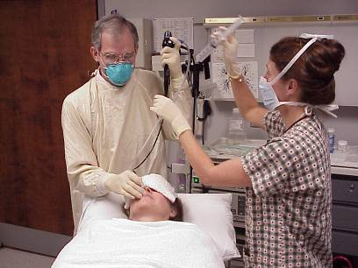
5. Bacteriologic Examination (6)
Bronchoscopy
Bronchoscopy may be used:
  If patient cannot cough up enough sputum
  If an induced sputum cannot be obtained
Procedure: instrument is passed through the mouth into the diseased portion of the lung to obtain sputum or lung tissue
Bronchoscopy being performed on a patient
Notes:
Review slide content
Bronchoscopy – Module 3, p. 49

Slide 103
5. Bacteriologic Examination (7)
Gastric Washing
Usually only used if sample cannot be obtained from other procedures
Often used with children
Tube is inserted through nose and into stomach to obtain gastric secretions that may contain sputum
Notes:
Review slide content
Explain that the goal of gastric washing is to get a sample of gastric secretions that contains sputum that has been coughed into the throat and swallowed
Explain that this technique is often used in children because most children produce little or no sputum when they cough
Gastric Washing – Module 3, p. 50

Slide 104
5. Bacteriologic Examination (8)
Extrapulmonary TB
Specimens other than sputum may be obtained
Depends on part of body affected
For example:
  Urine samples for TB disease of kidneys
  Fluid samples from area around spine for TB meningitis
Notes:
Review slide content
Extrapulmonary TB – Module 3, p. 50

Slide 105
5. Bacteriologic Examination (9)
Examination of AFB Smears
Specimens are smeared onto glass slide and stained
AFB are mycobacteria that remain stained after being washed in acid solution
AFB smear
Notes:
Review slide content
Explain that tubercle bacilli are one kind of AFB
Note that in this photograph, the AFB (shown in red) are tubercle bacilli
Examination of AFB Smears – Module 3, pp. 53-54

Slide 106
5. Bacteriologic Examination (10)
Examination of AFB Smears
Number of AFB on smear are counted
According to number of AFB seen, smears are classified as 4+, 3+, 2+, or 1+
  For example, 4+ smear has 10 times as many AFB than 3+ smear
If very few AFB are seen, the smear is classified by the actual number of AFB seen
A negative smear does not rule out the possibility of TB
Notes:
Review slide content
Explain that when very few AFB are seen, the smear is classified by the actual number of AFB seen and there is NOT a plus sign (+)
Examination of AFB Smears – Module 3, pp. 53-54

Slide 107
5. Bacteriologic Examination (11)
Examination of AFB Smears
Classification of Smear | Smear Result | Infectiousness of Patient
4+ | Strongly positive | Probably very infectious
3+ | Strongly positive | Probably very infectious
2+ | Moderately positive | Probably infectious
1+ | Moderately positive | Probably infectious
Actual number of AFB seen (no plus sign) | Weakly positive | Probably infectious
No AFB seen | Negative | May not be infectious
Notes:
Review slide content
Explain that even though a smear is considered negative if no AFB are seen it does not rule out the possibility of TB disease because there can be AFB in the smear that were not seen
Examination of AFB Smears – Module 3, p. 54

Slide 108
Bacteriologic Examination
Study Questions 3.29
What are the 4 ways to collect sputum specimens? Indicate which procedure is the least expensive and easiest to perform.
    Patient simply coughs up sputum and the sputum is collected in a sterile container. This is the least expensive and easiest procedure.
    Induced sputum
    Bronchoscopy
    Gastric washing
Notes:
Introduce study questions
Ask participants to turn to p. 55 (if participants have print-based modules)
Read question
Ask participants for answers
Answers – Module 3, p. 79

Slide 109
Bacteriologic Examination
Study Question 3.30
What do laboratory personnel look for in a smear?
    Acid-fast bacilli (AFB)
Notes:
Read question
Ask participants for answers
Answers – Module 3, p. 79

Slide 110
Bacteriologic Examination
Study Question 3.31
What does a positive smear indicate about a patient’s infectiousness?
  Patients who have many tubercle bacilli seen in their sputum have a positive smear. Patients who have positive smears are considered infectious because they can cough many tubercle bacilli into the air.
Notes:
Read question
Ask participants for answers
Answers – Module 3, p. 79

Slide 111
Diagnosis of TB Disease
Medical Evaluation
Bacteriologic Examination (continued)
Notes:
Introduce section

Slide 112
5. Bacteriologic Examination (12)
Nucleic Acid Amplification Tests (NAA)
NAA tests directly identify M. tuberculosis from sputum specimens by:
  Amplifying (copying) DNA and RNA segments
Can help guide clinician’s decision for patient therapy and isolation
Does not replace need for AFB smear, culture, or clinical judgment
Notes:
Review slide content
Nucleic Acid Amplification Tests – Module 3, p. 58

Slide 113
5. Bacteriologic Examination (13)
Nucleic Acid Amplification Tests (NAA)
If NAA test and AFB smears are positive:
  Patient is presumed to have TB and should begin treatment
If NAA test is negative and AFB smears are positive:
  Patient may have nontuberculous mycobacteria infection (NTM)
Notes:
Review slide content
Nucleic Acid Amplification Tests – Module 3, p. 58

Slide 114
5. Bacteriologic Examination (14)
Xpert MTB/RIF Assay
Xpert MTB/RIF assay is a NAA test that simultaneously detects Mycobacterium tuberculosis complex (MTBC) and resistance to rifampin
To conduct this test, a sputum sample is mixed with the reagent that is provided with the assay
A cartridge containing the mixture is placed in the GeneXpert machine
Results are available in less than 2 hours
Notes:
Review slide content
Xpert MTB/RIF Assay – Module 3, pp. 58-59

Slide 115
5. Bacteriologic Examination (15)
Xpert MTB/RIF Assay
Results that are positive for MTBC and for rifampin resistance indicate that the bacteria have a high probability of resistance to rifampin
  Should be confirmed by additional rapid testing
If rifampin resistance is confirmed, rapid molecular testing for drug resistance to both first-line and second-line drugs should be performed so an effective treatment regimen can be selected
Notes:
Review slide content
Xpert MTB/RIF Assay – Module 3, pp. 58-59

Slide 116
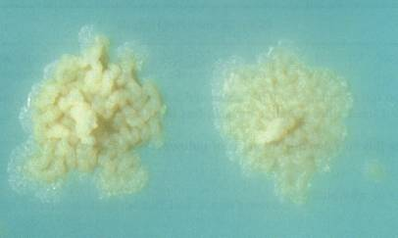
5. Bacteriologic Examination (16)
Culturing and Identifying Specimen
Culturing:
  Determines if specimen contains M. tuberculosis
  Confirms diagnosis of TB disease
All specimens should be cultured
Colonies of M. tuberculosis growing on media
Notes:
Review slide content
Explain that the image is of colonies of M. tuberculosis growing on solid media
Culturing and Identifying Specimen – Module 3, pp. 59-61

Slide 117
5. Bacteriologic Examination (17)
Culturing and Identifying Specimen
Step 1: Detect growth of mycobacteria
  Solid media: 3 to 6 weeks
  Liquid media: 4 to 14 days
Step 2: Identify organism that has grown
  Nucleic acid probes: 2 to 4 hours
Notes:
Review slide content
Explain that mycobacteria grow very slowly
Explain that it is necessary to identify the organism that has grown because all types of mycobacteria can grow on media. Laboratory tests must be done to determine whether the organism is M. tuberculosis or one of the nontuberculous mycobacteria.
Culturing and Identifying Specimen – Module 3, pp. 59-61

Slide 118
5. Bacteriologic Examination (18)
Culturing and Identifying Specimen
Positive culture: M. tuberculosis identified in patient’s culture
  Called M. tuberculosis isolate
  Confirms diagnosis of TB disease
Notes:
Review slide content
Culturing and Identifying Specimen – Module 3, pp. 59-61

Slide 119
5. Bacteriologic Examination (19)
Culturing and Identifying Specimen
Negative culture: M. tuberculosis NOT identified in patient’s culture
  Does not rule out TB disease
  Some patients with negative cultures are diagnosed with TB based on signs and symptoms
Notes:
Review slide content
Culturing and Identifying Specimen – Module 3, pp. 59-61

Slide 120
5. Bacteriologic Examination (20)
Culturing and Identifying Specimen
Bacteriological examinations are important for assessing infectiousness and response to treatment
Specimens should be obtained monthly until 2 consecutive cultures are negative
Culture conversion is the most important objective measure of response to treatment
Notes:
Review slide content
Explain that culture conversion is when the culture goes from positive growth to negative growth of M. tuberculosis
Culturing and Identifying Specimen – Module 3, pp. 59-61

Slide 121
5. Bacteriologic Examination (21)
Drug Susceptibility Testing
Conducted when patient is first found to have positive culture for TB
Determines which drugs kill tubercle bacilli
Tubercle bacilli killed by a particular drug are susceptible to that drug
Tubercle bacilli that grow in presence of a particular drug are resistant to that drug
Notes:
Review slide content
Explain that the drug susceptibility pattern of a strain of tubercle bacilli is the list of drugs to which the strain is susceptible and to which it is resistant
Stress that it is crucial to identify drug resistance as early as possible to ensure effective treatment
Drug Susceptibility Testing – Module 3, pp. 64-66

Slide 122
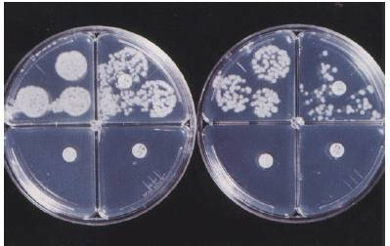
5. Bacteriologic Examination (22)
Drug Susceptibility Testing
Tests should be repeated if:
  Patient has positive culture after 3 months of treatment; or
  Patient does not get better
Drug susceptibility testing on solid media
Notes:
Review slide content
Explain that the image is of drug susceptibility testing on solid media. Organisms are resistant to the drug in the upper right compartment and susceptible to the drugs in the lower compartments. The upper left contains no drugs.
Drug Susceptibility Testing – Module 3, pp. 64-66

Slide 123
5. Bacteriologic Examination (23)
Types of Drug-Resistant TB
Mono-resistant | Resistant to any one TB treatment drug
Poly-resistant | Resistant to at least any two TB drugs (but not both isoniazid and rifampin)
Multidrug- resistant (MDR TB) | Resistant to at least isoniazid and rifampin, the two best first-line TB treatment drugs
Extensively drug-resistant (XDR TB) | Resistant to isoniazid and rifampin, PLUS resistant to any fluoroquinolone AND at least 1 of the 3 injectable second-line drugs (e.g., amikacin, kanamycin, or capreomycin)
Notes:
Explain that these are four types of drug-resistant TB
Review slide content
Types of Drug-Resistant TB – Module 3, p. 64

Slide 124
5. Bacteriologic Examination (24)
Growth-Based Drug Susceptibility Testing
Growth-based susceptibility testing can be done using a liquid or solid medium method
Organisms that grow in media containing a specific drug are considered resistant to that drug
Liquid medium methods are faster than solid media methods for determining susceptibility to first-line TB medications
Results can be obtained within 7 to 14 days for liquid medium method and up to 21 days for solid medium method
Notes:
Review slide content
Growth-Based Drug Susceptibility Testing - Module 3, p. 65

Slide 125
5. Bacteriologic Examination (25)
Molecular Detection of Drug Resistance
Molecular tests provide preliminary guidance on effective therapy for TB patients
These tests should be considered for patients with the following characteristics:
  High risk of rifampin resistance, including MDR TB;
  First-line drug susceptibility results are available and show resistance to rifampin;
  Infectiousness poses a risk to vulnerable contacts; and
  Contraindications to essential first-line medications
Notes:
Review slide content
Growth-Based Drug Susceptibility Testing - Module 3, p. 65

Slide 126
Culture Specimen
Study Question 3.32
Why is it necessary to culture a specimen?
    It is necessary to culture a specimen to determine whether the specimen contains M. tuberculosis and to confirm diagnosis of TB disease. Additionally, culture is needed for genotyping and for performing drug susceptibility testing.
Notes:
Introduce study questions
Ask participants to turn to p. 67 (if participants have print-based modules)
Read question
Ask participants for answers
Answers – Module 3, p. 79

Slide 127
Culture Specimen
Study Question 3.33
What does a positive culture for M. tuberculosis mean? How is this important for the TB diagnosis?
    It means that M. tuberculosis has been identified in a patient’s culture. A positive culture for M. tuberculosis confirms the diagnosis of TB disease.
Notes:
Read question
Ask participants for answers
Answers – Module 3, p. 80

Slide 128
Drug Susceptibility
Study Question 3.34
Why are drug susceptibility tests done?
    To determine which drugs will kill the tubercle bacilli that are causing disease in a particular patient. Test results can help clinicians choose the appropriate drugs for each patient.
Notes:
Read question
Ask participants for answers
Answers – Module 3, p. 80

Slide 129
Drug Susceptibility
Study Question 3.35
How often should drug susceptibility tests be done?
    Should be done when the patient is first found to have a positive culture for M. tuberculosis
    Tests should be repeated if a patient has a positive culture for M. tuberculosis after 3 months of treatment or if a patient is not getting better
Notes:
Read question
Ask participants for answers
Answers – Module 3, p. 80

Slide 130
Reporting TB Cases
Notes:
Introduce section
Reporting TB Cases – Module 3, p. 63

Slide 131
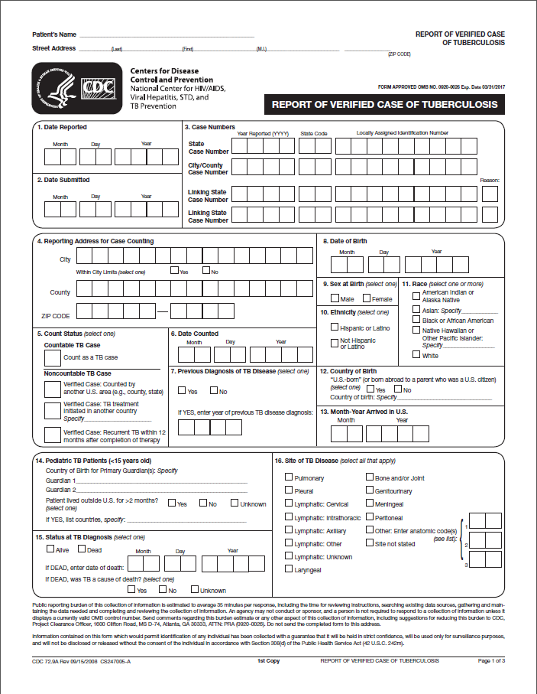
Reporting TB Cases
TB programs report TB cases to CDC using a standard case report form called the Report of Verified of Case of Tuberculosis (RVCT)
  All cases that meet criteria are called verified TB cases
Notes:
Review slide content
State that health care providers are required by law to report TB cases to state or local health departments
Note that the image is of the first page of the RVCT form
Reporting TB Cases – Module 3, p. 63

Slide 132
Criteria for Reporting TB Cases (1)
Cases that meet one of these four sets of criteria are counted as verified TB cases:
  Patient has positive culture for M. tuberculosis
  Patient has positive NAA test for M. tuberculosis
    NAA test must be accompanied by culture for mycobacteria species
Notes:
Explain that each reported TB case is checked to make sure it meets certain criteria. All cases that meet the criteria, called verified TB cases, are counted each year
Review slide content
Reporting TB Cases – Module 3, p. 63

Slide 133
Criteria for Reporting TB Cases (2)
  Patient has positive AFB smear, but culture has not been obtained or is falsely negative or contaminated
  In the absence of laboratory confirmation, patient meets all of the following criteria:
    Positive TST or IGRA,
    Other signs and symptoms of TB disease,
    Treatment with 2 or more TB drugs, and
    A completed diagnostic evaluation.
Notes:
Review slide content
Reporting TB Cases – Module 3, p. 63

Slide 134
Criteria for Reporting TB Cases (3)
Cases that do not meet any of these sets of criteria may be counted as a verified TB case if health care provider has reported the case and decided to treat the patient for TB disease
Notes:
Review slide content
Provide an example of this situation (e.g., a patient who is anergic and has a negative culture for M. tuberculosis but who has signs and symptoms of TB disease may be counted as a verified case of TB if the health care provider has reported the case and decided to treat the patient for TB disease)
Reporting TB Cases – Module 3, p. 63

Slide 135
Case Studies
Notes:
Introduce case studies

Slide 136
Module 3: Case Study 3.1
Which of the following patients have a positive TST reaction? Circle the best answer(s).
    Mr. West, 36 yrs. old, HIV infected, 8 mm induration
    Ms. Hernandez, 26 yrs. old, native of Mexico, 7 mm induration
    Ms. Jones, 56 yrs. old, diabetic, 12 mm induration
    Mr. Sung, 79 yrs. old, nursing home resident, 11 mm induration
    Mr. Williams, 21 yrs. old, no known risk factors, 13 mm induration
    Ms. Marcos, 42 yrs. old, chest x-rays findings suggestive of previous TB, 6 mm induration
    Ms. Rayle, 50 yrs. old, husband has pulmonary TB, 9 mm of induration
Notes:
Ask participants to turn to p. 16 (if participants have print-based modules)
Read case study
Ask participants which of the patients have a positive TST reaction
Answers – Module 3, p. 81

Slide 137
Module 3: Case Study 3.2 (1)
A 30 year-old man who recently immigrated to the United States from India is given a TST and found to have 14 mm of induration. He reports that he was vaccinated with BCG as a child. He also says that his wife was treated for pulmonary TB disease last year.
Notes:
Ask participants to turn to p. 19 (if participants have print-based modules)
Read case study
Case Study 3.2 – Module 3, p. 19

Slide 138
Module 3: Case Study 3.2 (2)
How should this man’s results be interpreted?
    Positive reaction to TST
    Should be further evaluated for LTBI or TB disease
What factors make it more likely that this man’s positive reaction is due to TB infection?
    From area of the world where TB is common
    Wife had pulmonary TB
Notes:
Read case study questions
Ask participants for answers
Answers – Module 3, p. 82

Slide 139
Module 3: Case Study 3.3 (1)
Mr. Bell comes to the TB clinic for a TST. He believes that he has been exposed to TB, and he knows he is at high risk for TB because he is HIV infected. He is given a TST, and his reaction is read 48 hours later as 0 mm of induration.
Notes:
Ask participants to turn to p. 24 (if participants have print-based modules)
Read case study
Case Study 3.3 – Module 3, p. 24

Slide 140
Module 3: Case Study 3.3 (2)
What are 3 ways to interpret this result?
    May not have TB infection
    May be anergic
    It may be less than 8 to 10 weeks since he was exposed to TB
Notes:
Read case study question
Ask participants for answers
Answers – Module 3, p. 82

Slide 141
Module 3: Case Study 3.4 (1)
Ms. Wilson is a 60-year-old nurse. When she started a job at the local hospital, she was given a TST, her first test in 25 years. Her reaction was read 48 hours later as 0 mm induration. Six months later, she was retested as part of the TB testing program in the unit where she works. Her skin test reaction was read 48 hours later as 11 mm of induration.
Notes:
Ask participants to turn to p. 38 (if participants have print-based modules)
Read case study
Case Study 3.4 – Module 3, p. 38

Slide 142
Module 3: Case Study 3.4 (2)
What are 2 ways to interpret this result?
    She was exposed to TB sometime in the 6 months between her first and second skin tests
    She had a boosted reaction
Notes:
Read case study question
Ask participants for answers
Answers – Module 3, p. 83

Slide 143
Module 3: Case Study 3.5 (1)
Mr. Lee has a cough and other symptoms of TB disease, and he is evaluated with a chest x-ray. However, he is unable to cough up any sputum on his own for the bacteriologic examination.
Notes:
Ask participants to turn to p. 52 (if participants have print-based modules)
Read case study
Case Study 3.5 – Module 3, p. 52

Slide 144
Module 3: Case Study 3.5 (2)
What should be done?
    Since he is unable to cough up sputum, other techniques can be used to obtain sputum. First, clinicians can try to obtain an induced sputum sample. If they cannot obtain the sample, a bronchoscopy or gastric washing may be done.
Notes:
Read case study question
Ask participants for answers
Answers – Module 3, p. 83

Slide 145
Module 3: Case Study 3.6 (1)
Ms. Thompson gave three sputum specimens, which were sent to the laboratory for smear examination and culture. The smear results were reported as 4+, 3+, and 4+.
Notes:
Ask participants to turn to p. 56 (if participants have print-based modules)
Read case study
Case Study 3.6 – Module 3, p. 56

Slide 146
Module 3: Case Study 3.6 (2)
What do these results tell you about Ms. Thompson’s diagnosis and her infectiousness?
    Results show that Ms. Thompson’s sputum specimens contain many acid-fast bacilli
    Clinicians should suspect that she has TB disease and should consider her infectious since her smears are positive
    It is possible that the AFB are mycobacteria other than tubercle bacilli
    Diagnosis cannot be confirmed until culture results are available
Notes:
Read case study question
Ask participants for answers
Answers – Module 3, p. 84

Slide 147
Module 3: Case Study 3.7 (1)
Mr. Sagoo has symptoms of TB disease and a cavity on his chest x-ray, but all of his sputum smears are negative for acid-fast bacilli.
Notes:
Ask participants to turn to p. 57 (if participants have print-based modules)
Read case study
Case Study 3.7 – Module 3, p. 57

Slide 148
Module 3: Case Study 3.7 (2)
Does this rule out the diagnosis of pulmonary TB disease?
No
Why or why not?
    M. tuberculosis may grow in the cultures even though there were no acid fast bacilli on the smear. Mr. Sagoo’s symptoms and his abnormal chest x-ray suggest that he has pulmonary TB disease.
Notes:
Read case study questions
Ask participants for answers
Answers – Module 3, p. 84

Slide 149
Module 3: Case Study 3.8 (1)
In the public health clinic, you see a patient, Ms. Sanchez, who complains of weight loss, fever, and a cough of 4 weeks duration. When questioned, she reports that she has been treated for TB disease in the past and that she occasionally injects heroin.
Notes:
Ask participants to turn to p. 68 (if participants have print-based modules)
Read case study
Case Study 3.8 – Module 3, p. 68

Slide 150
Module 3: Case Study 3.8 (2)
What parts of Ms. Sanchez’s medical history lead you to suspect TB disease?
    Symptoms of TB disease (weight loss, fever, persistent cough)
    Past treatment for TB disease
    History of injecting illegal drugs
What diagnostic tests should be done?
    Chest x-ray
    Sputum smear and culture
    Drug susceptibility testing
Notes:
Read case study questions
Ask participants for answers
Ask if there are any questions about Module 3 before moving on to Module 4
Answers – Module 3, p. 84

