Slide 1
Tuberculosis (TB) in Correctional Settings: What Corrections Staff Need to Know
Notes:
Facilitator Tips:
Introduce yourself to participants.
Ask participants to introduce themselves.
Take care of any presentation/room details.

Slide 2
Topics for Today
Basic TB information
TB testing
TB treatment
TB in correctional settings
Collaboration between correctional facilities and TB control programs
Discharge/release planning
Contact investigations
Notes:
Facilitator Tip:
Revise to reflect topics to be covered. For example, if the presentation needs to be shortened.

Slide 3
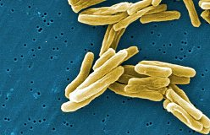
TB Basics
Notes:
Facilitator Tip:
Introduce this section and explain why it is important for staff in correctional environments to understand TB. You might want to discuss local epidemiology or a recent outbreak that may be pertinent to the correctional facility.

Slide 4
Tuberculosis (TB)
TB is a disease caused by a bacteria.
TB is spread through the air from person to person when a person with TB disease of the lungs (or throat) coughs, sneezes, speaks, or sings.
The bacteria usually attack the lungs, but can attack any part of the body such as the kidney, spine, and brain.
Notes:
Facilitator Tip:
Emphasize that TB is spread through the air from person to person.

Slide 5
Latent TB Infection and TB Disease
People who are infected with TB bacteria, but are not sick have latent TB infection.
Some people with latent TB infection go on to develop TB disease.
As a result, two TB-related conditions exist: latent TB infection and TB disease.
Notes:
Facilitator Tips:
Emphasize that not everyone who is exposed to someone with TB disease will become infected.
Risk of developing TB disease is increased by certain co-morbid conditions (including HIV and diabetes) and by recent exposure to TB.

Slide 6
Latent TB Infection
People with latent TB infection:
Do not have any symptoms
Cannot spread TB germs to others
May develop TB disease later
Usually have a TB skin test or TB blood test result that is positive for TB infection
Should consider treatment for latent TB infection to prevent TB disease
Notes:
Facilitator Tips:
Emphasize that those with latent TB infection are not sick, do not have symptoms and are not infectious.
Identify opportunities for treating latent TB infection to prevent TB disease, especially among high risk groups.
Some people with latent TB infection may develop TB disease. Explain importance of treating LTBI to prevent developing to TB disease.
TB disease can develop weeks, months, or years later.

Slide 7
TB Disease
People with TB disease:
Are sick and may have symptoms
May be able to spread TB germs to other people
Usually have a TB skin or TB blood test result that is positive for TB infection
May have an abnormal chest x-ray
Need treatment
Should seek medical evaluation if they have symptoms of TB disease
Notes:
Facilitator Tips:
Emphasize that those with TB disease are sick, may have symptoms, and may be able to spread bacteria to others.
Those with TB disease will need supervised, uninterrupted treatment.

Slide 8
Symptoms of TB Disease
Symptoms of TB disease may include:
A bad cough that lasts 3 weeks or longer
Pain in the chest
Coughing up blood
Tiredness
Weight loss (unexplained)
No appetite
Chills, fever, and sweating at night
Notes:
Facilitator Tip:
Discuss the symptoms of TB disease.

Slide 9
Persons at Risk for Exposure to TB
Includes:
Contacts of persons known or suspected to have TB disease
Persons from an area of the world where TB disease is very common (such as most countries in Latin America and the Caribbean, Africa, Asia, Eastern Europe, and Russia)
Homeless persons, and
Injection drug users
Notes:
Facilitator Tip:
Discuss and explain TB risk factors in the correctional population.

Slide 10
Persons at Risk for Exposure to TB in Congregate Settings
Workers or residents in these facilities or institutions where there is a higher risk for exposure to TB bacteria:
Correctional and detention facilities
Homeless shelters
Hospitals
Nursing homes
Residential facilities for patients with HIV/AIDS

Slide 11
Progression from Latent TB Infection to TB Disease
Progression from latent TB infection to TB disease is more likely in persons who:
Are living with HIV/AIDS
Have a weakened immune system from other diseases (e.g., cancer, diabetes)
Became infected with TB bacteria in the last 2 years
Were not treated correctly for TB in the past
Have low body weight (10% or below ideal)
Inject illicit drugs
Notes:
Facilitator Tip:
You may wish to include local data regarding groups in your jurisdiction/area that are at risk.

Slide 12
TB Testing in Correctional Facilities
Notes:
Facilitator Tips:
Introduce this section
Ask participants if they have any questions.

Slide 13
Testing for TB
TB testing helps find persons with latent TB infection who are at high risk for developing TB disease.
Treating latent TB infection can prevent the progression to TB disease.
Treating persons before they become ill with TB disease prevents the transmission of TB germs.
The health department is available to assist by providing TB consultation to correctional medical staff.
Notes:
Facilitator Tip:
Discuss the importance of TB testing for inmates and staff.

Slide 14
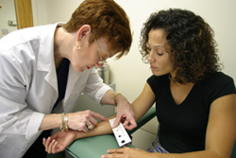
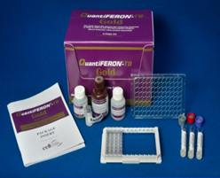
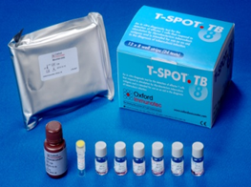
Types of TB Tests
There are 2 tests that can be used to detect TB infection:
The Mantoux tuberculin skin test (TST)
TB blood test (IGRA)
TST Reading
Blood Test
Notes:
Facilitator Tips:
Discuss TB testing.
TSPOT and QuantiFERON are the TB blood tests that are currently approved in the U.S.

Slide 15
TB Test Results
A positive TST or TB blood test result only shows that someone has been infected with TB bacteria. These tests cannot identify if a person has TB disease.
Persons with positive test results for TB infection, or symptoms consistent with TB disease, should be evaluated for TB disease by a health care provider and get a chest x-ray.
Notes:
Facilitator Tip:
This might be a good time to pause for questions.

Slide 16
TB Testing and Evaluation for TB Disease
Initial TB testing should be performed by
Health-care professionals whenever possible or
Adequately trained correctional staff
At intake, all incoming inmates should be screened for symptoms of TB disease. Inmates should be asked if they have
Symptoms of TB disease
A history of TB
Ever been treated for latent TB infection or TB disease

Slide 17
Think TB
Think TB when these symptoms are present:
A bad cough that lasts 3 weeks or longer
Pain in the chest
Coughing up blood
Tiredness
Weight loss (unexplained)
No appetite
Chills, fever, and sweating at night
Notes:
Facilitator Tips:
This is a reminder of the symptoms of TB disease.
You may wish to delete this if the audience is already knowledgeable about with TB prior to presentation.

Slide 18
TB Testing of Inmates in Correctional Facilities and in Other Short-Term Detention Facilities
Primary purpose of TB testing in correctional settings is to detect TB infection or TB disease
All inmates should be screened upon intake for symptoms of TB disease
Inmates with TB symptoms should be evaluated immediately for TB disease
Inmates with TB risk factors but no TB symptoms should be tested within seven days of arrival (or per state and local guidelines)
Notes:
Facilitator Tips:
Emphasize importance of collaboration between correctional facilities and local health department to ensure effective TB testing.
Correction staff should learn to screen inmates to get accurate information regarding TB from them.

Slide 19
TB Testing of Inmates in Holding or Booking Facilities
Provide TB symptom screening for all persons at the time of entry
Those with TB symptoms should be
Immediately isolated and transferred to a facility or hospital that has a medical isolation room
Evaluated for TB disease
Notes:
Facilitator Tips:
Discuss the testing process for those in holding and booking facilities. Explain an Airborne Infection Isolation (AII) room.
Note: if no negative AII room is available, place inmate outside in open air or in segregation until able to transfer to negative AII room.

Slide 20
Periodic TB Testing of Inmates
Long-term inmates with an initial negative TST or TB blood test result should have follow-up testing at least annually.
Inmates with a history of a positive TB test result should be examined for symptoms of TB disease at least annually.
Notes:
Facilitator Tip:
Identify those groups that should be tested annually in correctional facilities.

Slide 21
TB Testing of Correctional Employees
New employees should be tested for TB infection upon hire.
All employees with an initial negative TST or TB blood test result should have follow-up testing at least annually.
Employees with a history of a positive test result should be examined for symptoms of TB disease at least annually.
Notes:
Facilitator Tips:
Identify those groups that should be tested annually in correctional facilities.
Correctional facilities may include multiple employers (e.g., contractors, security, transportation).

Slide 22
Other Persons Who Need to be Tested in Correctional Settings
People who are neither inmates nor employees who visit high-risk facilities on a regular basis should be considered for TB testing (e.g., food handlers, service workers, volunteers, and those providing religious ministries)
TB testing should follow the same procedures used for employees
Notes:
Facilitator Tips:
Remember: testing of non-employees should follow the same procedures as testing for employees.
You may wish to ask the group to make of list of who has access to the facility to start thinking about who may need to be included in annual testing/screening.
Other people that may be considered for testing are attorneys, contract security, and transportation drivers who have contact with the inmates.

Slide 23
Determining Frequency of TB Testing
Frequency of testing is determined by an assessment of the risk for TB transmission within the facility.
Risk assessments for facilities should be
Performed at least annually
Done in collaboration with the local or state TB control program (health department)
Notes:
Facilitator Tips:
Discuss types of TB testing.
Ask participants how often a TB risk assessment is done in their facilities.
This is an opportunity for public health/TB program to assist the correctional facility with determining their risk classification.

Slide 24
What to do if an Inmate has TB Symptoms?
Inmates with symptoms of TB disease should immediately be separated from other inmates and receive a complete medical evaluation including
Test for TB infection (TB skin test or TB blood test)
Chest X-ray
Appropriate laboratory tests
Notes:
Facilitator Tip:
Ask participants if they have any questions.

Slide 25
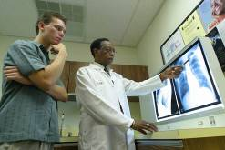
TB Treatment

Slide 26
Importance of Treating Latent TB Infection and TB Disease
Latent TB infection is treated to prevent progression to TB disease.
TB disease is treated to cure the patient and to prevent the transmission of TB bacteria to others.
Notes:
Facilitator Tip:
Discuss treatment adherence-This is essential to ensure completion of therapy and a determinant of treatment outcome.

Slide 27
Treatment of LTBI and TB Disease
Latent TB Infection
Depending on drugs used, treatment could last from 3 months (with 2 drugs) to 9 months (with a single drug).
TB Disease
Minimum of 6 months of treatment with multiple drugs.
Notes:
Facilitator Tip:
Treatment for LTBI should be considered for all persons with a positive skin test, and especially for those who are more likely to develop TB disease once infected.

Slide 28
Adherence to Treatment
Directly Observed Therapy (DOT) should be used throughout the entire course of therapy.
DOT is when a person is appointed to watch a patient take each dose of medications.
DOT should be coordinated with the local health department upon an inmate’s release.
DOT should be used for all TB disease treatment and for the short course 12-dose latent TB infection treatment.
Local health department may also be involved in monitoring therapy for correctional facility staff.
Notes:
Facilitator Tips:
For treatment outcome to be successful, patients must take all medication as instructed.
It is important to emphasize why adherence is so important (prevent MDR TB, completion of treatment in the shortest time period).
In detention settings, DOT should be implemented during pill line.

Slide 29
Environmental Control: TB in Correctional Settings

Slide 30
Correctional Facilities - The Environment
Inmates are from populations at higher risk for TB than non-inmates.
Correctional facilities have close living quarters, are typically overcrowded, and may have poor air circulation.
Interruption of TB treatment caused by frequent movement, transfers, and inmates returning to the community can affect treatment success and transmission of TB germs.
Notes:
Facilitator Tip:
Discuss and explain factors for TB in correctional settings. Emphasize the fact that overcrowding, inadequate ventilation, high risk populations are key factors.

Slide 31
Correctional Facilities- TB Transmission
Transmission of TB germs can occur in correctional facilities
Inmates with undiagnosed TB disease place other inmates and correctional staff at risk for TB; when released, they can spread TB bacteria to members of the community.
Immediate isolation of patients diagnosed with TB disease can help interrupt the spread of TB germs.
If inmates are co-infected with HIV and TB, they are at higher risk for developing TB disease.
Notes:
Facilitator Tips:
Discuss and explain that all people in correctional facilities inmates and staff may be at risk for TB.
TB disease should be considered contagious until determined noncontagious by a medical provider with expertise in the management of TB disease.

Slide 32
TB in Correctional Population in the United States, 2019
In 2019, approximately 3% of TB cases reported in the United States occurred among people who were incarcerated at the time of diagnosis
Notes:
Facilitator Tips:
Discuss and explain these statistics.
Approximately 4-6% of TB cases reported in the United States occur among people incarcerated at the time of diagnosis.

Slide 33
Working with the Health Department to Report a TB Case
All states require reporting of suspected and confirmed patients with TB disease to their local or state health department.
Non-medical correctional staff should report any persons with suspected TB disease to medical staff.
Correctional facility medical staff should report any suspected or confirmed TB cases among inmates or employees to the appropriate health agency according to state and local laws and regulations.
Notes:
Facilitator Tip:
All states require that suspected and confirmed cases of TB be reported to local and state health departments.
Correctional facility medical staff should report any suspected or confirmed TB cases among inmates or employees to the appropriate health agency in accordance with state and local laws and regulations, even if the inmate or detainee has already been released or transferred from the facility.

Slide 34
TB Patient Isolation
Since TB germs can be transmitted from person to person, it is important to practice appropriate isolation procedures to protect inmates and staff from exposure to TB bacteria.
Environmental control measures should be implemented to reduce the amount of TB bacteria in the air by
Removing contaminated air using ventilation
Cleaning the air using HEPA filtration and/or Ultraviolet Germ Irradiation (UVGI)
Notes:
Facilitator Tips:
Explain the purpose of TB isolation in the correctional setting.
Discuss how the correctional definition for isolation might be different from a medical definition of isolation.

Slide 35
Isolation Rooms
Inmates known or suspected to have TB disease should be placed in an airborne infection isolation (AII) room.
Infectious inmates should remain in isolation until treatment or further evaluation shows that they are no longer infectious.
Facilities without an on-site AII room should have a written plan for the transfer of patients with suspected or confirmed TB to a facility that can isolate, evaluate, and treat TB patients.
Notes:
Facilitator Tips:
Airborne Infection Isolation Rooms (AII) is the new terminology for Negative Pressure AFB Isolation Rooms.
More discussion about AII rooms-very important to isolate inmates known or suspected to have TB disease. A written plan is needed to transfer TB patients to facility that can isolate, evaluate, and treat TB patients.

Slide 36
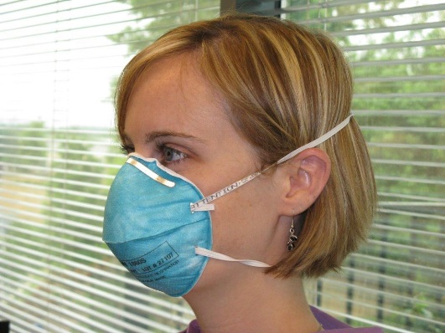
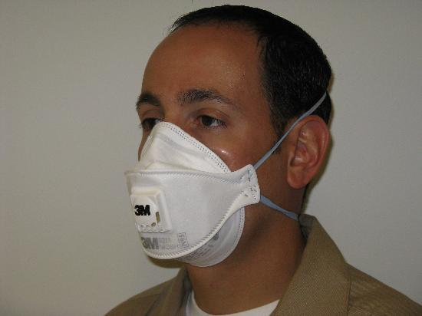
Implementing a Respiratory Protection Program
All facilities (i.e., employers) should develop, implement, and maintain a respiratory protection program for health-care workers and other staff (including officers and guards).
Respiratory protection is needed for inmates and staff who enter AII rooms, transport infectious persons in an enclosed vehicle, or perform cough-inducing procedures.
Respiratory protection programs are required for facilities covered by the U.S. Occupational Safety and Health Administration (OSHA).
Notes:
Facilitator Tips:
Explain the importance of implementing a respiratory protection program.
Respiratory protection is needed whenever inmates or staff share air (or share air space) with a person with infectious TB.

Slide 37
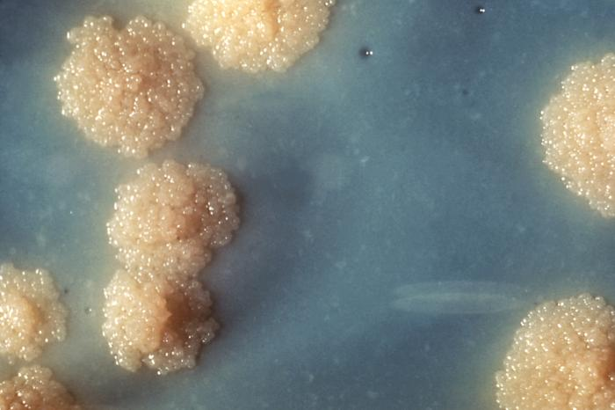
Collaboration Between Correctional Facilities and Public Health TB Control Programs

Slide 38
Collaboration
Correctional facilities and public health programs should work together to:
Ensure that TB-control efforts are undertaken in the most cost-effective manner.
Maximize the effectiveness of TB treatment begun in a correctional facility by linking released detainees to the public healthcare system.
Facilities should ensure transition plans are in place for all inmates with active TB disease prior to release.
Notes:
Facilitator Tips:
Discuss the components of planning for discharge/release and involve participants in discussion
Health department may need to include law enforcement agencies that have legal custody for the detainee or inmate (which is often different from the “facility” which provides shelter and care).

Slide 39
Points of Contact for TB-Associated Efforts
Correctional facilities should designate points of contact (POC) with the health department
State TB control offices have a designated correctional liaison. A list of liaisons can be found at the National TB Controllers Association Corrections website: http://www.tbcontrollers.org/ntca-2/committees/corrections/
Correctional staff POCs should be either responsible for, or familiar with, TB control
POCs should hold regular meetings with correctional facility and public health department staff to discuss TB control efforts
Notes:
Facilitator Tips:
Discuss the importance of a productive relationship between public health and correctional organizations.
Liaisons can help build this relationship.

Slide 40
Public Health & Correctional Point of Contact (POC) Collaboration
Public health and correctional facility POCs should collaborate on:
Planning for inmate release (if receiving treatment for TB)
Contact investigations
Implementation of TB control in correctional facility
Implementation of facility TB risk assessment and infection control measures
Notes:
Facilitator Tips:
Discuss the components of discharge planning and involve participants in discussion.
Discuss the components of planning for dishcharge/release from the correctional facility and involve participants in the discussion.
Include law enforcement agency POCs.
It is the law enforcement agency, not the facility, that controls and has authority for custody actions, transfer, release, court, transport.

Slide 41
Collaboration: Planning for Release
Collaboration and communication can reduce the disruption of TB treatment due to:
Short length of stay in a facility
Unanticipated release or transfer
Limited channels of communication
Limited resources - including staff, equipment, and medications
Loss to follow up without treatment completion
Due to transfer to other facilities or other cells
Due to release
Notes:
Facilitator Tip:
It is important that correctional and public health staff collaborate to make discharge/release planning successful.

Slide 42
TB Contact Investigations (1)
The overall goal is to interrupt the spread of TB bacteria and prevent future cases of TB disease
Ongoing transmission is prevented by
Identifying, isolating, and treating persons with TB disease
Identifying infected contacts of the TB patient and providing them with a complete course of treatment for latent TB infection
Notes:
Facilitator Tip:
Discuss overall purpose and goal of contact investigation.

Slide 43
TB Contact Investigations (2)
A multidisciplinary team should be formed to address the complicated nature of a contact investigation in correctional facilities including:
Correctional healthcare workers
Public health staff
Administrative staff to track inmate movements

Slide 44
TB Contact Investigations (3)
Two correctional data systems are critical in a contact investigation
Inmate medical record system containing TB testing results and other relevant information
An inmate tracking system
Health departments can assist correctional facilities in planning, implementing, and evaluating a contact investigation.

Slide 45
Collaboration Among TB Control Programs and Correctional Facilities is Key to TB Reduction.
Notes:
Facilitator Tip:
Determining roles and opportunities for collaboration is best when done prior to a TB incident.

Slide 46
Collaboration Opportunities
Testing and treating inmates for latent TB infection and TB disease
Follow-up of inmates with TB symptoms or abnormal chest X-rays
Medical consultation regarding persons with confirmed and suspected TB disease
Contact investigations for reported TB cases
Evaluation of screening effectiveness and case management
Facility risk assessment
Release planning
Notes:
Facilitator Tips:
Discuss roles that require collaboration between correctional facilities and health departments. Ask correctional staff “how would this work for you?”
Start the dialogue for collaboration.

Slide 47
Correctional Facilities Can Assist With:
Reporting TB disease promptly according to state and local regulations
Continuity of treatment and release planning for persons with TB disease and latent TB infection
Notes:
Facilitator Tip:
Discuss roles that require collaboration between correctional facilities and health departments.

Slide 48
Community-Based Case Management After Release (1)
Case management strategies (for example directly observed therapy) begun in the correctional facility should be continued after release for former inmates with
Confirmed or suspected TB disease
Latent TB infection who are at high risk for progression to TB disease
Notes:
Facilitator Tips:
Discuss the importance of having a plan for community-based case management after inmates are released.
Note: May delete depending on audience.

Slide 49
Community-Based Case Management After Release (2)
Providing incentives and enablers (for example meal coupons, bus passes, and gift cards) combined with education and counseling can help improve short-and long-term adherence to TB treatment
Curing TB is essential to reducing the spread of TB in the community
Notes:
Facilitator Tips:
Discuss the importance of having a plan for community-based case management after inmates are released.
Note: May delete depending on audience.

Slide 50
Release Planning for U.S. Immigration and Customs Enforcement Detainees (1)
Persons with TB disease detained by U.S. Immigration and Customs Enforcement (ICE) are a potential public health threat because they are
Typically highly mobile
Likely to be transported from the U.S.
May re-enter the U.S. before completion of TB therapy
At high risk for not completing treatment upon release without close coordination of release planning for transnational continuity of care
Notes:
Facilitator Tips:
Discuss the process of discharge planning if ICE is involved.
Note: May delete depending on audience.

Slide 51
Release Planning for U.S. Immigration and Customs Enforcement Detainees (2)
Ensuring treatment of detainees is important to the national strategy to eliminate TB in the United States
Detention facility staff should notify their local ICE Field Medical Coordinator of any ICE detainee with suspected or confirmed TB disease
There are organizations that can assist in continuity of care for detainees who may be removed to their country of nationality (ANY country)
Notes:
Facilitator Tips:
Discuss the process of discharge planning if ICE is involved.
There are organizations that can assist in continuity of care for ICE detainees:
CureTB.org (For Mexico and other parts of Latin America)
TBNet website (For Asia, Africa, Europe, etc.)
Health departments should verify which law enforcement agency has legal custody of TB patients identified in correctional facilities.
Note: May delete depending on audience.

Slide 52
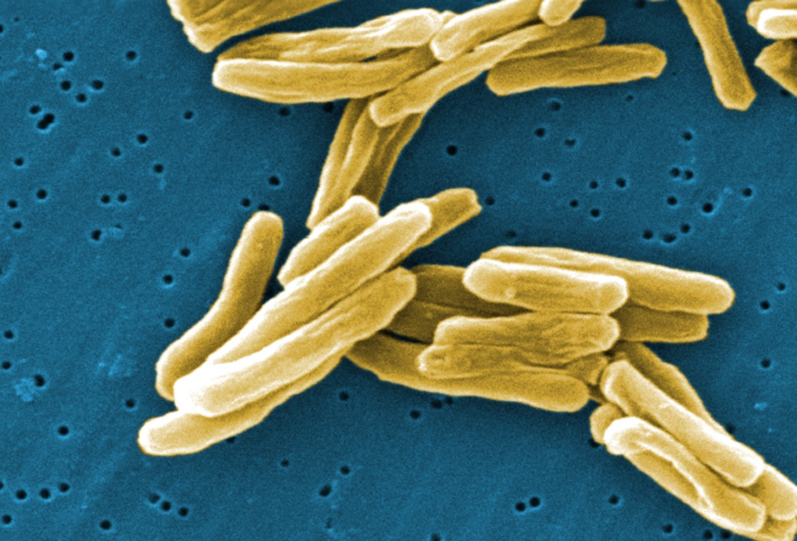
Resources
Notes:
Facilitator Tips:
Conclusion
Ask participants if they have any questions.

Slide 53
CDC Resources
Questions and Answers about Tuberculosis http://www.cdc.gov/tb/publications/faqs/default.htm
Tuberculosis Fact Series http://www.cdc.gov/tb/publications/factsheets/general.htm
Correctional Facilities Website http://www.cdc.gov/tb/topic/populations/correctional/default.htm
Tuberculosis Case Management for Undocumented and Deportable Inmates/Prisoners/Detainees in Federal Custody http://tbcontrollers.org/docs/corrections/Federal_TBCaseMgmt_for_Undoc-Deport_Corrections_v3_08-12-2014.pdf

Slide 54
Disclaimer
This presentation is designed to provide an overview of CDC recommendations for TB prevention and control in correctional facilities. TB programs may adapt this presentation to reflect their own regulations and policies.
This slide set was developed using the CDC Guidelines Prevention and Control of Tuberculosis in Correction and Detention Facilities: Recommendations from CDC, 2006. For more detailed information, please visit this link:
http://www.cdc.gov/mmwr/preview/mmwrhtml/rr5509a1.htm

