Slide 1
Special Circumstances

Slide 2
Learning Objectives
After completing this session, participants will be able to:
    Decide when to use a proxy for an interview
    Explain how to work with the management of congregate settings
    List two strategies for working with the media during a contact investigation
Notes:
Review slide content

Slide 3
Conducting Interviews with Persons Other than the Case

Slide 4
Proxy Interviews
Notes:
Ask participants if they know what a proxy interview is

Slide 5
What is a Proxy Interview?
A proxy interview is when a person is interviewed in place of the case.
Notes:
Read the definition of a proxy interview
Ask participants to share any experiences they have had interviewing a proxy

Slide 6
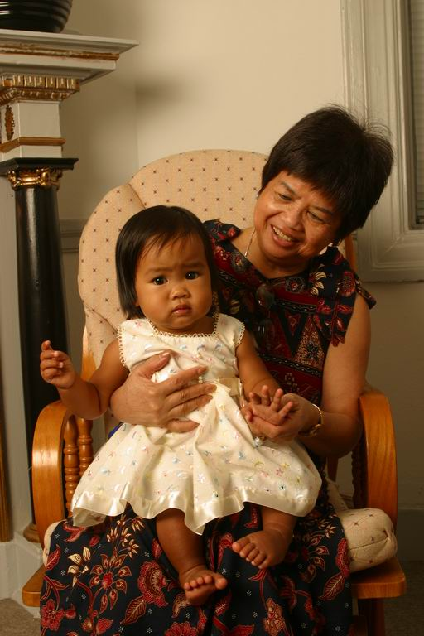
When to Use Proxy?
Proxies are used when a case cannot be interviewed because they are
A child
Physically or mentally unable to communicate
Deceased
Unable to be located
Notes:
Review slide content
Stress that a contact investigation will occur even if it is not possible to interview the case
Ask participants if they can think of other circumstances a proxy would be appropriate to use

Slide 7
Who is an Appropriate Proxy? (1)
An appropriate proxy is someone who
Knows the case’s practices, habits, and behaviors
Is able to identify persons whom the case has been in contact with
Notes:
Review slide content

Slide 8
Who is an Appropriate Proxy? (2)
An appropriate proxy can be:
A family member
A close friend
Someone else who knows the case well
  In congregate settings, the proxy may not have personal knowledge of the case, but may have access to documentation about the case.
Notes:
Review slide content
Ask participants if they can think of other appropriate proxies
Note that family members who visit the case in the hospital or at home regularly or are designated as next of kin or emergency contacts are the best choice
Provide an example of a congregate setting proxy interview: In a correctional setting, if a case has been released and cannot be located, a worker within the setting may be able to provide information on contacts based on records of the inmate’s locations during incarceration and his or her documented routine

Slide 9
What Information Should be Gathered from a Proxy?
Where the case spent time
Who the case spent time with
What activities the case participated in
Notes:
Review slide content
Ask participants for examples of other information they may need to collect from a proxy
Emphasize that needed information relates to the case’s infectious period (i.e., you want to know where the case spent time while infectious)

Slide 10
Maintaining Confidentiality
Proxies should be educated about
His or her responsibility to keep the case’s information confidential
The health department’s confidentiality policy
Notes:
Review slide content
Explain that because proxy interviews have the potential to jeopardize case confidentiality, it is important for interviewer to discuss the importance of maintaining confidentiality

Slide 11
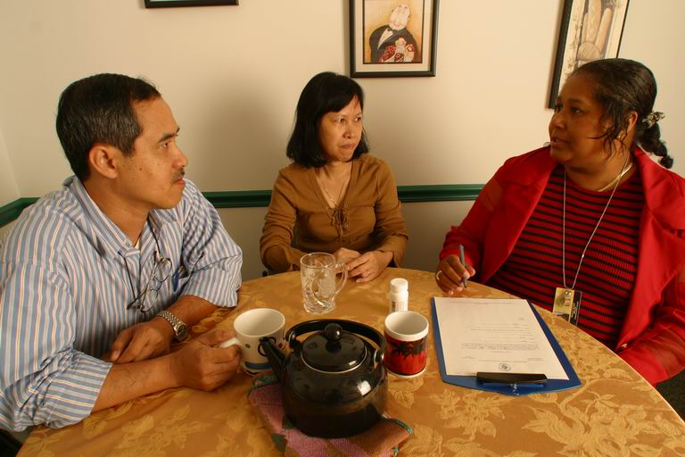
When NOT to Use a Proxy Interview
Proxies should not be used simply because the case
  Is unwilling to be interviewed
  Speaks a different language than the interviewer
11
Notes:
Review slide content
Note that an interpreter should be used when necessary (for example, the interviewer and the case do not speak the same language)

Slide 12
Source Case Investigations
Notes:
Ask participants if they know what a source case investigation is

Slide 13
What is a Source Case?
A source case is a person with TB disease who is responsible for transmitting M. tuberculosis to another person or persons.
Notes:
Review the slide content

Slide 14
What is a Source Case Investigation?
A source case investigation is a method of identifying source cases of TB disease.
Notes:
Review the slide content
Ask participants if they have ever conducted a source case investigation

Slide 15

When to Conduct a Source Case Investigation
Source-case investigations should be considered for
  Children younger than 5 years of age who have TB disease
  Children younger than 2 years of age who have LTBI
  Health care workers whose serial testing indicates recent transmission
15
Notes:
Review the slide content
Note that source case investigations for children with LTBI are generally not very productive

Slide 16
Procedures for a
Source Case Investigation
Use the same procedures as a standard contact investigation, but in the opposite direction.
The case or guardians are the best informants.
Focus on associates who have symptoms of TB disease.
Begin with the closest associates such as household members.
16
Notes:
Review slide content
Explain that source case work in the opposite direction as a contact investigation, but that the same principles still apply
Mention to participants to remember child care providers and frequent visitors

Slide 17
Social Networks

Slide 18
What is a Social Network?
A social network is a group of people connected by common behavior/activities
  Drug use
  Gathering places
  (e.g., church, work, bars)
  Other connections that promote disease transmission
Focuses on groups and places rather than individuals
Case
Contact
18
Notes:
Review slide content
Explain that social network in this context is not the same thing as social network sites such as Facebook or MySpace

Slide 19
Why Use a Social Network Strategy for a TB Contact Investigation?
Complements the traditional CI approach by interviewing contacts for more information related to potential TB transmission
Helps narrow or expand CI activities by
  Identifying groups of contacts that might be infected because of common activities and/or locations
  Identifying possible places of transmission (exposure settings)
Helps to detect and stop outbreaks
19
Notes:
Review slide content
Note that sometimes contacts and the case may not even know each other (e.g., they might just both go to the same bar at the same time everyday). It is important to look outside the case’s circle of friends.

Slide 20
When to Use Social Network Strategies?
There are gaps in information provided by case
Epidemiology indicates transmission is ongoing
There is insufficient locating information for contacts
  Homeless populations, drug partners, full name of contact not known, etc.
There are gaps in exposure dates
20
Notes:
Review slide content
Explain that the case may be unclear or withholding information, so talking to contacts can help provide more information related to potential TB transmission

Slide 21
How is the Social Networking Strategy Implemented for CI?
Interview the case and contacts to increase an understanding of who is part of the “social network”
Use the information from various interviews to identify commonly named
  Locations of exposure
  Contacts
Conduct a field visit at commonly named sites and assess commonly named contacts
Notes:
Review slide content
Explain to the participants that sometimes actual names may not all be the same, as some cases may identify contacts by nicknames, a first name, or by physical description. Sort cases by first name and look for persons who may be mentioned several times (e.g., Dave, David, Davey or Rich, Richie, Ricco, Richard, Dick).
Explain to the participants that further details can be noted and more field visits conducted to common exposure sites. The field visits should be conducted per health department guidelines on congregate-setting investigations. However, if the congregate setting is social in nature, it may take the interviewer several visits to determine the pattern of social mixing, who frequents the setting, and who are the appropriate individuals from whom to gain additional information. Again, this process should be completed while only revealing the name of the case per health department standards of practice.

Slide 22
What Types of Questions to ask in Social Network Interview?
What kind of activities are you involved in?
Who do you know who has been coughing or may have TB?
Where do you like to spend your time/hangout?
Who are your closest friends?
Notes:
Review slide content

Slide 23
Congregate Settings
Notes:
Ask participants if they can define a congregate setting

Slide 24
What is a Congregate Setting?
A congregate setting is a setting in which a group of usually unrelated persons reside, meet, or gather either for a limited or extended period of time in close physical proximity.
24
Notes:
Read definition of congregate setting
Ask the participants for examples of congregate settings

Slide 25
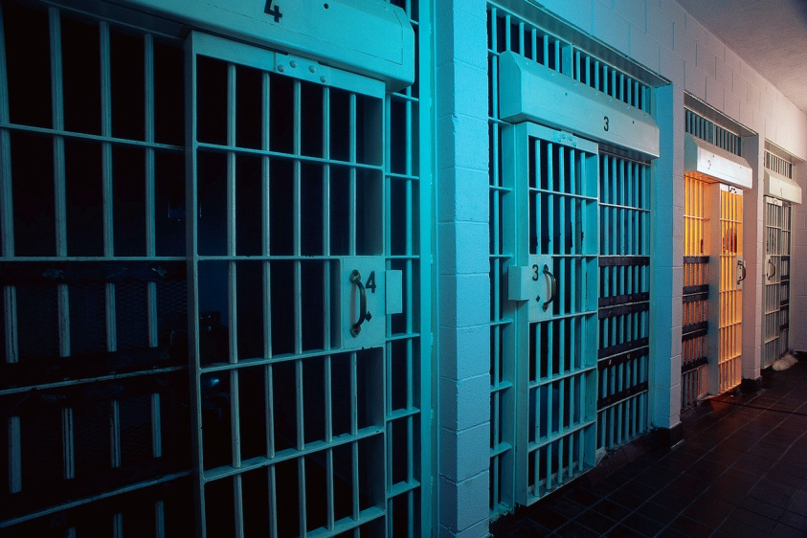
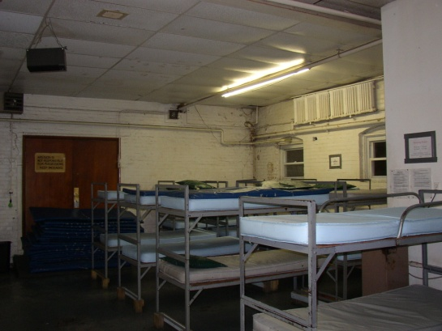
Examples of Congregate Settings (1)
  Schools
  Nursing homes
  Correctional facilities
  Places of worship
  Hospitals
  Shelters
  Social settings
  Workplace settings
25
Notes:
Cover any settings that were not mentioned by the participants
Examples of additional congregate settings: day care, adult care facilities

Slide 26
Examples of Congregate Settings (2)
Adolescents
Adults
Elderly
House of Worship
House of Worship
House of Worship
Hospital
Hospital
Hospital
Work
Work
Work
School
School
Juvenile Detention Center
Correctional Facilities
Correctional Facilities
Drug Treatment Center
Shelters
Shelters
Shelters
Long Term Care
Notes:
Explain that sometimes based on the age of the case, you can identify of a list of potential congregate settings that may be applicable to the case
Review slide content
Ask participants if they agree with this list and if they can think of other age-specific examples
Additional examples: senior centers, bars, etc.

Slide 27
What Are Some Challenges for Contact Investigations in Congregate Settings?
Collaboration with officials and administrators unfamiliar with TB
Legal implications
Media coverage
Substantial number of contacts
Incomplete information regarding contact names and location
Incomplete data for determining priorities
Difficulty in maintaining confidentiality
Notes:
** Animated slide**
Ask participants to name some challenges they have encountered while conducting CIs in congregate settings
Click to display slide content
Review slide content

Slide 28
Working with Congregate
Setting Management
  When a CI is needed in a congregate setting, it is important to communicate effectively and immediately begin to build trust and rapport with the management.
Initial notification of the need for a CI can occur by telephone
  Do not provide specific case information and risk violating medical privacy
An in-person meeting to discuss CI process should be scheduled
28
Notes:
Review slide content
Explain that the initial notification should occur by telephone because mail is too slow, impersonal, and unreliable. Also, unscheduled visits or emails are generally inappropriate ways to notify management
Explain that an in-person meeting should be scheduled after initial telephone notification because:
- Providing case information over the telephone risks violating medical privacy
- The telephone is an inappropriate means to provide TB education
- In a very brief period of time on the telephone, health care worker must project a sense of professionalism, sensitivity, and expertise
Stress that it is important to start building trust and rapport early on. If the management of the congregate setting does not trust you or the health department, it will not be easy to work with them in the future

Slide 29
What Should Occur at the
Initial Meeting? (1)
Agenda items to discuss:
Provide basic TB education
Discuss potential media interest
Discuss confidentiality issues
  In some situations, the case’s identity may be released to management. If so, obtain signed confidentiality agreement
Discuss case information (e.g., medical status, infectiousness)
29
Notes:
Review slide content

Slide 30
What Should Occur at the
Initial Meeting? (2)
Agenda items to discuss (continued)
Explain infectious period
Conduct site tour
Determine total number of individuals in setting
Explain process of identifying and testing contacts
      Provision of TB education
      Explanation of testing
      Who will be administering tests
      Where testing will take place
      Follow-up testing
30
Notes:
Review slide content
Explain that the site tour should include looking at factors such as:
Volume of shared air space
Adequacy of ventilation
Re-circulated air
Upper room ultraviolet light (if applicable)

Slide 31
What are the Steps for Conducting the CI for a Congregate Setting?
Identify and prioritize contacts to be assessed
  Can be challenging to limit to high priority contacts
Assess contacts
  Most convenient approach: on-site
  Alternative approach: at the health dept. with additional personnel and extended hours
  Last resort: notify contacts to seek TB evaluation with own healthcare provider
31
Notes:
Review slide content
Explain that it can be difficult to track results if contacts seek evaluation with their own providers

Slide 32
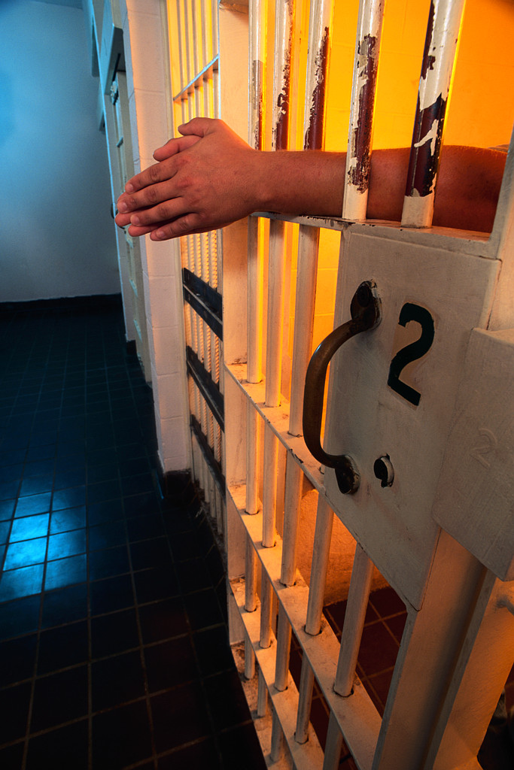
Working with Congregate Settings: Correctional Facilities
Establish collaboration between the correctional facility and the health department
Identify priority contacts who have been transferred, released, or paroled
Unless follow-up supervision can be arranged, there is a possibility of low completion rate
32
Notes:
Review slide content
Explain that when conducting a site visit at a correctional facility, investigators should assess the size and ventilation of cells, review work assignments, and identify activities of prison staff and prisoners

Slide 33

Working with Congregate Settings: Workplaces
Duration and proximity of exposure can be greater than in other settings
Details to gather from the case during the initial interview include
  Employment hours
  Working conditions
  Workplace contacts
Occasional customers are not a priority
33
Notes:
Review slide content

Slide 34
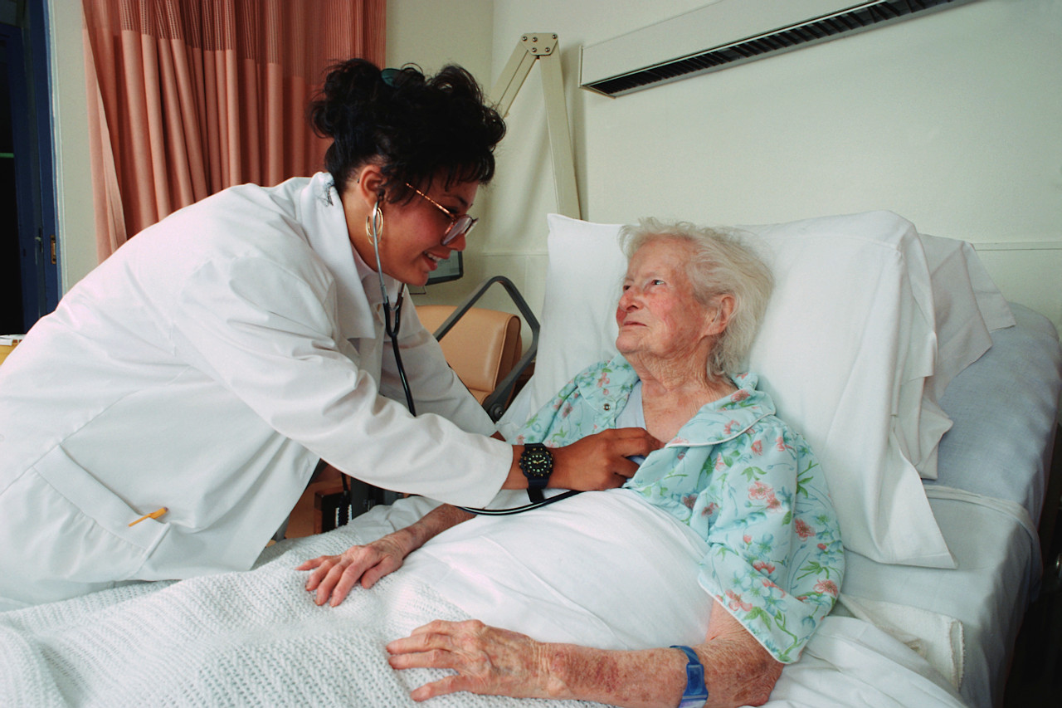
Working with Congregate Settings:
Health Care Settings
Majority of hospitals and other health care settings test employees for TB infection on regular basis
Plan CI jointly with health care settings
  Responsibilities should be divided between occupational health and TB program
34
Notes:
Review slide content
Mention that during a CI involving hospital employees, shifts and work areas should be identified
Explain that visitors and roommates might also be considered contacts
Note that sometimes hospitals have their own protocols for TB

Slide 35

Working with Congregate Settings: Schools
Early collaboration with school officials and community members is recommended
Issues of consent and disclosure of information more complex for minors
Establish and focus on priority contacts rather than testing the whole school
  Be aware of possible political pressure
35
Notes:
Review slide content
Mention that information needs to be collected on potential exposure:
Number and duration of classes
Transportation
Social clubs and teams
Cafeteria
Explain that with schools, sometimes parents can become very concerned and demand that everyone should be tested (even if they wouldn’t normally be considered ‘true contacts’)

Slide 36
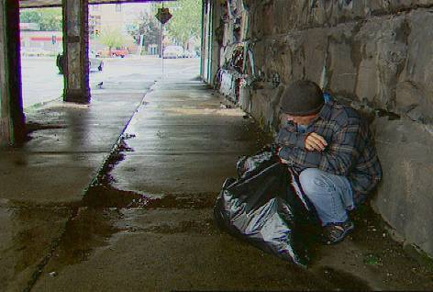
Working with Congregate Settings: Homeless Shelters
Challenges include
  Locating cases and contacts
  Mental illness
  Periodic incarceration
  Migration between jurisdictions
Site visits and interviews are crucial
Work with administrators to offer onsite treatment
36
Notes:
Review slide content

Slide 37
Working with the Media

Slide 38
Possible Situations for News Coverage
Certain CIs have potential for sensational news coverage
Examples include CIs that
  Involve numerous contacts (especially children)
  Occur in public settings
  Occur in workplaces
  Are associated with TB fatalities
  Are associated with drug-resistant TB
38
Notes:
Review slide content
Ask participants if they have ever had TB contact investigations that generated a lot of media interest

Slide 39
Reasons for Participating in News Media Coverage (1)
Educates the public about TB
Reminds the public of the continued presence of TB and the importance of public health efforts
Provides another method to alert exposed contacts for the need to seek a medical evaluation
Relieves public fears regarding TB
39
Notes:
Review slide content
Mention that media coverage may result in an influx of worried-well
Emphasize that each agency has their own policy for speaking to the media; most government employees are not allowed to speak to the media unless they are granted permission

Slide 40
Reasons for Participating in News Media Coverage (2)
Illustrates health department leadership in communicable disease control
Guides public inquiries to the health department
Validates the need for public resources to be directed to disease control
40
Notes:
Review slide content
Mention that participants should be prepared to provide timely and accurate information to a spokesperson

Slide 41
Potential Drawbacks to News Coverage
May increase public anxiety
Persons may seek unnecessary medical care
Could contribute to unfavorable views of the health department
Could contribute to the spread of misinformation
Unintended disclosure of confidential information
41
Notes:
Review the slide content

Slide 42

Strategy for News Coverage
Prepare media messages
Develop communication objectives
Issue news release in advance of any other media coverage
Collaborate with partners outside the health department
42
Notes:
Review slide content
Remind participants that there may be a designated staff member at the health department who deals with media inquiries
Inform participants that a good resource is the CDC Crisis Emergency Risk Communication by Leaders for Leaders: http://emergency.cdc.gov/cerc/pdf/leaders.pdf

Slide 43
Review

Slide 44
Review
What is a proxy interview?
Who is considered an appropriate proxy?
What should be discussed with the management of a congregate setting if one of their clients has been diagnosed with TB disease?
Notes:
Review slide content
Note to facilitator: Answer to review questions:
A proxy interview is when a person is interviewed in place of the case.
An appropriate proxy is someone who Knows the case’s practices, habits, and behaviors and is able to identify persons whom the case has been in contact. Examples include:
Family member
Close friend
Someone else who knows the case well
Items to discuss with congregate settings management may include:
Describe purpose of meeting
Provide basic TB education
Discuss potential media interest
Discuss confidentiality issues
Discuss case information
Explain infectious period
Conduct site tour
Determine total number of individuals in setting
Explain process of identifying and testing contacts

Slide 45
Role Plays
  Refer to Appendix V
Notes:
Inform participants that they will be broken into different groups and will conduct role plays regarding the following situations:
1) School
2) Homeless shelter director
3) Proxy interview
Refer participants to Appendix V for further instructions

